Slide 1
Angle prediction
Criterion | RGB | Depth | RGBD- parallel | RGBD- early | RGBD- late
RMSE | 8.69 | 35.72 | 15.47 | 11.23 | 6.94
MAE | 6.65 | 25.38 | 11.78 | 8.43 | 5.30
68% error | 1.81±8.5 | -0.68±35.71 | 0.73±15.45 | -1.76±11.10 | 0.26±6.93
95% error | 1.81±17.00 | -0.68±71.42 | 0.73±30.90 | -1.76±22.19 | 0.26±13.87
Rank | 2 | 5 | 4 | 3 | 1
Radius prediction
Criterion | RGB | Depth | RGBD- parallel | RGBD- early | RGBD- late
RMSE | 0.76 | 1.34 | 0.8 | 0.77 | 0.70
MAE | 0.59 | 1.03 | 0.64 | 0.61 | 0.53
68% error | -0.02±0.75 | -0.46±1.26 | 0.21±0.77 | -0.43±0.64 | 0.07±0.69
95% error | -0.02±1.51 | -0.46±2.51 | 0.21±1.54 | -0.43±1.28 | 0.07±1.38
Rank | 2 | 5 | 4 | 3 | 1

Slide 2
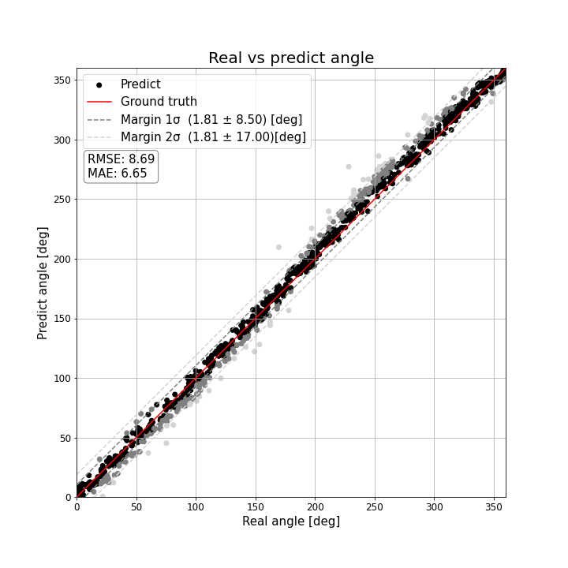
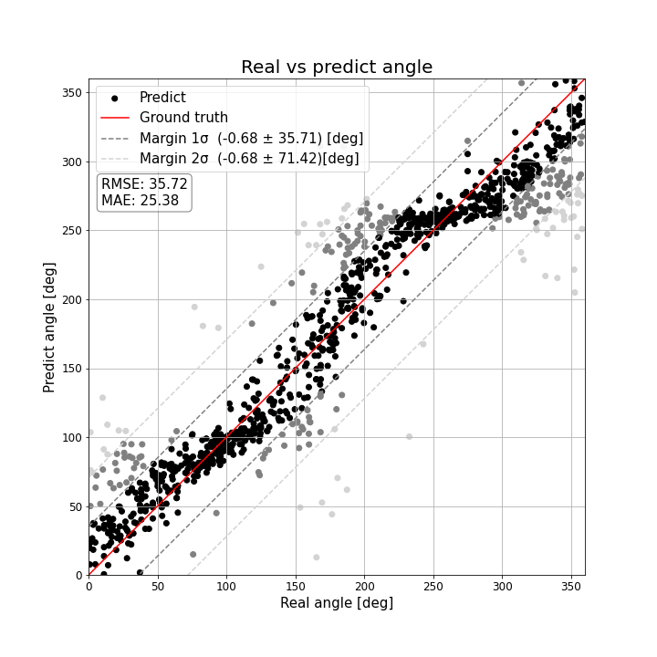
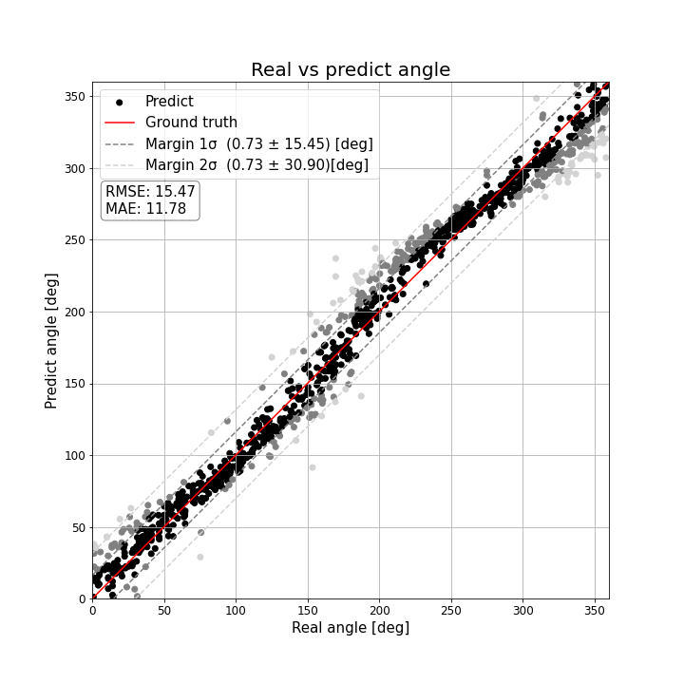
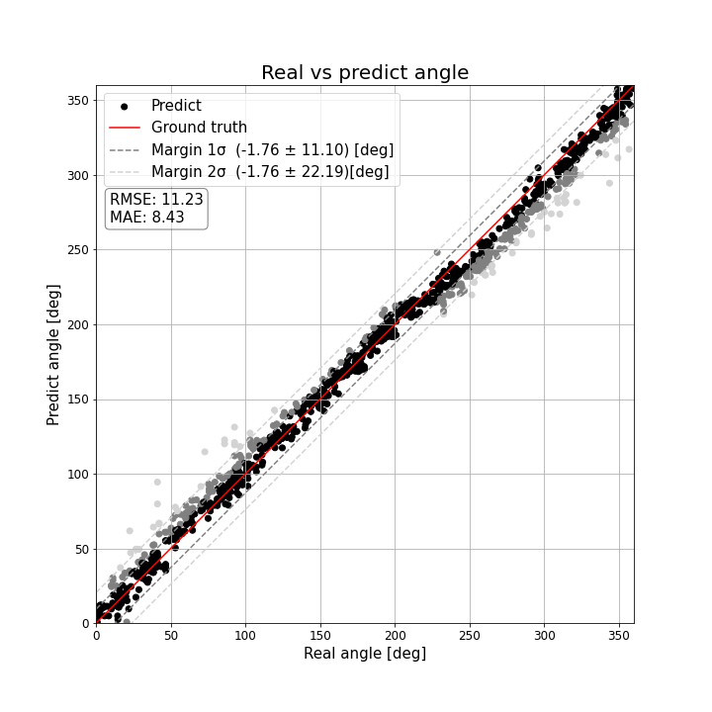
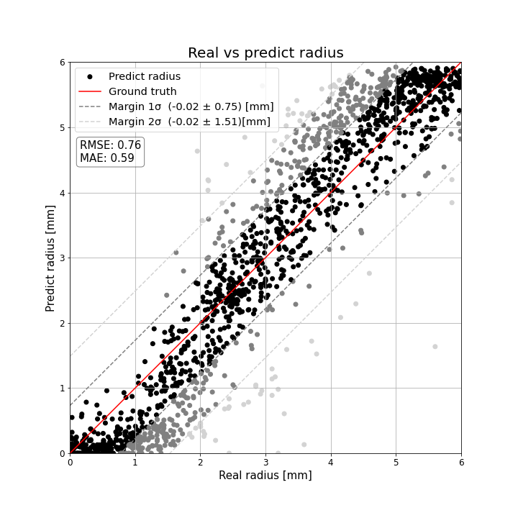
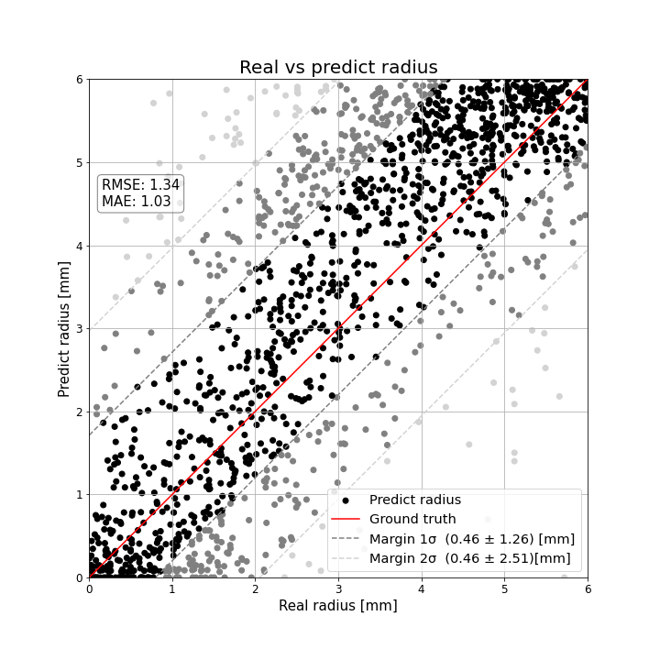
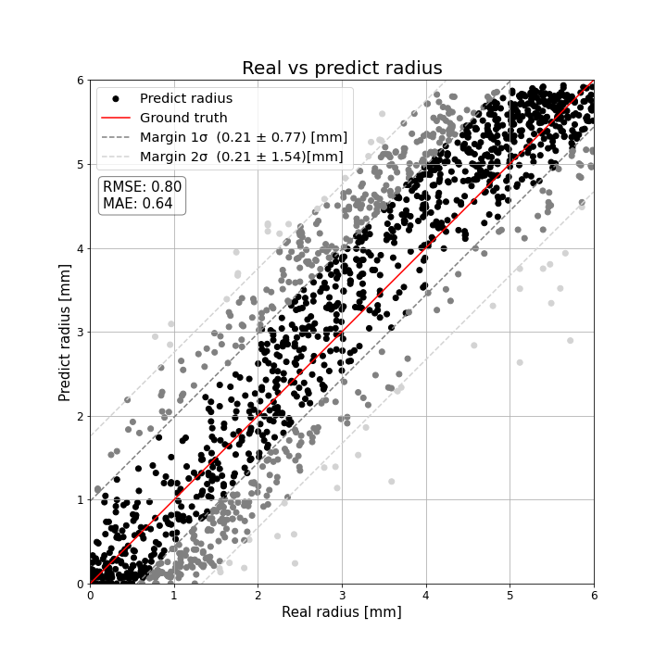
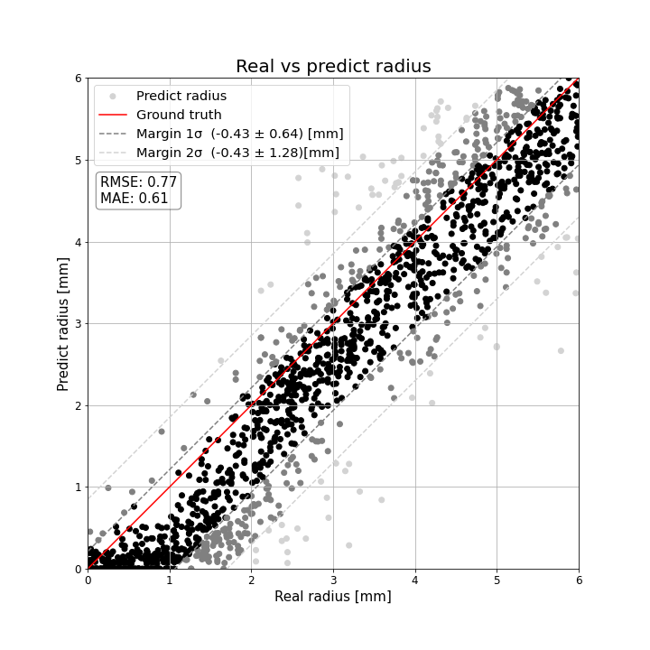
Angle prediction
RGB | Depth | RGBD- parallel | RGBD- early
Radius prediction
RGB | Depth | RGBD- parallel | RGBD- early

Slide 3
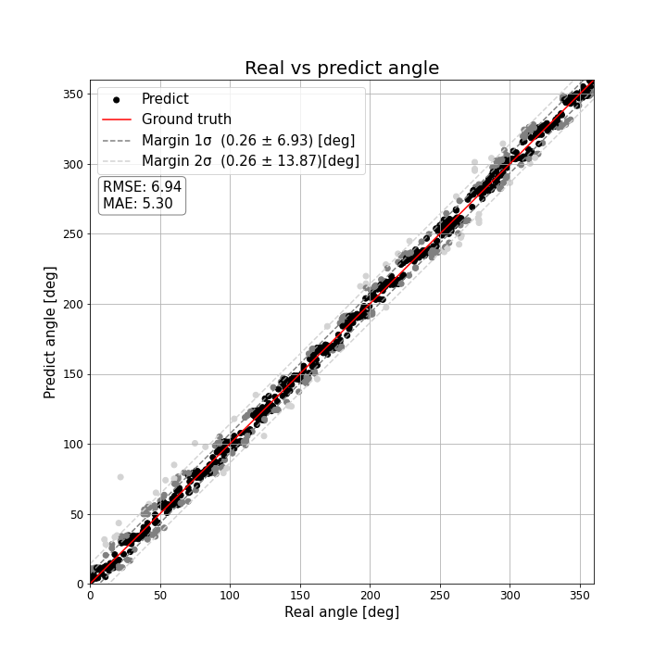
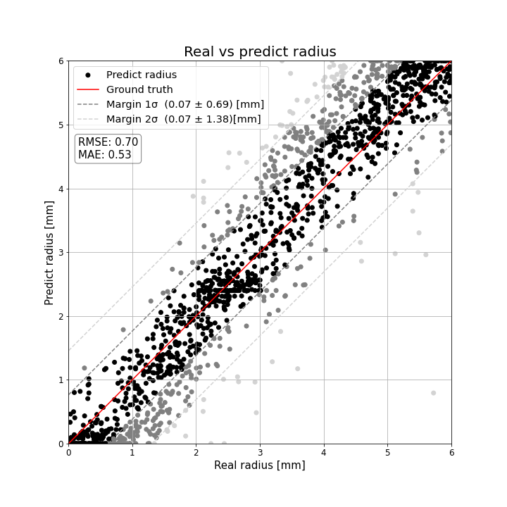
RGBD- late
Angle prediction | Radius prediction

Slide 4
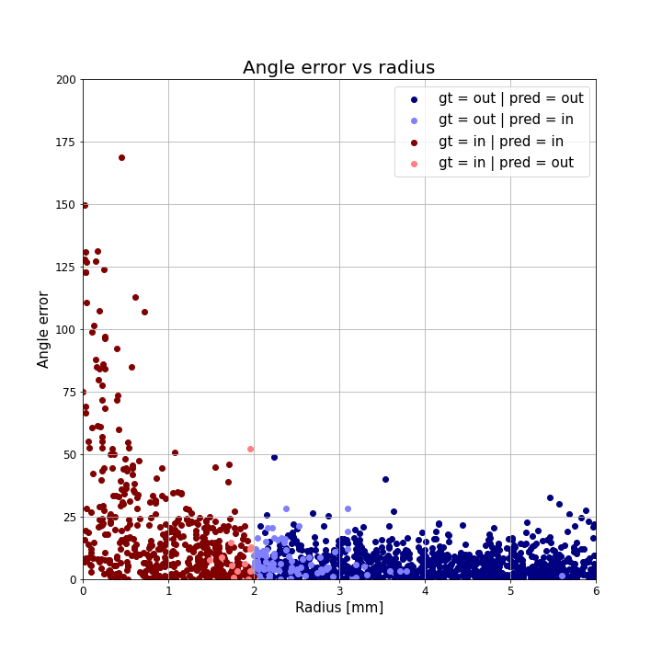
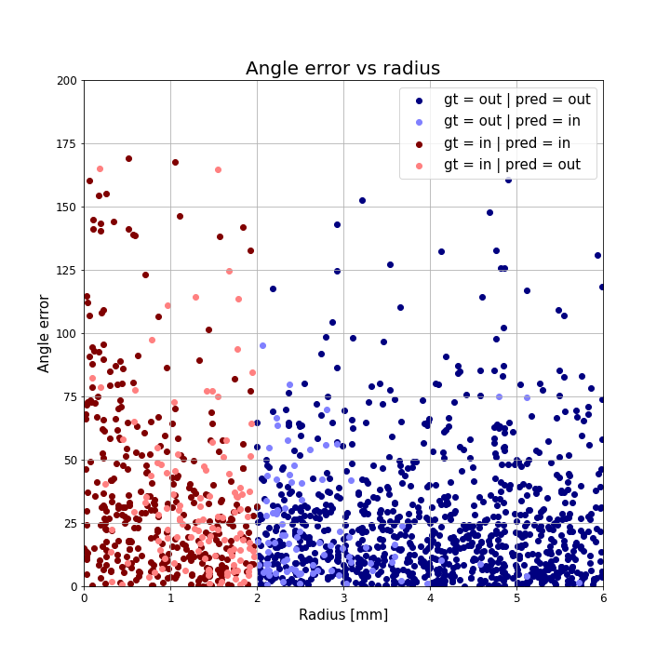
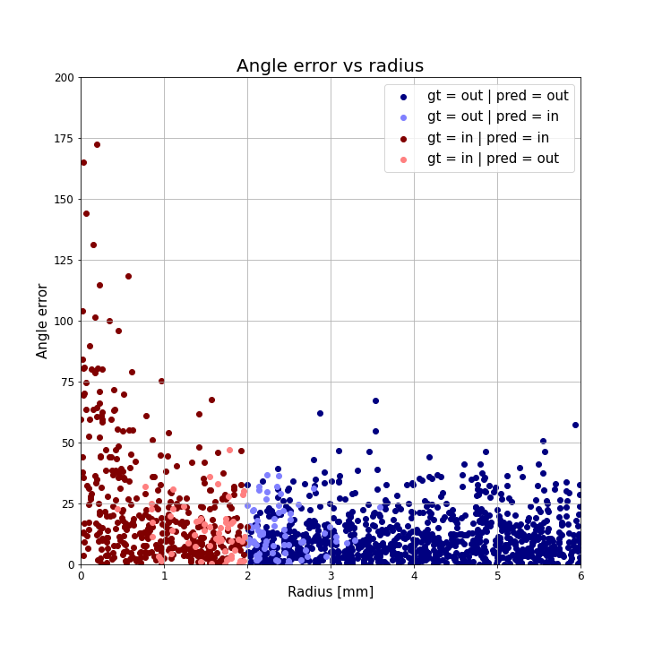
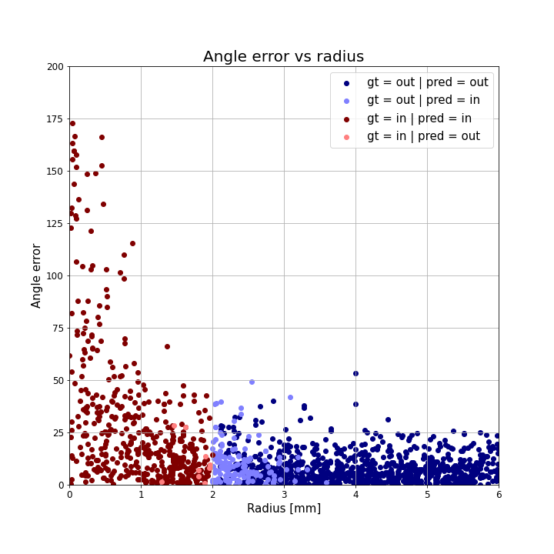
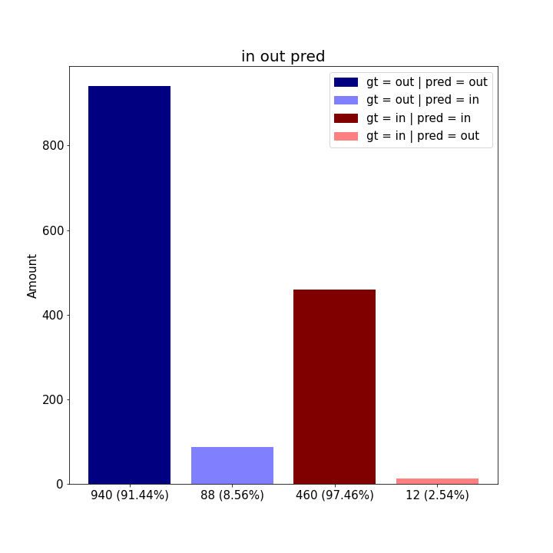
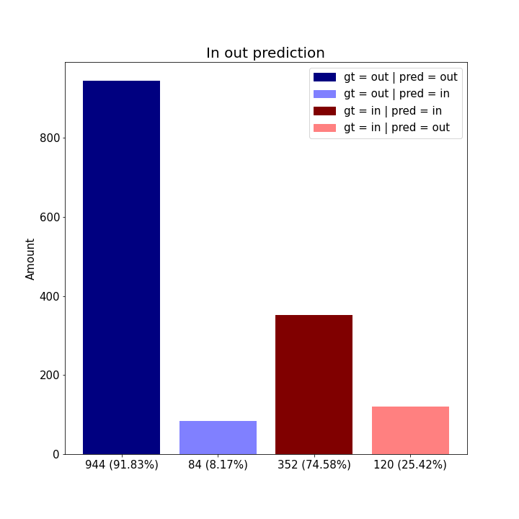
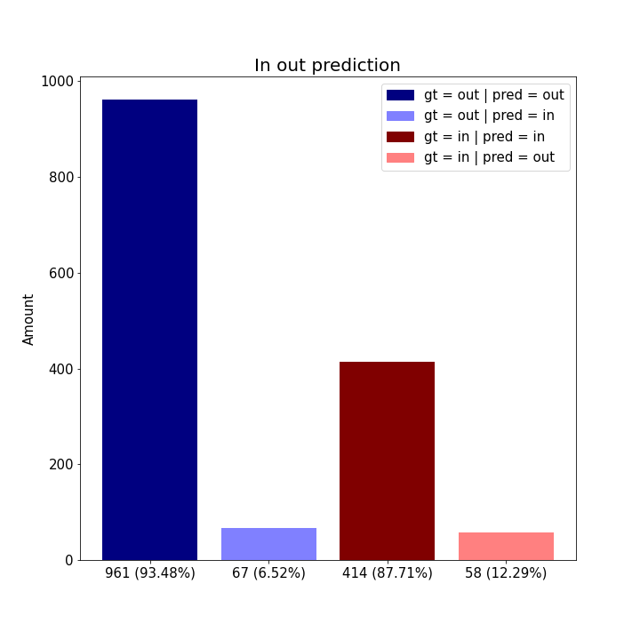
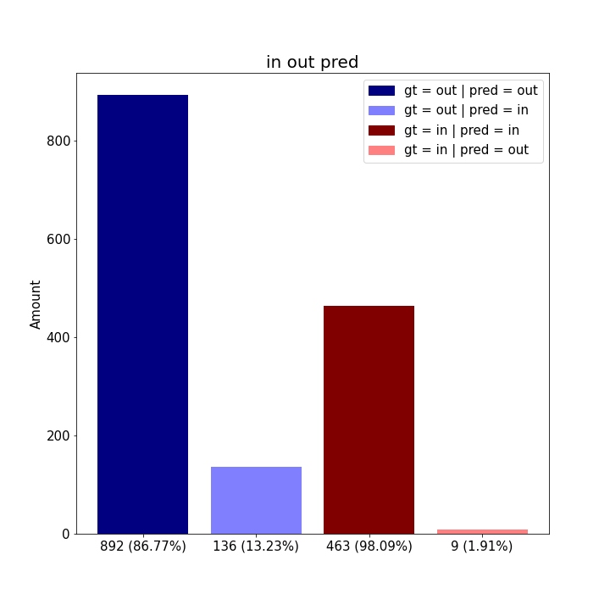
Angle error vs radius
RGB | Depth | RGBD- parallel | RGBD- early
In out prediction
RGB | Depth | RGBD- parallel | RGBD- early

Slide 5
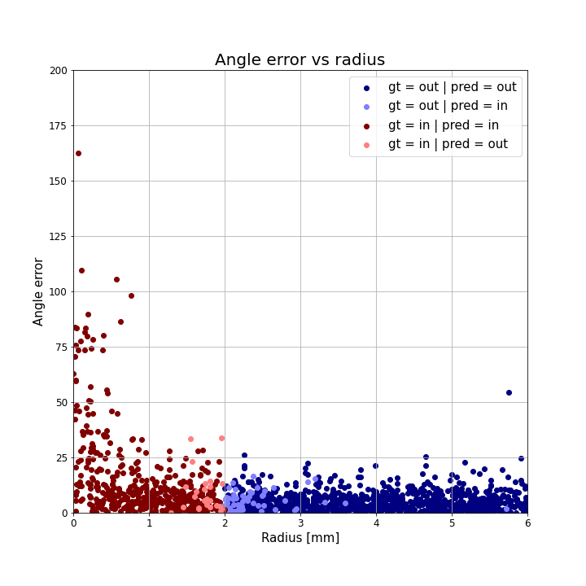
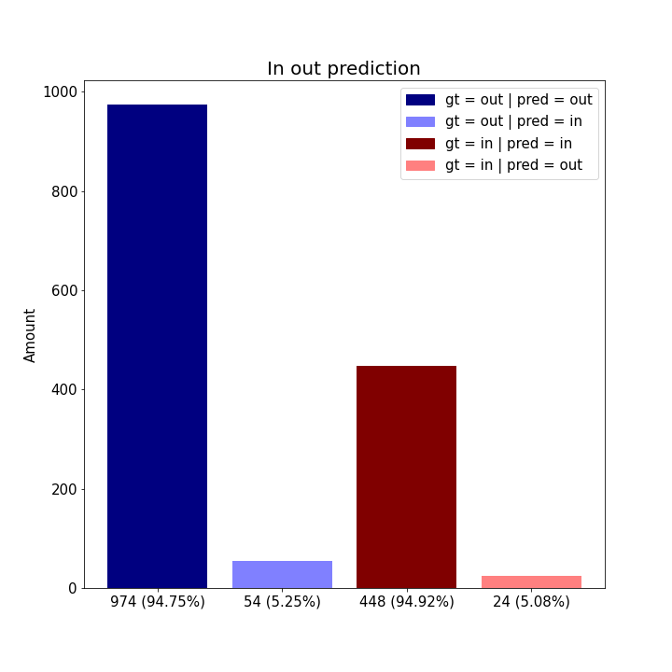
RGBD- late
Angle error vs radius | In out prediction

Slide 6
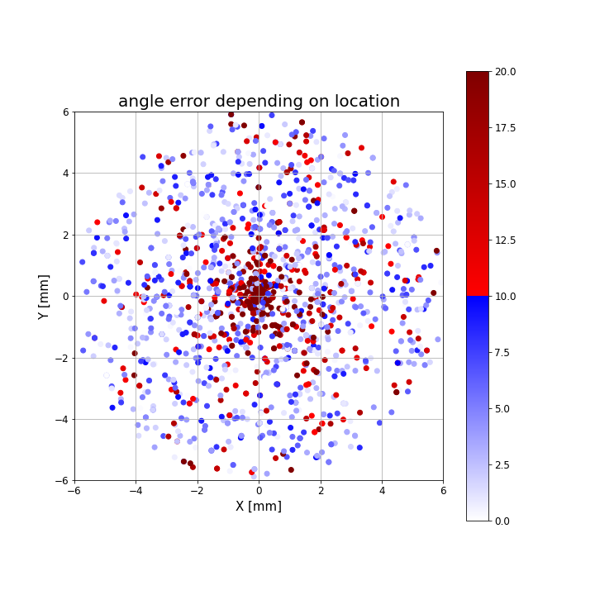
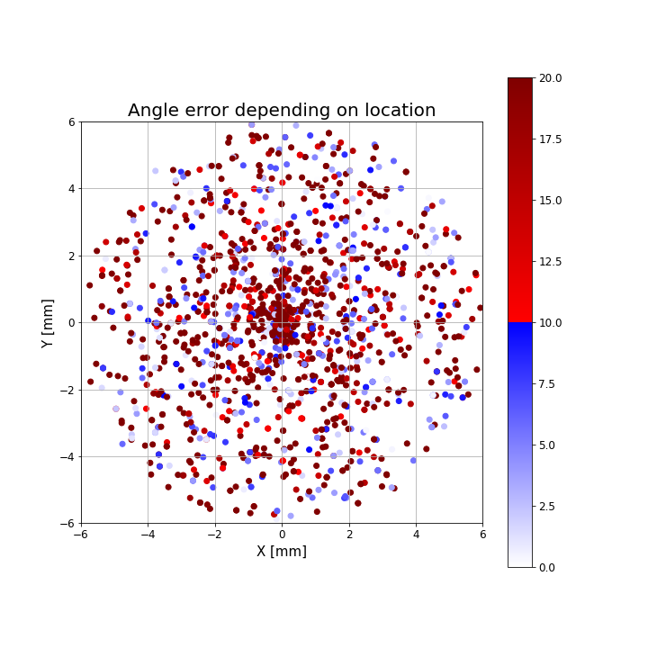
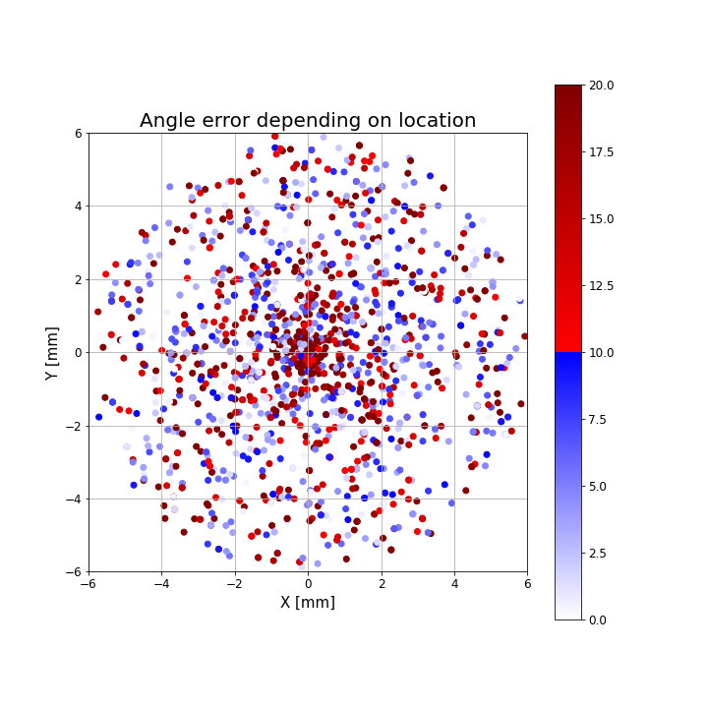
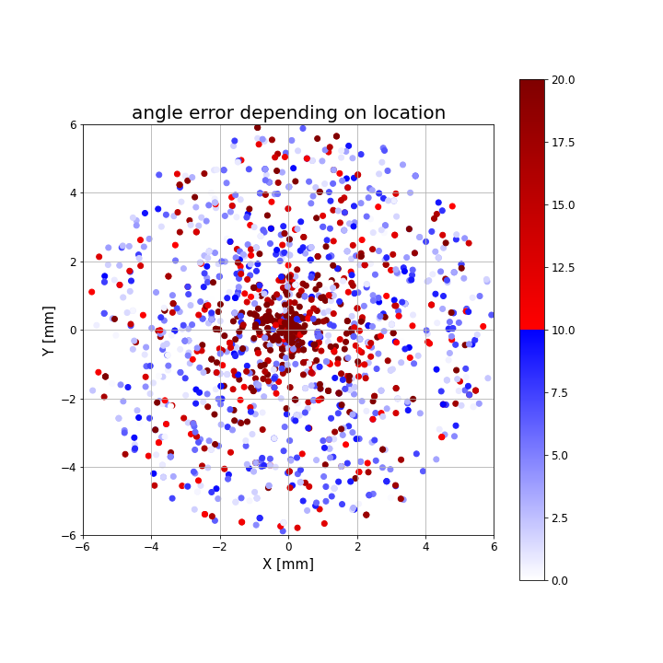
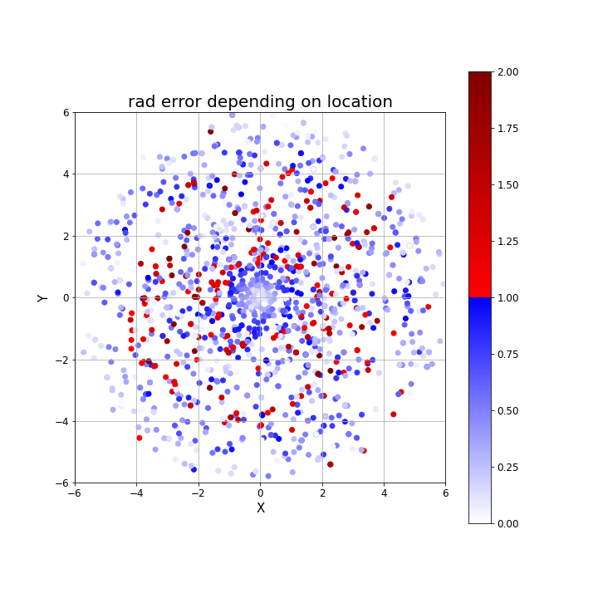
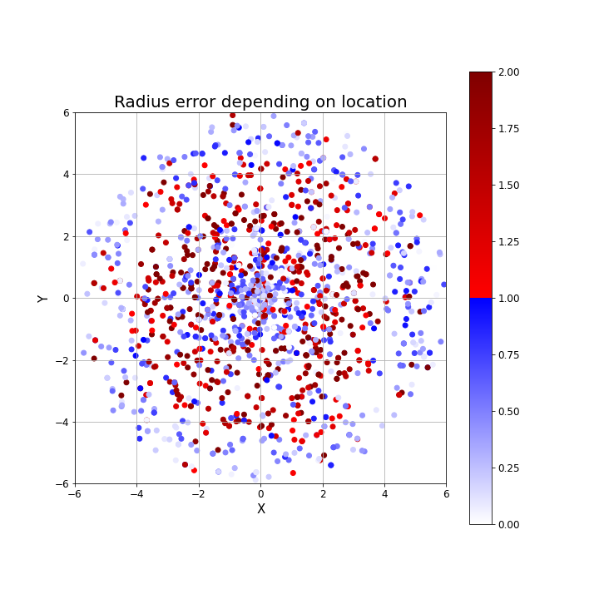
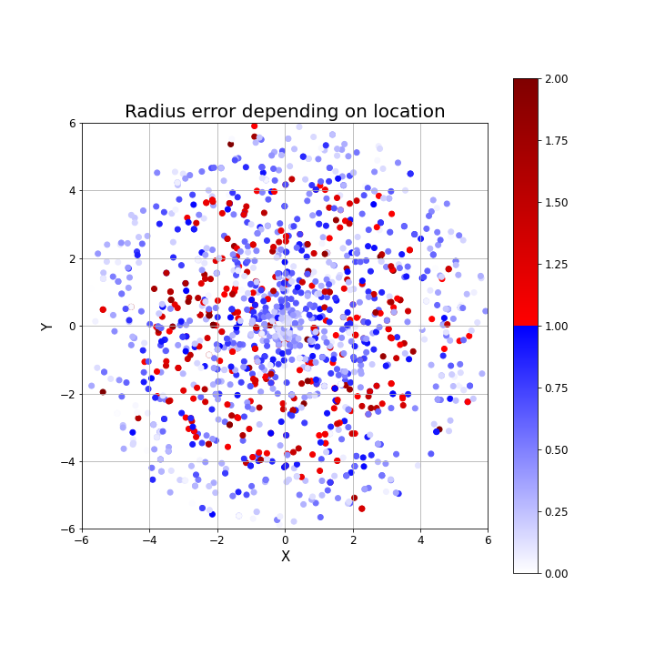
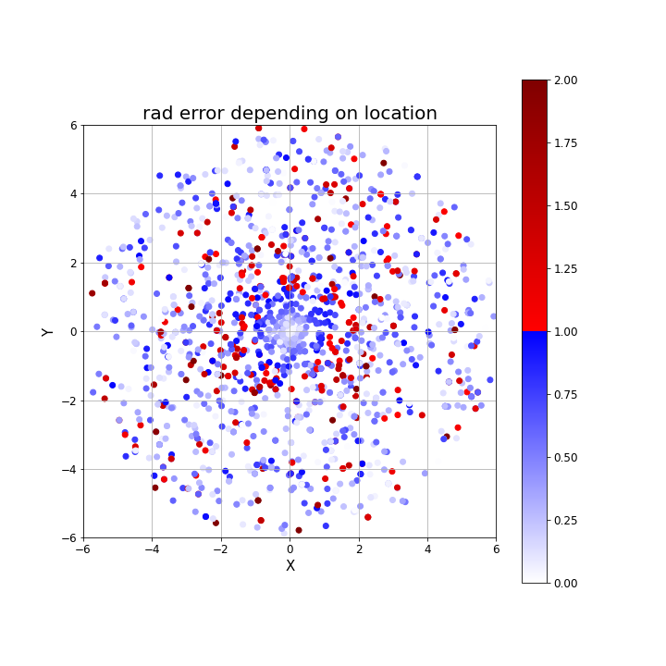
Angle error depending on location
RGB | Depth | RGBD- parallel | RGBD- early
Radius error depending on location
RGB | Depth | RGBD- parallel | RGBD- early

Slide 7
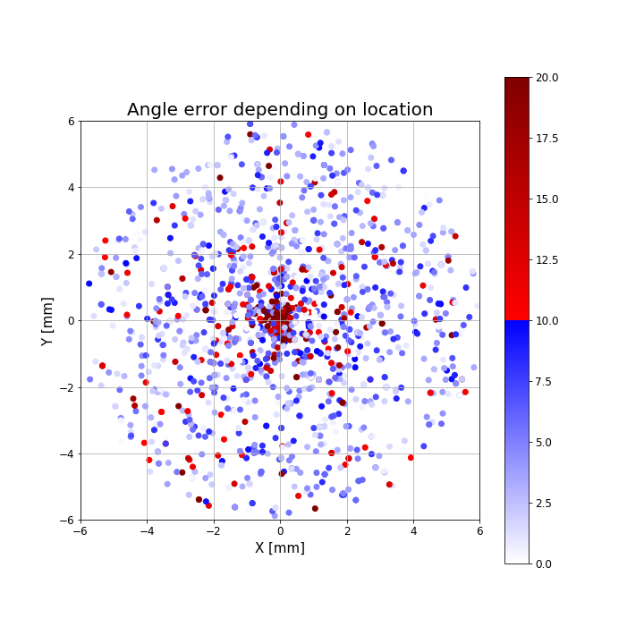
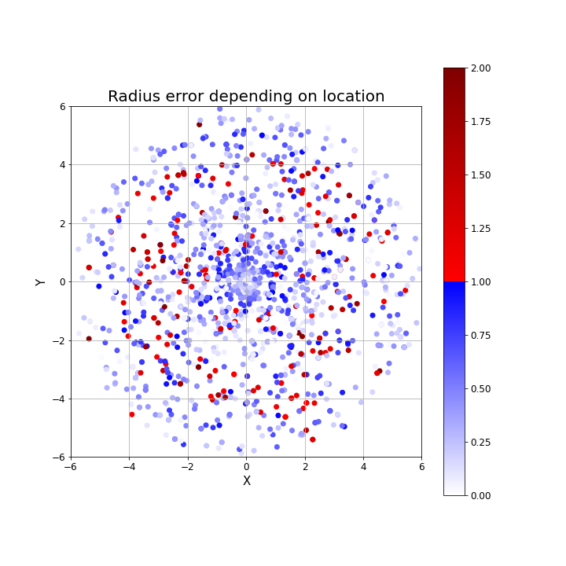
RGBD- late
Angle error depending on location | Radius error depending on location

