Slide 1
Angle prediction
Criterion | RGB | Depth | RGBD- parallel | RGBD- early | RGBD- late
RMSE | 7.30 | 16.03 | 9.46 | 7.12 | 6.27
MAE | 5.43 | 10.86 | 6.96 | 5.37 | 4.75
68% error | 0.97±7.23 | -2.23±15.87 | -0.60±9.44 | -0.68±7.09 | 0.54±6.25
95% error | 0.97±14.47 | -2.23±3175 | -0.60±18.88 | -0.68±14.18 | 0.54±12.49
Rank | 3 | 5 | 4 | 2 | 1
Radius prediction
Criterion | RGB | Depth | RGBD- parallel | RGBD- early | RGBD- late
RMSE | 0.75 | 1.01 | 0.73 | 0.65 | 0.66
MAE | 0.56 | 0.78 | 0.57 | 0.45 | 0.49
68% error | -0.03±0.75 | 0.22±0.98 | 0.08±0.73 | 0.05±0.65 | 0.03±0.66
95% error | -0.03±1.50 | 0.22±1.96 | 0.08±1.46 | 0.05±1.30 | 0.03±1.32
Rank | 4 | 5 | 3 | 1 | 2

Slide 2
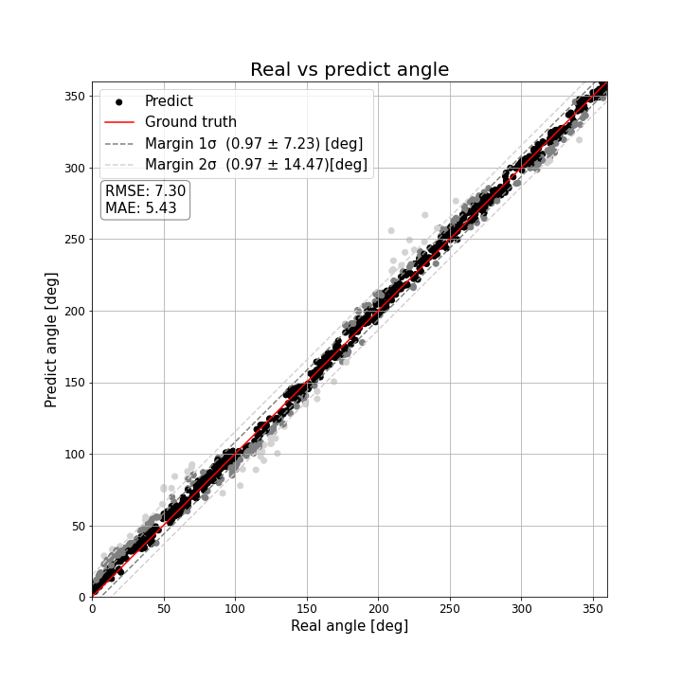
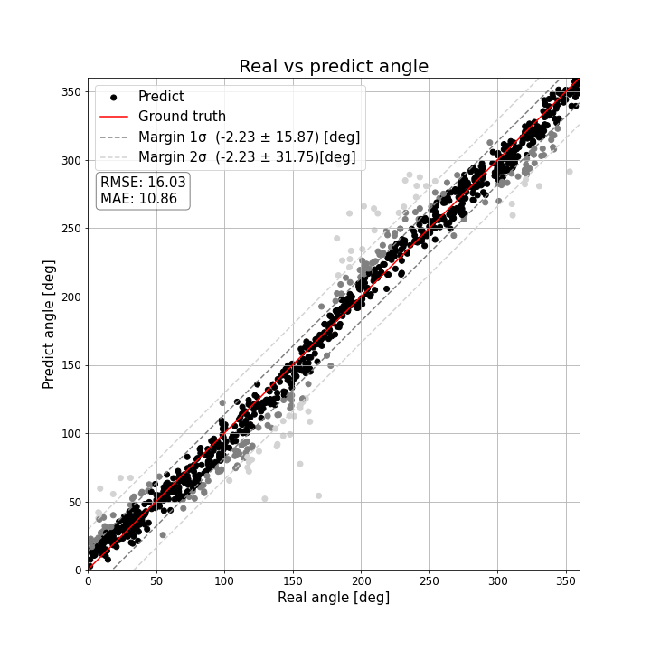
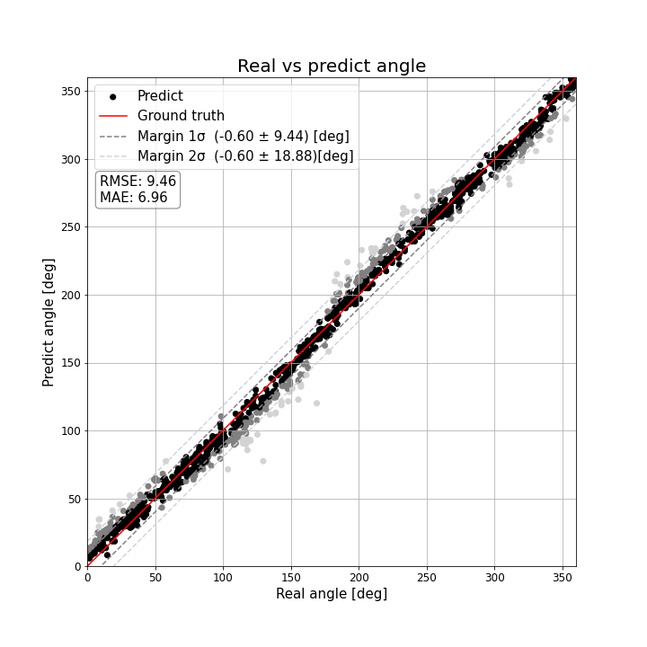
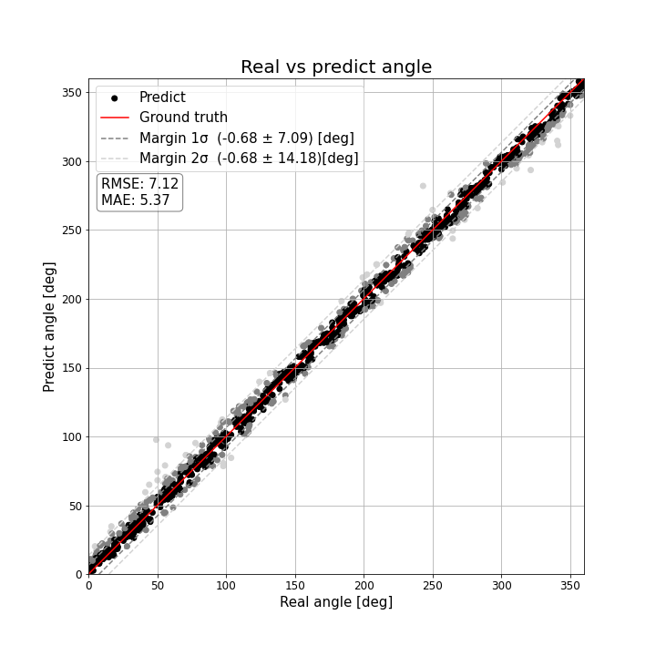
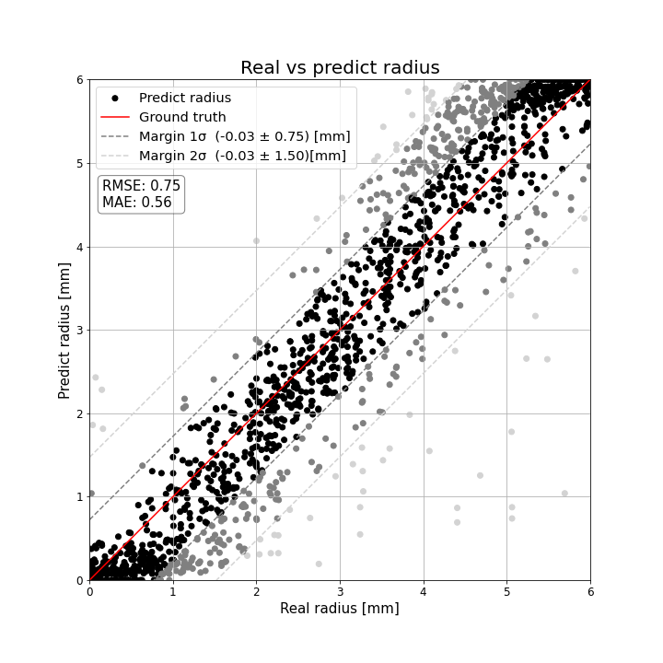
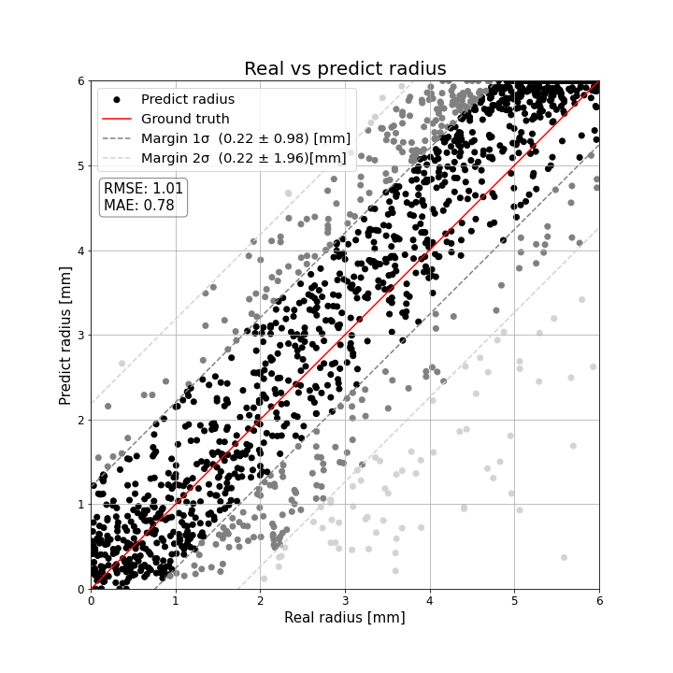
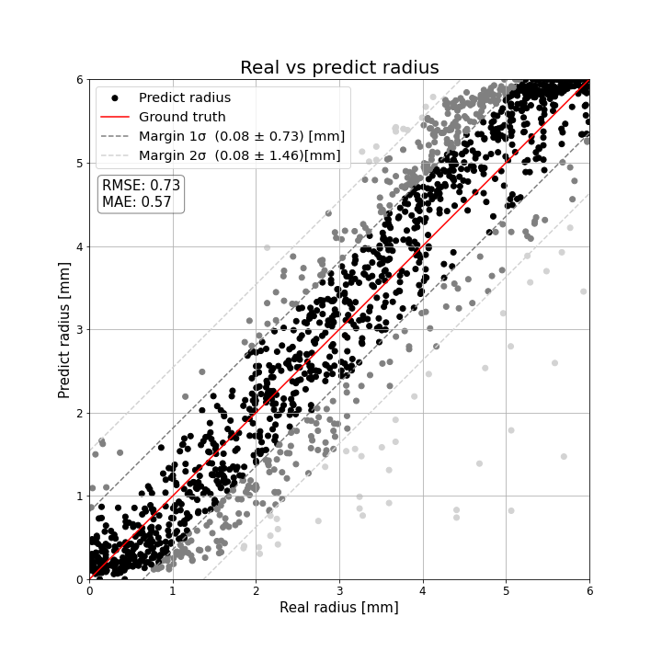
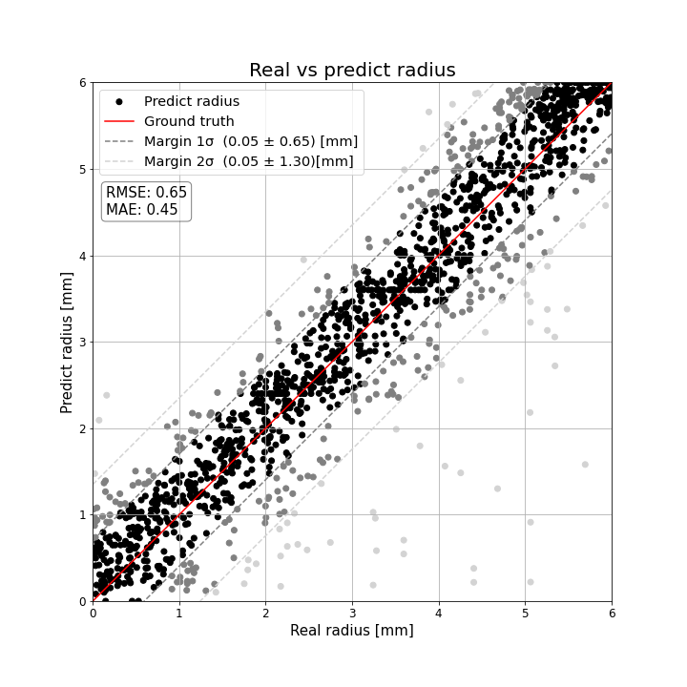
Angle prediction
RGB | Depth | RGBD- parallel | RGBD- early
Radius prediction
RGB | Depth | RGBD- parallel | RGBD- early

Slide 3

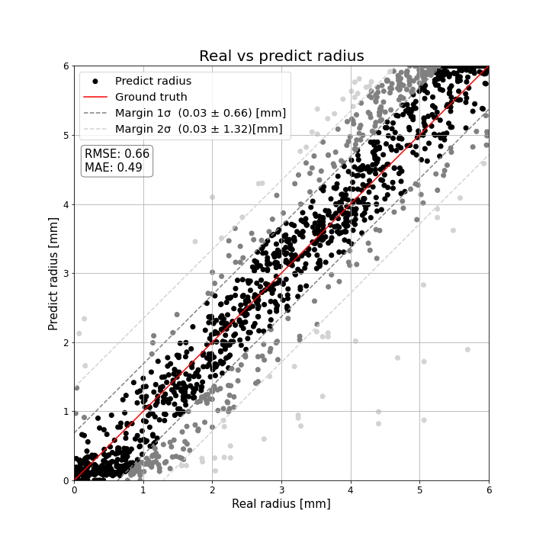
RGBD- late
Angle prediction | Radius prediction

Slide 4
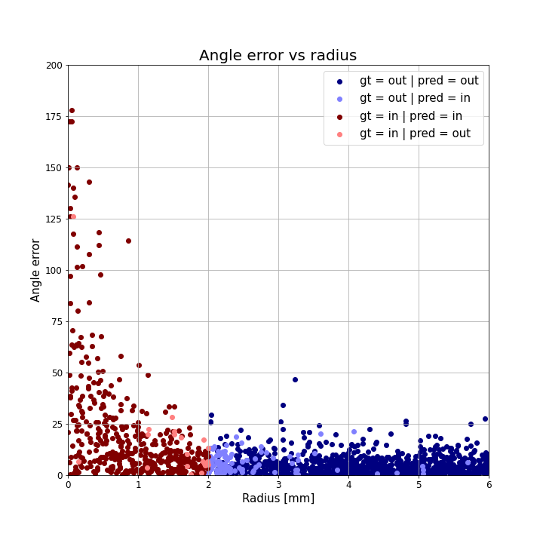
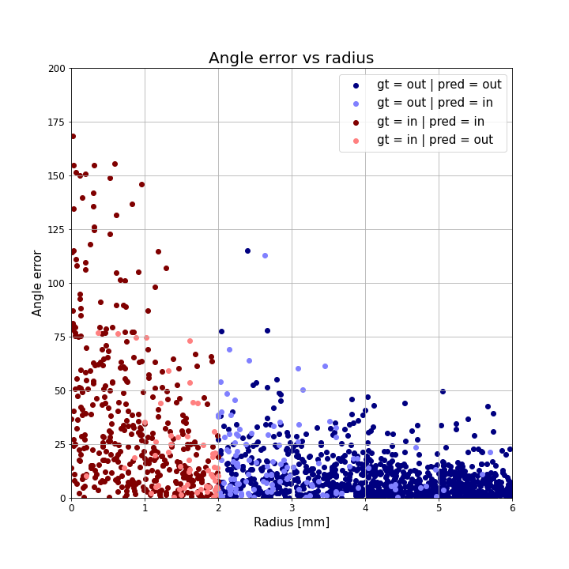
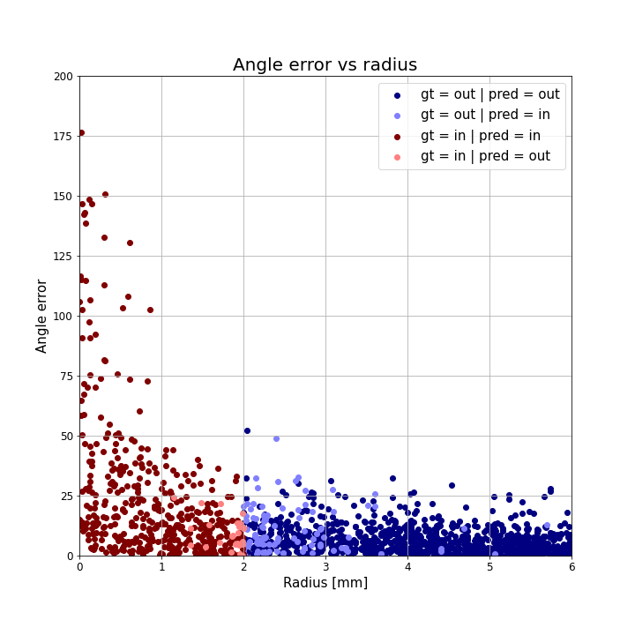

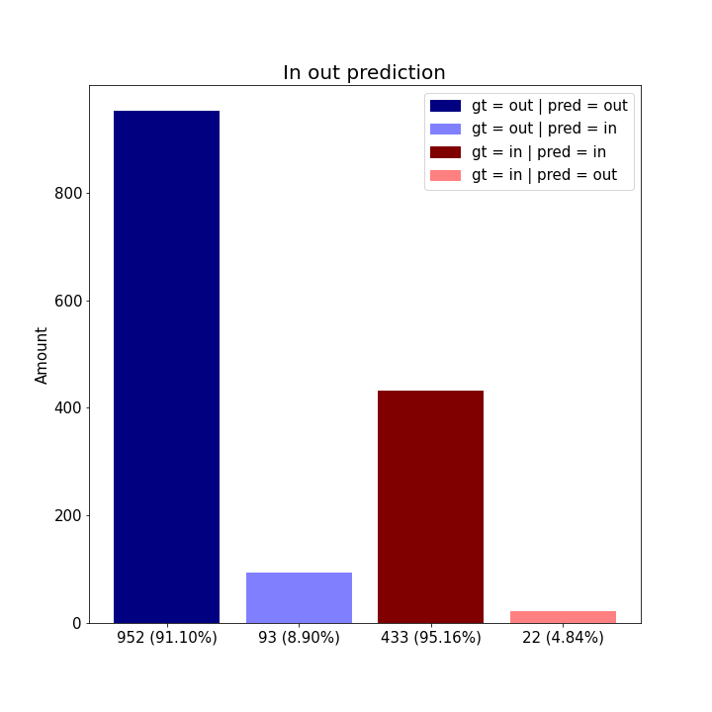
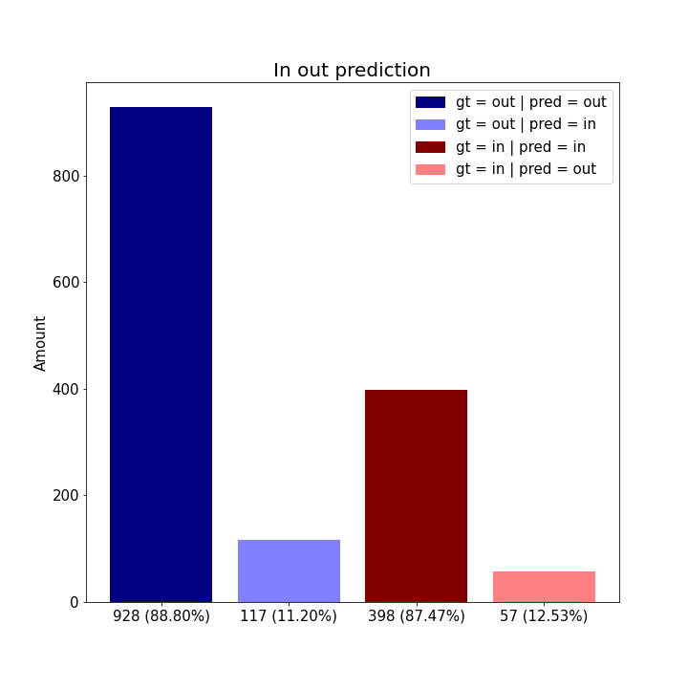

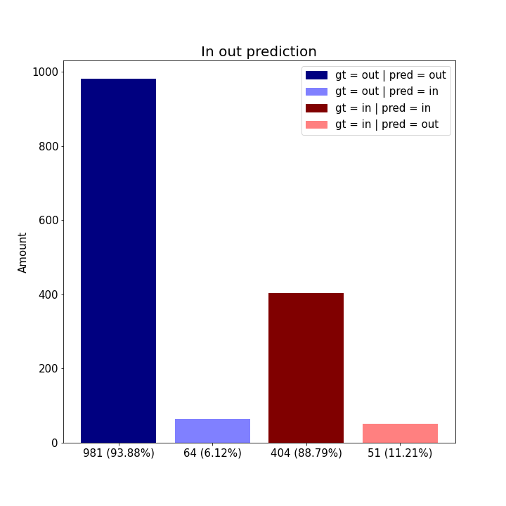
Angle error vs radius
RGB | Depth | RGBD- parallel | RGBD- early
In out prediction
RGB | Depth | RGBD- parallel | RGBD- early

Slide 5
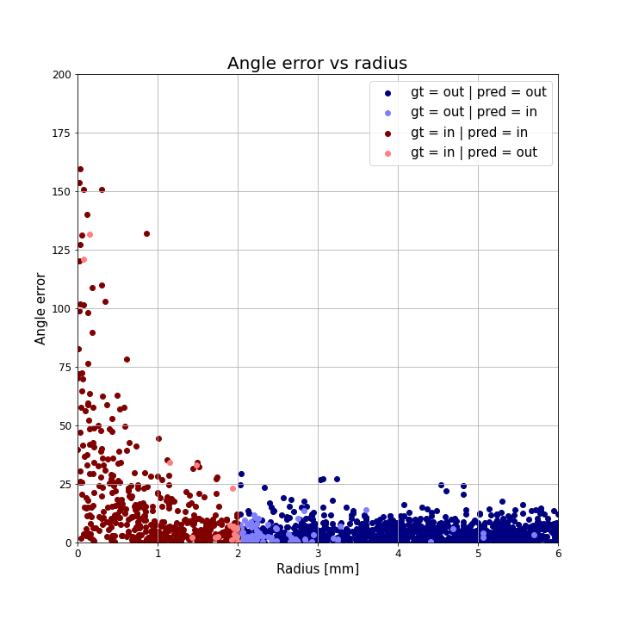
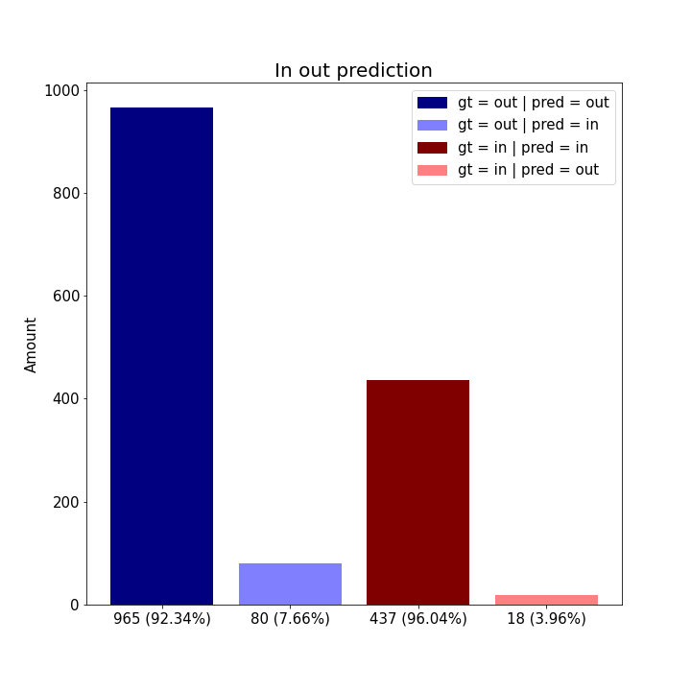
RGBD- late
Angle error vs radius | In out prediction

Slide 6
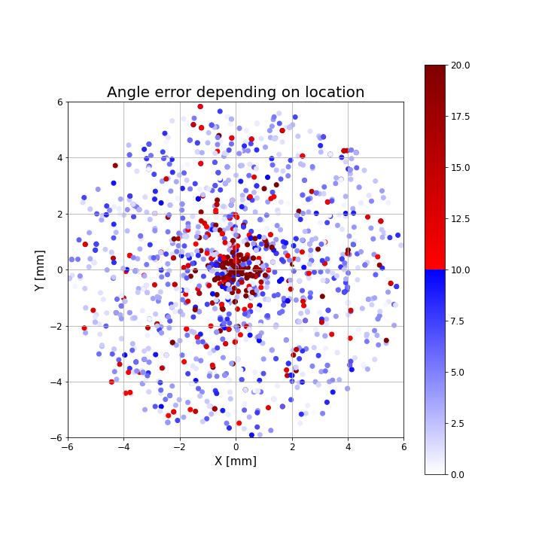
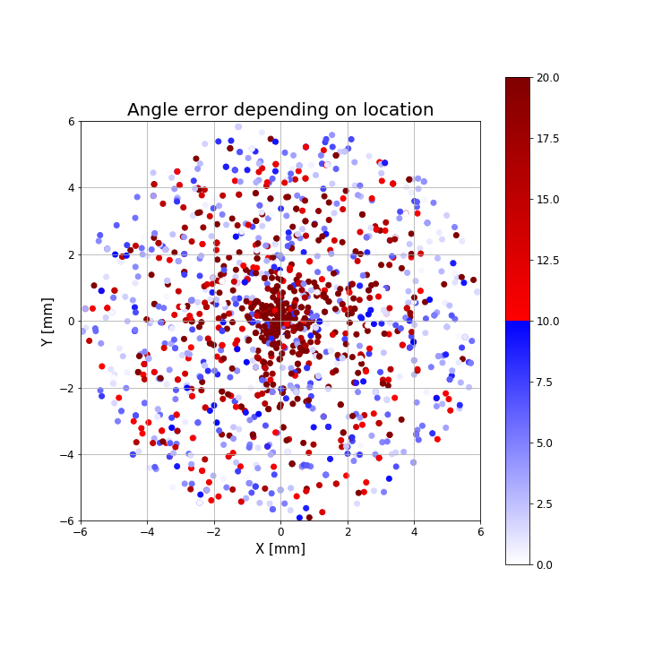
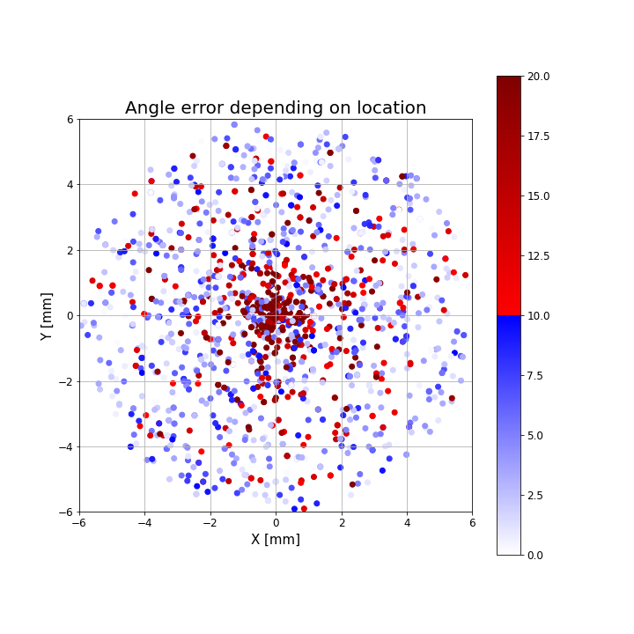

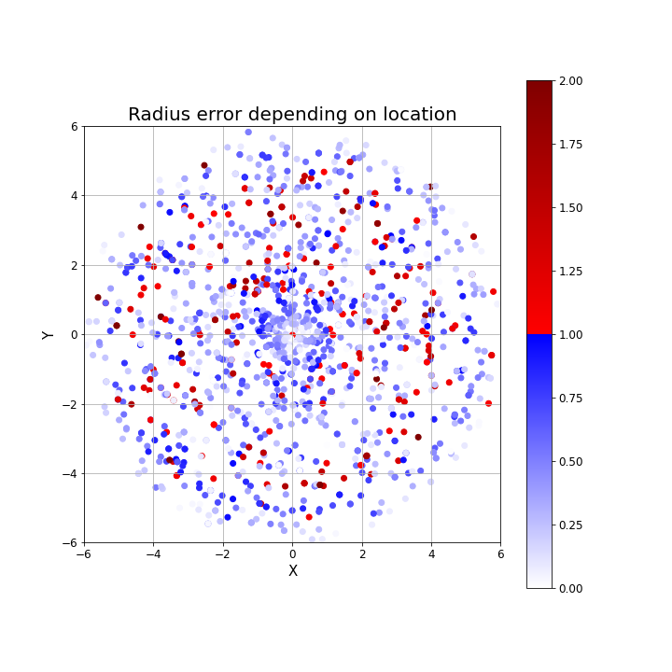
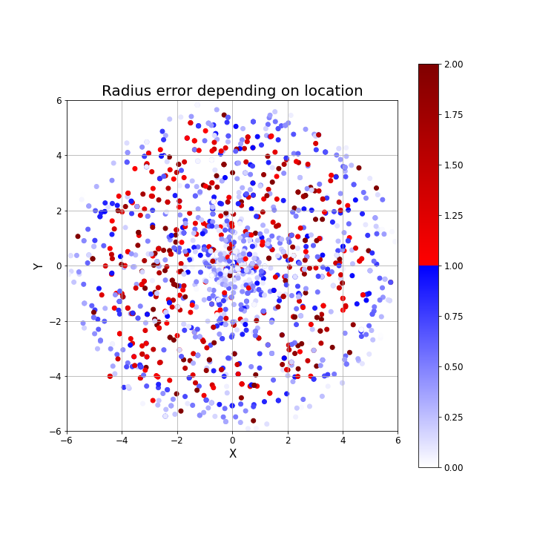
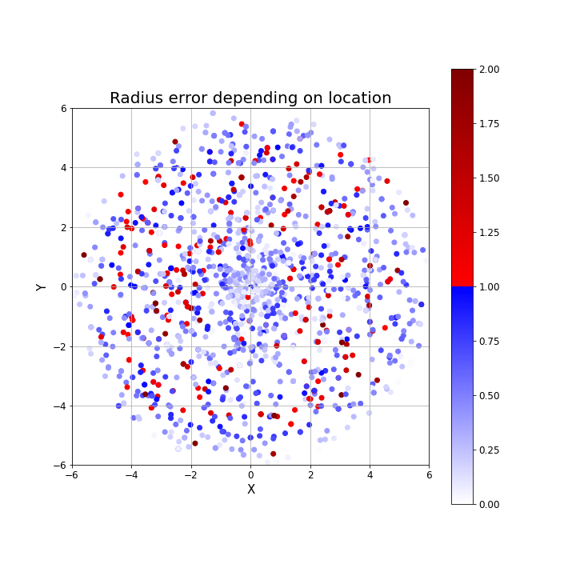
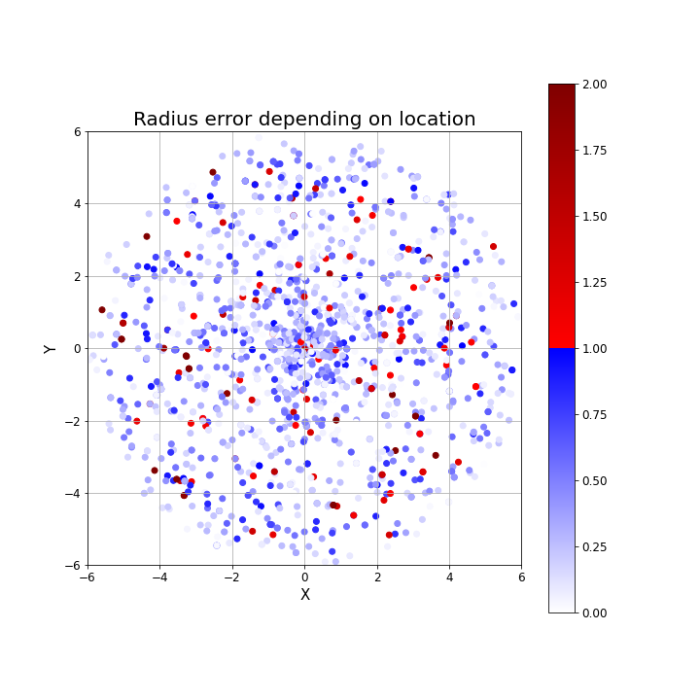
Angle error depending on location
RGB | Depth | RGBD- parallel | RGBD- early
Radius error depending on location
RGB | Depth | RGBD- parallel | RGBD- early

Slide 7
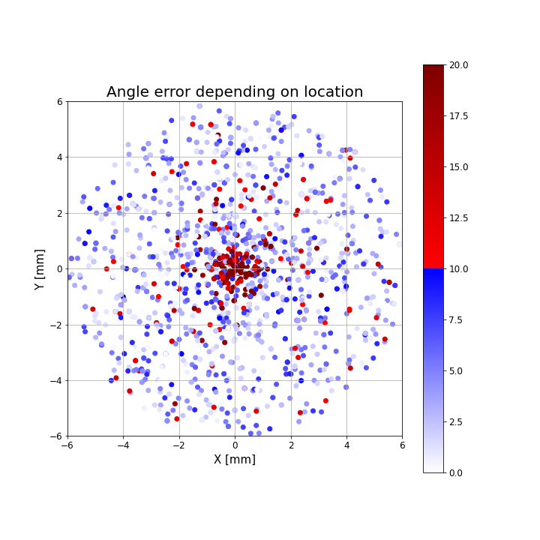
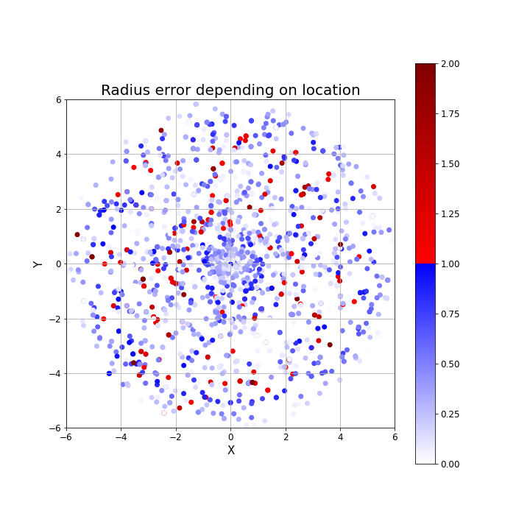
RGBD- late
Angle error depending on location | Radius error depending on location

