Slide 1
Angle prediction
Criterion | RGB | Depth | RGBD- parallel | RGBD- early | RGBD- late
RMSE | 11.54 |  |  | 19.45
MAE | 8.61 |  |  | 15.20
68% error | -2.64±11.23 |  |  | -2.35±19.31
95% error | -2.64±22.47 |  |  | -2.35±38.62
Rank
Radius prediction
Criterion | RGB | Depth | RGBD- parallel | RGBD- early | RGBD- late
RMSE | 0.72 |  |  | 0.69
MAE | 0.55 |  |  | 0.54
68% error | 0.16±0.70 |  |  | -0.29±0.63
95% error | 0.16±1.41 |  |  | -0.29±1.25
Rank

Slide 2
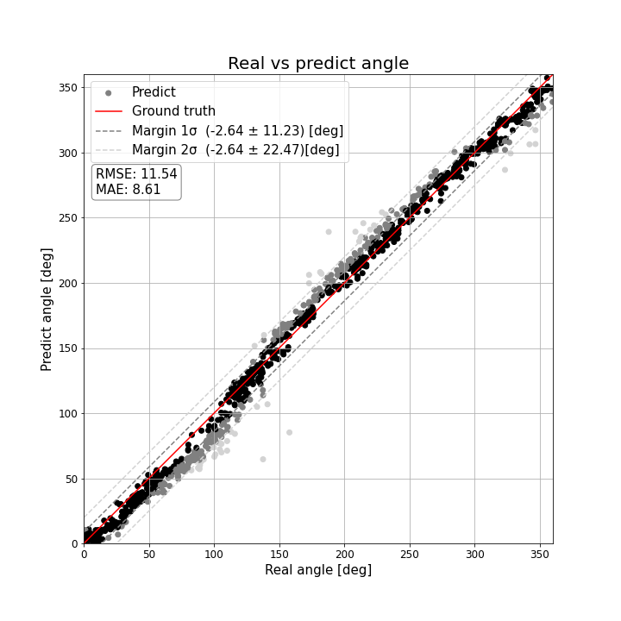
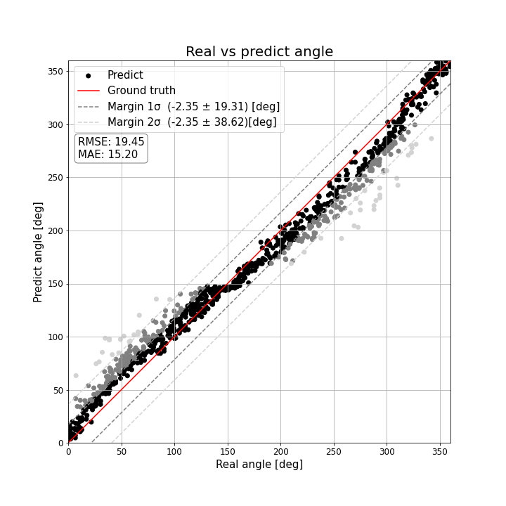


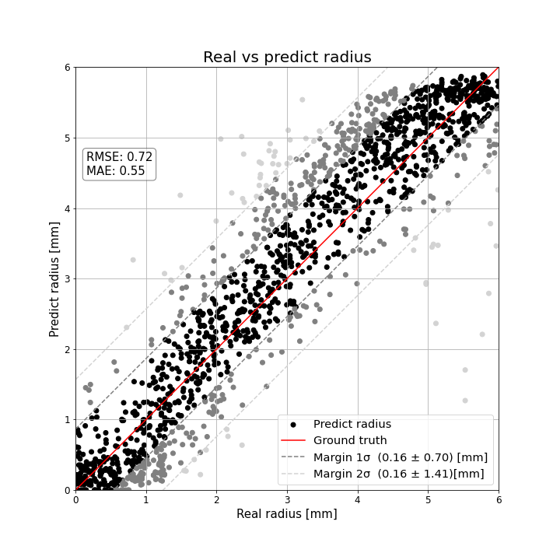
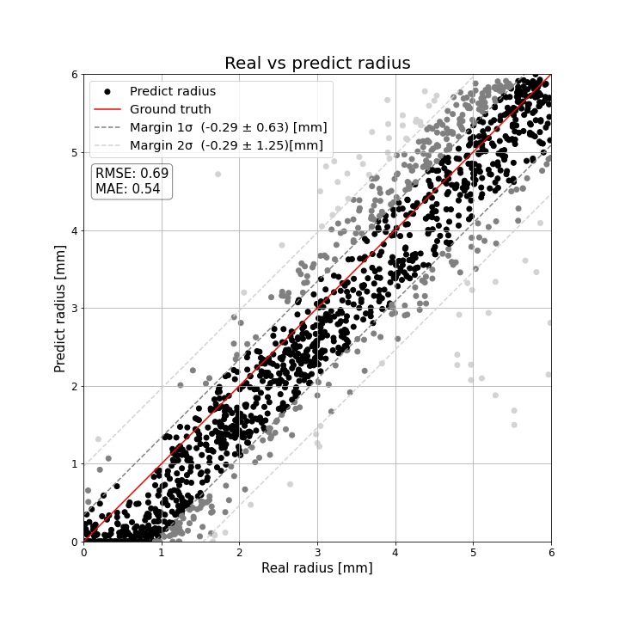
Angle prediction
RGB | Depth | RGBD- parallel | RGBD- early
Radius prediction
RGB | Depth | RGBD- parallel | RGBD- early

Slide 3
RGBD- late
Angle prediction | Radius prediction

Slide 4
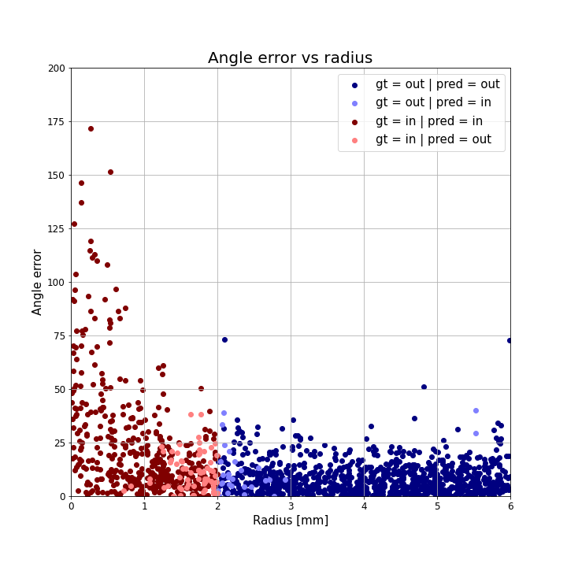
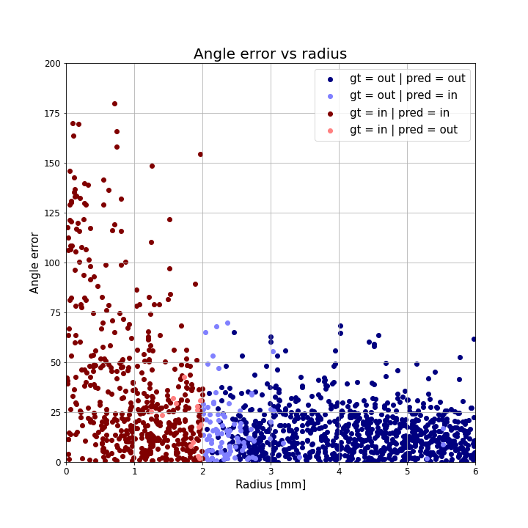
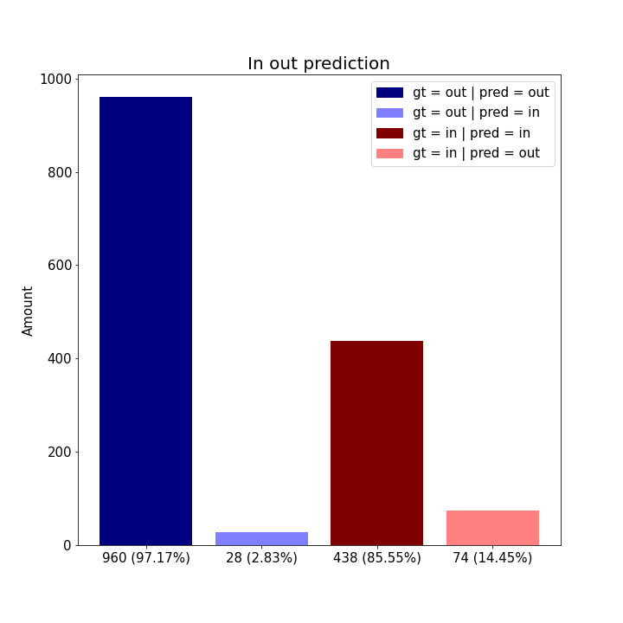
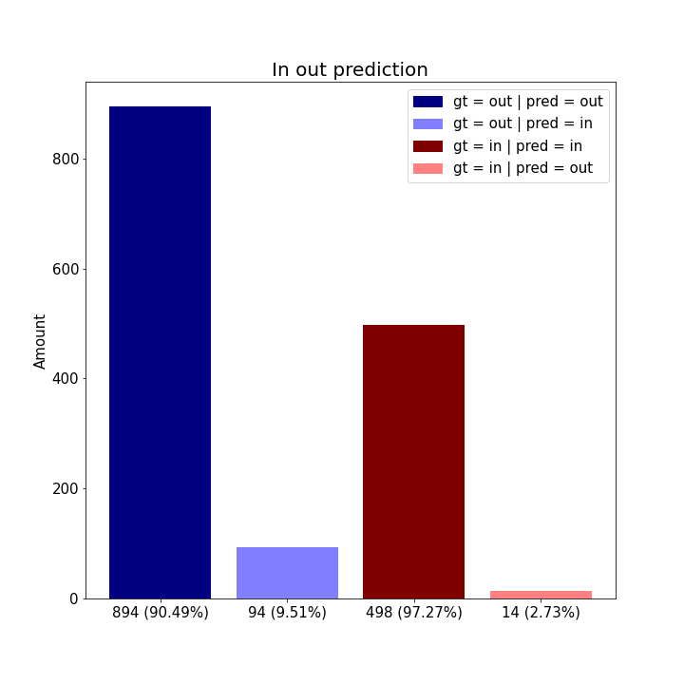
Angle error vs radius
RGB | Depth | RGBD- parallel | RGBD- early
In out prediction
RGB | Depth | RGBD- parallel | RGBD- early

Slide 5
RGBD- late
Angle error vs radius | In out prediction

Slide 6
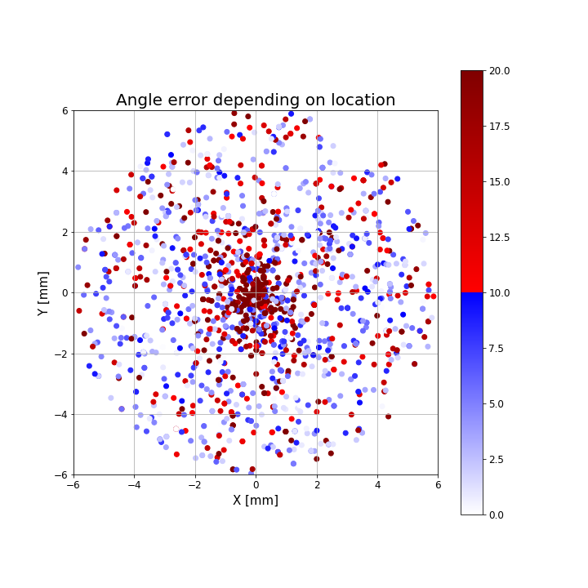
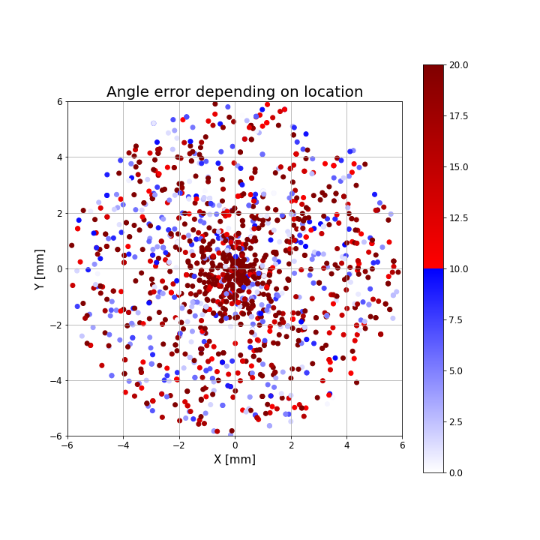
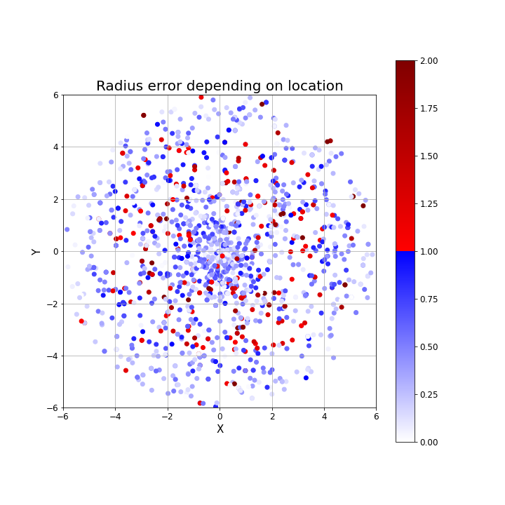
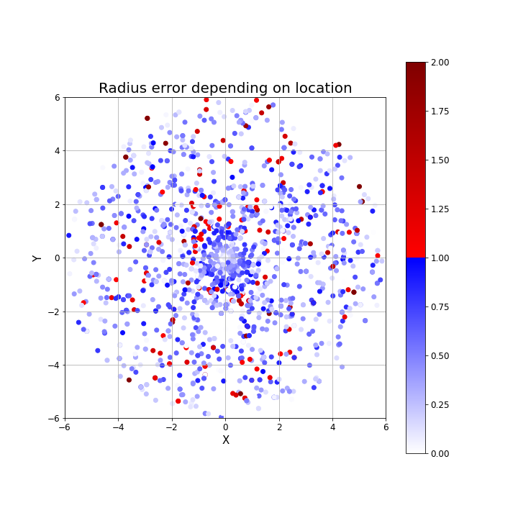
Angle error depending on location
RGB | Depth | RGBD- parallel | RGBD- early
Radius error depending on location
RGB | Depth | RGBD- parallel | RGBD- early

Slide 7
RGBD- late
Angle error depending on location | Radius error depending on location

