Slide 1
Angle prediction
Criterion | RGB | Depth | RGBD- parallel | RGBD- early | RGBD- late
RMSE | 30.69 | 32.27 | 15.17 | 14.46 | 8.95
MAE | 25.13 | 22.72 | 12.09 | 11.04 | 6.88
68% error | 1.11±30.67 | -2.63±32.16 | -0.71±15.15 | 4.44±13.76 | 0.77±8.92
95% error | 1.11±61.33 | -2.63±64.32 | -0.71±30.31 | 4.44±27.53 | 0.77±17.84
Rank | 4 | 5 | 3 | 2 | 1
Radius prediction
Criterion | RGB | Depth | RGBD- parallel | RGBD- early | RGBD- late
RMSE | 0.46 | 0.51 | 0.44 | 0.45 | 0.45
MAE | 0.36 | 0.39 | 0.35 | 0.31 | 0.32
68% error | 0.09±0.45 | 0.17±0.48 | 0.13±0.42 | -0.11±0.45 | -0.11±0.44
95% error | 0.09±0.91 | 0.17±0.97 | 0.13±0.85 | -0.11±0.90 | -0.11±0.88
Rank | 4 | 5 | 1 | 3 | 2

Slide 2
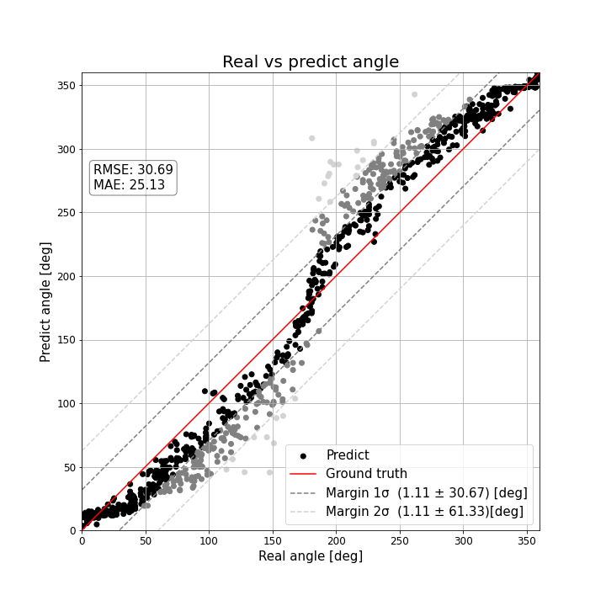
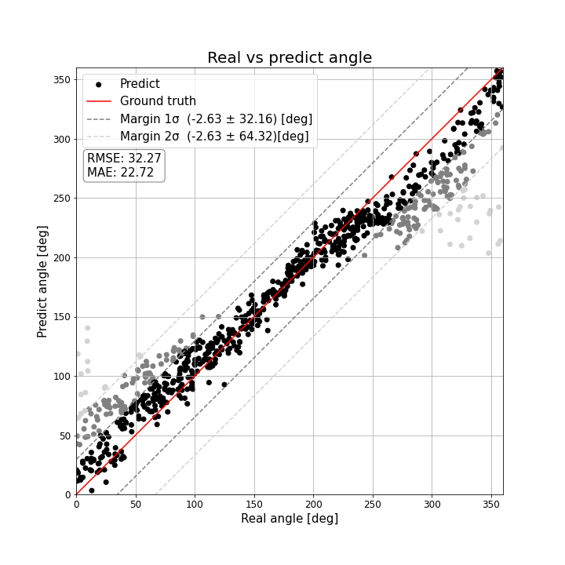
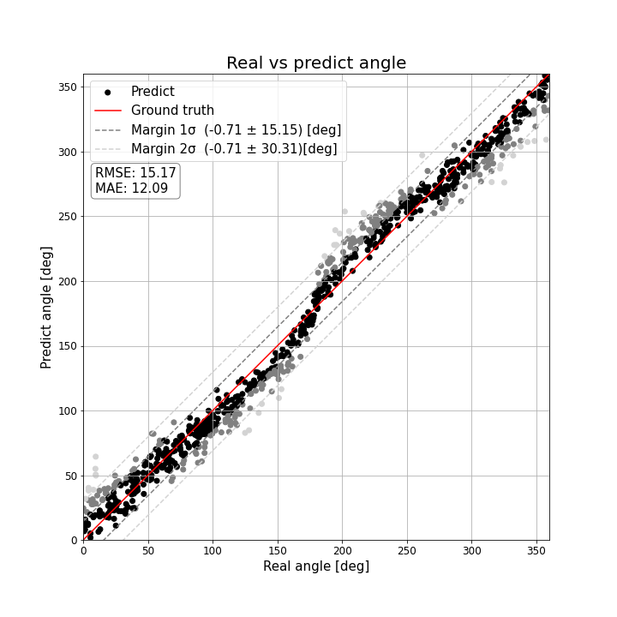
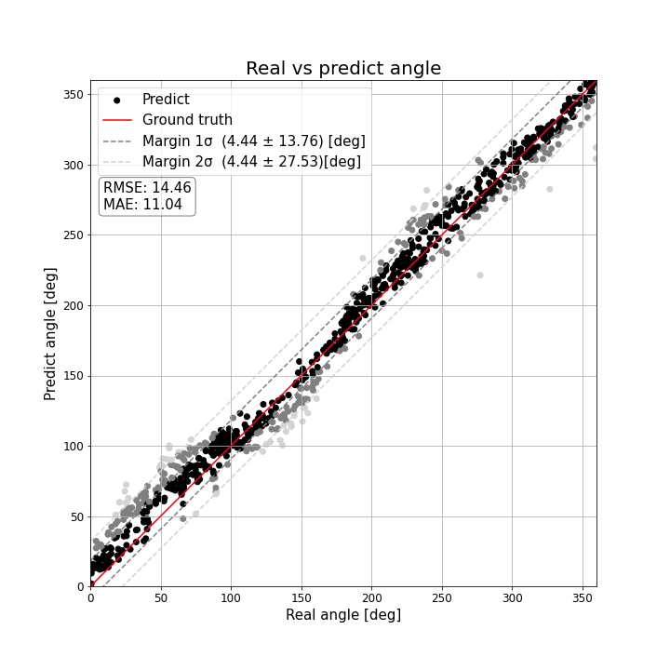
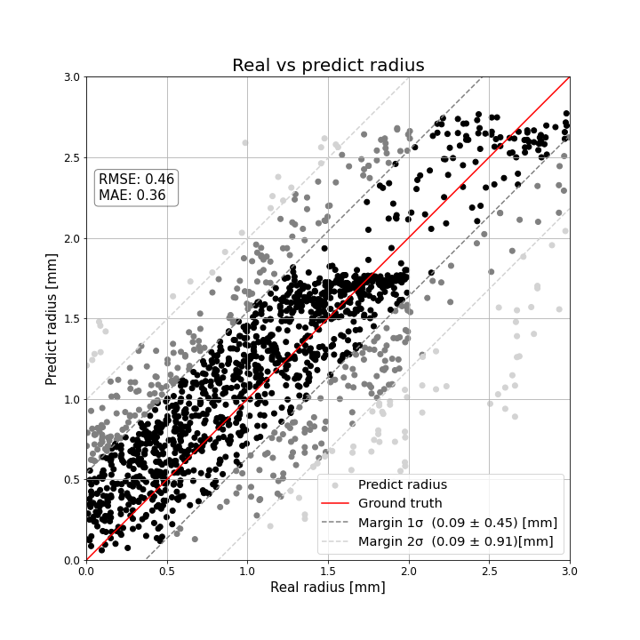
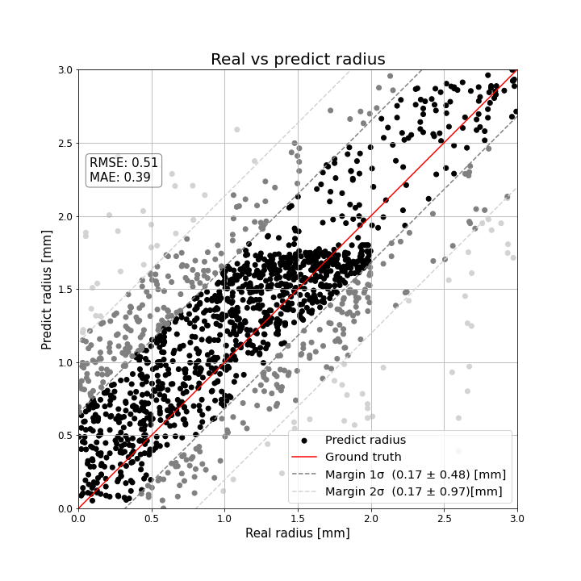
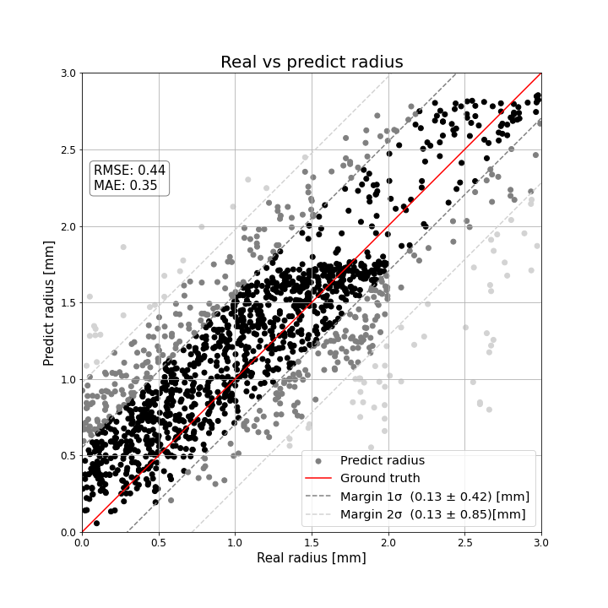
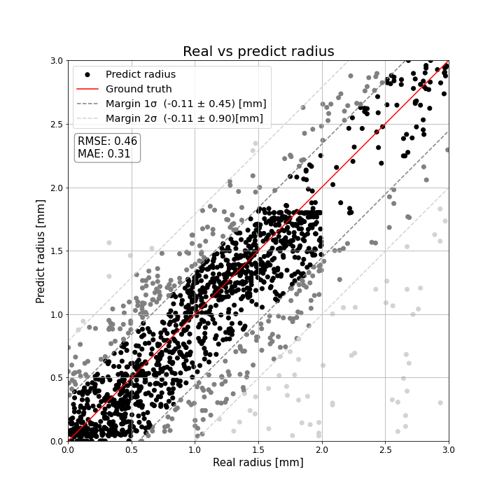
Angle prediction
RGB | Depth | RGBD- parallel | RGBD- early
Radius prediction
RGB | Depth | RGBD- parallel | RGBD- early

Slide 3
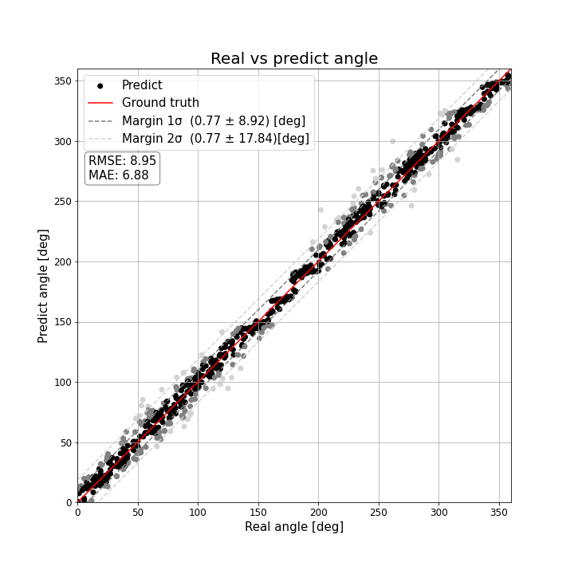
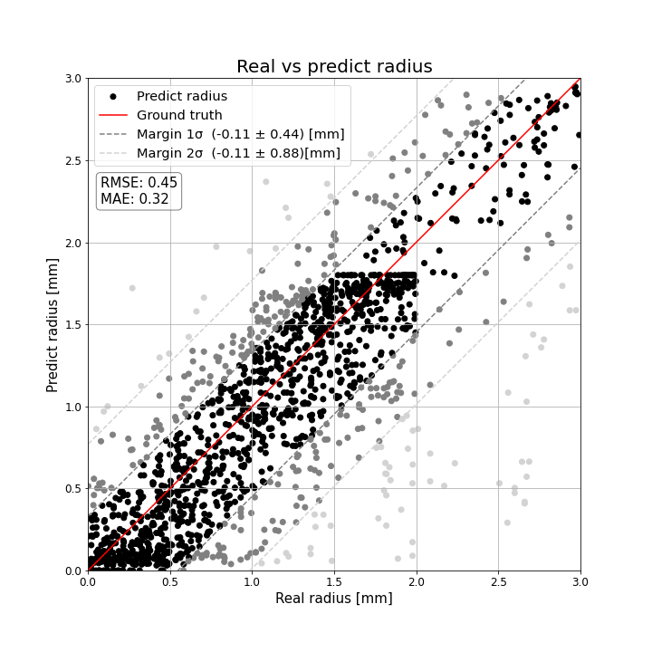
RGBD- late
Angle prediction | Radius prediction

Slide 4
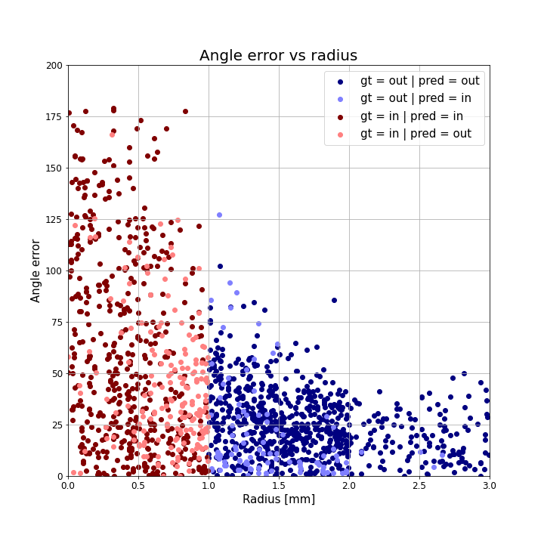
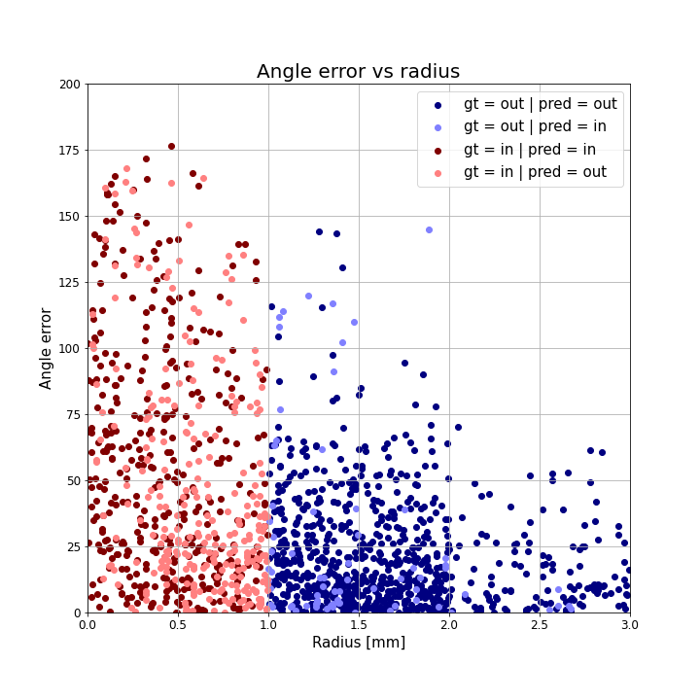
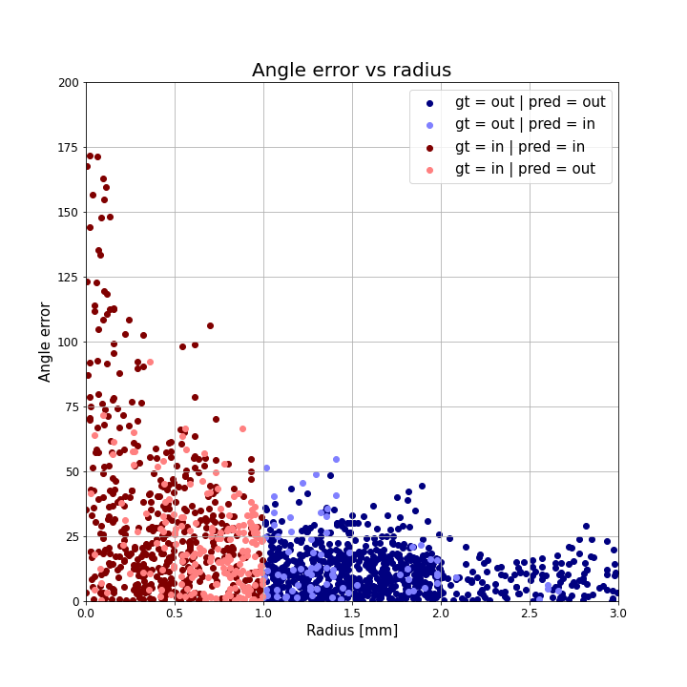
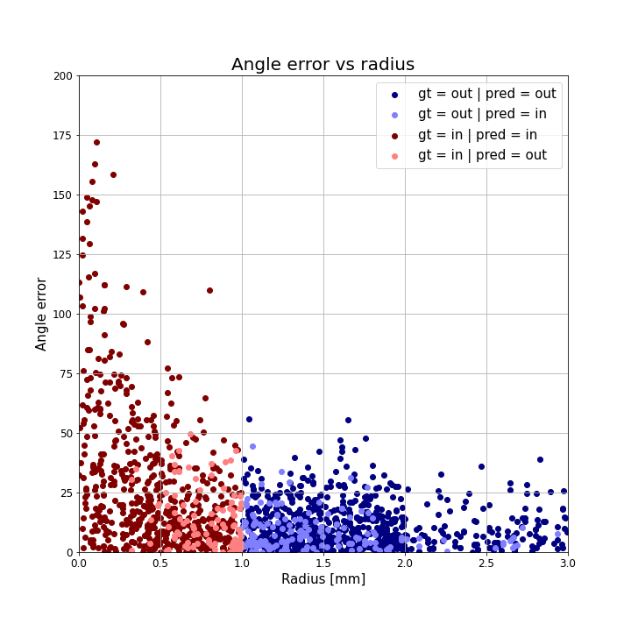
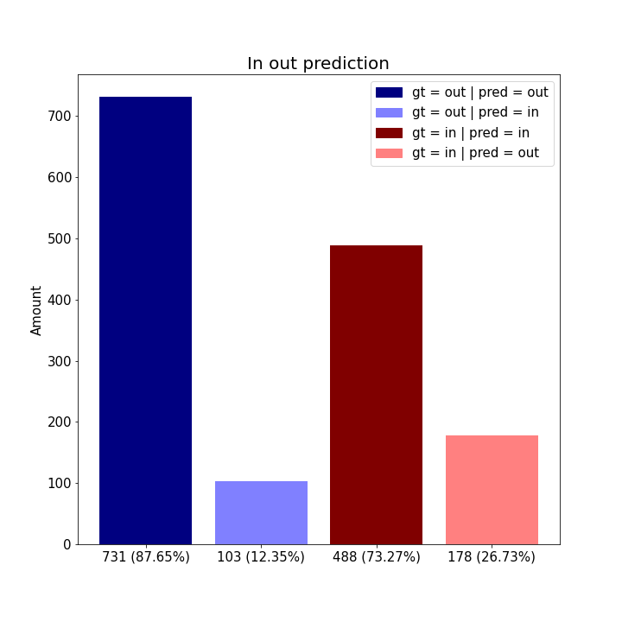
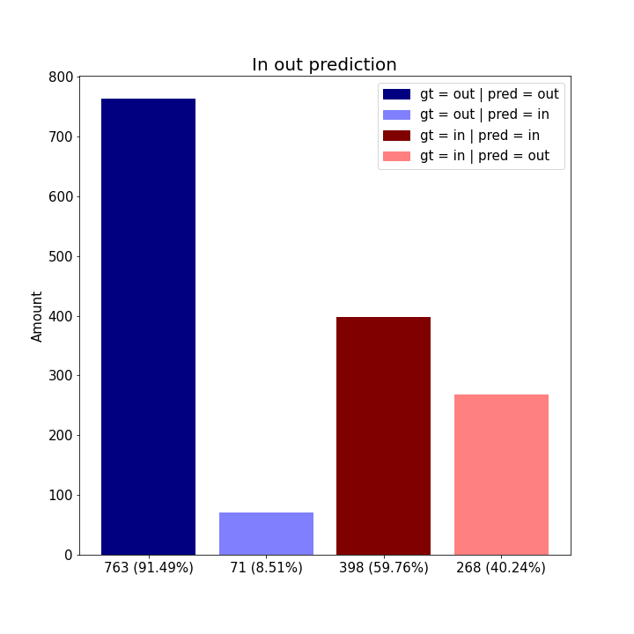
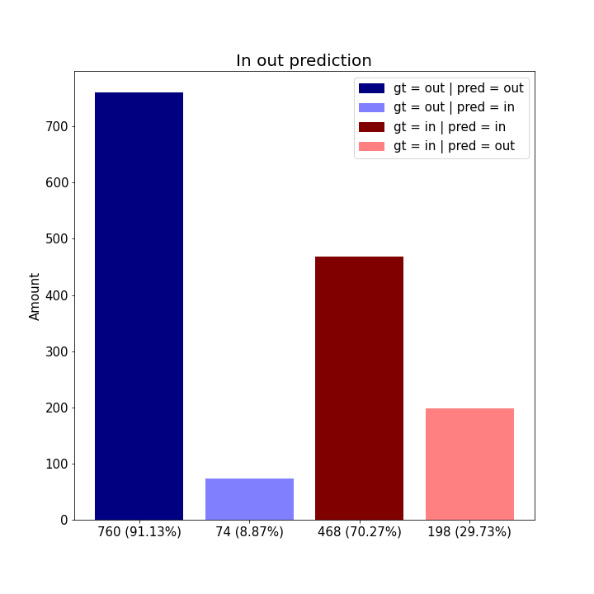
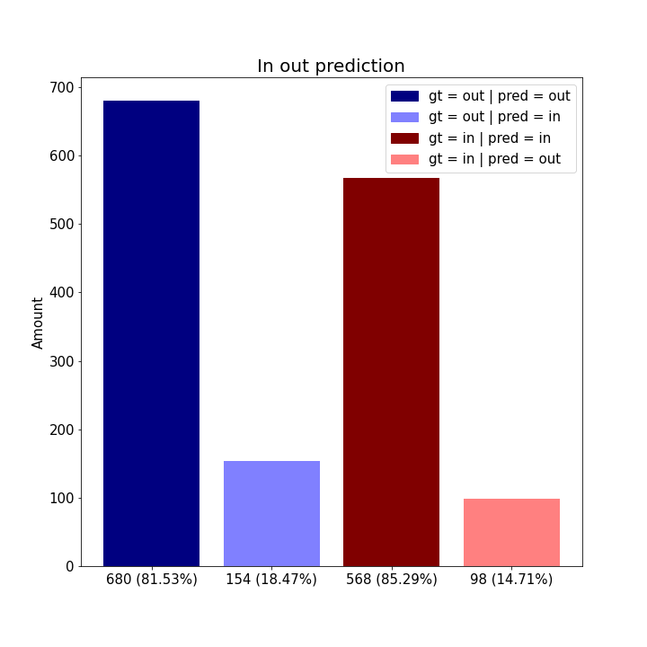
Angle error vs radius
RGB | Depth | RGBD- parallel | RGBD- early
In out prediction
RGB | Depth | RGBD- parallel | RGBD- early

Slide 5
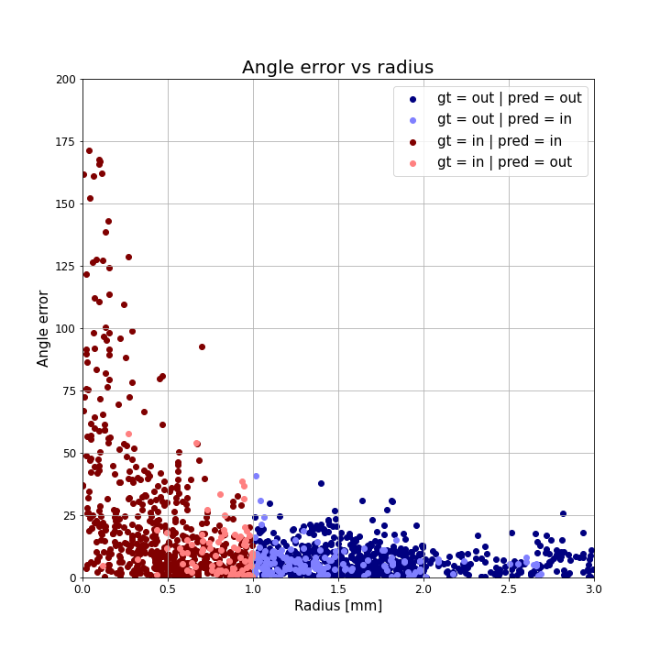
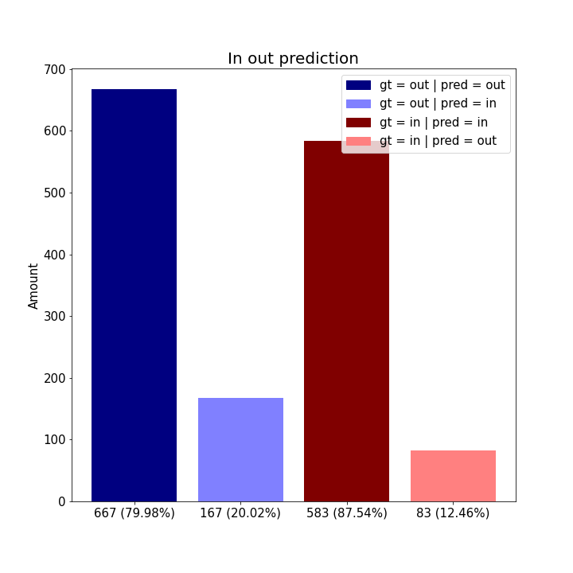
RGBD- late
Angle error vs radius | In out prediction

Slide 6
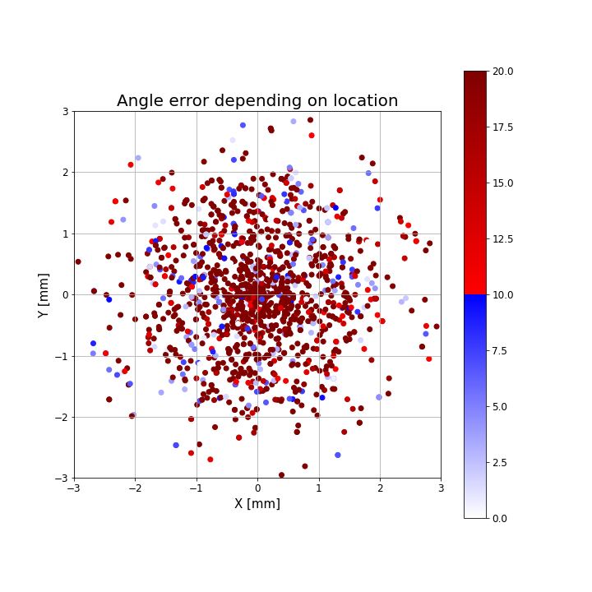
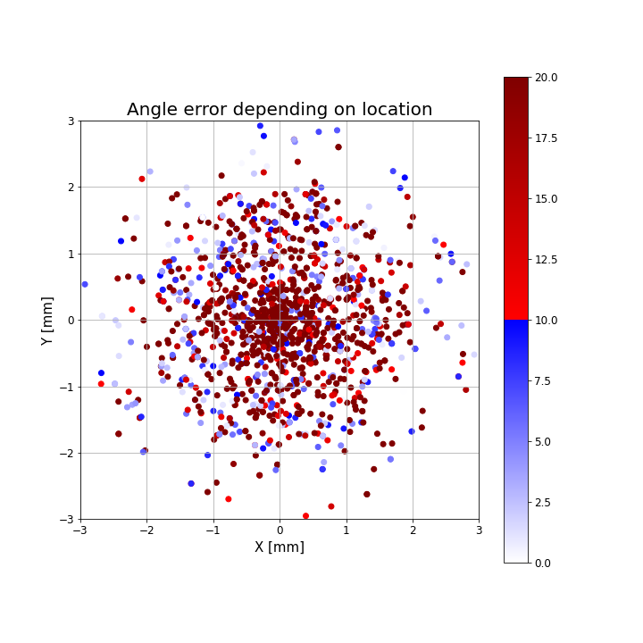
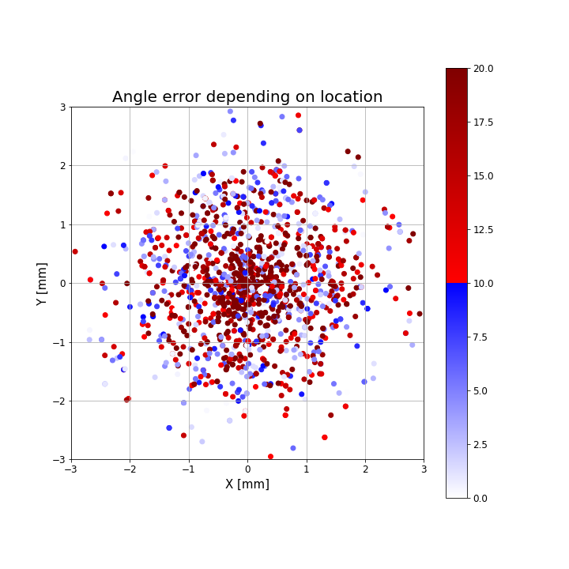
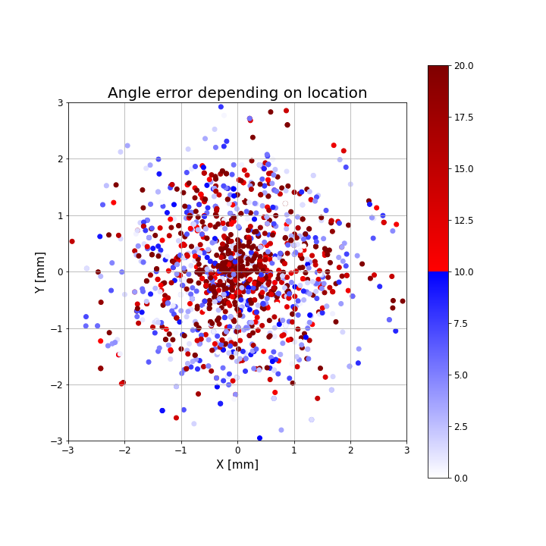
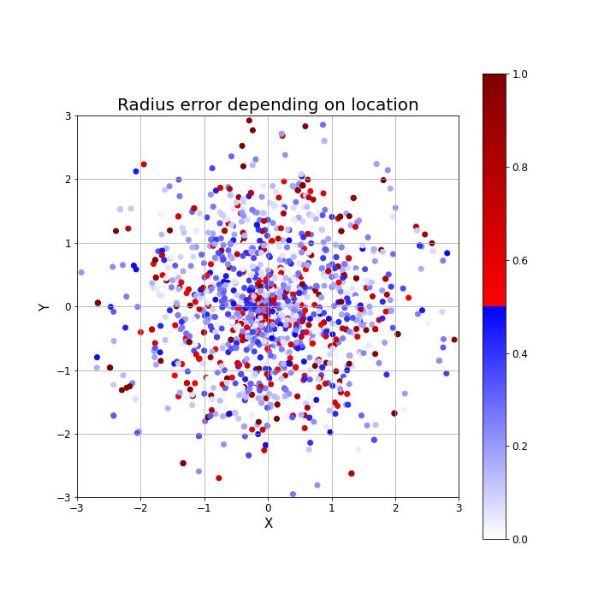
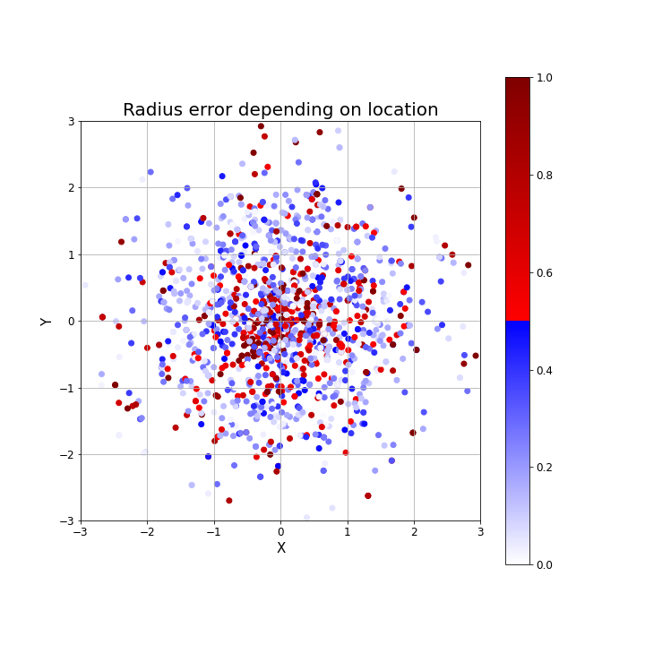
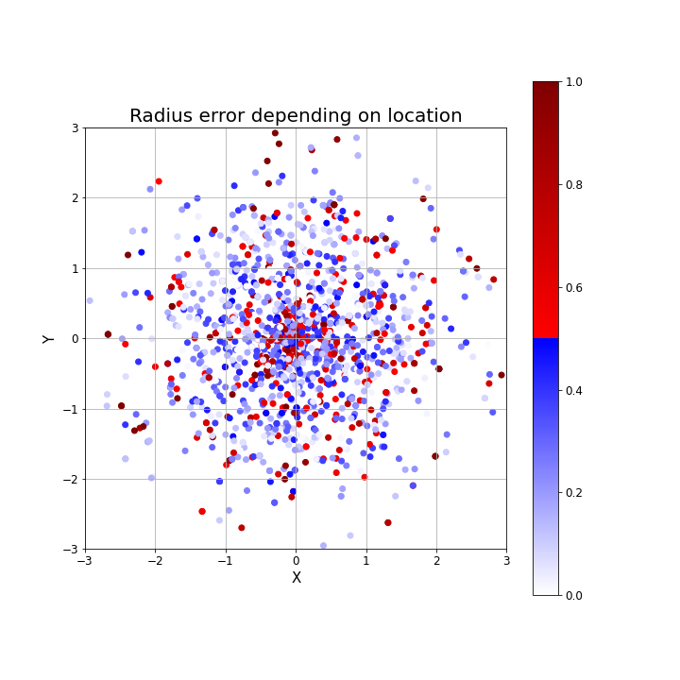
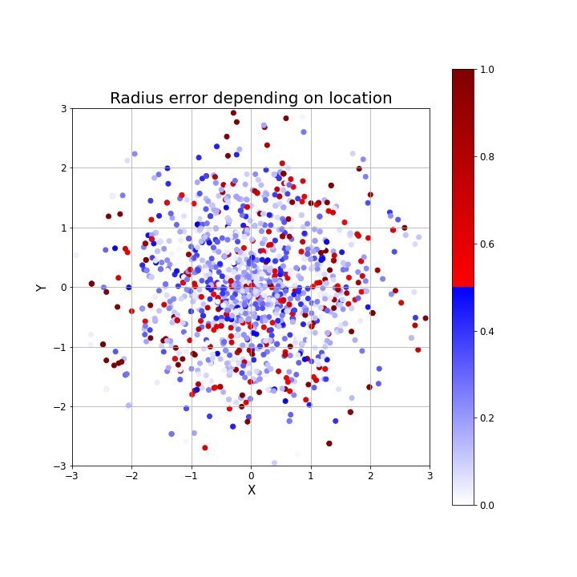
Angle error depending on location
RGB | Depth | RGBD- parallel | RGBD- early
Radius error depending on location
RGB | Depth | RGBD- parallel | RGBD- early

Slide 7
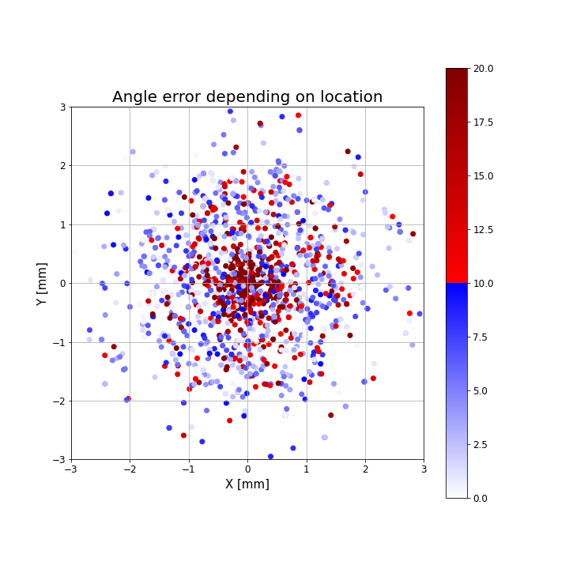
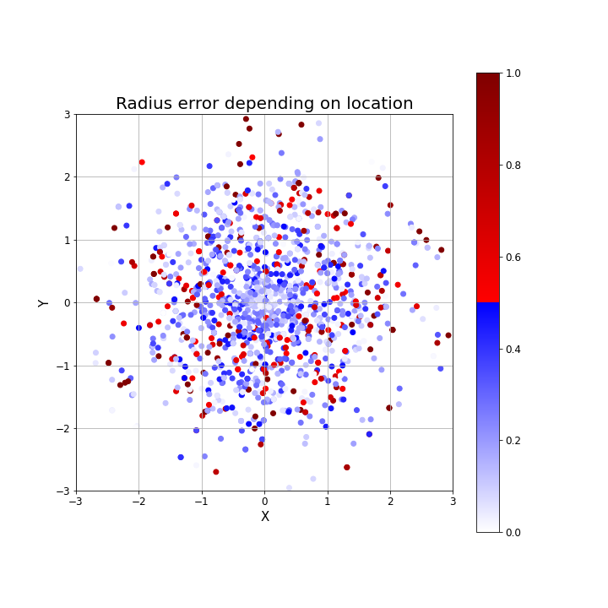
RGBD- late
Angle error depending on location | Radius error depending on location

