Slide 1


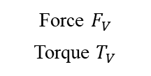


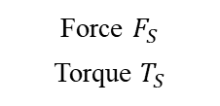

3D vision sensor
Relative radius $\hat{R}$
Relative angle $\hat{θ}$
Insertion process
Friction force $\hat{F}$
Virtual friction force sensor
Force $F_{V}$
Torque $T_{V}$
Virtual F/T sensor
Force $F_{S}$
Torque $T_{S}$
OnRobot F/T sensor
Location improvement
$\hat{R}>$ Threshold
Decision making
Insertion
$\hat{R}≤$ Threshold

