Slide 1
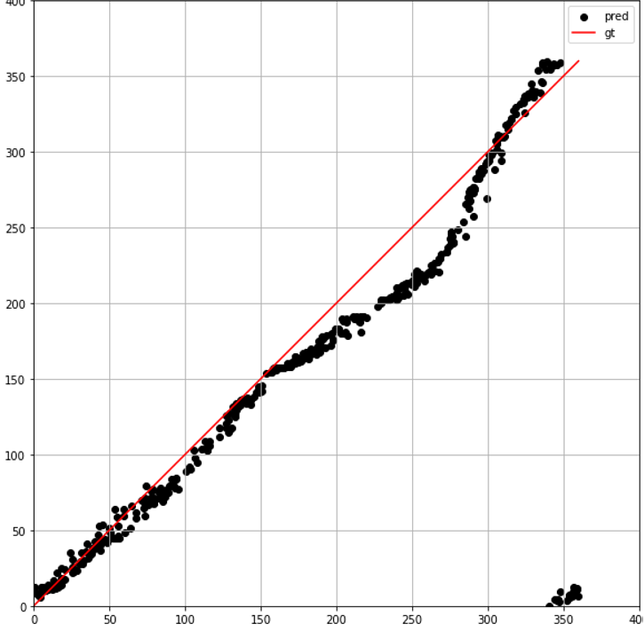


Estimated relative angle $\hat{θ}$ [deg]
Real relative angle $θ$ [deg]
(a)

