Slide 1
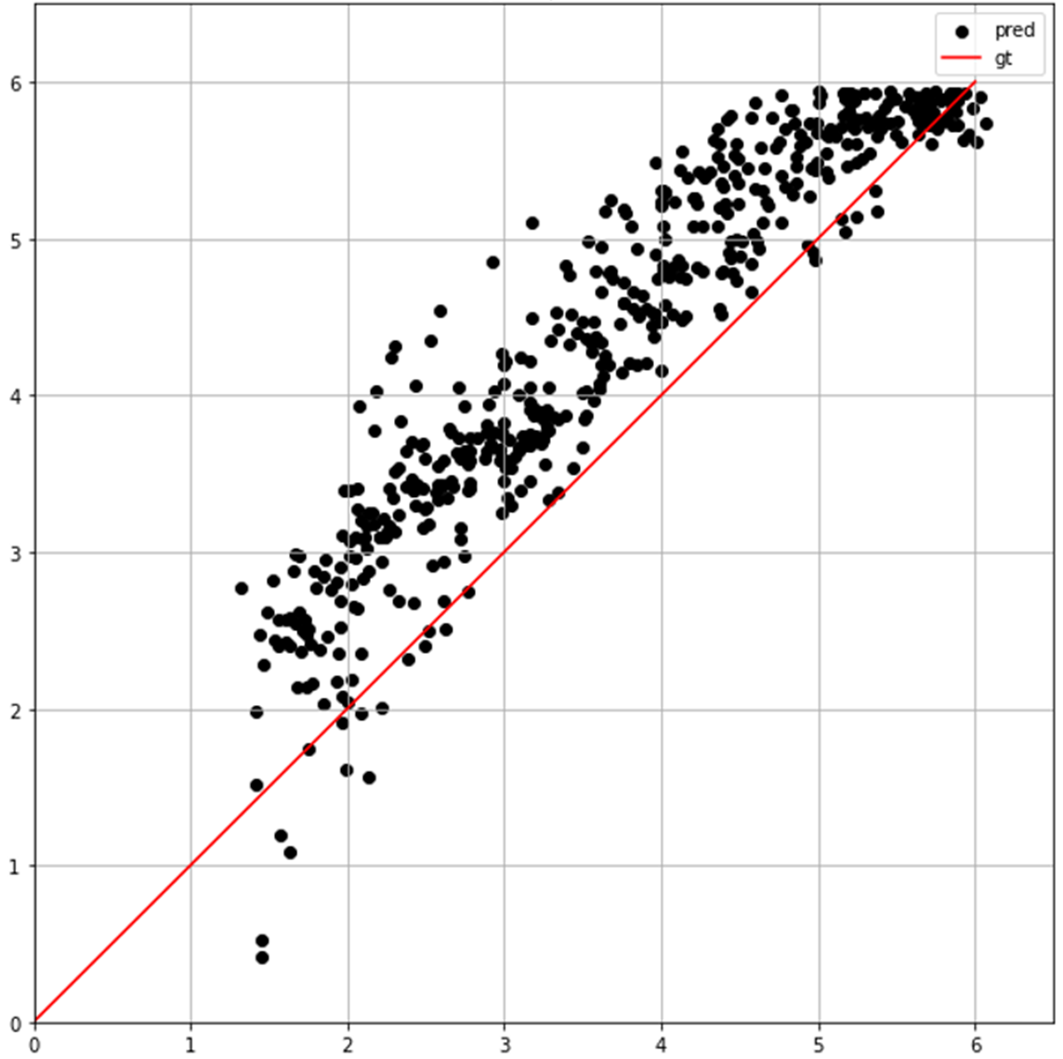

Estimated relative radius $\hat{R}$ [mm]
Real relative radius 𝑅 [mm]
(b)

