Slide 1

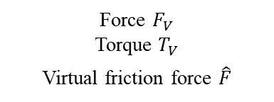




3D vision sensor
Relative radius $\hat{R}$
PIH insertion process
Relative angle $\hat{θ}$
Force $F_{V}$
Torque $T_{V}$
Virtual friction force $\hat{F}$
Force $F_{V}$
Torque $T_{V}$
Virtual
F/T sensor
+
Location improvement
$\hat{R}>$ Threshold
Threshold
Insertion
$\hat{R}≤$ Threshold

Slide 2

CNN
weights
Vision sensor
Capturing
3D scene
RGB image
Depth data
Relative position
classification
Probabilities
vector
Relative position
extraction
Robotic system
Updated scene
PIH insertion process
Relative angle $\hat{θ}$
Relative radius $\hat{R}$

Slide 3
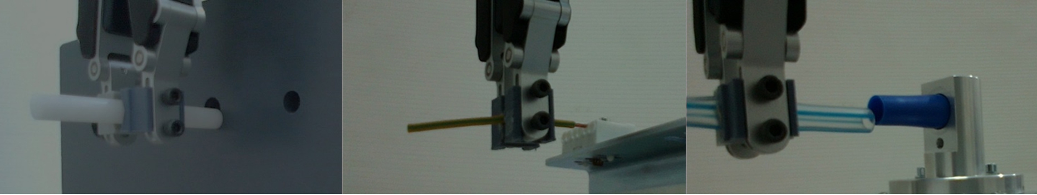
(a)
(b)
(c)

Slide 4
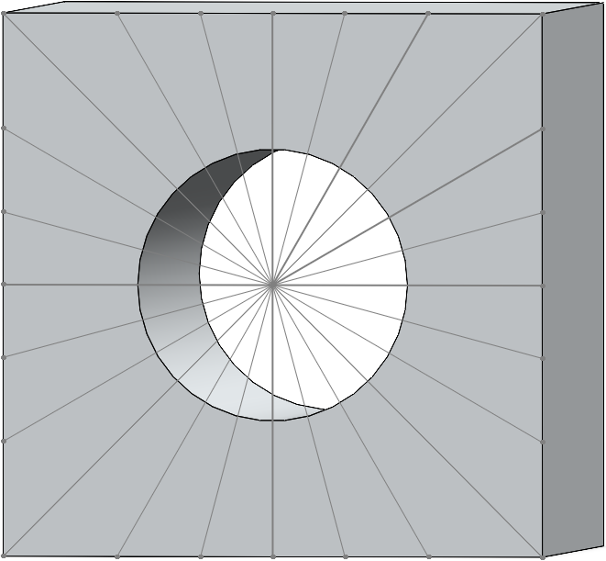
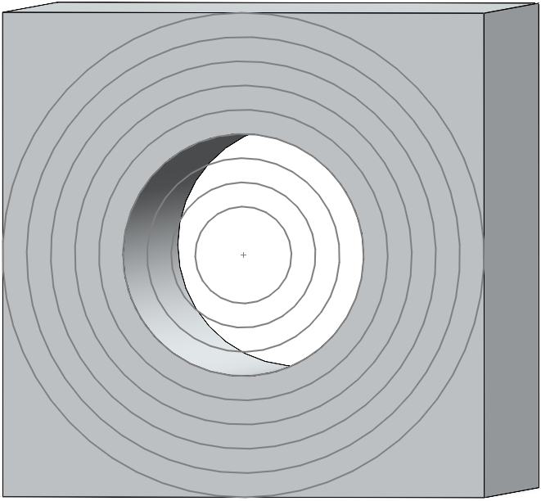
(a)
(b)

Slide 5
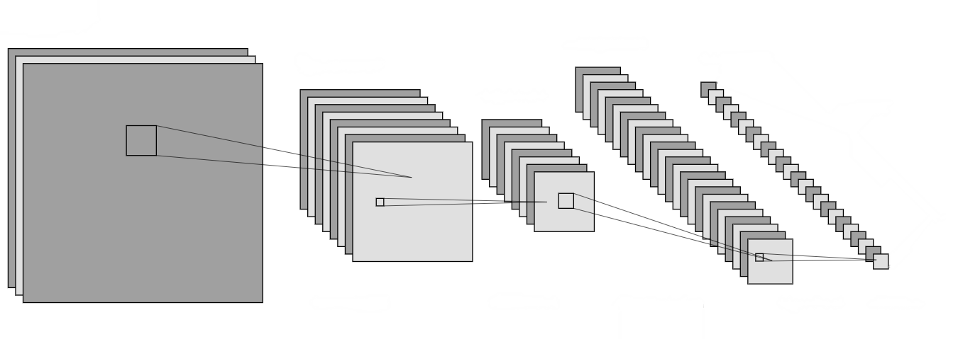
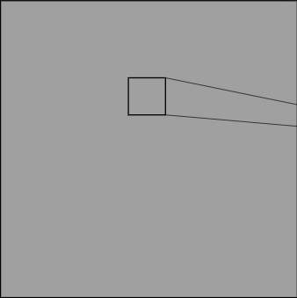
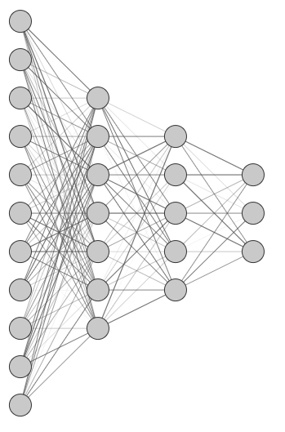
RGB input
Convolutional layers
Fully Connected
Depth input

Slide 6
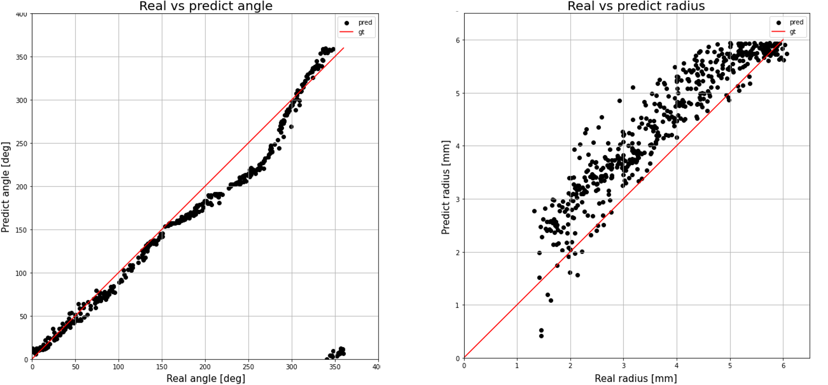


Real vs. Estimated relative angle
Estimated relative angle $\hat{θ}$ [deg]
Real relative angle $θ$ [deg]

Slide 7


Real vs. Estimated relative radius
Estimated relative radius $\hat{R}$ [mm]
Real relative radius $R$ [mm]

