Slide 1
WasedaJW
Waseda Timetable Planner
A Better Way to Plan Your Time

Slide 2
Object-Oriented Programming
Templates
Timetable page
Course info page
Database (Data Access Object)
Notes:
Templates → inheritance and polymorphism → fundamentally the same template but depending on if they are the course info page or the timetable page, they are implemented differently
DAO → information hiding → abstraction, encapsulation

Slide 3
Export object example
class Pprint:
def __init__(self,listofDict):
self.dicts=listofDict
def toTXT(self):
#write to txt
def toPDF(self,listofDict):
#write to PDF
def toiCal(self,listofDict):
#write to iCal
Notes:
It’s structured this way idgi what do you want me to say

Slide 4
Design Choices
Backend
DAOs give us data persistence and modularity
User experience
Waseda colours are familiar to our target demographic
Notes:
Persistence → the data is still going to be there even after the process that created it is long over
Modularity → the parts of the application are separate from each other so that even when one part changed the other parts are unaffected. This allows us to make frequent and independent changes to the different parts of the application, which we will since we have plans to develop it

Slide 5
Challenges Overcome
Time constraints
Visualising the user experience

Slide 6
Coming Soon!!
.pdf, .jpg, .iCal export formats
Ratings and reviews
Semester toggle

Slide 7
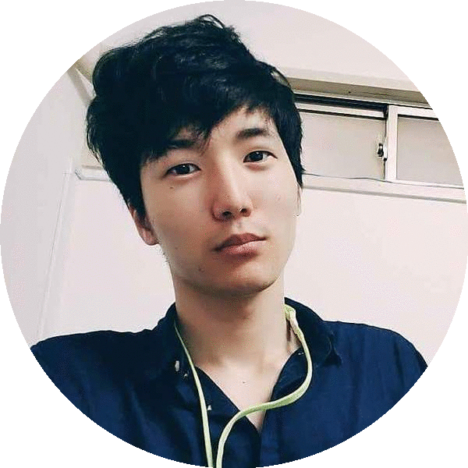
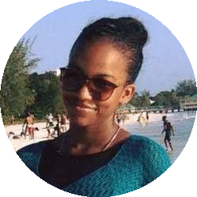
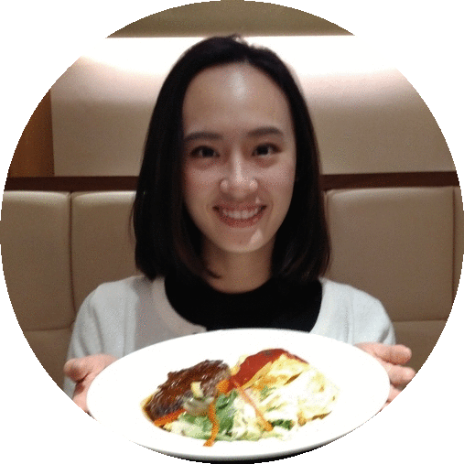

Jin
Alexia
Rebekah
WasedaJW

