Slide 1
Project about Orthopedic classification
Machine Learning

Slide 2
Team member
Sherif Ashraf Ahmed Roshdy (Team Leader)
Abdelrahman Mohamed Khalil
Mohamed Hosny Mosad
Sobeh Salah Sobeh
Yahia Zakria Ebrahim

Slide 3
Content
Domain of problem.
Skills Used and Project Objective.
Information about dataset.
Exploratory Dataset.
Training with more than one model.
Compare with accurse of each model.
Conclusion.

Slide 4
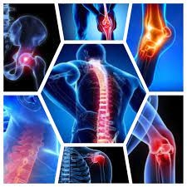
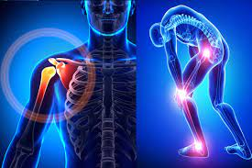
Domain of problem
Orthopedic relating to the branch of medicine dealing with the correction of deformities of bones or muscles.

Slide 5
Skills Used and Project Objective.
Skills Used:
Python >> Pandas, SKLearn, Seaborn, Matplotlib, numby.
Dataset >> Kaggle.
Project Objective
Used machine learning algorithms to classify a patient’s condition as normal or abnormal based on various orthopedic parameters

Slide 6
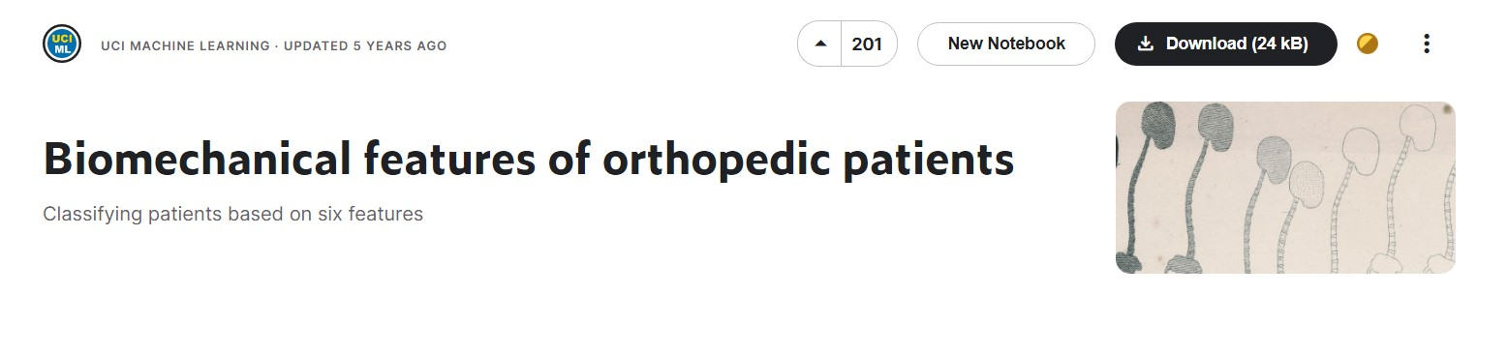
Information about dataset
Biomechanical features of orthopedic patients
Biomechanical features of orthopedic patients | Kaggle

Slide 7
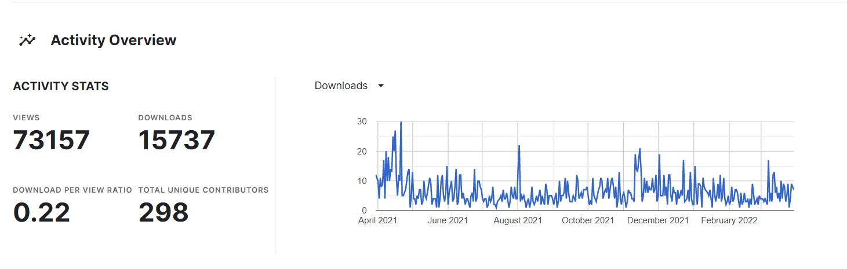
Conn…..
The task consists in classifying patients as belonging to one out of two categories: Normal (100 patients) or Abnormal (210 patients).
Activity Overview of dataset

Slide 8
Conn….
Each patient is represented in the data set by six biomechanical attributes derived from the shape and orientation of the pelvis and lumbar spine (each one is a column):
pelvic incidence حدوث الحوض
pelvic tilt إمالة الحوض
lumbar lordosis angle زاوية قعس قطني
sacral slope منحدر عجزي
pelvic radius نصف قطر الحوض
grade of spondylolisthesis درجة انزلاق الفقار

Slide 9
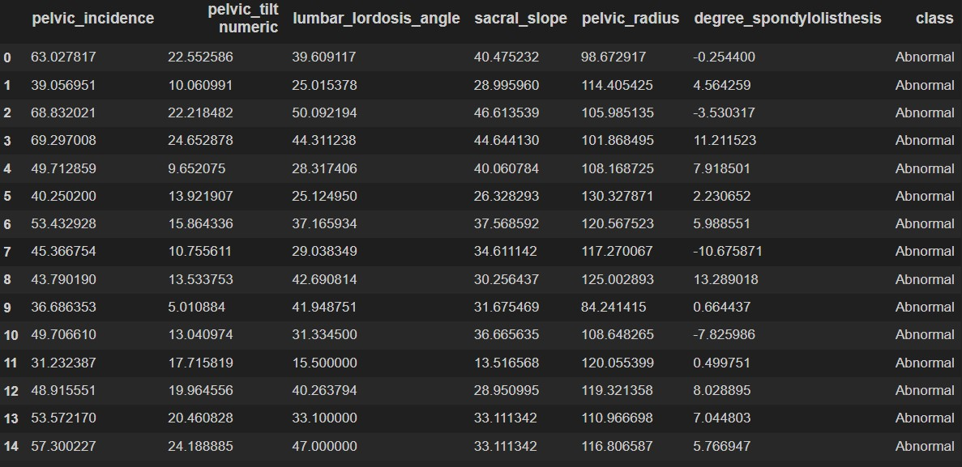
Exploratory Dataset.
Show the first 15 rows.

Slide 10
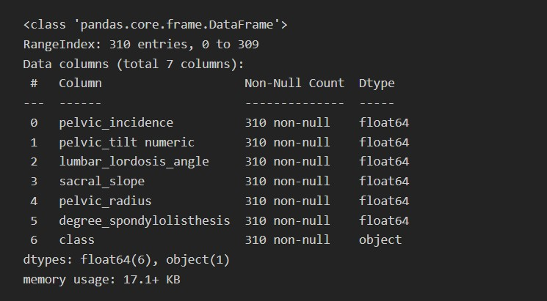
Conn..
Print a concise summary of a DataFrame.
The shape >> (310,7)

Slide 11
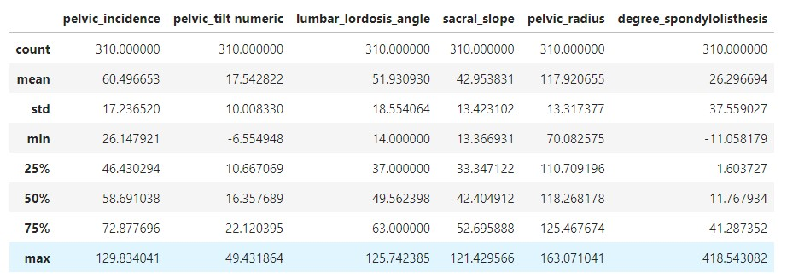
Conn…
Show descriptive statistics include those that summarize the central tendency, dispersion and shape of a dataset's distribution.

