Slide 1

INDEPENDENT VALUATION STUDIES · PARTNERSHIP BRIEF
testahil
Distributions, not tips.
Machine-generated, analyst-reviewed research for the modern wealth platform — every forecast published, time-stamped, and graded in public. Never edited.
93
4,081
90.9%
275
INSTRUMENTS · 8 MARKETS — A FULL STUDY BEHIND EVERY ONE
BACKTEST WINDOWS · UP TO 15 YEARS PER NAME
LANDED INSIDE THE STATED 90% BAND
PUBLIC FORECASTS SINCE JUN-2026
One in ten lands outside — by design. So far, three of fifty have.
Prepared for partnership discussion · August 2026 · testahil.com
Notes:
Open on the four numbers. 93 instruments, each with a full study behind it. 90.9% inside a stated 90% band — and on the live ledger, three of fifty have landed outside: 6%, under the designed 10%. [Numbers restruck 24-Aug on main @ d0bf624: 93 instruments / 4,081 windows / 90.9% / 275 ledger rows, 50 graded, 3 misses.]

Slide 2
02
02 · THE GAP
Who covers stock #200?
Nobody. Excellent research exists — for forty names, in twenty-page reports a first-time investor will never open.
40–60
hundreds
93
names one desk of analysts can carry with real depth
names retail actually trades — covered today by Telegram tips
instruments Testahil covers — a full ground-up study behind every one
276,000 registered investors in Egypt, up ~20% in a year — market cap +42% in 2025. A record wave of first-timers, walking into this vacuum.
EGX CHAIRMAN · AL ARABIYA · 29 DEC 2025
They trade blind, lose, and churn — and the most expensive client a platform can acquire is the one who leaves burned.
Testahil — distributions, not tips · 2
Notes:
Stock #200 has no analyst anywhere. The wave arriving into that vacuum is the whole pitch — let the three numbers do the talking. CONCEPTS — Long tail: the hundreds of smaller names retail actually trades but no research desk covers, because hand-building a study on a small cap costs the same analyst-month as on a blue chip with none of the client demand to pay for it. Churn: clients who lose money unguided leave the platform; replacing them costs more in acquisition than keeping them.

Slide 3
03
03 · THE SOLUTION
Machines write. Machines audit. A human signs.
STEP 1 · MACHINES WRITE
STEP 2 · MACHINES AUDIT
STEP 3 · A HUMAN SIGNS
A multi-model AI system writes the research
The system examines itself
Final review and approval by a human analyst
Nothing ships unless it survives the out-of-sample exam: walk-forward backtests against a stated 90% band. What fails is rejected — and named.
Every study built ground-up — fundamental, technical and simulation — for every covered name. Adding a stock costs compute and a review pass, not an analyst-month.
A named reviewer approves every number before it publishes — then it goes on the public ledger, time-stamped, graded, never edited.
That is how the gap closes: machine scale, exam discipline, human accountability.
Testahil — distributions, not tips · 3
Notes:
The system in one sentence: a multi-model AI writes the research, the system audits itself against the out-of-sample exam, and a named human signs before anything publishes. Scale from the machines, accountability from a human. Everything after this slide is each step in detail. CONCEPTS — Multi-model: several specialised AI models in a pipeline (one reads filings, one builds the financial model, one runs simulations), not one chatbot. Out-of-sample exam: the simulation is tested on data it never saw during fitting — the only honest test. Walk-forward backtest: replay history step by step; at each step the simulation may only use data available up to that date, then its forecast is graded against what actually happened next. 90% band: a price range published with the claim that the true price will land inside it 9 times out of 10 — so about 1 in 10 SHOULD land outside; if none do, the band is too wide to be useful.

Slide 4
04
04 · THE PRODUCT
Odds, not orders.
Three reads on every stock, in order: the destination, the starting point, and the odds of the journey.
READ 1 · FUNDAMENTAL — WHERE IS IT WORTH IN A YEAR?
THE LIVE READ — ADNOC LOGISTICS & SERVICES · 3 MONTHS
A fair-value range built from official filings only — product by product, volume × price — checked by an analyst before it publishes.
Latest price
AED 6.16 · close 7 Aug 2026
Chance higher than today
51%
READ 2 · TECHNICAL — WHERE DOES IT STAND TODAY?
Support, resistance, trend — the levels traders actually watch, computed from the same cleaned series, refreshed with every update.
+10% or better vs −10% or worse
24% vs 22% · ≈ 1.1:1 up
Bad case · good case (1-in-20)
4.95 · 7.73 (−20% / +25%)
READ 3 · SIMULATION — THE ODDS OF THE JOURNEY
Live read as computed by testahil.com on the 7-Aug close (simulation run 10 Aug 2026) — the same numbers the public sees.
50,000 Monte-Carlo paths per name, calibrated on up to 15 years of that stock’s own market — the odds of every price bracket on the road to fair value, over the next 1–3 months.
It never says buy. It says 24% vs 22% — how likely, and by when.
Testahil — distributions, not tips · 4
Notes:
Teach the path: read the fundamental for the destination (fair value, 1 year out), the technical for where it stands today, then the simulation for the odds of the journey between the two over 1–3 months. Never blended into one number. Then the live card: real ADNOC numbers, the same the public sees. CONCEPTS — Fair value: what the business is worth per share based on the cash it can generate, independent of today's price mood. Support/resistance: price levels where a stock has repeatedly stopped falling (support) or stopped rising (resistance) — the levels traders watch. Monte-Carlo simulation: instead of one prediction, generate 50,000 plausible price paths by drawing from the stock's own historical behaviour; the fraction of paths ending in each price bracket IS the probability. Median: the middle outcome — half the paths end above it, half below. The 1-in-20 cases on the card: the 5th and 95th percentile paths — the realistic bad case and good case.

Slide 5
05
05 · HOW IT’S BUILT
What we built — and what we rejected.
FILINGS — THE FUNDAMENTAL READ
OFFICIAL FILINGS
→
GROUND-UP MODEL
→
LIVE DCF CHAIN
→
FAIR-VALUE RANGE
audited accounts — never vendor feeds
drivers → IS → BS → CF → DCF
volume × price · cost per unit
never a point · never a target
THE SITE
PRICES — THE TECHNICAL & SIMULATION READS
cones · fair values · the Picker · the ledger
RAW PRICES
→
STEP-0 GATE
→
50,000 PATHS
→
THE EXAM
→
VERDICTS
every session — up to 15 years
exchange limits catch impossible moves
carry-anchored YZ-HAR-t · fixed seed
walk-forward vs a random walk
PASS · PARITY · FAIL per name, per market
8 MC simulation candidate techniques tested and rejected — each failed the exam above. Naming them is the proof the 90.9% wasn’t cherry-picked.
CRPS-tuned selection · raw & trend drift · fair-value pull · dynamic tail thickness · HARQ · skew-t · per-stock drift & width · ratio reversion
Testahil publishes fair-value ranges and probability distributions. It does not publish ratings, price targets, or recommendations, and nothing it publishes is investment advice.
Testahil — distributions, not tips · 5
Notes:
Two tracks — filings for the fundamental read, prices for the technical and simulation reads — meeting at the site. The dashed box at the bottom is the moat: everything tested and rejected, named. CONCEPTS — Step-0 gate: an automated data-quality screen; every exchange has daily price-limit rules, so a move that breaks them is a data error to fix, not a price to model. Carry-anchored: the simulation's centre is tied to the local risk-free rate minus the stock's dividend yield — what holding the stock 'costs' vs cash — instead of assuming yesterday's trend continues. YZ: Yang-Zhang volatility, an estimator that uses open, high, low AND close (not just close-to-close), so overnight gaps are counted — essential where limit rules mute intraday moves. HAR-t: volatility forecast blending yesterday, last week and last month (markets have memory at all three scales), with a fat-tailed t-distribution so extreme days are expected, not 'impossible'. Fixed seed: the random generator starts from a recorded number, so any auditor can re-run the exact same 50,000 paths and get identical output. IS/BS/CF → DCF: income statement, balance sheet, cash flow, all live formulas feeding a discounted-cash-flow valuation — future cash translated into today's money. Rejected list: CRPS = a scoring rule for probability forecasts; HARQ and skew-t = fancier volatility/distribution variants; each version beaten by the simpler one on out-of-sample data.

Slide 6
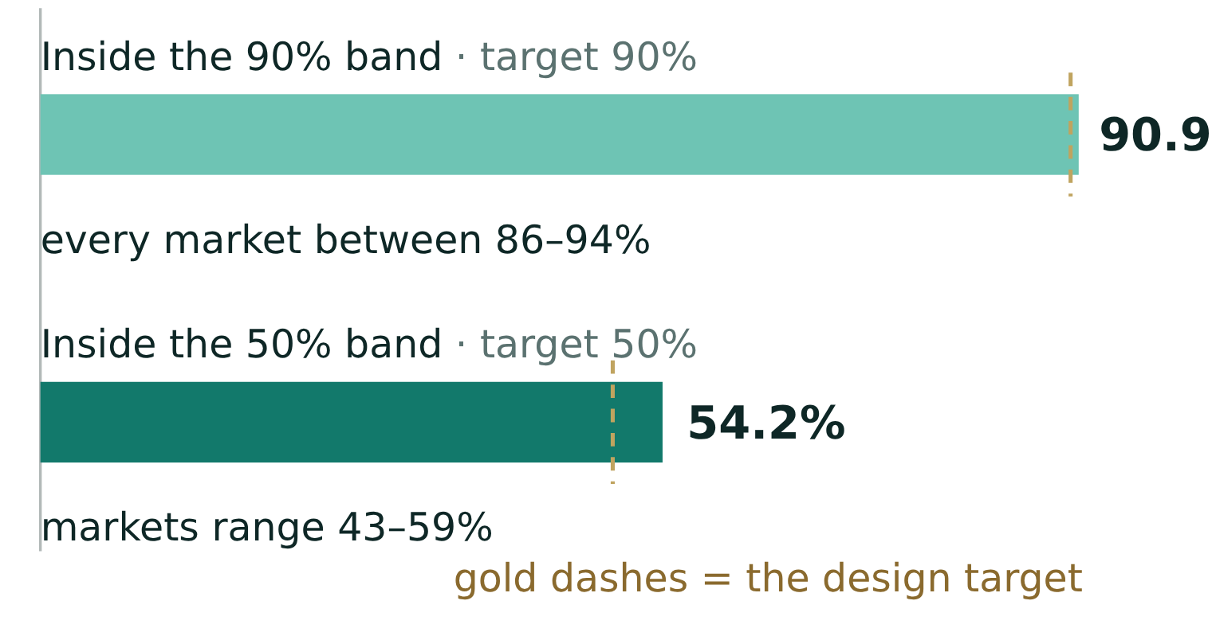
06
06 · THE EVIDENCE
The simulation sat the exam 4,081 times.
Through a revolution, a currency float, a pandemic and three devaluations — graded blind, market by market.
90.9%
of walk-forward windows landed inside the stated 90% band — every market between 86–94%. The design target, not a discovery — running above target means slightly too cautious, flagged for tightening, not celebrated.
Calibrated at two depths: the 90% band and the 50% band both land where they claim — slightly cautious, never overconfident.
The live ledger: 47 of 50 matured inside — 94% on a 90% claim. The misses are the next slide.
Backtest panels as maintained by the unattended pipeline (engine/panels), read live 24 Aug 2026 · per-market table and verdicts: appendix.
Testahil — distributions, not tips · 6
Notes:
Exams through a revolution, a float, a pandemic, three devaluations. 90.9% inside the 90% band, every market between 86–94%; 54.2% inside the 50% band, markets 43–59%. Slightly cautious at both depths — never overconfident. CONCEPTS — A window: one exam question — stand at a past date, forecast the 3-month band using only data known then, wait, grade it. 4,081 windows = 4,081 graded questions across the whole panel. Why 90.9% is the win, not 100%: the claim is calibration — saying 90% and delivering 90% — because a band that always contains the price is too wide to act on. Above the target: slightly TOO cautious — bands wider than claimed — flagged for tightening, not bragging. Below it: slightly overconfident — watched the other way. The 50% band is the second, harder exam: it checks the MIDDLE of the distribution, not just the edges — 54.2% against a 50% claim means the whole shape is honest, not just the extremes. Backtest vs ledger: backtests are simulated history (large sample, weaker proof); the ledger is real published forecasts graded in public (strongest proof — now 50 graded). Ledger state 24-Aug: Egypt 30 of 32 inside the 90% band (94%), 17 of 32 inside the 50% (53%); UAE 10 of 10 and 7 of 10; three misses total — Samsung, OIH, RMDA. Direction detail: 12 of Egypt's 15 closes outside the 50% band were ABOVE it — a strong upward month the untilted cones under-called; the momentum tilt adopted since addresses exactly that, first tilted strikes at this roll-forward. UAE grades used the 21-Aug close under the bounded early-grade rule; 8 UAE names still open. Both shown, never mixed.

Slide 7
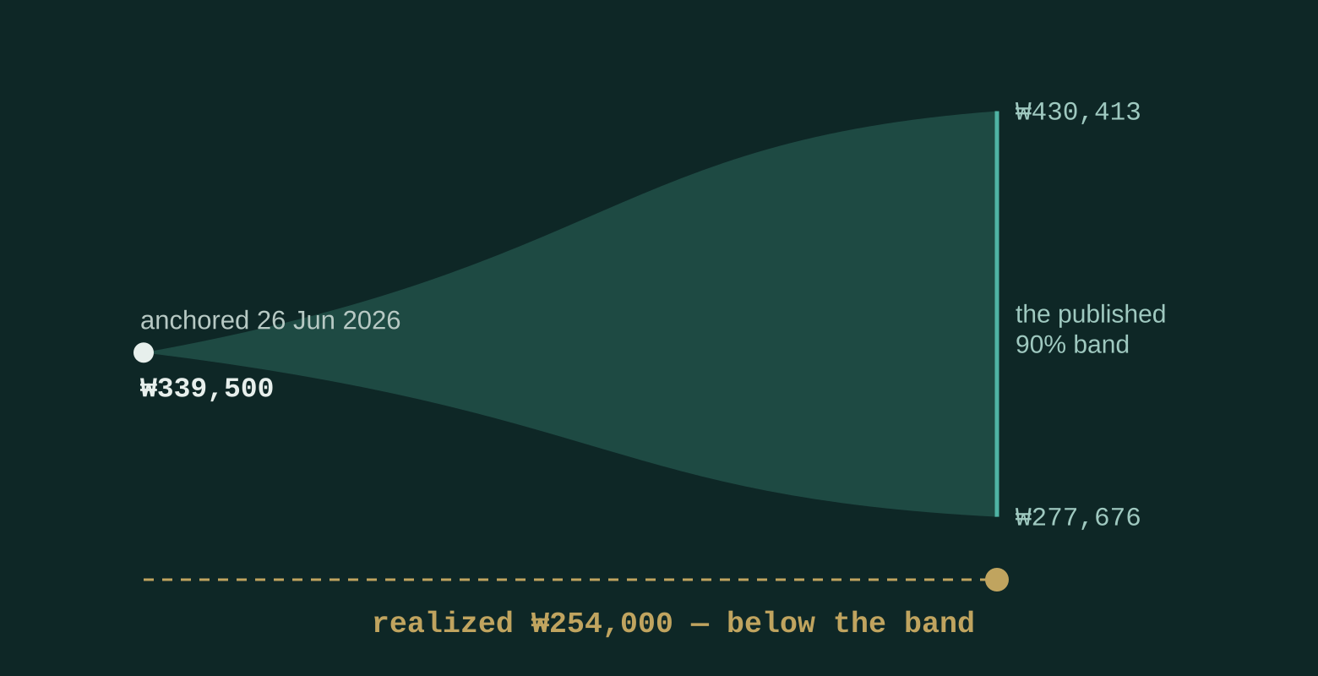
07 · THE MISS
1 in 10 is designed to miss. Our record: 3 of 50.
A 90% band that never missed would be too wide to be useful. Calibration means the misses arrive on schedule — about one in ten, not never.
THE FIRST MISS — SAMSUNG ELECTRONICS
1-month cone · anchored 26 Jun 2026 at ₩339,500 Published band ₩277,676 – ₩430,413 Realized ₩254,000 — below the band. Two more arrived in the 23-Aug Egypt grading — OIH and RMDA, both above their bands in a sharply upward month, struck before the momentum tilt.
47 of 50 matured forecasts inside their band. Every miss is named, plotted, and permanent.
No competitor can show you this slide. A public miss record cannot be backdated — only started. Ours started in June.
Testahil — distributions, not tips · 7
Notes:
Three of fifty — 6%, still under the designed 10%: Samsung (below its band), OIH and RMDA (above, in a sharply upward Egypt month, all struck before the momentum tilt). No competitor can show this slide — a public miss record cannot be backdated, only started. CONCEPTS — Cone: the band drawn over time; it widens with the horizon because uncertainty grows the further out you look. Anchored: the date and price the forecast was struck from — fixed and time-stamped when published, so it cannot be quietly moved. Matured: the horizon date arrived, the real price is known, the forecast can be graded. Why a miss is healthy: at a 90% claim, ~1 in 10 SHOULD land outside; 50 matured with 3 outside (6%) is on schedule — slightly under, if anything. Zero misses over a long record would mean the bands are wastefully wide. Samsung landed below the lower edge — the tail the band accepts missing 5% of the time on each side.

Slide 8
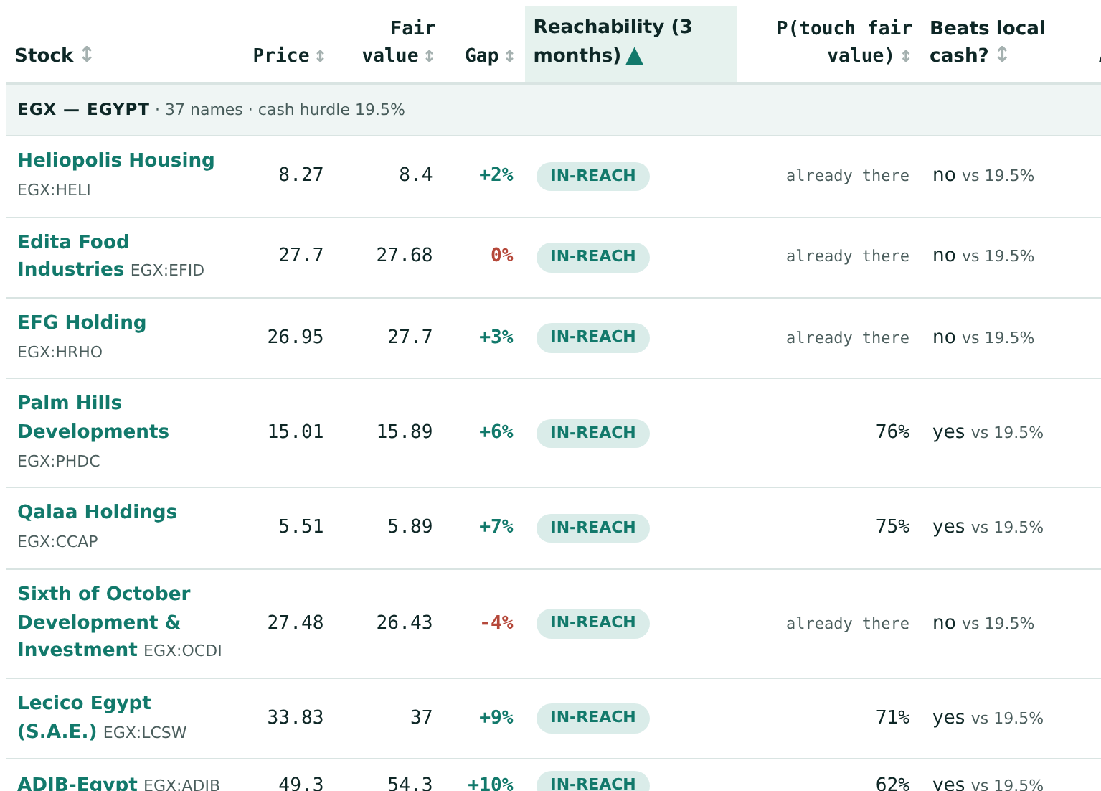
08
08 · BOTH READS TOGETHER
Ticker Picker: can it get there in time?
Where the fundamental read meets the simulation read — one page, one question.
Every covered stock publishes two objects: a fair value from its study, and a simulated price range from its calibrated Monte Carlo. The new Ticker Picker reads them together and asks the one question neither answers alone: is the fair value even reachable in the time given, at the speed this stock actually moves?
At short horizons, the upside ranking and the reachability ranking are nearly opposite.
A stock 70% below fair value cannot close that gap in a month no matter how right the study is; a stock 6% below can. The Picker sorts all 93 by what is closable — and tests every case against its own market’s cash rate (Egypt’s hurdle today: 19.5%).
Honest by construction: the odds machinery is graded on the public ledger. Whether fair values predict returns is not yet provable — the page itself says it needs ~783 graded observations and has 5, verdict expected around 2027. In red, before the table.
The live table — Egypt group, 3-month horizon, sorted by reachability · testahil.com/picker · shipped 10 Aug 2026
Testahil — distributions, not tips · 8
Notes:
The Picker reads fair value and simulated range together: is the fair value even reachable in the time given? At short horizons the upside ranking and the reachability ranking are nearly opposite. The page itself flags what is not yet provable — in red, before the table. CONCEPTS — Upside: the % gap between today's price and fair value — how far the stock COULD go. Reachability: whether the simulation says the stock moves fast enough to close that gap within the horizon — a 70% gap can't close in a month at any realistic speed; a 6% gap can. That's why the two rankings nearly invert at short horizons. Hurdle rate (Egypt 19.5%): the local risk-free cash return; a trade only makes sense if its expected move beats what cash pays for the same period. The red caveat: whether fair values predict returns needs ~783 graded observations to prove statistically; we have 5, verdict ~2027 — printed on the page before the table so nobody discovers it for us.

Slide 9
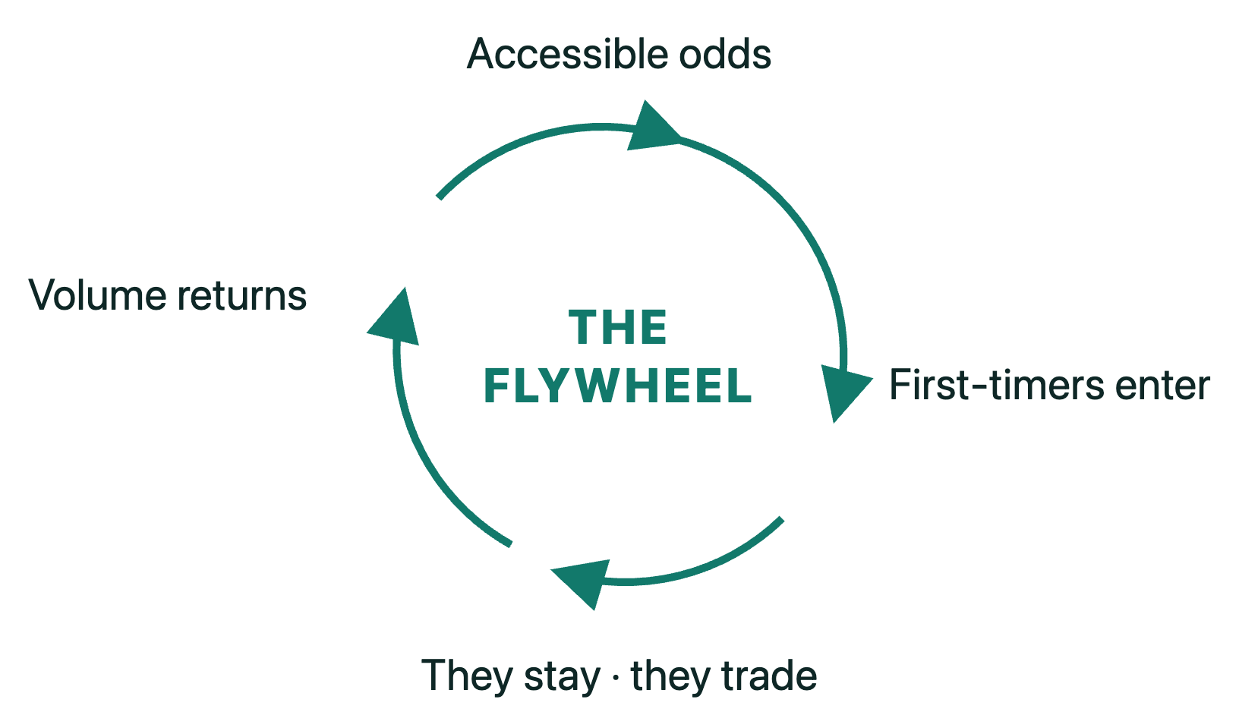
09
09 · THE BUSINESS
How this makes money.
WHITE-LABEL OR API — UNDER YOUR BRAND →
+ Portfolio
+ Compare · Trade
+ Ticker Picker
Base cones
licensed tiers — features, not giveaways
One partner, one deep integration — scoped per country, per language, per feature tier. NEXT: every stock carrying 95% of daily traded value across Middle East and EM exchanges. THEN: Arabic delivery across the full list, and portfolio-level tools — strictly inside your licensed perimeter.
The marginal name is nearly free. Each new market is priced openly — data, licensing, residency — never buried.
Testahil — distributions, not tips · 9
Notes:
The flywheel on the left, the licensed tiers on the right — features, not giveaways. Close on the roadmap band: 95% of daily traded value next, then Arabic across the full list. CONCEPTS — Flywheel: each turn feeds the next — accessible odds bring first-timers in, guided clients stay and trade, volume funds the next name; it compounds instead of needing fresh marketing spend each cycle. White-label: our engine, your brand — clients never see Testahil. API: the raw numbers delivered into your own app's screens. Tiers: base cones for everyone, then Picker, Compare/Trade, Portfolio as licensed upgrades. 95% of daily traded value: cover every stock that carries 95% of what actually trades each day — near-total practical coverage without chasing every dormant listing. Marginal name nearly free: the pipeline is built; stock #94 costs compute and one review pass.

Slide 10
APPENDIX
Appendix.
The reference layer — for the readers who go deeper.
THE LIVE READ
THE ALTERNATIVES
GOVERNANCE
CONTINUOUS IMPROVEMENT
THE FULL TABLE
Testahil — distributions, not tips · 10
Notes:
The main story is done. What follows is the reference layer — for the quants, compliance and vendor-risk readers who go deeper: the live read, the alternatives, governance, the improvement loop, and the full per-market table.

Slide 11
APPENDIX · THE LIVE READ
Two clocks, two lists — live on the site.
FUNDAMENTAL · 1-YEAR GAP TO FAIR VALUE
SIMULATION · 3-MONTH MEDIAN MOVE
1
Emaar Misr for Development (EGX)
+72.1%
1
Heliopolis Housing (EGX)
+9.0%
2
Talaat Moustafa Group (EGX)
+50.4%
2
Pioneers Properties (EGX)
+8.7%
3
Burjeel Holdings (ADX)
+48.0%
3
Cleopatra Hospitals (EGX)
+7.5%
Ranked estimates, not picks. The 3-month simulation lens is graded on the public ledger; the 1-year fundamental lens is not — its first cohort matures June 2027. Every number on the site is tagged with its source lens. · Computed from the live TICKERS object in assets/data.js, 24 Aug 2026 — sort by (fair.base/spot − 1) and by (dist.t60.p50/spot − 1).
They rarely agree — and that disagreement is the product: a 1-year value clock and a 3-month odds clock, never blended into one number. The Ticker Picker exists to read them together.
Testahil — distributions, not tips · 11
Notes:
They rarely agree — and that disagreement is the product. The Ticker Picker exists to read the two clocks together. CONCEPTS — The two clocks: fundamental runs on a 1-year clock (business value), simulation on a 1–3-month clock (price odds); a stock can be cheap on one and dead on the other. Gap to fair value: how far price sits below the study's value — the value list. Median move: the middle of the simulated 3-month distribution — the odds list. Why not blended: one number would hide which clock is speaking; every figure on the site is tagged with its source lens. Graded vs not yet: the 3-month lens has a public graded record; the 1-year lens's first cohort matures June 2027 — until then it is honest to say it is unproven. CAVEAT — Cleopatra Hospitals (CLHO) enters the simulation list while its own calibration verdict reads FAIL on the 24-Aug registry (skill −2.0%): the “ranked estimates, not picks” guard is doing real work here — say so if asked.

Slide 12
APPENDIX · THE ALTERNATIVES
Couldn’t we buy this from a vendor — or build it ourselves?
COVERS THE EGX·ADX·TADAWUL LONG TAIL, FROM FILINGS
A PUBLIC RECORD, MISSES KEPT
LIVE FOR YOUR CLIENTS TODAY
Global vendors
No — built from vendor feeds, for developed markets
Trading Central, Morningstar & peers
No public record
Not in these markets
Build it in-house
Possible — in months, at your model risk
Starts at zero — a record can’t be backdated
a capable quant desk
Nothing live today
Do nothing
the status quo for the long tail
Nobody covers them
No record at all
Telegram tips fill the gap
Testahil
93 names — ground-up, from official filings
Graded in public since Jun-26, misses kept
live at testahil.com
Yes — testahil.com
We are not asking you to replace a vendor. We are asking you to cover the names no vendor covers.
Testahil — distributions, not tips · 12
Notes:
Read it row by row: vendors don't reach these names, building in-house starts a record at zero and moves model risk in-house, doing nothing leaves the long tail to Telegram. Testahil is the only cell that is live today. CONCEPTS — Vendor feeds: global data suppliers' pre-packaged numbers; fine for Apple, absent or stale for an EGX mid-cap — which is why our studies rebuild from the company's own filings instead. Model risk: the risk a model is wrong and the losses land on whoever owns it; buy the research under a supplier contract and the supplier carries it, build in-house and your balance sheet does. Record can't be backdated: a public track record only counts from the day it starts being published in public — a competitor starting today starts at zero, while ours has compounded in public since June 2026.

Slide 13
APPENDIX · GOVERNANCE
Five checkpoints before a number goes public.
Written for the three teams who will read this deck without us in the room: compliance, model risk, vendor risk.
THE ENGINE
→
THE DATA GATE
→
A NAMED REVIEWER
→
PUBLISH
→
THE LEDGER
fixed seed — reproducible runs
per-exchange error screens
ranges only — never a rating or target
append-only · graded · misses kept
a human analyst signs every number
auditable end to end — third-party reproducible · every rejected technique named · nothing deleted
Published, time-stamped, graded, misses kept — that’s what honest AI looks like to a regulator. Continuity is a deliverable, not a promise.
Testahil — distributions, not tips · 13
Notes:
Written for compliance, model risk, and vendor risk — the three teams who read this without us in the room. The audit trail exists by construction. CONCEPTS — Ranges, never ratings: publishing a probability distribution is education; publishing 'BUY' is regulated investment advice — staying on the right side of that line is what lets the public site exist, while true advice happens only inside the partner's licensed perimeter. Named reviewer: a specific accountable person signs each release — under integration, the partner's own analyst, so output becomes the partner's process. Append-only ledger: entries can be added, never edited or removed — deletion-proof by construction. Reproducible runs: fixed seed + documented pipeline means a third party can re-run everything and get identical numbers; continuity survives any one person leaving.

Slide 14
APPENDIX · CONTINUOUS IMPROVEMENT
The simulation never stops sitting exams.
EVERY WINDOW GRADES
→
AUTOMATIC REFITS
→
CHALLENGERS RUN
→
BEAT IT OR BIN IT
→
HISTORY STAYS PUT
an upgrade ships only on a statistically significant win — never by preference
each matured forecast is new out-of-sample evidence — the exam never closes
a whole market refits in seconds when a name updates
candidate techniques race the production engine on identical windows
every forecast keeps the engine version that made it — upgrades never rewrite the ledger
FUNDAMENTAL — REFRESHED BY FILINGS
TECHNICAL — REFRESHED BY PRICES
Every new filing re-runs the whole study: the live formula chain (drivers → IS → BS → CF → DCF) recomputes, and the fair-value range moves with the accounts — re-reviewed and re-signed by an analyst before it republishes.
Support, resistance and trend recompute from the cleaned series with every session close — no lag between the market moving and the levels updating. The same closes feed the next simulation refit.
The 8 rejected techniques are this loop’s exhaust — and the joint model & research board steers it: partner analysts and quants approve upgrades, audit calibration, and direct coverage.
Calibration is not a launch claim — it is re-earned every month, in public, window by window.
Testahil — distributions, not tips · 14
Notes:
The loop never stops — and it runs on all three reads. Simulation: every graded window is new evidence, refits are automatic, upgrades ship only by beating the incumbent on the same exam. Fundamental: each new filing re-runs the study's live formula chain and the fair value republishes after analyst re-sign-off. Technical: levels recompute every close from the same cleaned series. CONCEPTS — Refit: re-estimating a model's parameters on the latest data without changing its structure; the pipeline refits a whole market in seconds when a name updates. Challenger: a candidate simulation technique run side-by-side against the production one on identical out-of-sample windows; it replaces the incumbent only on a statistically significant win. Champion/challenger is standard model-risk practice — banks' own model-validation teams will recognise it. Version pinning: every published forecast records the exact engine version that produced it, so an engine upgrade never rewrites history — old forecasts stay graded under the engine that made them. LIVE EXAMPLE — the 23-Aug UAE material-change review: two arriving names flagged FAIL on day one (BOROUGE, EMPOWER), the published UAE cone narrowed by 5.1% — announced by the pipeline itself, before any human asked. (The review’s two borderline flags, ADIB and DEWA, did not persist: the 24-Aug registry reads ADIB PASS and DEWA PARITY. Verdicts are volatile — re-read before quoting.)

Slide 15
APPENDIX · THE FULL TABLE
Every market, every window.
Every verdict here means the bands are honestly calibrated. PASS adds a statistically proven edge over the naive benchmark; on the 24-Aug panel UAE prints PASS and every other market PARITY — calibrated everywhere, the edge proven in one. The honest print of an un-gamed exam.
MARKET
NAMES
WINDOWS
INSIDE
MISS RATE
VERDICT
Egypt (EGX)
37
1,794
1,665
7.2%
PARITY — calibrated
UAE (ADX + DFM)
28
910
823
9.6%
PASS — edge proven
Saudi Arabia (Tadawul)
13
554
482
13.0%
PARITY — calibrated
USA (NASDAQ)
3
174
149
14.4%
PARITY — calibrated
India (NSE)
3
172
151
12.2%
PARITY — calibrated
Korea (KRX)
3
125
110
12.0%
PARITY — calibrated
Qatar (QSE)
3
174
162
6.9%
PARITY — calibrated
Metals (Au · Ag · Pt)
3
178
167
6.2%
PARITY — calibrated
TOTAL
93
4,081
3,709
9.1%
—
A PARITY market still delivers its full product — calibrated cones, graded in public. Four name-level robust FAILs — EXTRA (Tadawul), CLHO (EGX), and newcomers BOROUGE and EMPOWER (ADX), the latter two flagged on arrival by the 23-Aug material-change review — kept, unedited. Metals is the weakest calibration and we say so: gold is a single-name self-fit, silver borrows gold’s fit until its history is long enough.
Run: 24 Aug 2026, production panels, calendar 3-month walk-forward windows, up to 15 years per name. Live per-name detail: testahil.com/ledger
Testahil — distributions, not tips · 15
Notes:
On the 24-Aug registry UAE prints PASS (skill +1.4%, CI [0.6%, 2.2%]) — the one market-level edge — and the other seven print PARITY. Egypt's earlier market-level PASS did not persist as the panel grew: calibration held (7.2% miss rate) but the edge over the benchmark is no longer statistically significant at market level. Say it before they find it. Four name-level FAILs, kept unedited: EXTRA (Tadawul, skill −3.7%), CLHO (EGX, −2.0%, new on the 24-Aug refit), and the two UAE newcomers BOROUGE (−6.2%) and EMPOWER (−2.7%), flagged on arrival by the 23-Aug material-change review — which also narrowed the published UAE cone by 5.1%. (The review's two borderline flags, ADIB and DEWA, did not persist: the 24-Aug registry reads ADIB PASS, DEWA PARITY.) 50% band by market: Egypt 56.9, UAE 58.8, Saudi 45.1, USA 44.8, India 50.0, Korea 43.2, Qatar 55.2, Metals 51.1 — pooled 54.2. CONCEPTS — The benchmark: a carry-anchored random walk — the naive strategy of assuming no predictable move beyond the cash rate; the simulation must beat THAT, not zero. PASS: beats the benchmark with statistical confidence. PARITY: matches it — correctly calibrated bands, edge not yet proven. FAIL: a name where the simulation is measurably worse — kept on the record unedited. Miss rate: share of windows landing outside the band; target ~10%, so 6.2% means slightly too wide, 14.4% slightly overconfident. Metals caveat: gold's verdict is a self-fit (circular) and silver borrows gold's parameters — the weakest calibration in the system, said out loud.

