Slide 1

INDEPENDENT VALUATION STUDIES · PARTNERSHIP BRIEF
testahil?
Distributions, not tips.
Machine-generated, analyst-reviewed research for the modern wealth platform — every forecast published, time-stamped, and graded in public. Never edited.
91
3,944
90.6%
199
INSTRUMENTS · 8 MARKETS —
A FULL STUDY BEHIND EVERY ONE
BACKTEST WINDOWS ·
UP TO 15 YEARS PER NAME
LANDED INSIDE THE
STATED 90% BAND
PUBLIC FORECASTS
SINCE JUN-2026
One in ten lands outside — by design. So far, one of thirteen has.
Prepared for partnership discussion · August 2026 · testahil.com
Notes:
PURPOSE: in ten seconds — who we are, the four proofs, and the one sentence competitors cannot say. If the room reads nothing else, it reads this. v3 of the partnership deck (v1: 3-Aug carried 74 / 3,373 / 89.6% / 161; v2: 18-Aug same-day). The kicker was sharpened per the Prof G pass: "One in ten misses. On schedule. In public." — three beats, same claim as before, now felt rather than explained. ——— JARGON ON THIS SLIDE ——— Distribution (vs. a tip) — a tip is one number ("buy at 50, target 65"). A distribution is the whole spread of where the price could land, with a probability on each zone. We sell the spread, never the single number. The 90% band — the price range expected to contain the real outcome nine times out of ten. A promise about frequency across many forecasts, not a guarantee about any one stock. Backtest window — one historical test: stand at a past date, forecast forward using only what was known then, then check what actually happened. "One in ten lands outside — by design. So far, one of thirteen has." — the headline defence in two halves: the SPEC (a 90% band must miss ~10% or it is too wide to be worth anything) and the LIVE TALLY (1 miss in 13 graded forecasts). [REWORDED 18-Aug v5: an earlier draft read "One in ten misses. On schedule." — which was misread as the tally. Design fraction and record now always appear together; never present one without the other.] ——— HOW THESE NUMBERS WERE COMPUTED (18-Aug-2026, live repo) ——— 91 — instruments in the persistent library engine/raw_ohlc/{MARKET}/: EG 37, AE 28 (19 ADX + 9 DFM), SA 11, IN/KR/QA/US 3 each, gold+silver 2, platinum 1. 8 markets = 7 equity markets + metals. "A full study behind every one" — 91 distinct names carry a Valuation_Study PDF in files/ (80 with the _public suffix + the Aug-2026 batch without it); every one of the 88 equities also has a live fair value in assets/data.js (fair.base present for 88 of 88). 3,944 / 90.6% — sum of rows / in90=True rows across all 88 engine/panels/{MKT}_{NAME}_3m.csv files, the walk-forward panels the unattended pipeline itself maintains (content-hashed, refit whenever a name posts). 3,572 of 3,944 inside → 90.57%. The three ADX names published 17-Aug (ADNOCDIST, ADNOCDRILL, ADNOCLS) enter the panels at their market's next refit. 199 — LEDGER.length in assets/data.js (104 one-month, 93 three-month, 2 twelve-month rows; earliest anchor 11-Jun-2026).

Slide 2
02 · THE GAP
Who covers stock #200?
Nobody. Excellent research exists — for forty names, in twenty-page reports a first-time investor will never open.
40–60
names one desk of analysts can carry with real depth
hundreds
names retail actually trades — covered today by Telegram tips
91
instruments Testahil covers — a full ground-up study behind every one
276,000 registered investors in Egypt, up ~20% in a year — market cap +42% in 2025. A record wave of first-timers, walking into this vacuum.
EGX Chairman · Al Arabiya · 29 Dec 2025
They trade blind, lose, and churn — and the most expensive client a platform can acquire is the one who leaves burned.
Testahil — distributions, not tips · 2
Notes:
PURPOSE: make the room feel the vacuum — a record demand wave meeting a hard supply ceiling — in one picture. (v2 spent two slides on this; the wave and the ceiling are one idea: the gap.) The title is the Prof G trap-question: it begs its own answer ("nobody"), and the answer is the business. The gold bar carries the sting: the long tail's current research provider is Telegram. ——— JARGON ON THIS SLIDE ——— Coverage — the formal list of stocks an analyst follows. A desk carries a few dozen names with depth, not a market. The long tail isn't neglected — it is uneconomic to cover by hand, at any bank. Churn — a client who signs up, loses money, and leaves; the acquisition spend is wasted. That is what "burned" costs. Registered investors — people holding an active brokerage account on the exchange. Market cap moves with prices AND new listings, so it is not the same as the EGX 30 index return (~+40% in 2025). Two failure modes that used to have their own slide, kept for the room: fundamentals move on a one-year clock and technicals on a three-month one — delivered as a single number, the client cannot tell an investment from a trade; and a price target is one number, while the question clients actually ask is how likely, and by when. Context (verify before quoting aloud): EFG writes on ~232 stocks across 9 Arab markets, not all current. ——— SOURCES / CAVEATS (carried from v1, still open) ——— 276,000 (stock of accounts, ~+20% y/y) and market cap +42% (2025) are as attributed on-slide to the EGX Chairman via Al Arabiya, 29-Dec-2025 — attach the primary EGX/FRA release before an institutional audience. Cross-checks on the public record: ~123,000 NEW retail investors in H1-2025 (flow, EGX chairman, Aug-2025 wires); EGX 30 ≈ +40% over 2025. Stock vs flow: both can be true at once — say which you mean. Bar lengths are schematic for 50 / several hundred / 91 — the labels carry the numbers. 91 and the studies claim: cover note.

Slide 3
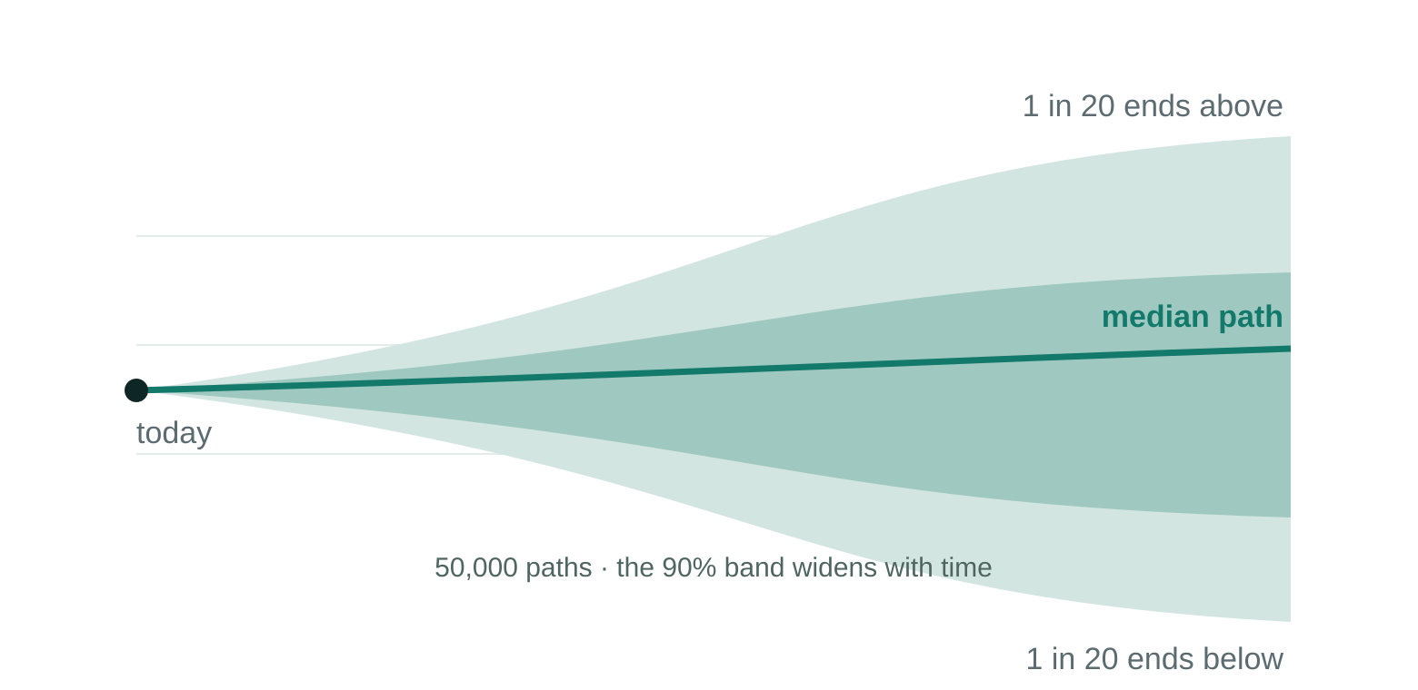
03 · THE SOLUTION
Odds, not orders.
Three lenses on every stock — and above all, the probability of every price, one to three months out.
FUNDAMENTAL — THE 1-YEAR CLOCK
A fair-value range built from official filings only — product by product, volume × price — checked by an analyst before it publishes.
TECHNICAL — THE SHORT-TERM CHART
Support, resistance, trend — the levels traders actually watch, computed from the same cleaned series, refreshed with every update.
SIMULATION — ABOVE ALL, THE ODDS
THE LIVE READ — ADNOC LOGISTICS & SERVICES · 3 MONTHS
50,000 Monte-Carlo paths per name, calibrated on up to 15 years of that stock’s own market — a probability on every price bracket.
Latest price
AED 6.16 · close 7 Aug 2026
Chance higher than today
51%
+10% or better vs −10% or worse
24% vs 22% · ≈ 1.1:1 up
Bad case · good case (1-in-20)
4.95 · 7.73 (−20% / +25%)
It never says buy. It says 24% vs 22% — how likely, and by when.
Live read as computed by testahil.com on the 7-Aug close (simulation run 10 Aug 2026) — the same numbers the public sees.
Testahil — distributions, not tips · 3
Notes:
PURPOSE: define the product in one sentence a Wealth head can repeat — odds, not orders — and prove it with the site's own live read instead of a claim. The closing line is the elevator pitch and deliberately concrete: "24% vs 22%" is on the card directly above it — the room can check the sentence against the evidence in real time. ——— JARGON ON THIS SLIDE ——— Fair value — what the business is worth on its own economics, published as a range, never a point. Official filings — the company's own published, audited accounts. No data vendors, no broker estimates, ever, for a company's reported history. Monte Carlo / path — run the future 50,000 times with randomness; each run is a full price journey; the counts across runs become the probabilities. Calibrated — tuned on that stock's own market history so stated odds match observed frequencies. 1-in-20 — the 5th and 95th percentile single outcomes: the honest "bad case / good case". ——— HOW THESE NUMBERS WERE COMPUTED ——— ADNOC L&S card — transcribed verbatim from the live homepage probability read (ADNOCLS at 3 months): AED 6.16 close 7-Aug-2026; 51% higher; 24% vs 22% (≈1.1:1); worst/best 1-in-20 4.95 / 7.73 (−20%/+25%); 50% band 5.67–6.73 (dropped from the card for focus — it is on the site); simulation computed 10-Aug-2026. Re-read the site before reusing — these refresh with every library update. The cone graphic is schematic (drawn for this deck); every real cone on the site is computed per name.

Slide 4
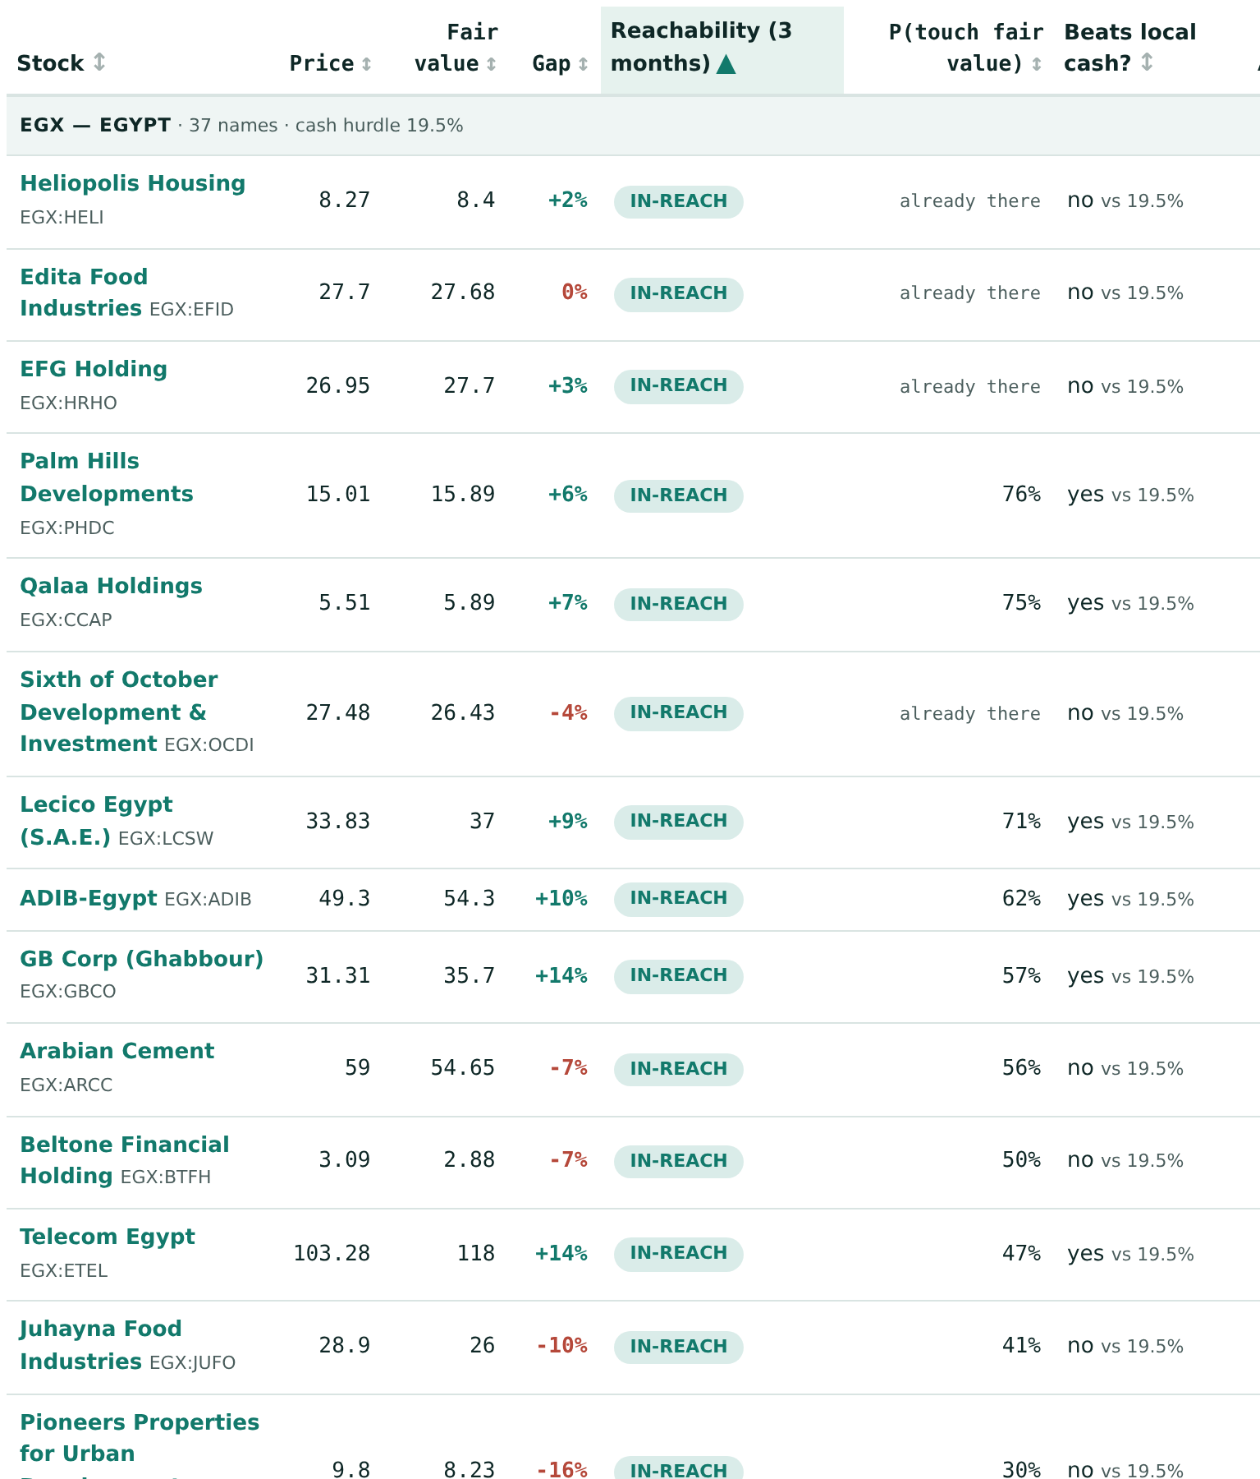
04 · NEW THIS MONTH
Ticker Picker: can it get there in time?
Every covered stock publishes two objects: a fair value from its study, and a simulated price range from its calibrated Monte Carlo. The new Ticker Picker reads them together and asks the one question neither answers alone: is the fair value even reachable in the time given, at the speed this stock actually moves?
At short horizons, the upside ranking and the reachability ranking are nearly opposite.
A stock 70% below fair value cannot close that gap in a month no matter how right the study is; a stock 6% below can. The Picker sorts all 91 by what is closable — and tests every case against its own market’s cash rate (Egypt’s hurdle today: 19.5%).
Honest by construction: the odds machinery is graded on the public ledger. Whether fair values predict returns is not yet provable — the page itself says it needs ~783 graded observations and has 5, verdict expected around 2027. In red, before the table.
The live table — Egypt group, 3-month horizon, sorted by reachability · testahil.com/picker · shipped 10 Aug 2026
Testahil — distributions, not tips · 4
Notes:
PURPOSE: land the month's product news — the two clocks finally on one screen — and spring the surprise that earns the slide: upside and reachability rank nearly opposite at short horizons. The gold pull-quote is the "wow test" line; if the room remembers one product fact, it should be that one. The honesty box is drama of a different kind: a research shop telling you, in red, what it cannot prove yet. ——— JARGON ON THIS SLIDE ——— Reachability — how far fair value sits from the price measured in that stock's own volatility, and the odds of touching it within the horizon. The table's default sort. P(touch fair value) — the probability, from the same 50,000 published paths, that the price touches fair value at any point inside the horizon; "already there" marks names trading at or through it. Cash hurdle — each market's own risk-free rate; a case that cannot beat local cash is flagged (Egypt's hurdle reads 19.5% on the live page today — volatile, re-read before quoting). Filters — only in-reach / only beats-local-cash / only undervalued. ——— HOW THESE NUMBERS WERE COMPUTED ——— Screenshot — the live page rendered from the repo at 18-Aug-2026 (Chromium, light theme), EGX group, 3-month horizon, cropped to the first ~15 rows. Real rows, e.g. Palm Hills +6% gap · 76% touch; Egypt Aluminum −17% gap · 20%. "~783 graded observations; we have 5" and "verdict ~2027" — the page's own read-this-first disclosure, quoted, not our claim recomputed. Shipped 10-Aug-2026 (PR #133, "Ticker Picker carries every market, per-row engine fits"). Site tabs now: Home · Stocks · Metals · Compare · Trade · Portfolio · Ticker Picker · Calculator · Ledger · Methodology (a daily EGX news brief also publishes at /news.html, and a Real-Return Calculator answers "CDs, gold, or dollars?" after inflation).

Slide 5

05 · THE EVIDENCE
We sat the exam 3,944 times.
Through a revolution, a currency float, a pandemic and three devaluations — graded blind, market by market.
90.6%
of 3,944 walk-forward windows landed inside the stated 90% band. The design target, not a discovery — and the markets above the gold line are flagged too wide, not celebrated.
The live ledger so far. The one miss is the next slide.
Axis zoomed to 80–100 so the differences show: every market within five points of target. Gold dashes = the 90% design spec.
Backtest panels as maintained by the unattended pipeline (engine/panels), read live 18 Aug 2026 · per-market table and verdicts: appendix.
Testahil — distributions, not tips · 5
Notes:
PURPOSE: answer "does it actually work?" with one chart, one baseline, one giant number — and set the trap for the next slide by promising the miss. "We sat the exam" is the honest metaphor: each window is a forecast made blind and then graded. The subtitle does the drama the old version buried in a side column: revolution, float, pandemic, three devaluations — the band held. ——— JARGON ON THIS SLIDE ——— Walk-forward backtest — stand at a past date, use only information available then, forecast, check the real outcome, walk forward, repeat. No period reused. Design target — 90% was the specification. Landing at 90.6% means the machine did what it promised; never say "exactly". Over-coverage — a market ABOVE the gold line (Qatar 93.1%, Metals 93.8%, Egypt 92.6%) is arguably too wide, not too good — we say that out loud; it is what an un-gamed system looks like. ——— HOW THESE NUMBERS WERE COMPUTED ——— Per-market bars — inside/windows per engine/panels/{MKT}_*_3m.csv, 18-Aug-2026: Egypt 1,654/1,787 (92.6%), UAE 759/848 (89.5%), Saudi 420/486 (86.4%), USA 149/174 (85.6%), Korea 110/125 (88.0%), India 151/172 (87.8%), Qatar 162/174 (93.1%), Metals 167/178 (93.8%). Total 3,572/3,944 = 90.57%. These are the pipeline's own stored in-band flags — each market scored under its live fitted (ν, width_cal) as of its last refit — not re-simulated for this deck. 12/13 banner — screenshot of the live site's own scoreboard strip (12 of 13 graded ledger forecasts inside; the miss is Samsung).

Slide 6
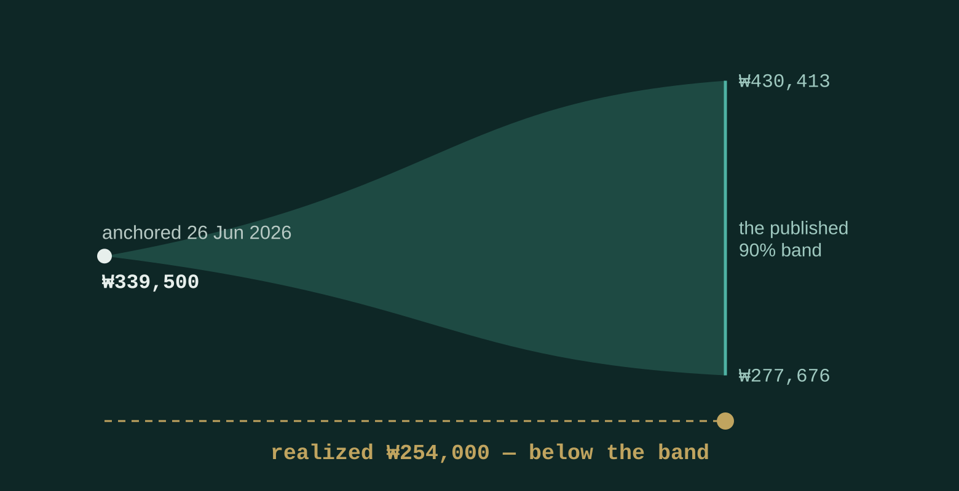
06 · THE MISS
1 in 10 is designed to miss. Our record: 1 of 13.
A 90% band that never missed would be too wide to be useful. Calibration means the misses arrive on schedule — about one in ten, not never.
THE ONE LIVE MISS SO FAR
Samsung Electronics — 1-month cone
Anchored 26 Jun 2026 at ₩339,500
Published band ₩277,676 – ₩430,413
Realized ₩254,000 — below the band
Graded as a miss. Kept on the ledger, unedited.
12 of 13 matured forecasts inside their band. The miss is named, plotted, and permanent.
No competitor can show you this slide. A public miss record cannot be backdated — only started. Ours started in June.
Testahil — distributions, not tips · 6
Notes:
PURPOSE: the dramatic center — convert the one blemish into the one asset nobody else can copy. The room must leave remembering that we showed them our worst call, on purpose. The closing line is the moat argument compressed to a knife: an engine can be rebuilt in months, but a time-stamped public record with the misses kept can only be STARTED — and every day a competitor waits, ours compounds. (The regulator framing — published, time-stamped, graded, misses kept is exactly the audit trail a supervisor wants from an AI system — moved to the governance appendix; say it aloud here if compliance is in the room.) ——— JARGON ON THIS SLIDE ——— Cone / anchored / published band / realized — the forecast drawn widening into the future; its launch date and price; the range stated in advance; what the price actually did on the end date. Calibration — stated odds matching reality. A properly calibrated 90% band MUST miss about one time in ten; misses arriving on schedule is evidence the system works, not evidence it broke. ₩ — Korean won; Samsung trades in Seoul. ——— HOW THESE NUMBERS WERE COMPUTED ——— 1 in 10 vs 1 of 13 — two different numbers, now both in the headline so neither can be mistaken for the other. "1 in 10" is the DESIGN fraction: the complement of the 90% target (live backtest miss rate 9.4%), not a tally. "1 of 13" is the LIVE RECORD: 13 graded ledger forecasts, one miss (7.7% — at/below the designed rate, as it should be on a small sample). [REWORDED 18-Aug v5 after the earlier headline "1 in 10 misses. Here is ours." was read as claiming one miss in ten graded — say the spec and the record together, always.] Samsung figures — that ledger row's own immutable fields (anchor 26-Jun-2026 at 339,500; band 277,676–430,413; realized 254,000; graded 27-Jul-2026). Unchanged since grading. 12 of 13 — assets/data.js LEDGER rows with realized_close populated: 13 graded (all 1-month so far), 12 inside their [p5,p95]. The graded names: PHDC, TMGH, EMFD, OCDI, ORHD, COMI, Gold, Silver, Samsung (miss), Kakao, LGES, TMPV, QNB. "Ours started in June" — earliest ledger anchor 11-Jun-2026.

Slide 7
07 · THE TRAJECTORY
This deck aged in fifteen days.
+17
instruments — the whole ADNOC family, du, Borouge, Empower, Air Arabia and more
+38
public forecasts struck, dated and on the ledger
12
new full ground-up studies shipped, 9–17 Aug
1
new product tab — the Ticker Picker, live 10 Aug
NEXT: every stock carrying 95% of daily traded value across Middle East and EM exchanges. THEN: Arabic delivery across the full list, and portfolio-level tools — strictly inside your licensed perimeter.
By the time we meet, these numbers will be stale again. That is the pitch.
Testahil — distributions, not tips · 7
Notes:
PURPOSE: prove the machine's compounding speed with its own aging deck — the growth rate IS the moat demo, and the self-deprecating title is the surprise that keeps it honest. The closing line replaces v2's abstract "marginal name is nearly free" with the same economics made personal: the deck going stale between meetings is the marginal-cost argument, felt. (The abstract version — the marginal name costs compute and one review pass, not an analyst-month — stays here for the room.) ——— JARGON ON THIS SLIDE ——— Unattended pipeline — post one refreshed price file and the system re-tests, re-fits and re-publishes that entire market in seconds, no human in the loop. It is why 17 names in 15 days is routine, not a sprint. 95% of daily traded value — deliberately NOT "95% of listed companies": the stocks accounting for 95% of the money actually changing hands. A far shorter list than it sounds. Arabic — roadmap, not shipped: the public site is English today (an /ar URL layer is staged but redirects). Say it plainly if asked. ——— HOW THESE NUMBERS WERE COMPUTED ——— 74 → 91 instruments and 161 → 199 ledger rows — v1 deck's own stated numbers (computed 30-Jul/3-Aug) vs today's live counts (cover note method). 12 new studies — new-coverage publishes merged 9–17 Aug per git history: MODON, AMR, FERTIGLB, PHAR, EGCH, EMPOWER, AIRARABIA, BOROUGE, DU, ADNOCDIST, ADNOCDRILL, ADNOCLS (re-publishes of existing names not counted). Ticker Picker — merged 10-Aug-2026 (PR #133).

Slide 8
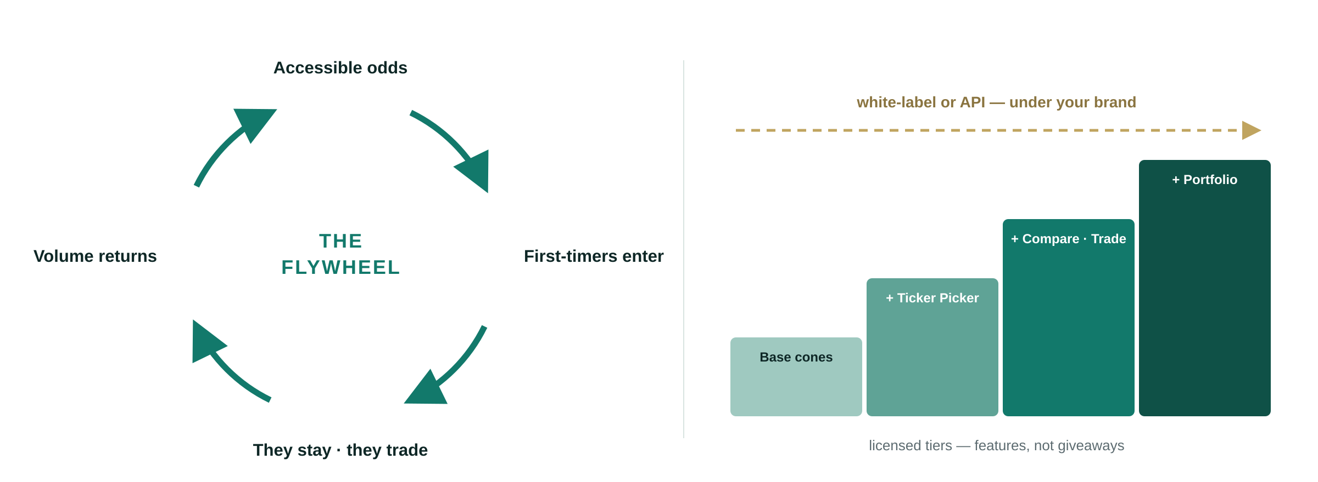
08 · THE BUSINESS
How this makes money.
Accessible odds create investors — and guided clients stay, trade, and fund the next name.
One partner, one deep integration — scoped per country, per language, per feature tier.
The marginal name is nearly free. Each new market is priced openly — data, licensing, residency — never buried.
Testahil — distributions, not tips · 8
Notes:
PURPOSE: give the budget holder the two revenue mechanics in one picture — the engine grows the market itself (flywheel), and it is licensed once, deeply, per partner (the tier staircase). No invented pricing; the model shape, not fabricated numbers. SPOKEN TRACK (the old body copy, now said aloud over the drawing): Capture the new-investor wave — and create it: people who never invested because they couldn't read the research finally get information they can act on, and informed odds bring first-timers into ME/EM exchanges and keep them. One deep integration, delivered white-label or by API under the partner's umbrella; premium modules — Ticker Picker, Compare, Trade, Portfolio — roll out as licensed tiers, not giveaways. The partner's return: engagement, retention, volume, and first-mover ownership of publicly-graded AI research in their markets. ——— JARGON ON THIS SLIDE ——— Licence — a recurring fee for the right to run the engine, not research reports bought one at a time. White-label / API — under the bank's own brand with the Testahil name invisible / a data pipe the bank's own app renders inside its own interface. Feature tier — the staircase: base cones at one level; Ticker Picker, Compare, Trade, Portfolio above it. Marginal cost — what one more market, language or stock costs. Near zero once the engine exists — the whole economics of the model. First-mover — the first bank in the region to OWN publicly graded AI research, before a competitor does.

Slide 9
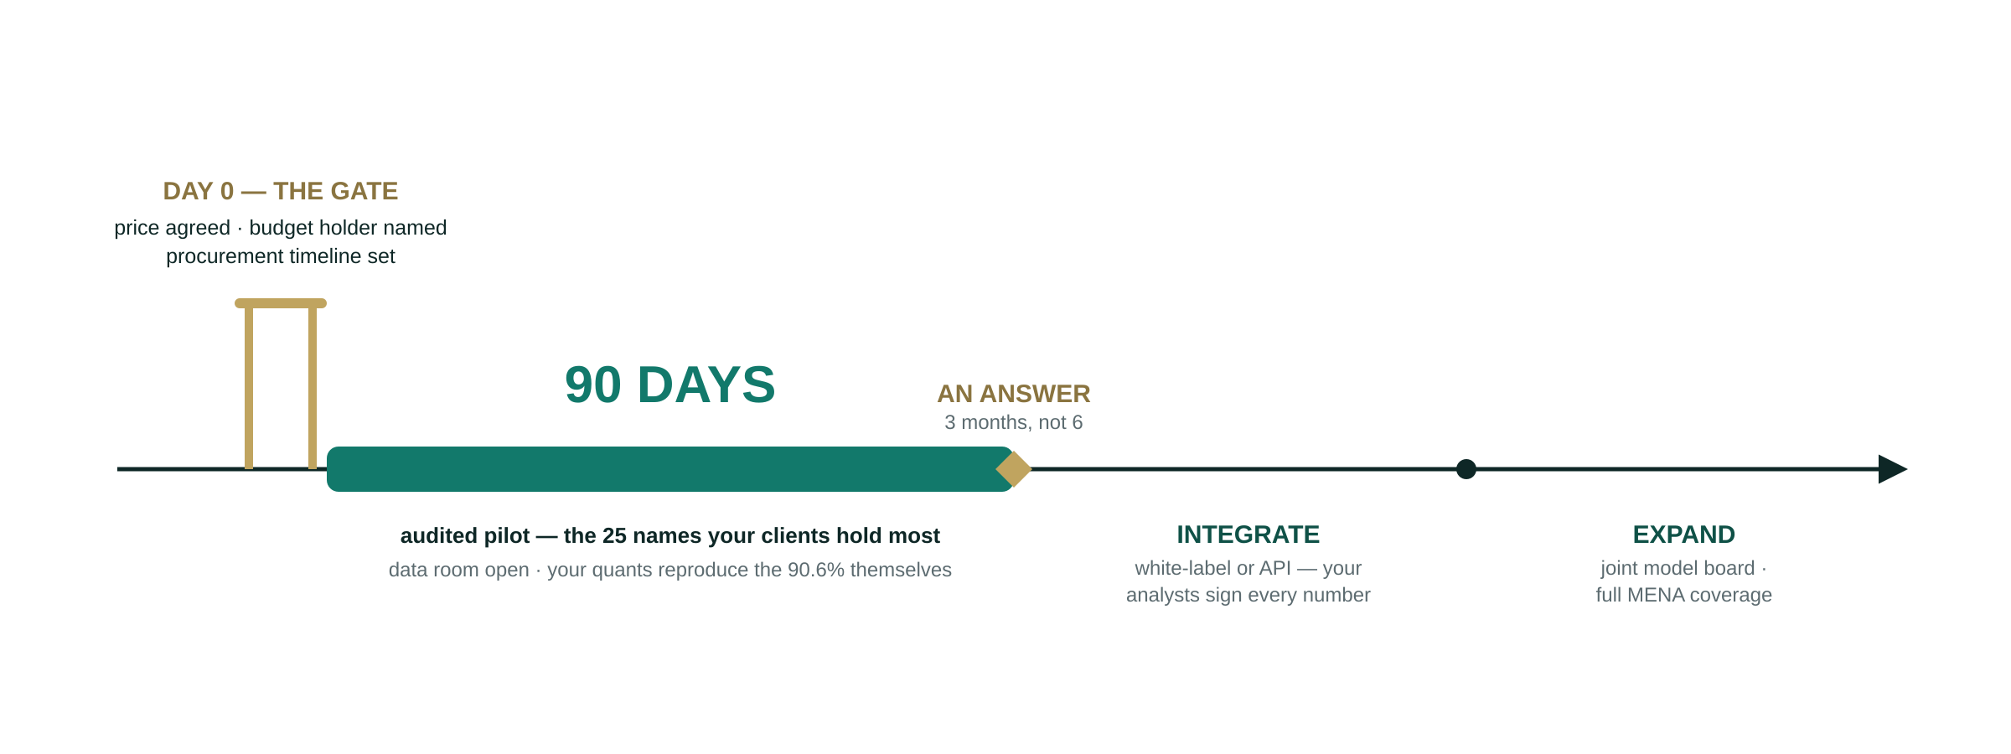
09 · THE ASK
90 days to an answer.
What we bring: the engine, the ledger, the discipline. What we ask: your umbrella, your licence, your scale.
Testahil — distributions, not tips · 9
Notes:
PURPOSE: one screenshot-able picture the sponsor can forward internally — gate, pilot, answer, integrate, expand, with the dates and numbers on it. The gate is drawn as a literal gate: nothing starts until price, budget holder and timeline exist. Why the gate exists: a free pilot with no pre-agreed price, no named budget holder and no procurement timeline is unpaid consulting. Banks convert pilots when someone with budget authority commits in advance; they stall when the budget conversation is deferred to the end. A pilot should end in an answer, not a delay. SPOKEN TRACK per phase — Pilot: 90 days, audited, on the 25 names their clients hold most; opens with the data room (full 15-year calibration archive, every window, every cone, every miss) plus a verification script their quants run to reproduce the 90.6% before any client sees a number (v1 offered 89.6% on 3,373 windows; the archive now reproduces 90.6% on 3,944 — the number updates with the record). Integrate: under their umbrella, white-label pages or API; their analysts become the review layer, so the output is their firm's process, not a third party's black box. Expand: a joint model & research board — their senior analysts and quants with Testahil — approving upgrades, auditing calibration, resourcing full MENA coverage. The licence, when asked: scoped by market, language, feature tier — and channel. Exclusivity where it matters, never universal: testahil.com keeps publishing publicly, because the graded record is what makes the engine credible to their compliance team. Each new market priced on its own data and residency cost. Where no licence line exists: equity, revenue share, or build-operate-transfer with a pre-agreed buyout — open on structure, not on whether there is one. ——— ON PRICE (notes only, deliberate) ——— No figure appears on the slide. Arrive with a range settled in your own mind — the gate commits to an agreed price before day one and the question WILL be asked. If they ask for a number first, ask for scope first (markets, languages, tiers, seats); price follows scope. If they name a number first, do not accept or reject in the room — take it away, price the scope, come back. A single buyer with no competing bid sets the price only if you let them.

Slide 10
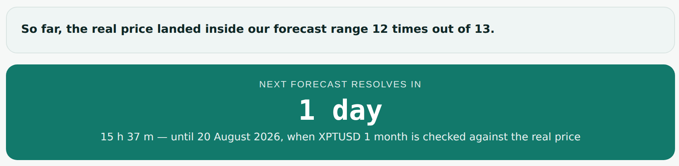
10 · THE DEMO
Enough slides. The engine is live.
testahil.com — Ticker Picker · Compare · Trade · Portfolio · the public Ledger
Every number in the demo is the same number the public sees — graded, dated, and accountable.
Leave-behind for your technical team: the full Tata Motors validation study — every assumption on the record.
Live on the ledger right now: the record so far, and a countdown to the next grading — platinum’s 1-month resolves 20 August. Watch us be right, or wrong, in real time.
as rendered 18 Aug 2026 · testahil.com/ledger
INFO@TESTAHIL.COM · TESTAHIL.COM
Testahil — distributions, not tips · 10
Notes:
PURPOSE: get out of the slides and into the product while the room is leaning forward — with the site's own countdown clock, screenshotted live, as the hook that makes them open the ledger tonight. The countdown is real and self-updating on the site: at capture (18-Aug) it read "1 day — until 20 August 2026, when XPTUSD 1 month is checked against the real price". Check it live before the meeting and say the actual instrument and date aloud; if the screenshot has aged, retake it (the deck source rebuilds it in one command). Demo route that lands hardest, in order: (1) the Ticker Picker — sort by reachability, flip the horizon, show the red read-this-first box: honesty as a feature; (2) one ticker page (Fertiglobe or ADNOC L&S) — the odds card, the cone, "Open the study / model / source register"; (3) the Ledger — "Were we right?", 12/13, the countdown, Samsung kept red on the record. ——— JARGON ON THIS SLIDE ——— Validation study / leave-behind — a full worked example on one company (Tata Motors) with every assumption and source on the record, handed over for their specialists to attack afterwards. "The same number the public sees" — nothing in the demo is a special build. It is the live site.

Slide 11
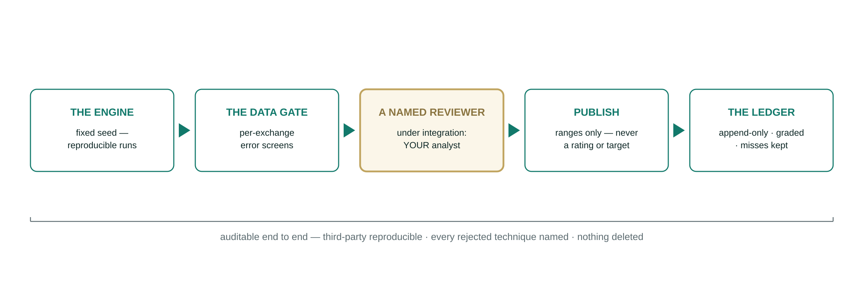
APPENDIX · GOVERNANCE
Every number runs this gauntlet.
Written for the three teams who will read this deck without us in the room: compliance, model risk, vendor risk.
Published, time-stamped, graded, misses kept — that’s what honest AI looks like to a regulator. Continuity is a deliverable, not a promise.
Testahil — distributions, not tips · 11
Notes:
PURPOSE: the forwarded slide — compliance, model-risk and vendor-risk decide this deal before any regulator is consulted. The gauntlet drawing answers their three questions in one line of sight: what publishes (ranges only — never a rating, target or recommendation; the public site is education only, advice happens inside the partner's perimeter, given by their licensed people), who is accountable (a NAMED human reviewer before every release — under integration, the partner's own analyst; the gold node is the point), and what can be inspected (fixed-seed reproducible runs, full documentation, every rejected technique named, an append-only ledger). ——— LIKELY QUESTIONS ——— "What if you are hit by a bus?" — the pipeline is documented to the standard where an independent quant can reproduce it. Offer the reproduction test as evidence. "Is this AI making recommendations?" — no. It publishes distributions. The recommendation, if any, is made by the partner's licensed staff. "Data residency in Saudi or the UAE?" — market data and filings are public; nothing touches client data unless the partner asks for it, and residency is priced per market. "How do we operate day to day?" — integrate (white-label/API into your app and advisor desktops), license (advice from your licensed teams inside your perimeter, powered by our calibrated numbers), govern (the joint model board approves upgrades and audits calibration; your analysts sign what publishes). ——— JARGON ——— Education only — general information, explicitly not a personal recommendation; the distinction that keeps the public site outside advice regulation. Fixed seed — the simulation's randomness is reproducible; a reviewer re-running it gets our exact numbers back. Append-only ledger — records are added, never altered or deleted; corrections are new entries with a named note. Suitability-aware — advice matched to that individual's risk tolerance and circumstances, as regulators require; only the partner's licensed people give it.

Slide 12
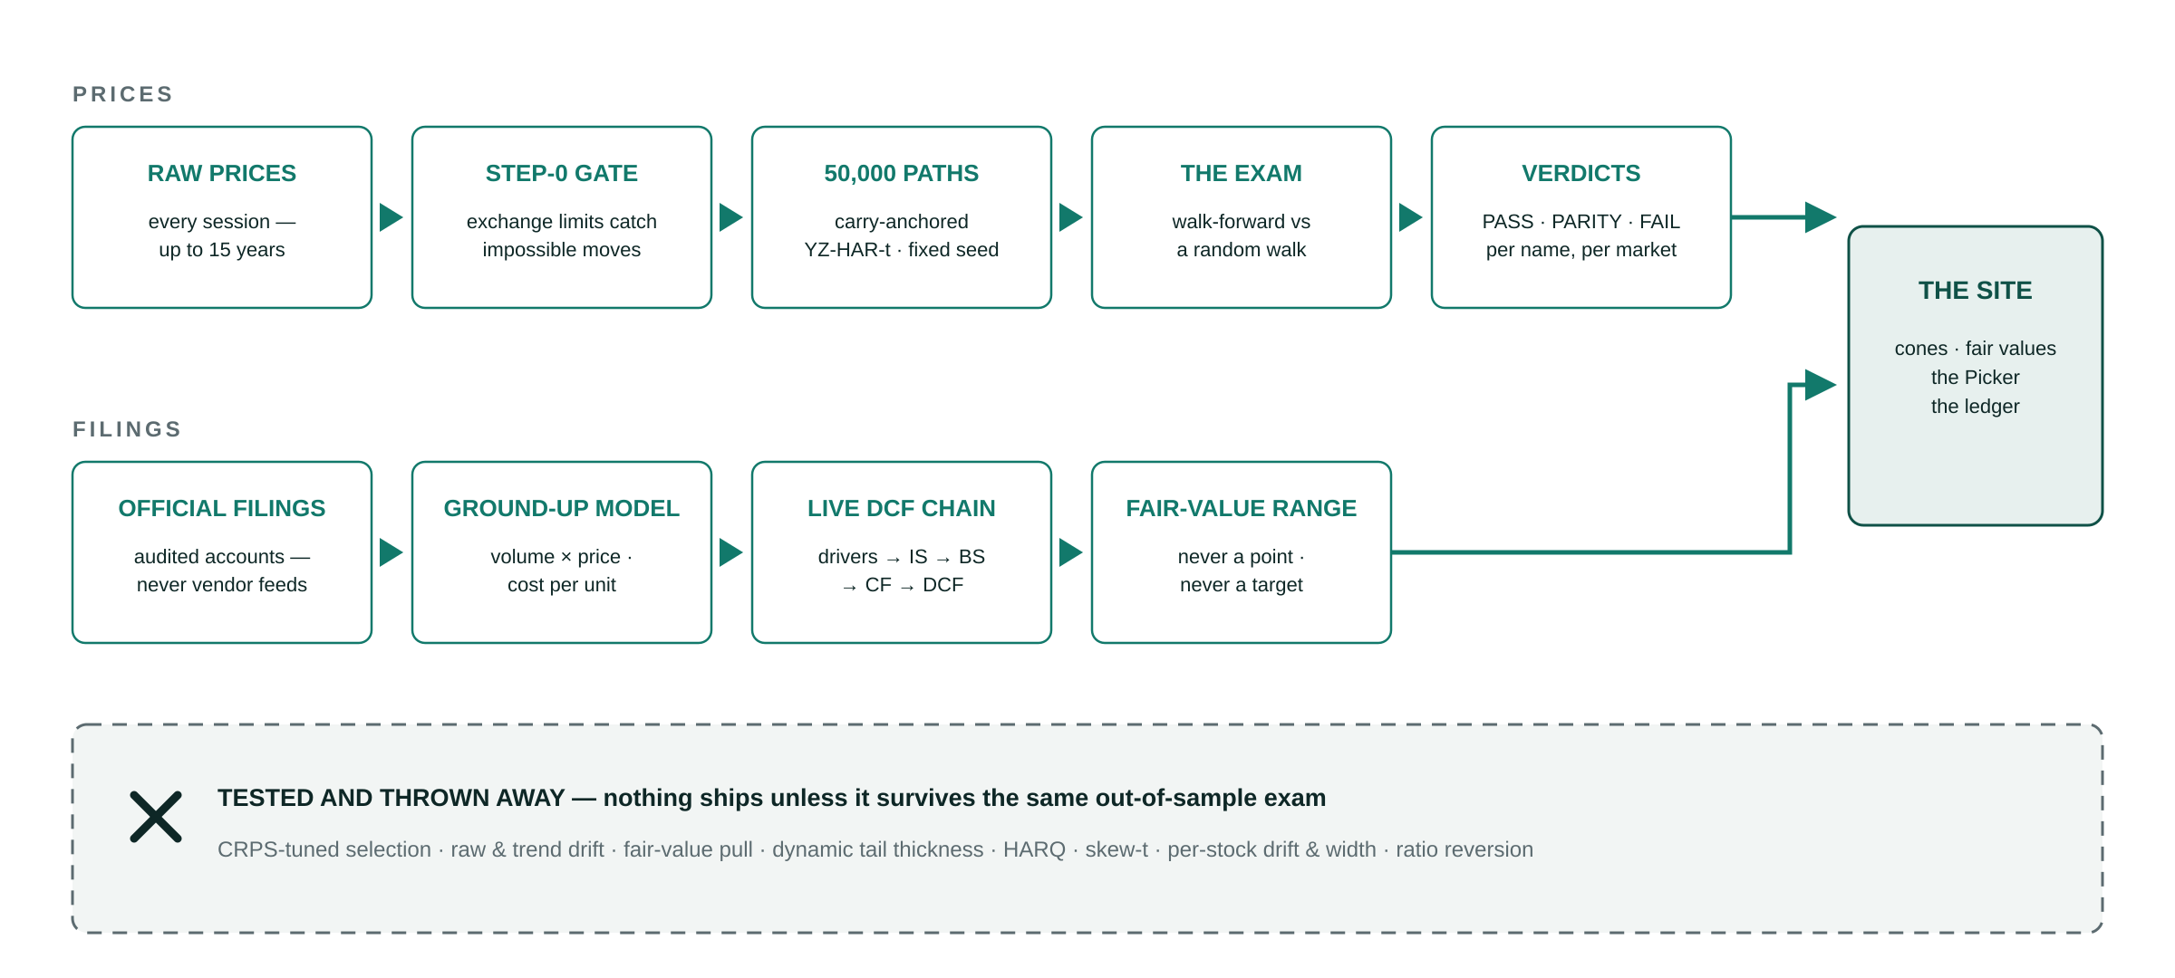
APPENDIX · METHOD
What we built — and what we threw away.
Testahil publishes fair-value ranges and probability distributions. It does not publish ratings, price targets, or recommendations, and nothing it publishes is investment advice.
Testahil — distributions, not tips · 12
Notes:
PURPOSE: one drawing for the quant who will try to break it — both pipelines end to end, and the discard bin in plain sight. What a research shop threw away says as much as what it kept; showing the bin IS the credibility move. ——— JARGON ON THIS SLIDE ——— Carry-anchored — the simulation is centred on carry (local risk-free minus yield), not on a predicted direction — so claimed skill can never secretly be the time value of money. YZ-HAR-t — volatility measured from open-high-low-close (captures overnight gaps); blended across daily/weekly/monthly speeds (volatility clusters); fat-tailed bell curve (extreme moves rare but real). Tail and width fitted PER MARKET — Cairo and New York do not crash the same way; Egypt adds a history-gated per-name width overlay. Step-0 gate — every price file passes an automated check first: each exchange's own daily price limit defines what one session can physically do (Egypt ±20%, Korea ±30%), so impossible moves are caught without a guessed global threshold. The exam / verdicts — walk-forward, non-overlapping windows scored against a carry-anchored random-walk benchmark; PASS (beats it with confidence) / PARITY (honestly calibrated, no proven edge) / FAIL (benchmark won), published per name and per market. One statistically robust name-level FAIL is on the record today — EXTRA (Tadawul), read live from the fit registry 18-Aug-2026 (v1 said "three" from an older registry state; the count is volatile, re-read before presenting). The bin — CRPS-tuned selection looked better in-sample and LOST out of sample; the standing promotion rule (nothing ships unless it survives the same out-of-sample exam the forecasts face) exists because of it. The beta rule — adopted 10-Aug-2026: every beta regresses on the published index of the stock's own exchange (EGX30, FADGI, TASI, …), never a composite of covered names; every legacy beta was re-derived. On the first name run both ways the composite understated beta ~40% and overstated fair value 21.6%. Filings lane — official audited accounts only, never vendor feeds; ground-up volume × price and cost per unit; a live formula chain drivers → IS → BS → CF → DCF; debt split local vs foreign currency; working capital projected, not plugged; output is a range, never a point.

Slide 13
APPENDIX · THE FULL TABLE
Every market, every window.
MARKET | NAMES | WINDOWS | INSIDE | MISS RATE | VERDICT
Egypt (EGX) | 37 | 1,787 | 1,654 | 7.4% | PASS
UAE (ADX + DFM) | 25* | 848 | 759 | 10.5% | PARITY
Saudi Arabia (Tadawul) | 11 | 486 | 420 | 13.6% | PARITY
USA (NASDAQ) | 3 | 174 | 149 | 14.4% | PARITY
India (NSE) | 3 | 172 | 151 | 12.2% | PARITY
Korea (KRX) | 3 | 125 | 110 | 12.0% | PARITY
Qatar (QSE) | 3 | 174 | 162 | 6.9% | PARITY
Metals (Au · Ag · Pt) | 3 | 178 | 167 | 6.2% | PARITY
TOTAL | 88 | 3,944 | 3,572 | 9.4% | —
PASS = beats a carry-anchored benchmark with statistical confidence. PARITY = honestly calibrated, edge not yet proven — what an un-gamed system looks like outside its deepest market.
One name-level robust FAIL on the record — EXTRA (Tadawul) — kept, unedited.
* UAE covers 28 names; the three ADNOC names published 17-Aug enter the panel at the next market refit. Metals is the weakest calibration in the system and we say so: gold is a single-name self-fit (its verdict is circular) and silver borrows gold’s fit until its own history is long enough.
Run: 18 Aug 2026, production panels, calendar 3-month walk-forward windows, up to 15 years per name — spanning the 2011 revolution, the 2016 EGP float, COVID and the 2022–24 devaluations. Live per-name detail: testahil.com/ledger
Testahil — distributions, not tips · 13
Notes:
PURPOSE: the auditor's page — every market's raw score with nothing smoothed, including the two footnotes a quant would otherwise catch us on (the UAE panel lag and the circular metals fit). Saying them first is the credibility play. ——— JARGON ON THIS SLIDE ——— Windows / inside / miss rate — completed historical test periods; how many landed within the stated 90% band; the share outside (supposed to be ~10% — a market at 6.2% is arguably too wide, not too good). Verdict — a DIFFERENT computation from the miss-rate column: the calibration gate's scale-normalized CRPS-skill test against a carry-anchored benchmark (band containment can be bought with width; skill cannot). That is why Qatar reads PARITY despite a near-target miss rate. Robust FAIL — a failure that survives re-testing across bootstrap configurations, not one unlucky slice. EXTRA (SA) carries the one current name-level robust FAIL (skill −0.037, CI excluding zero), read live from the fit registry. ——— HOW THESE NUMBERS WERE COMPUTED ——— Names/Windows/Inside — row counts and in90 flags per engine/panels/{MKT}_{NAME}_3m.csv summed per market (the pipeline's own stored scoring under each market's live fit). Verdicts — market_verdict per market in the live fit registry: Egypt PASS, all others PARITY.

Slide 14
APPENDIX · THE ALTERNATIVES
Why not just add this to a vendor contract?
Covers the EGX·ADX·Tadawul
long tail, from filings
A public record,
misses kept
Live for your
clients today
Global vendors
NO
NO
NOT HERE
Trading Central, Morningstar & peers
Build it in-house
IN MONTHS
STARTS AT 0
NO
a capable quant desk
Do nothing
NO
NO
TELEGRAM
the status quo for the long tail
Testahil
91 NAMES
SINCE JUN-26
YES
live at testahil.com
We are not asking you to replace a vendor. We are asking you to cover the names no vendor covers.
Testahil — distributions, not tips · 14
Notes:
PURPOSE: kill the three escape routes — "our vendor can add this", "we'll build it", "we'll wait" — in one scannable verdict matrix, with the Testahil row reading green across. The TELEGRAM pill is the sting: for the long tail, doing nothing has a research provider, and it is Telegram. SPOKEN TRACK per row — Vendors: Trading Central, Morningstar and peers already sell analytics into brokers, which proves the category rather than closing it; their emphasis is developed-market equities, FX, indices and commodities from vendor feeds — EGX/ADX/Tadawul small and mid caps rebuilt from the companies' own filings is the part they do not reach ("NOT HERE": their products are live, just not for these names). Build: a capable quant desk can rebuild a cone engine in months, but a time-stamped public record with the misses kept cannot be rebuilt — only started, and ours started June 2026; building also moves the model risk onto the bank's own balance sheet. Do nothing: the long tail's current research provider is Telegram tips and social media — the churn machine. Order matters when speaking: concede the category first; never argue you are better at what vendors already do well. ——— IF PRESSED ——— "They could add local coverage." They could. It would take the same fifteen years of restated local price history and the same filings work, and their public record would still start at zero. "Their brand is stronger." Yes. That is why this is offered under YOUR brand, not ours. ——— HOW THESE CELLS ARE FILLED ——— 91 NAMES / SINCE JUN-26 — the live coverage count and the earliest ledger anchor (11-Jun-2026), cover-note method. The other cells are characterisations argued in the spoken track, not measurements — keep them defensible: "NOT HERE" (coverage focus), "STARTS AT 0" (any new public record), "TELEGRAM" (the status-quo provider for uncovered names).

Slide 15
APPENDIX · THE LIVE READ
Two clocks, two lists — live on the site.
FUNDAMENTAL · 1-YEAR GAP TO FAIR VALUE
SIMULATION · 3-MONTH MEDIAN MOVE
1
Emaar Misr for Development (EGX)
+72.1%
1
Beltone Financial (EGX)
+4.9%
2
Burjeel Holdings (ADX)
+54.2%
2
Sinai Cement (EGX)
+4.8%
3
Ibnsina Pharma (EGX)
+51.6%
3
El Nasr Clothing (EGX)
+4.8%
Ranked estimates, not picks. The 3-month simulation lens is graded on the public ledger; the 1-year fundamental lens is not — its first cohort matures June 2027. Every number on the site is tagged with its source lens.
They rarely agree — and that disagreement is the product: a 1-year value clock and a 3-month odds clock, never blended into one number. The Ticker Picker exists to read them together.
Computed from the live TICKERS object in assets/data.js, 18 Aug 2026 — sort by (fair.base/spot − 1) and by (dist.t60.p50/spot − 1).
Testahil — distributions, not tips · 15
Notes:
PURPOSE: leave the room with the product's taste in their mouth — six real names, two clocks disagreeing, and the guard rail ("not picks") that shows the discipline travels all the way to the last slide. ——— JARGON ON THIS SLIDE ——— Gap to fair value — how far today's price sits below the study's fair value. "+72.1%" means fair value sits 72.1% above the price — NOT a prediction it gets there (that is exactly what the Ticker Picker's reachability column tests). 3-month median move — the middle of the 50,000 simulated outcomes: half land above, half below. The centre of the odds, not a target. Lens — which method produced a number (Fundamental / Simulation / Chart); every figure on the site carries its tag. ——— HOW THESE NUMBERS WERE COMPUTED ——— Both lists — sorting the live TICKERS object in assets/data.js: fundamental by (fair.base/spot − 1) descending → EMFD +72.1% (spot close 28-Jul), BURJEEL +54.2% (24-Jul), ISPH +51.6% (22-Jul); simulation by (dist.t60.p50/spot − 1) descending → BTFH +4.9%, SCEM +4.8%, KABO +4.8%. vs the 30-Jul v1 read: fundamental unchanged; SCEM entered the simulation list at #2 (was RAYA). Spot dates differ per name (each name's last posted close) — the "as computed" honesty matters more than false simultaneity.

