Slide 1




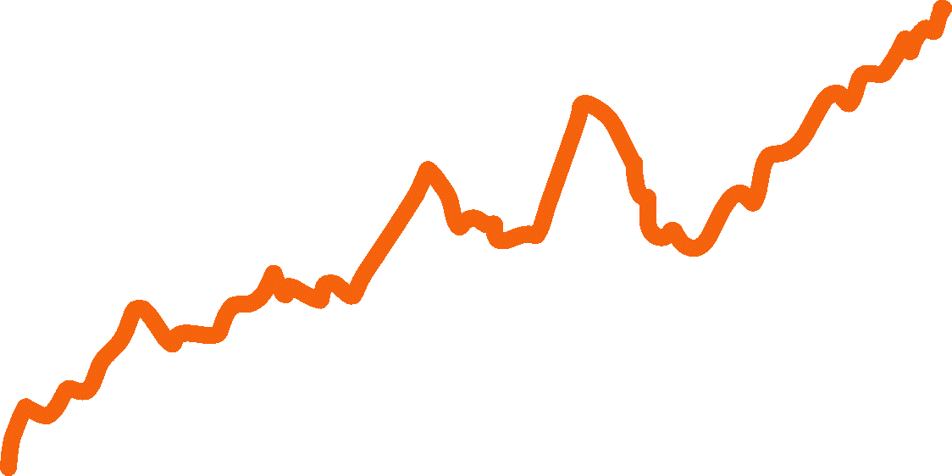

Machine learning
ARIMAX
Seasonality
Cycles

Slide 2
