Slide 1
Cropping-Resistant Robust Reversible Watermarking Using Local Zernike Moments and CNN-Based Feature Detection
GUIDED BY: MR. SREEKANTH E S
ASSISTANT PROFESSOR
DEPARTMENT OF CSE
PREPARED BY: SHERIN P
S3 M. Tech
MES24CSCE05

Slide 2
Introduction
Digital media is vulnerable to unauthorized copying and tampering.
What is Digital Watermarking?
  A technique that embeds copyright information or privacy labels into a carrier based on specific rules.
  Watermarking ensures ownership, authenticity, and integrity.

Slide 3
Introduction
  Traditional watermarking methods change the original image in a way that cannot be fully recovered after the watermark is removed.
  In fields like medical, military, and satellite imaging, even tiny changes in the image are not acceptable.
  Reversible watermarking is a technique that allows the hidden watermark to be removed and the original image can be completely restored without any loss or change.

Slide 4
LITERATURE REVIEW
Reversible Image Watermarking Based on Histogram Modification and Virtual Border[1]
This paper proposes a reversible image watermarking method using histogram modification and a virtual border to protect the originality of digital images.
Main Idea:
  The color histogram of the image is slightly modified to embed bits.
  All changes are stored in a virtual border (around the image) to allow exact recovery.
Embedding steps:
  Compute the image color histogram (pixel intensity distribution).
  Embed watermark bits by modifying histogram bins:
  Increment the pixel count for one histogram bin → embed bit ‘1’
  Decrement the pixel count for one histogram bin → embed bit ‘0’

Slide 5
LITERATURE REVIEW
3. Store details of modified pixels in the LSBs of the virtual border.
4. At the receiver side:
  Extract bits from the histogram.
  Use border data to reverse changes and recover the original image perfectly.
Limitations:
  Sensitive to cropping, compression, or rotation , watermark easily destroyed.
  Fails for images with sparse or irregular histograms.

Slide 6
LITERATURE REVIEW
Robust Lossless Image Data Hiding Designed for Semi-Fragile Image Authentication[2]
This paper combines robust watermarking (survives compression) and reversible watermarking (lossless recovery) Based on the Patchwork Statistical Theory.
Main Idea:
  Divide the image into random pixel groups (A and B).
  Embed watermark bits by slightly modifying their average pixel values:
    Bit ‘1’ → make Group A’s average > Group B’s
    Bit ‘0’ → make Group A’s average < Group B’s
  Changes are tiny (±1), keeping image quality high.

Slide 7
LITERATURE REVIEW
Embedding Steps:
  Divide the image into random pixel group pairs (A, B) using a secret key.
  For each watermark bit:
    Bit 1: increase mean of Group A slightly.
    Bit 0: decrease mean of Group A slightly.
  Extraction Process:
  Recreate pixel group pairs using the same secret key.
  Compare mean values:
    μA > μB → bit 1
    μA < μB → bit 0

Slide 8
LITERATURE REVIEW
Limitations:
Fails under geometric attacks (rotation, scaling, cropping).
Low capacity for data embedding.

Slide 9
LITERATURE REVIEW
Quantization Index Modulation: A Class of Provably Good Methods for Digital Watermarking and Information Embedding[3]
The paper explains the limitations of existing watermarking methods and proposes a new technique called Quantization Index Modulation (QIM) to overcome them.
Before QIM was proposed, researchers mainly used:
Least Significant Bit (LSB) Embedding:
    Replace the last bit of pixel values with watermark bits.
    Easily destroyed by noise, compression, or small attacks.

Slide 10
LITERATURE REVIEW
Quantization Index Modulation(QIM)
It hides bit 0 or 1 by slightly adjusting each pixel to match one of two quantizers.
During detection, the receiver checks which quantizer the pixel fits into to get the hidden bit.
  Two sets of quantization levels (quantizers) are defined.
  Q₀ → represents bit 0
  Q₁ → represents bit 1
  Embedding: Each pixel is mapped to the nearest level of the corresponding quantizer based on the watermark bit.
  Extraction: The decoder checks which quantizer level the pixel belongs to and retrieves the hidden bit

Slide 11
LITERATURE REVIEW
Numerical Example:
Quantizer levels:
  Q₀ → 0, 2, 4, 6… (for bit 0)
  Q₁ → 1, 3, 5, 7… (for bit 1)
Original pixel = 5
  Watermark bit = 1 → nearest Q₁ level = 5 → pixel becomes 5.
Original pixel = 5
  Watermark bit = 0 → nearest Q₀ level = 4 → pixel becomes 4
Extraction:
Pixel 5 → closer to Q₁ → bit 1 recovered
Pixel 4 → closer to Q₀ → bit 0 recovered

Slide 12
LITERATURE REVIEW
Cover-Lossless Robust Watermarking Against Geometric Deformations[4]
This paper proposes a watermarking method that can get back the original image when there is no attack and stay strong against changes like rotation and scaling.
  The method uses Zernike Moments (ZMs) for embedding to ensure the watermark is robust to image rotation.
  Zernike Moments (ZMs) are mathematical features that represent the shape and intensity patterns of an image.

Slide 13
LITERATURE REVIEW
Embedding process:
Global Zernike Moments (ZMs) are calculated for the entire image (not local regions).
The watermark is embedded into the ZM magnitudes using Quantization Index Modulation (QIM).
The final watermarked image is obtained by applying the inverse Zernike transform and embedding the compensation data reversibly.

Slide 14
LITERATURE REVIEW
Extraction & Recovery Process:
At the receiver side, ZMs of the received image are recalculated
The embedded watermark bits are extracted using the inverse QIM rule.
If no attack then the original image is perfectly reconstructed using the stored compensation data.
If attacked then the ZMs’ invariance allows the watermark to be detected correctly even after rotation or scaling.
Limitations:
  Embedding is done on global ZMs → not effective against cropping or localized geometric attacks.

Slide 15
Base Method Overview
  The method targets combined attacks such as cropping + rotation.
  To resist these, Zernike Moments are computed in local circular regions instead of over the whole image.
  The watermark is embedded redundantly in each local circular region to improve robustness.

Slide 16
Base Method Overview
Embedding process:
  Apply SIFT(Scale-Invariant Feature Transform algorithm) to the cover image to detect key feature points.
  From the detected points, select stable feature points and create non-overlapping circular regions around them.
  Compute Zernike Moments (ZMs) for each circular region.
  Embed the watermark bits into the ZM magnitudes using Quantization Index Modulation (QIM).
  Apply Inverse Zernike Transform to obtain the watermarked circular regions.
  Reserve the first (h + l) bits of the non-circular region to store the hash value (H) and feature point location information (l).

Slide 17
Base Method Overview
Use the remaining non-circular area to embed compensation information.
Calculate the hash (H) of the final watermarked image and embed it into the reserved ‘h’ bits,
while the location information (l) of the keypoints is embedded into the next ‘l’ bits.
Now we have final watermarked image.
Watermark Extraction and Image Recovery Process:
  Extract the first (h + l) bits from the non-circular region ,
  these contain the hash value (H) and feature point location information (l).
  Reset the extracted bits to zero and compute a new hash (H′) of the received image.
  Compare H and H′:
    If H = H′, → the image is not attacked.
    If H ≠ H′, → the image is attacked.

Slide 18
Base Method Overview
When no attack is detected:
  Use the keypoints location info from ‘l’ to identify the same circular regions.
  Compute Zernike Moments (ZMs) of each circular region.
  Extract watermark bits using the inverse QIM rule.
  Extract compensation information from the non-watermarked area.
  Reconstruct the original image by applying Inverse Zernike Transform and adding the compensation information.

Slide 19
Base Method Overview
When an attack is detected:
  Full image recovery is not possible because the compensation data may be damaged or lost.
  Apply SIFT on the attacked image to detect keypoints.
  Use the keypoints to locate the circular embedding regions.
  Compute Zernike Moments (ZMs) on those regions and apply inverse QIM to extract the watermark bits.
  If some circular regions are cropped or missing, extract the watermark from the remaining intact regions

Slide 20
Limitation of Existing System
  Uses SIFT for feature point detection which performs poorly under large geometric transformations and illumination changes.
  SIFT points may shift or disappear after image scaling, rotation, or cropping, causing errors in region localization.
  Feature extraction and matching are computationally expensive for high-resolution images.
  Limited ability to detect repeatable keypoints in texture-less or low-contrast areas.

Slide 21
Objectives
  To design a robust and reversible watermarking system resistant to cropping and geometric attacks using SuperPoint CNN[7] and Local Zernike Moment embedding.

Slide 22
Proposed Improvement
Replace traditional SIFT-based feature extraction with SuperPoint CNN, a deep learning-based keypoint detector and descriptor.
SuperPoint provides high repeatability and stability under various image transformations.
Enhances robustness, accuracy, and processing efficiency compared to the existing SIFT-based approach.

Slide 23
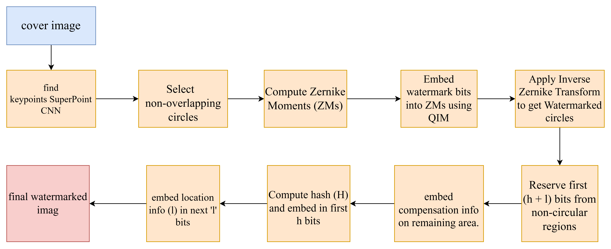
Embedding architecture

Slide 24
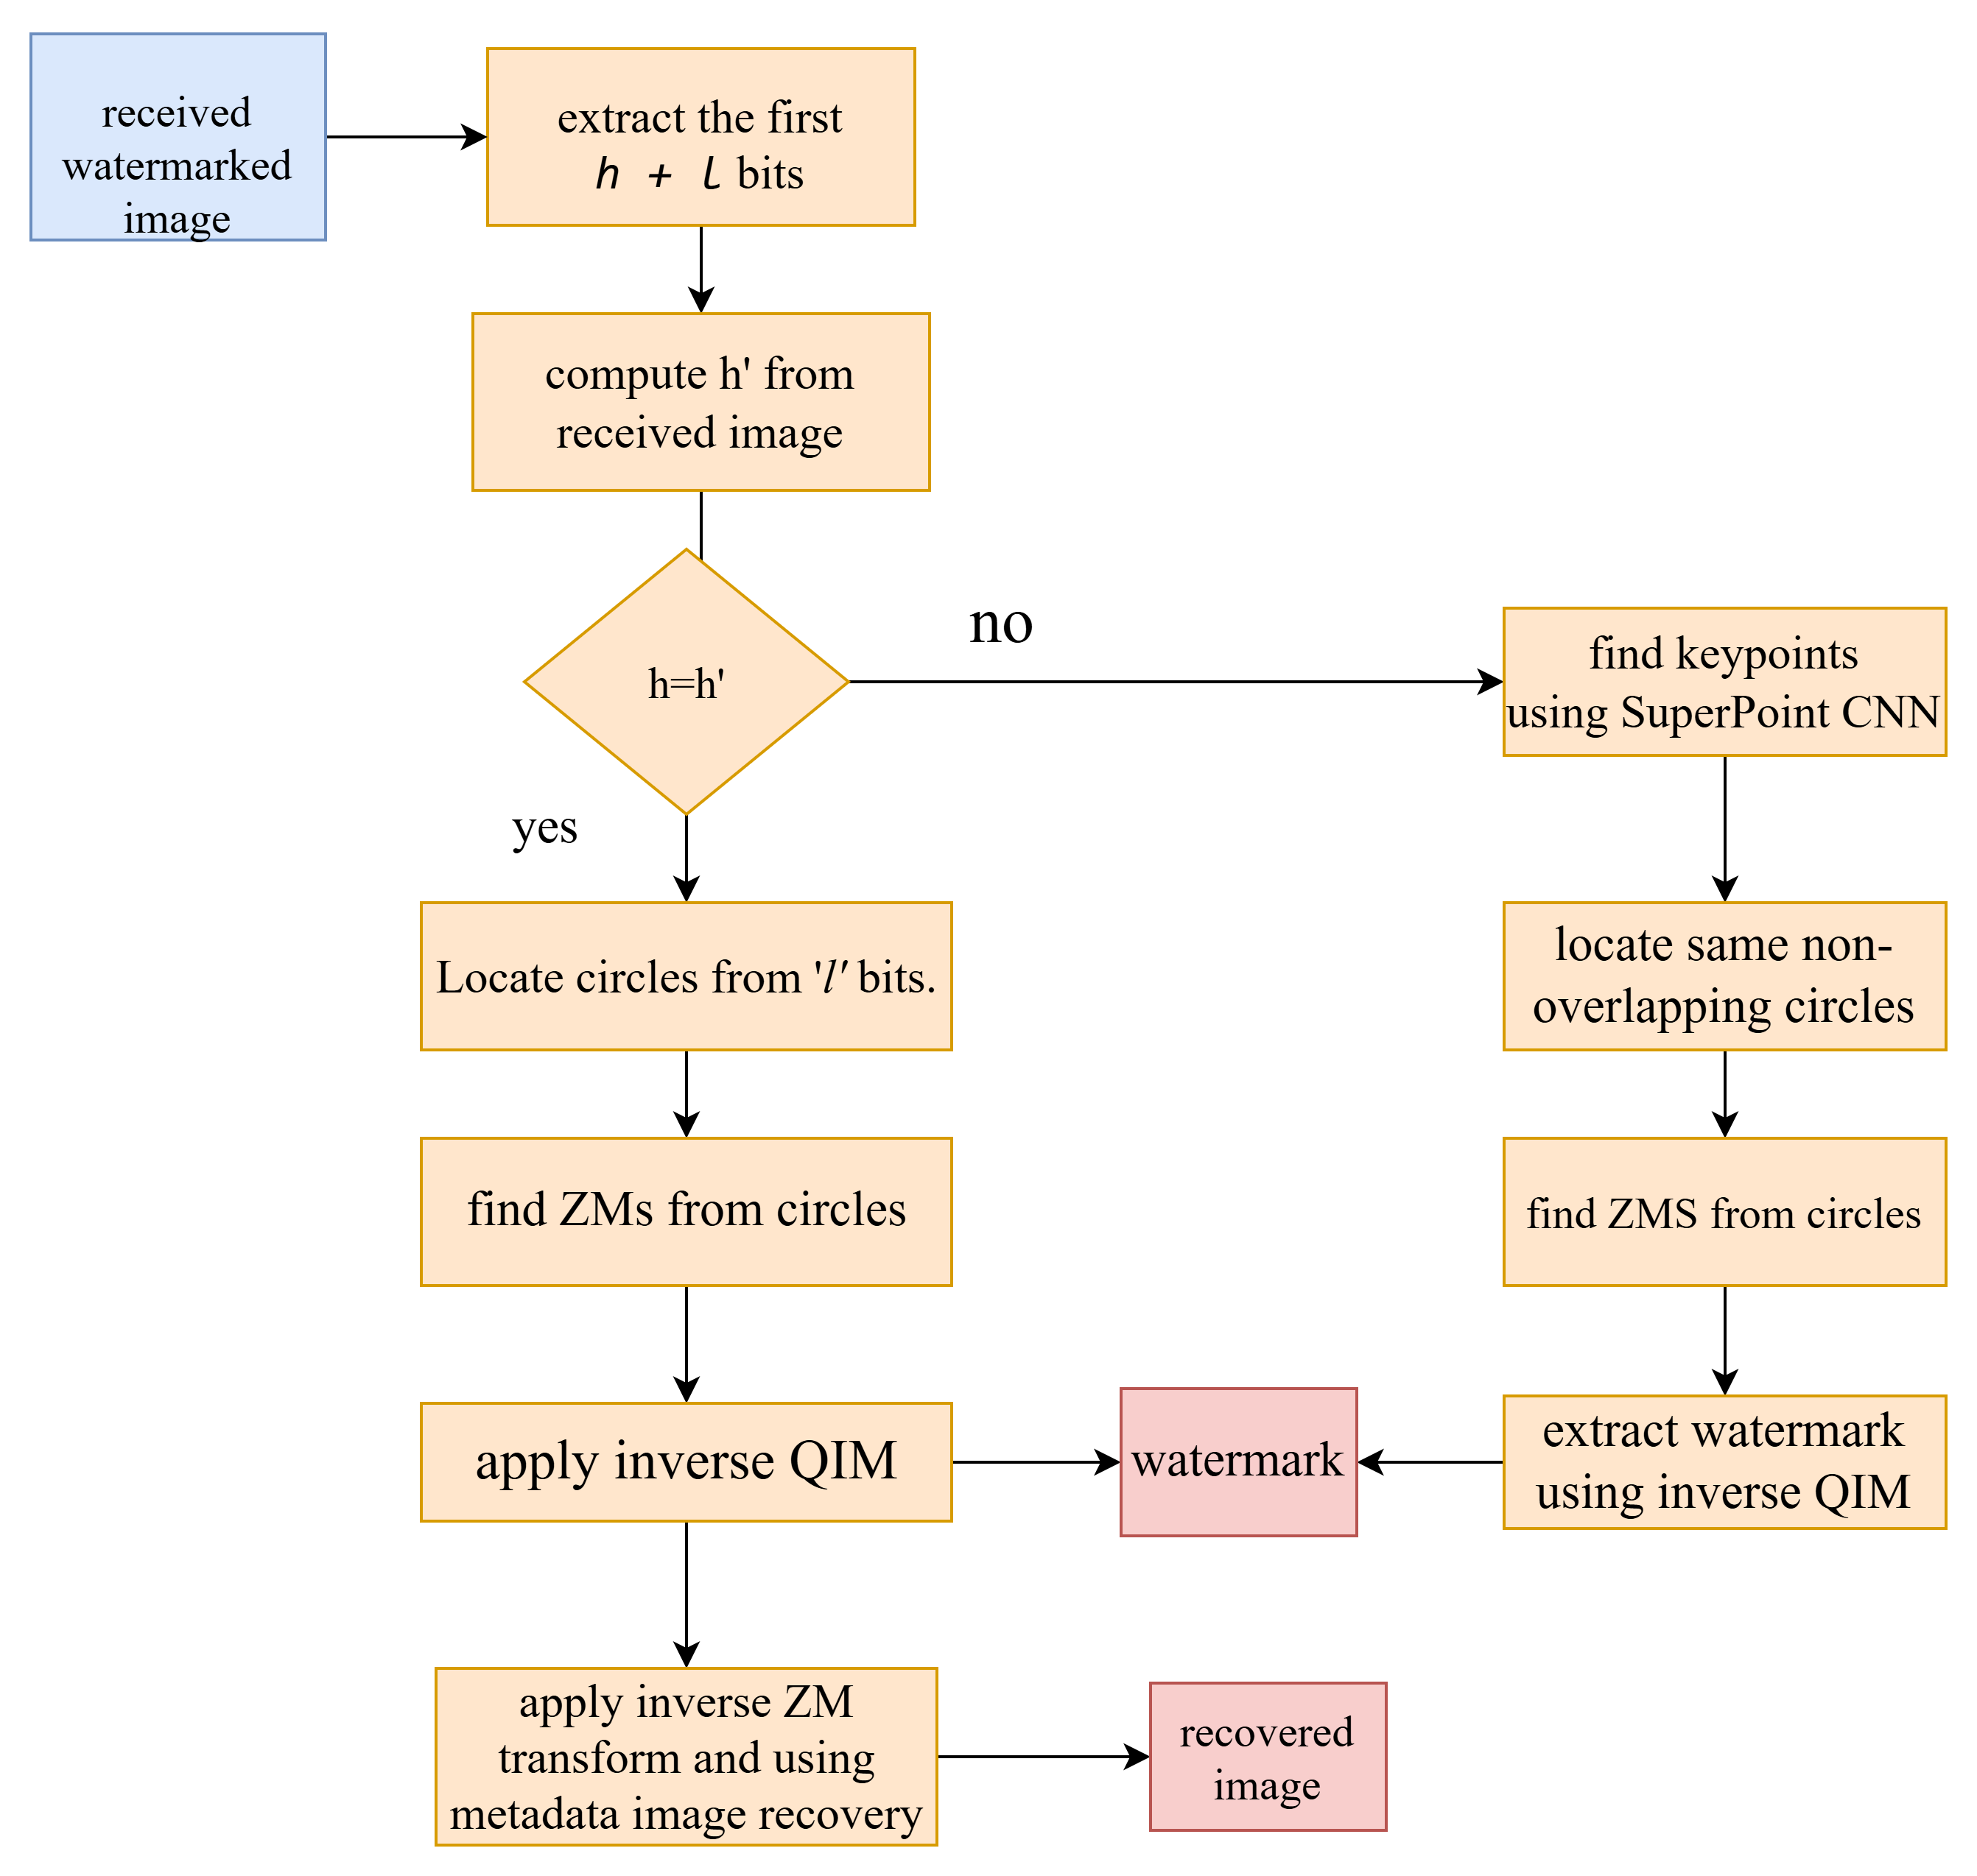
Extraction architecture

Slide 25
Advantages of the Proposed Method
better invariance to geometric and photometric changes.
Improved keypoint stability which helps in consistent circle localization after attacks.
Higher extraction accuracy and improved watermark integrity.
Lower computational cost for keypoint detection compared to SIFT

Slide 26
Summary
Watermarking protects digital media from tampering and unauthorized use.
Redundant local ZMs + CNN-detected features → robust, moderately cropping-resistant embedding.
Method ensures watermark extraction and cover image recovery.
Provides foundation for future research in secure and reversible watermarking.

Slide 27
References
[1] N. H. Lestriandoko and D. Rosiyadi, “Reversible image watermarking based on histogram modification and virtual border,” in Proceedings of the 8th International Conference on Telecommunication Systems, Services, and Applications (TSSA), Oct. 2014, pp. 1–4.
[2] Z. Ni, Y. Q. Shi, N. Ansari, W. Su, Q. Sun, and X. Lin, “Robust lossless image data hiding designed for semi-fragile image authentication,” IEEE Transactions on Circuits and Systems for Video Technology, vol. 18, no. 4, pp. 497–509, Apr. 2008.
[3] B. Chen and G. W. Wornell, “Quantization index modulation: A class of provably good methods for digital watermarking and information embedding,” IEEE Trans. Inf. Theory, vol. 47, no. 4, pp. 1423–1443, May 2001.
[4] G. Gao, M. Wang, and B. Wu, “Efficient robust reversible watermarking based on ZMs and integer wavelet transform,” IEEE Trans. Ind. Informat., vol. 20, no. 3, pp. 4115–4123, Mar. 2024.
[5] H. Wang, H. Yao, C. Qin, and X. Zhang, “When robust reversible watermarking meets cropping attacks,” IEEE Trans. Circuits Syst. Video Technol., vol. 34, no. 1, pp. 1–14, 2024.
[6] G. Gao, M. Wang, and B. Wu, “Efficient robust reversible watermarking based on ZMs and integer wavelet transform,” IEEE Trans. Ind. Informat., vol. 20, no. 3, pp. 4115–4123, Mar. 2024

Slide 28
References
[7] Petrakis, Georgios. "a Superpoint Neural Network Implementation for Accurate Feature Extraction in Unstructured Environments." The International Archives of the Photogrammetry, Remote Sensing and Spatial Information Sciences 48 (2023): 1215-1222.

Slide 29
Thank you

