Slide 1

Blinkit Analysis Report
This presentation delves into the analytical insights derived from Blinkit's sales and operational data, empowering stakeholders with actionable intelligence.

Slide 2
About Blinkit
Blinkit (formerly Grofers) is an Indian quick-commerce company that delivers groceries, essentials, fresh produce, household items, and more to customers’ doorsteps.
Founded in 2013 by Albinder Dhindsa and Saurabh Kumar, it operates on a 10–20-minute delivery promise in selected cities.
Headquartered in Gurugram, India, Blinkit partners with local stores and uses a network of dark stores (small fulfillment centers) to fulfill orders rapidly.
In 2022, Blinkit was acquired by Zomato, strengthening its resources and market presence. The company focuses on speed, convenience, and competitive pricing to capture the growing quick-commerce market in India.
This presentation delves into the analytical insights derived from Blinkit's sales and operational data, empowering stakeholders with actionable intelligence.

Slide 3
Project Overview & Methodology
This interactive Power BI dashboard provides a comprehensive analysis of Blinkit's sales, customer behaviour, and operational efficiency. It enables quick identification of trends, tracking of key performance indicators (KPIs), and supports data-driven decision-making.
Tools Used
Key Methodologies
Power BI Desktop: For data visualisation and dashboard creation.
Data Cleaning & Transformation: Including null value removal, duplicate elimination, and data standardisation.
Power Query: For robust data extraction, transformation, and loading (ETL).
Data Modelling: Establishing relationships for optimised performance with a star schema.
DAX (Data Analysis Expressions): For calculated measures and KPIs.
DAX Measures: Calculating metrics like Total Sales, AOV, Profit Margin %, and YoY Growth.
Microsoft Excel / CSV: As the raw data source.
Visualisation Techniques: Utilising KPI cards, line charts, bar charts, and slicers for interactive insights.

Slide 4
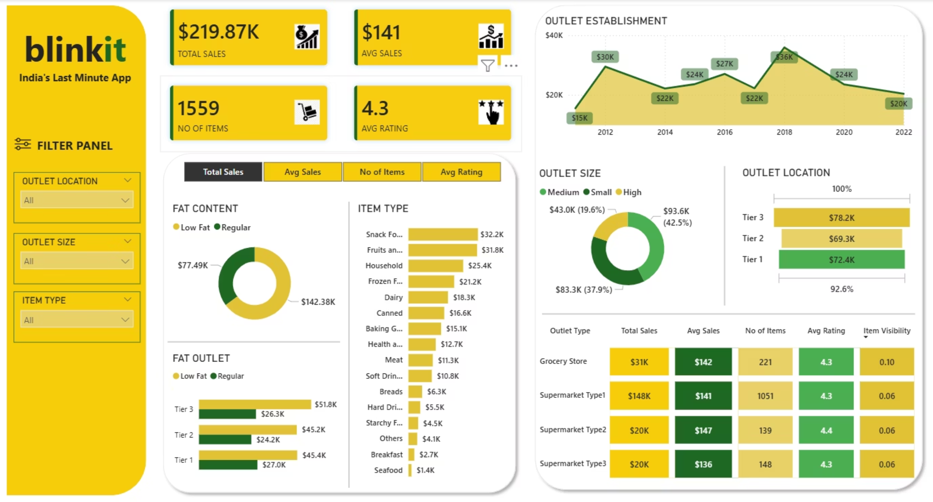
Unlocking Growth: A Data-Driven Approach
for Blinkit
This presentation delves into the analytical insights derived from Blinkit's sales and operational data, empowering stakeholders with actionable intelligence.

Slide 5
Analysis Breakdown
Highest Total Sales from each category:
Outlet Size: High - $93.6K
Outlet Location: Tier 3 - $78.2K
Fat Content: Regular - $142.38K
Fat Outlet: Low Fat products in Tier 1 - $27.0K
Outlet Type: Supermarket Type 1 - $148K
Top 5 Item Type with Highest Sales:
Snack Food: $32.2K
Fruits and Vegetables: $31.8K
Household: $25.4K
Frozen Foods: $21.2K
Dairy: $18.3K
Based on the "Outlet Establishment" chart, the overall performance shows a fluctuating trend. Sales began at $15K in 2012, peaked at $36K in 2018, and then saw a decline, finishing at $20K in 2022. While sales in 2022 are higher than the initial year, they are significantly lower than the peak performance in 2018.

Slide 6
Key Insights: Sales & Customer Behaviour
Our analysis reveals compelling patterns in sales trends and customer interactions, providing a clear roadmap for strategic interventions.
Sales Trends
Category Performance
Customer Insights
Peak sales during weekends indicate strong demand for promotions. Seasonal spikes highlight opportunities for targeted campaigns during festivals.
Beverages and Dairy Products are top revenue contributors. Some categories show low sales but high profit margins, indicating niche opportunities.
Repeat customers drive significant revenue, emphasising loyalty programme importance. Underperforming regions suggest low market penetration or competition.

Slide 7
Operational Performance & Strategic Recommendations
While order fulfilment rates are high, delivery time variability in certain locations requires attention. Our recommendations aim to optimise performance across marketing, customer retention, and operations.
Marketing & Sales
Customer Retention
Operational Efficiency
Increase weekend and festival-specific promotions.
Implement loyalty rewards for repeat buyers.
Investigate causes of longer delivery times in specific regions.
Cross-sell high-margin products with popular items.
Personalised recommendations based on purchase history.
Optimise supply chain for underperforming categories.

Slide 8

Conclusion: Driving Growth Through Action
Blinkit possesses the demand, loyal customers, and a significant data advantage. The key lies in translating these insights into targeted actions to foster rapid growth, enhance profitability, and deliver an unparalleled customer experience.
“By turning these insights into targeted action, we can drive faster growth, higher profits, and an unbeatable customer experience.”

