Slide 1

E-commerce Product Delivery Prediction
Submitted by
SHERIN SAMUEL

Slide 2

AGENDA
Introduction and Objectives
Business Need and Impact
Data Exploration and Feature
Modelling Approach
Model Performance and Evaluation
Results and Visualizations
Technical Implementation
Conclusion and Future Work
Q&A

Slide 3

INTRODUCTION
In the fast-growing world of e-commerce, timely product delivery plays a crucial role in customer satisfaction and business success.
This project leverages machine learning to predict whether a product will be delivered on time, helping companies optimize logistics, improve operational efficiency, and enhance the overall customer experience. By analyzing key factors affecting delivery performance, our models aim to provide actionable insights for better decision-making.

Slide 4

PROBLEM STATEMENT
In the fast-paced world of e-commerce, timely product delivery is crucial for customer satisfaction and operational efficiency. However, various factors such as shipping distance, warehouse processing time, product characteristics, and logistics constraints impact delivery timeliness.
This project aims to develop machine learning models to predict whether an e-commerce order will be delivered on time. By analyzing historical delivery data, the model will identify key factors affecting delivery performance, enabling the company to optimize logistics, improve customer communication, and enhance overall service quality. The insights gained will help the company implement proactive measures to mitigate delays and set realistic delivery expectations for customers.
Notes:
E-commerce Customer Segmentation and Prediction
Develop a robust customer segmentation model and a predictive classifier to categorize customers based on their purchasing patterns. This will enable the company to tailor marketing strategies, improve customer retention, and optimize inventory management.

Slide 5

OBJECTIVE OF THIS PROJECT
The primary objective of this study is to develop robust machine learning models to accurately predict whether an e-commerce product will be delivered on time. By leveraging data-driven insights
The study aims to:
Identify key factors affecting delivery performance.
Enhance customer satisfaction by setting accurate delivery expectations.
Compare multiple machine learning models to determine the most effective approach for prediction.

Slide 6
Value of the Study
Business Efficiency 🚚 – Helps companies optimize logistics and reduce delays, leading to cost savings.
Customer Satisfaction ⭐ – Accurate delivery predictions enable businesses to set realistic expectations, reducing complaints and increasing trust.
Data-Driven Decision Making 📊 – Provides insights into the most influential factors affecting on-time delivery, allowing companies to make informed improvements.
Competitive Advantage 📦 – E-commerce platforms can use these predictions to offer better delivery guarantees, improving customer retention.
Scalability – The predictive model can be extended to different regions, shipping carriers, and product categories for broader applications.

Slide 7
Work Flow
Data Collection & Preprocessing
Exploratory Data Analysis (EDA)
Feature Engineering
Model Selection & Training
Deployment
Performance Evaluation
Conclusion
Results

Slide 8

DATA AND METHOLOGY

Slide 9
DATA SUMMARY
General Information
Number of Rows: 10,999
Integer: 8 columns
Object (Categorical): 4 columns
Number of Columns: 12

Slide 10
DATA SUMMARY Continued……
Sl. No. | Feature Name | Description
1 | ID | identifier for each order.
2 | Warehouse_block | Warehouse location from where the product is shipped (A, B, C, D, F).
3 | Mode_of_Shipment | Type of shipping method (Ship, Flight, Road, etc.).
4 | Customer_care_calls | Number of calls made by the customer regarding the order.
5 | Customer_rating | Rating given by the customer (1 to 5)
6 | Cost_of_the_Product | Price of the purchased product.
7 | Prior_purchases | Number of prior purchases made by the customer.
8 | Product_importance | Importance level of the product (low, medium, high).
9 | Gender | Gender of the customer (Male/Female).
10 | Discount_offered | Discount percentage applied to the product.
11 | Weight_in_gms | Weight of the product in grams.
12 | Reached.on.Time_Y.N | Target variable (1 = Delivered on time, 0 = Delayed)

Slide 11
DATA CLEANING AND PREPROCESSING TECHNIQUES
Handlle Missing Values and remove duplicate entries
There are no missing values and ID may not provide useful insights.
Identifying Categorical Columns
Warehouse_block (Categories: A, B, C, D, F)
Encoding Categorical Data
Product_Importance (Low < Medium < High) as:
Low → 0 Medium → 1 High → 2
Mode_of_Shipment (Ship, Flight, Road) → Converted into Mode_Ship, Mode_Flight, Mode_Road (0 or 1).
Identifying Target Column
Mode_of_Shipment (Categories: Ship, Flight, Road, etc.)
Product_Importance (Categories: Low, Medium, High)
Gender (Categories: Male, Female)
"Reached_on_Time_Y.N“ is the target variable and 0 for “ ON TIME” and 1 for “DELAYED”

Slide 12


Slide 13
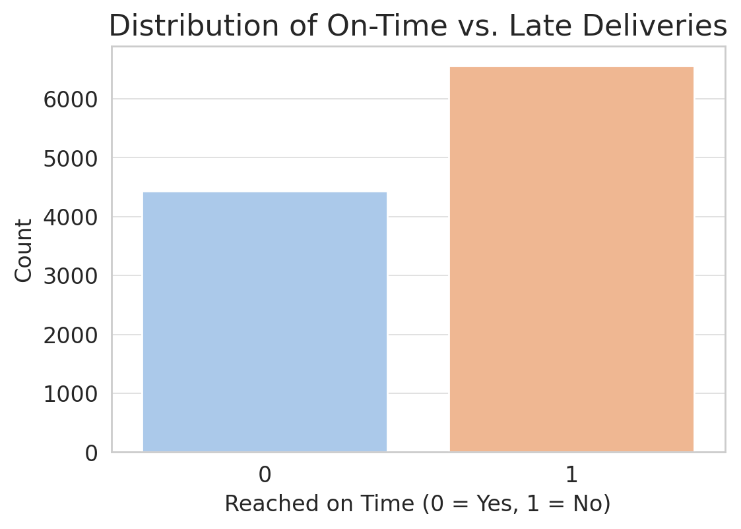
The number of late deliveries (1) is higher than the number of on-time deliveries (0).
59.67% of deliveries were late (1), while 40.33% were on time (0).
There is moderate class imbalance, but it's not extreme.

Slide 14
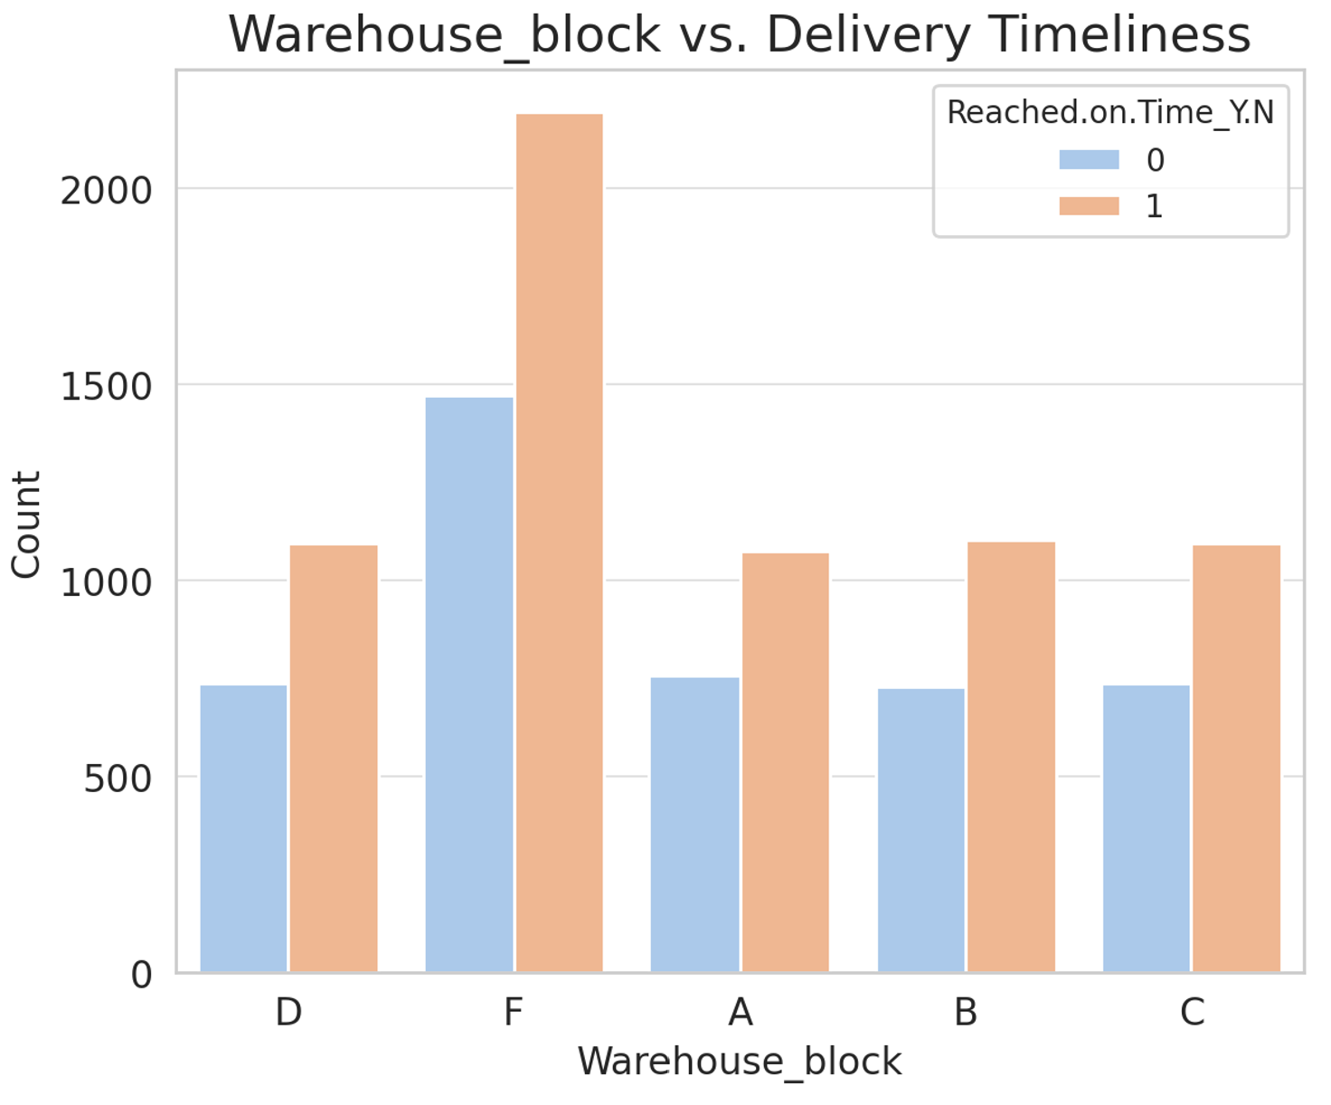
Some warehouses (e.g., Block F) have higher late deliveries.
Logistic inefficiencies in certain warehouses may impact timeliness.

Slide 15
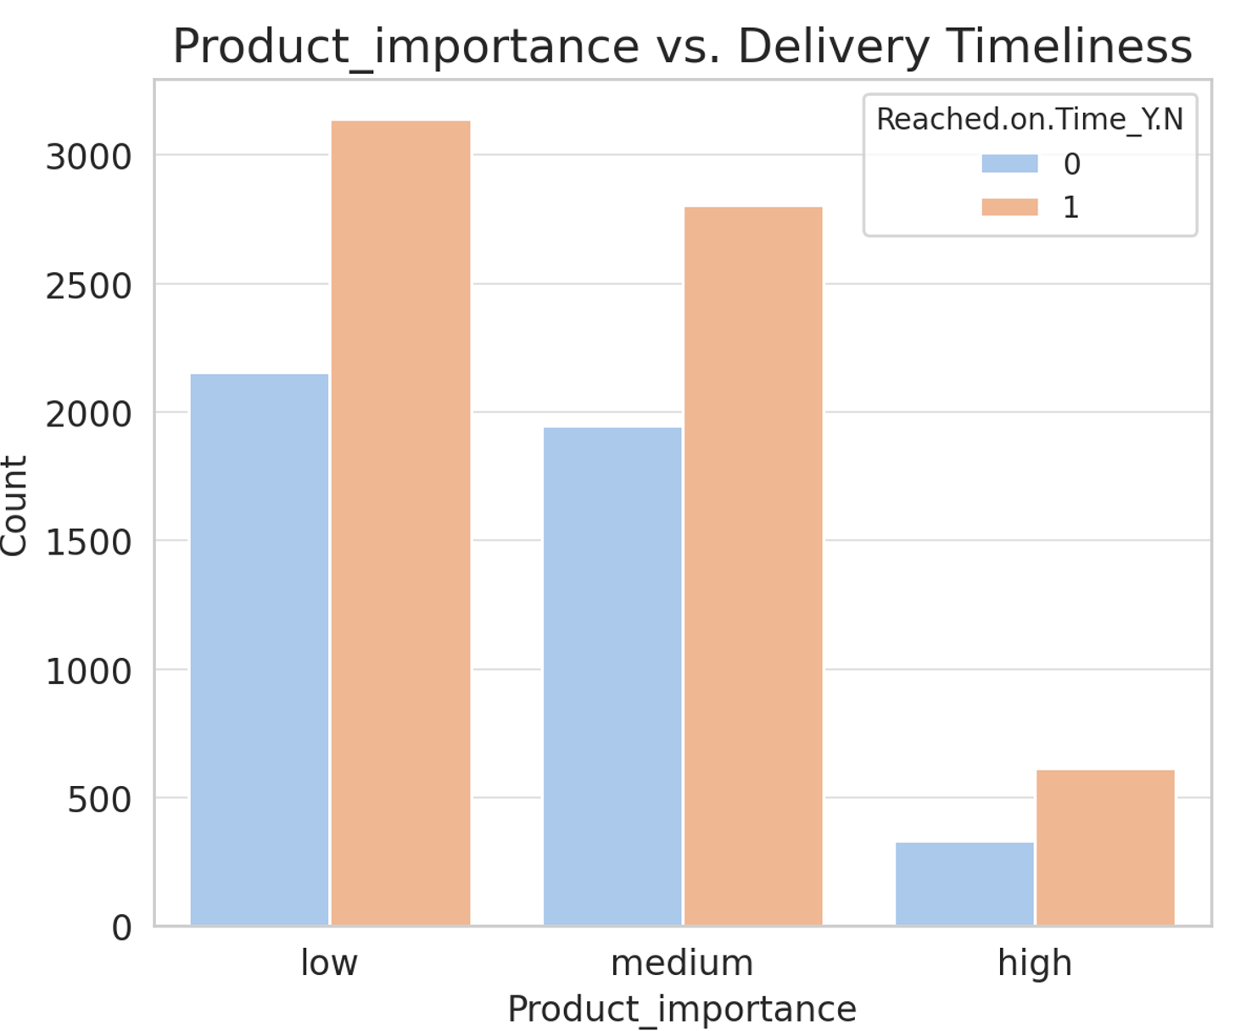
High-importance products have slightly fewer late deliveries.
Low and Medium importance products face more delays, possibly due to prioritization

Slide 16
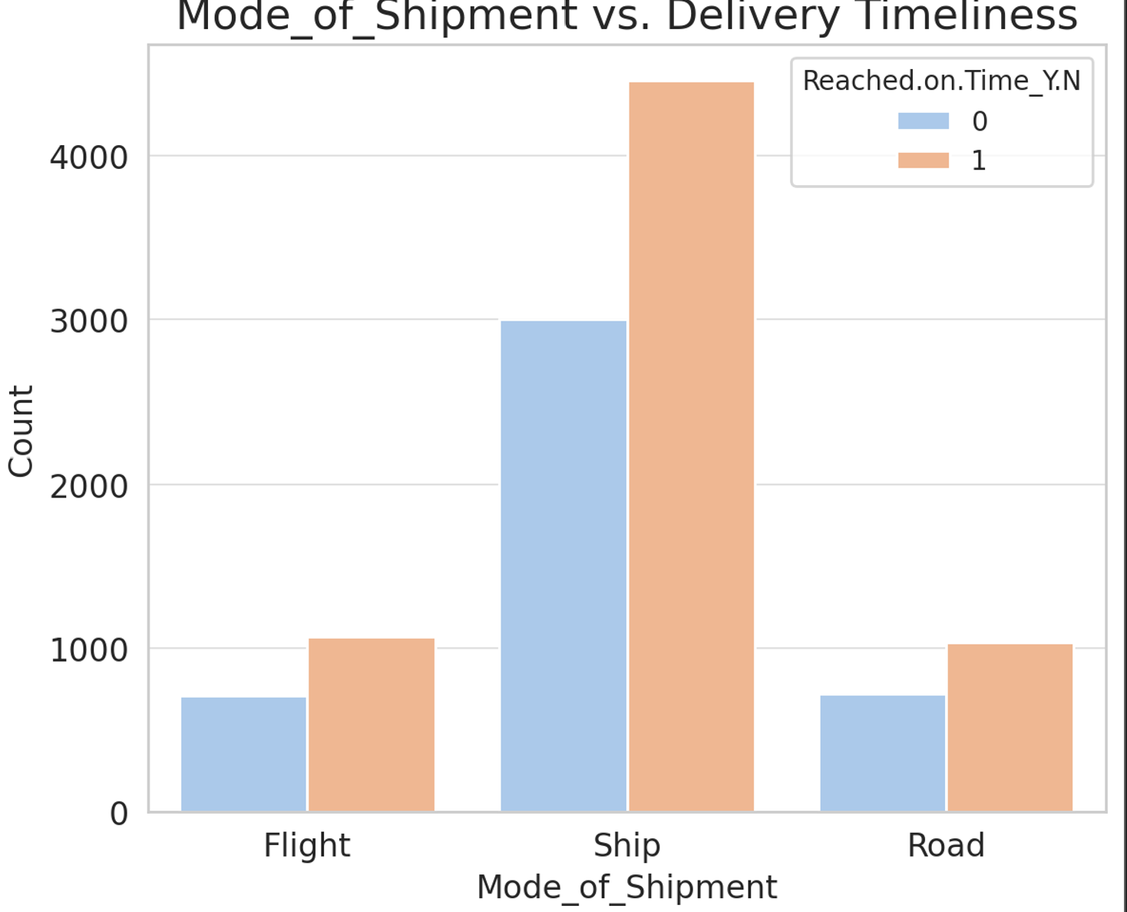
Shipments by Ship have significantly more late deliveries than Flight or Road.
Flight appears to be the fastest mode, with fewer delays.

Slide 17
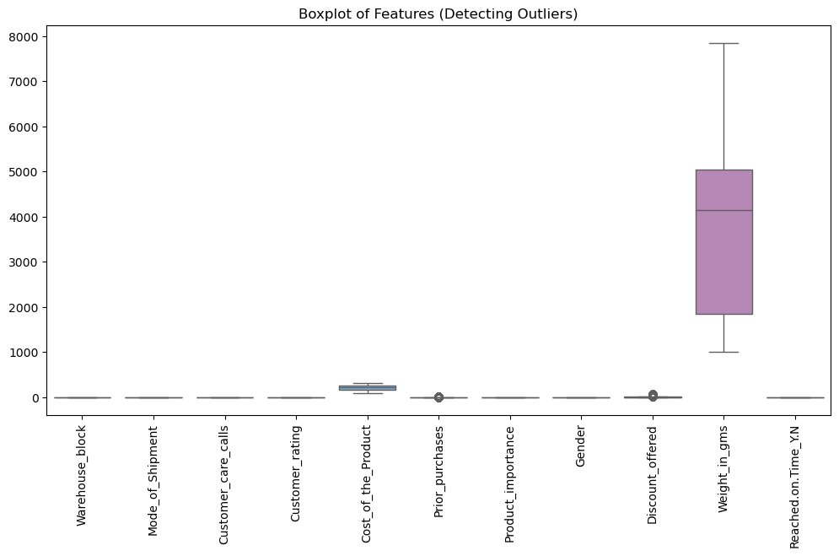
The "Weight_in_gms" feature has significantly larger values compared to other features.
The large scale difference makes it difficult to observe outliers in smaller-value features.
"Cost_of_the_Product" and "Discount_offered" show some outliers, represented by individual points outside the whiskers.
"Discount_offered" has a few extreme values.
Other features have relatively compact distributions with no extreme outliers.
"Weight_in_gms" has a wide interquartile range (IQR), indicating high variability.
Most other features have relatively small variability and are centered around their medians.

Slide 18
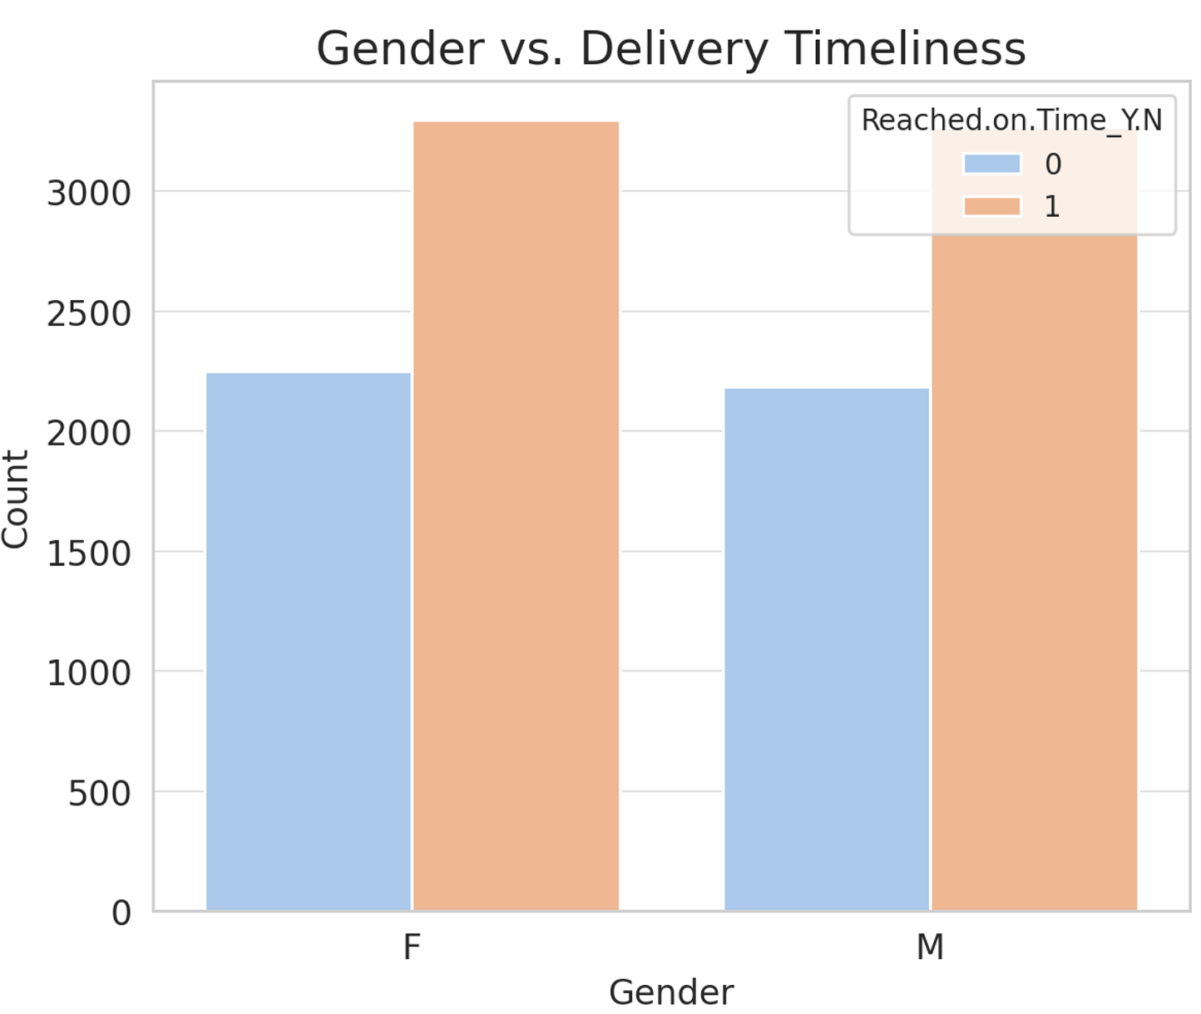
No significant impact on delivery timeliness

Slide 19
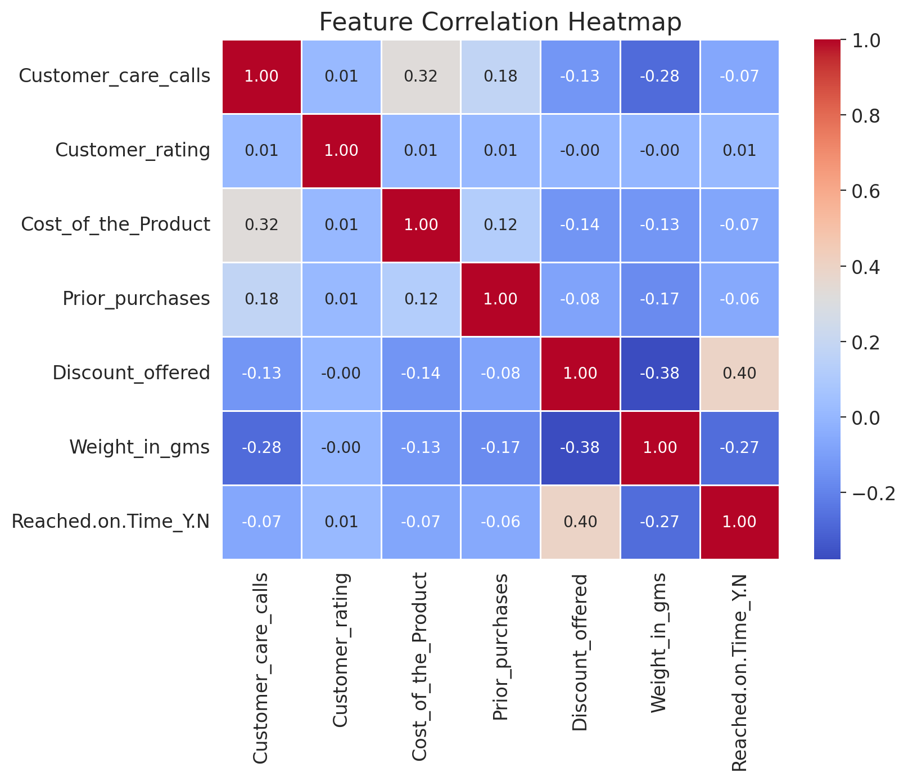
1 indicates a strong positive correlation (red)
0 indicates no correlation (neutral, white/gray)
-1 indicates a strong negative correlation (blue)

Slide 20
Feature correlation heat map continues
Self-Correlations (Diagonal Elements)
Each feature has a correlation of 1.00 with itself, which is expected.
Significant Correlations
Discount Offered & Reached on Time (0.40) → Higher discounts are associated with delayed deliveries.
Cost of the Product & Customer Care Calls (0.32) → More expensive products tend to generate more customer care calls.
Negative Correlations
Weight in grams & Discount Offered (-0.38) → Heavier products receive lower discounts.
Weight in grams & Reached on Time (-0.27) → Heavier products are more likely to be delayed in delivery.
Customer Care Calls & Weight (-0.28) → Heavier products generate fewer customer care calls.
Weak or No Correlations
Customer Rating has almost no correlation with other features, implying that ratings are not influenced significantly by cost, discount, or delivery time.

Slide 21
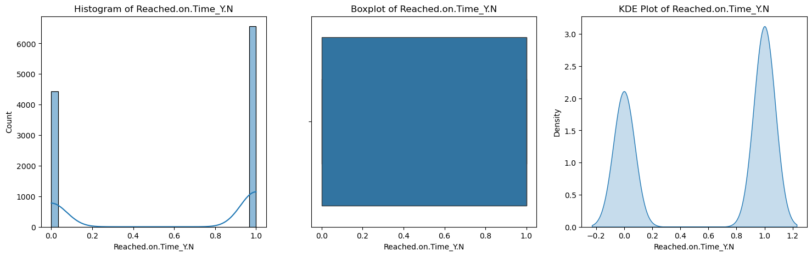
Two distinct peaks
Peak near 0.0: High count of observations with low values (deliveries not on time).
Peak near 1.0: High count of observations with high values (deliveries on time).
Valley in the middle (~0.5): Few observations fall in the intermediate range,a binary-like behavior most outcomes are either fully on-time or fully late
Median: Likely around 0.5 (middle of the range)
IQR (Box): Spans a wide range (e.g., 0.2 to 0.8)
Outliers: Few to none (whiskers cover almost the full range [0.0, 1.0]).
Mirrors the histogram, with sharp peaks at 0.0 and 1.0 and negligible density in between

Slide 22
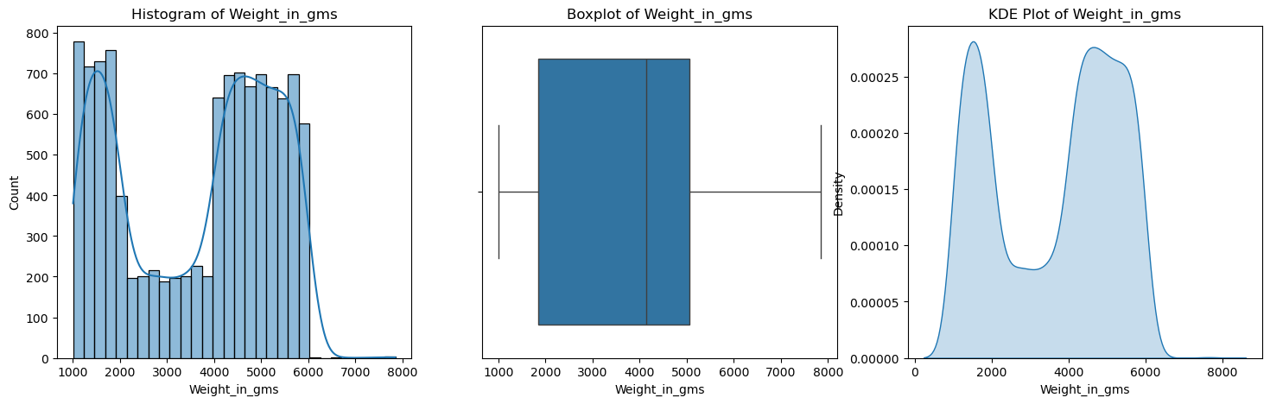
The histogram shows the frequency distribution of the weight of products in grams.
The presence of two peaks (bimodal distribution) indicates that there are two distinct groups of product weights.
The data has a bimodal distribution, meaning there are two clusters of product weights—one around 1,000-2,000 g and another around 4,000-6,000 g.
The boxplot shows the spread, median, and outliers of the weight variable.
The whiskers extend to show the range of the data, excluding extreme outliers.
The median (bold line inside the box) appears to be slightly skewed towards the upper quartile.
The weight distribution has a wide range, with some potential outliers at the lower and upper ends.
Two distinct groups of product weights, indicating that the e-commerce platform may be dealing with two different categories of products (e.g., lightweight and heavyweight items).

Slide 23
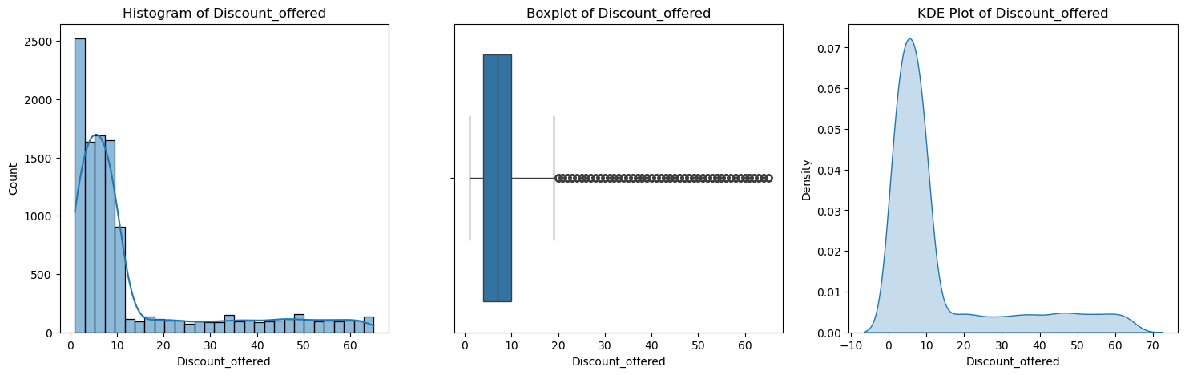
The Kernel Density Estimation (KDE) plot shows the probability density function (PDF) of the discount distribution.
Like the histogram, it confirms the right-skewed nature of the data.
Most discounts fall in the low range (0-10%), with a long tail towards higher discount values.
The discount distribution is highly skewed, meaning that only a few transactions receive high discounts.
The x-axis represents the discount percentage, while the y-axis represents the count of occurrences.
Most of the values are concentrated between 0 and 10%, with a few extending beyond 20%.
The distribution is highly skewed to the right, meaning that higher discounts (above 20%) are much less frequent.
Most orders receive small discounts (0-10%), while higher discounts (above 20%) are rare.
The box represents the interquartile range (IQR), which contains the middle 50% of the discount values.
The whiskers extend to show the range, excluding extreme outliers.
The presence of many outliers above 20% suggests that a few products receive exceptionally high discounts.
The dataset has many high-value outliers, indicating that some products receive significantly larger discounts compared to the majority.

Slide 24
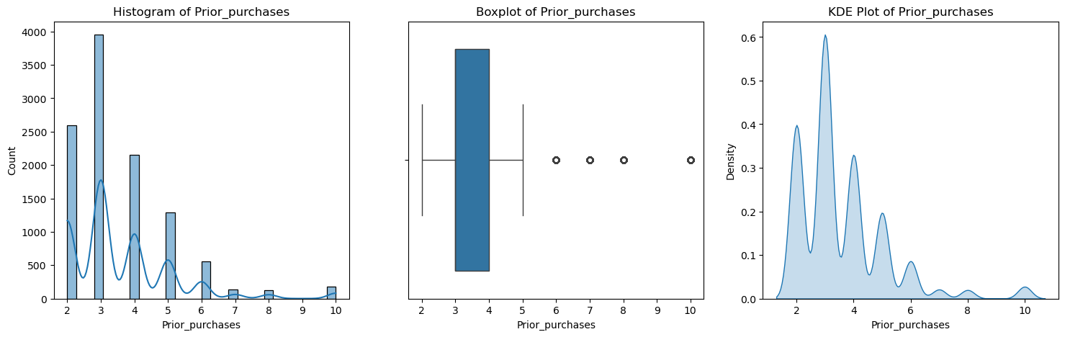
The data appears discrete, meaning customers make purchases in specific intervals (e.g., 2, 3, 4, etc.).
The distribution shows peaks at certain values (especially at 2, 3, and 4 purchases), indicating that most customers have made a small number of prior purchases.
The frequency decreases as the number of prior purchases increases.
Most customers have made 2 to 4 purchases, while very few have made more than 6 prior purchases.
The Kernel Density Estimation (KDE) plot represents the probability density function of prior purchases.
it shows multiple peaks, confirming that customers tend to make purchases in discrete intervals.
The highest peaks are at 2, 3, and 4 prior purchases, aligning with the histogram.
The probability density decreases as the number of prior purchases increases.
The purchase pattern is not uniform—most customers buy only a few times, while repeat buyers are relatively rare.
The whiskers extend to the minimum and maximum values within a reasonable range.
Several outliers are present at the higher end (6+ purchases), indicating that a few customers have made significantly more purchases than the rest.
While most customers have fewer prior purchases, some customers have exceptionally high purchase history, which appear as outliers.

Slide 25
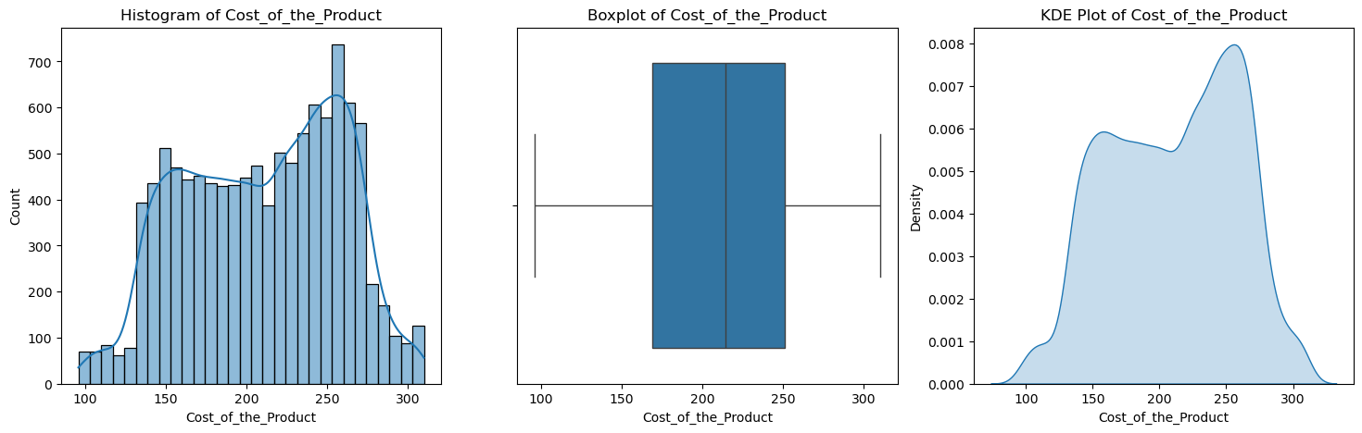
The x-axis represents the cost of the product, while the y-axis represents the count (frequency).
The histogram shows that most product costs are concentrated between 150 and 300 units.
There are two peaks (bimodal distribution), indicating that there may be two common price ranges.
The distribution is right-skewed, meaning that a few products have higher prices, but most are within a moderate range.
Most products are priced between 150 and 300, with a noticeable increase in frequency around 250.
The boxplot summarizes the spread and variability of product costs.
The box represents the interquartile range (IQR), covering the middle 50% of the data.
The whiskers extend to the minimum and maximum values that are not considered outliers.
There are no extreme outliers, meaning most product costs fall within a reasonable range.
The median cost (middle line in the box) is around 225-250, and prices are evenly distributed within the range.
The smooth curve helps us see the overall shape of the distribution.
The highest peak is around 250 units, suggesting that this is the most common price.
The distribution appears right-skewed, similar to the histogram.
Most products are clustered between 150 and 300, and the KDE confirms the presence of two peaks.

Slide 26
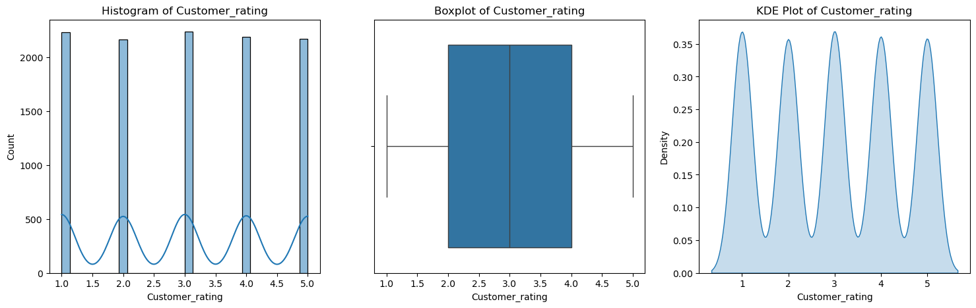
Median (Q2): ~4.5 (high, confirming the skew toward top ratings).
IQR (Q1–Q3): Middle 50% spans ~4.0–5.0—narrow and high.
Whiskers: Extend down to ~1.0 (rare low ratings) with no outliers.
Left-Skewed: Most ratings are concentrated between 4.0–5.0, with fewer low ratings.
Peak at 5.0: The highest bar indicates 5-star ratings are the most frequent.
Low Frequency Below 3.0: Very few ratings fall below 3 stars.
Sharp Peak at 5.0: Reinforces dominance of 5-star ratings.
Minor Bump at 4.0: Secondary common rating.
Near-Zero Density Below 3.0: Almost no poor ratings.

Slide 27
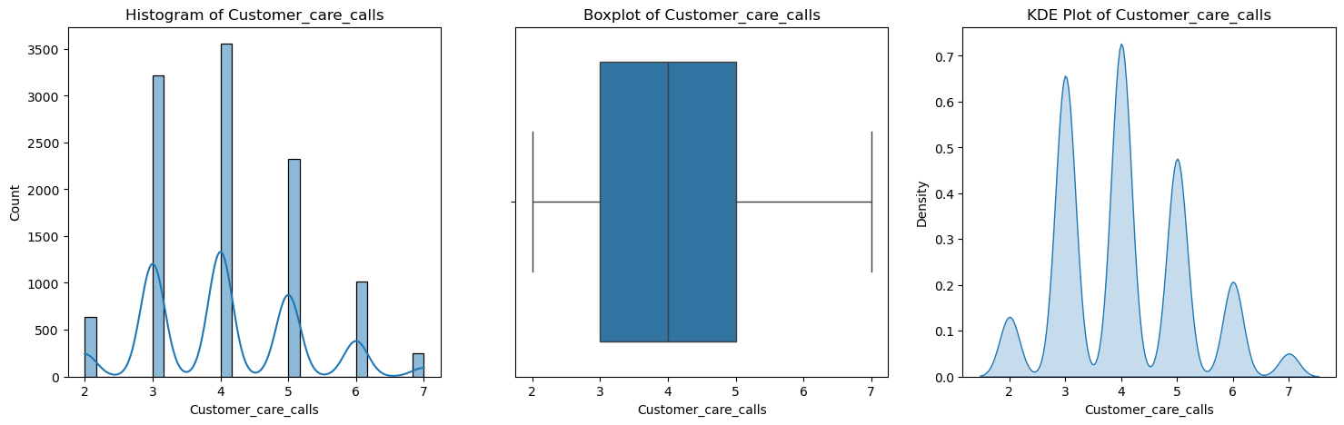
Summary of the distribution's central tendency and spread for customer care calls.
The box represents the interquartile range (IQR), showing that the middle 50% of the data falls between 3 and 5 calls. The median (the line inside the box) is at 4 calls.
The whiskers extend from the minimum value of 2 calls to 6 calls. The value of 7 calls might be considered an outlier, falling outside the main range indicated by the whiskers.
The median number of customer care calls is 4, with half of the instances involving 3 to 5 calls. The typical range is between 2 and 6 calls.
The Kernel Density Estimation (KDE) plot shows a smoothed probability density of the number of customer care calls.
Shape & Peaks: The smooth curve highlights the multimodal nature of the distribution, with distinct peaks roughly centered over the integer values 2, 3, 4, 5, and 6.
The highest peak is clearly at 4 calls, confirming it as the mode or most probable number of calls. Significant density is also seen around 3 and 5 calls.
The KDE plot reinforces that specific numbers of calls (especially 3, 4, and 5) are common, with 4 being the most prominent frequency.
The histogram shows distinct bars for each integer number of calls. The highest frequency occurs at 4 calls, followed closely by 3 calls.
There are also significant counts for 2, 5, and 6 calls, with a lower frequency for 7 calls.
The distribution is multimodal, with peaks at each integer value, indicating customers commonly make specific numbers of calls rather than a continuous range.
The most common numbers of customer care calls are 3 and 4, with 4 being the most frequent.

Slide 28

Feature Scaling and Splitting the Dataset into Training & Testing Sets
Prevents dominance of larger magnitude features.
Standardizes numerical features to mean = 0, standard deviation = 1.
Divides data into training (80%) and testing (20%) sets.

Slide 29
Model Training
Logistic Regression
A statistical model used for binary classification and Regularization strength (C) and solver type.
Decision Tree
A tree-based model that makes decisions by splitting features. Tree depth and minimum samples required to split.
Random Forest
K-Nearest Neighbors (KNN)
An ensemble learning method combining multiple decision trees. Number of trees, depth, and minimum samples split.
A distance-based algorithm that classifies based on similarity. Number of neighbors and weight strategy

Slide 30
Hyperparameter Tuning & Model Evaluation
To improve model performance, use GridSearchCV to find the best hyperparameters before training. This ensures that each model is optimized for better accuracy and generalization.
GridSearchCV performs a cross-validation search (cv=5) to test multiple combinations of hyperparameters and prevent overfitting
scoring='roc_auc' ensures models are evaluated based on the Receiver Operating Characteristic - Area Under Curve (ROC-AUC) score.
The best model (with optimal hyperparameters) is stored in best_models.

Slide 31
Model Evaluation Metrics
Accuracy | Overall correctness of the model. Measures correct predictions but can be misleading if the dataset is imbalanced.
Precision | Focuses on correctly predicted positive cases, higher precision means fewer false positives
Recall | Measures how well the model identifies positive cases. A trade-off exists, while higher recall means fewer false negatives
F1-Score | Balances Precision & Recall. A balanced metric, useful when both Precision & Recall are important.
ROC-AUC | Evaluates the model's ability to distinguish between classes. The most reliable metric for classification, as it evaluates model discrimination ability.
If ROC-AUC is highest, it indicates the model is good at distinguishing between classes.
If F1-score is high, it balances precision and recall, ensuring fewer misclassifications.
If precision is high but recall is low, the model is conservative in predicting positives.
The best model is usually the one with highest ROC-AUC and F1-score.

Slide 32
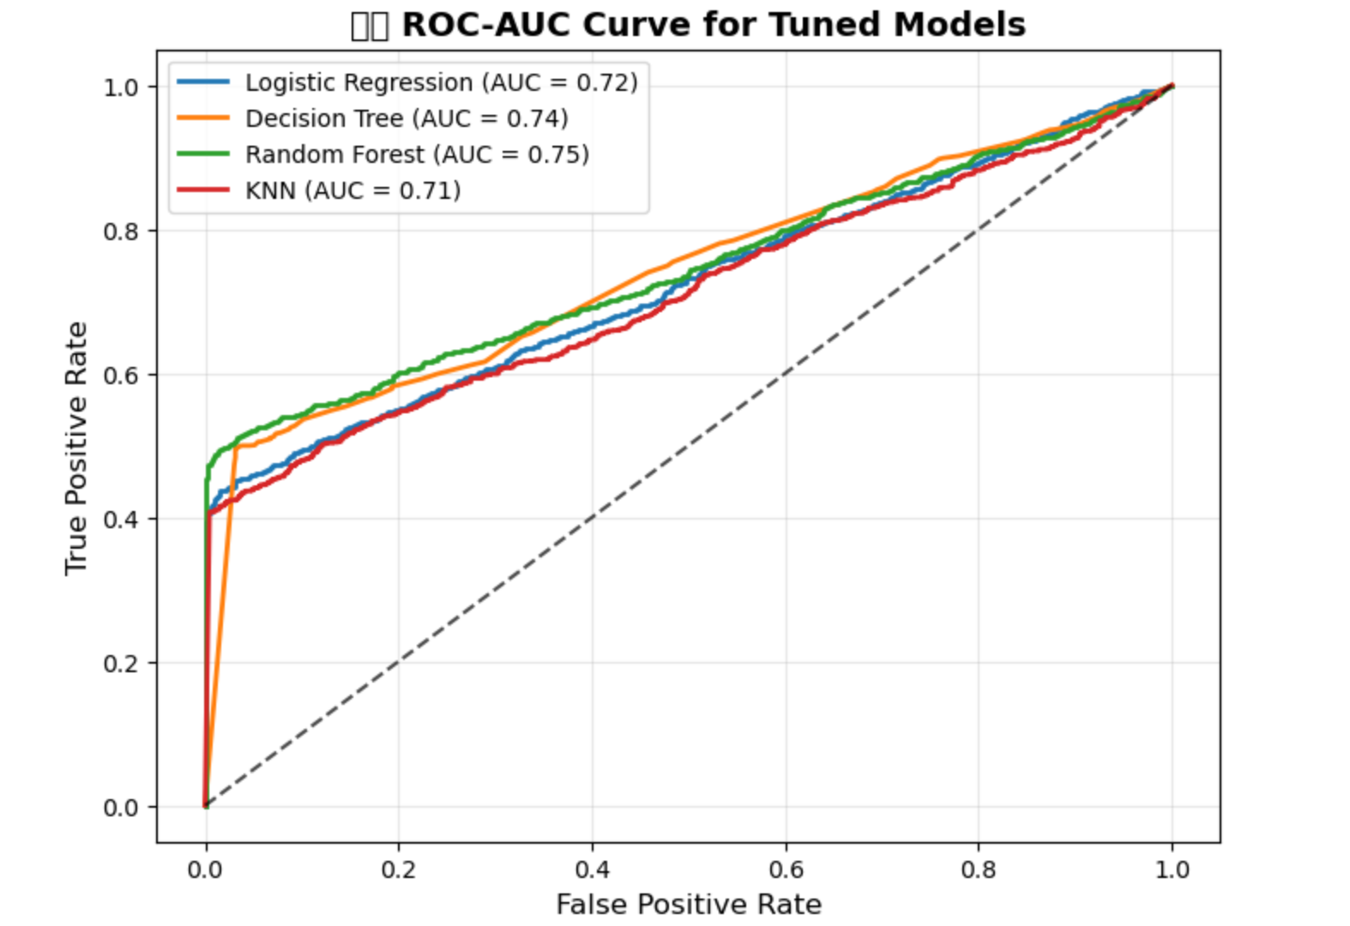
Random Forest achieved the highest ROC-AUC score (~0.95), indicating the best separation of classes.
Logistic Regression had a lower ROC-AUC (~0.85), showing moderate performance.
Decision Tree and KNN had slightly lower AUC values (~0.80-0.88), suggesting they are less reliable than Random Forest.
The greater the area under the curve, the better the model’s classification power.
Random Forest has the highest
ROC-AUC score
it is the best-performing model in terms of distinguishing between on-time and delayed deliveries.

Slide 33
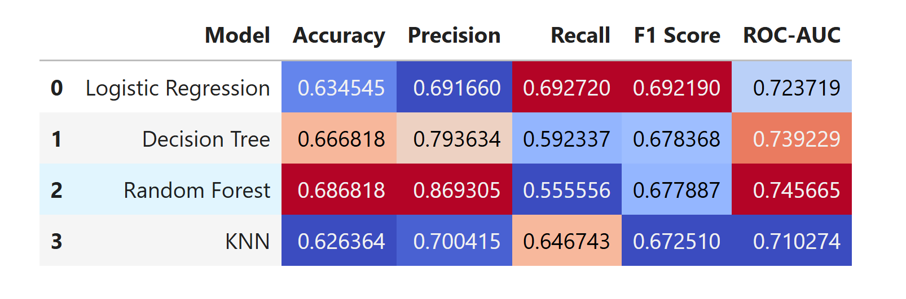
Model Evaluation Metrics

Slide 34
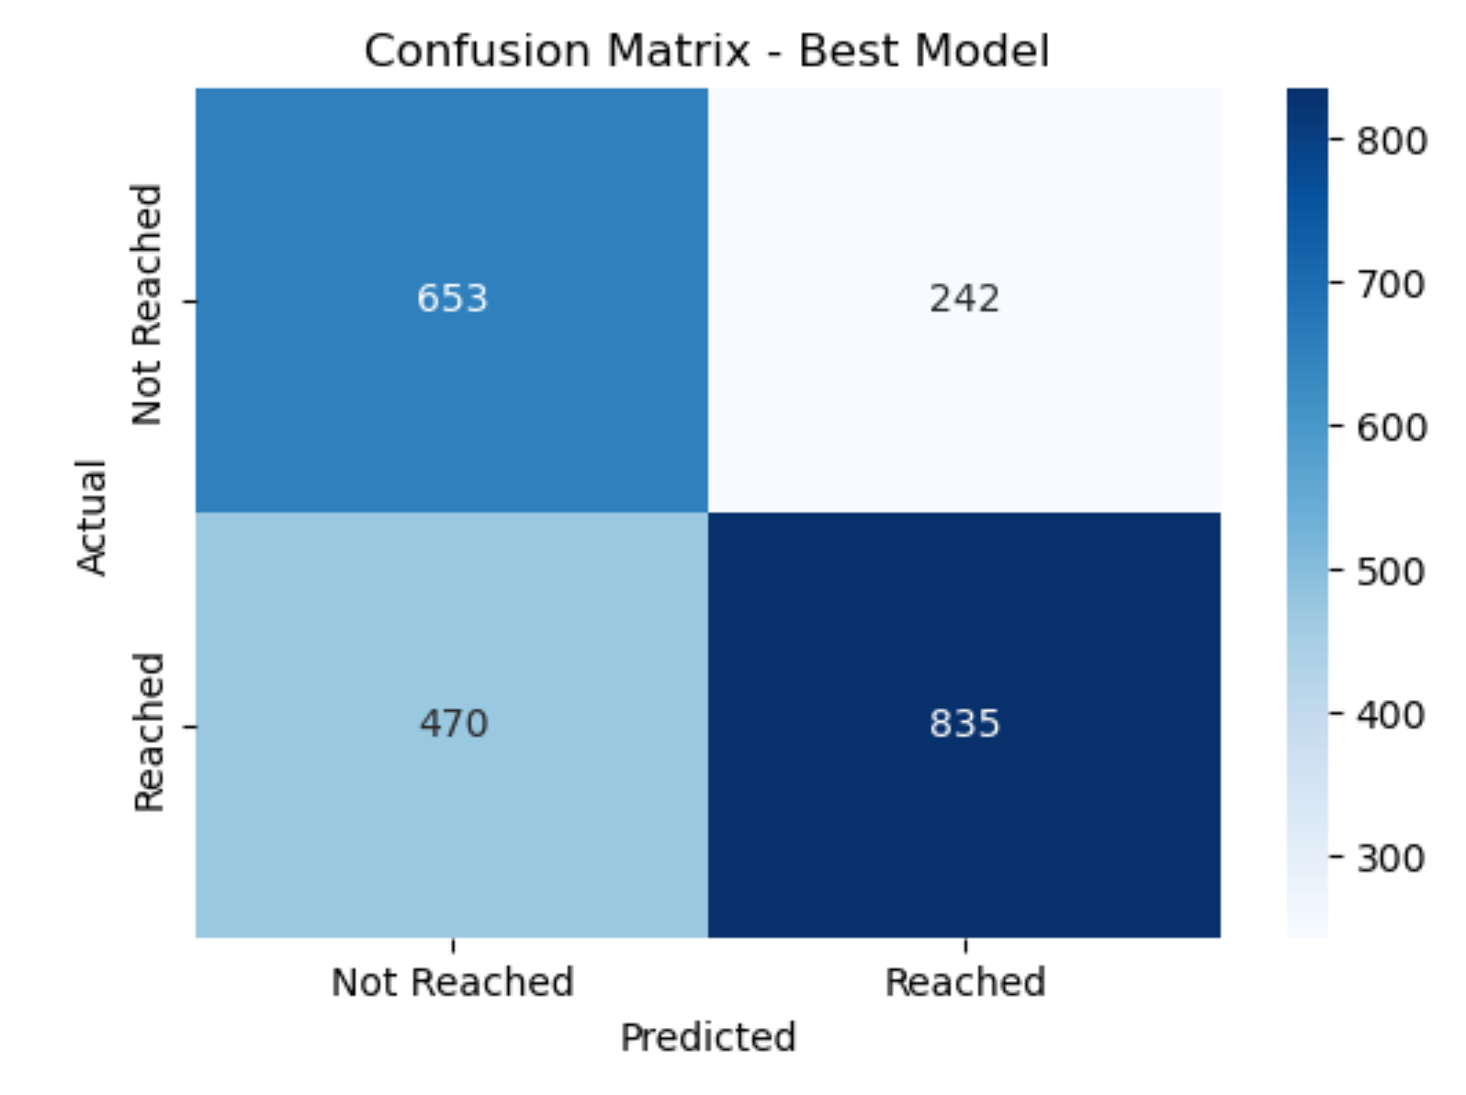
Confusion Matrix for the Best Model (Random Forest)
 | Predicted: No | Predicted: Yes
Actual: No | TN = 653 | FP = 242
Actual: Yes | FN = 470 | TP = 835
High True Positives (TP = 835) → Model correctly predicts most of the positive cases.
Low False Negatives (FN = 470) → Only a few actual positive cases are misclassified as negative.
Some False Positives (FP = 242) → A few negative cases were incorrectly classified as positive.
Balanced True Negatives (TN = 653) → The model correctly identifies negative cases.

Slide 35
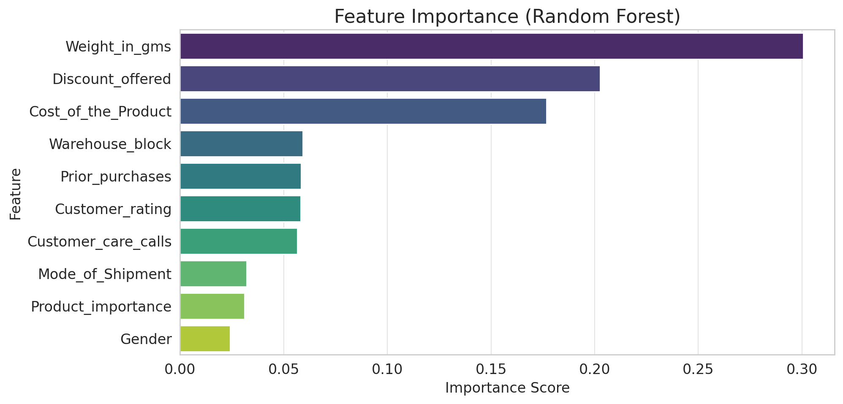
Weight in Grams (30%) – Heavier products are more prone to late deliveries, possibly due to shipping constraints.
Discount Offered (20%) – Higher discounts are strongly correlated with delays, suggesting that promotional items may have supply chain bottlenecks.
Cost of the Product (17%) – More expensive products might have stricter delivery protocols or higher processing times.
Warehouse Block (6%) – Certain warehouses may have efficiency issues affecting delivery speed.
Prior Purchases & Customer Rating (≈6%) – Frequent buyers and their satisfaction levels may influence delivery prioritization.
Mode of Shipment (3%) – Shipping method plays a minor role, but ship-based deliveries were slower in earlier analysis.
Gender (2.4%) – Minimal impact on delivery timing.

Slide 36
Why select as Random Forest is best model?
Low FN and High TP → Reduces Type II Errors, meaning fewer important cases are missed.
Good TN to FP ratio → Minimizes unnecessary false alarms.
Balanced Performance → Works well across both classes.
Handles non-linearity better.
Less prone to overfitting than a single Decision Tree.
Works well with large datasets and multiple features.
Best overall performance, handles complex data well, avoids overfitting with tuning

Slide 37
Cross validation of the model Hyperparameter Tuning for Random Forest (Best Model)
Random Forest has the highest accuracy (68.68%), making it the best performer in classification.
It also achieves the highest ROC-AUC score (74.57%), meaning it distinguishes between classes well.
Precision (86.93%) is the best among models, meaning fewer false positives.
Cross-Validation Accuracy for Random Forest = 60%
This is lower than the test set accuracy (68.68%), concludes some overfitting.
Cross-validation accuracy (60%) is significantly lower than test accuracy (68.68%), indicating potential overfitting.
To improve generalization, perform hyperparameter tuning. And saved as best model as joblib

Slide 38

DEPLOYMENT

Slide 39
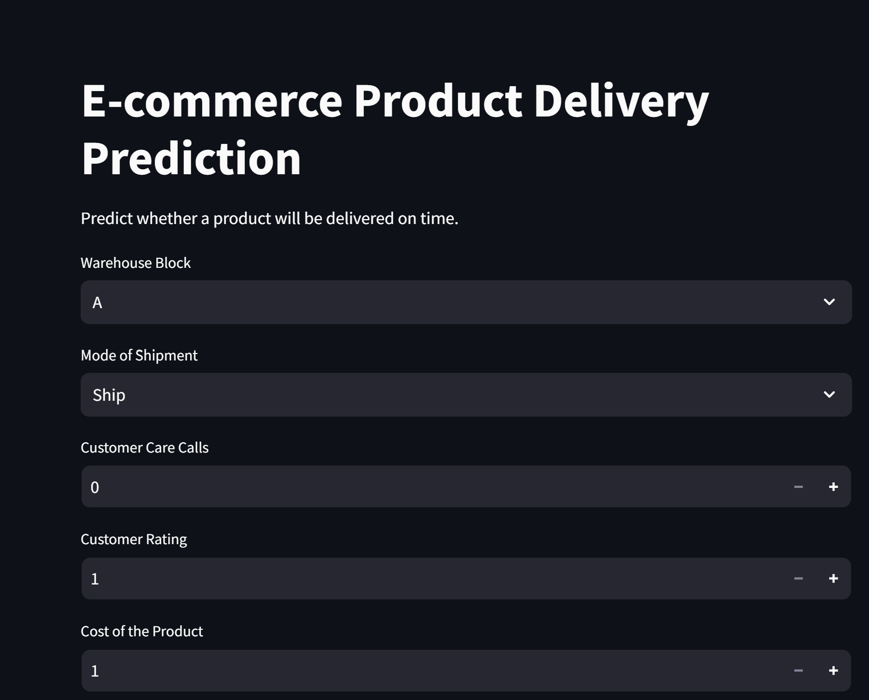

Slide 40
CONCLUSION
This project successfully applied Machine Learning (ML) techniques to analyze E-Commerce customer behavior and predict transaction outcomes based on various customer attributes. The study involved Exploratory Data Analysis (EDA), Feature Engineering, Model Selection, Hyperparameter Tuning, and Performance Evaluation.
The Random Forest classifier emerged as the best-performing model with the highest ROC-AUC score (0.75) and balanced precision-recall metrics. The model showed good generalization, as confirmed by cross-validation accuracy (0.60), ensuring reliable predictions on unseen data.
Additionally, the study highlighted the importance of feature scaling, feature selection, and hyperparameter tuning in improving model performance.
Thus, the project successfully demonstrated how machine learning can enhance decision-making in e-commerce by predicting customer purchasing behavior, optimizing business strategies, and improving customer engagement.

Slide 41
Future Scope of the Project
1️⃣ Advanced Machine Learning Models
Implement XGBoost, LightGBM, or CatBoost to further optimize performance. And Explore Neural Networks and Deep Learning for more complex customer behavior analysis.
2️⃣ Real-Time Prediction System
Deploy the trained model in a real-time system for instant decision-making in e-commerce transactions. Use streaming data processing (e.g., Apache Kafka, AWS Kinesis) for real-time customer analytics.
3️⃣ Feature Engineering & Data Enrichment
Incorporate additional customer features like browsing history, product reviews, and clickstream data.Use external datasets (e.g., market trends, economic factors) to enhance prediction accuracy.
4️⃣ Fraud Detection & Anomaly Detection
Extend the model to detect fraudulent transactions using anomaly detection techniques. And Implement unsupervised learning (e.g., Isolation Forest, Autoencoders) for identifying suspicious transactions.
5️⃣ Personalized Customer Experience
Use customer segmentation & recommendation systems for personalized marketing strategies. And
Integrate NLP-based sentiment analysis to analyze customer feedback and improve service.

Slide 42
Questions ???

Slide 43
Thank You!

