Slide 1
Real-Time Public Sentiment Dashboard using Twitter Data
A Sentiment Monitoring System for Tesla Tweets
Presented by: SHERIN SAMUEL
Date: 03/05/2025

Slide 2
Project Objective
Analyze public sentiment about Tesla using Twitter data
Adapted to manual data collection due to API limitations

Slide 3
Tools and Technologies
Python: Tweepy, NLTK, Pandas, TextBlob
Visualization: Tableau, Matplotlib
Storage: Google Sheets (API), CSV Logs
Retry Handling: Tenacity

Slide 4
Workflow Overview
Data Collection – Manually from Twitter
Preprocessing – Clean tweets (remove noise, stopwords)
Sentiment Scoring – Using TextBlob (positive, negative, neutral)
Daily Aggregation – Count sentiments per day
Visualization – Python & Tableau dashboards

Slide 5
Tweet Cleaning Logic
Remove: URLs, mentions (@), hashtags, punctuation
Convert to lowercase
Tokenize and remove stopwords
Output: Cleaned text for sentiment analysis

Slide 6
Sentiment Analysis Logic
Tool: TextBlob
Polarity > 0: Positive
Polarity < 0: Negative
Polarity = 0: Neutral
Example: 'Tesla’s innovation is inspiring' → Positive

Slide 7
Daily Sentiment Summary
CSV log: daily_summary.csv
Tracks daily positive, negative, and neutral counts
Used to create summary charts

Slide 8
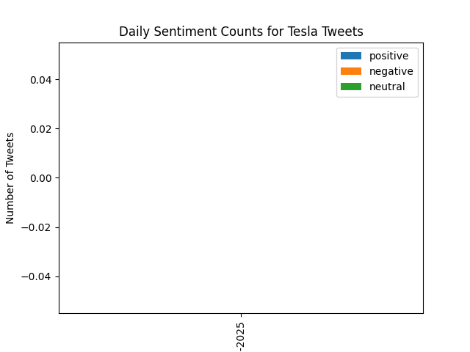
Daily Sentiment Counts for Tesla Tweets

Slide 9
Deliverables
✅ Python script for processing and logging tweets
✅ Cleaned and labeled dataset
✅ Daily sentiment summary CSV
✅ Summary visualization
⚠️ Tableau dashboard planned (pending API access)

Slide 10
Challenges & Resolutions
Twitter API issues → Used manual tweet collection
Noisy tweets → Cleaned using NLTK
Data upload failures → Solved with retry logic (Tenacity)

Slide 11
Conclusion & Future Work
Simulated real-time tracking using manual data
Foundation ready for real-time stream once API access resumes
Next: Tableau dashboard, multilingual sentiment

