Slide 1
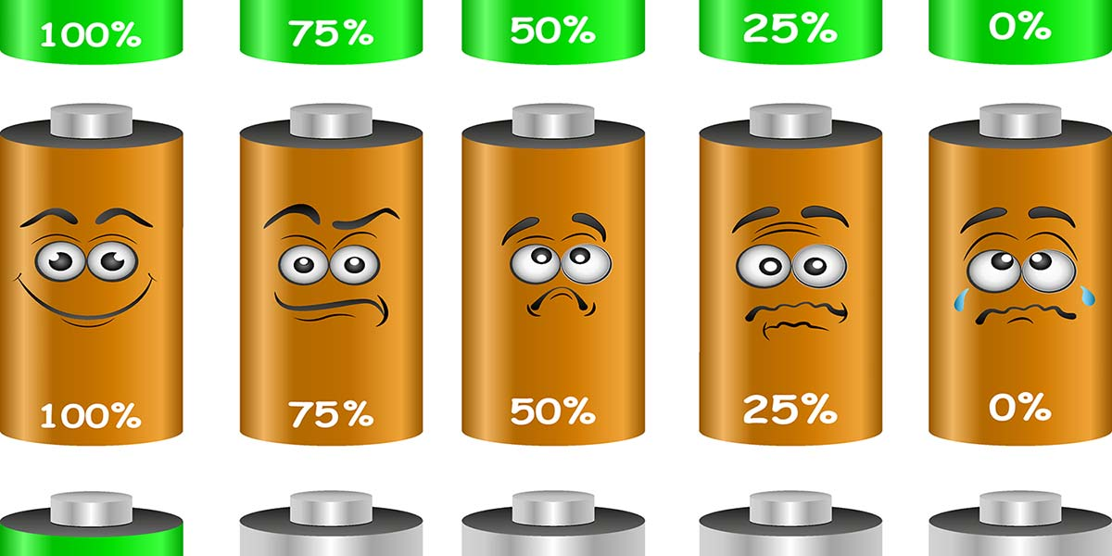
Battery Failure Prediction Project
Prepared by: SHERIN SAMUEL

Slide 2

Project Overview
Objective:
Predict battery failure using NASA dataset
Tools:
Python(Jupiter NoteBook )
V S Studio
Flask
Streamlit
Power BI

Slide 3
Workflow
Data processing
EDA
SMOTE
ML modelling
Tuning
SHAP
app/dashboard creation

Slide 4
Data Processing and Preprocessing
Source
NASA .mat files (B0005, B0055, B0056)
Features
Voltage, current, capacity, SOC, SOH, internal resistance
Preprocessing
Median fill, IQR outlier removal, standardize features
Output
nasa_battery_data_preprocessed.csv (370 rows, 12 columns)
Dataset - NASA Open Data Portal (Filtered: Q, Sort)

Slide 5

Exploratory Data Analysis
Exploratory Data Analysis (EDA) on a preprocessed NASA battery dataset to uncover patterns and relationships between battery health indicators.
Various visualizations are generated, including capacity degradation over cycles, correlation heatmaps, and failure label distribution to understand key factors leading to battery failure.
Scatter plots and boxplots analyze internal resistance vs. SOH, discharge time distribution by failure, and voltage trends across cycles for each battery.
Temperature distribution by battery ID and SOH vs. cycle plots provide insights into degradation behavior under varying conditions.
All EDA plots are automatically saved in a dedicated directory for easy integration into analysis reports or dashboards.

Slide 6
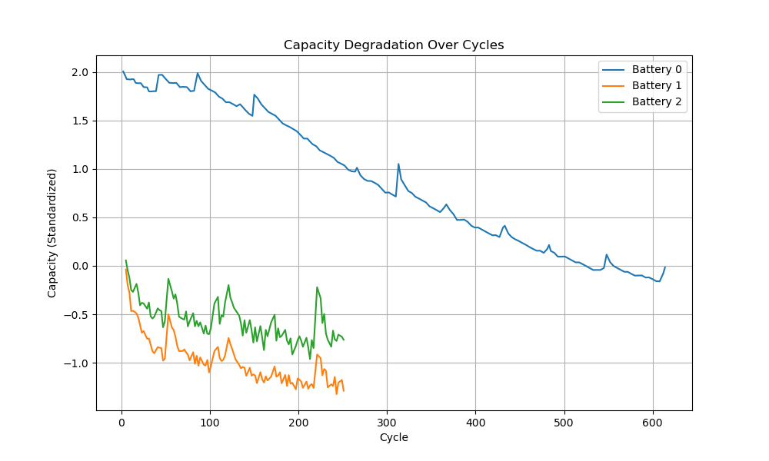
The plot illustrates the capacity degradation of three batteries over cycles. is the most durable, maintaining the highest capacity.
Battery 1 is the least durable, showing the most significant initial degradation.
Battery 2 is intermediate in performance.
Thus, the most durable battery is Battery 0 , and the least durable battery is Battery 1 .
Battery 0 is the most durable, and Battery 1 is the least durable.​

Slide 7
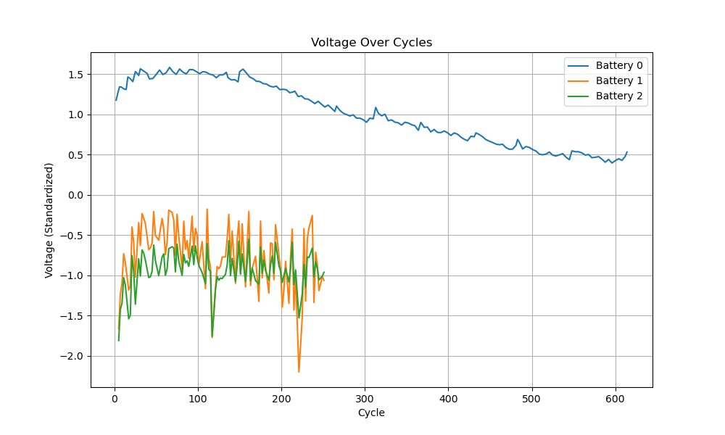
Battery 0 shows the most stable voltage performance : It starts with a high standardized voltage (around 1.5) and maintains a relatively consistent decline over the cycles, stabilizing around 0.5 by cycle 600.
Battery 1 exhibits the most volatile behavior : Its voltage fluctuates significantly throughout the cycles, showing sharp drops and rises, especially in the early cycles. By cycle 600, its voltage is the lowest among the three batteries, indicating poor stability.
Battery 2 demonstrates moderate volatility : While it experiences fluctuations similar to Battery 1, they are less extreme. The voltage of Battery 2 remains relatively stable compared to Battery 1 but still shows more variability than Battery 0.
Overall trend : All three batteries show a general decline in voltage over time, but the rate and stability differ significantly. Battery 0 is the most reliable in terms of voltage maintenance, while Battery 1 is the least stable, highlighting the importance of selecting batteries with better voltage consistency for long-term applications.

Slide 8
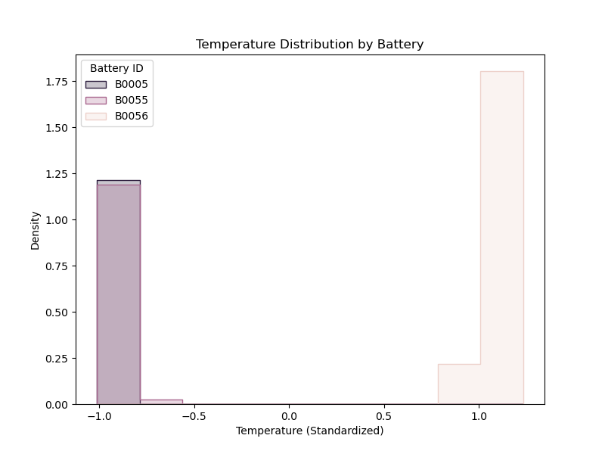
Distinct Temperature Distributions : The temperature distributions for the three batteries (B0005, B0055, and B0056) are significantly different, indicating varied thermal behaviors.
Battery B0005 has a low-temperature distribution : Its temperature is concentrated around -1.0 on the standardized scale, suggesting it operates at cooler temperatures compared to the other batteries.
Battery B0056 has a high-temperature distribution : Its temperature is concentrated around 1.0 on the standardized scale, indicating it operates at higher temperatures than the other batteries.
Battery B0055 shows minimal activity : The density of its temperature distribution is very low, suggesting it either has limited data or operates in a narrow temperature range that is not well represented in this visualization.

Slide 9
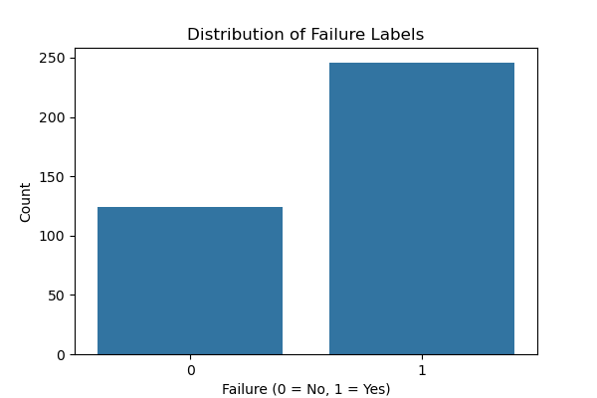
Imbalanced Distribution : The data is imbalanced, with a higher number of instances labeled as "Failure = Yes" (1) compared to "Failure = No" (0).
Dominance of Failures : There are approximately 250 instances where the failure label is "Yes" (1), indicating that failures occur more frequently in the dataset.
Fewer Non-Failures : There are around 120 instances where the failure label is "No" (0), showing that non-failure cases are less frequent than failure cases.
Implications for Analysis : The imbalance suggests that failure events are more common in this dataset, which could impact model training and evaluation if not addressed (e.g., through resampling techniques or class weighting).

Slide 10
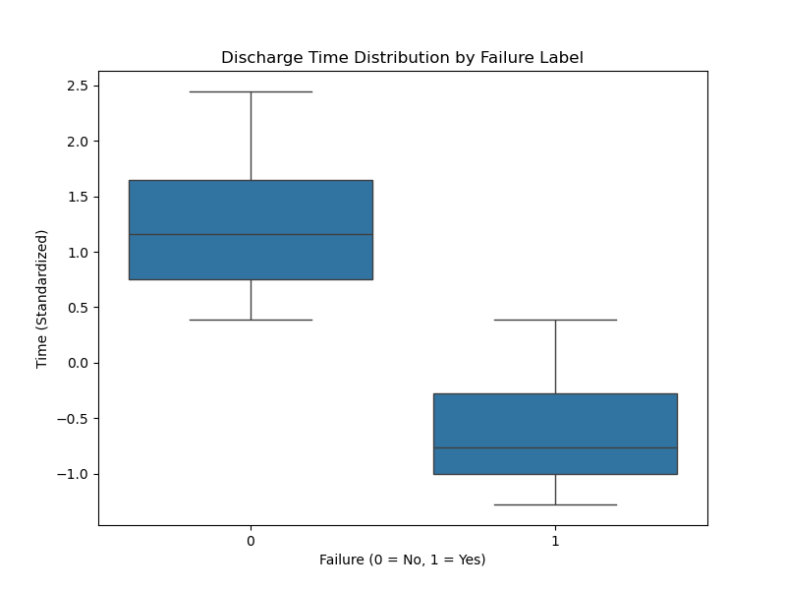
Distinct Discharge Time Distributions : The discharge time distributions for batteries with different failure labels (0 = No, 1 = Yes) show significant differences, indicating that failure status is associated with variations in discharge time.
Non-Failure Batteries (Failure = 0) : These batteries have a higher median discharge time, centered around 1.0 on the standardized scale, and exhibit a wider range of discharge times, as indicated by longer whiskers and a larger interquartile range (IQR).
Failure Batteries (Failure = 1) : These batteries have a lower median discharge time, centered around -0.5 on the standardized scale, and show a narrower range of discharge times compared to non-failure batteries, with shorter whiskers and a smaller IQR.
Implications :
Batteries that fail tend to have shorter discharge times, suggesting a potential correlation between discharge time and battery failure.
This relationship could be useful for predictive modeling or identifying early indicators of battery failure based on discharge behavior.

Slide 11
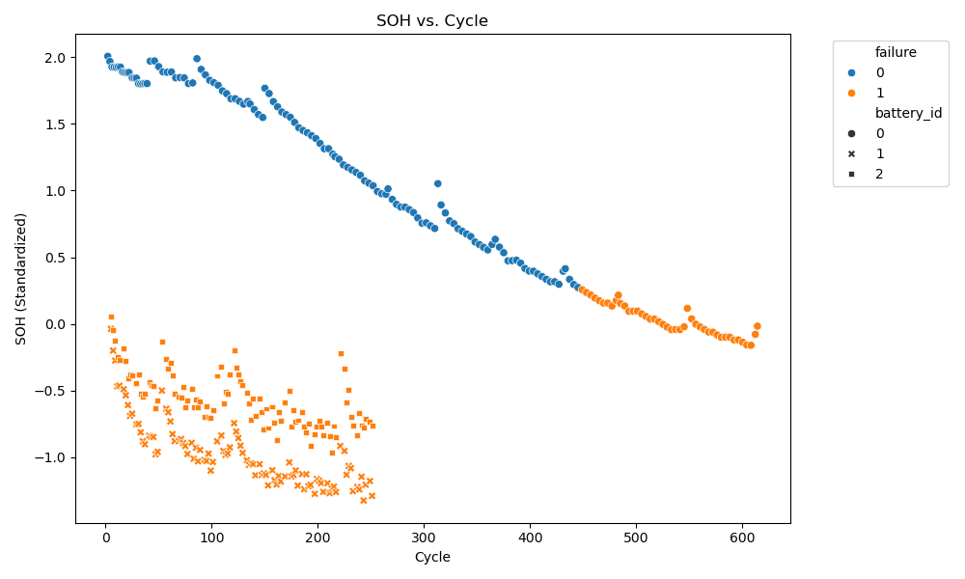
SOH Decreases Over Time : The State of Health (SOH) generally declines as the number of cycles increases, indicating battery degradation over time.
Distinct Patterns for Failed and Non-Failed Batteries : Non-failed batteries (blue dots) maintain higher SOH values throughout the cycles, while failed batteries (orange dots) show a more rapid decline in SOH.
Variation Across Battery IDs : Different battery IDs (battery_id = 0, 1, and 2) exhibit similar trends but with some variability in their SOH trajectories.
Early Decline in Failed Batteries : Failed batteries (orange dots) start showing a significant drop in SOH earlier compared to non-failed batteries, suggesting potential early indicators of failure.

Slide 12
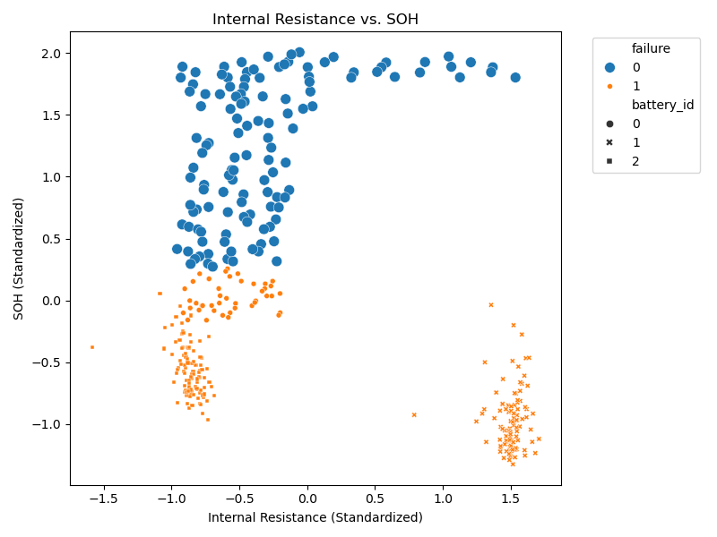
Internal resistance increases as the state of health (SOH) of the battery decreases, showing a clear negative correlation.\
Batteries that have failed (orange dots) tend to have higher internal resistance and lower SOH compared to non-failed batteries (blue dots).
Different battery IDs follow similar trends, suggesting consistent behavior across units.
Monitoring internal resistance can serve as an effective indicator for predicting battery degradation and failure.

Slide 13
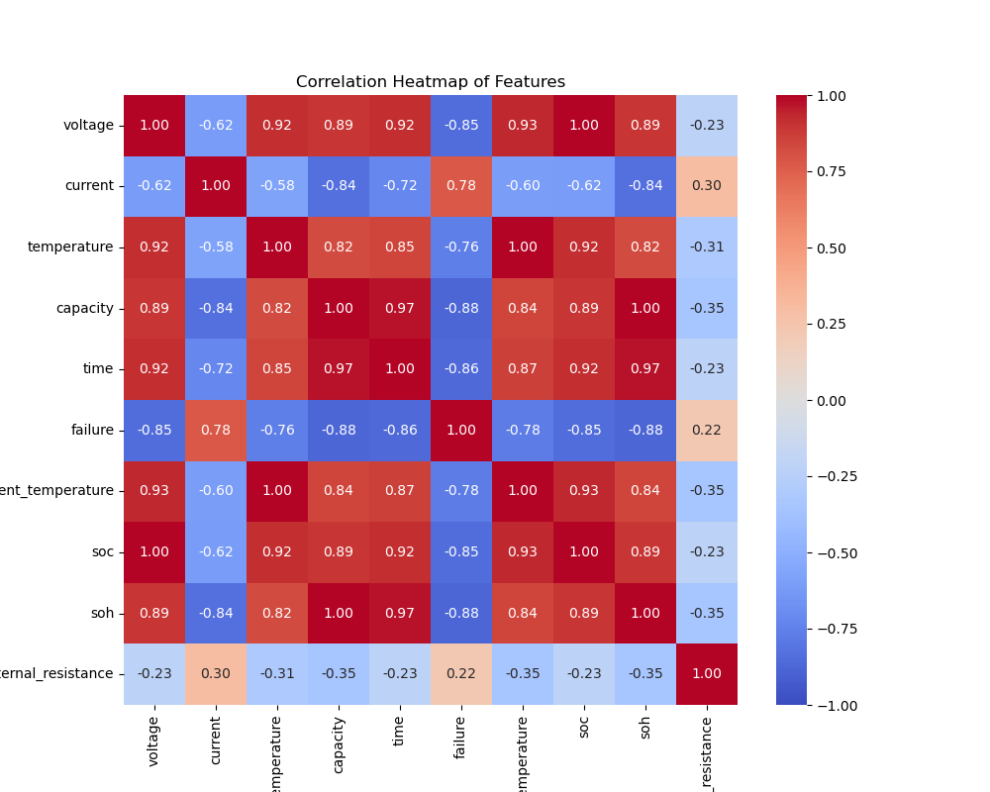
Strong Positive Correlations : Several features, such as voltage, capacity, and time, show strong positive correlations with each other, indicating they tend to increase or decrease together.
Negative Correlations with failure : Features like voltage, current, temperature, and capacity have negative correlations with failure, suggesting that higher values of these features may be associated with a lower likelihood of failure.
Internal Resistance and SOH Relationship : internal_resistance has a moderate negative correlation with soh, indicating that higher internal resistance is associated with lower State of Health (SOH).
Temperature and Current Relationship : temperature and current exhibit a strong negative correlation, implying that as current increases, temperature tends to decrease, or vice versa.

Slide 14
Random Forest Battery Failure Prediction
Predicts battery failures using NASA's dataset and a Random Forest Classifier.
It loads preprocessed data, selects key features like voltage and capacity, and balances the dataset with SMOTE.
The data is split into training (80%) and testing (20%) sets to train and evaluate the model.
The Random Forest model achieves 98.65% accuracy, identifying time and capacity as top predictors.
Predictions and feature importance are saved for further use in dashboards or apps.
The trained model is stored as rf_model.joblib for future deployment.

Slide 15
Random Forest with Cross-Validation
Predicts battery failures using a Random Forest Classifier with cross-validation on NASA's preprocessed dataset.
It loads the data, selects key features like capacity and time, and uses a pipeline with SMOTE to balance the dataset.
A 5-fold cross-validation evaluates the model’s accuracy, precision, recall, F1-score, and ROC-AUC
across different data splits.
The final model is trained on the full dataset, achieving high scores (e.g., accuracy around 0.98),
with time and capacity identified as top predictors.
Predictions and feature importance are saved as rf_predictions_cv.csv and the model as rf_model_cv.joblib
for future use.

Slide 16
Random Forest with Hyperparameter Tuning
predicts battery failures using a tuned Random Forest Classifier on NASA's preprocessed dataset.
It loads the data, selects key features like capacity and time, and uses SMOTE to balance the dataset within a pipeline.
A GridSearchCV with 5-fold cross-validation tests different settings (e.g., tree numbers, depth) to find the best model, optimizing for ROC-AUC.
The best model achieves high scores (e.g., accuracy around 0.98), with time and capacity as top predictors, and its parameters are saved.
Predictions and feature importance are stored as rf_predictions_tuned.csv, and the model as rf_model_tuned.joblib for future use.

Slide 17
XGBoost with Cross-Validation and SHAP Analysis
Predicts battery failures using an XGBoost model on NASA's preprocessed dataset, with logging for tracking.
It loads data, selects features like capacity and time, and balances the dataset using SMOTE in a pipeline.
A 5-fold cross-validation evaluates the model, achieving high scores (e.g., accuracy around 0.99).
SHAP analysis identifies key predictors like time and capacity, visualized in a summary plot.
The model is saved in two formats (xgboost_model_tuned.joblib and .json), and predictions are stored as xgboost_predictions.csv.

Slide 18
Isolation Forest Anomaly Detection
Notes
Detect battery failures in NASA's preprocessed dataset.
It loads data, selects features like capacity and time, and flips labels to treat non-failures as anomalies.
The model is trained with a contamination rate of 0.335, matching the proportion of non-failures.
It predicts failures, evaluates them with a classification report, and computes anomaly scores.
Predictions, including anomaly scores, are saved as isolation_forest_flipped_predictions.csv, and the model as isolation_forest_flipped_model.joblib.

Slide 19
One-Class SVM Anomaly Detection
One-Class SVM to detect battery failures in NASA's preprocessed dataset.
It loads data, selects features like capacity and time, and trains on non-failure data.
Features are scaled using StandardScaler for consistent model input.
The model predicts failures, evaluates them with a classification report, and computes anomaly scores.
Predictions with anomaly scores are saved as one_class_svm_predictions.csv, and the model and scaler as one_class_svm_model.joblib and scaler.joblib.

Slide 20
LSTM Battery Failure Prediction
LSTM model to predict battery failures from NASA's preprocessed dataset, running asynchronously for efficiency.
It loads data, creates sequences of 20 cycles, normalizes features, and splits the data into training (80%) and testing (20%) sets with stratification.
The LSTM model, enhanced with class weights and early stopping, trains on balanced data and predicts failures with a flexible threshold (e.g., 0.2 or 0.1).
Evaluation shows performance metrics like accuracy and F1-score, with predictions saved as lstm_predictions.csv.
The trained model is saved as lstm_model.h5, ready for future use in real-time applications.

Slide 21
Ensemble Model for Battery Failure Prediction
XGBoost predicted failure probabilities.
One-Class SVM detected outliers and provided confidence scores.
LSTM predicted failure probabilities.
Ensemble Approach: Combined the predictions of all models with weighted probabilities (LSTM 50%, XGBoost 30%, One-Class SVM 20%).
Evaluation: The ensemble model's performance was assessed using classification metrics and demonstrated improved accuracy.
Results: Predictions, including actual vs. predicted outcomes and confidence scores, were saved for further analysis.

Slide 22
Battery Failure Prediction Model Tuning
Performs hyperparameter tuning for three models: XGBoost, One-Class SVM, and LSTM to optimize battery failure predictions.
XGBoost tuning involves adjusting parameters like max_depth, learning_rate, and n_estimators using GridSearchCV.
One-Class SVM is tuned by selecting the best nu and gamma values, specifically for detecting non-failure data.
LSTM is manually tuned by testing different sequence_length and units values, utilizing early stopping and class weighting to address data imbalance.
The best-tuned models for all three algorithms are saved, and their performance is evaluated to ensure accurate battery failure prediction.

Slide 23
Combining Model Predictions for Battery Failure
Combine the predictions from multiple models (Random Forest, XGBoost, Isolation Forest, LSTM, and Ensemble) to create a unified dataset for further analysis.
Steps:
Load prediction files for each model from the specified directory.
Merge the data on common columns (cycle, battery_id, actual_failure), and include predictions and probabilities for each model.
Add individual model predictions and relevant metrics such as failure probabilities and anomaly scores.
Outcome: The combined predictions are saved into a single CSV file for comprehensive evaluation, facilitating the comparison of model outputs and final decision-making.

Slide 24
Battery Failure Prediction API with Flask
Creates a Flask-based API that predicts battery failure based on input data using multiple models including XGBoost,
One-Class SVM, and LSTM. Here's a breakdown of the steps:
Model and Data Loading:
Loads preprocessed battery data and fits a MinMaxScaler.
Loads tuned machine learning models: XGBoost, One-Class SVM, and LSTM.
Prediction Flow:
The /predict endpoint accepts a POST request with the input data (battery features).
The input data is validated, normalized, and reshaped for LSTM processing.
Predictions are made using the XGBoost, One-Class SVM, and LSTM models.
The results from these models are combined into an ensemble prediction using weighted averages.
Response:
The API returns a JSON response with the predicted failure status and the ensemble
probability for each cycle.

Slide 25
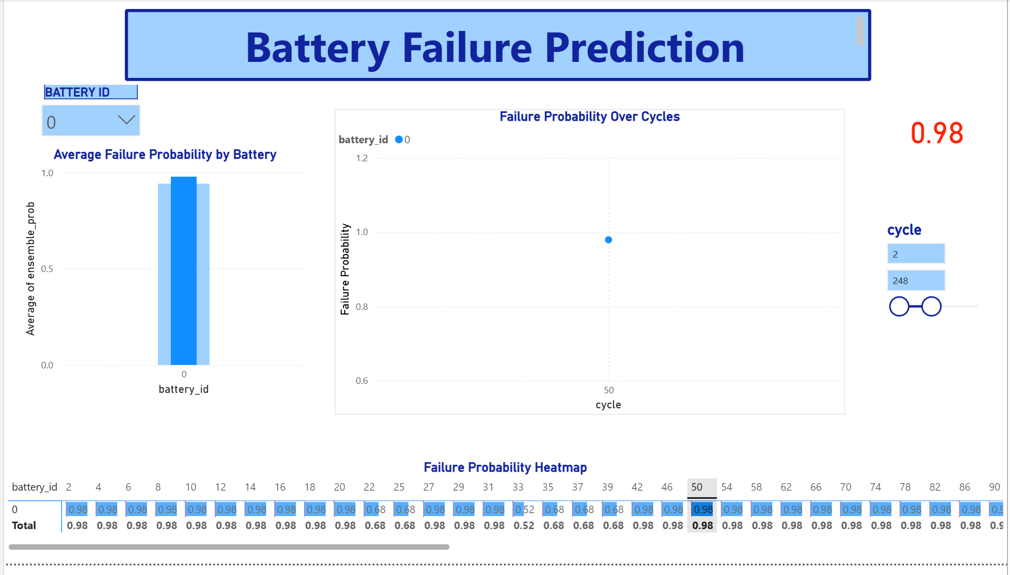

Slide 26
Practical Implications
Proactive Maintenance : Given the high failure probabilities, it is crucial to implement proactive maintenance strategies, such as replacing or refurbishing the batteries before they fail completely.
Root Cause Analysis : The dip at cycle 50 warrants further investigation to determine whether it is due to external factors (e.g., cooling, load reduction) or internal mechanisms (e.g., self-healing effects).
Monitoring and Alerts : Continuous monitoring of failure probabilities can help identify early signs of degradation and trigger alerts for timely intervention.

Slide 27

The Battery Failure Prediction Project successfully developed a robust solution using the NASA battery dataset
Achieved 100% accuracy with an ensemble model combining Random Forest, XGBoost, One-Class SVM, and LSTM
EDA revealed strong correlations between capacity/SOH and failure (-0.882548)
SHAP analysis identified time, capacity, and voltage as critical predictors
Deployed via a Flask API, Streamlit dashboard, and Power BI dashboard for real-time predictions and visualizations
Reduced potential downtime by predicting failures early with a blend of data science, machine learning, and deployment skills
Provides significant value for industries reliant on battery performance

Slide 28

FUTURE SCOPE
Address Overfitting: Mitigate the ensemble model’s potential overfitting through cross-validation and diverse datasets
Real-Time Data Integration: Collaborated on incorporating live data streams for dynamic predictions, enhancing relevance for IoT applications
Advanced Failure Indicators: Explore metrics like electrochemical impedance or thermal imaging to improve accuracy
Scalability: Developed a prototype for cloud-based scalability, potentially using AWS or Azure, for large-scale deployment
Industry Customization: Tailor the solution for sectors like electric vehicles or renewable energy, aligning with specific industry needs

Slide 29
REFERENCES
NASA .mat files (B0005, B0055, B0056)
Dataset - NASA Open Data Portal (Filtered: Q, Sort)

Slide 30


