Slide 1



Software Forum
Software Design Pattern
Date: 12/05/2015
Project Team:
In partnership with

Slide 2
Design Pattern
https://github.com/sherkarsl/ARTC-Design-Pattern.git

Slide 3
Agenda
Revision
What are design patterns? Why should we study them?
List of all design pattern names and categories
Singleton pattern
Command pattern
Decorator pattern

Slide 4
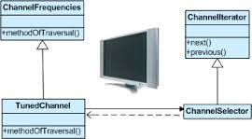
Design Pattern
A Design Pattern systematically names, explains, and implements an important recurring design.
These define well-engineered design solutions that practitioners can apply when crafting their applications.
A solution to a common software problem in a context
example: Iterator pattern
The Iterator pattern defines an interface that declares methods for sequentially accessing the objects in a collection.

Slide 5
More about patterns
A pattern describes a recurring software structure
is abstract from concrete design elements such as problem domain, programming language
identifies classes that play a role in the solution to a problem, describes their collaborations and responsibilities
lists implementation trade-offs
patterns are not code or designs; must be instantiated/applied
the software engineer is required to:
evaluate trade-offs and impact of using a pattern in the system at hand
make design and implementation decision how best to apply the pattern, perhaps modify it slightly
implement the pattern in code and combine it with other patterns

Slide 6
Benefits of using patterns
patterns are a common design vocabulary
allows engineers to abstract a problem and talk about that abstraction in isolation from its implementation
embodies a culture; domain specific patterns increase design speed
patterns capture design expertise and allow that expertise to be communicated
promotes design reuse and avoid mistakes
improve documentation (less is needed) and understandability (patterns are described well once)

Slide 7
Gang of Four (GoF) patterns
Creational Patterns (concerned with abstracting the object-instantiation process)
Factory Method Abstract Factory Singleton
Builder Prototype
Structural Patterns (concerned with how objects/classes can be combined to form larger structures)
Adapter Bridge Composite
Decorator Facade Flyweight
Proxy
Behavioral Patterns (concerned with communication between objects)
Command Interpreter Iterator
Mediator Observer State
Strategy Chain of Responsibility Visitor
Template Method

Slide 8
Singleton Pattern
In many systems, there should often only be one object instance for a given class
Print spooler
File system
Window manager
Device log File
This pattern answers the question: How to design the class such that any client cannot create more than one instance of the class?
The key participants in this pattern are:
The Singleton, the class which only allows one instance to be created

Slide 9
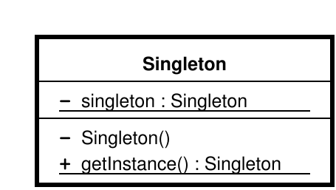
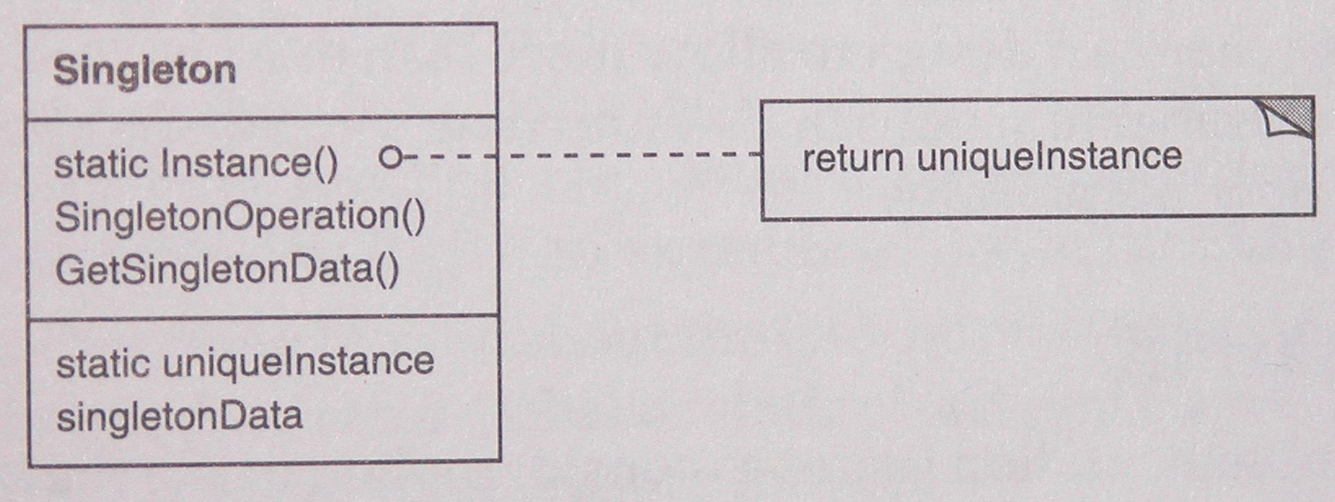
Class Diagram
Class referenced to itself
Private Constructor
Method to return single instance of object

Slide 10
Code Snippet
class Singleton
{
public:
// method to get instance of object
static Singleton* GetInstance();
int a;
~Singleton() { cout << "In Dtor" << endl; }
private:
// private constructor for Singleton pattern
Singleton(int _a) : a(_a) { cout << "In Ctor" << endl; }
static Mutex mutex;
// Not defined, to prevent copying
Singleton(const Singleton&);
Singleton& operator =(const Singleton& other);
};
Method to return single instance of object
Private Constructor
Class referenced to itself

Slide 11
Singleton Demo

Slide 12
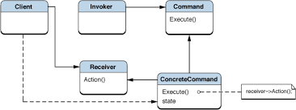
Command pattern
A command - the action to be executed
An invoker - this can be anything starting from a button, a menu or toolbar item up to some callback manager, or a thread pool.
A receiver - this should be the object the command acts upon

Slide 13
Command Implementation
a command - the action to be executed
//only requirement from the command : it should be executable
// interface with a single pure virtual function:
class Command
{
public:
virtual void Execute() = 0;
};
Method to execute command
Receiver
//simple class with single method receiving command
class Receiver
{
public:
//the action to be executed
void Action()
{std::cout << "Command received" << std::endl;}
}
Method to do some action using receiver class

Slide 14
Command Implementation
/ invoker to invoke the command
class Invoker
{
Command *m_command;
public:
Invoker(Command *cmd = 0) : m_command(cmd)
{
}
//SetCommand() function which lets to bind another command to the Invoker at run-time
void SetCommad(Command *cmd)
{m_command = cmd;}
void Invoke()
{
// yoda notation
if (0 != m_command)
{m_command->Execute();}
}
};
Referencing command to invoker

Slide 15
Command Demo

Slide 16
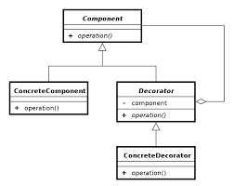
Decorator
Attach additional responsibilities to an object dynamically.
Decorators provide a flexible alternative to sub-classing to extend flexibility
Commonly known as Wrapper
Motivation
Want to add properties to an existing object.
3 Examples
Add borders or scrollbars to a GUI component
Add headers and footers to an advertisement
Add stream functionality such as reading a line of input or compressing a file before sending it over the wire

Slide 17
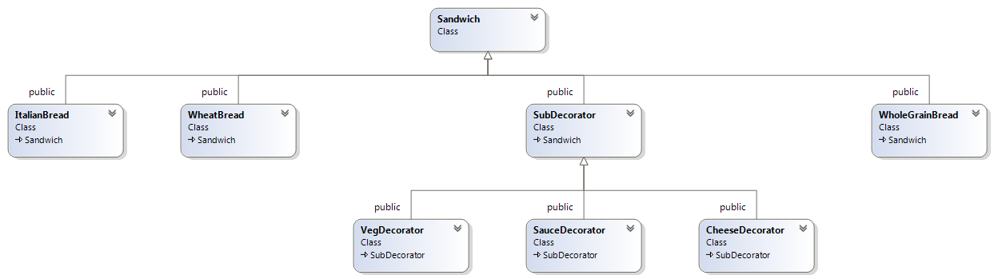
Decorator Example ( Class Diagram)
Base component class – Sandwich
Concrete Component Class – Italian, Wheat and Whole Grain
Base Decorator class – Sub Decorator
Concrete Decorator Class – Veg, Sauce and Cheese Grain

Slide 18
Decorator Implementation
Concrete Component Bread
Component Class for Sandwich
/*Concrete component class*/
class WheatBread :public Sandwich
{
public:
WheatBread() {
}
~WheatBread() {
}
std::string getDesc()
{
return "Wheat Bread";
}
double getCost()
{
return 2.0;
}
};
/*Base component class*/
class Sandwich
{
public:
virtual ~Sandwich() { }
virtual double getCost() = 0;
virtual std::string getDesc() = 0;
};

Slide 19
Decorator Implementation
Concrete Sub decorator
Sub decorator
/*Decorator Base class*/
class SubDecorator : public Sandwich
{Sandwich *sandwich;
public:
SubDecorator(Sandwich *sandwichRef)
{
sandwich = sandwichRef;
}
~SubDecorator() {
delete sandwich;
}
double getCost()
{
return sandwich->getCost();
}
std::string getDesc()
{return sandwich->getDesc();}
};
/*Decorator concrete class*/
class CheeseDecorator :public SubDecorator
{
private:
std::string cheese_desc()
{return " + Cheese";}
double cheese_cost;
public:
CheeseDecorator(Sandwich *sandwich) :SubDecorator(sandwich)
{
cheese_cost = 3.0;
}
~CheeseDecorator() {}
std::string getDesc()
{returnSubDecorator::getDesc().append(cheese_desc());}
double getCost()
{return SubDecorator::getCost() + cheese_cost;}
};

Slide 20
Revision

Slide 21
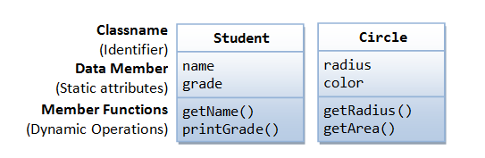
Class
Class: A class is a definition of objects of the same kind.
It defines and describes the static attributes and dynamic behaviours common to all objects of the same kind.
Instance: An instance is a realization of a particular item of a class; In other words, an instance is an instantiation of a class

Slide 22
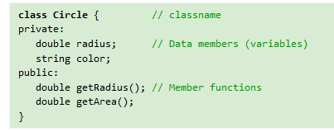
Class Implementation
A class is a programmer-defined, abstract, self-contained, reusable software entity that mimics a real-world thing.
A class is a 3-compartment box containing the name, data members (variables) and the member functions.
A class encapsulates the data structures (in data members) and algorithms (member functions). The values of the data members constitute its state. The member functions constitute its behaviors.
An instance is an instantiation (or realization) of a particular item of a class.

Slide 23
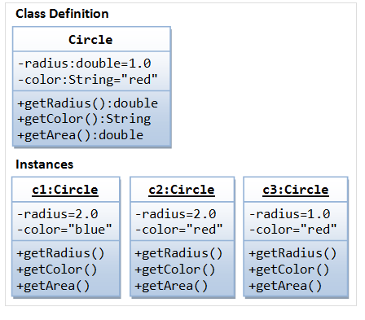
Class Instance
// Construct a Circle instance
Circle c1(1.2, "blue");
cout << "Radius=" << c1.getRadius() << " Area=" << c1.getArea()
<< " Color=" << c1.getColor() << endl;
// Construct another Circle instance
Circle c2(3.4); // default color
cout << "Radius=" << c2.getRadius() << " Area=" << c2.getArea()
<< " Color=" << c2.getColor() << endl;
// Construct a Circle instance using default no-arg constructor
Circle c3; // default radius and color

Slide 24
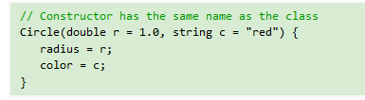
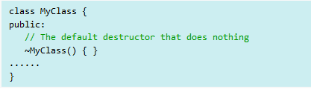
Constructor and Destructor
A constructor is a special function that has the function name same as the classname. In the above Circle class, we define a constructor as follows:
A destructor, similar to constructor, is a special function that has the same name as the classname, with a prefix ~, e.g., ~Circle(). Destructor is called implicitly when an object is destroyed

Slide 25
Class Demo

Slide 26
Object Oriented Design
Modern object-oriented (OO) languages provide 3 capabilities:
encapsulation
inheritance
polymorphism
Improve the design, structure and reusability of code.

Slide 27
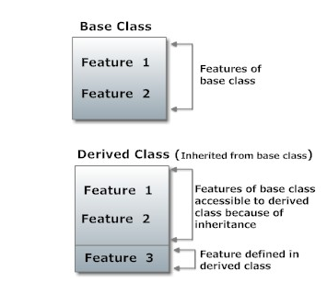
Inheritance
Inheritance is one of the key feature of object-oriented programming including C++ which allows user to create a new class(derived class) from a existing class(base class)

Slide 28
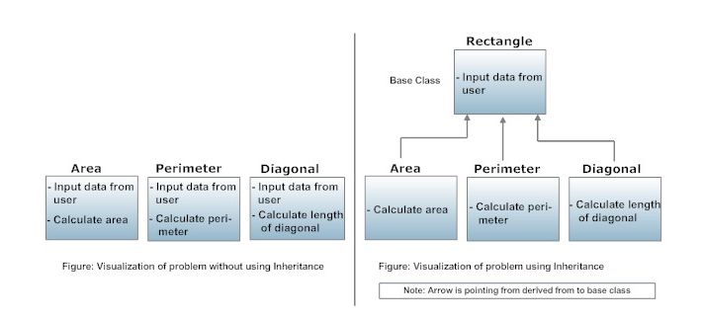
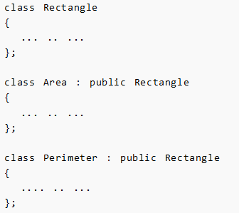
Inheritance

Slide 29
Inheritance Demo

