Slide 1
Secure File Exchange Portal
CSS 519 A – Incident Response and Risk Management
Sherkhan Zakiryanov
Notes:
Hello everyone. My name is Sherkhan. Today, I’m going to show you my project: the Secure File Exchange Portal.

Slide 2
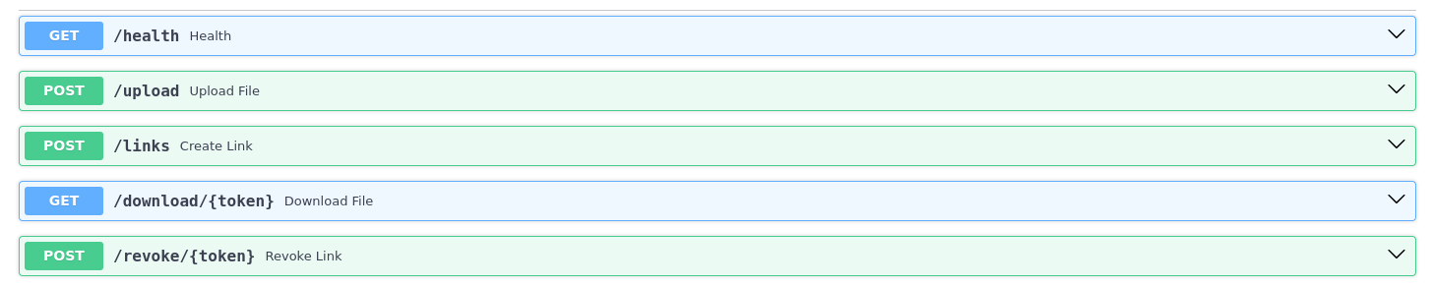
What Is This Product?
API service for temporary file sharing
Built with FastAPI (Python), SQLite, Docker
5 endpoints
Notes:
This project is a REST API for temporary file sharing. A user uploads a file, gets a download token, and sends the link. The recipient uses that token to download the file.
It is built with FastAPI in Python, uses SQLite for logs, and runs in Docker. As you can see, it has five simple endpoints.

Slide 3
Why This Product?
→ Simple to build in one quarter
→ Real attack vectors to test
→ Easy to make intentionally vulnerable
→ File sharing — everyone understands it
Notes:
I chose this product for practical reasons.
First — it's simple to build. No complex business logic. I could focus on the security side, not the application side.
Second — it has real attack vectors like authentication gaps, unrestricted uploads, and token enumeration. All testable with real tools.
I think, File sharing is something everyone understands. That made it easy to explain — and easy to break.

Slide 4
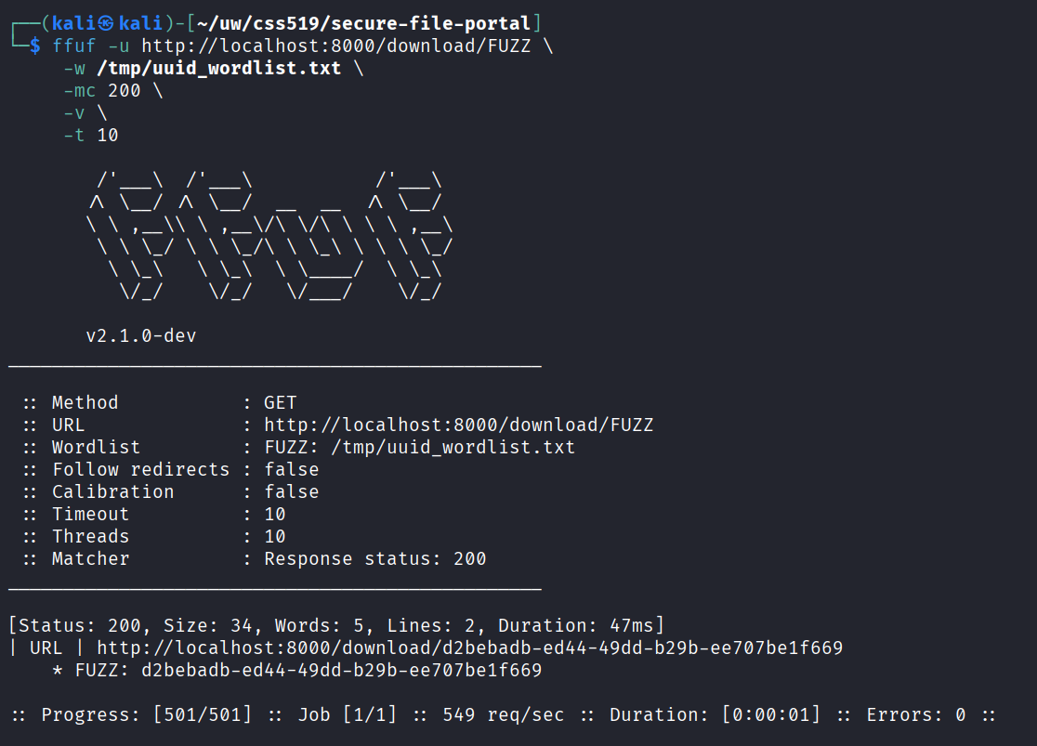
Risk 1: Unauthenticated Download (IDOR)
❌ /download/{token} has no authentication
❌ No rate limiting
❌ Token valid for unlimited downloads
Proved with fuzzing tool (ffuf): 549 req/sec, 0 errors
Notes:
Now, let's look at the Top 3 Risks from my threat model.
Risk number one — and the most critical — is an IDOR vulnerability.
The download endpoint — has no authentication. Anyone with a token can download the file. No login. No check.
And there is no rate limiting. For example, I used a fuzzing tool called fuff to test this. The server allowed over five hundred requests per second without blocking me.
I believe this is a top risk because an attacker can easily brute-force tokens and gain access to sensitive files.

Slide 5
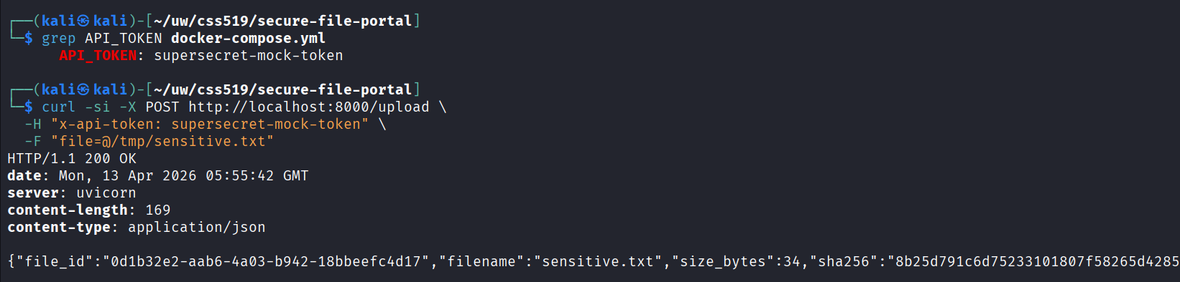
Risk 2: Hardcoded API Token
❌ Token in plaintext in docker-compose.yml
❌ Committed to GitHub — permanent exposure
❌ One token for all users — no attribution
Notes:
Risk number two - is a hardcoded API token.
The API password is written in plaintext in the docker-compose file. And this file is on GitHub. So the password is public.
This is a top risk for two reasons.
First, anyone who finds it has full control over the system.
Second, because all users share one token, logs become blind. If an attack happens, there is no accountability. We cannot trace who did it.

Slide 6
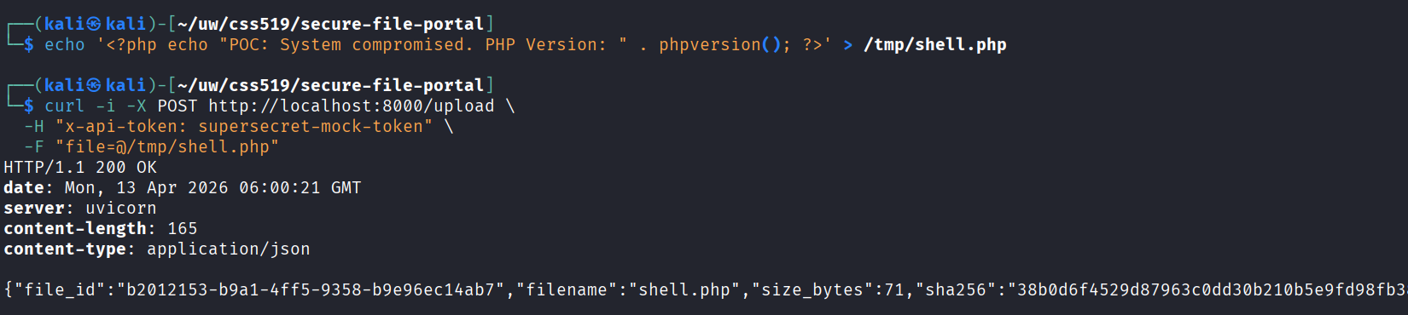
Risk 3: Unrestricted File Upload
❌ No file type validation
❌ .php, .sh, .exe — all accepted
Full attack chain: upload → share link → deliver malware
Notes:
My final top risk - is Unrestricted File Upload.
The upload endpoint has no validation for file types. A user can upload any file, including bash or PHP scripts.
This is a critical top risk for two main reasons.
First, attackers can use it to distribute malware. They can upload a virus, create a link, and send it to anyone.
Second, it can lead to Remote Code Execution. A malicious script can completely compromise the server.

Slide 7
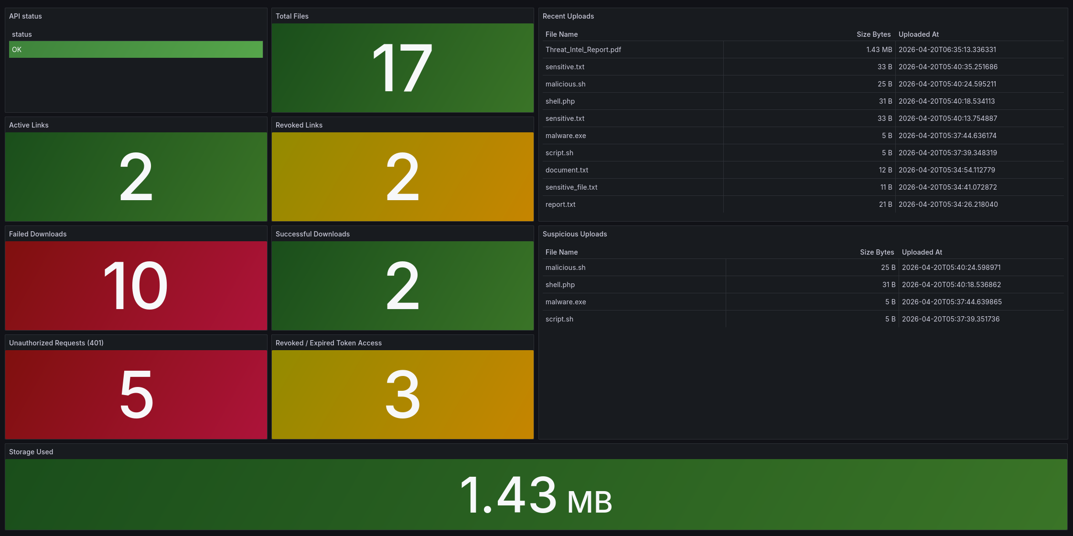
OE Dashboard: FastAPI → SQLite audit_log → Grafana
Notes:
Now let me show you my OE Dashboard.
First — API status. If it's green, the service is running.
Every event in the API — upload, download, failed attempt — is written to a SQLite table called audit_log. Grafana reads that table and shows it in real time.
The red Failed Downloads panel — if this number spikes, someone is running token enumeration. That's Risk 1 in action
The last 10 uploaded files — you can see filenames, file sizes, and timestamps.
And below that — Suspicious Uploads. Any row here means someone uploaded a .php, .sh, or .exe file. This is how I detect malicious file uploads in real time.
At the bottom — storage used. My limit is 20 megabytes. At 19 megabytes — it shows red. That's how I know when storage is almost full.

Slide 8
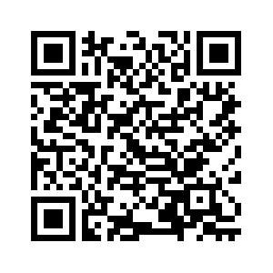
Secure File Exchange Portal
Thank you
github.com/sherkhanz/secure-file-exchange-portal
Notes:
That's my presentation.
The full project — code, threat model, security testing — is on GitHub. You can scan the QR code here.
Thank you.
1. Why did you choose SQLite instead of a real database like PostgreSQL?
SQLite is simple to run in Docker — no extra container needed. For a POC project with one user, it's fine. In production I would switch to PostgreSQL.
2. How would you fix the IDOR vulnerability?
Add Depends(require_auth) to the download endpoint. One line of code. I also need rate limiting — maximum 5 requests per minute per IP.
3. If the API token is already on GitHub, isn't the system already compromised?
Yes — that's exactly the point. This is an intentionally vulnerable system for security analysis. In production, the token would be in Docker Secrets, not in the config file.
4. How does Grafana get data from SQLite?
I use a plugin called frser-sqlite-datasource. Grafana mounts the same Docker volume as the API — read-only. Then I write SQL queries directly in Grafana panels.
5. What happens if someone uploads a 1GB file?
The API rejects it. There is a hard limit — 20 megabytes — set in docker-compose.yml. Anything bigger returns HTTP 413.
6. Can the PHP webshell actually execute on your system?
No — not in the current setup. FastAPI serves it as a download, not as a script. But if someone puts an nginx or Apache server in front of the files folder — it becomes remote code execution.
7. How is this different from just using Google Drive with an expiry link?
Google Drive doesn't give you full audit logs, programmatic revocation via API, or the ability to build intentional vulnerabilities for security testing. This is a controlled environment.
8. What would you do first if Failed Downloads spiked to 100?
First — check the audit log to confirm it's enumeration. Then block at the network level. Then add rate limiting to the download endpoint. Then rotate all active tokens.
9. Why is there no HTTPS?
It's a known gap — listed as Threat 5 in my threat model. The fix is an nginx reverse proxy with TLS in a separate container. Out of scope for this version.
10. What would you build next if you had more time?
Three things — add authentication to the download endpoint, move the API token to Docker Secrets, and add rate limiting with slowapi. These are the P0 items in my remediation roadmap.

