Slide 1
C300 FINAL EVALUATION
Team ID:
SOI-2024-2420-0006
Team Members:
1. Mohammed Adil Shah
2. Hanun Fathima Esa
3. Jayanth Menon
4. Skariya Benny
Project ID:
SOI-2024-2420-0006
Project Title:
[IP] Impact Calculator and Reduce Food Wastage App

Slide 2
INTRODUCTION
Food waste is a growing global issue. Studies show that households contribute significantly to food wastage due to poor grocery management, inefficient meal planning, and a lack of awareness about sustainability.
THE IMPACT CALCULATOR & FOOD WASTAGE APP This project is designed to help young homeowners in their 30s to 40s reduce food waste, lower grocery spending, and adopt sustainable food habits by making food management simpler and more habitual

Slide 3
PROJECT PARTNERS:
This project is developed in collaboration with the company POTATO PRODUCTIONS and SOH team.
Potato Productions are a group of companies spanning industries, working on new products and ideas to drive change.
The SOH team provided important survey data conducted among locals, to provide insight on user spending, wasting habits.

Slide 4
Our project aims to raise awareness about food waste and sustainability. To encourage cost-saving habits by reducing unnecessary purchases. We have used real time data survey conducted by SOH team to make our application realistic and helpful to our users.

Slide 5
SURVEY DATA

Slide 6
By the survey conducted among young homeowners by SOH team, we were able gather the following data: 80% of the respondents agreed that food wasted leads to financial loss.
76% of respondents check expiration dates before buying food.
Fruits and vegetables (35%) were the most wasted items, followed by dairy products and grains (10-15%).
41% of respondents dispose of food waste 2-3 times per week, while 27% do so daily.

Slide 7
Key Factors Contributing to Food Waste
Top causes of food wastage included:
Over-buying (46%)
Poor meal planning (42%)
Improper food storage (29%)
Not utilizing leftovers (39%)

Slide 8
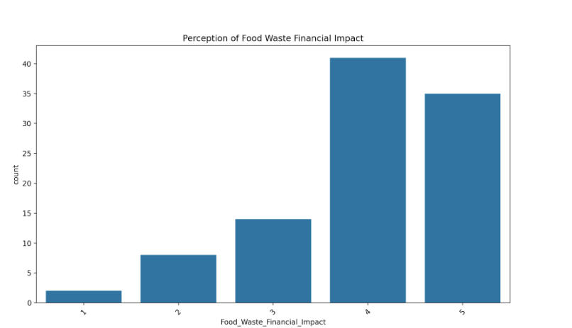
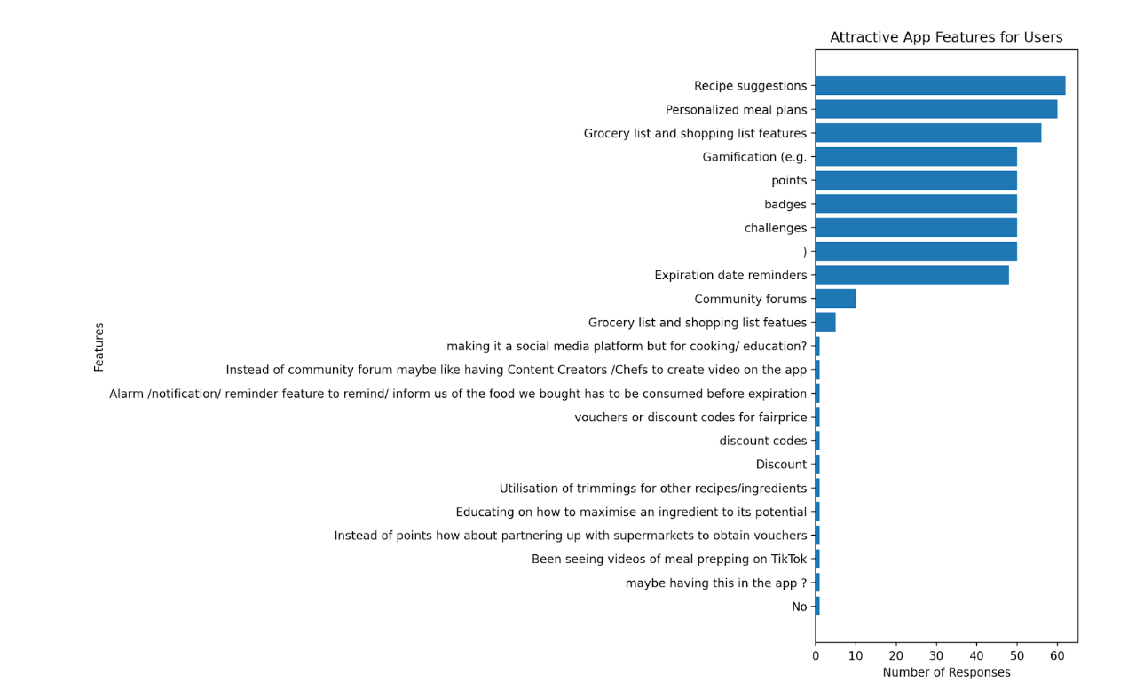
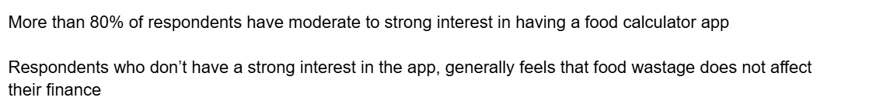

Slide 9
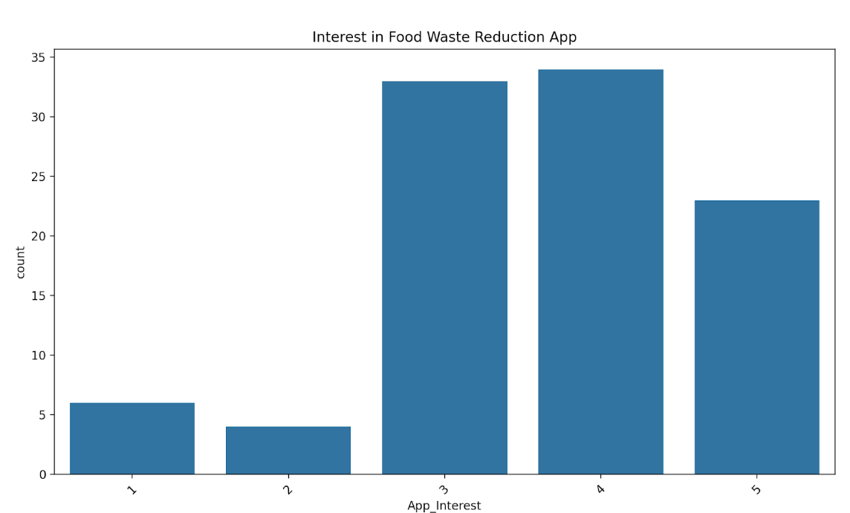
When asked about whether they were interested in an app that could help them reduce food waste, they showed an overwhelming interest.
Hence we created our SUSTAINABLE BAO, catering to the needs of these people.

Slide 10

SUSTAINABLE BAO

Slide 11
Our app focuses these key features:
Smart grocery tracking & expiration alerts
Recipe suggestion based on available inventory
An Impact calculator for tracking waste & savings

Slide 12
Smart Grocery Tracking
Users can log groceries manually
Each grocery item is stored with details like name, category, quantity, purchase date, and expiration date.
The app tracks usage and adjusts inventory in real-time when items are used.
Benefits:
Helps users keep track of what they have.
Reduces duplicate purchases and prevents forgotten items.
Encourages better grocery management, saving money and reducing food waste.

Slide 13
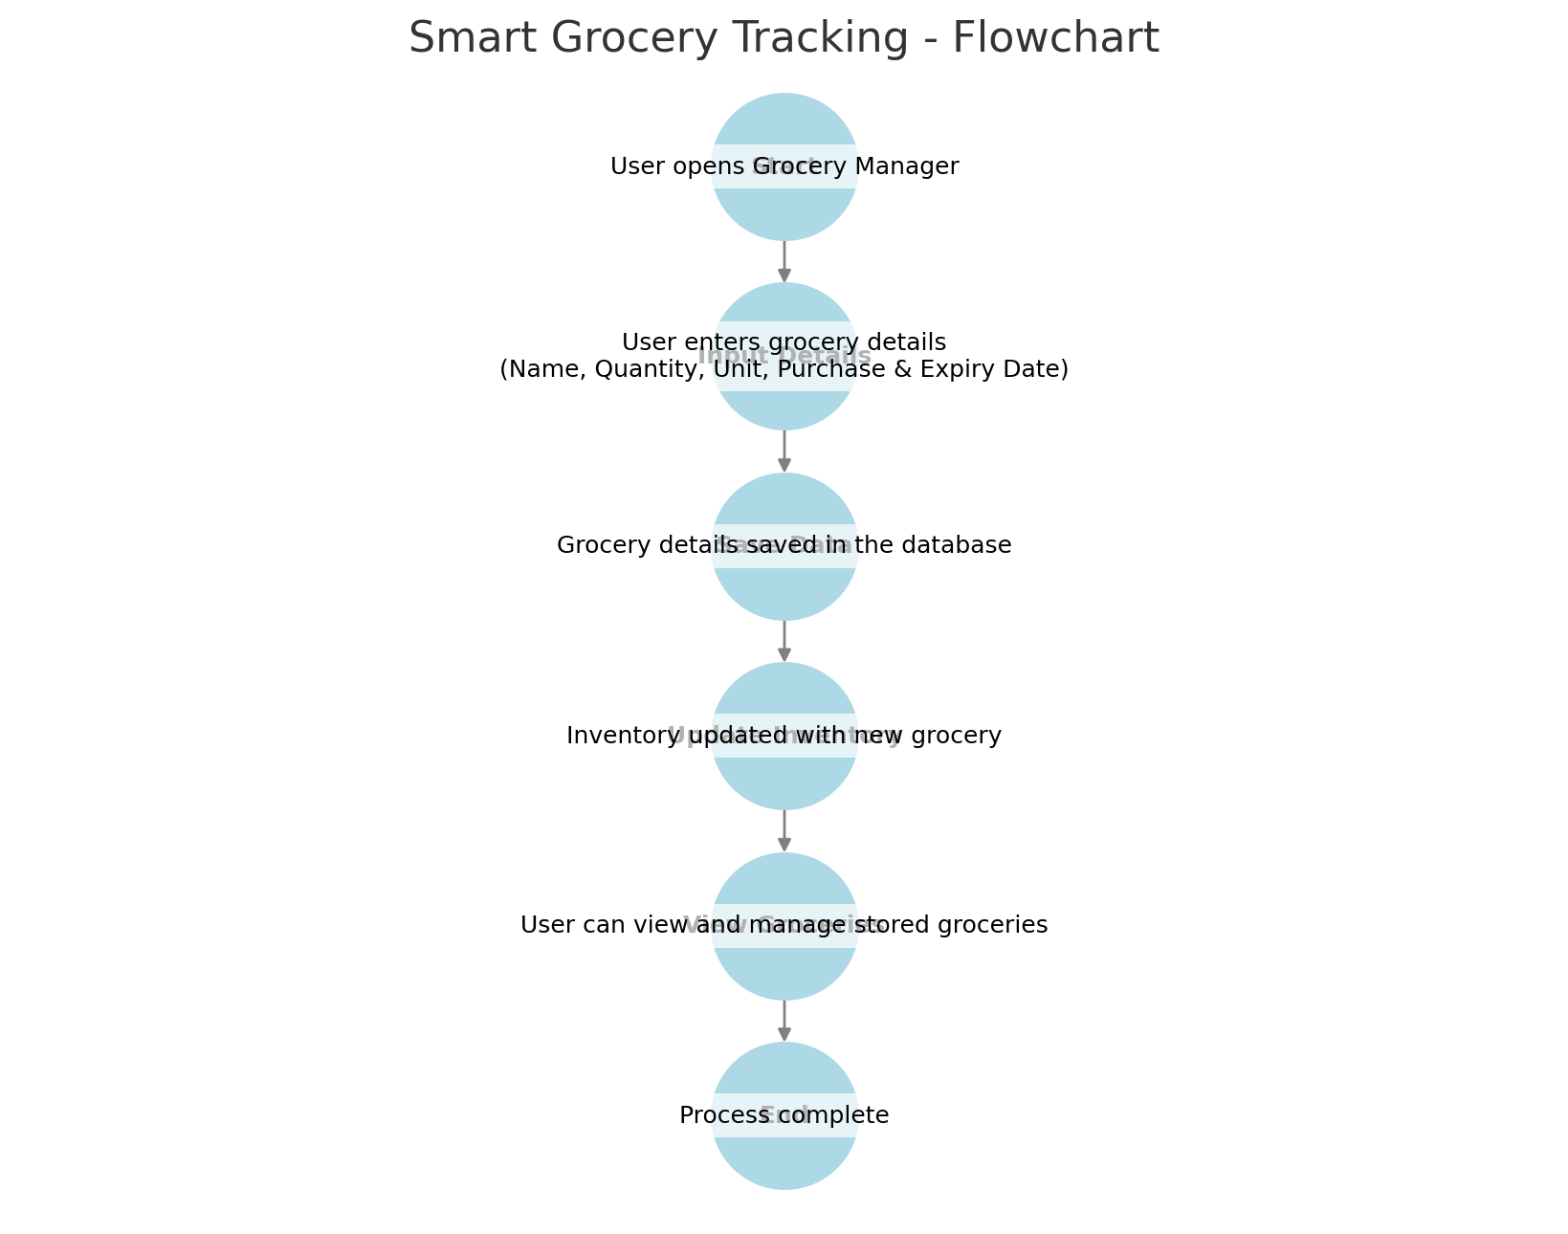

Slide 14
Expiration Alerts
The app calculates expiration dates based on user input Users receive timely notifications (push notifications, emails, or in-app alerts) when an item is close to expiring.
A color-coded system shows "Expiring Soon," and "Expired" categories in the Grocery Manager.
Benefits:
Reduces waste by reminding users before food expires.
Helps in meal planning to prioritize expiring ingredients.

Slide 15
RECIPE SUGGESTION
The app suggests recipes based on available groceries in the inventory.
Recipes display step-by-step instructions, estimated prep time.
Benefits:
Encourages users to cook with available ingredients, reducing food waste.
Saves money by optimizing grocery usage.

Slide 16
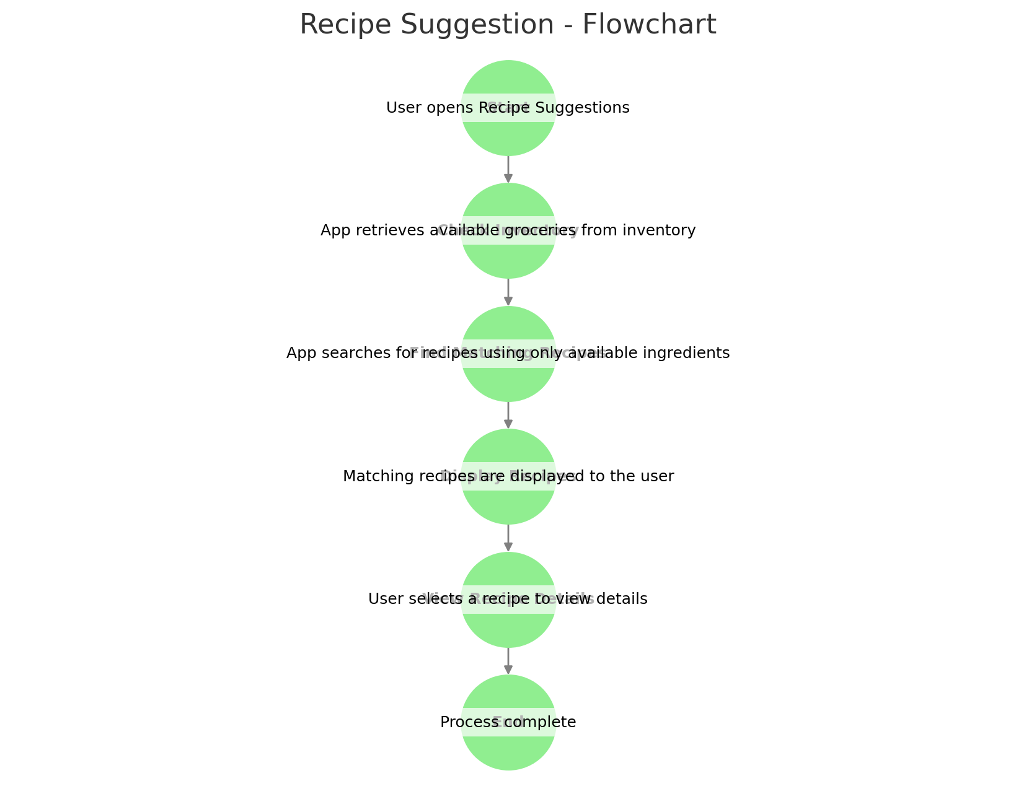

Slide 17
IMPACT CALCULATOR
Users log discarded food items, and the app calculates their waste percentage
Data is visualized using charts.
Benefits:
Raises awareness of the environmental and financial impact of food waste.
Encourages sustainable food habits.

Slide 18
USER STORY

Slide 19
USER MANAGEMENT
As an admin, I want to add a recipe to the website, so that users can access it.
As an user, I want to register an account, so that I can access the app.
As an user , I want to login to my account, so I can browse the functionality of the app.
As an admin, I want to delete user accounts so that I can remove inactive or unauthorized users from the system.

Slide 20
GROCERY MANAGEMENT
As a user, I want to receive reminders about grocery items that are close to their expiration date so that I can use them before they go bad.
As a user, I want to add my grocery, so I can keep track of my inventory accurately.
As a user , I want to access the inventory, so that I can keep track of my grocery list.

Slide 21
RECIPE MANAGEMENT
As a user, I want to receive recipe suggestions based on my available groceries so that I can cook meals without wasting ingredients.
As a user, I want to scale ingredient quantities based on the number of servings I need so that I don’t buy or cook more than necessary.
As a user, I want to view detailed recipe steps, so I can easily follow along while cooking.

Slide 22
CALCULATOR MANAGEMENT
As a user, I want to track the amount of food I waste weekly so that I can monitor my progress in reducing waste.
As a user, I want to receive tips on how to store food properly so that I can extend the shelf life of my groceries.
As a user, I want to view graphs of my food waste statistics, so I can adjust my habits accordingly.

Slide 23
USE CASE DIAGRAM

Slide 24
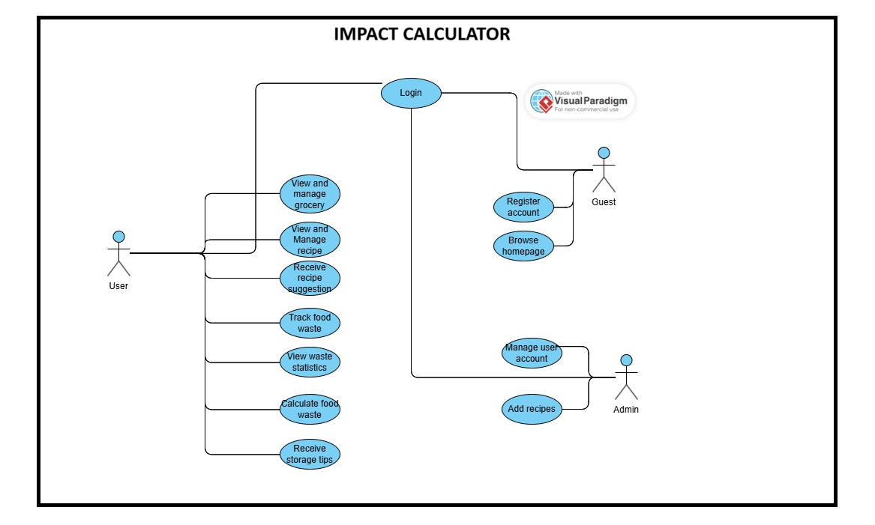
USE CASE DIAGRAM

Slide 25
Process Flow
A guest registers for an account.
The user logs in to access full features.
The user adds grocery items to their list.
The app tracks expiration dates and sends reminders.
The user views recipe suggestions based on available groceries.
The user logs discarded food items in the app.
The system calculates waste impact.
Users can view waste statistics and track progress.

Slide 26
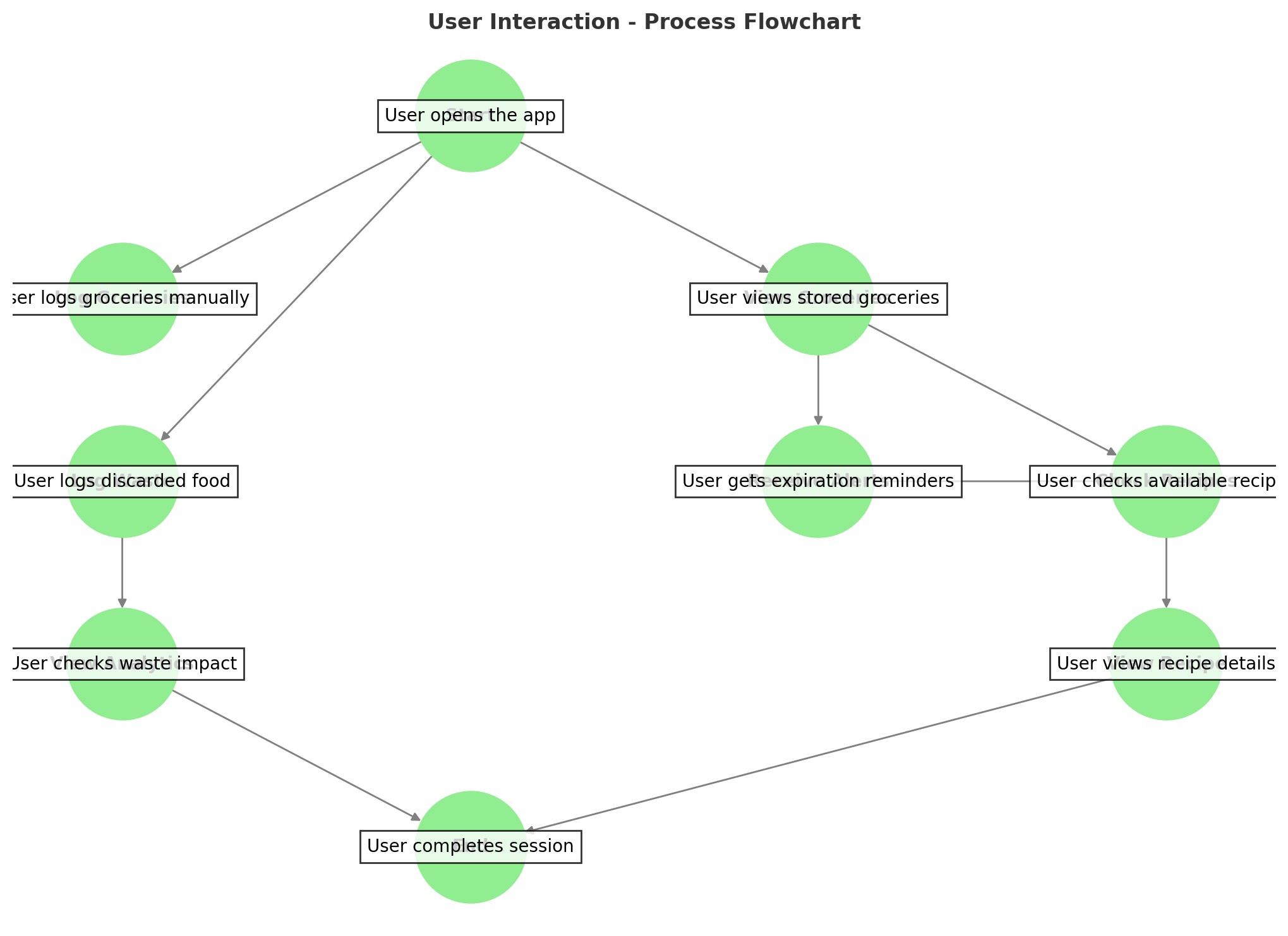

Slide 27


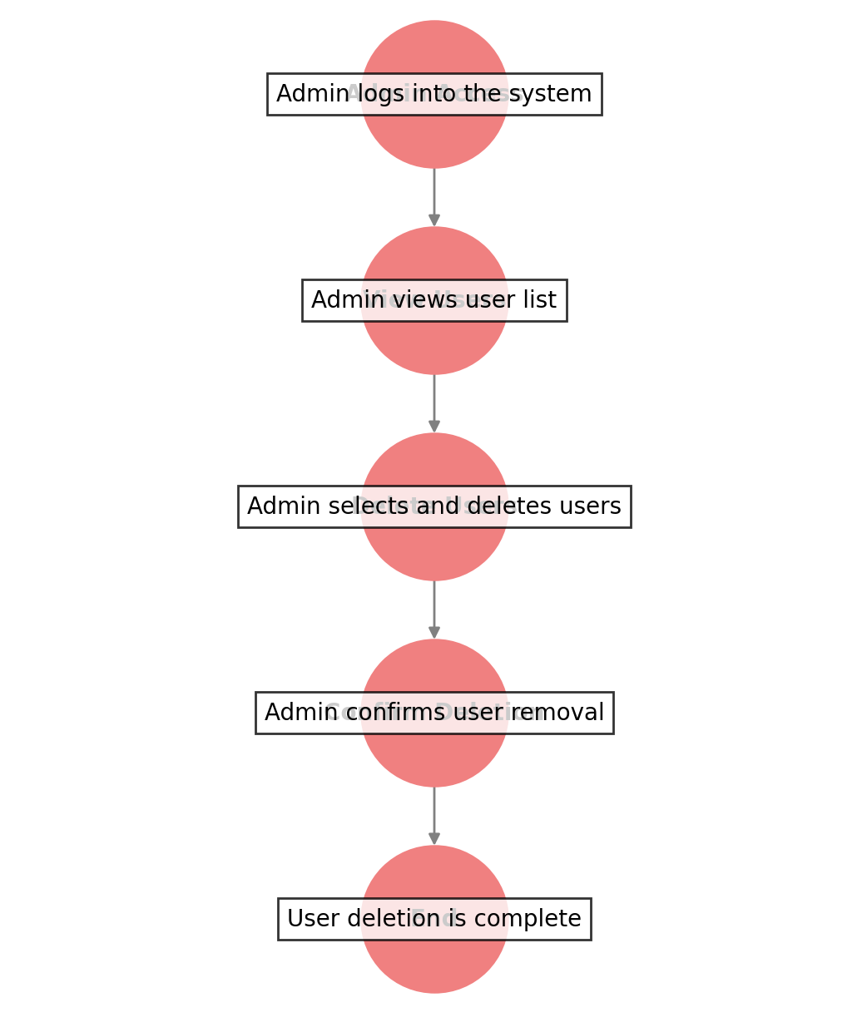

Admin Management & Moderation
Admins manage user accounts
Admins can add/update recipes in the system.

Slide 28
Technology Stack
The application is built using the PERN stack (PostgreSQL, Express.js, React.js, Node.js) along with Supabase for database hosting.
Tech Stack Breakdown:
Frontend: React.js
Provides a dynamic and interactive user interface.
Handles client-side logic and UI updates efficiently.
Backend: Node.js & Express.js
Manages API requests, authentication, and business logic.
Express.js simplifies routing and request handling.

Slide 29
Database: PostgreSQL
Stores user data, grocery inventory, recipes, and waste logs.
Ensures structured, efficient, and scalable data management.
Supabase:
Provides cloud-hosted PostgreSQL database services.
Handles authentication and real-time database updates.

Slide 30
System Interaction Flow:
User interacts with React.js frontend, performing actions like adding groceries or requesting recipe suggestions.
Frontend sends API requests to the Express.js backend, which processes requests and fetches or updates data.
Backend queries the PostgreSQL database via Supabase, retrieving relevant information.
Supabase manages authentication and real-time updates, ensuring data consistency.
Processed data is sent back to the frontend, displaying updated information to the user.

Slide 31
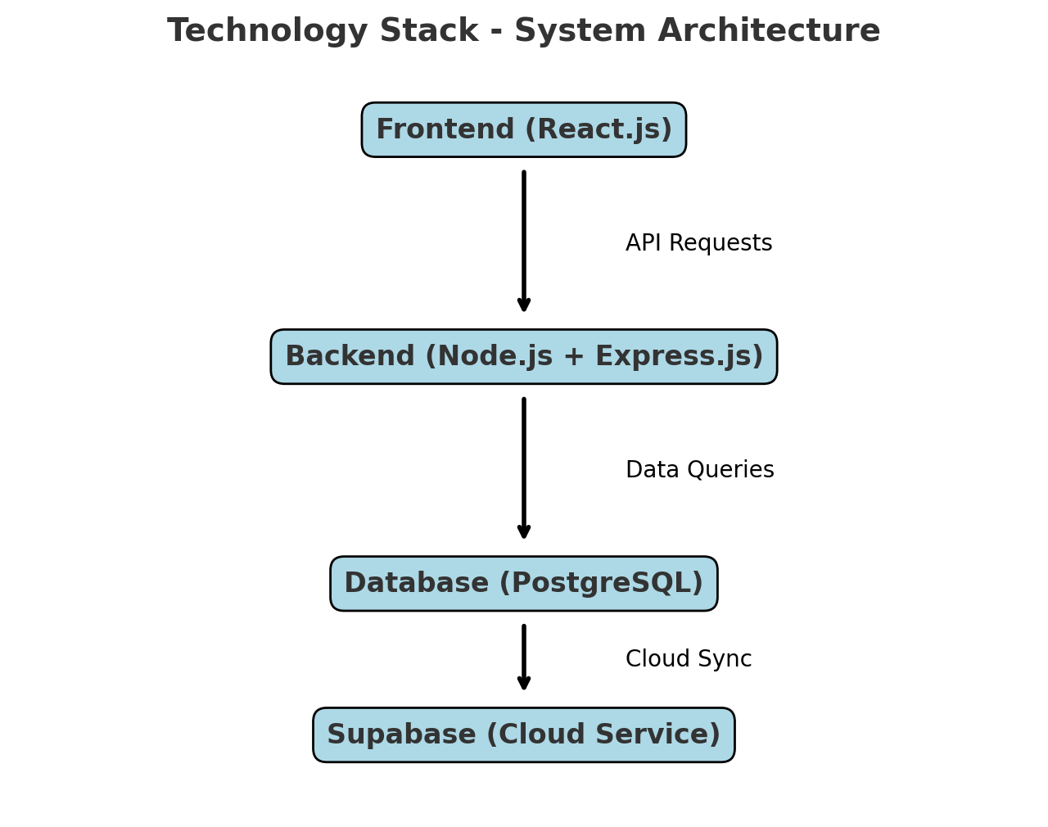

Slide 32
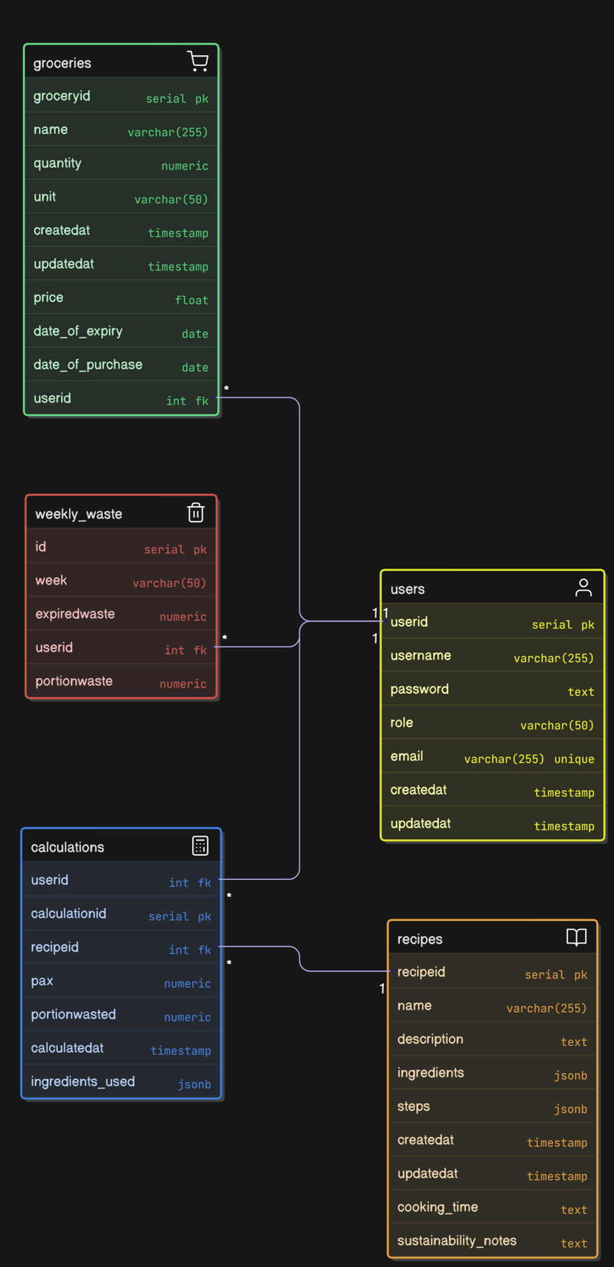
ERD

Slide 33
Benefits and Impacts
Cost Savings:
- Users avoid unnecessary purchases by tracking their grocery inventory.
- Reduced food waste leads to lower grocery expenses.
Better Meal Planning:
- Recipe suggestions based on available groceries make cooking easier.
- Expiration alerts ensure users prioritize using ingredients before they spoil.
Less Food Waste::
- Awareness of discarded food and its impact encourages users to consume wisely.
- Helps households contribute to a more sustainable environment.

Slide 34
Societal Impact:
- Promotes sustainable food habits and reduces global food waste.
- Encourages environmental responsibility among individuals.
Business Benefits:
- Grocery retailers can gain insights into consumer habits, helping optimize inventory management.
- Businesses can reduce food waste by aligning supply with demand, cutting down on surplus.
- Restaurants and meal planners can use data to create waste-efficient meal strategies.

Slide 35
Future Enhancements
AI-Powered Personalized Recipe Suggestions:
- Future updates will integrate AI to analyze user preferences, past meals, and dietary needs.
AI can suggest customized recipes based on available groceries and user eating habits.
Smart Grocery Insights:
- AI will predict grocery usage patterns, helping users optimize their purchases.
- Users can get reminders for frequently used ingredients and auto-generate grocery lists.

Slide 36
Supermarket API Integration:
- Users can view real-time pricing and promotions from partnered supermarkets.
- The app will suggest budget-friendly grocery options to help users save money.
- Users can compare ingredient prices and make better purchasing decisions.
Gamification & Rewards System:
- Introducing a reward system for users who reduce food waste.
- Users can earn points for logging waste, following recipe suggestions, and using groceries efficiently.
- Points can be redeemed for discounts or special offers from partnered supermarkets.

Slide 37
Thank You

