Slide 1
IMPLEMENTATION
Most of the coding was done in sublime without using any IDE as the 3D grid had to be built from scratch and for everything else there was no need for using Scene Builder. Basic logic is that after each input from the user, check if the no. of spheres in that cell are permissible or not. If no, then distribute the spheres to the neighbouring cells and recursively check in the neighbouring cells as well. Our game has three core functions which is play(), burst(), conquer(). play() function takes in the input from the user, places the sphere at the centre of the cell where the user clicked and then calls the burst() function. burst() is the the function where it checks if there are one, two, three or four spheres in a cell and if there are more than what is allowed in that cell then start the animation. After this conquer() functions adds them to the new cell and also readjusts their position so that it is visible how many spheres there are in that cell.
DESIGN PATTERNS
SINGLETON – Only one Grid is being created at a time.
OBSERVER – Grid and Player info are being serialized at each move.
DECORATOR – Used for variables for serializing and deserializing
FAÇADE – Main Menu initializes objects of classes Settings and Game for their respective page creation.

Slide 2
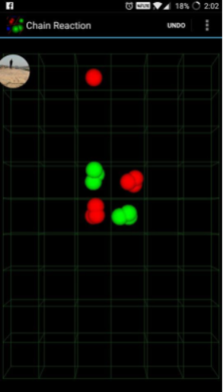
EXTRAS
Problems with animation- In the beginning the two animations i.e Rotation of spheres and Translation were happening simultaneously so the upon breaking up the spheres were not move in a straight path but it was resolved using ParallelTransition. There was also a case where the output shown on the grid was different from that on the backend. This was because when Player 2 tried to burst one of them then two spheres were trying to access the same grid cell at the same time so one of them was not added on the grid. This issue was resolved using setOnFinished() function.
Configuring resume button- For resume button we had to serialize the grid, the current list of players who are playing, whose turn it was at the time of shutdown. However while trying to serialize the Player class the data was not being appended so we were forced to write onto the resume.txt file, the colors that each player had. Upon pressing the resume button, the list of players playing was updated by reading the colors that were stored onto the file.
Color Choices for Each Player- In player settings, (in our implementation)the player is provided with a color panel of 15 colors from which they can choose any color that has not been allocated to any other player.

Slide 3
CONTRIBUTION
APOORV KHATTAR (2016016)-
  Implementation of Backend
  Implementation of Recursive Functions
  Main Menu
  Resuming of Game
NIKHIL SACHDEVA (2016061)-
  Grid Creation
  Rotation and Transition of Spheres
  Player Settings
  Undo

