Slide 1
Operation Research
-Swetha Muralidharan
-20PW35

Slide 2
1.18 Transport Planning in a Olive Production Firm
A firm from Jaén has three production plants located in Jaén, Seville and Almería. The firm distributes olives by means of four regional distribution centres located in Valencia, Madrid, Barcelona and La Coruña. The firm’s management wishes to determine how much of its production must be sent from each plant to each Distribution Centre.

Slide 3
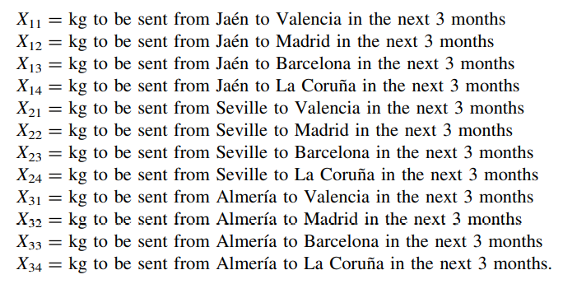
Decision Variables

Slide 4
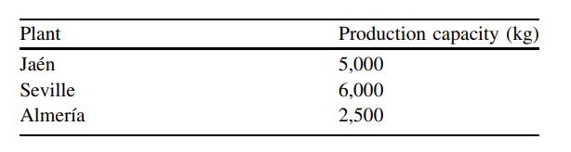
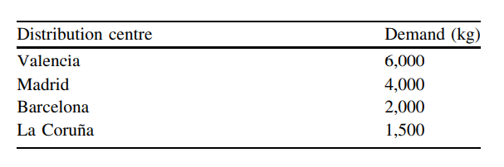

Slide 5
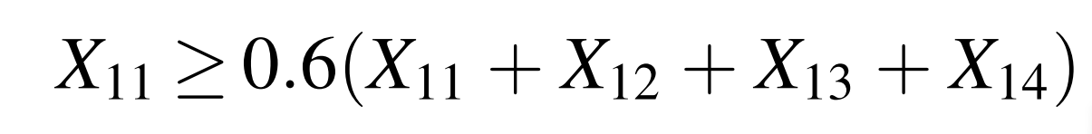
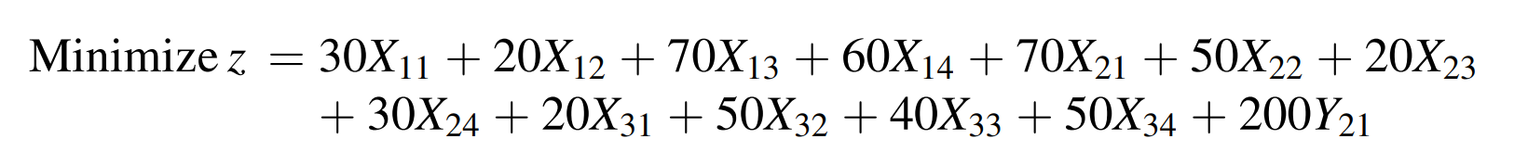




ADDITIONAL CONSTRAINTS
At least 60 % of the total production from Jaén must be sent to Valencia.
Deliveries from Seville to Valencia will have a fixed cost of $200.
Only Seville or Almería can deliver to La Coruña, but never both.

Slide 6
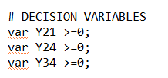
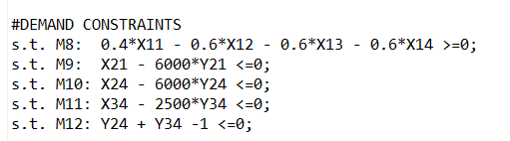

USING AMPL

Slide 7
7.6 Providing Personal Loan
CARCREDIT is a lending agency that specializes in providing personal loans to purchase new cars with. Normally, it automatically provides loans of up to $30,000 over a maximum period of 4 years. Nevertheless, the recent rise in arrears of payment, which affects 1 in 4 customers, has meant that it has had to reconsider its credit-loaning strategy.
This agency obtains, on average, a 10 % profit from the capital loaned if customers return it, but loses 20 % of the capital loaned with defaulters.

Slide 8
CARCREDIT can contract the services of MORCONSULT, a consultancy firm specialized in making rapid evaluations (under 24 h) of potential customers, and it charges a percent of the credit to be loaned.
The consultancy firm publishes the success rates obtained to date: it is successful in 70 % of the cases in which a potential customer becomes a defaulting debtor, and in 80 % of the cases where a potential customer completely pays back the loan.

