Slide 1

UDP Transport Protocol

Slide 2
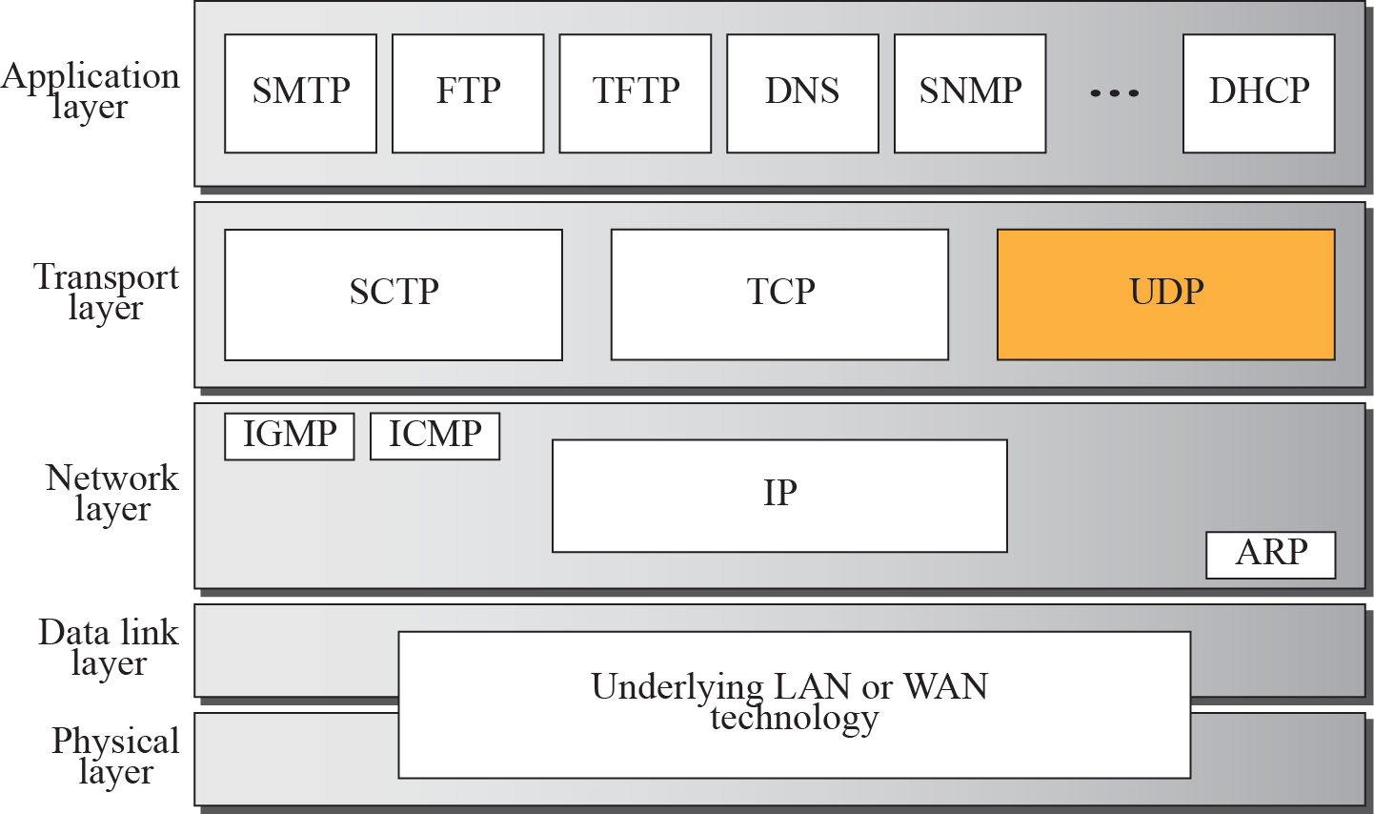
UDP

Slide 3
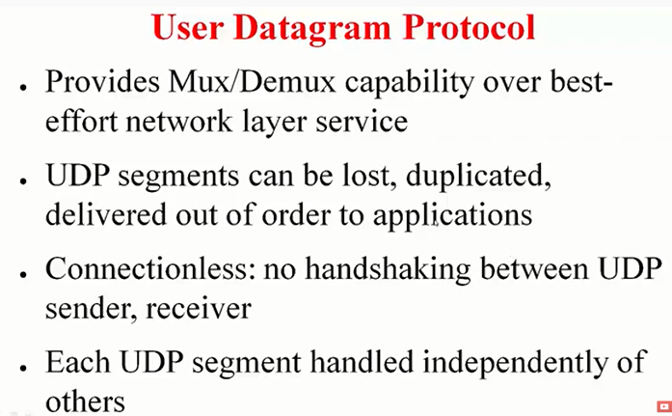
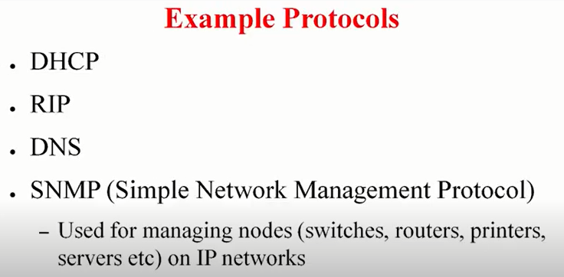
Notes:
No need to maintain state
quic google protocol for transport
QUIC (Quick UDP Internet Connections)
Chrome browser when you connect to YouTube and google servers

Slide 4
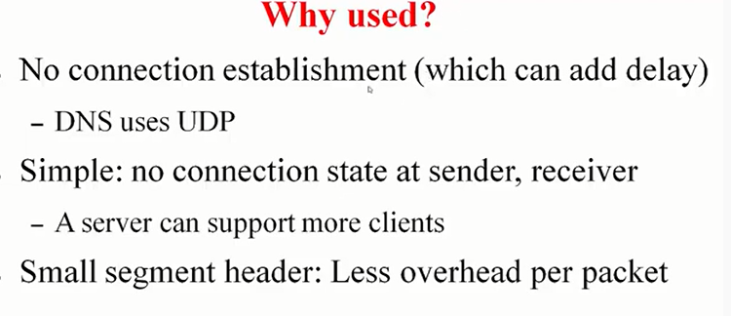
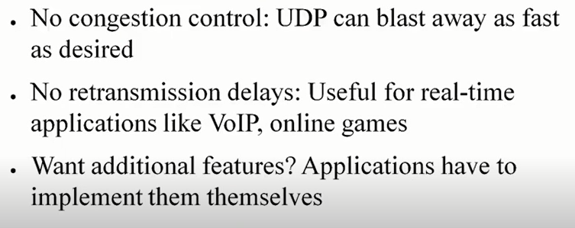
Notes:
Dns sends only few packets and for connecction no need to add packets
Tolerate some packet loss.

Slide 5
UDP – Key Points
Process to process communication using port numbers
Example protocols that uses UDP: RPC, NTP, TFTP, SNMP, DHCP , DNS (both UDP and TCP)
Connectionless, unreliable protocol
UDP = IP services + process to process communication
Error Control - to some extent through checksum. But once receiver detects error “user datagram” is discarded
Flow control – No Flow control by UDP. Upper layer must take care of this function
Congestion control – UDP does not support.
UDP packets, called user datagrams, have a fixed-size header of 8 bytes.

Slide 6
Ports in Network Communication
Port numbers can run from 0 to 65353
Well Known ports - A number from 0 through 1023 used to identify a network service on a private IP network or the public Internet
Registered Ports - The Internet Assigned Numbers Authority (IANA) registers ports 1024 to 49151 for the convenience of the Internet community
Private Ports - Port numbers from 49152 to 65535 are private ports, also called "dynamic ports"
Ports used on servers are persistent in the sense that they last for a long time, or at least as long as the application is running.
Ports used on clients are ephemeral (“lasting a short time,” although the term technically means “lasting a day”) in the sense that they “come and go” as the user runs client applications.

Slide 7
Ephemeral ports
The ephemeral ports are the short-lived transport protocol ports for Internet Protocol (IP) communications.
Ephemeral ports are allocated automatically from a predefined range by the IP stack software.
An ephemeral port is typically used by the Transmission Control Protocol (TCP), User Datagram Protocol (UDP) or the Stream Control Transmission Protocol (SCTP) as the port assignment for the client end of a client-server communication to a well-known port on a server.
What that means is, when a client initiates a request it choose a random port from ephemeral port range and it expects the response at that port only.
Many Linux kernels use the port range 32768 to 60999

Slide 8
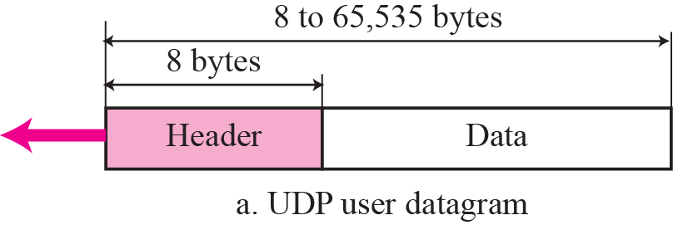
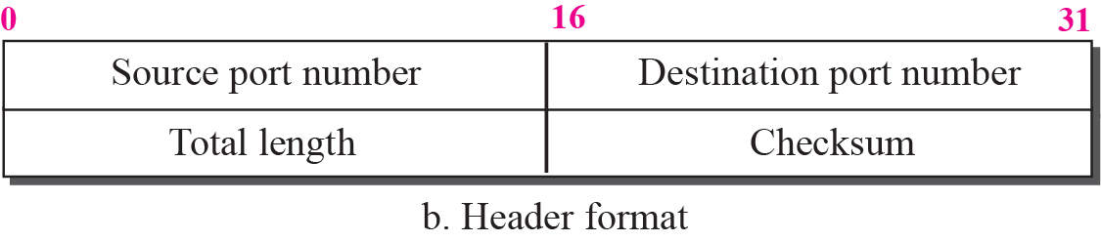
Figure 14.2 User datagram format
Total length
of user datagram
=
LENGTH –
HEADER’S
LENGTH
To detect errors over entire datagram

Slide 9
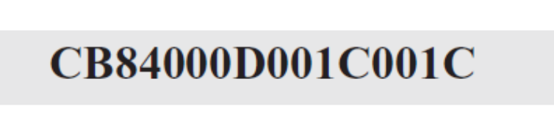
Example 14.1
The following is a dump of a UDP header in hexadecimal format.
a. What is the source port number?
b. What is the destination port number?
c. What is the total length of the user datagram?
d. What is the length of the data?
e. Is the packet directed from a client to a server or vice versa?
f. What is the client process?

Slide 10
Example 14.1 Continued
Solution
a. The source port number is the first four hexadecimal digits (CB84)₁₆ or 52100.
b. The destination port number is the second four hexadecimal digits (000D)₁₆ or 13.
c. The third four hexadecimal digits (001C)₁₆ define the length of the whole UDP packet as 28 bytes.
d. The length of the data is the length of the whole packet
minus the length of the header, or 28 – 8 = 20 bytes.
e. Since the destination port number is 13 (well-known port), the packet is from the client to the server.
f. The client process is the Daytime (see Table 14.1).

Slide 11
14-3 UDP Services
Process-to-Process Communication
Connectionless Service
Flow Control
Error Control
Congestion Control
Encapsulation and Decapsulation
Queuing
Multiplexing and Demultiplexing
Comparison between UDP and Generic Simple
Protocol

Slide 12
Connectionless service
As mentioned previously, UDP provides a connectionless service. This means that each user datagram sent by UDP is an independent datagram.
There is no relationship between the different user datagrams even if they are coming from the same source process and going to the same destination program.
The user datagrams are not numbered.
Also, there is no connection establishment and no connection termination as is the case for TCP.
This means that each user datagram can travel on a different path.

Slide 13
Connectionless service
The process that uses UDP cannot send a stream of data to UDP and expect UDP to chop them into different related user datagrams. Instead each request must be small enough to fit into one user datagram.
Only those processes sending short messages, messages less than 65,507 bytes (65,535 minus 8 bytes for the UDP header and minus 20 bytes for the IP header), can use UDP.

Slide 14
Flow control
Whenever an entity produces items and another entity consumes them, there should be a balance between production and consumption rates.
First Issue: If the items are produced faster than they can be consumed, the consumer can be overwhelmed and needs to discard some items.
Second Issue: If the items are produced slower than they can be consumed, the consumer should wait; the system becomes less efficient.
Flow control is related to the first issue. Consuming device must not be overwhelmed and packets must not be discarded
We need to prevent losing the data items at the consumer site.

Slide 15
Error control
Error control at the transport layer is responsible for the following functions:
1. Detect and discard corrupted packets.
2. Keep track of lost and discarded packets and resend them.
3. Recognize duplicate packets and discard them.
4. Buffer out-of-order packets until the missing packets arrive.

Slide 16
Congestion control
An important issue in the Internet is congestion.
Congestion in a network may occur if the load on the network (the number of packets sent to the network) is greater than the capacity of the network - the number of packets a network can handle.
if ( the load on the network > capacity of the network )
then congestion results

Slide 17
Congestion control
Congestion control refers to the mechanisms and techniques to control the congestion and keep the load below the capacity.
Congestion in a network or internetwork occurs because routers and switches have queues—buffers that hold the packets before and after processing.
These queues are finite, so it is possible for more packets to arrive at a router than the router can buffer.

Slide 18
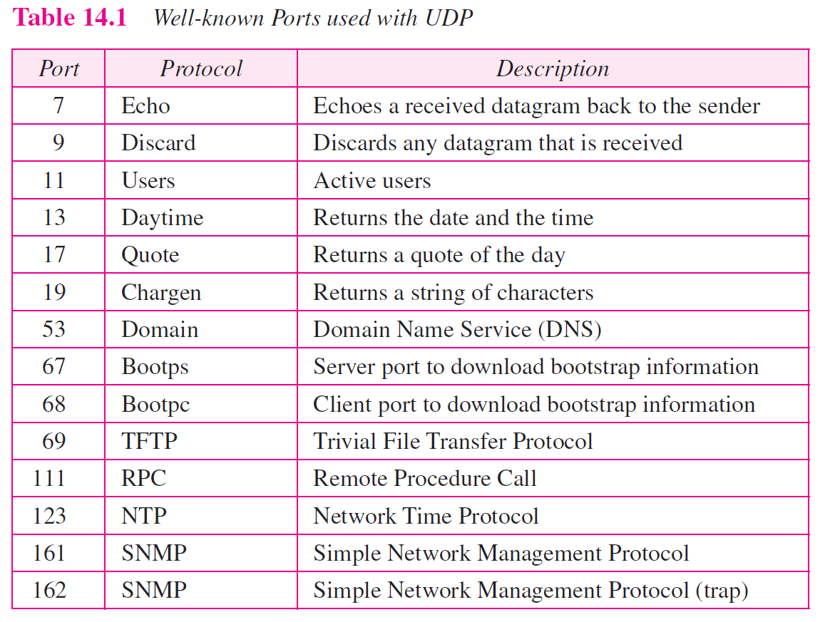

Slide 19
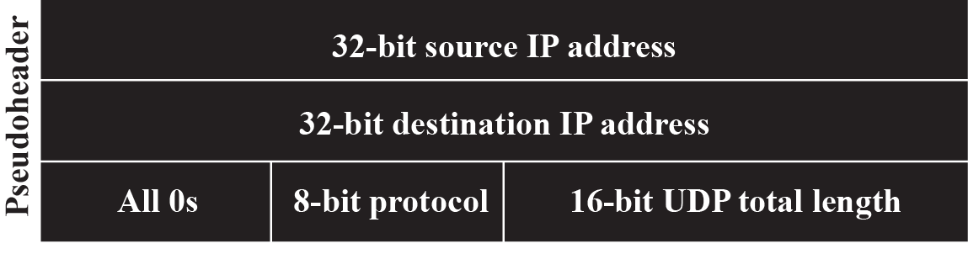
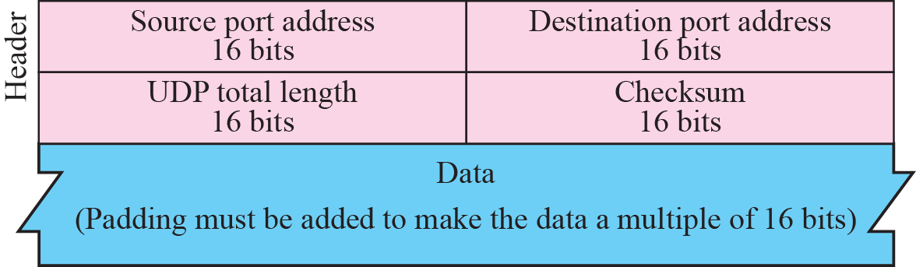
Figure 14.3 Pseudoheader for checksum calculation
Set to UDP=17

Slide 20
Why UDP checksum computation includes Pseudo header?
UDP checksum computed on following three sections:
    Pseudo header
    UDP header
    UDP data
Pseudo header: part of header of IP packet
Reason:
  IP header can be corrupted, bits may be flipped causing checksum to be same. So wrong host may receive the data.
Checksum in IP Packet covers only header and not data (Recall)
UDP checksum calculation is optional. Sender may choose not to calculate as well.

Slide 21
Example 14.2
Figure 14.4 shows the checksum calculation for a very small user datagram with only 7 bytes of data. Because the number of bytes of data is odd, padding is added for checksum calculation. The pseudoheader as well as the padding will be dropped when the user datagram is delivered to IP (see Appendix F).

Slide 22
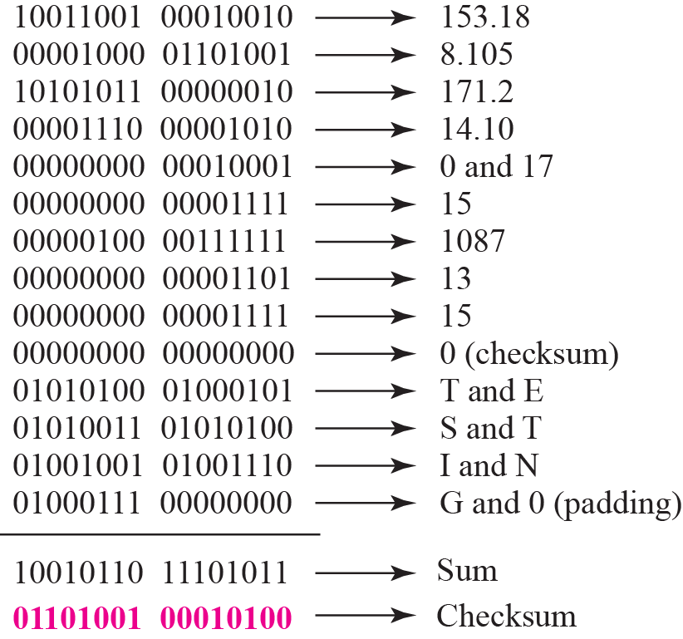
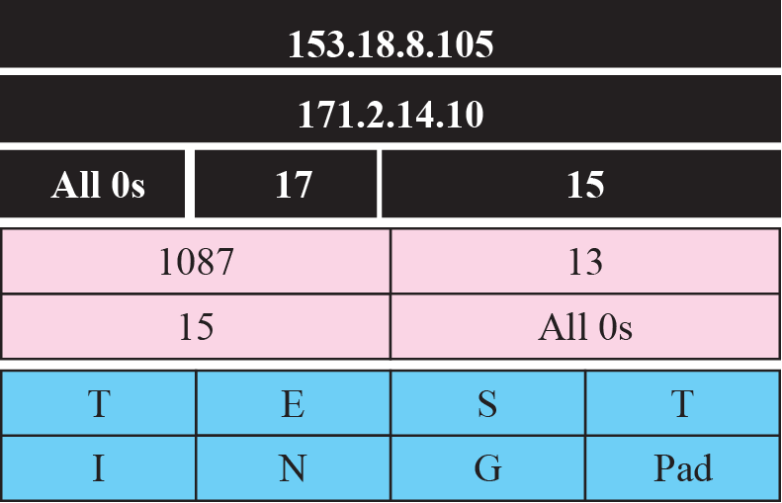
Figure 14.4 Checksum calculation for a simple UDP user datagram

Slide 23
Example 14.3
What value is sent for the checksum in one of the following hypothetical situations?
a. The sender decides not to include the checksum.
b. The sender decides to include the checksum, but the value of the sum is all 1s.
c. The sender decides to include the checksum, but the value of the sum is all 0s.

Slide 24
Example 14.3 Continued
Solution
a. The value sent for the checksum field is all 0s to show that the checksum is not calculated.
b. When the sender complements the sum, the result is all 0s; the sender complements the result again before sending. The value sent for the checksum is all 1s. The second complement operation is needed to avoid confusion with the case in part a.
c. This situation never happens because it implies that the value of every term included in the calculation of the sum is all 0s, which is impossible; some fields in the pseudoheader have nonzero values (see Appendix D).

Slide 25
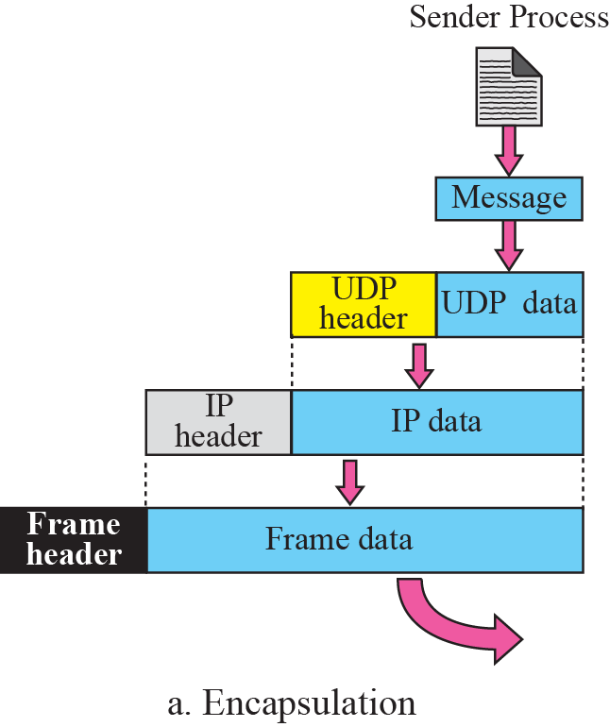
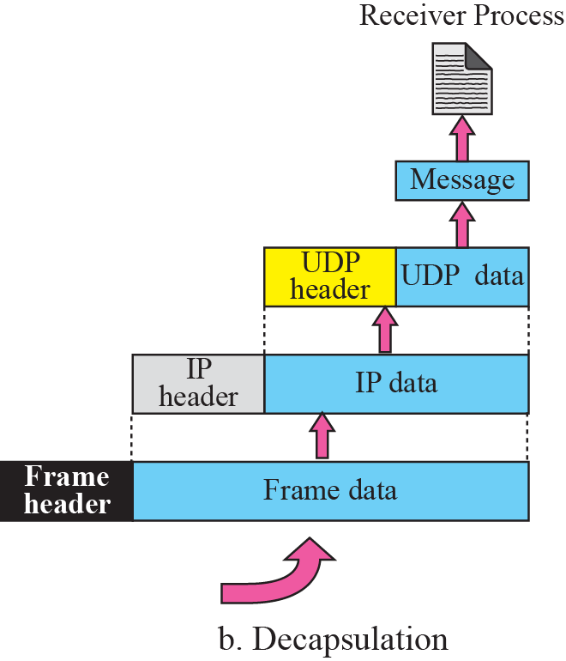

Figure 14.5 Encapsulation and decapsulation

Slide 26
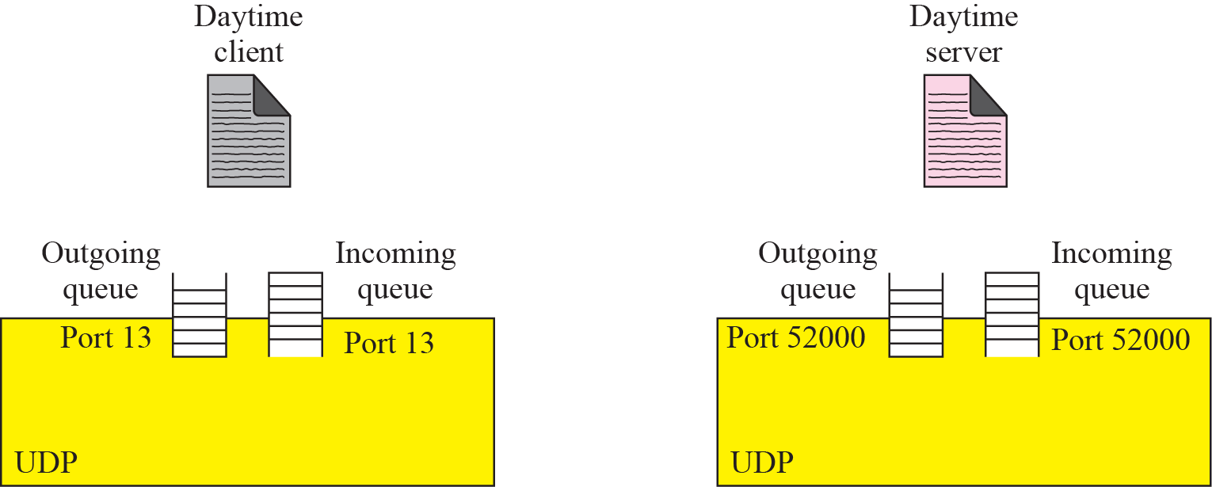




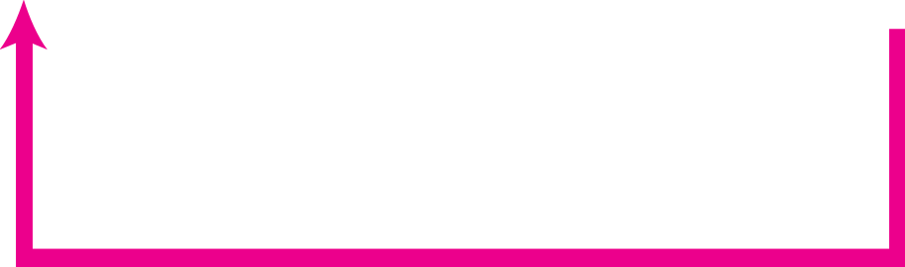
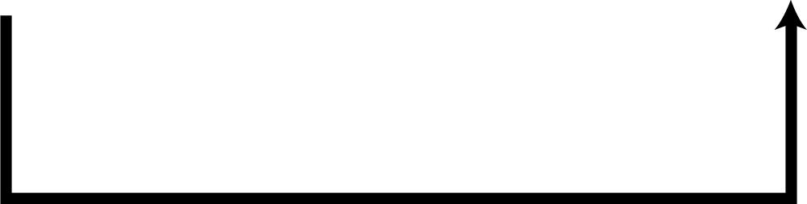
Figure 14.6 Queues in UDP

Slide 27
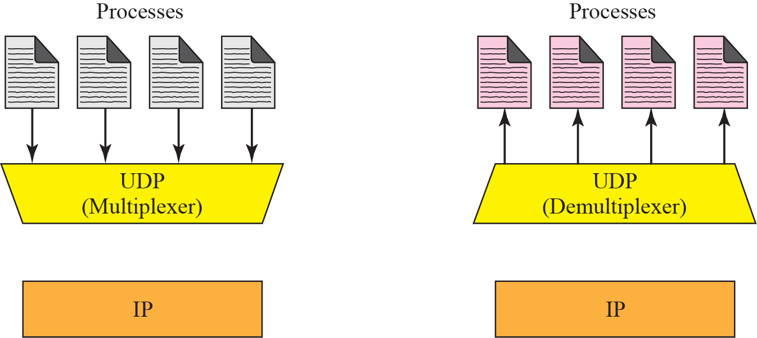





Figure 14.7 Multiplexing and demultiplexing

Slide 28

Note
UDP is an example of the connectionless simple protocol we discussed in Chapter 13 with the exception of an optional checksum added to packets for error detection.

Slide 29
14-4 UDP APPLICATION
Although UDP meets almost none of the criteria we mentioned in Chapter 13 for a reliable transport-layer protocol, UDP is preferable for some applications. The reason is that some services may have some side effects that are either unacceptable or not preferable. An application designer needs sometimes to compromise to get the optimum.

Slide 30
Topics Discussed in the Section
UDP Features
Typical Applications

Slide 31
Example 14.4
A client-server application such as DNS (see Chapter 19) uses the services of UDP because a client needs to send a short request to a server and to receive a quick response from it. The request and response can each fit in one user datagram. Since only one message is exchanged in each direction, the connectionless feature is not an issue; the client or server does not worry that messages are delivered out of order.

Slide 32
Example 14.5
A client-server application such as SMTP (see Chapter 23), which is used in electronic mail, cannot use the services of UDP because a user can send a long e-mail message, which may include multimedia (images, audio, or video). If the application uses UDP and the message does not fit in one single user datagram, the message must be split by the application into different user datagrams. Here the connectionless service may create problems. The user datagrams may arrive and be delivered to the receiver application out of order. The receiver application may not be able to reorder the pieces. This means the connectionless service has a disadvantage for an application program that sends long messages.

Slide 33
Example 14.6
Assume we are downloading a very large text file from the Internet. We definitely need to use a transport layer that provides reliable service. We don’t want part of the file to be missing or corrupted when we open the file. The delay created between the delivery of the parts are not an overriding concern for us; we wait until the whole file is composed before looking at it. In this case, UDP is not a suitable transport layer.

Slide 34
Example 14.7
Assume we are watching a real-time stream video on our computer. Such a program is considered a long file; it is divided into many small parts and broadcast in real time. The parts of the message are sent one after another. If the transport layer is supposed to resend a corrupted or lost frame, the synchronizing of the whole transmission may be lost. The viewer suddenly sees a blank screen and needs to wait until the second transmission arrives. This is not tolerable. However, if each small part of the screen is sent using one single user datagram, the receiving UDP can easily ignore the corrupted or lost packet and deliver the rest to the application program. That part of the screen is blank for a very short period of the time, which most viewers do not even notice. However, video cannot be viewed out of order, so streaming audio, video, and voice applications that run over UDP must reorder or drop frames that are out of sequence.

Slide 35
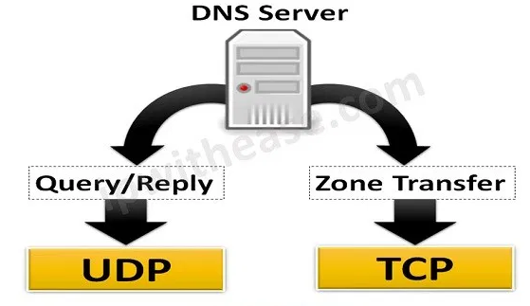

Slide 36
UDP - Summary
Process to process communication using port numbers
Example protocols that uses UDP: RPC, NTP, TFTP, SNMP, DHCP , DNS (both UDP and TCP)
Connectionless, unreliable protocol
UDP = IP services + process to process communication (instead of host to host communication)
Error Control - to some extent through checksum. But once receiver detects error “user datagram” is discarded
Flow control – No Flow control by UDP. Upper layer must take care of this function
Congestion control – UDP does not support.
Suitable for real time applications and to transfer less data quickly

