Slide 1
HYPERTEXT TRANSFER PROTOCOL

Slide 2
Introduction

Slide 3
HTTP (Hypertext Transfer Protocol) is the set of rules for transferring files such as text, graphic images, sound, video, and other multimedia files on the World Wide Web.
HTTP is based on request-response activity.
A client, running an application called a browser, establishes a connection with a server and sends a request to the server in the form of a request method.
HTTP uses the services of TCP on well-known port 80.

Slide 4
OVERVIEW OF HTTP
An HTTP transaction is divided into four steps:
1. The browser opens a connection.
2. The browser sends a request to the server.
3. The server sends a response to the browser.
4. The connection is closed.

Slide 5
HTTP - URLs
Uniform Resource Locator
protocol (http, ftp, news)
host name (name. domain name)
port (usually 80 but many on 8080)
directory path to the resource
resource name
http://xxx.myplace.com/www/index.html
http://xxx.myplace.com:80/cgi-bin/t.exe

Slide 6
AN HTTP CONVERSATION
Client
Server
OK
Send page or error message
OK
I would like to open a connection
GET <file location>
Display response
Close connection

Slide 7
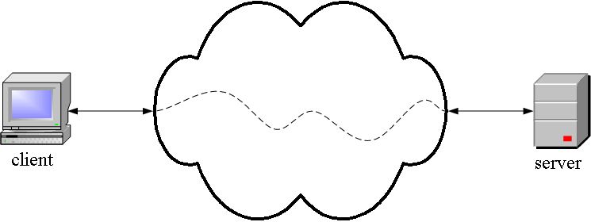
HTTP is an application layer protocol.
Application layer programs do useful work like retrieving Web pages, sending and receiving email or transferring files

Slide 8
HTTP MESSAGE FORMAT
Two types of http messages:
REQUEST
RESPONSE

Slide 9
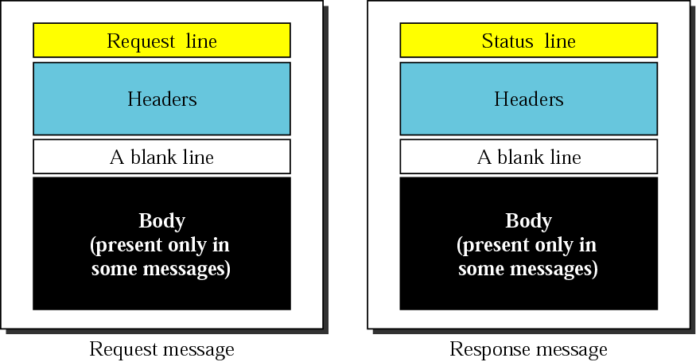

Slide 10
REQUEST AND STATUS LINES
request line(GET, POST, HEAD commands)
GET /somedir/page.htmlHTTP/1.0
status line
HTTP/1.0 200 OK

Slide 11
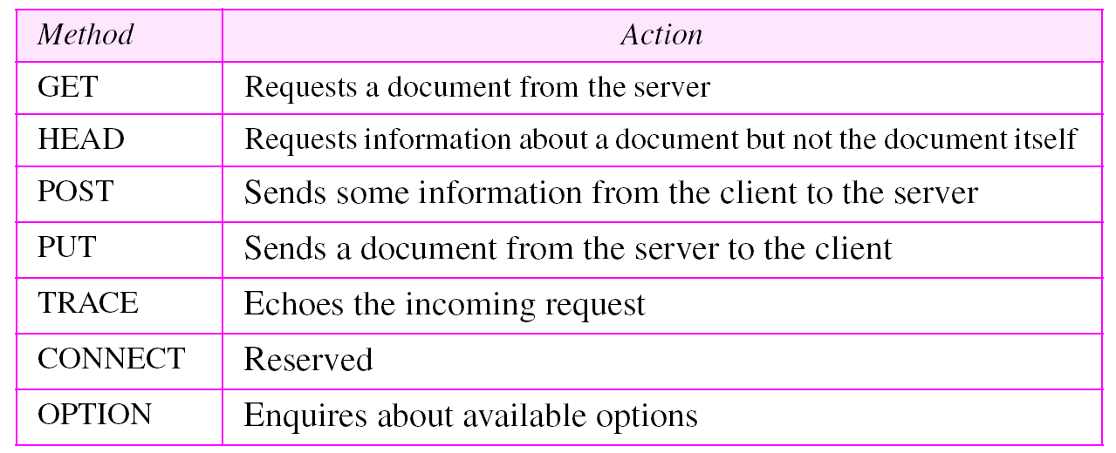
http request message methods

Slide 12
MESSAGE HEADER
The HTTP message header field can be one of the following:
General header
Request header
Response header
Entity header

Slide 13
GENERAL HEADER FIELD
General header fields can apply both request and response messages.

Slide 14
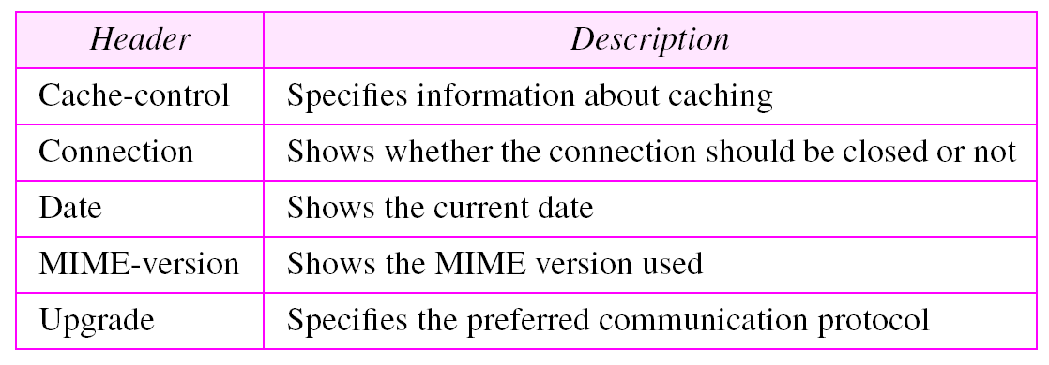
GENERAL HEADER

Slide 15
REQUEST HEADER
REQUEST
It is a message to a server includes a request that is sent by the client.
A request message field is as follows:
Request = Request-Line
*( general-header | request-header | entity-header )
CRLF
[ message-body ]

Slide 16
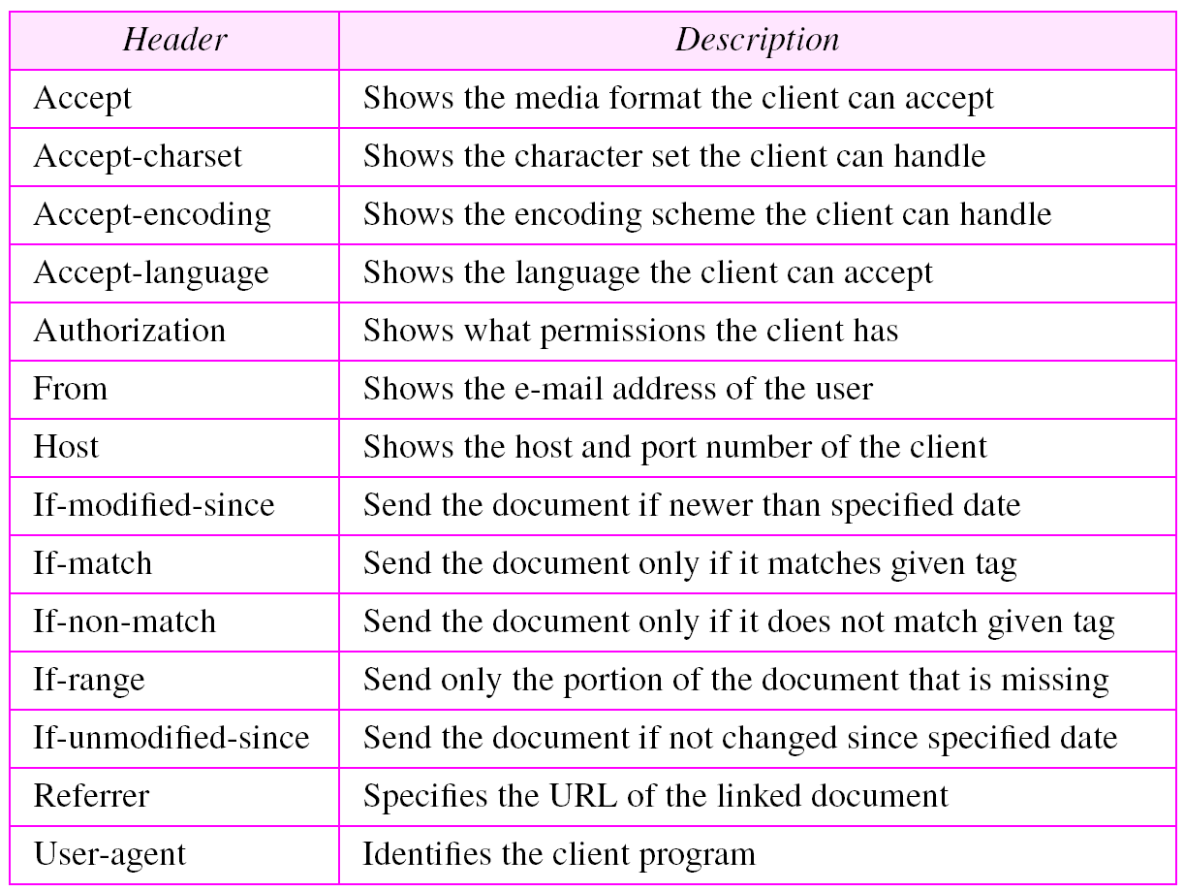
REQUEST HEADER

Slide 17
RESPONSE HEADER
RESPONSE
An HTTP server returns a response after evaluating the client request.
A response message field is as follows:
Response = status-Line
*( general-header | response-header | entity-header )
CRLF
[ message-body ]

Slide 18
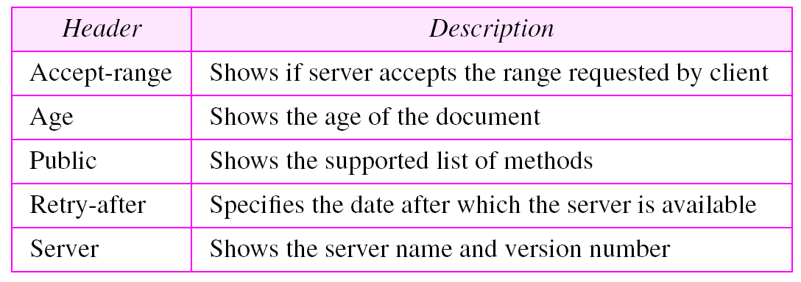
RESPONSE HEADER

Slide 19
ENTITY HEADER
ENTITY
Either the client or server might send Entity in the request message or the response message, unless otherwise indicated.
Entity consists of the following:
Entity header fields
Entity body

Slide 20
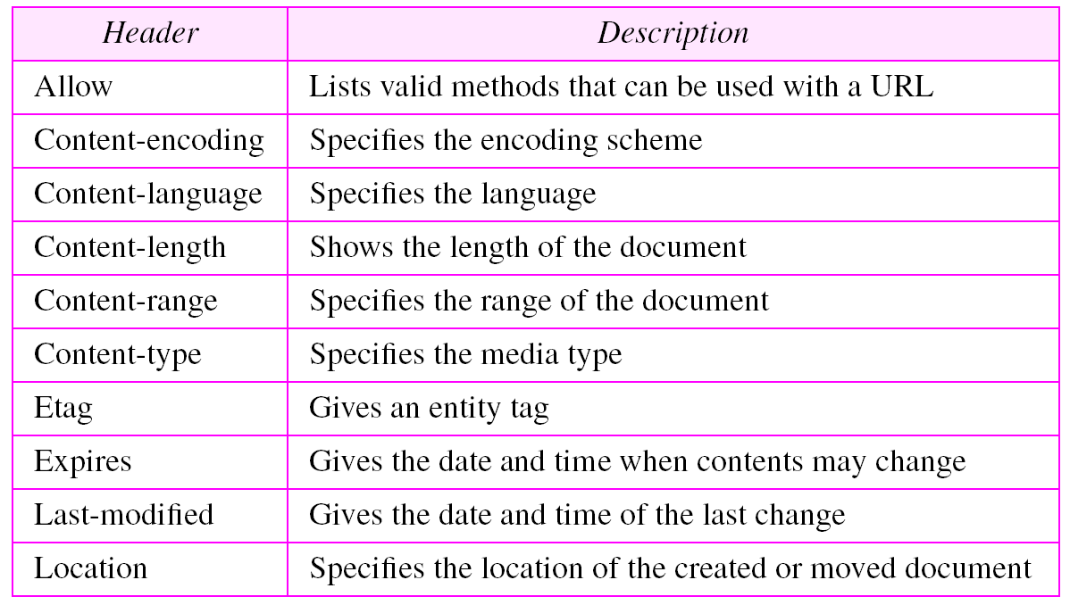
ENTITY HEADER

Slide 21
MESSAGE BODY
Message body can be referred to as entity body if there is no
transfer coding has been applied.
Message body simply carries the entity body of the relevant request or response.
MESSAGE LENGTH
Message length indicates the length of the message
body if it is included.

Slide 22
Example 1
In this example, the client wants to send data to the server. We use the POST method. The request line shows the method (POST), URL, and HTTP version (1.1). There are four lines of headers. The request body contains the input information. The response message contains the status line and four lines of headers. The created document, which is a CGI document, is included as the body .

Slide 23
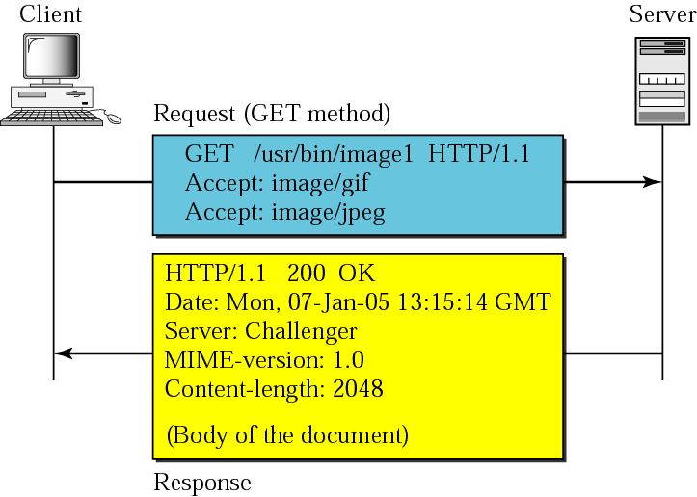

Slide 24
Status Code
The status code is a three-digit integer, and the first digit identifies the general category of response:
1xx indicates an informational message
2xx indicates success of some kind
3xx redirects the client to another URL
4xx indicates an error on the client's part
Yes, the system blames it on the client if a resource is not found (i.e., 404)
5xx indicates an error on the server's part

Slide 25
Status Codes
100 continue
101 switching protocols
200 OK
201 created
202 accepted
204 no content
301 moved permanently
302 moved temporarily
304 not modified
400 bad request
401 unauthorized
403 forbidden
404 not found
500 internal server error
501 not implemented
502 bad gateway
503 service unavailable

Slide 26
Statelessness
Because of the Connect, Request, Response, Disconnect nature of HTTP it is said to be a stateless protocol.
i.e. from one web page to the next there is nothing in the protocol that allows a web program to maintain program “state” (like a desktop program).

