Slide 1
Electronic Mail
SMTP,POP3 &IMAP

Slide 2
Electronic Mail
Electronic mail (or e-mail) allows users to exchange messages.
In an application such as HTTP or FTP, the server program is running all the time, waiting for a request from a client.
When the request arrives, the server provides the service. There is a request and there is a response.
In the case of electronic mail, response is not mandatory. E-mail is considered a one-way transaction. If there is a response, it is another one- way transaction.
It is neither feasible nor logical for someone to run a server program and wait until the sender sends an e-mail to them.
This means that the idea of client/server programming should be implemented in another way: using some intermediate computers (servers). The users run only client programs when they want

Slide 3
Architecture

Slide 4
ARCHITECTURE
First Scenario
The sender and the receiver of the e-mail are users (or application programs) on the same mail server; they are directly connected to a shared mail server.
The administrator has created one mailbox for each user where the received messages are stored.
When Alice needs to send a message to Bob, she runs a user agent (UA) program to prepare the message and store it in Bob’s mailbox.
The message has the sender and recipient mailbox addresses (names of files). When the sender and the receiver of an e-mail are on the same mail server, we need only two user agents.

Slide 5
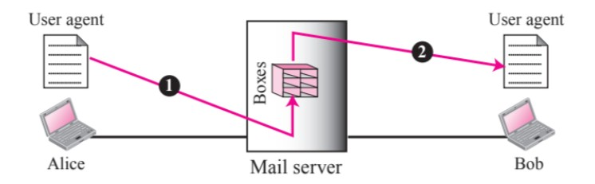

Slide 6
Second Scenario
The sender and the receiver of the e-mail are users on two different mail servers. The message needs to be sent over the Internet. Here we need user agents (UA) and message transfer agents (MTAs).
Alice needs to use a user agent program to send her message to the mail server at her own site. The mail server at her site uses a queue (spool) to store messages waiting to be sent.
Bob also needs a user agent program to retrieve messages stored in the mailbox of the system at his site.
The message needs to be sent through the Internet from Alice’s site to Bob’s site. The server needs to run all of the time, the client can be triggered by the system when there is a message in the queue to be sent.

Slide 7
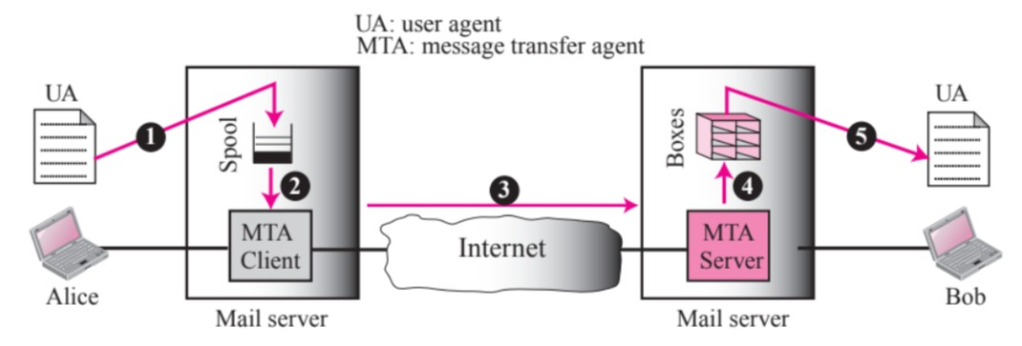

Slide 8
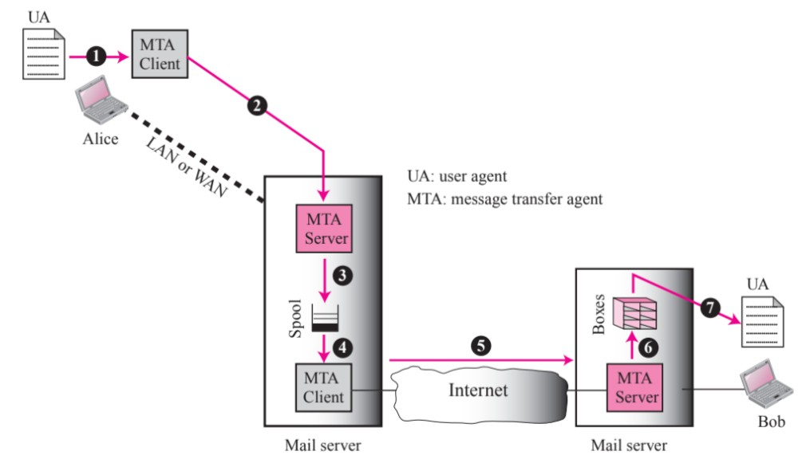
Third Scenario

Slide 9
Bob, as in the second scenario, is directly connected to his mail server. Alice is either connected to the mail server via a point-to-point WAN or she is connected to a LAN in an organization that uses one mail server for handling e-mails.
Alice uses a user agent to prepare her message and sends the message through the LAN or WAN. This can be done through a pair of message transfer agents (client and server).
Whenever Alice has a message to send, she calls the user agent which, in turn, calls the MTA client. The MTA client establishes a connection with the MTA server on the system and sends the messages to Bob’s site.
The received messages are stored in Bob’s mailbox.
When the sender is connected to the mail server via a LAN or a WAN, we need two UAs and two pairs of MTAs (client and server).

Slide 10
Fourth Scenario
In the common scenario, the sender and the receiver of the e-mail are connected via a LAN or a WAN to two mail servers.
We use three different agents in a mail transfer: a user agent (UA), a message transfer agent (MTA), and a message access agent (MAA).
Bob uses an MAA client to retrieve his messages. The client sends a request to the MAA server, which is running all the time, and requests the transfer of the messages.
There are two important points we need to emphasize.
First, Bob cannot bypass the mail server and use the MTA server directly. To use the MTA server directly, Bob would need to run the MTA server all the time because he does not know when a message will arrive.
Second, Bob needs another pair of client-server programs: message access programs.

Slide 11
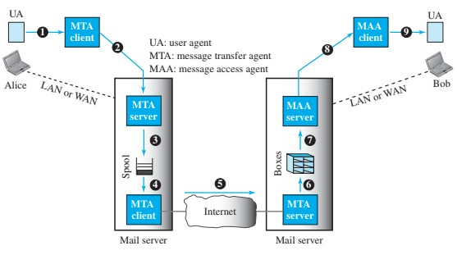
This is because an MTA client-server program is a push program: the client pushes the message to the server. Bob needs a pull program.

Slide 12
Who’s this UA?

Slide 13
User Agent
A user agent is a software package (program) that composes, reads, replies to, and forwards messages.
There are two types of user agents: command-driven and GUI-based.
A command-driven user agent normally accepts a one character command from the keyboard to perform its task. For example, a user can type the character r, at the command prompt, to reply to the sender of the message, or type the character R to reply to the sender and all recipients.
They contain graphical user interface (GUI) components that allow the user to interact with the software by using both the keyboard and the mouse.
They have graphical components such as icons, menu bars, and windows that make the services easy to access.

Slide 14
Sending mail
The message contains the header and the body. The header of the message defines the sender, the receiver, the subject of the message, and some other information. The body of the message contains the actual information to be read by the recipient.
Receiving mail
If a user has mail, the UA informs the user with a notice. If the user is ready to read the mail, a list is displayed in which each line contains a summary of the information about a particular message in the mailbox.
The summary usually includes the sender mail address, the subject, and the time the mail was sent or received.

Slide 15
Addresses
The address consists of two parts: a local part and a domain name, separated by an @ sign.
The local part defines the name of a special file, called the user mailbox, where all the mail received for a user is stored for retrieval by the message access agent. The second part of the address is the domain name.
Mailing list or Group List
Electronic mail allows one name, an alias, to represent several different e-mail addresses; this is called a mailing list. Every time a message is to be sent, the system checks the recipient’s name against the alias database; if there is a mailing list for the defined alias, separate messages, one for each entry in the list, must be prepared and handed to the MTA.

Slide 16
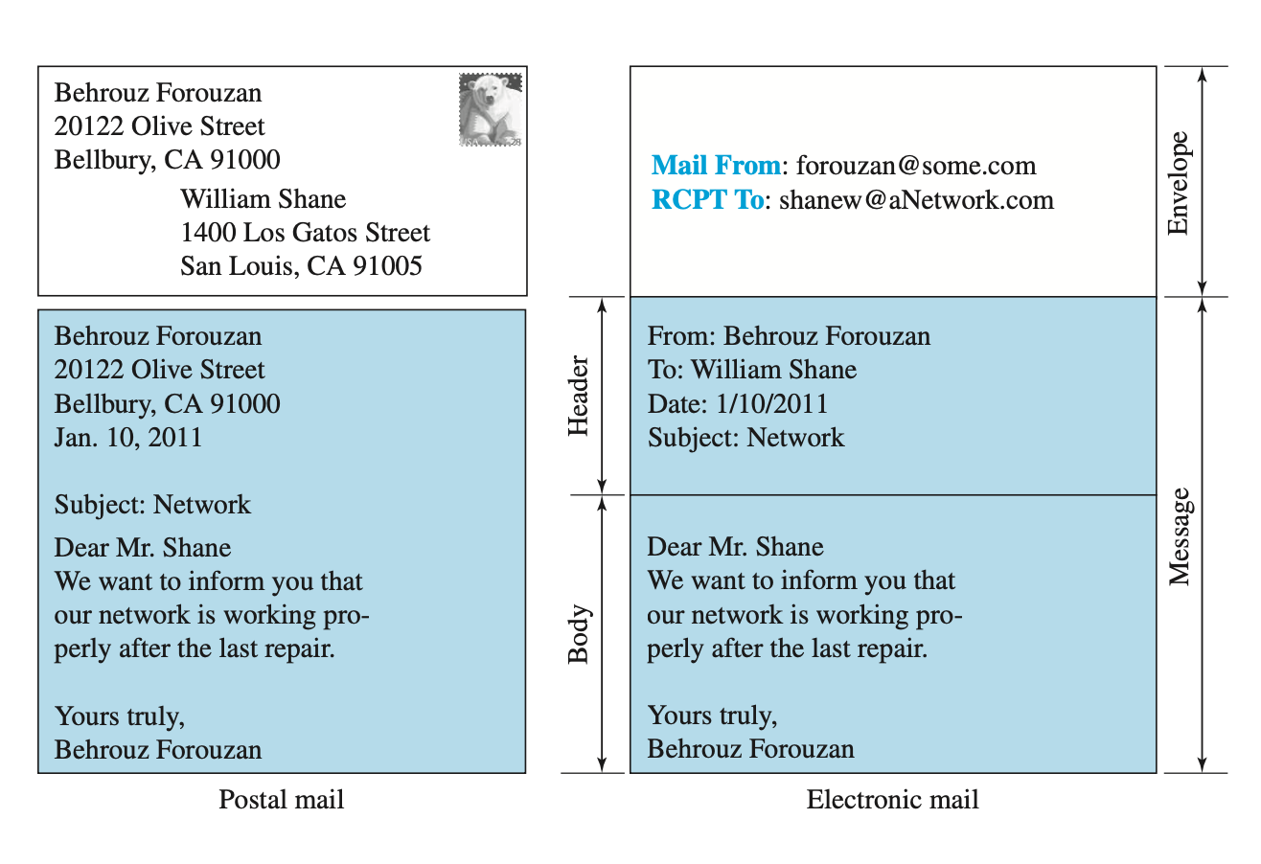

Slide 17
Mail Transfer Agent

Slide 18
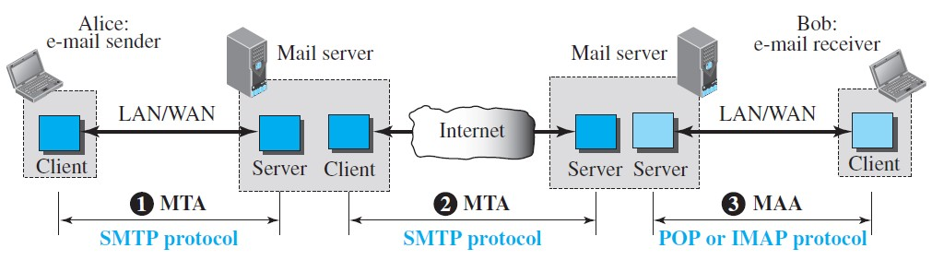
MAIL TRANSFER AGENT: SMTP
Based on the common scenario, we refer to the first and the second as Message Transfer Agents (MTAs), the third as Message Access Agent (MAA).
The formal protocol that defines the MTA client and server in the Internet is called Simple Mail Transfer Protocol (SMTP). SMTP is used two times, between the sender and the sender’s mail server and between the two mail servers. SMTP simply defines how commands and responses must be sent back and forth.

Slide 19
How Does It Work?

Slide 20
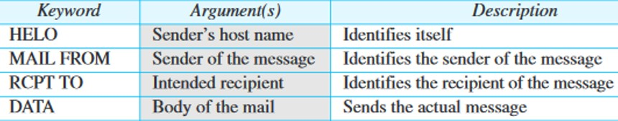
Commands and Responses
SMTP uses commands and responses to transfer messages between an MTA client and an MTA server.
The command is from an MTA client to an MTA server; the response is from an MTA serv to the MTA client.
Each command or reply is terminated by a two-character end-of-line token.
Commands

Slide 21
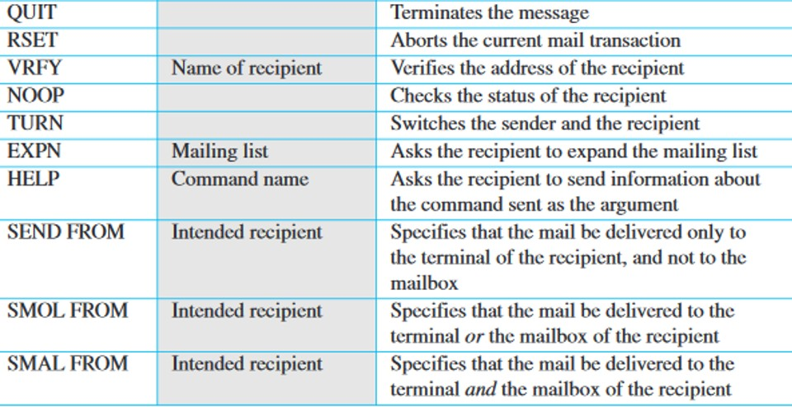

Slide 22
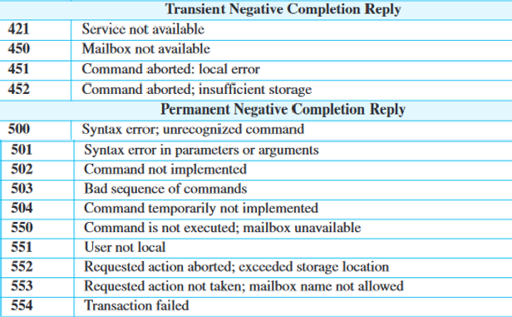

Slide 23
MAIL TRANSFER PHASES
CONNECTION ESTABLISH
The SMTP server starts the connection phase after a client has made a TCP connection to the port 25.
STEPS:
The server sends code 220 (service ready). If the server is not ready, it sends code 421.
The client sends the HELO message to identify itself, using its domain name address. The server responds with code 250 or some other code depending on the situation.

Slide 24
MESSAGE TRANSFER
After connection has been established between the SMTP client and server, a single message between a sender and one or more recipients can be exchanged.
STEPS:
The client sends the MAIL FROM message (for returning errors and messages) which includes the mail address of the sender.
The server responds with code 250 or some other appropriate code. The client sends the RCPT TO message.
The server responds with code 250 or some other appropriate code. The client sends the DATA message to initialize the message transfer.
The server responds with code 354 or some other appropriate message.
The client sends the contents of the message in consecutive lines. Each line is terminated by a two-character end-of-line token (carriage return and line feed). The message is terminated by a line containing just one period.
The server responds with code 250 (OK) or some other appropriate code.

Slide 25
CONNECTION TERMINATION
After the message is transferred successfully, the client terminates the connection.
STEPS:
The client sends the QUIT command.
The server responds with code 221 or some other appropriate code.

Slide 26
EXAMPLE
To show the three mail transfer phases, we show all of the steps described above using the information depicted in Figure 26.16.
In the figure, we have separated the messages related to the envelope, header, and body in the data transfer section. Note that the steps in this figure are repeated two times in each e- mail transfer: once from the e-mail sender to the local mail server and once from the local mail server to the remote mail server. The local mail server, after receiving the whole e-mail message, may spool it and send it to the remote mail server at another time.

Slide 27
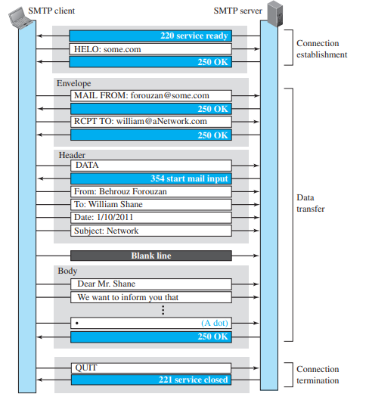

Slide 28
Message Access Agent

Slide 29
MESSAGE ACCESS AGENT
The first and second stages of mail delivery use SMTP. SMTP is a push protocol.
The third stage needs a pull protocol. It uses a message access agent.
Two message access protocols are available: POP3-Post Office Protocol, version 3
IMAP4 - Internet Mail Access Protocol, version 4

Slide 30
POP3

Slide 31
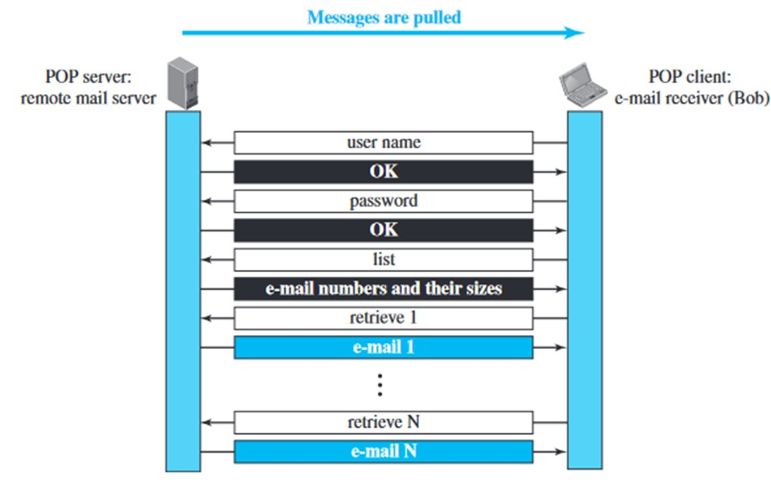
POP3
The client POP3 software is installed on the recipient computer; the server POP3 software is installed on the mail server.
Mail access starts with the client when the user needs to download its e-mail from the mailbox on the mail server.
The client opens a connection to the server on TCP port 110.
It then sends its user name and password to access the mailbox. The user can then list and retrieve the mail messages, one by one.

Slide 32
There are two modes:
1. Delete 2.Keep
In the delete mode, the mail is deleted from the mailbox after each retrieval. In the keep mode, the mail remains in the mailbox after retrieval.
The delete mode is normally used when the user is working at her permanent computer and can save and organize the received mail after reading or replying.
The keep mode is normally used when the user accesses her mail away from her primary computer.
The mail is read but kept in the system for later retrieval and organizing.

Slide 33
IMAP

Slide 34
❑ A user can check the e-mail header prior to downloading. ❑ A user can search the contents of the e-mail for a specific string of characters prior to downloading. ❑ A user can partially download e-mail. This is especially useful if bandwidth is lim- ited and the e-mail contains multimedia with high bandwidth requirements. ❑ A user can create, delete, or rename mailboxes on the mail server. ❑ A user can create a hierarchy of mailboxes in a folder for e-mail storage.

Slide 35
IMAP4
More features and more powerful and complex than POP3.
POP3 does not allow the user to organize her mail on the server and also doesn't allow the partial check of contents before downloading.
Functions:
A user can check the e-mail header prior to downloading.
A user can search the contents of the e-mail for a specific string of characters prior to downloading.
A user can partially download e-mail. This is especially useful if bandwidth is limited and the e-mail contains multimedia with high bandwidth requirements.
A user can create, delete, or rename mailboxes on the mail server.
A user can create a hierarchy of mailboxes in a folder for e-mail storage.

