Slide 1
Simple Network Management Protocol (SNMP)
DHIVYA DHARSHINI – 20PW09
Swetha Muralidharan-20pw35

Slide 2
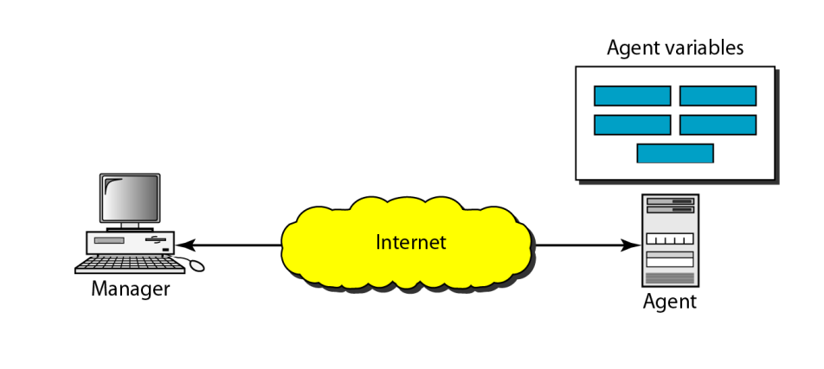
SNMP – Intro.
A framework for managing devices in an internet
Provides a set of fundamental operations
Uses the concept of manager and agent.
A manager is usually a host, controls and monitors a set of agents

Slide 3
SNMP – Intro.
It is an application-level protocol.
can monitor devices made by different manufacturers and installed on different physical networks.
heterogeneous internet made of different LANs and WANs
defines the format of packets exchanged between a manager and an agent. It reads and changes the status (value) of objects (variables) in SNMP packets

Slide 4
Managers and Agents
A Management station , called a Manager -> SNMP client program.
A Managed station , called an Agent -> SNMP server program.
Through simple interaction between a manager and an agent.
Agent - keep the information in a database
Manager - access the values in the database.
Eg: A router can store in appropriate variables such as a number of packets received and forwarded while the manager can compare these variables to determine whether the router is congested or not.
Agents - contribute to the management process.
A server program on the agent checks the environment, if something goes wrong, the agent sends a warning message to the manager

Slide 5
3 basic ideas
A manager checks an agent by requesting information that reflects the behavior of the agent.
A manager forces an agent to perform a task by resetting values in the agent database.
An agent contributes to the management process by warning the manager of an unusual situation

Slide 6
Structure of Management Information
Structure of Management Information, version 2 (SMIv2)
It emphasizes three attributes to handle an object
name
data type
encoding method.
Its functions are:
To name objects
To define the type of data that can be stored in an object.
To show how to encode data for transmission over the network

Slide 7
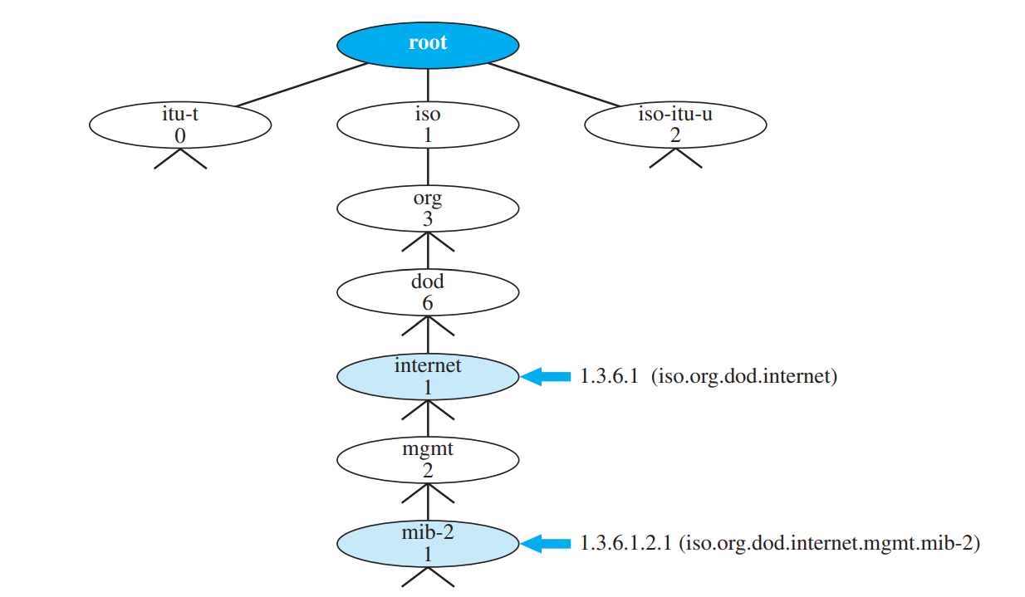
Name :
Have a unique name.
object identifier -> globally
hierarchical identifier based on a tree structure
tree structure starts with an unnamed root.
defined using a sequence of integers separated by dots
define using a sequence of textual names separated by dots.

Slide 8
Name :
The integer-dot representation is used in SNMP
The name-dot notation is used by people
The objects that are used in SNMP are located under the mib-2 object
Identifiers always start with 1.3.6.1.2.1.

Slide 9
Type:
Type of data stored in it.
SMI uses Abstract Syntax Notation One (ASN.1) definitions
adds some new definitions.
SMI is both a subset and a superset of ASN.1.
Two broad categories of data types
Simple
Structured

Slide 10
Simple Type
TYPE | SIZE | DISCRIPTION
Integer | 4 bytes | An integer with a value between −2^31 and 2^31−1
Integer32 | 4 bytes | Same as INTEGER
Unsigned32 | 4 bytes | Unsigned with a value between 0 and 2^32−1
OCTECT STRING | Variable | Byte-string up to 65,535 bytes long
OBJECT IDENTIFIER | Variable | An object identifier
IPAddress | 4 bytes | An IP address made of four integers
Counter32 | 4 bytes | An integer whose value can be incremented from zero to 232; when it reaches its maximum value it wraps back to zero

Slide 11
Simple Type
TYPE | SIZE | DISCRIPTION
Counter64 | 8 bytes | 64-bit counter
Gauge32 | 4 bytes | Same as Counter32, but when it reaches its maximum value, it does not wrap; it remains there until it is reset
TimeTicks | 4 bytes | A counting value that records time in 1/100ths of a second
BITS |  | string of bits
Opaque | Variable | Uninterpreted string

Slide 12
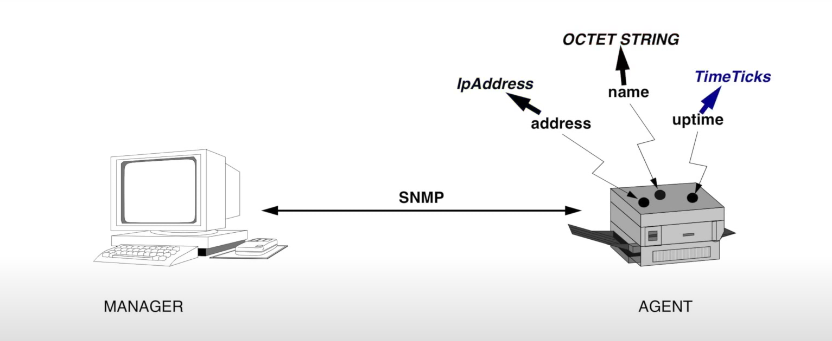

Slide 13
Structured data type
SMI defines two structured data types: Sequence and Sequence of.
Sequence.
combination of simple data types
analogous to the concept of a struct or a record used in programming languages such as C.
Sequence of.
combination of simple data types all of the same type
combination of sequence data types all of the same type.
analogous to the concept of an array used in programming languages such as C.

Slide 14
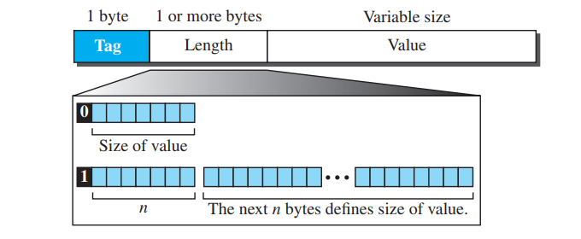
Encoding Method
Basic Encoding Rules (BER)
To encode data to be transmitted over the network.
Each piece of data be encoded in triplet format: Tag, length, and value (TLV)

Slide 15
Encoding Method
Tag : 1-byte field - defines the type of data
length field : can be 1 or more bytes .
If it is 1 byte, the most significant bit must be 0
other 7 bits define the length of the data
If it is more than 1 byte, the most significant bit of the first byte must be 1
The other 7 bits of the first byte specify the number of bytes needed to define the bit.
Value Field : The value field codes the value of the data according to the rules defined in BER.

Slide 16
Encoding Method
DATA TYPE | TAG(HEX) | DATA TYPE | TAG(HEX)
INTEGER | 02 | IPAddress | 40
OCTECT STRING | 04 | Counter | 41
OBJETC IDENTIFIER | 06 | Gauge | 42
NULL | 05 | TimeTicks | 43
SEQUENCE , SEQUENCE OF | 30 | Opaque | 44

Slide 17
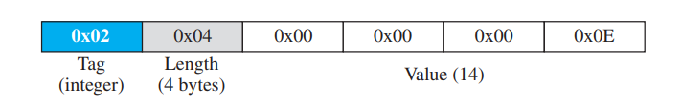
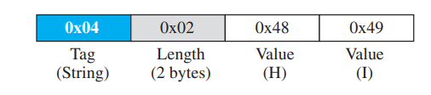
Define INTEGER 14
DEFINE OCTECT STRING “ HI “

Slide 18
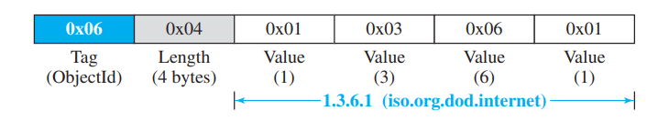
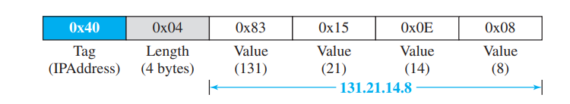
Define OBJECT IDENTIFIER 1.3.6.1
DEFINE IPAddress131.21.14.8

