Slide 1
Black-body radiation
Stefan-Boltzmann Law

Slide 2
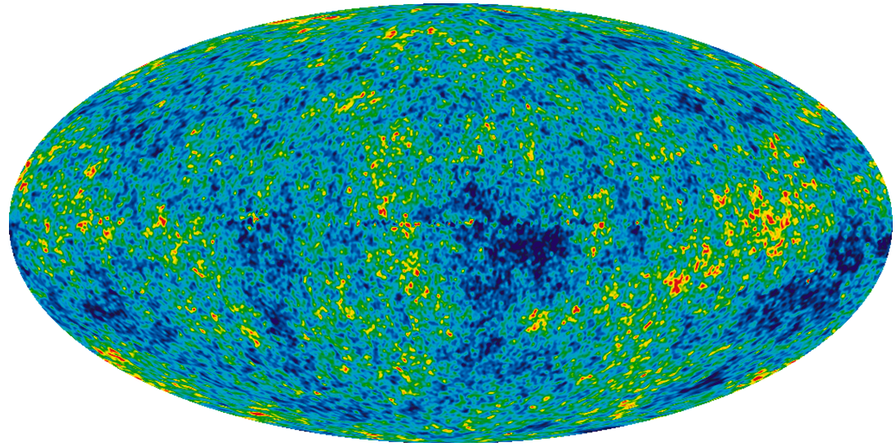
Interaction of Matter & Light
Thermodynamics does not allow for any object to have a temperature of ZERO
By virtue of its temperature (always non-zero), the object will emit light in the form of thermal radiation
This Photo by Unknown Author is licensed under CC BY

Slide 3
Interaction of Matter & Light
Matter emits light through other forms like fluorescence, bioluminescence, etc. Unlike thermal radiation, these emissions depend on the material composition & surface structure
Note:- Emission of radiation is completely different from reflection, refraction or scattering of light
All objects glow, even when they are not reflecting light
For most objects perceived by human eyes, this glow is not in the visible range. Reflection is the only reason they are visible

Slide 4
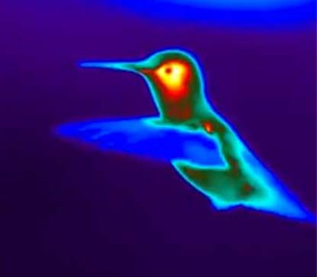
Interaction of Matter & Light
When light hits some object:
Depending on the material, specific wavelengths may be reflected or scattered, and others absorbed
The absorption leads to an increase in temperature, which requires the object to radiate away light as thermal radiation - emission

Slide 5
Black body
The concept of a black body makes things easier to compare & analyse. It is a hypothetical object that absorbs any & all wavelengths of light, and radiates it as thermal radiation
It is a perfect absorber & perfect emitter; therefore, it is forever in a state of thermal equilibrium with its surroundings
Its emission only depends on its temperature and nothing else.
Temperature cannot be “deleted”, and so a black body is an idealised baseline model

Slide 6
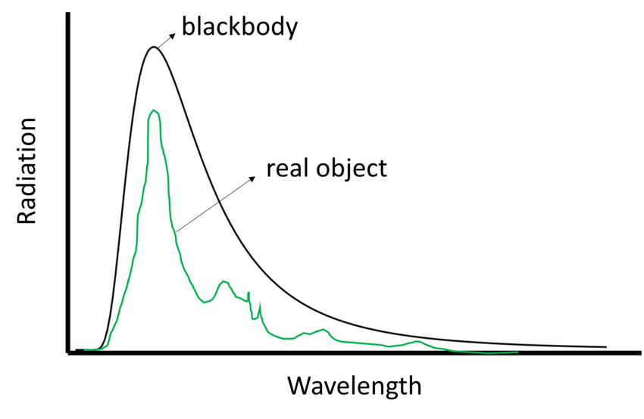

Slide 7
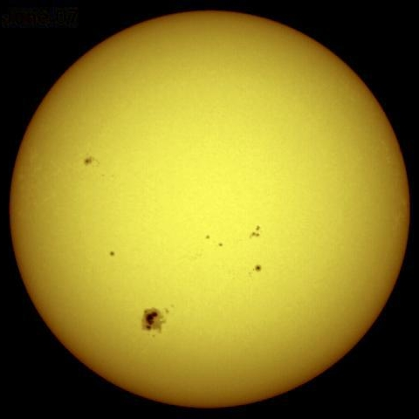
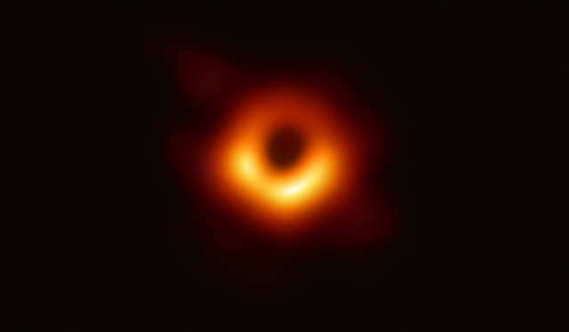
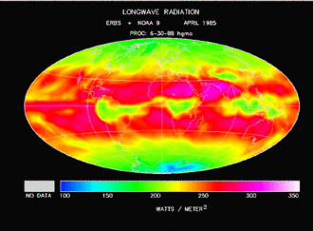
Black body
The thermal radiation emitted by a black body is called black body radiation
While there are no actual black bodies, there are close approximations of black bodies in nature

Slide 8
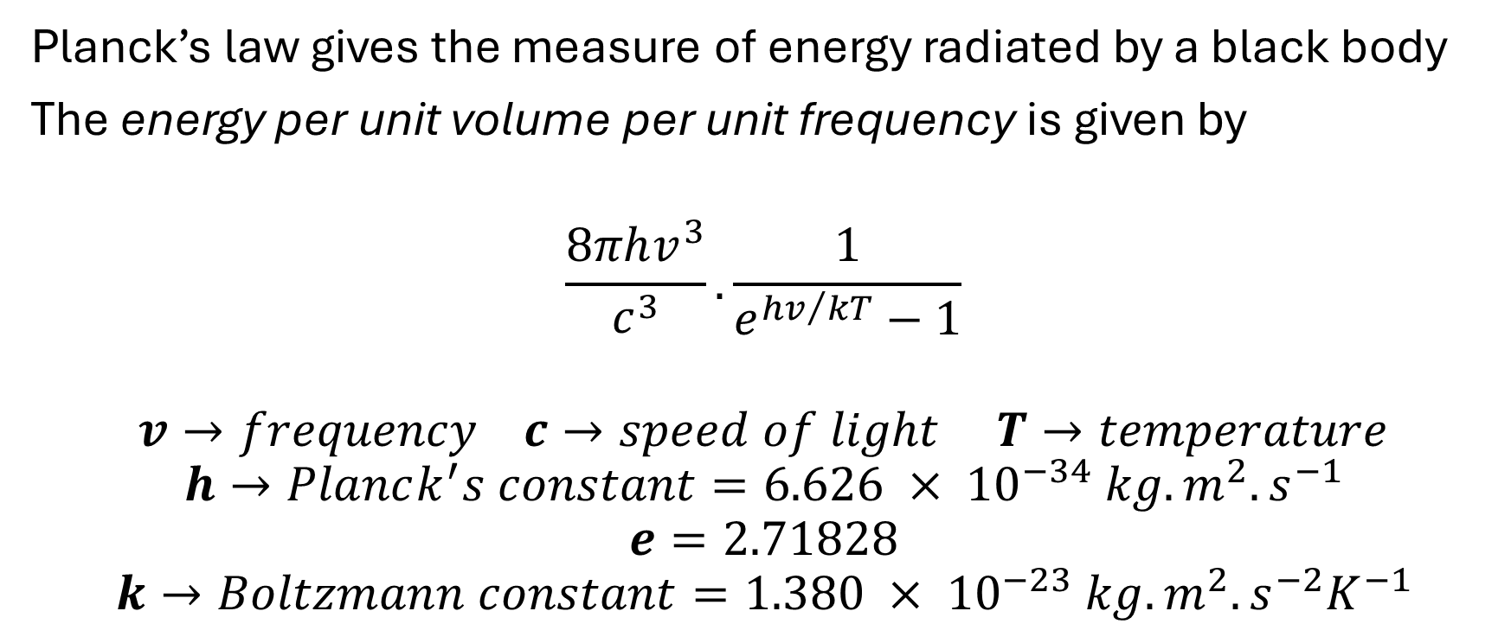
Planck’s law
Planck’s law gives the measure of energy radiated by a black body
The energy per unit volume per unit frequency is given by
$$\frac{8πhv^{3}}{c^{3}}. \frac{1}{e^{{hv}/{kT}}−1}$$
$$v→frequency c→speed of light T→temperature$$
$$h→Planck^{′}s constant=6.626 × {10}^{−34} kg.m^{2}.s^{−1}$$
$$e=2.71828$$
$$k→Boltzmann constant=1.380 × {10}^{−23} kg.m^{2}.s^{−2}K^{−1}$$

Slide 9
Stefan-Boltzmann law
The intensity of the thermal radiation due to the temperature is given by this law:
For a black body, the total energy radiated per unit surface area per unit time is directly proportional to the 4th power of the black body’s temperature
This law is a consequence of Planck’s law

Slide 10
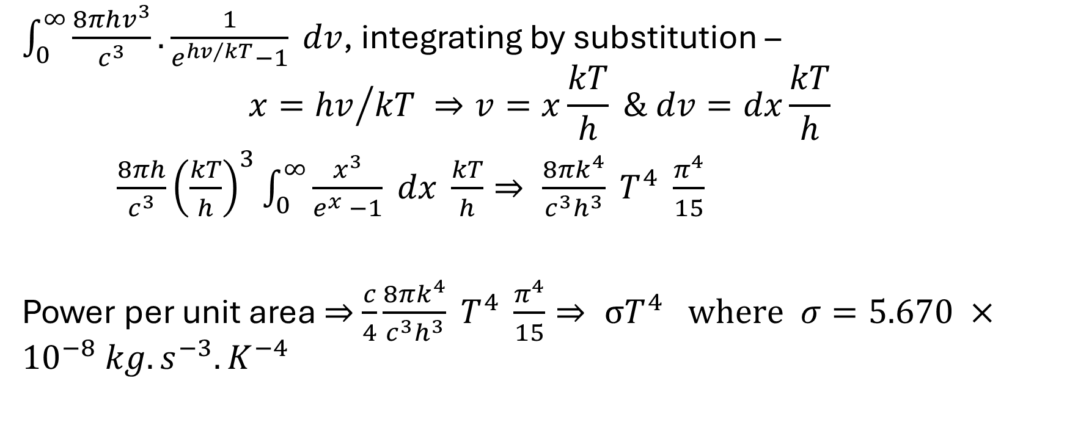
Stefan-Boltzmann law
$\int_{0}^{∞}{\frac{8πhv^{3}}{c^{3}}. \frac{1}{e^{{hv}/{kT}}−1} dv}$, integrating by substitution –
$$x={hv}/{kT ⇒v=x\frac{kT}{h} \& dv=dx\frac{kT}{h}}$$
$\frac{8πh}{c^{3}}{\left(\frac{kT}{h}\right)}^{3}\int_{0}^{∞}{\frac{x^{3}}{e^{x} −1} dx \frac{kT}{h}}⇒ \frac{8πk^{4}}{c^{3}h^{3}} T^{4} \frac{π^{4}}{15}$
Power per unit area $⇒$ $\frac{c}{4}\frac{8πk^{4}}{c^{3}h^{3}} T^{4} \frac{π^{4}}{15}⇒ σT^{4} where σ=5.670 ×{10}^{−8} kg.s^{−3}.K^{−4}$

Slide 11
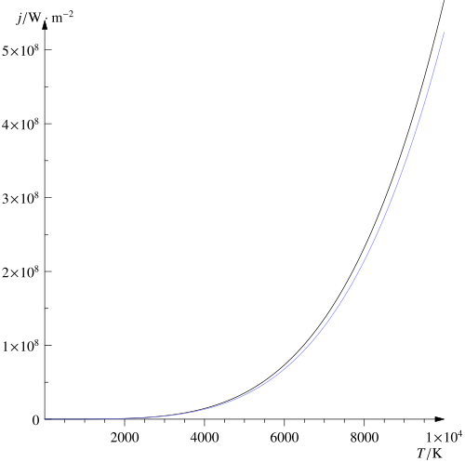

Stefan-Boltzmann law
Since black bodies are perfect absorbers & emitters, their emissivity $ε$= 1
General case:- P = $εσT^{4}$

Slide 12
