Slide 1
Two-Body Problem
D Likhith

Slide 2



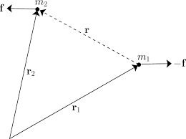
(Fair) Assumptions
2 bodies in free 3-dimensional space
No other force(s) involved other than the gravitational force by virtue of their masses
Define a reference frame. Draw position vectors from the center of masses of the two bodies and masses
Let be the relative distance between the 2 bodies

Slide 3
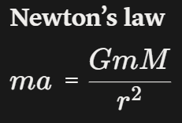



Two Content Layout with Table
On integration:-
So total linear momentum of the system is conserved

Slide 4


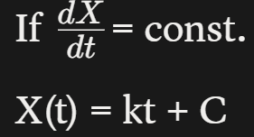


This implies it is constant also in direction, not just magnitide. Therefore, unless the centre of mass is at rest, it is otherwise moving in a straight line, at a constant speed
So, represents the initial position if it hasn’t moved

Slide 5






Now, for the total angular momentum
Angular momentum is defined as , for any object relative to an origin, which we have in our reference frame
So, we have
we know that R is a straight line and constant in magnitude. So, for our purposes, let’s keep R = 0

Slide 6
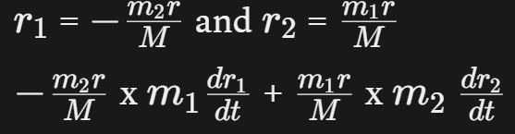






Doesn’t have any sideways or perpendicular component(s), if you look at the formula, only depends on the position vectors
Therefore, and angular momentum is conserved
Just like before, it is constant in magnitude & direction, but this is angular momentum ⇒ in 3-D

Slide 7
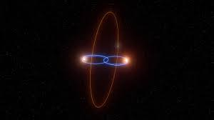
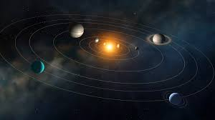
Therefore, the 2 bodies interact with each other in the same plane

Slide 8
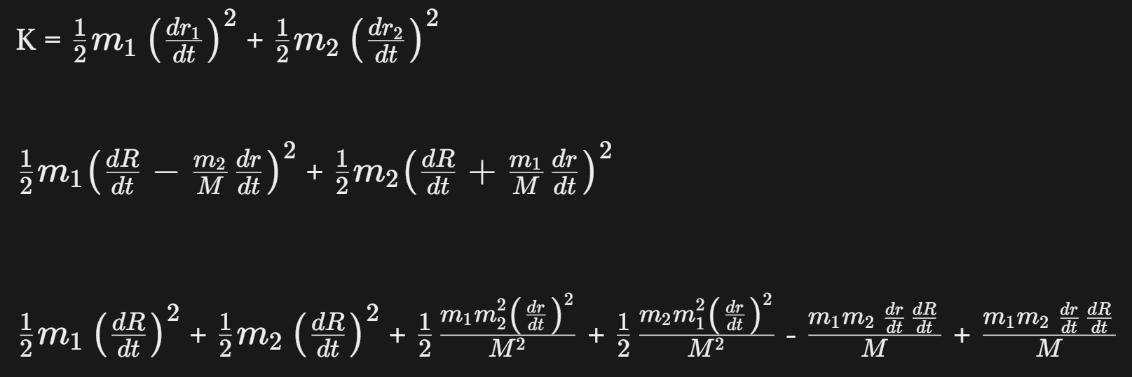
Now, let’s look at the energy of the system
T = K + P

Slide 9
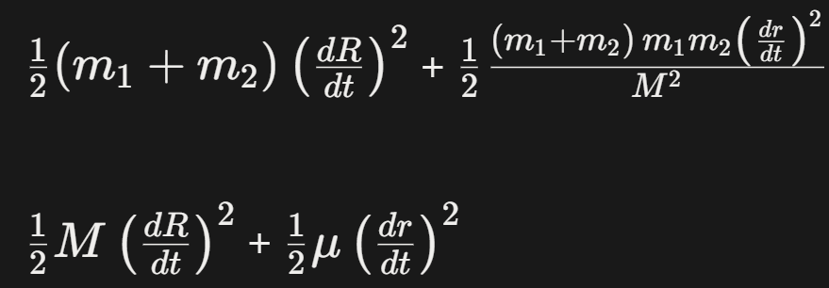

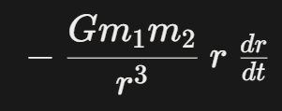
Now, differentiating this

Slide 10

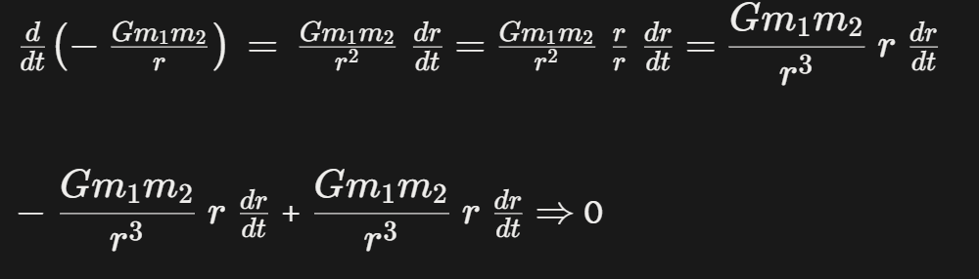
So total energy is constant; conserved

Slide 11
This directly explains Kepler’s 2nd law: when one body comes closer in its orbit, it goes faster as the potential energy terms becomes a large negative number, KE increases by that much as well
Similar action when it orbits further away, it moves slowest
When the total energy is exactly 0, KE = PE, meaning the bodies have the perfect escape velocity, the trajectory results in a parabola
When total energy is < 0, potential energy dominates since it is negative. The bodies do not have enough KE and so are gravitationally bound to each other, resulting in an ellipse
When total energy is > 0, the opposite, resulting in a hyperbola. The bodies are free and are not bound.

Slide 12
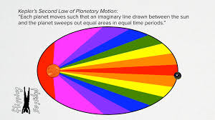

Slide 13
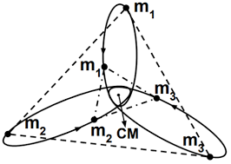
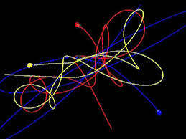
3-Body Problem
Unsolvable, too many unknowns
We would have 3 position vectors, but no relative position vector to connect all 3
More importantly, making microscopic changes dramatically changes the system in a very short period of time
When sending spacecraft, the approximate solutions are good enough, the 3-Body Problem demands a perfect answer, which is impossible
In supercomputer simulations, the effect of each body is calculated and updated, one step at a time dt
The approximate solutions work very well, giving reliable predictions for long periods of time

