Slide 1
Financial Transaction Fraud Detection Dashboard

Slide 2
Project Overview
This project focuses on analyzing financial transactions to detect fraudulent activities.
The dashboard was developed using Power BI to visualize patterns and anomalies in transactions.
The solution enables interactive exploration of transaction types, fraud distribution, and financial impact.
It helps financial institutions quickly identify suspicious behavior and potential fraud risks.

Slide 3
Project Objectives
Identify fraudulent transactions within large financial datasets.
Analyze transaction distribution by type and value.
Measure fraud rate and total financial impact.
Monitor fraud trends over time.
Provide an interactive dashboard for fraud investigation.

Slide 4
Dataset Overview
Dataset contains financial transaction records used for fraud detection analysis.
Key attributes include: Transaction Type, Amount, Old Balance, New Balance, and Fraud Flag.
Transaction types analyzed: CASH_IN, CASH_OUT, TRANSFER, DEBIT, PAYMENT.
The dataset includes thousands of records enabling realistic financial analysis.
Dataset contains 6000+ financial transaction records

Slide 5
Visuals Used in the Dashboard
Main Dashboard (Transaction Overview) Donut Chart – Transaction Distribution by Type Pie Chart – Fraud vs Non-Fraud Transactions Line Chart – Fraud Transactions Trend by Step Card Visuals – Total Transactions, Total Transaction Amount, Total Fraud Transactions, Average Transaction Amount Slicers – Transaction Type, Fraud Status
Fraud Analysis Dashboard Clustered Column Chart – Fraud Amount by Transaction Type Bar Chart – Fraud Transactions by Type Line Chart – Fraud Trend Over Time Card Visuals – Fraud Transaction Count, Fraud Amount, Fraud Rate
Fraud Investigation Dashboard Table Visual – Detailed Fraud Transaction Records Column Chart – Fraud Transactions by Transaction Type Bar Chart – Fraud Amount Distribution by Type Slicers – Transaction Type, Fraud Status, Step

Slide 6
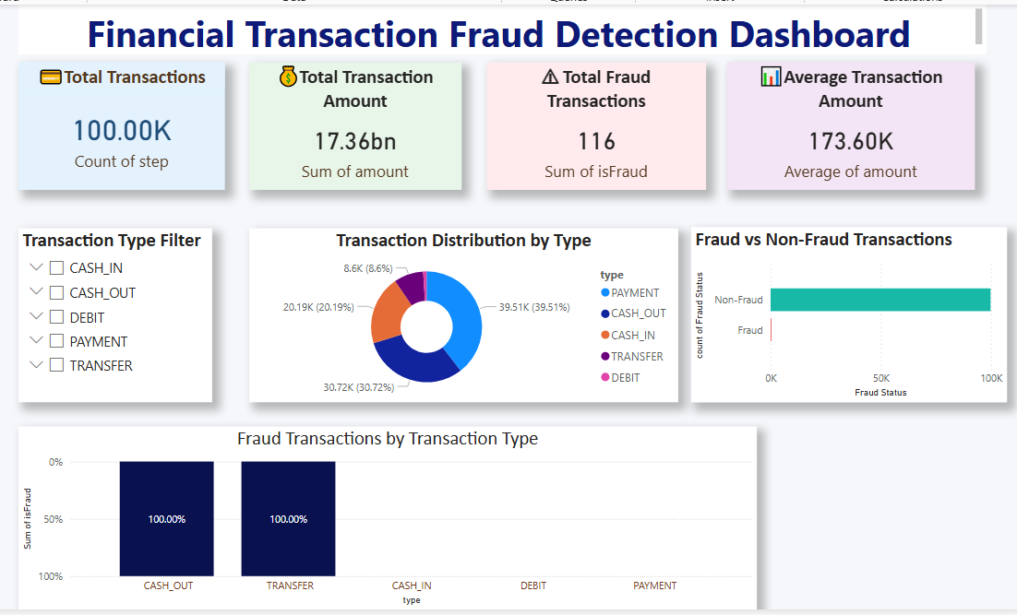
Snapshots

Slide 7
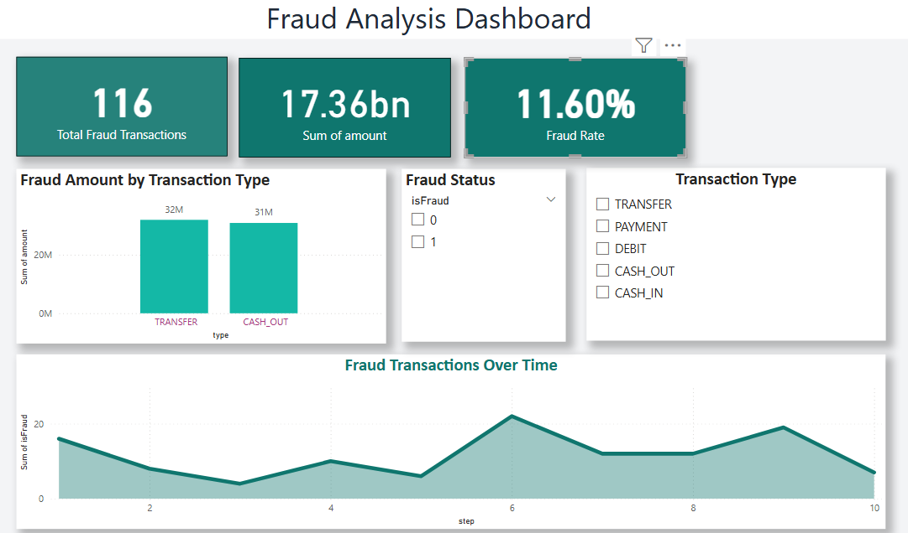

Slide 8
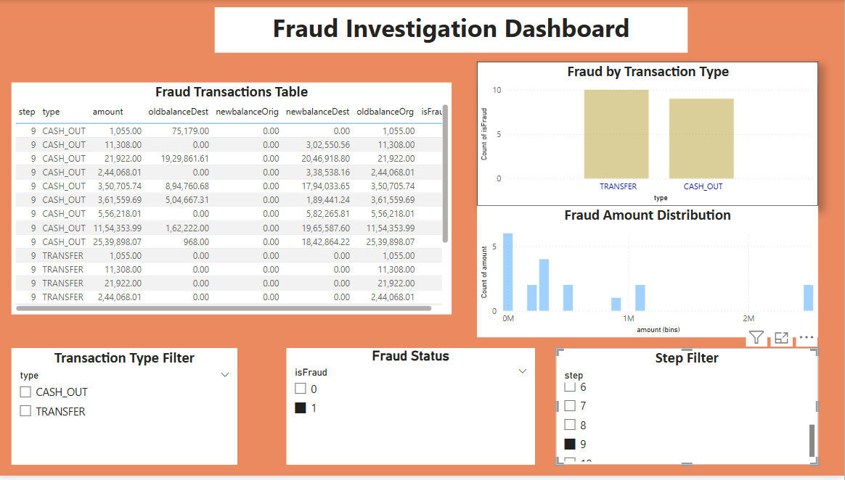

Slide 9
Key Insights
Total Transactions: 6,362 Fraud Transactions: 821 Fraud Rate: 12.9%
CASH_OUT and TRANSFER transactions show the highest fraud occurrence.
Most transactions are legitimate, with fraud representing a small percentage.
Large transaction amounts are more likely to be associated with fraudulent activity.
Fraud trends fluctuate over time, indicating periods of higher risk.

Slide 10
Business Value
Helps banks and financial institutions detect suspicious activities quickly.
Improves fraud monitoring and investigation efficiency.
Supports data-driven decisions in financial risk management.
Enhances transparency in financial transaction analysis.

Slide 11
Conclusion
The Power BI Fraud Detection Dashboard provides clear insights into transaction behavior.
Interactive filters allow analysts to explore fraud patterns efficiently.
The project demonstrates strong skills in data cleaning, modeling, and visualization.
This solution can be extended using machine learning models for advanced fraud prediction.

