Slide 1
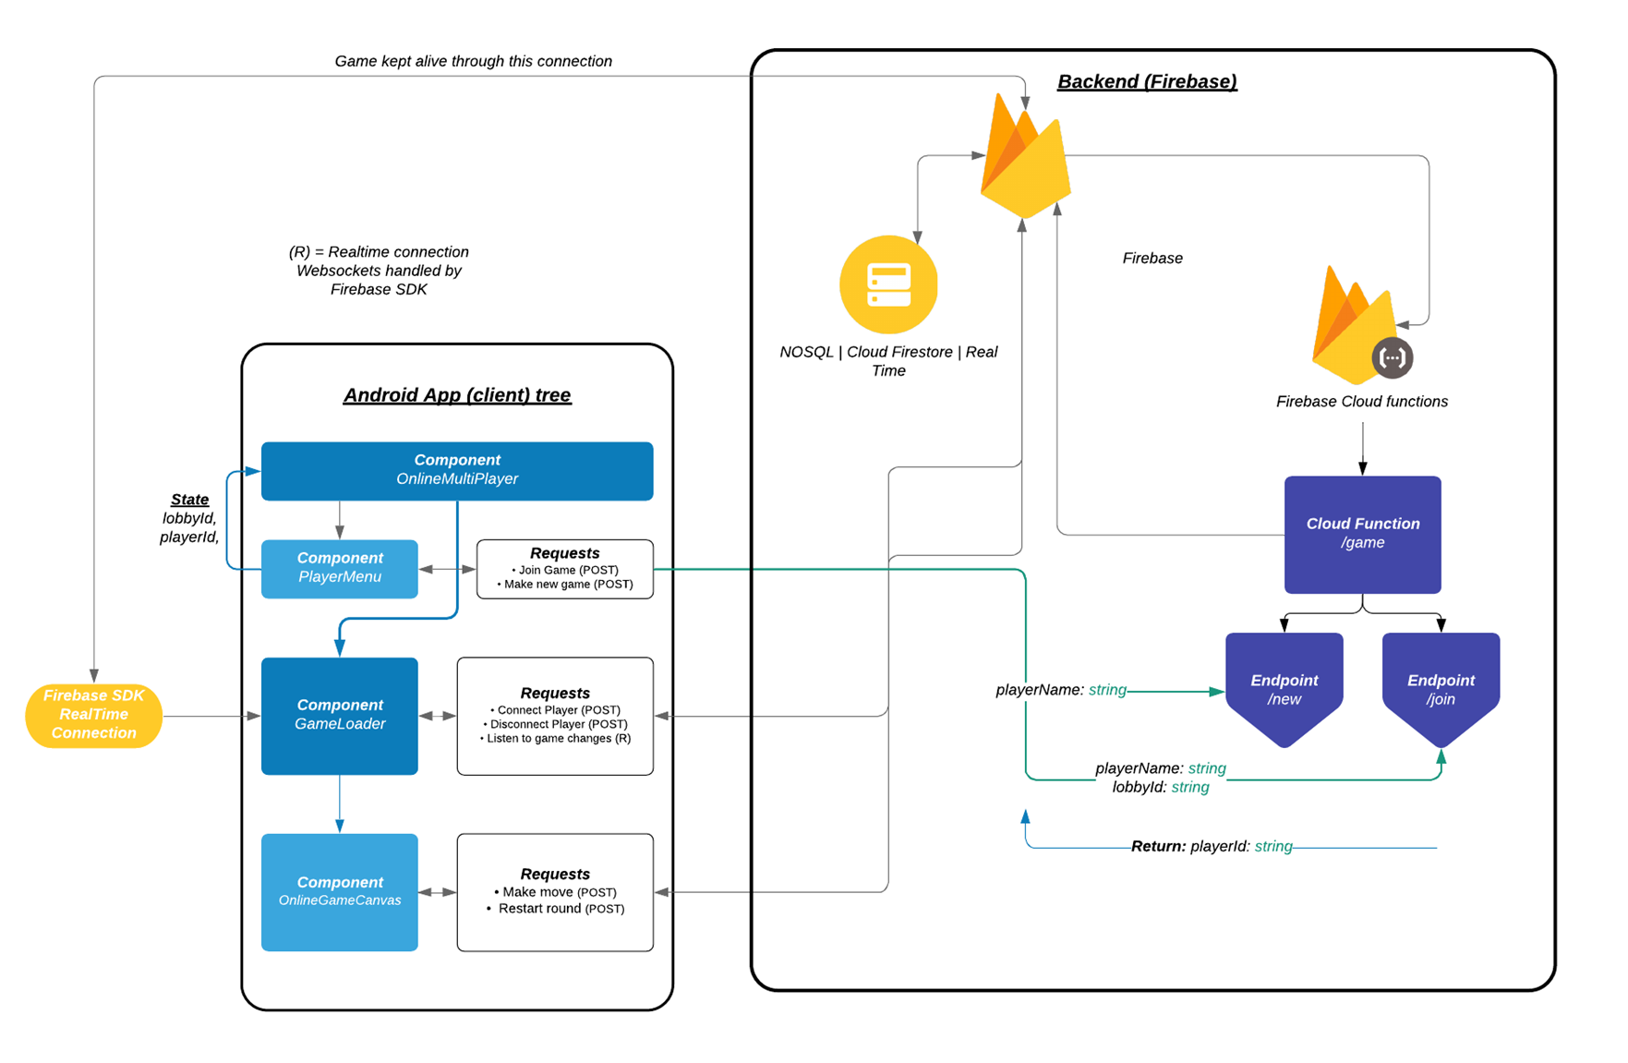

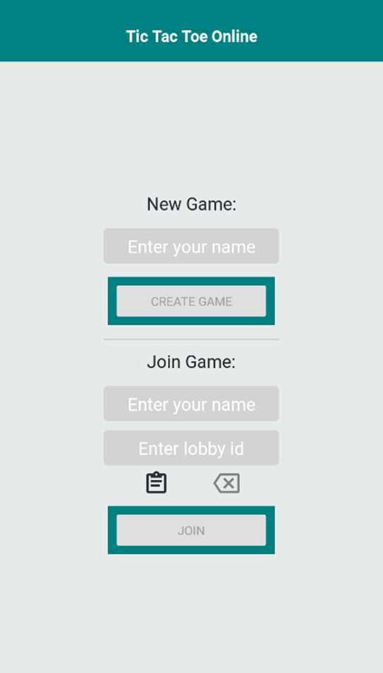
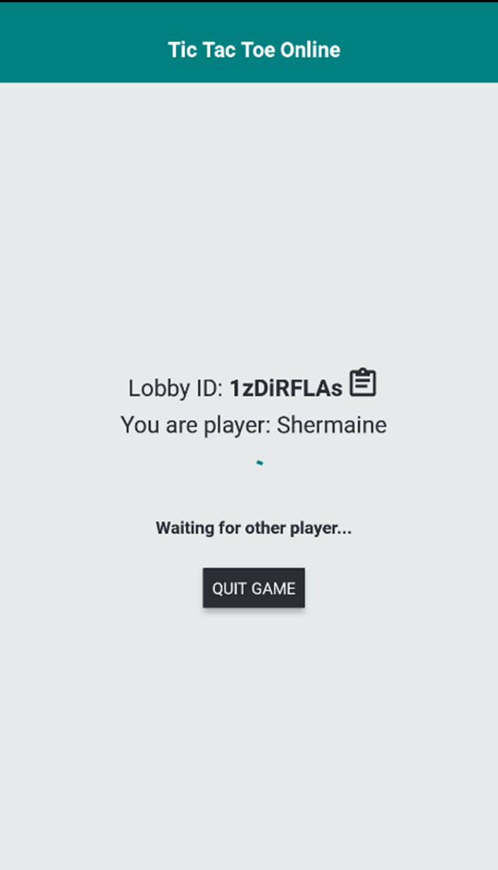
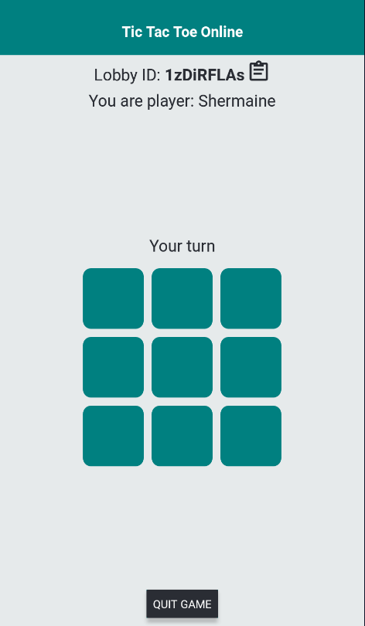
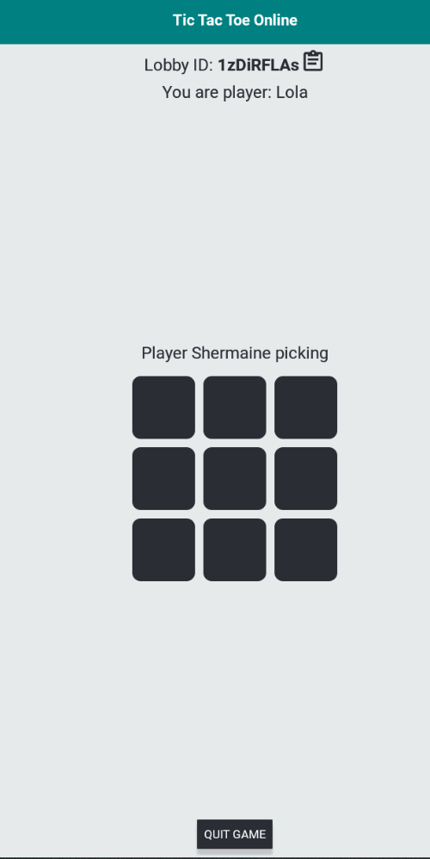
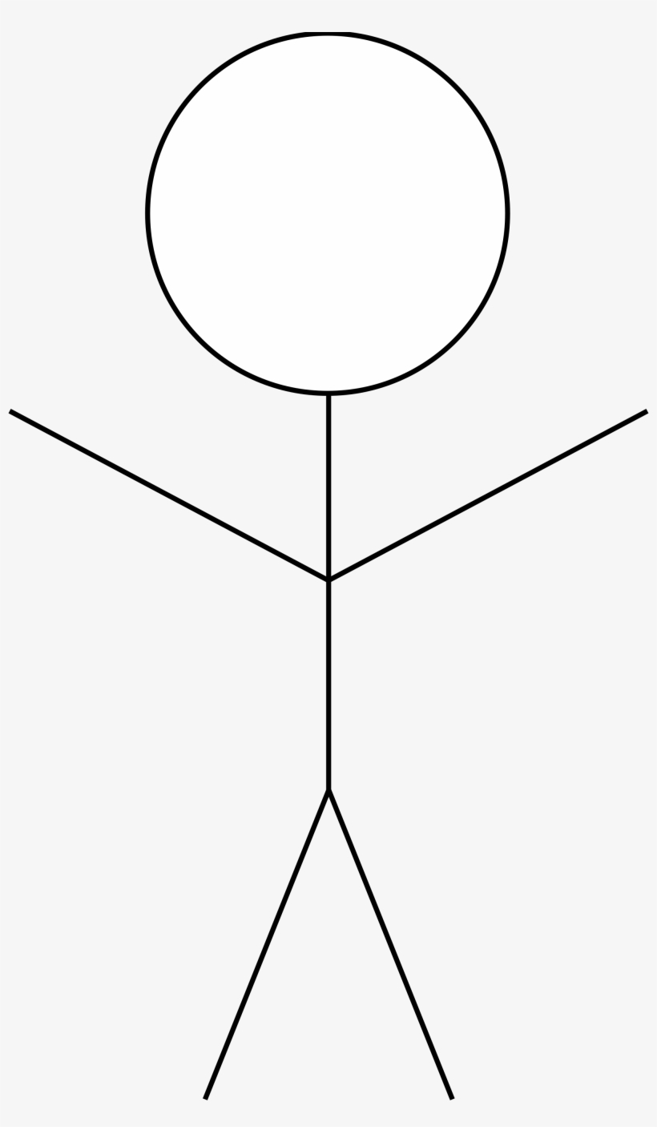

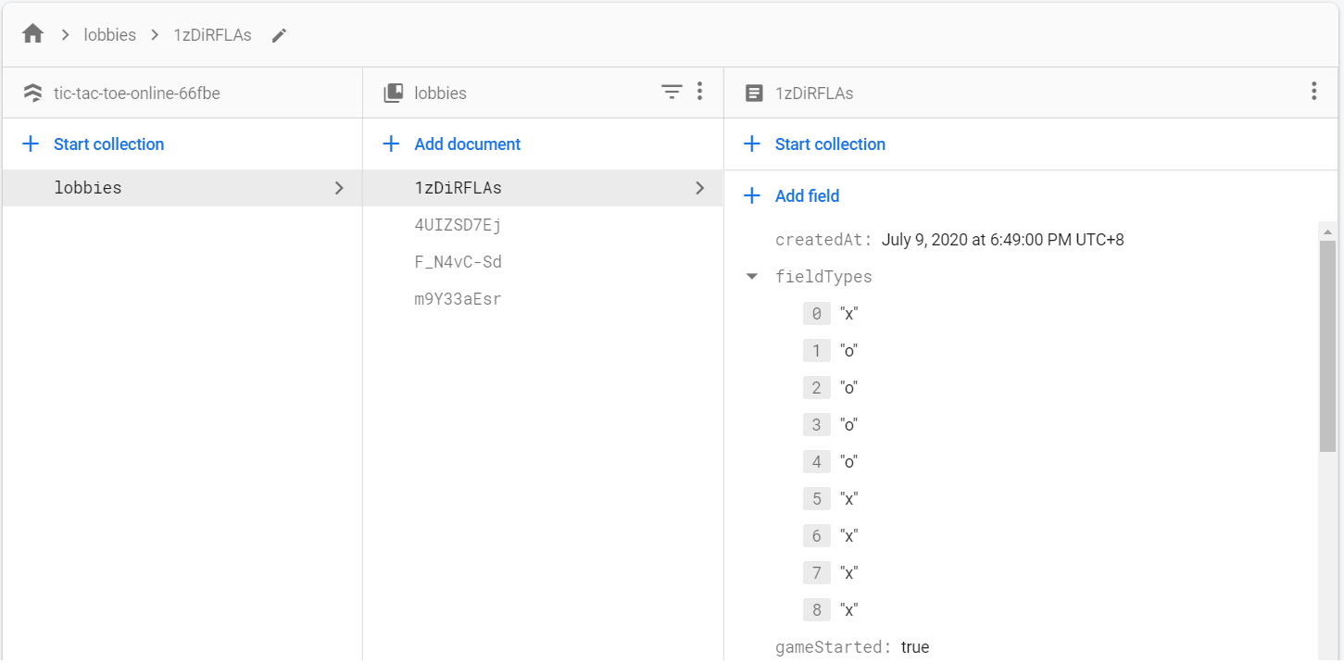
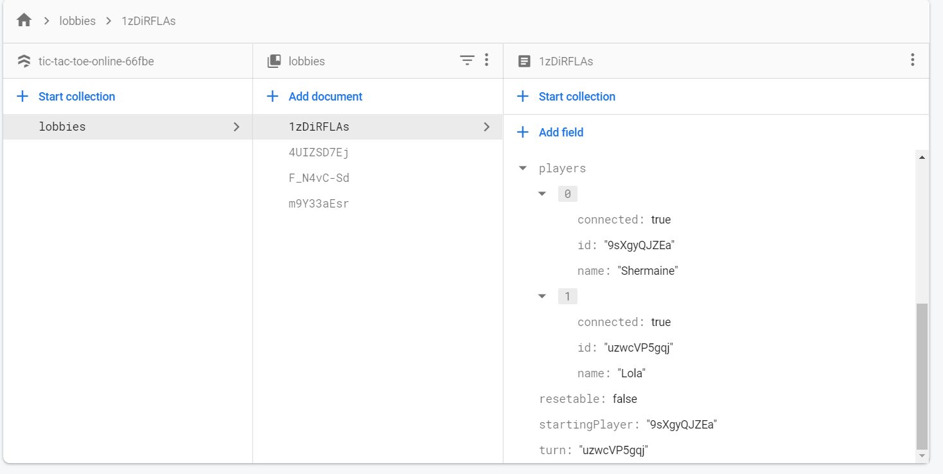
System Architecture and infrastructure components
A look at how the game functions
Moves recorded in cloud database
Lobby ID, Player Name, Player ID are recorded in cloud database
8. Player 1: X makes a move first. Green tiles when it is the player’s turn.
9. Player 2: O makes a move after Player 1: X. Black tiles when it is not the player’s turn.
2 Players
Player 1: X
1. Enter Name
3. Await Player 2: O
2. Create Game
-Call /new endpoint
7. Both Players Connected
Makes a move
4. Enter Name
Makes a move
Player 2: O
5. Enter Lobby ID
6. Join – Get Lobby Info
A look at the data records in Cloud Database
Various Lobby ID , date/time created, and fieldTypes of Tic Tac Toe Grid with moves stored
Player Name and ID are stored.

Slide 2


AWS Lambda versus Firebase
Ease of deployment
Efficient scalability
Cost
Future Improvements
Garbage Collection

