Slide 1

Distance Learning On Demand:
Creating a Student-Friendly Platform for Instructional Library Videos

Slide 2
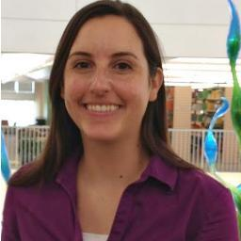
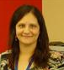

Project Leaders
Michelle Keba
Distance & Instructional Services Librarian
Nova Southeastern University
Evaluating Video Best Practices
Jamie Segno
Reference/Outreach Librarian
Nova Southeastern University
Transformational Change
Michael Schofield
Web Services Librarian
Nova Southeastern University
Designing the Video Platform

Slide 3
Outline
Overview of Nova Southeastern University Libraries & Students
Instructional Video Best Practices that Shaped Our Platform
How We Implemented Changes
Notes:
Today we’re going to discuss a little background on NSU Libraries and the students we serve, the instructional video best practices that influenced our decisions regarding our video platform, and how we managed to successfully implement these changes.

Slide 4
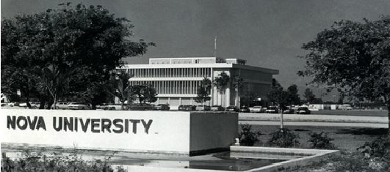
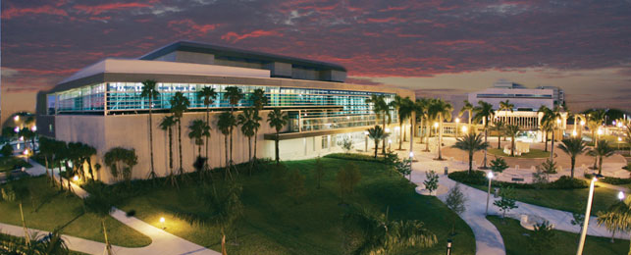
Nova Southeastern University
Notes:
To start, we wanted to share a little information about Nova Southeastern University to help put our project in context, which influenced our decisions throughout this project. NSU is the eighth largest not-for-profit private institution in the United States and has been a pioneer in distance education since 1972.

Slide 5
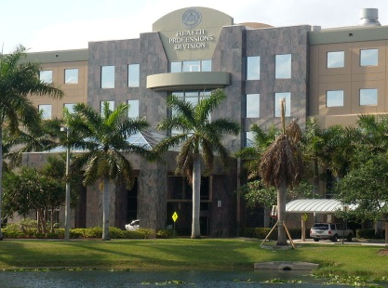
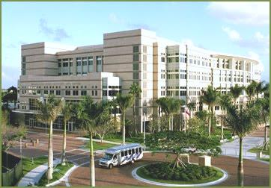
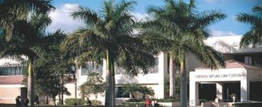
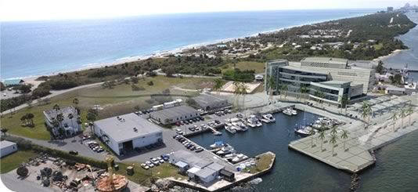
NSU Libraries
Notes:
NSU’s library system is primarily comprised of four branches: (1) the Alvin Sherman Library, Research, and Information Technology Center, (2) the Health Professions Division Library, (3) the Law Library, and (4) the Ocean Sciences Library.
The Alvin Sherman Library on the main campus in Fort Lauderdale, Florida, serves as NSU’s main library and is a joint-use facility that is also open to the public as well as NSU students and faculty.

Slide 6
NSU Students
(NSU Office of Institutional Effectiveness, 2013)
Notes:
Current enrollment nears 27,000 students with a breakdown of approximately 21% undergraduate, 64% graduate, and 15% professional students. As you may have noticed, NSU is a little unique in that it primarily awards graduate, doctoral, and professional degrees so, for us, that is something we need to consider when creating our instructional library videos.

Slide 7
NSU Students
(NSU Office of Institutional Effectiveness, 2013)
Notes:
Approximately 22% of NSU students attend classes outside of Broward County, of which, 2% attend classes at international sites.

Slide 8
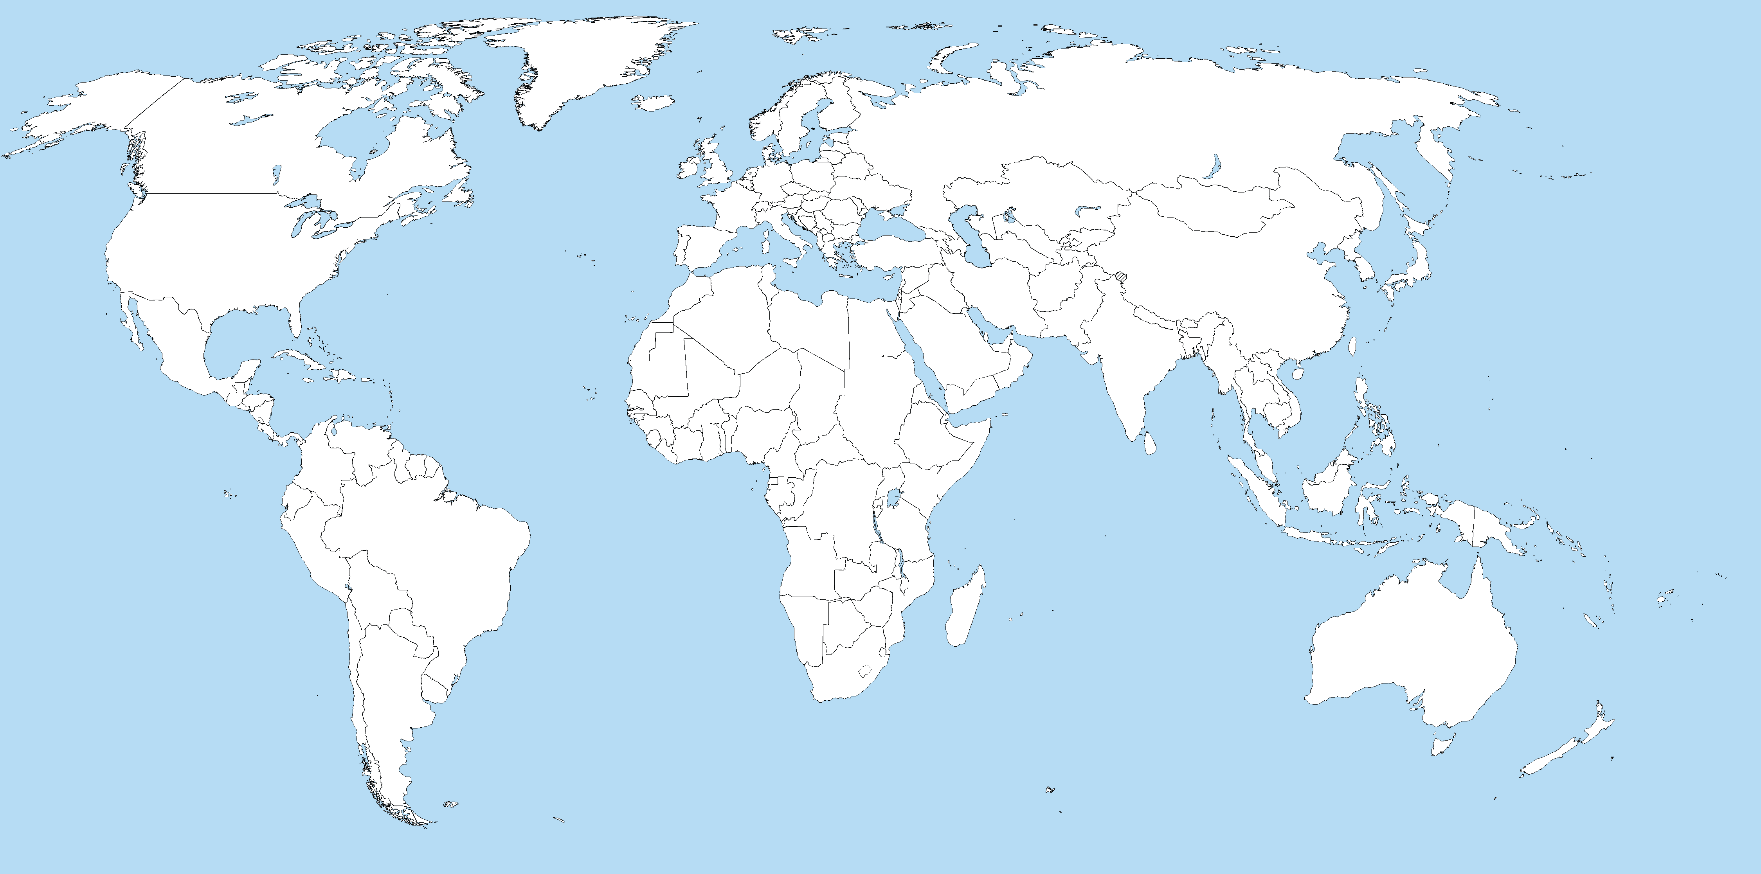
Distance Students
Notes:
NSU has distance education programs in 12 countries, 16 states including Florida, and Puerto Rico. With so many students participating in a distance education program, the library’s instructional video tutorials provide an invaluable resource for students in need of asynchronous library training.

Slide 9
The Problem
User Experience &
Content Creation Procedures
Notes:
Thus, NSU librarians have created many helpful video tutorials instructing how to use the library’s resources. However, until recently, there was no consistent method for presenting and maintaining these videos.

Slide 10



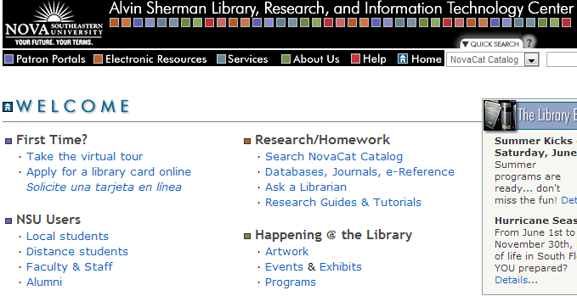
Inconsistencies
Notes:
These inconsistencies left students without a designated location to look for tutorials and often exposed students to diverse video formats that hindered the ease and fluidity of viewing multiple recordings, disrupted accessibility compliance, and resulted in incompatibility issues among different Internet browsers and mobile devices. Moreover, librarians lacked an efficient process for taking inventory and updating existing videos, which often resulted in duplicated work efforts, diminished productivity, and loss of original videos files upon staff departures.
-no persistent URL in YouTube

Slide 11
Our Solution
LIBRARYLEARN
Learn to use the library like a pro
View short videos by NSU Librarians
Notes:
In order to overcome these challenges, a team of NSU librarians came together to investigate the best practices for creating, maintaining, and hosting videos as well as how to lead a video reorganization project through a transformational change that would result in the creation of the LibraryLearn platform.

Slide 12
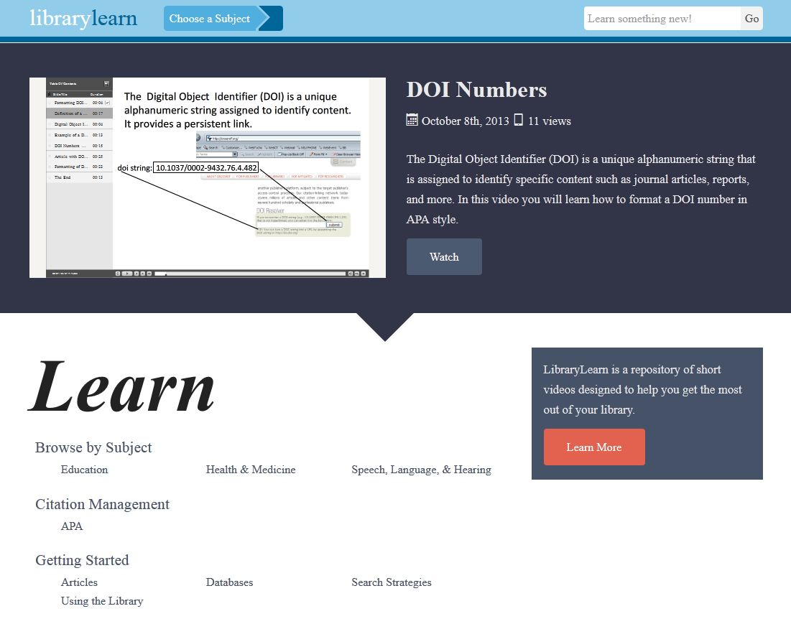

Slide 13
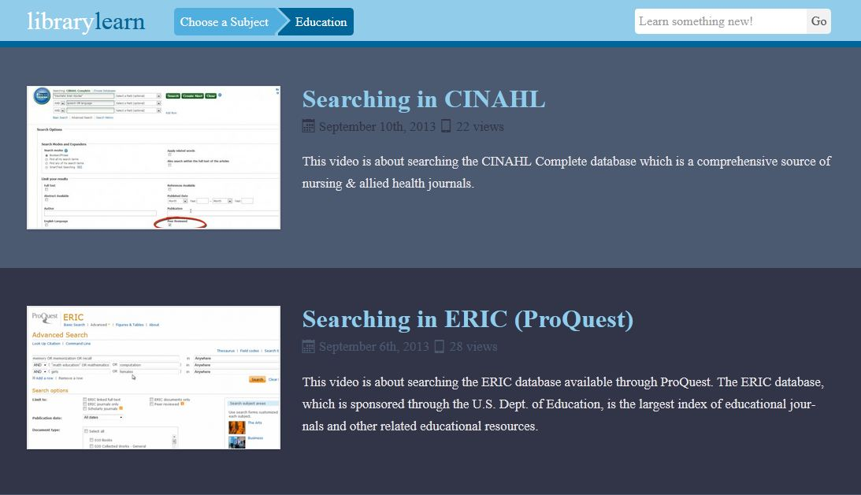

Slide 14
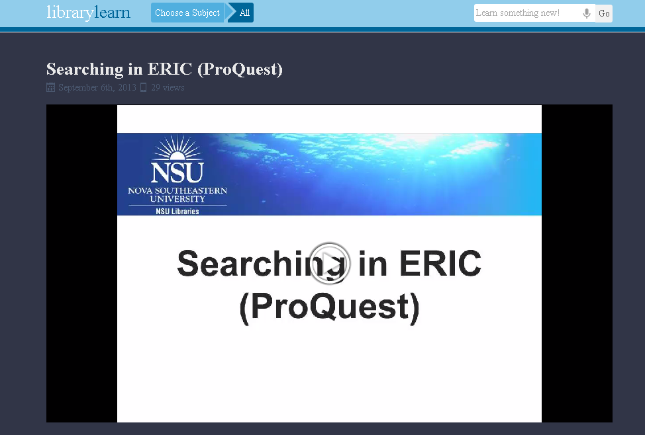

Slide 15
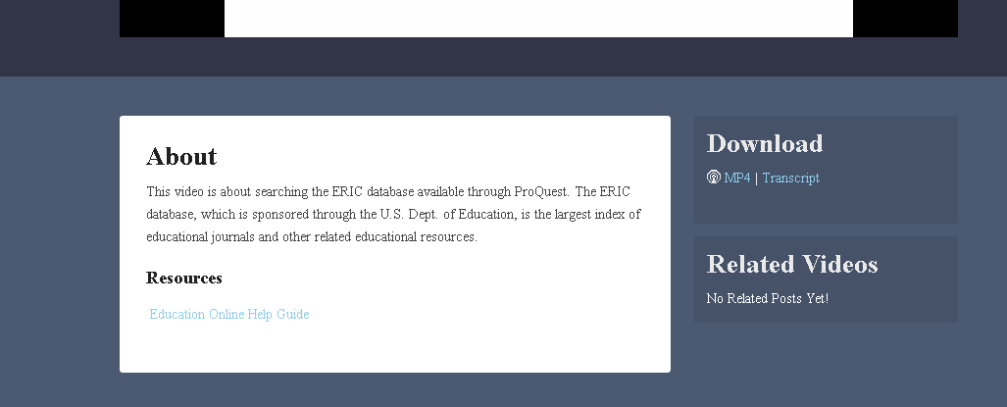

Slide 16
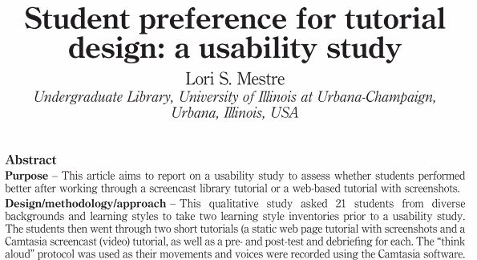
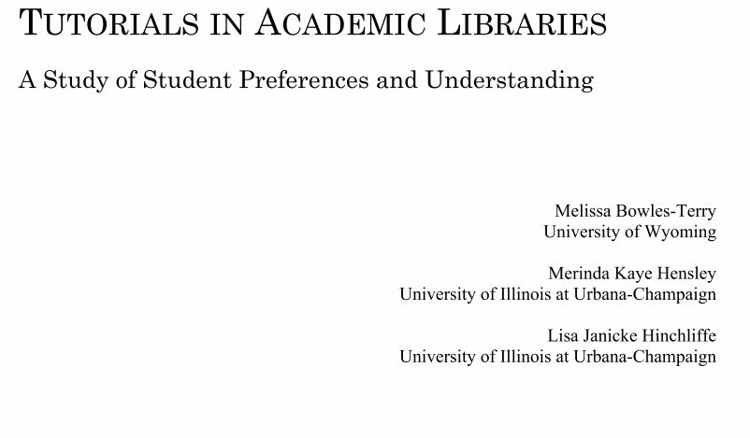
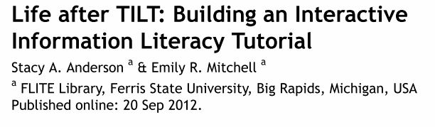
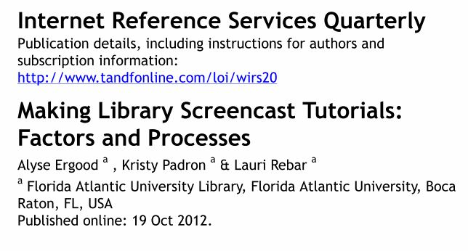
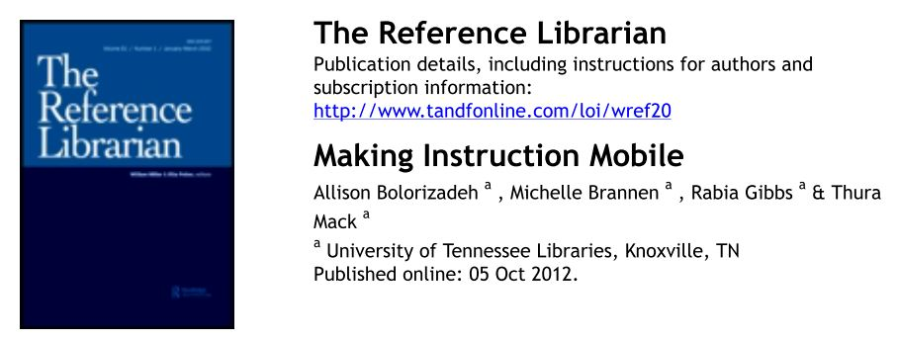
Review of the Literature
Notes:
Discuss the libraries that were investigated:
-Ferris State University Big Rapids, Michigan
-University of Illinois at Urbana-Champaign
-Florida Atlantic University
-University of Tennessee Libraries
Where to find the bibliography?

Slide 17
Best Practices
Video Management
Length
Location
Content

Slide 18
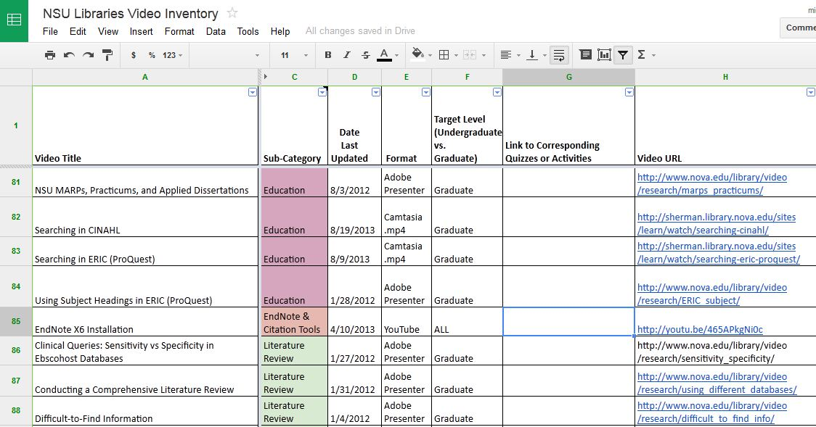
Managing Videos: Inventory

Slide 19
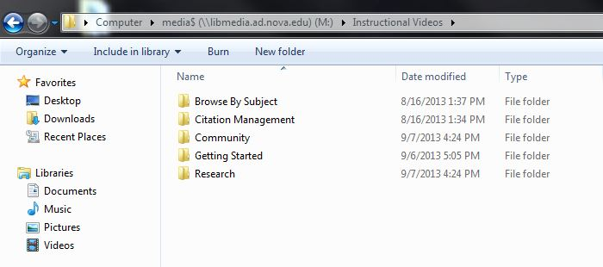
Managing Videos: File Storage

Slide 20
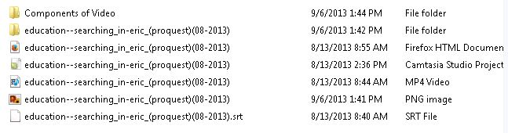
Managing Videos: File Naming
Notes:
-Made a through file naming convention

Slide 21
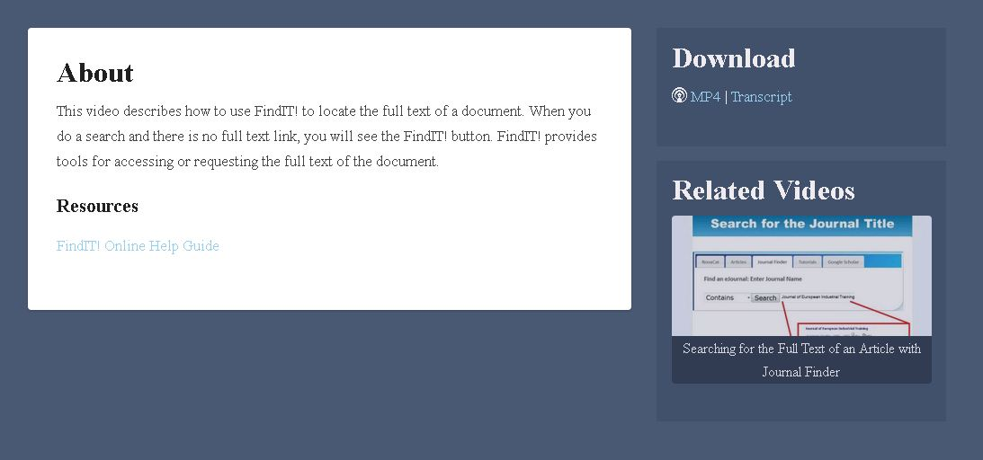
Length
Notes:
-short and to the point (Anderson & Mitchell, 2012; Bolorizadeh, Brannen, Gibbs, & Mack, 2012; Bowles-Terry, Hensley, & Hinchliffe, 2010; Ergood, Padron, & Rebar, 2012)
-modular (Anderson & Mitchell, 2012)

Slide 22
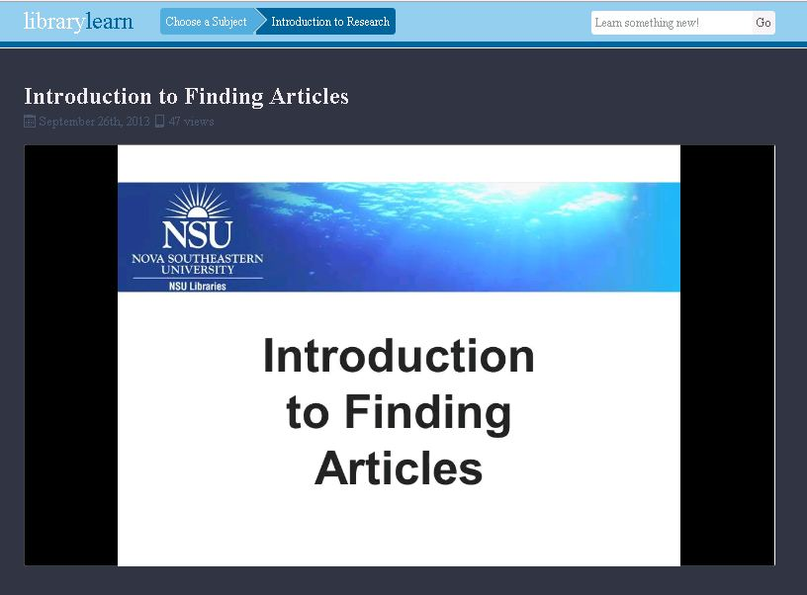
Content
Notes:
-important information introduced at the beginning of the video (Bowles-Terry et al., 2010)
-clean straightforward manner, can be utilitarian rather than overly flashy (Bowles-Terry et al., 2010)
-standardization through the use of a common introductory slide and a final slide with a summary of the video’s most important points (Ergood et al., 2012)
-Include captions to not only meet accessibility standards, but also for viewers who do not have access to computer speakers as well as English language learners who might benefit from processing the information both visually and aurally (Bowles-Terry et al., 2012; Ergood, Padron, & Rebar, 2012)

Slide 23
Accessible
ADA-Compliant Captions or Transcript
Providing text alternatives makes the audio information accessible to people who are deaf or hard of hearing. This also gives the search engines something to digest.
Camtasia exports .SRT, and that’s fine for now, but the future standard is WebVTT (.vtt).
The track element has okay support
Chrome 23, IE 10, Opera 12.10, Safari 6.
Not Firefox (yet).
Support will get better.
Example <video> <source src=“/your/video.webm” > <source src=“/your/video.mp4” > <track kind=“subtitles” src=“/your/video.srt” srclang=“en” label=“English”> </video>

Slide 24
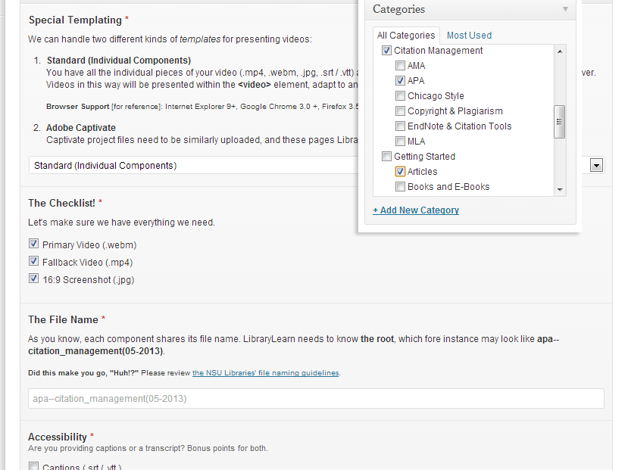
Content Modeling: the Pieces of the Puzzle
Rather than having a dashboard where one can just attach the video and publish, we broke the process into multi-part steps.
Notes:
Rather than having a dashboard where one can just attach the video and publish, we broke the process into multi-part steps. On one hand, this makes it easier on the library staff who can walk through each step, refer to instructions without jumping off screen, as well as prevent publishing if required fields aren’t filled – like the check list.

Slide 25
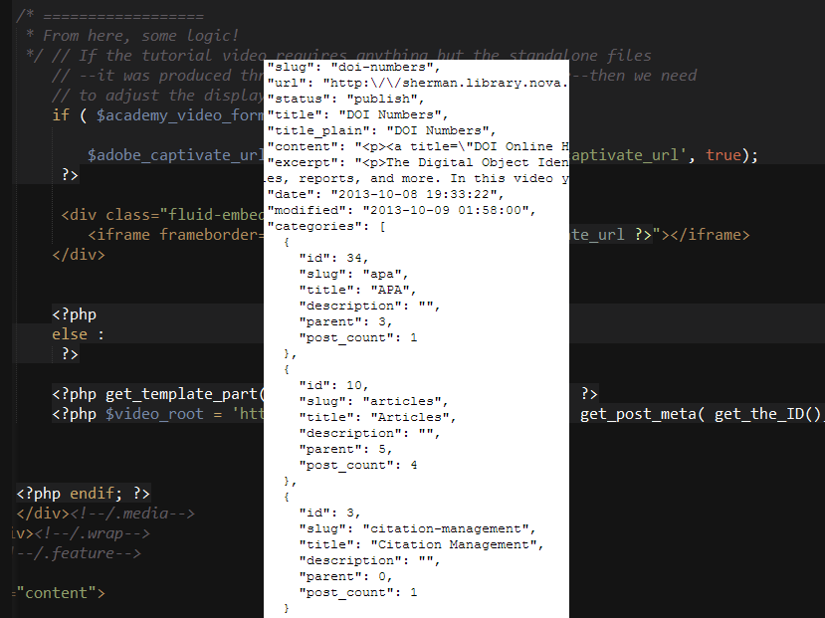
Content Modeling: Granular Control
The real advantage of breaking the process into multiple parts is that it allows developers granular control.
Notes:
The real advantage of breaking the process into multiple parts is that it allows developers granular control over how the content is displayed and which content is displayed for what circumstance. Note: If anyone asks, the black part is PHP, and the white part is the JSON (pronounced “Jason”) data that can be used to dynamically syndicate content.
You can show what pieces of content you want per device. For example, mobile users won’t necessarily need to download the video so this option could be removed for mobile users.

Slide 26
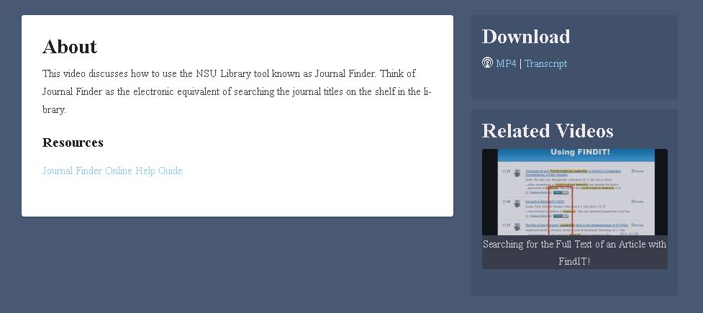
Appealing to Multiple Learning Styles
Notes:
While several studies (Anderson & Mitchell, 2012; Bowles-Terry, Hensley, & Hinchliffe, 2010; Mestre, 2010) encouraged librarians to create multiple formats which would appeal to students’ various learning styles, a recent study by Mestre (2012) found that students actually preferred and performed better when using a static web page tutorial as opposed to a screencast tutorial. In their article Bolorizadeh, Brannen, Gibbs, and Mack (2012), also highlight the increasing use of mobile devices. As mobile use increases, librarians should ensure that their videos will be mobile friendly.

Slide 27
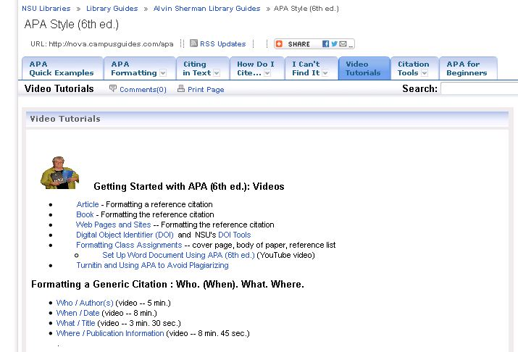
Location
Notes:
-Point of need (Bolorizadeh, Brannen, Gibbs, & Mack, 2012; Bowles-Terry, Hensley, & Hinchliffe, 2010; Ergood, Padron, & Rebar, 2012)
-We also needed a centralized location so that libraries are aware of all the available videos Bowles-Terry, Hensley, and Hinchliffe (2010)

Slide 28
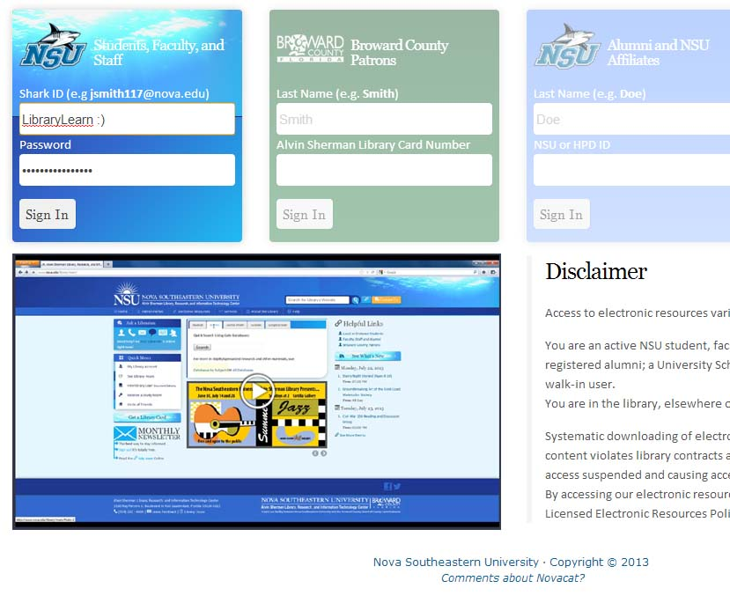
Dynamically Created Locations
Notes:
- Ability to link-to or embed them. Both can be dynamic, i.e., if a user is browsing through subject databases, the website can query LibraryLearn to see if there are any topically relevant videos, and if there is a match bring that video right to the user.

Slide 29
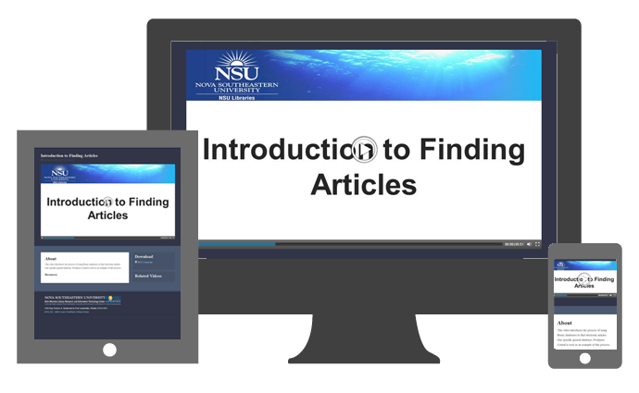
Device Agnostic
Notes:
-“Projections for the next 5–10 years are that the majority of the population will have mobile access and that smartphone ownership will eventually match PC ownership, which currently included 80% of the population in the U.S. (Smith, 2010). In addition, mobile devices will become the primary method of Internet access (Rainie & Anderson, 2008).” (Bolorizadeh, Brannen, Gibbs, & Mack, 2012)
-Needed to move videos into non Flash format
-Wanted a mobile first design

Slide 30
Implementing Change
Build a Working Group
Communicate Effectively
Meet Project Deadlines
Document Final Procedures
Notes:
Now that we’ve discussed an overview of the best practices that helped shape our decisions for LibraryLearn, we’ll shift gears to discuss how we were able to successfully implement these changes. As you might imagine, the process for designing a student-friendly video repository required a transformation in how our librarians created instructional videos. To do this, effective leadership was essential so let’s take a closer look at how we were able to build an efficient working group, communicate effectively, meet project deadlines, and document the final procedures for creating and maintaining instructional videos at our institution.

Slide 31
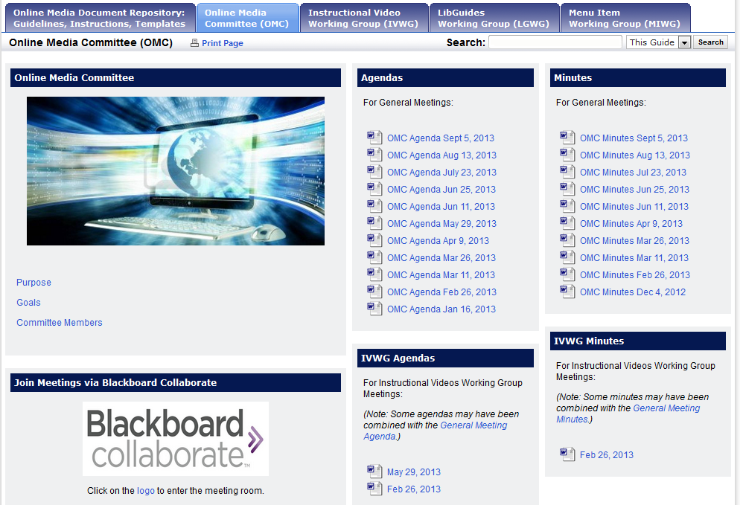
Building a Working Group
Notes:
So, the first step in this process was to establish a team of librarians to work on this project. While autonomy in video production would still be encouraged, librarians now needed to consider their actions in relation to an overarching procedure that would govern all librarians working on similar video projects. To lead this transformational change toward a more collaborative process, an Instructional Video Working Group was created and integrated as a subset of the library’s Online Media Committee, which oversees librarian-created online content.

Slide 32
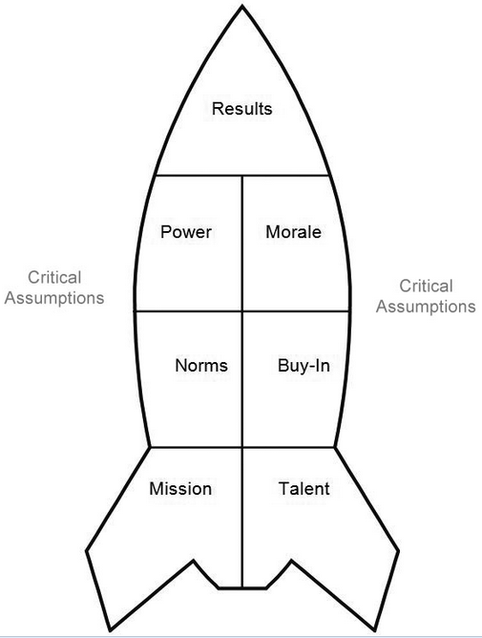

Building a Working Group
Notes:
As co-chairs of the Online Media Committee, Michelle and I utilized the Rocket Model of Team Performance to build an effective, high performing team by focusing on the six interrelated components that influence results (Curphy, 2008). This model emphasizes that successful work teams are comprised of the right number of members with clearly defined roles and the skills required to achieve team goals. While LibraryLearn originally began as a project within the Alvin Sherman Library, we decided to try to make our team as inclusive as possible so we extended invitations to the other three branches to participate. Membership selection was based on primary job function and related skills, which ultimately led to a team comprised of instructional librarians from the four NSU Libraries that each possessed knowledge of student needs, video editing, and basic web design.

Slide 33
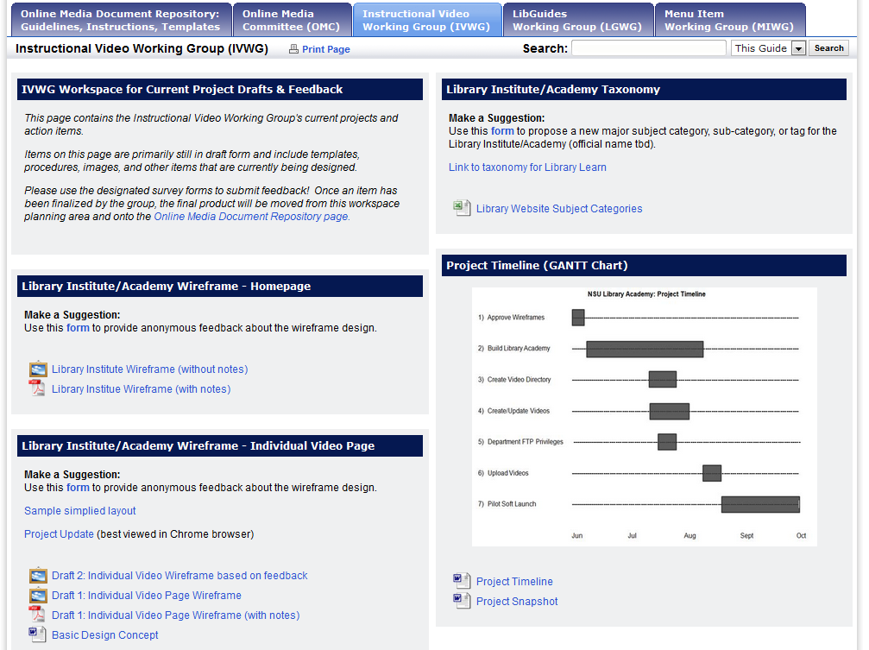
Communication
Notes:
Once the working group was assembled, the team met twice a month to discuss various stages of the project. In addition to the bi-monthly meetings, the working group maintained an internal LibGuide that served as a place for the group to share draft policies, design templates, project updates, and goal timelines. This internal LibGuide enabled project transparency among the working group members and helped facilitate effective communication. We were fortunate to have access to LibGuides but if we didn’t, then we could have used another sharing tool such as Google Docs or SharePoint.

Slide 34
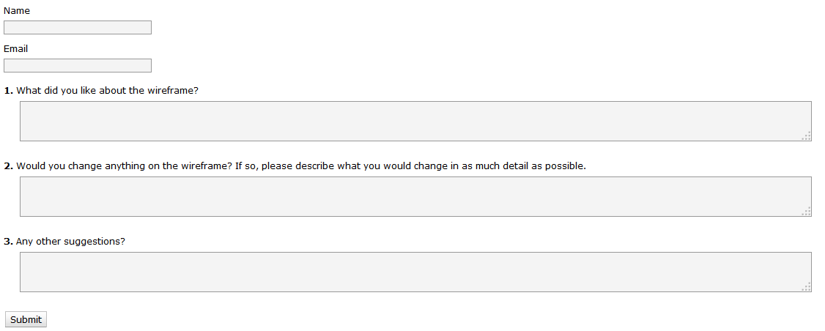
Communication
Notes:
The internal LibGuide also included links to online surveys in order to provide members an opportunity to candidly submit anonymous feedback. In order to communicate clearly with all members of the working group, it was important to us to reach out and provide all members with a chance to voice their opinions even if they preferred not to speak during the group meetings. Additionally, we set up an online meeting room so members that were not able to attend meetings in person could still participate virtually. For us, we used Blackboard Collaborate but this could be done with any software that you may have access to, such as Adobe Connect.

Slide 35
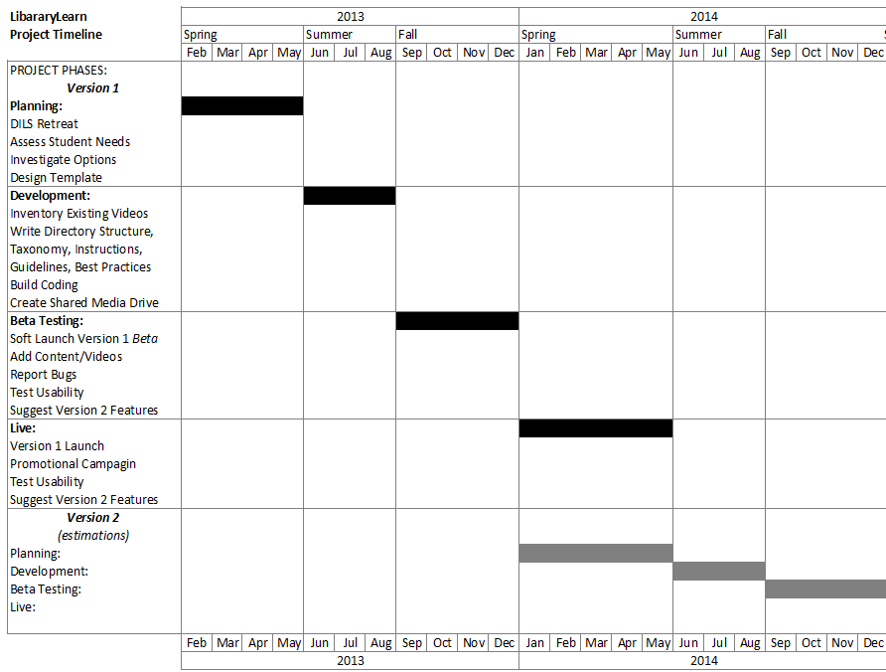
Timeline
Notes:
Throughout this process, Michelle and I essentially served as transformational leaders that acted as agents of change and kept the project moving forward. As the committee co-chairs, we served as the “project sponsors” that reported directly to the library’s web team with input for instructional design. In order to stay on track, it was crucial that we not only developed a detailed project timeline but that we also made sure that all members of the working group remained aware of our goal deadlines. Simply creating the timeline was not enough. We needed it to be visible to all group members so we posted it on our internal LibGuide.

Slide 36
Timeline
Notes:
During the planning stage, which occurred during the Spring 2013 semester, the working group assessed student needs, investigated video options, and began designing a platform template. By Summer 2013, the team moved into the development phase by creating guidelines, taxonomies, and instructional documentation as the web librarian simultaneously built the platform. As you can imagine, there were many moving pieces to this project so it was essential that all members understood the timeline and that Michelle and I reinforced upcoming deadlines.

Slide 37
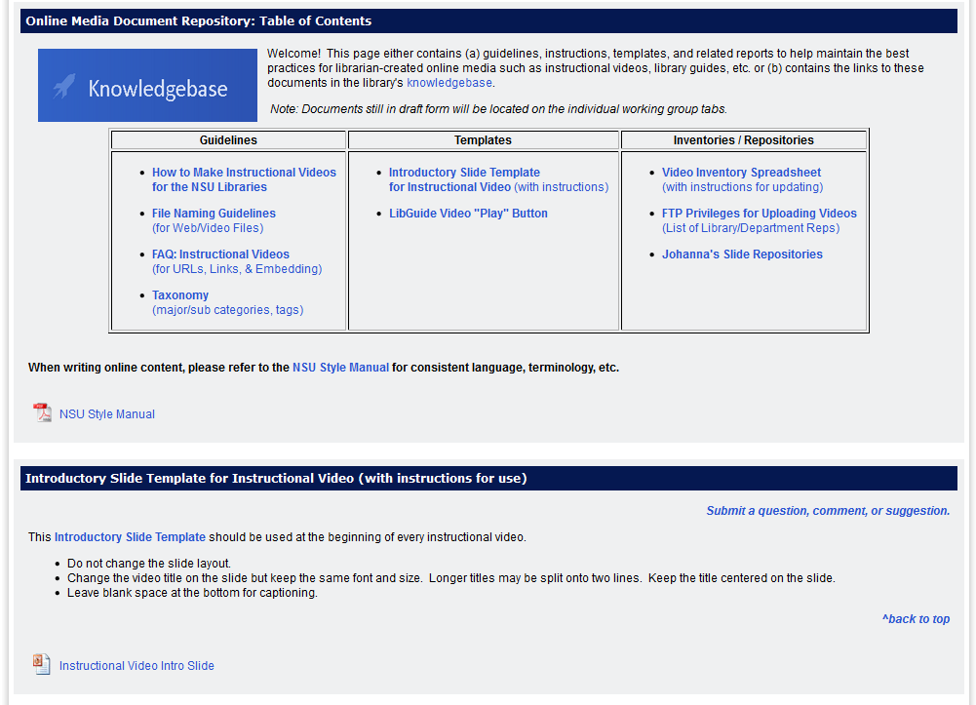
Knowledgebase
Notes:
As guidelines and recommended best practices were finalized, the official procedures were uploaded to the library’s internal LibGuide, which linked to our library’s online Knowledgebase. By providing these documents all in one location, staff could easily refer to them for guidance, which helped reinforce consistency.

Slide 38
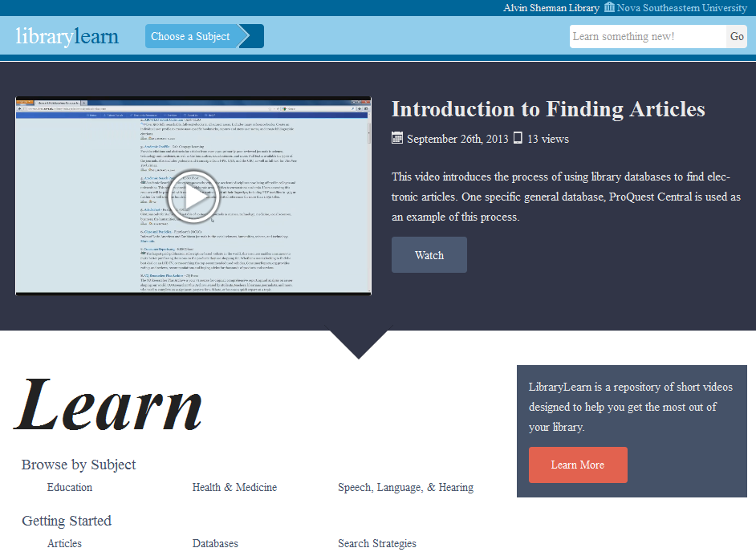
Beta
Notes:
By the start of the Fall 2013 semester, the project moved into its live beta phase. At this point, the best practices had been completed and documented within the Knowledgebase and the beta version of the platform was ready to receive content. Thus, the NSU Libraries now possessed a single location for viewing instructional library videos and a systematic process for creating and maintaining these videos.

Slide 39
Beta
Notes:
During the live Beta stage, staff received training on how to use the product and were given the opportunity to provide feedback and suggestions for future iterations.

Slide 40
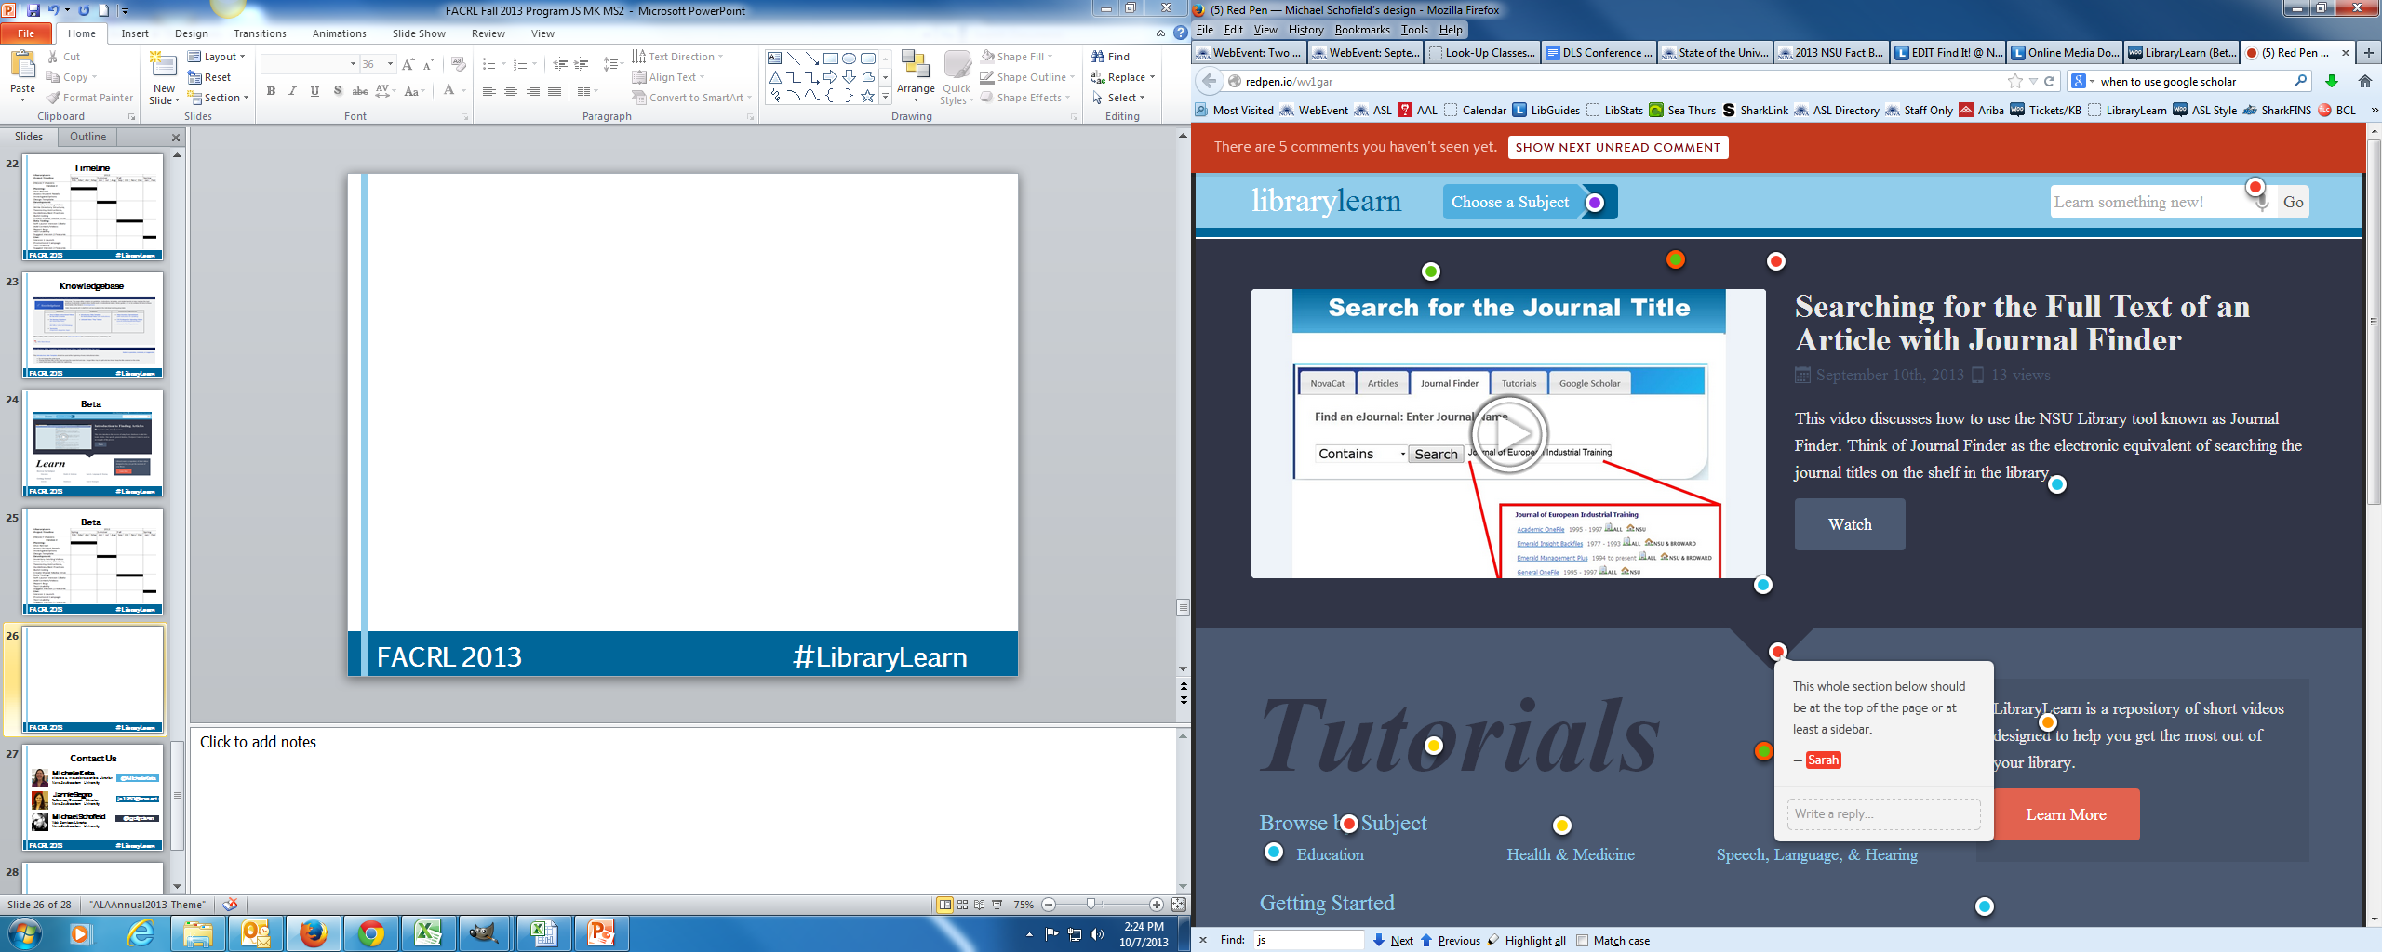
Beta
Notes:
Staff feedback was collected through a free online service called Red Pen. Once screenshots were uploaded, staff could click on the image and leave comments.
At the end of the Fall semester, the platform will go live to students and the working group will begin to focus on usability testing with students.

Slide 41
Contact Us
Michelle Keba
Distance & Instructional Services Librarian
Nova Southeastern University
@MichelleKeba
Jamie Segno
Reference/Outreach Librarian
Nova Southeastern University
js1830@nova.edu
Michael Schofield
Web Services Librarian
Nova Southeastern University
@gollydamn

Slide 42
Appendix A: Things the Web Person Should Know about HTML5 Video
HTML5 Video has pretty good support, but without a Flash fallback it cuts out old browsers (like IE8). We decided we were okay with this. That’s not a small decision.
Refer to www.caniuse.com to see browser support, i.e., type “video” or “flexbox.” Some HTML5 Video players do Flash fallbacks better than others, i.e., MediaElements.js.
MediaElements.js is now included by default with WordPress 3.6+
At this stage, for wide browser support, videos have to be exported in multiple formats. We went with mp4 and webm.
Between the two, we support Internet Explorer 9+, FireFox, Chrome, Safari [desktop and iOS], Android browser, Opera, Opera Mini, Blackberry, IE Mobile.
Why not OGG? WEBM has much wider current and future support.
Make sure your web server supports the proper MIME Types for your video formats (mp4, webm, ogv, etc.) and caption files (srt, vtt).

Slide 43
Appendix A: Things the Web Person Should Know about LibraryLearn
It’s just a blown-out WordPress Theme. Hopefully you’re not a Drupal Library ☺.
Uses the MediaElements.js bundled with WordPress 3.6+, but you can add support using the MediaElements plugin for previous versions.
We mostly use this to make sure the videos look the same regardless of browser and, in the future, the potential for custom skins. Unless you’re using it for Flash Fallback, it has no affect on the videos’ playability.
Will support workflows for just linking-up and embedding existing YouTube, Vimeo, Adobe Captivate videos, or if videos—like ours—are hosted on a different in-house server.
Freely downloadable in April. www.librarylearn.com

