Slide 1
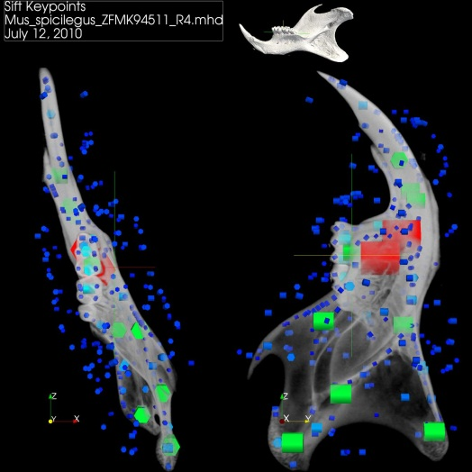
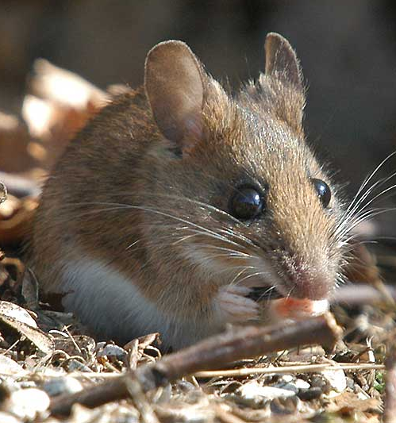
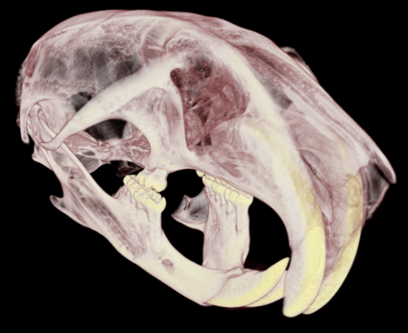
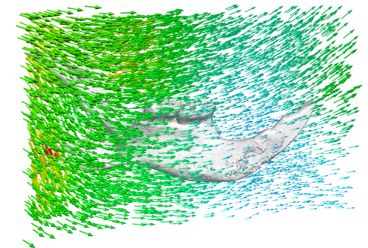





Acquisition
Registration
Shape Model
Specimens
$μ$CT-scans
Rigid alignment
(SIFT based)
Elastic registr.
(Diffeom. Demons)
Mean shape
Deformations
SDM
$$T_{i}$$
$$S_{μ}$$
$${\{T}_{i}\}$$
$$T_{i}=Φλ_{i}$$

Slide 2




Acquisition
Registration
Shape Model
Specimens
$μ$CT-scans
Rigid alignment
(SIFT based)
Elastic registr.
(Diffeom. Demons)
Mean shape + Deformations
SDM
$$T_{i}$$
$S_{μ}$+${\{T}_{i}\}$
$$T_{i}=Φλ_{i}$$

