Slide 1
AN ANALYSIS ON GOOGLE PLAYSTORE APPS
NEETHA SHERRA

Slide 2
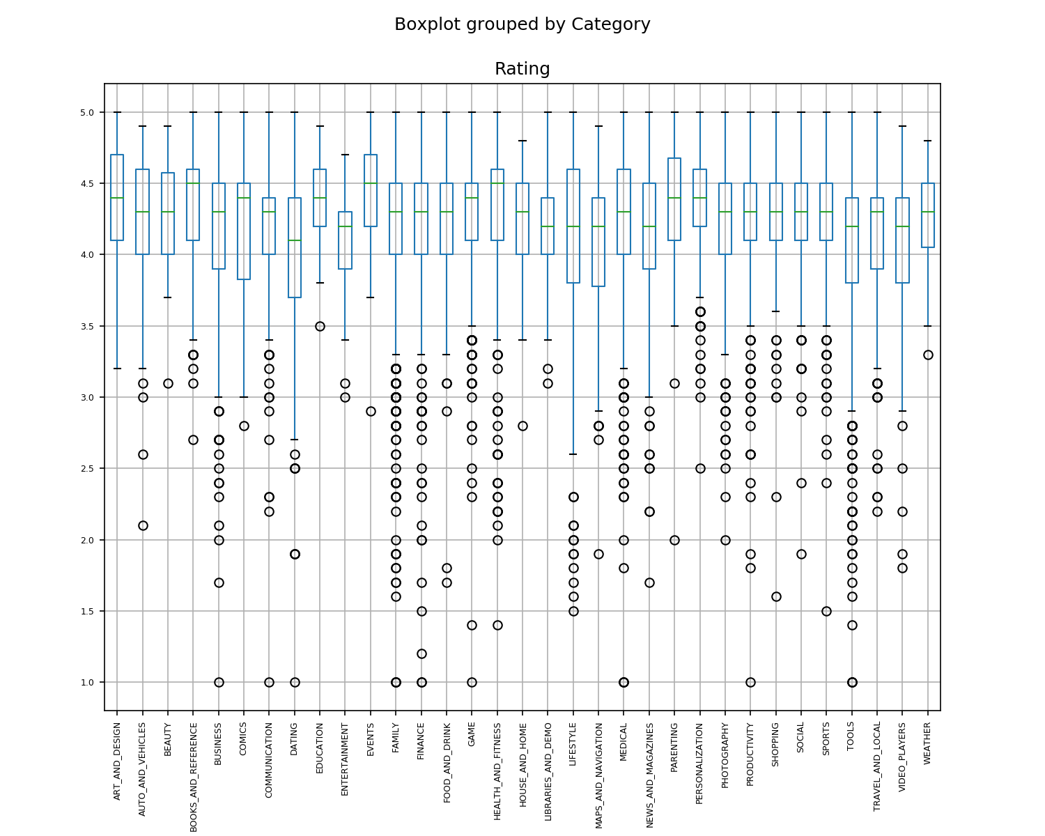
BOXPLOT OF RATING WITHIN APP CATEGORIES
Median Rating of Apps within all Categories falls between 4 to 4.5
Lowest value in the range doesn’t go below 2.5
All outliers are on the lower end of the graph

Slide 3
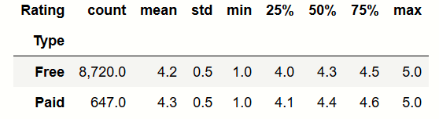
STATISTICAL SUMMARY VALUES FOR RATING WITHIN ‘FREE’ AND ‘PAID’ TYPE
The Type ‘Free’ has 8720 Apps and a median rating of 4.3
The Type ‘Paid’ has 647 Apps and a median rating of 4.4

Slide 4
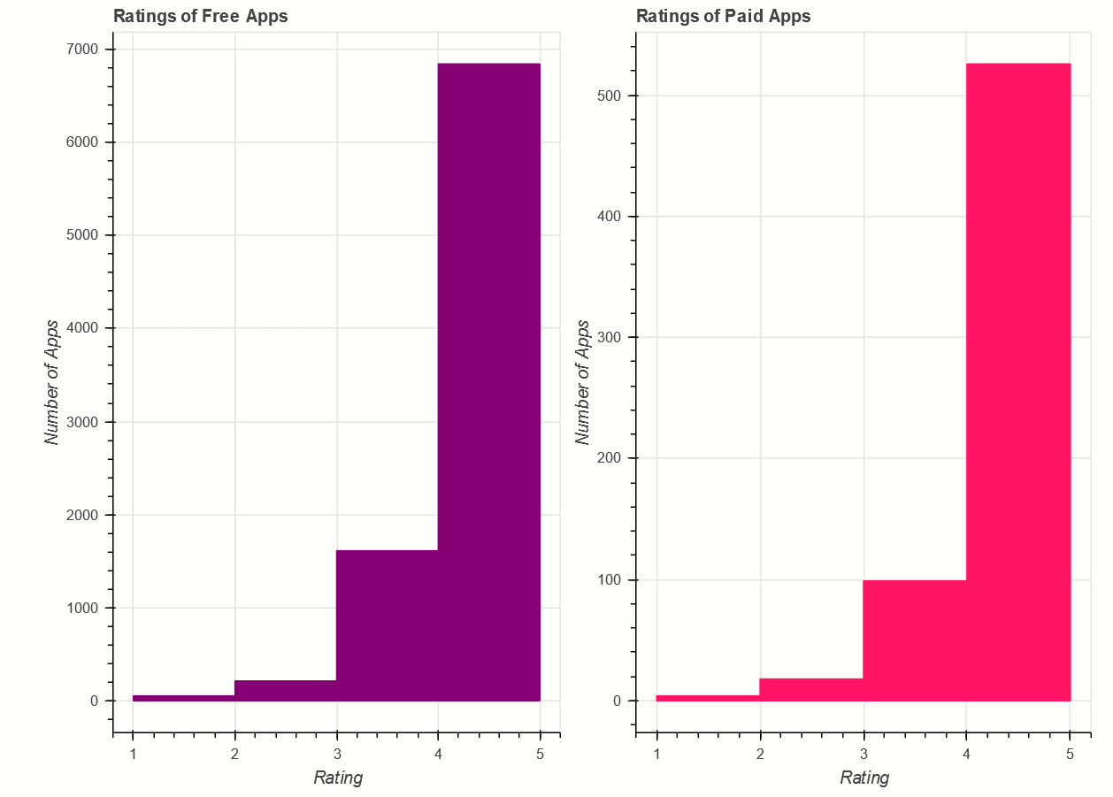
HISTOGRAM OF RATINGS FOR FREE AND PAID APPS
For Free apps, the highest frequency of 6842 falls within Rating 4-5 and the lowest frequency of 53 falls within Rating 1-2
For Paid apps, the highest frequency of 526 falls within Rating 4-5 and the lowest frequency of 4 falls within Rating 1-2

Slide 5
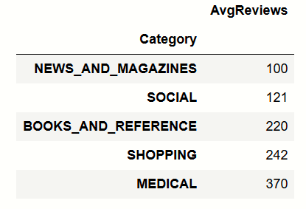
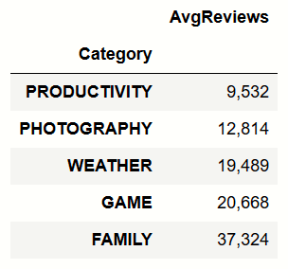
AVERAGE REVIEWS WITHIN APP CATEGORIES (TOP 5 AND BOTTOM 5)
‘News and Magazines’ category has the lowest of average reviews at 100
‘Family’ category has the highest number of average reviews at 37,324

Slide 6
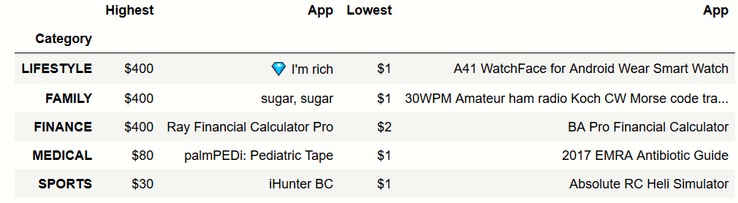
TOP 5 HIGHEST SELLING APPS (CATEGORY, PRICE, NAME OF THE APP)
The price of the highest selling App is $400 and it falls in the category ‘Lifestyle’
This category has $1 as the price of its lowest selling app

Slide 7
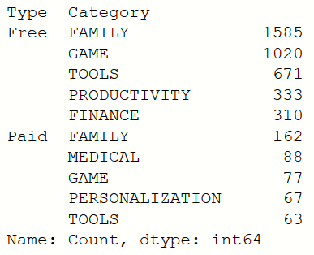
TOP 5 CATEGORIES WITH HIGHEST NUMBER OF APPS WITHIN ‘FREE’ AND ‘PAID’ TYPE
The ‘Family’ category has the highest number of Free and Paid apps

Slide 8
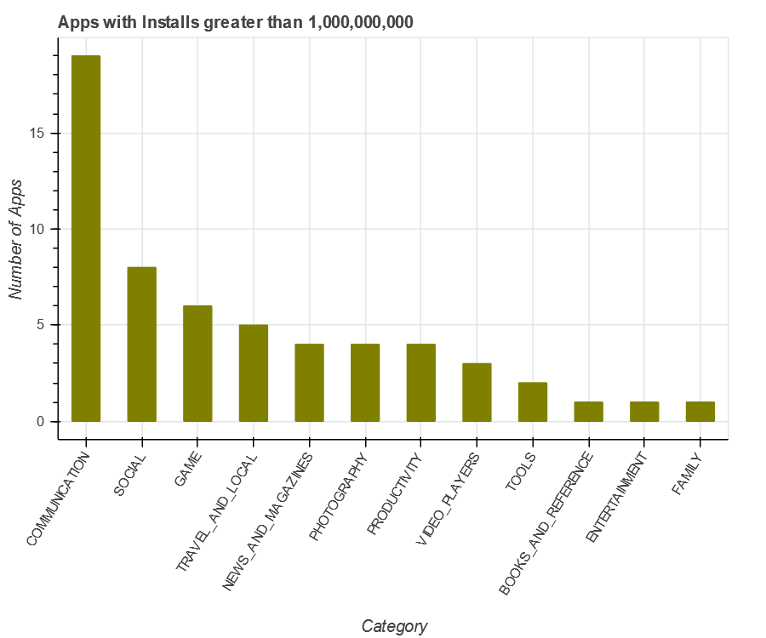
BARCHART OF NUMBER OF APPS WITHIN CATEGORIES WITH INSTALLS GREATER THAN 1,000,000,000 (IN DESCENDING ORDER)
Out of 58 Apps that record installs greater than 1,000,000,000, 19 of them fall in the category ‘Communication’
The ‘Communication’ category contains the highest number of apps with the highest number of installs

Slide 9
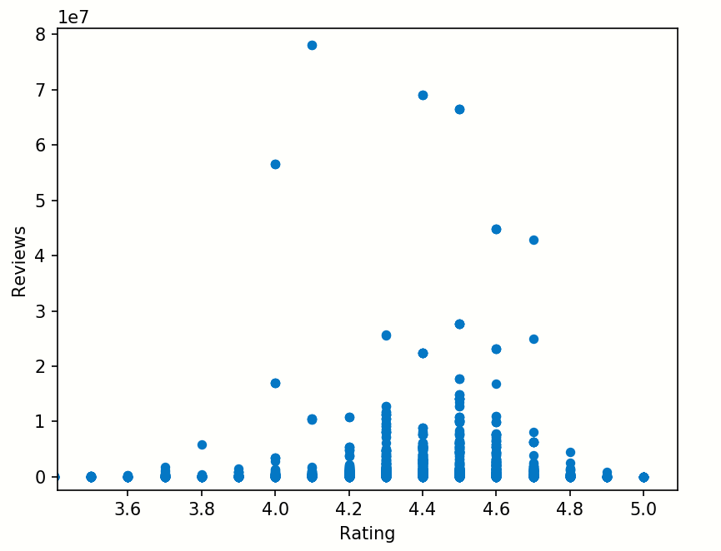
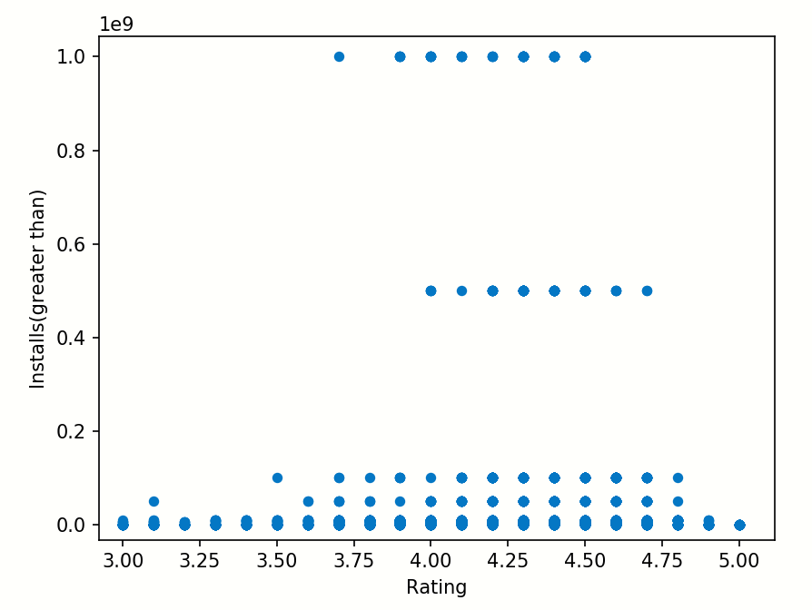
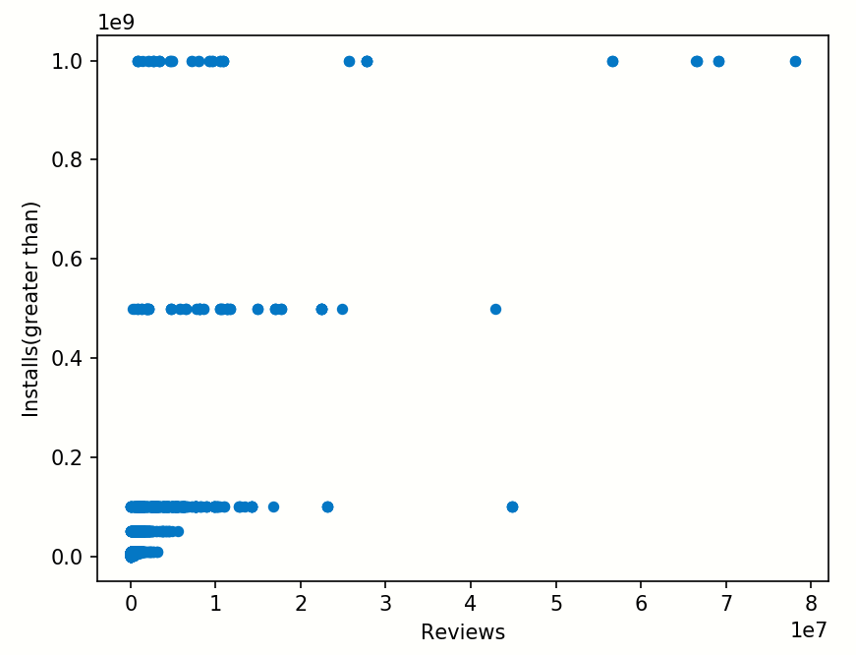
CORRELATION AND SCATTER PLOTS
Ratings and Reviews
Normal curve between Ratings 3 to 5
Ratings and Installs(greater than)
Normal curve between Ratings 3.5 to 5
Reviews and Installs(greater than)
Highest Reviews for the highest level of Installs but few in number(of datapoints)

