Slide 1
Database Systems
Lecture #1 : Introduction

Slide 2
General Information
Ext #: 144
Email: shoaib.khan@nu.edu.pk

Slide 3
Prerequisites
Data Structures

Slide 4
Grading Scheme
Quizzes – 10% -
Homeworks – 10%
Project – 20%
Midterm1 – 10%
Midterm2 – 10%
Final – 50%

Slide 5
Grading Policy
All deadlines will be hard.

Slide 6
Academic Dishonesty
Any form of cheating on exams/homeworks/quizzes is subject to serious penalty.

Slide 7
Reference Books
Fundamentals of Database Systems by Elmasri & Navathe
Database Systems, A Practical Approach by Connolly & Begg

Slide 8
Contents
Introduction to Databases, Basic Concepts and Architecture
Relational Model, Relational Algebra
SQL, Data Manipulatgion, Data Defination
ER Modelling, Functional Dependencies and Normalization
Normalization, Relational Database Design Algorithms,
Methodology-Conceptual, Logical, Physical Database Design
Record Storage and Primary File Organization
Index Structures for Files
Query Processing and Optimizations
Transaction Processing
Concurrency Control, Recovery Techniques
Review, Midterm
Distributed Databases
Object Oriennted Databases
Data Warehousing Concepts
Introduction to Databases, Basic Concepts and Architecture
Relational Model, Relational Algebra
SQL, Data Manipulatgion, Data Defination
ER Modelling, Functional Dependencies and Normalization
Normalization, Relational Database Design Algorithms,
Methodology-Conceptual, Logical, Physical Database Design
Record Storage and Primary File Organization
Index Structures for Files
Query Processing and Optimizations
Transaction Processing
Concurrency Control, Recovery Techniques
Review, Midterm
Distributed Databases
Object Oriennted Databases
Data Warehousing Concepts
Introduction to Databases
Basic Concepts and Architecture
Relational Model
Relational Algebra
SQL
Data Manipulation, Data Definition
ER Modeling
Functional Dependencies
Normalization
Relational Database Design
Conceptual, Logical & Physical Database Design
Record Storage and Primary File Organization

Slide 9
Contents
Index Structures for Files
Query Processing and Optimizations
Transaction Processing
Concurrency Control
Recovery Techniques
Data Mining Concepts
Data Warehousing Concepts

Slide 10
Basic Concepts

Slide 11
Basic Definitions
Database: A collection of related data.
Data: Known facts that can be recorded and have an implicit meaning.
Database Management System (DBMS): A software package/ system to facilitate the creation and maintenance of a computerized database.
Examples:
  Oracle
  DB2 (IBM)
  MS SQL Server
  MS Access
  Ingres
  PostgreSQL
  MySQL
Database System: The DBMS software together with the data itself. Sometimes, the applications are also included.

Slide 12
Databases
Library catalogues
Medical records
Bank accounts
Stock control
Personnel systems
Product catalogues
Telephone directories
Train timetables
Airline bookings
Credit card details
Student records
Customer histories
Stock market prices
and so on…

Slide 13
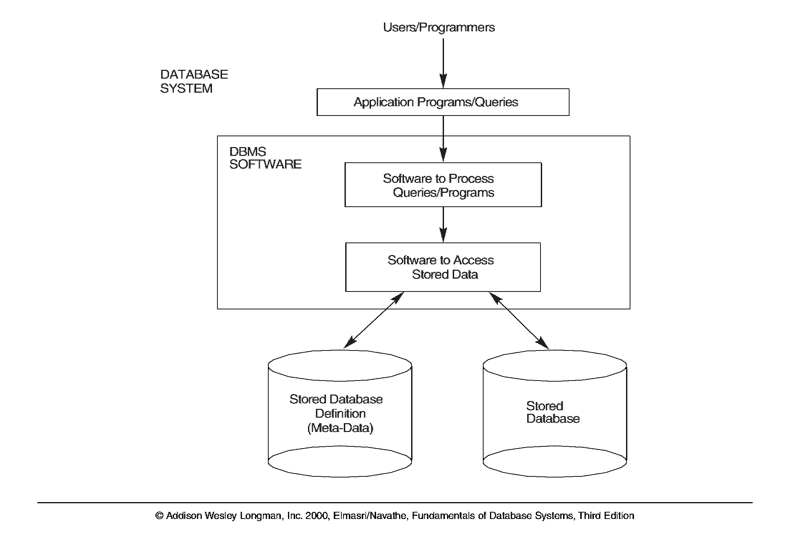
Simplified Database Systems Environment

Slide 14
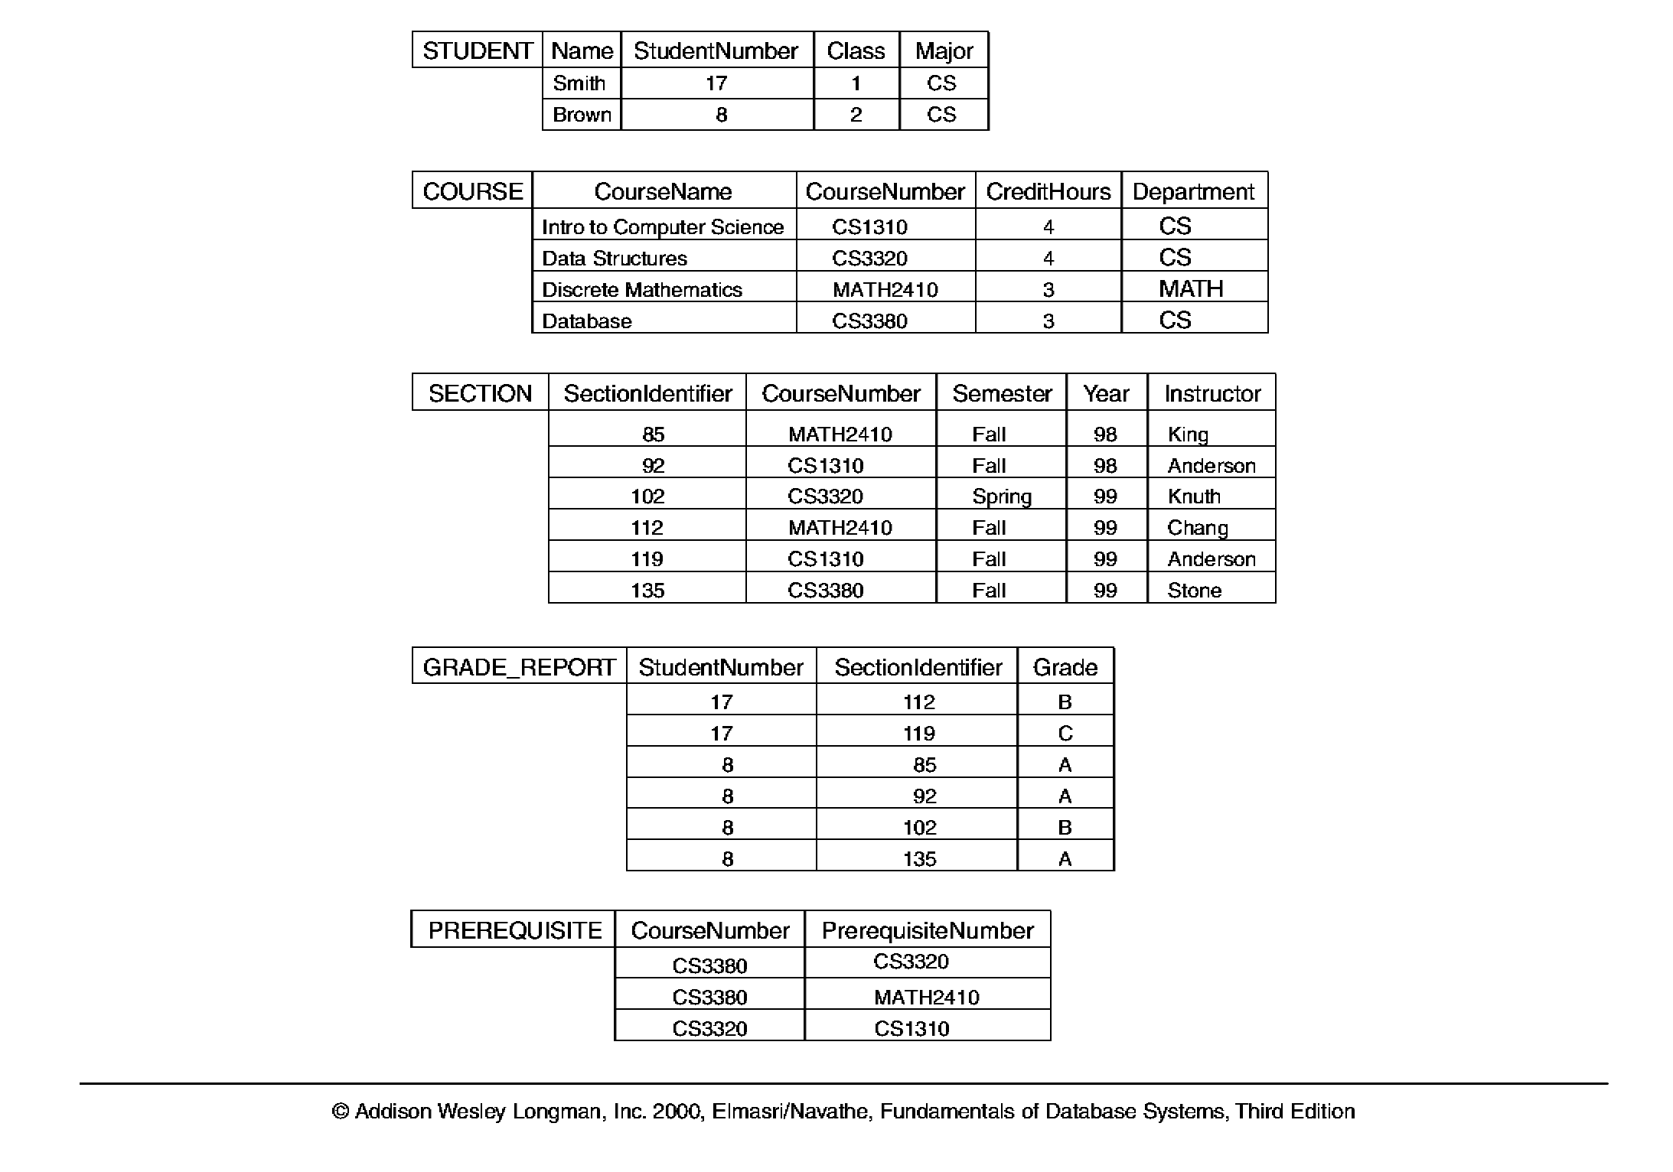
Database Example

Slide 15
File Processing Systems
Library
Examination
Registration
Library app
Examination app
Registration app
Library Data Files
Examination Data Files
Registration Data Files

Slide 16
Why Database System..?
Problems with regular file system
Separation and isolation of data
Duplication of data
Data and Program interdependence
Incompatible file formats

Slide 17
Database System Environment
Library
Examination
Registration
Library app
Examination app
Registration app
DBMS
Student Database

Slide 18
Advantages of Database System
Shared data
Reduce redundancy
Help avoid inconsistencies
Enforce integrity
Crash recovery
Data independence

Slide 19
Why not to use a DBMS?
Complexity
Cost of DBMS
Additional hardware costs
Cost of conversion

Slide 20
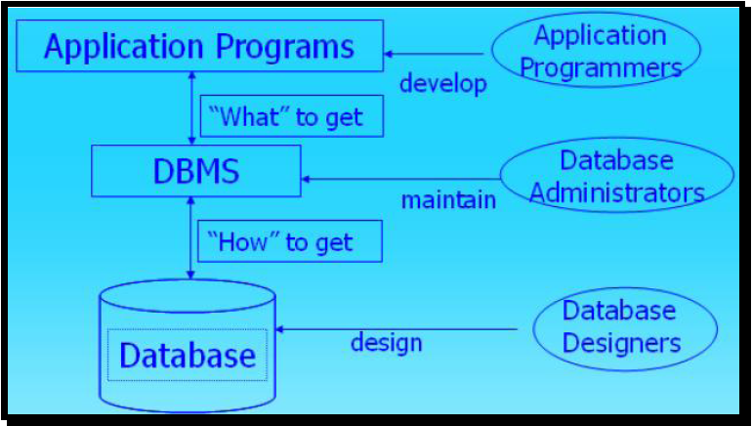
Application Programmers, Administrators and Designers

Slide 21
ANSI/SPARC Architecture
ANSI - American National Standards Institute
SPARC - Standards Planning and Requirements Committee
1975 - proposed a framework for DBs
A three-level architecture
  Internal level
  Conceptual level
  External level

Slide 22
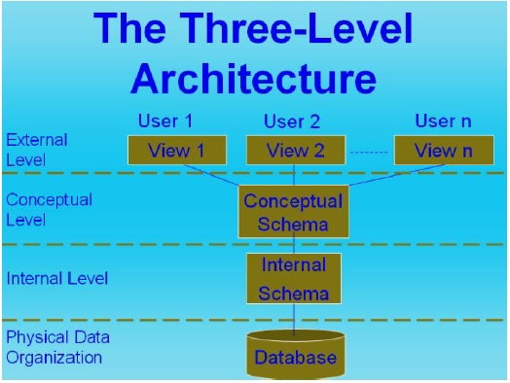
ANSI/SPARC Architecture

Slide 23
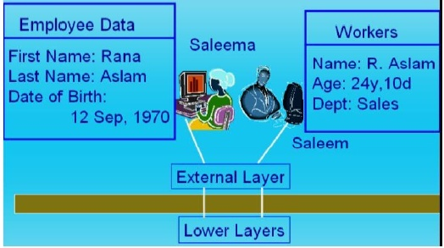
External Level
Provides a view of the database tailored to a user
  Parts of the data may be hidden
  Data is presented in a useful form
  Used by end users

Slide 24
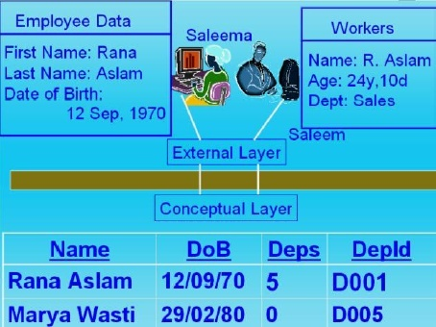
Conceptual Level
Deals with the organisation of the data as a whole
  Abstractions are used to remove unnecessary details of the internal level

Slide 25
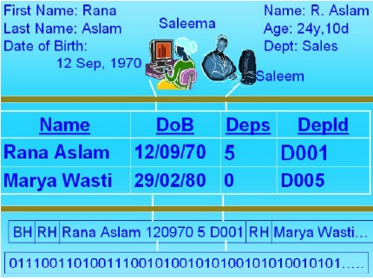
Internal Level
Deals with physical storage of data
  Structure of records on disk - files, pages, blocks

Slide 26
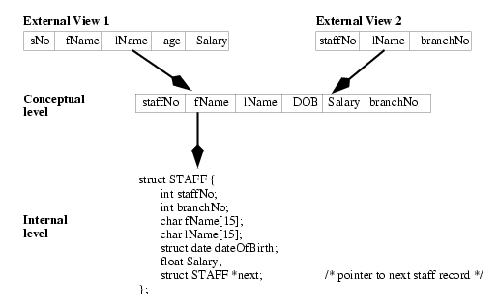
ANSI/SPARC Architecture

