Slide 1
Transforming ERD into Relations

Slide 2
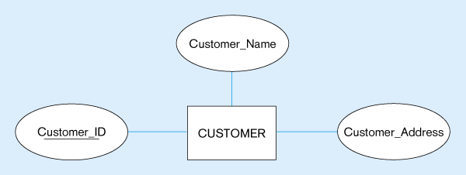
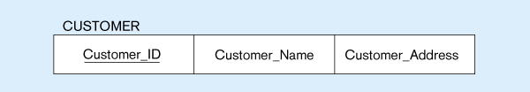
Mapping a regular entity
CUSTOMER entity type with simple attributes
CUSTOMER relation

Slide 3
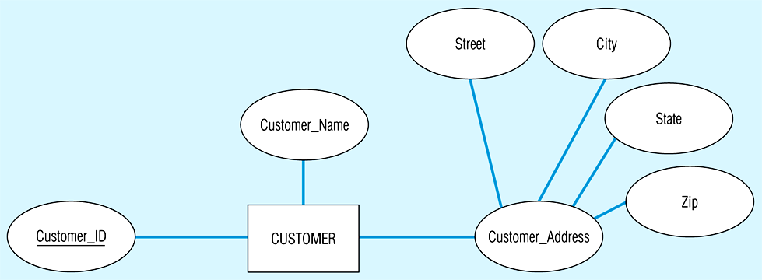
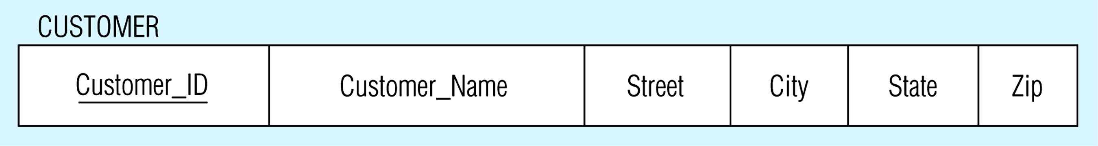
Mapping a composite attribute
CUSTOMER entity type with composite attribute
CUSTOMER relation with address detail

Slide 4
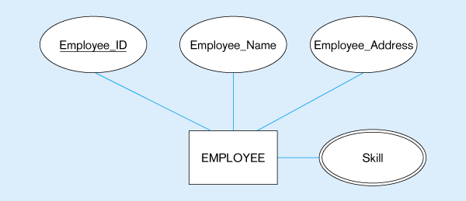
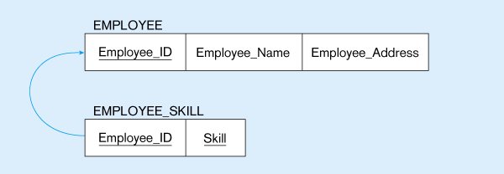
Mapping a multivalued attribute
Multivalued attribute becomes a separate relation with foreign key
1 – to – many relationship between original entity and new relation

Slide 5
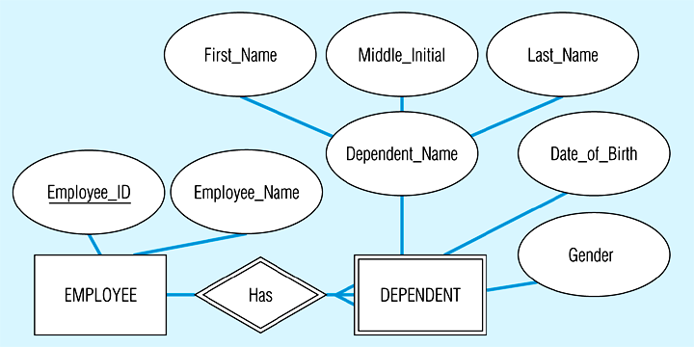
Example of mapping a weak entity
Weak entity DEPENDENT

Slide 6
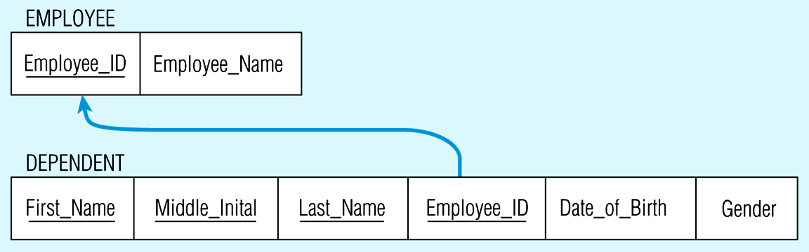
Relations resulting from weak entity
NOTE: the domain constraint for the foreign key should NOT allow null value if DEPENDENT is a weak entity
Foreign key
Composite primary key

Slide 7
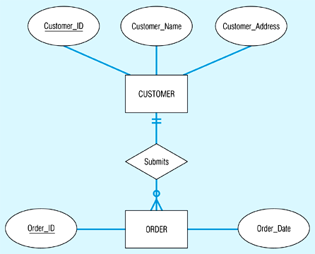
Example of mapping a 1:M relationship
Relationship between customers and orders

Slide 8
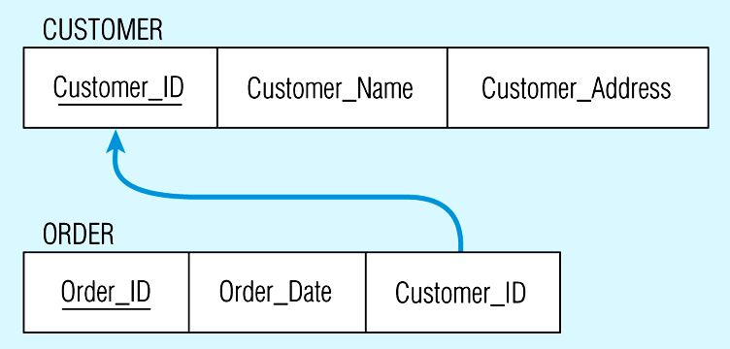
Mapping the relationship
Foreign key

Slide 9
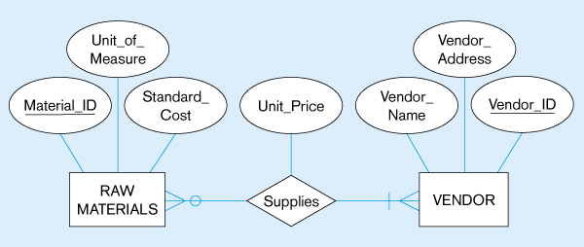
Example of mapping an M:N relationship
ER diagram (M:N)
The Supplies relationship will need to become a separate relation

Slide 10
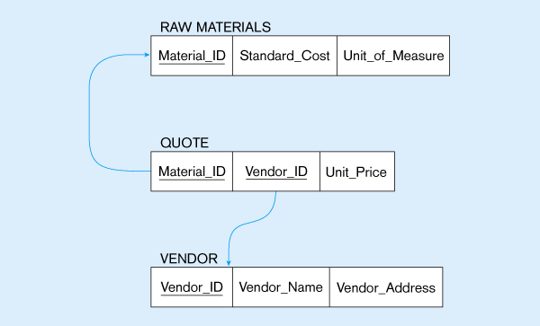
Three resulting relations
Composite primary key
New intersection relation
Foreign key
Foreign key

Slide 11
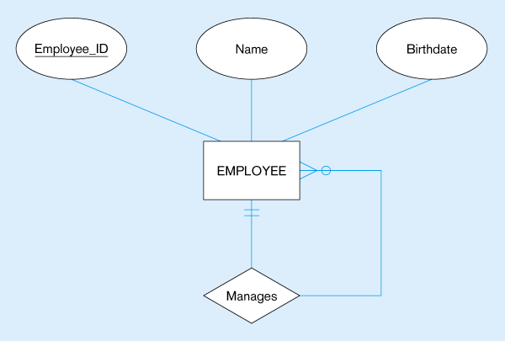

Mapping a unary 1:N relationship

Slide 12
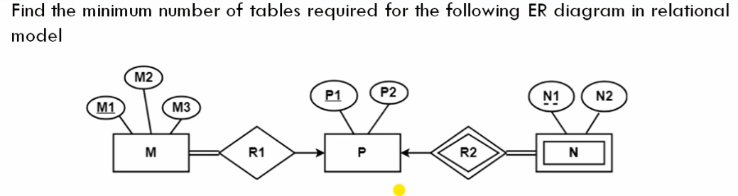
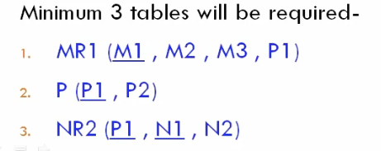

Slide 13
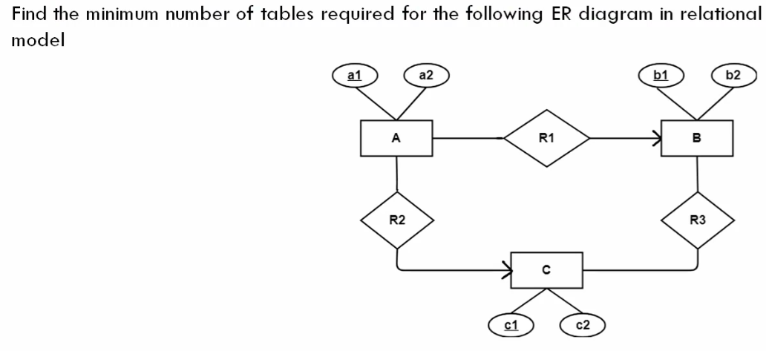
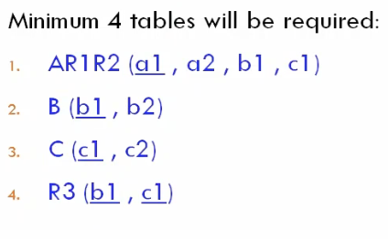

Slide 14
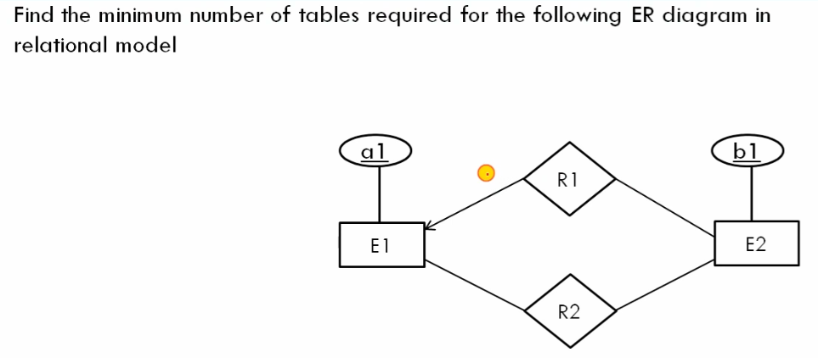
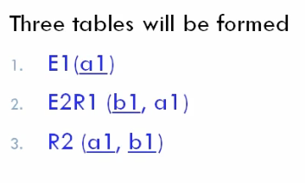

Slide 15
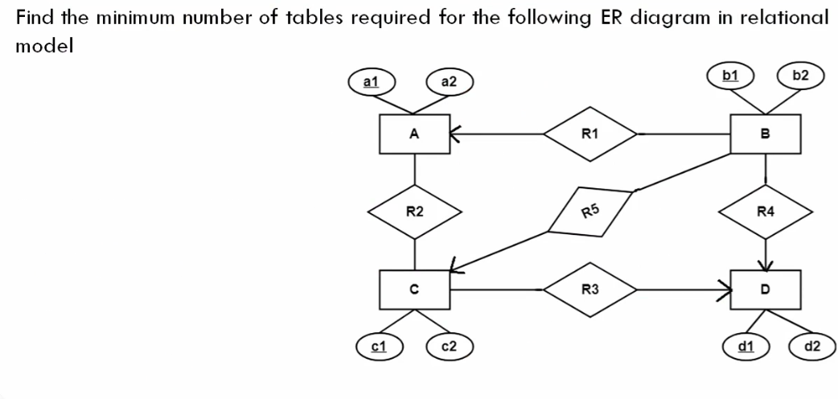
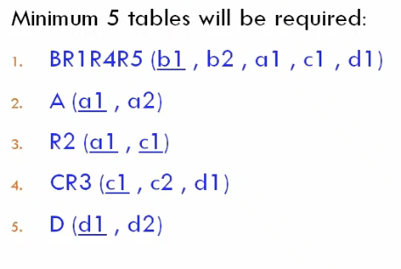

Slide 16
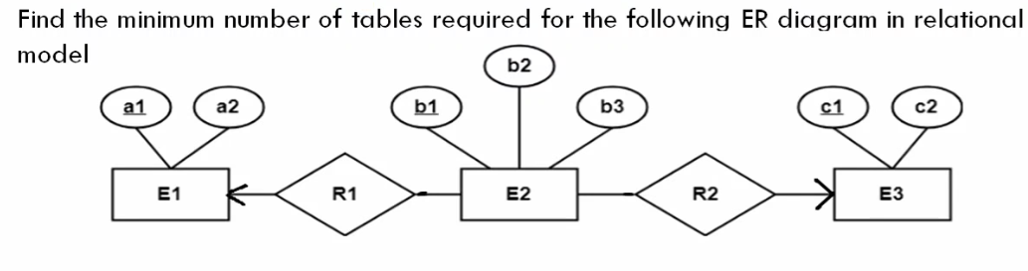
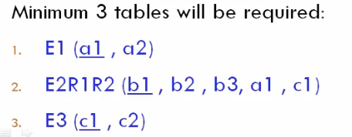

Slide 17
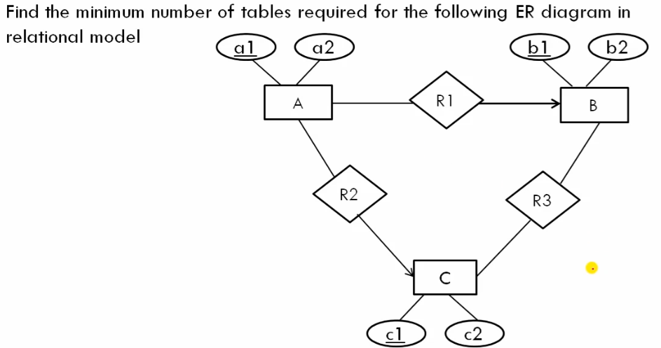
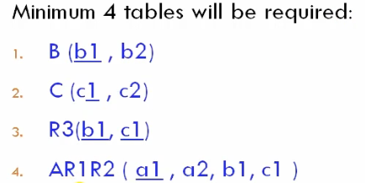

Slide 18
Mapping of Binary 1:1 Relationship Types
For each binary 1:1 relationship type R in the ER schema, identify the relations S and T that correspond to the entity types participating in R.
There are three possible approaches:
Foreign Key approach: Choose one of the relations-say S-and include a foreign key in S the primary key of T. It is better to choose an entity type with total participation in R in the role of S.
Example: 1:1 relation MANAGES is mapped by choosing the participating entity type DEPARTMENT to serve in the role of S, because its participation in the MANAGES relationship type is total.
Merged relation option: An alternate mapping of a 1:1 relationship type is possible by merging the two entity types and the relationship into a single relation. This may be appropriate when both participations are total.
Cross-reference or relationship relation option: The third alternative is to set up a third relation R for the purpose of cross-referencing the primary keys of the two relations S and T representing the entity types.

Slide 19
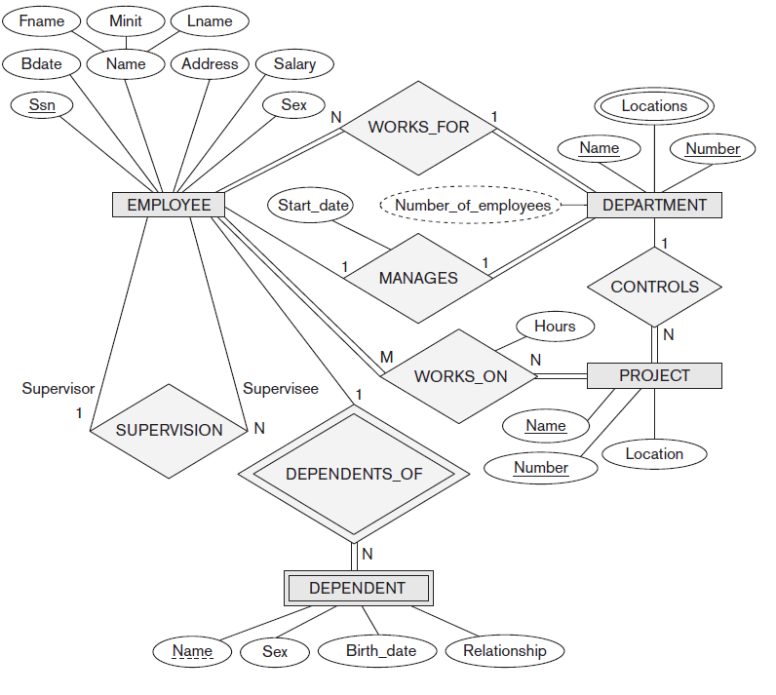
Quiz Transform ERD into Relations

Slide 20
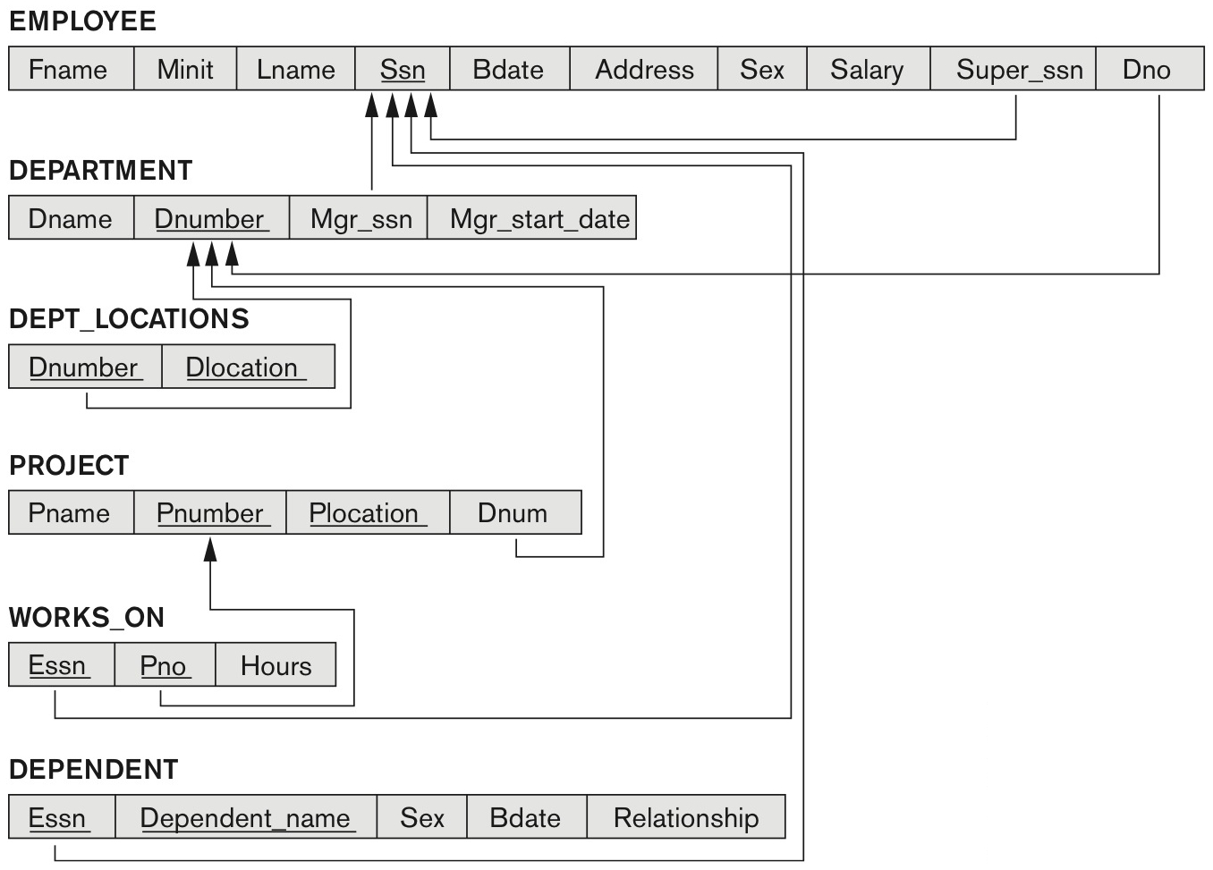
Solution

Slide 21
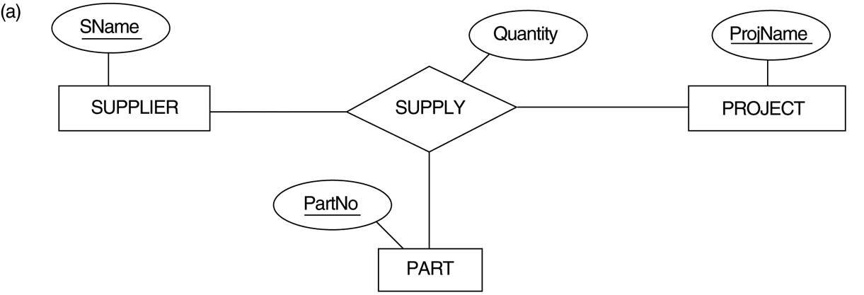
TERNARY RELATIONSHIP: SUPPLY

Slide 22
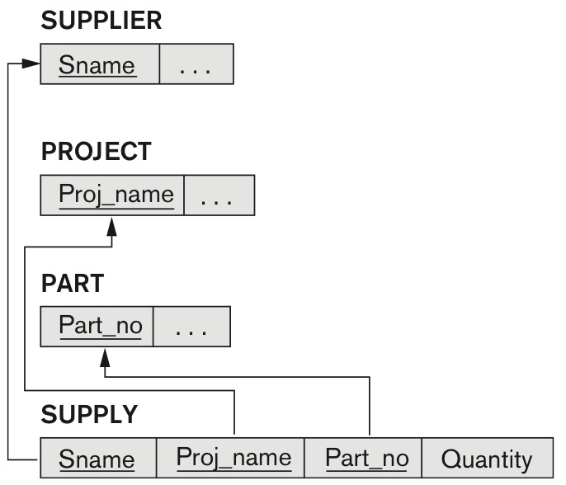
Mapping the Ternary relationship type SUPPLY

Slide 23
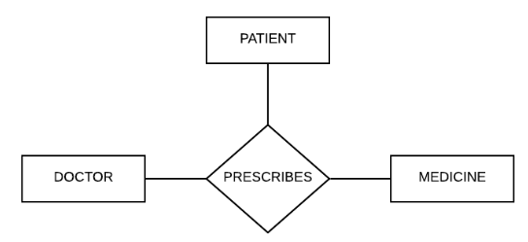
TERNARY RELATIONSHIP: PRESCRIBES

