Slide 1
Good Database Design
no redundancy of FACT (!)
no inconsistency
no insertion, deletion or update anomalies
no information loss
no dependency loss
1

Slide 2
Data Redundancy
Major aim of relational database design is to group attributes into relations to minimize data redundancy and reduce file storage space required by base relations.
Problems associated with data redundancy are illustrated by comparing the following Staff and Branch relations with the StaffBranch relation.

Slide 3


Data Redundancy

Slide 4
Data Redundancy
StaffBranch relation has redundant data: details of a branch are repeated for every member of staff.
In contrast, branch information appears only once for each branch in Branch relation and only branchNo is repeated in Staff relation, to represent where each member of staff works.

Slide 5
Update Anomalies
Relations that contain redundant information may potentially suffer from update anomalies.
Types of update anomalies include:
  Insertion
  Deletion
  Modification

Slide 6
Data Redundancy

Slide 7
Insertion Anomalies
New member of staff joins branch B005
  Insert new row into StaffBranch table
  Type wrong address: 163 Main St, Glasgow.
  Database is now inconsistent!
Establish new branch with no members of staff
  B008, 57 Princes St, Edinburgh
  No staff members, so staffNo must be NULL
  But staffNo is the primary key of the StaffBranch table, so cannot be NULL!

Slide 8
Deletion Anomaly
Mary Howe, staffNo SA9, leaves the company
  Delete the appropriate row of StaffBranch
  This also deletes details of branch B007 where Mary Howe works
  But no-one else works at branch B007, so we no longer know the address of this branch!

Slide 9
Modification Anomaly
Branch B003 has transferred to a new location
  New address is 145 Main St, Glasgow
  Must change three rows of the StaffBranch relation

Slide 10
Functional Dependency
Functional Dependency
  Describes relationship between attributes in a relation.
  If A and B are attributes of relation R, B is functionally dependent on A (denoted A ->B), if each value of A in R is associated with exactly one value of B in R.

Slide 11

Functional Dependency
Diagrammatic representation:
Determinant of a functional dependency refers to attribute or group of attributes on left-hand side of the arrow.

Slide 12
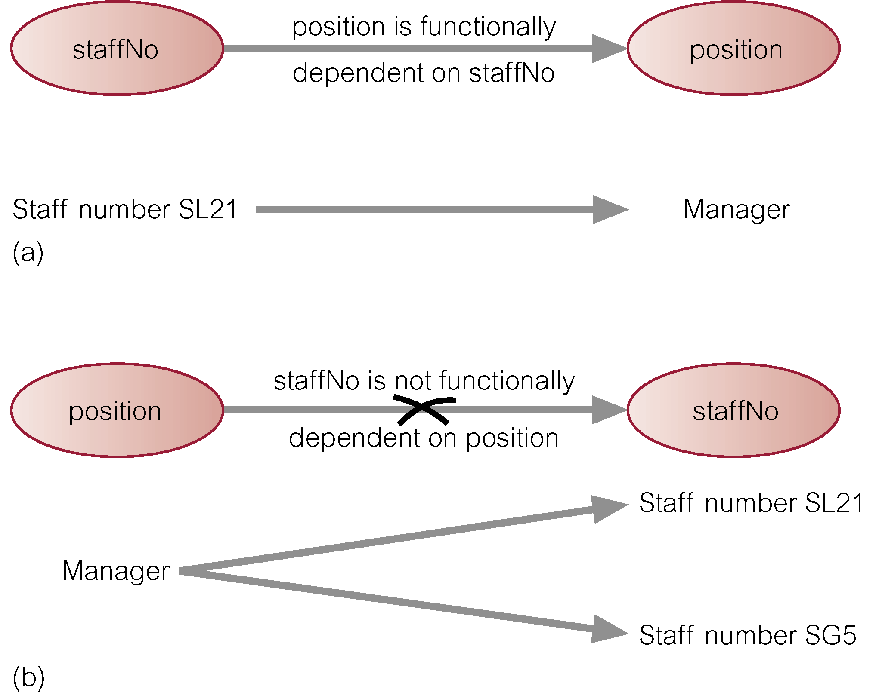
Example - Functional Dependency

Slide 13
Identifying Candidate Keys
A candidate key is an attribute, or set of attributes, that uniquely identifies a row
  Must be irreducible
  No part of a candidate can ever be NULL
An attribute A that functionally determines every other attribute of the relation is a candidate key
  For each value of A there is exactly one value of each of the other attributes
  So each value of A must identify a single row

Slide 14
Identifying Primary Keys
A primary key is a candidate key chosen to identify rows uniquely within a table
  Other candidate keys called alternate keys
Some guidelines on choosing the primary key
  Pick the candidate key with fewest attributes
  Pick the candidate key that makes most sense for the business!

Slide 15
Functional Dependency
Formal Definition: Attribute B is functionally dependant upon attribute A (or a collection of attributes) if a value of A determines a single value of attribute B at any one time.
Formal Notation: A → B This should be read as ‘A determines B’ or ‘B is functionally dependant on A’. A is called the determinant and B is called the object of the determinant.
Example:
Functional Dependencies
staffNo job dept dname
SL10 Salesman 10 Sales
SA51 Manager 20 Accounts
DS40 Clerk 20 Accounts
OS45 Clerk 30 Operations
staffNo → job
staffNo → dept
staffNo → dname
dept → dname

Slide 16
Partial Functional Dependency
Partial Functional Dependency: This is the situation that exists if it is necessary to only use a subset of the attributes of the composite determinant to identify its object uniquely.
Example:
Full Functional Dependencies
Student# Crs# CrsName grade
(Student#, Crs#) → grade
Partial Functional Dependencies
Crs# → CrsName

Slide 17
Full Functional Dependency
Full Functional Dependency: Only of relevance with composite determinants. This is the situation when it is necessary to use all the attributes of the composite determinant to identify its object uniquely.
Example:
Full Functional Dependencies
order# Pd# qty price
A001 001 10 200
A002 001 20 400
A002 002 20 800
A004 001 15 300
(Order#, Pd#) → qty
(Order#, Pd#) → price

