Slide 1

Case study: Leveraging Business Intelligence for Strategic Insights
Group members
Adeniyi Talabi
Ahmad Seayar Sroosh
Dhruvik Patva
Pavani Pingili
Sheroz Shaikh

Slide 2

Table of Content
Problem Statement
Company Background
Current BI and Analytics Structure
Main Components of BI Solution
Data Warehouse Structure
Case Study 1
Case Study 2
Data Analytics
Implementation – Managerial
Implementation – Technical
Implementation – Ethical
Summary and Conclusion

Slide 3
Problem Statement
Airbnb's current data architecture, marked by disjointed data sets and some manual processes, presents significant challenges in identifying inefficiencies and generating actionable insights. The lack of a unified data repository and standardized procedures hinders the company’s agility and growth, particularly in adapting to the fast-evolving market demands of New York City.
The Goal
This project aims to revolutionize Airbnb's data capabilities through the implementation of a robust business intelligence system. By harnessing the power of integrated data, the new system will streamline operations, enable growth, and exceed customer expectations, positioning Airbnb to capitalize on data-driven opportunities in New York City.

Slide 4
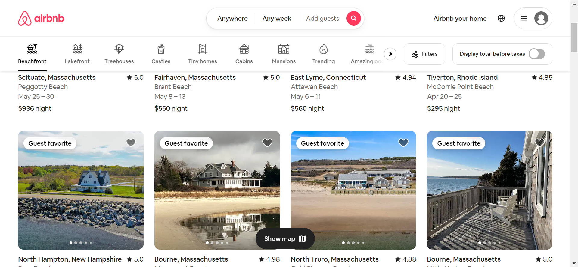
Company Background

Slide 5
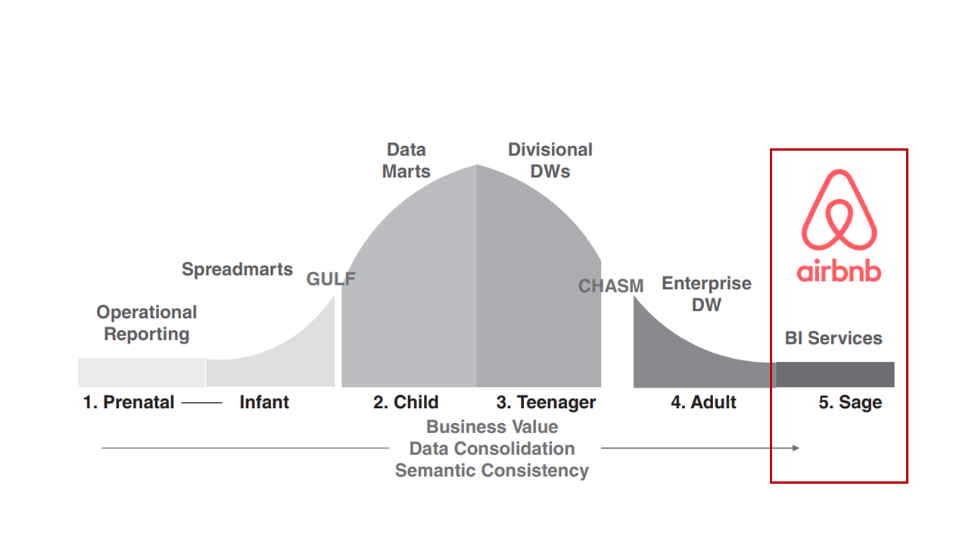
Current BI and Analytics Structure

Slide 6
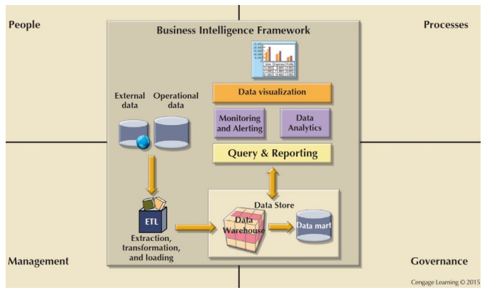
Main Components of BI Solution

Slide 7
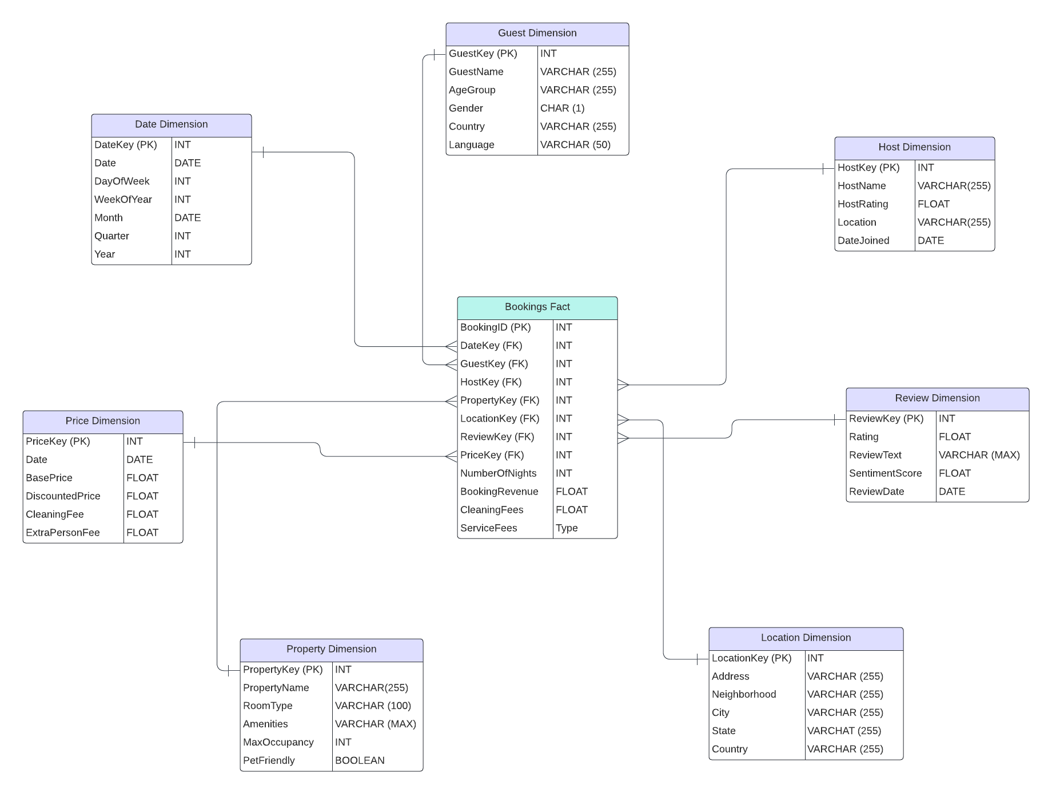
Data Warehouse Structure

Slide 8
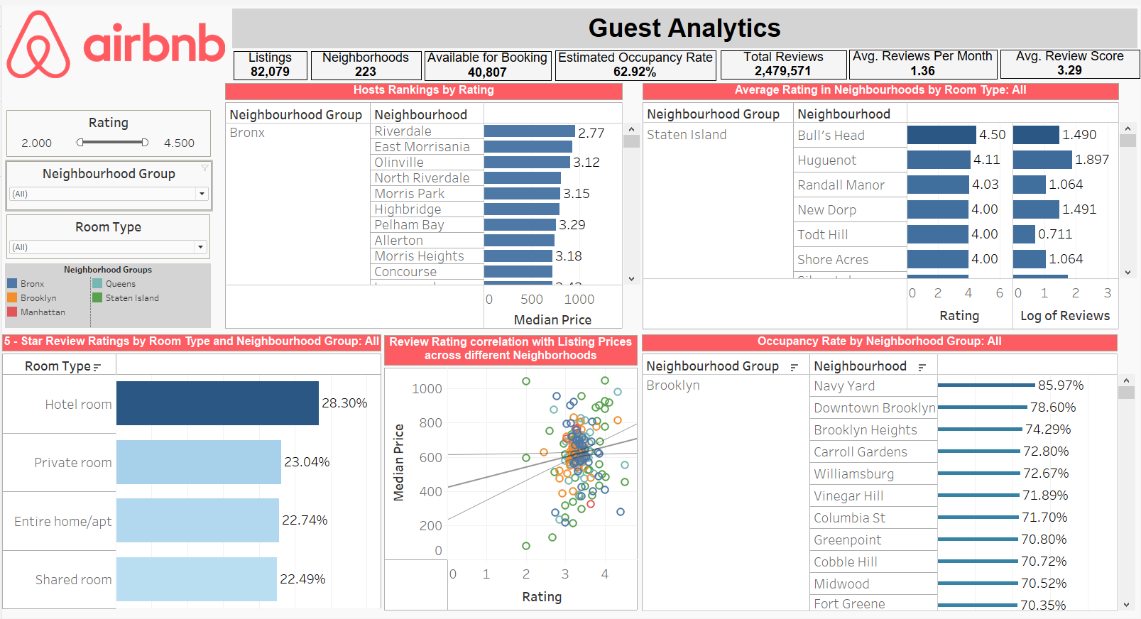
Case Study 1

Slide 9
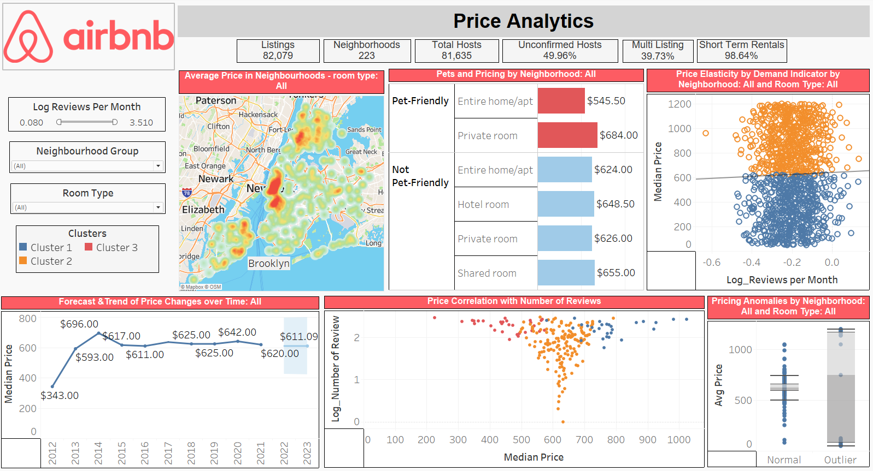
Case Study 2

Slide 10
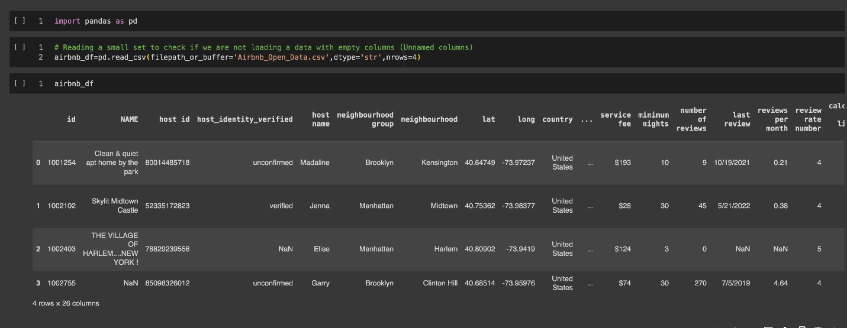
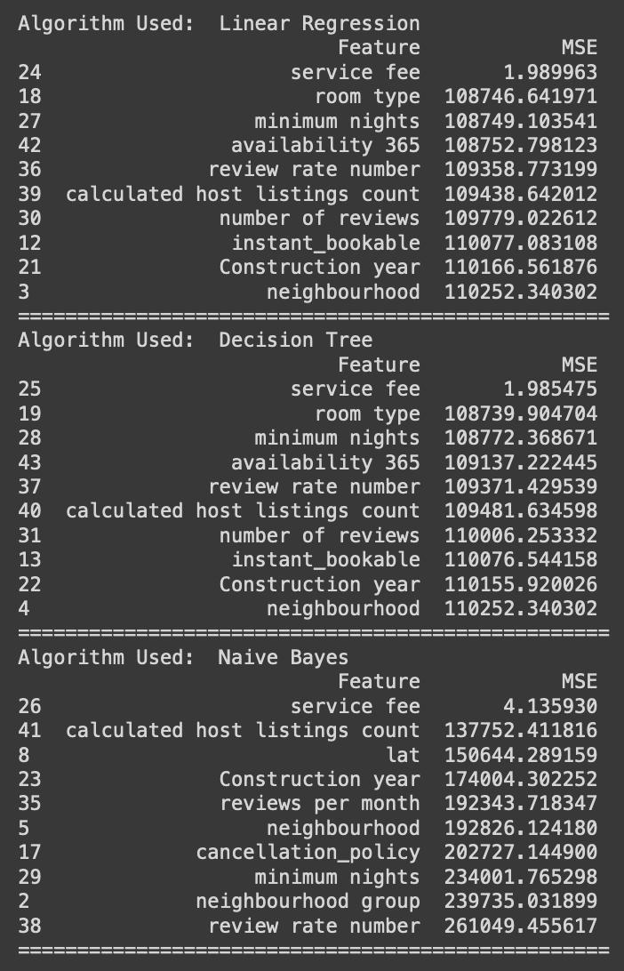
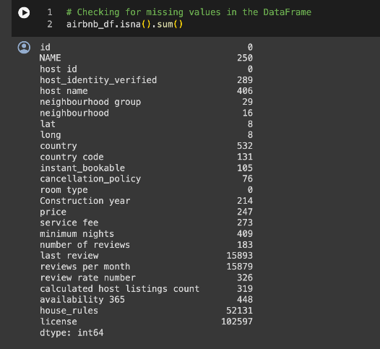


Data Analytics

Slide 11
Implementation – Managerial
(Kotter’s eight-step model)
Establish a sense of urgency | A notable percentage of Airbnb bookings, approximately (62%), face booking cancellations issues, while (25%) of guests express dissatisfaction with our products.
Form a powerful guiding coalition | Engage the Head of Customer Experience and the Head of Product at Airbnb to spearhead the change efforts.
Create a Vision | Develop a vision centered around consistent monitoring of guest reviews and booking processes within Airbnb to enhance customer experience.
​​Communicate the vision | Organize a committee to oversee dashboard monitoring, involving middle management from Customer Experience and Product departments to ensure alignment and commitment.
Empower others to act on the vision | Explain the necessity to teams, highlighting projected outcomes and the importance of addressing booking cancellations and negative feedback.
Plan for and create short-term wins | Aim for short-term victories such as addressing issues related to booking completion rates, address issues leading to negative feedback, and utilize dashboards for decision-making.
Consolidate improvements and produce more changes | Integrate other departments and aspects of the Airbnb platform into the system for comprehensive monitoring.
Institutionalize the new approaches | Enhance overall customer satisfaction, resulting in better average reviews and a strengthened customer experience at Airbnb, solidifying the newly established practices within Airbnb's culture.

Slide 12
Implementation – Technical
Inconsistent Formats
Data Integrity
Missing Values
CHALLENGES
Data Governance
SOLUTIONS
Inaccuracies
Cloud Storage

Slide 13
Implementation – Ethical
Addressing Algorithmic Bias
Privacy Protection
Data Security Measures
Transparency and Accountability

Slide 14

The strategic implementation of Business Intelligence (BI) systems is a game-changer for Airbnb in enhancing its operational efficiency and strategic decision-making. This move is set to revolutionize Airbnb’s approach to harnessing internal and external data sources, such as guest feedback and market trends, through a streamlined data warehouse structure. The insights gleaned from sophisticated data analytics will empower Airbnb to forecast demand, fine-tune pricing strategies, and manage resources with precision. Incorporating tactical and operational dashboards will bring financial and guest engagement metrics into sharp focus, enabling continuous operational refinement and superior customer experiences. With these BI-driven enhancements, Airbnb is well on its way to optimizing its operations and maintaining its competitive edge in the global lodging and vacation rental market.
Summary and Conclusion

Slide 15
QUESTIONS

