Slide 1

Welcome to the DEU Students Forum Website
Connecting Dong-Eui University students through community and collaboration

Slide 2
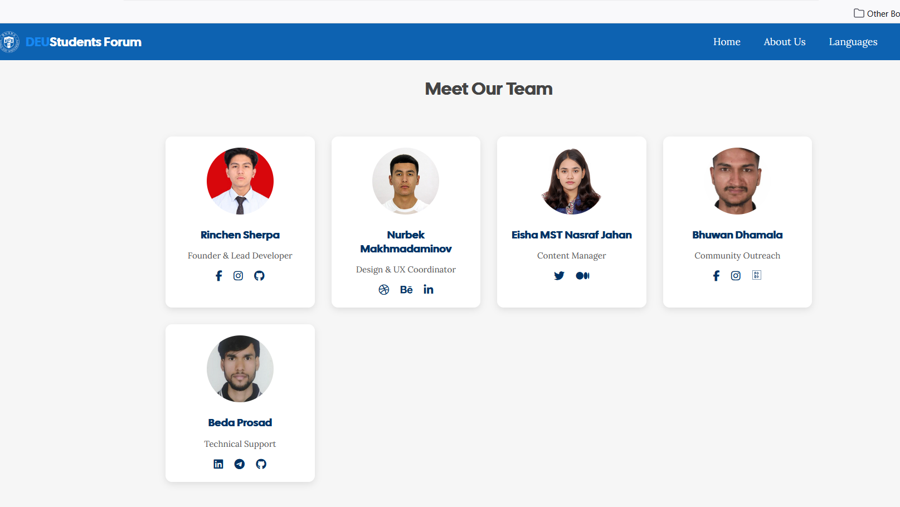

Slide 3
A one-stop platform for international students.
Share experiences, ask questions, and get help.
Academic, career, and lifestyle guidance.
Clean design, inspired by real websites
Built by students, for students!
What is the Student Forum?

Slide 4
Semantic HTML Structure
Clean, organized code using semantic tags:
<header>
<nav>
<main>
<section>
<article>
<footer>
Improves accessibility and SEO

Slide 5
📍 The <header> acts as our navigation command center with: 📖 About Us | 🏠 Homepage | 🌐 Language Selector | 👤 Dashboard | 🔐 Login | 🚪 Logout
📍 The <main> body hosts key sections like: 🎓 Academics | 💼 Job Hunt | 🛂 Visa Renewal | 🧑‍🏫 Teacher Evaluation, plus 🗞️ Announcements, 💬 Discussions, and a 🔍 Search Bar. All elements are wrapped in modular HTML files for clarity.
📍 The <footer> wraps up the page with essential links: ⚡ Quick Links | 📅 Events | 👨‍🏫 Team | 🧑‍🏫 Mentors | 🖼️ Gallery | 📜 Terms—all styled with CSS Flexbox & Grid for responsive design.

Slide 6
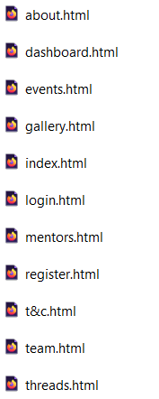
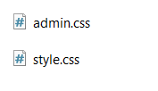
🧾 Program structures:
🧩 HTML files like index.html, about.html, dashboard.html, login.html, team.html, threats.html—each for specific content.
🎨 CSS files: style.css (for all pages) & admin.css (for admin layout).
💼 This modular system keeps things clean, scalable & maintainable.

Slide 7
🧭 Header: Navigation Hub
<header> + <nav> with quick links:
🏠 Home | 📖 About Us | 🌐 Language(EN/KR)
User controls: 👤 Dashboard
🔐 Login / 🚪 Logout

Slide 8

Main Body Structure
Sections for: Academics, Job Hunt, Visa Renew, Teacher Eval 🎯
Search bar with <form> for quick find 🔍

Slide 9
HTML Modular Magic
Each function lives in its own HTML file—organized with <article> and <section> for clear content blocks.
🔗 Internal links make it seamless for users to browse, interact, and return without confusion.

Slide 10
Fancy Yet Functional Footer
Our <footer> provides the final touch with stylish links to
📅 Events,
👥 Team,
🧑‍🏫 Mentors,
🖼️ Gallery, and
📜 Terms.

Slide 11
Social Media & Responsive Design
Responsive layouts (Flex/Grid) ensure accessibility across devices.
Interactive social media icons with tooltips & ARIA labels.
Smooth hover animations & dark mode friendly styling
📱 Social media icons & 📬 contact info bring it all together.

Slide 12

HTML Highlights
🗂️ <section> and <article> for info blocks
📄 <form> for search and interaction
🧭 <nav> guides all navigation
🧱 <div> and <span> used for layouts and styling

Slide 13
🎨 Styling Power – CSS Toolkit
🎨 style.css gives color, spacing, fonts, responsiveness 🛠️ admin.css focuses on dashboard layout 🧰 We used Flexbox, Grid, and Media Queries for clean, mobile-friendly design

Slide 14
Features Overview
User-centered design for students 👩‍🎓👨‍🎓
Semantic tags + clean code ✔️
Responsive & easy navigation 📲
Real-time updates & modular files 🔄

Slide 15
Project Impact
Connects students & simplifies info access 🔗
Boosts community & peer support 🤗
Creates a safer, informed environment 🛡️

Slide 16
Demo:

Slide 17
🙌 Thank You!
Any Questions? 🎤 Let’s discuss how this website could evolve even further.
💡 Powered by HTML5 + CSS3 🌏 For students, by students!

