Slide 1
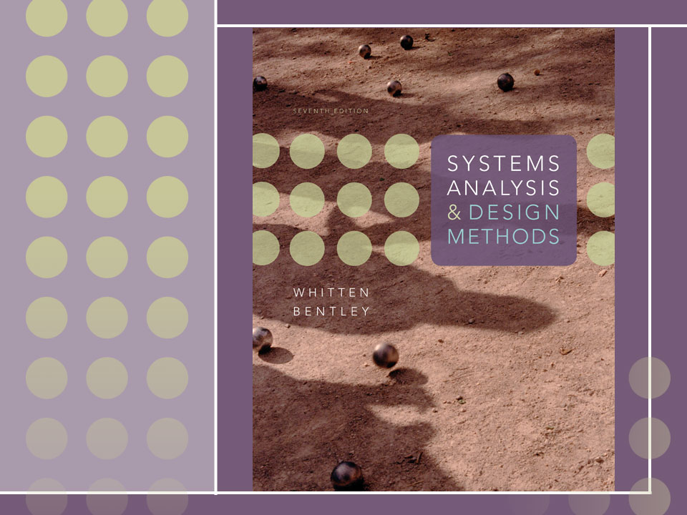
Chapter 18
Object-Oriented
Design and Modeling
Using the UML

Slide 2
Objectives
Understand entity, interface, control, persistence, and system classes.
Understand the concepts of dependency and navigability.
Define visibility and explain its three levels.
Understand the concept object responsibility and how it is related to message sending between object types.
Describe the activities involved in object-oriented design.
Differentiate between a design use-case narrative and an analysis use-case narrative.
Describe CRC card modeling.
Model class interactions with sequence diagrams.
Construct a class diagram that reflects design specifics.
Model object states with state machine diagrams.
Understand the role of coupling and cohesion in object reuse.
Describe the use of design patterns and two common design patterns.
Differentiate between design patterns, object frameworks, and components.
Understand the use of communication diagrams, component diagrams, and deployment diagrams.
Notes:
Chapter 18 – Object-Oriented Design and Modeling Using the UML

Slide 3
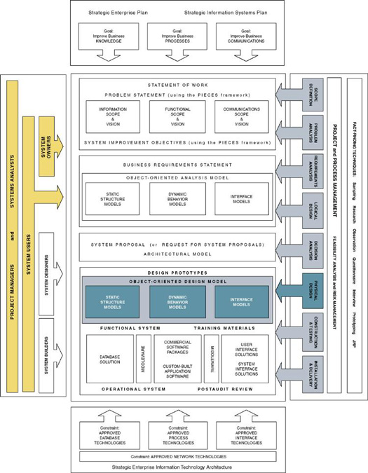
Notes:
Chapter 18 – Object-Oriented Design and Modeling Using the UML

Slide 4
Object-Oriented Design
Object-oriented design (OOD) – an approach used to specify the software solution in terms of collaborating objects, their attributes, and their methods.
  Continuation of object-oriented analysis

Slide 5
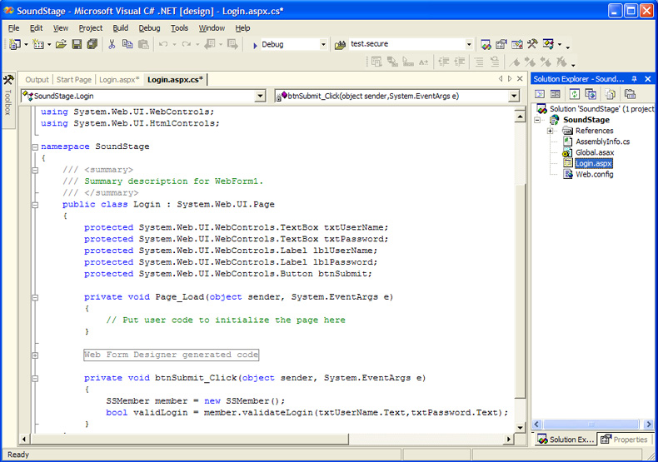
Design Classes
In OO programming every piece of code resides inside an object class

Slide 6
Types of Design Classes
Entity Class - contains business related information and implements analysis classes.
Interface Class - provides the means by which an actor interacts with the system.
  A window, dialogue box, or screen.
  For nonhuman actors, an application program interface (API).
Control Class - contains application logic.
Persistence Class - provides functionality to read and write to a database.
System Class - handles operating system-specific functionality.

Slide 7
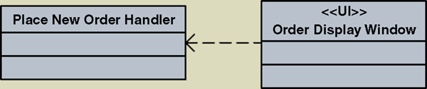
Design Relationships - Dependency
A dependency relationship is used to model the association between two classes:
  To indicate that when a change occurs in one class, it may affect the other class.
  To indicate the association between a persistent class and a transient class.
    Interface classes typically are transient
  Illustrated with a dashed arrow

Slide 8
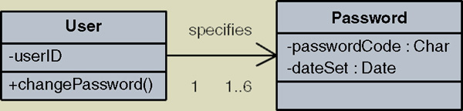
Design Relationships - Navigability
Classes with associations can navigate (send messages) to each other.
By default the associations are bidirectional.
Sometimes you want to limit the message sending to only one direction.
Illustrated with an arrow pointing in the direction a message can be sent.

Slide 9
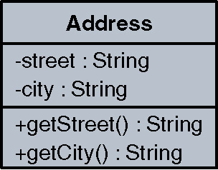
Attribute and Method Visibility
Visibility – the level of access an external object has to an attribute or method.
  Public attributes/methods can be accessed/invoked by any other method in any other object or class. Denoted by the + symbol
  Protected attributes/methods can be accessed/ invoked by any method in the same class or in subclasses of that class. Denoted by the # symbol
  Private attributes/methods can be accessed/invoked by any method in the same class. Denoted by the – symbol
Method – the software logic that
is executed in response to a message.

Slide 10
Object Responsibilities
Object responsibility – the obligation that an object has to provide a service when requested and thus collaborate with other objects to satisfy the request if required.
  An object responsibility is implemented by the creation of methods that may have to collaborate with other objects and methods.
Notes:
Chapter 18 – Object-Oriented Design and Modeling Using the UML

Slide 11
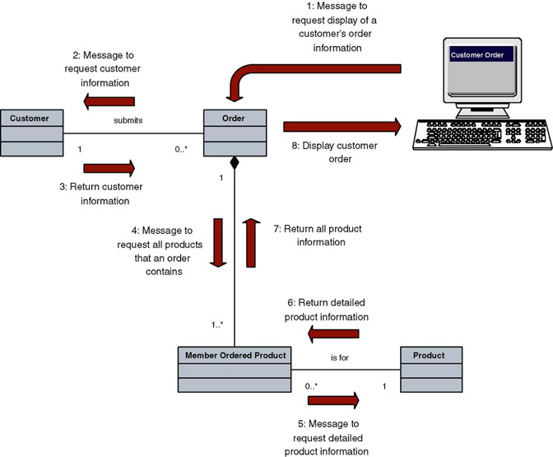
Object Responsibility

Slide 12
The Process of Object-Oriented Design
Refining the use case model to reflect the implementation environment.
Modeling class interactions, behaviors, and states that support the use case scenario.
Updating the class diagram to reflect the implementation environment.
Notes:
Chapter 18 – Object-Oriented Design and Modeling Using the UML

Slide 13
Refining The Use Case Model
Step 1: Transform the “Analysis” Use Cases to “Design” Use Cases
  Implementation details
  Controls
  Window/web page names
  Navigation instructions
Step 2: Update the Use Case Model Diagram and Other Documentation to Reflect any New Use Cases

Slide 14
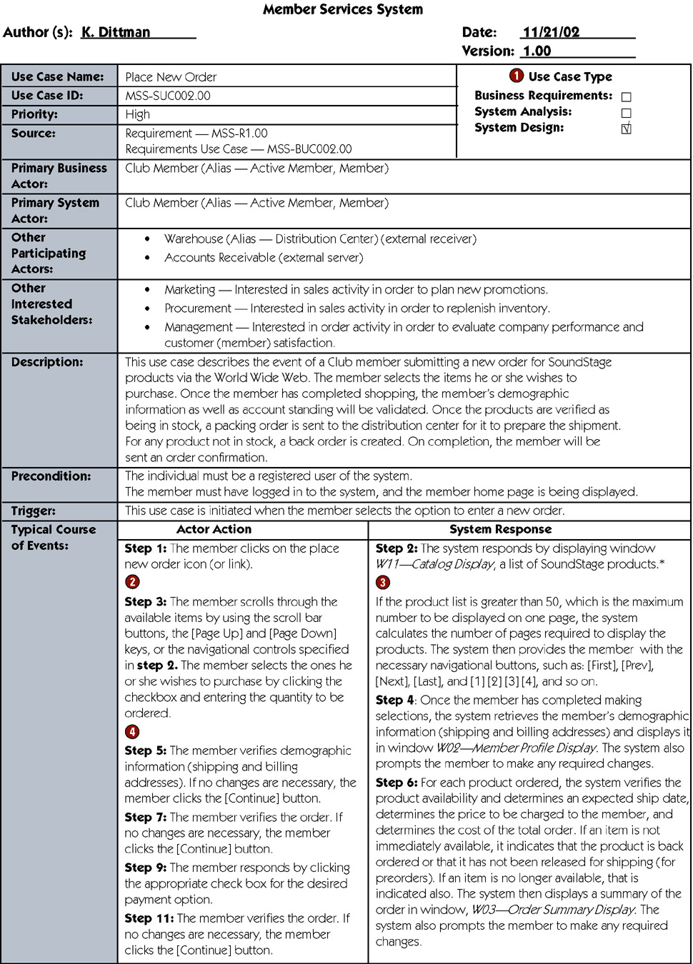
Design Use Case
Notes:
Chapter 18 – Object-Oriented Design and Modeling Using the UML

Slide 15
Design Use Case (continued)
Notes:
Chapter 18 – Object-Oriented Design and Modeling Using the UML

Slide 16
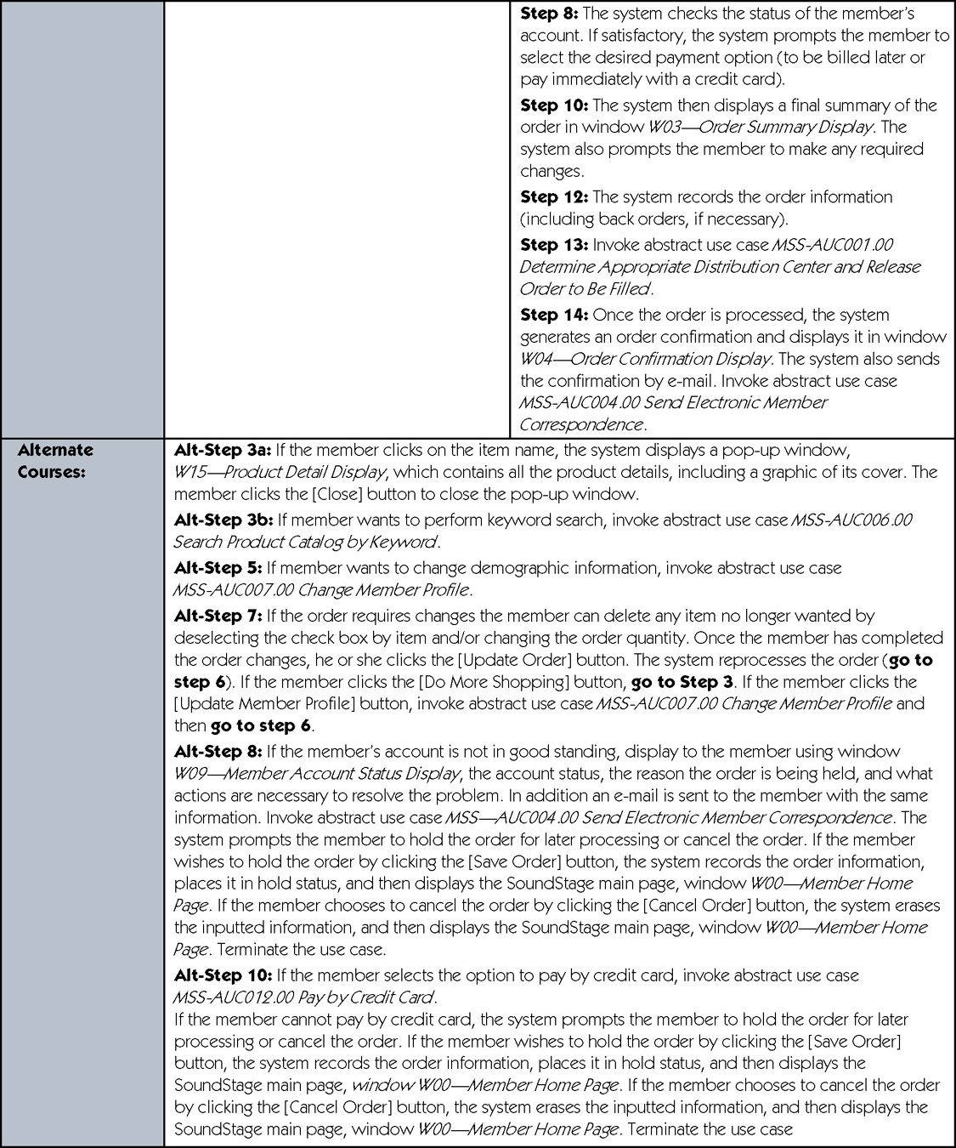
Design Use Case (continued)
Notes:
Chapter 18 – Object-Oriented Design and Modeling Using the UML

Slide 17
Design Use Case (concluded)
Notes:
Chapter 18 – Object-Oriented Design and Modeling Using the UML

Slide 18
Modeling Class Interactions, Behaviors, and States
Step 1: Identify and Classify Use-Case Design Classes
Step 2: Identify Class Attributes
Step 3: Identify Class Behaviors and Responsibilities
Step 4: Model Object States
Step 5: Model Detailed Object Interactions

Slide 19
Step 1: Identify and Classify Use-Case Design Classes
Interface, Control, and Entity Classes of Place New Order Use Case
Interface Classes | Controller Classes | Entity Classes
W00-Member Home Page W02-Member Profile Display W03-Display Order Summary W04-Display Order Confirmation W09-Member Account Status Display W11-Catalog Display W15-Product Detail Display | Place New Order Handler | Billing Address Shipping Address Email Address Active Member Member Order Member Ordered Product Product Title Audio Title Game Title Video Title Transaction
Notes:
Chapter 18 – Object-Oriented Design and Modeling Using the UML

Slide 20
Step 2: Identify Class Attributes
Many attributes already identified during object-oriented analysis.
Revised use cases may mention additional attributes.
Must update class diagram to include new attributes.

Slide 21
Step 3: Identify Class Behaviors and Responsibilities
Analyze use cases to identify required system behaviors
  Search for verb phrases
  Some will reflect manual actions, others automated
Associate behaviors and responsibilities with classes
Model classes that have complex behavior
Examine class diagram for additional behaviors
Verify classifications

Slide 22
Condensed Behavior List
Condensed Behavior List for Place New Order Use Case
Behaviors | Class Type
Process new member order | Control
Retrieve product catalog information | Entity
Display W11-Catalog Display window | Interface
Retrieve member demographic information | Entity
Display W02-Member Profile Display window | Interface
Validate quantity amount | Entity
Verify the product availability | Entity
Determine an expected ship date | Entity
Determine cost of the total order | Entity
Display W03-Order Summary Display window | Interface
Prompt user | Interface
Check Status of member account | Entity
...
Notes:
Chapter 18 – Object-Oriented Design and Modeling Using the UML

Slide 23
Tools for Identifying Behaviors and Responsibilities
Class Responsibility Collaboration (CRC) Card - a card that lists all behaviors and responsibilities assigned to a class.
  Often built interactively in a group setting that walks through a use case
Sequence diagram - a UML diagram that models the logic of a use case by depicting the interaction of messages between objects in time sequence.

Slide 24
CRC Card Listing Behaviors and Collaborators of a Class
Object Name: Member Order
Sub Object:
Super Object: Transaction
Behaviors and Responsibilities | Collaborators
Report order information Calculate subtotal cost Calculate total order cost Update order status Create Ordered Product Delete Ordered Product | Member Ordered Product
Notes:
Chapter 18 – Object-Oriented Design and Modeling Using the UML

Slide 25
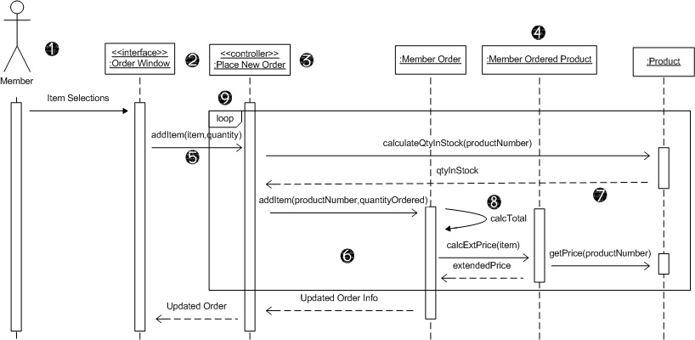
Sequence Diagram
Actor
Interface class
Controller class
Entity classes
Messages
Activation bars
Return messages
Self-call
Frame

Slide 26
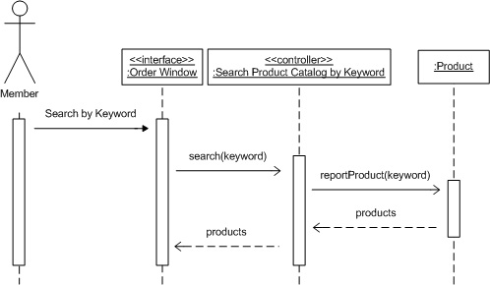
Another Sequence Diagram

Slide 27
Guidelines for Constructing Sequence Diagrams
Identify the scope of the sequence diagram, whether entire use-case scenario or one step.
Draw actor and interface class if scope includes that.
List use-case steps down the left-hand side.
Draw boxes for controller class and each entity class that must collaborate in the sequence (based on attributes or behaviors previously assigned).
Add persistence and system classes if scope includes that.
Draw messages and point each to class that will fulfill the responsibility.
Add activation bars to indicate object instance lifetimes.
Add return messages as needed for clarity.
Add frames for loops, optional steps, alternate steps, etc.

Slide 28
Step 4: Model Object States
Object state – a condition of the object at one point in its lifetime.
State transition event –occurrence that triggers a change in an object’s state through updating of one or more of its attribute values.
State machine diagram – a UML diagram that depicts:
  the combination of states that an object can assume during its lifetime,
  the events that trigger transitions between states,
  the rules governing the objects in transition.

Slide 29
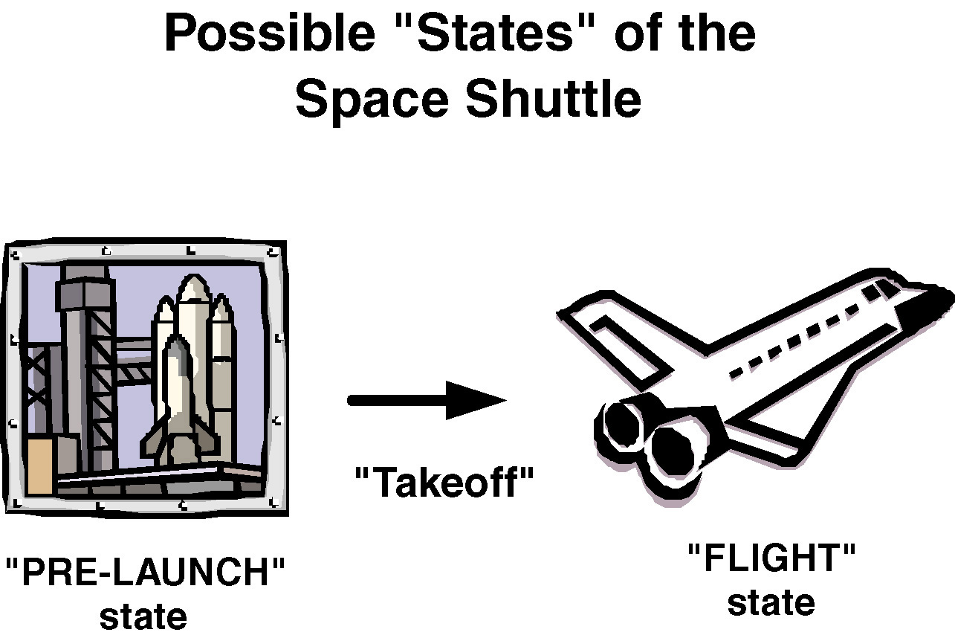
Object State Example

Slide 30
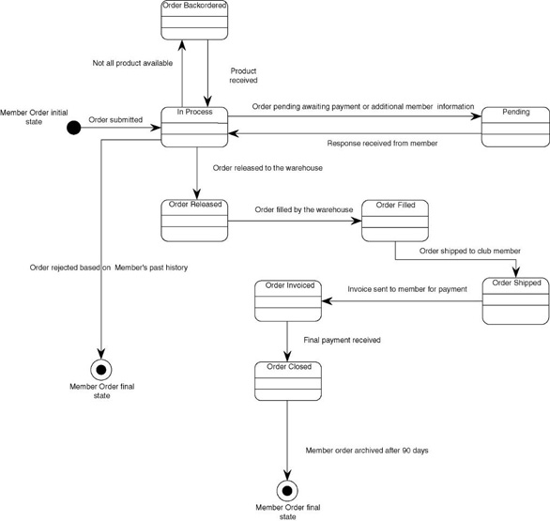
State Machine Diagram

Slide 31
Verifying Object Behavior and Collaboration
Role playing – the act of simulating object behavior and collaboration by acting out an object’s behaviors and responsibilities.
  Participants may assume the role of an actor on an object type
  Message sending is simulated by using an item such as a ball that is passed between the participants.
  Useful for discovering missing objects and behaviors.

Slide 32
Updating Object Model to Reflect Implementation Environment
Design class diagram – a diagram that depicts classes that correspond to software components that are used to build the software application. Includes:
  Classes
  Associations and gen/spec and aggregation relationships
  Attributes and attribute-type information
  Methods with parameters
  Navigability
  Dependencies

Slide 33
Transforming Analysis Class Diagram to Design Class Diagram
Add design objects to diagram
Add attributes and attribute-type information to design objects
Add attribute visibility
Add methods to design objects
Add method visibility
Add association navigability
Add dependency relationships

Slide 34
Four Implicit Object Behaviors
Create new instances
Update data or attributes
Delete instances
Display information
Notes:
Chapter 18 – Object-Oriented Design and Modeling Using the UML

Slide 35
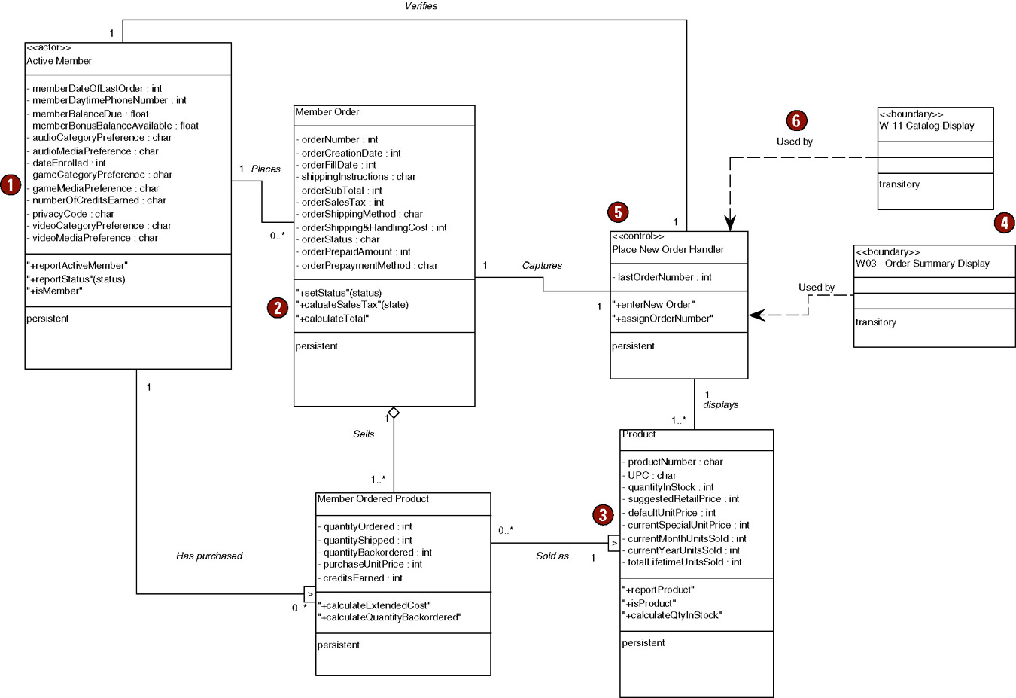
Partial Design Class Diagram
Notes:
Chapter 18 – Object-Oriented Design and Modeling Using the UML

Slide 36
Object Reusability
Coupling - the degree to which one class is connected to or relies upon other classes.
Cohesion - the degree to which the attributes and behaviors of a single class are related to each other.
  The two overarching goals of object-oriented design are low coupling and high cohesion.
  Allows for object reuse.

Slide 37
Object Reusability
The OO Success Story
Comparison of an OO Language and a 3GL Language
Programming Language | Project Duration (calendar months) | Level of Effort (person months) | Software Size (lines of code)
PL/1 | 19 | 152 | 265,000
Smalltalk | 3.5 | 10.4 | 22,000
Notes:
Chapter 18 – Object-Oriented Design and Modeling Using the UML

Slide 38
Design Patterns
Design pattern - a common solution to a give problem in a given context, which supports reuse of proven approaches and techniques.
Advantages
  Allow us to design with the experiences of those who came before rather than having to "reinvent the wheel."
  Provide designers a short-hand notation for discussing design issues.

Slide 39
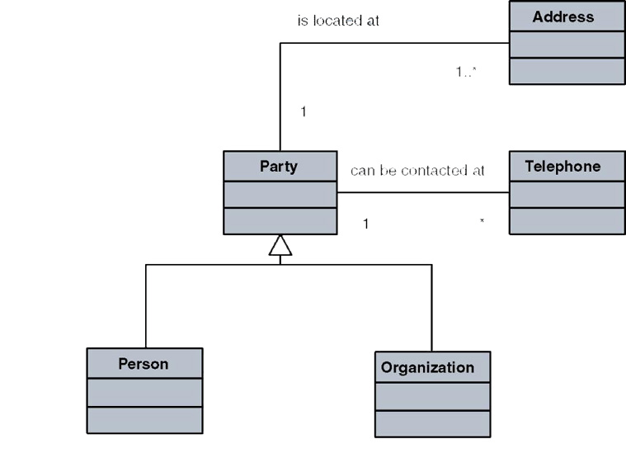
Sample Design Pattern

Slide 40
Gang-of-Four Patterns
Creational Abstract factor Builder Factory method Prototype Singleton | Structural Adapter Bridge Composite Decorator Façade Proxy | Behavioral Chain of responsibility Command Flyweight Interpreter Iterator Mediator Memento Observer State Strategy Template method Visitor

Slide 41
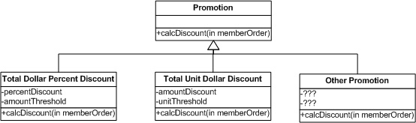
Strategy Pattern
Pattern: | Strategy
Category: | Behavioral
Problem: | How to design for varying and changing policy algorithms?
Solution: | Define each algorithm in a separate class with a common interface.

Slide 42
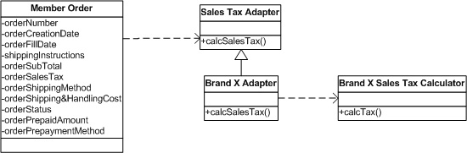
Adapter Pattern
Pattern: | Adapter
Category: | Structural
Problem: | How to provide a stable interface to similar classes with different interfaces?
Solution: | Add a class that acts as an adapter to convert the interface of a class into another interface that the client classes expect.

Slide 43
Frameworks and Components
Object framework – a set of related, interacting objects that provide a well-defined set of services for accomplishing a task.
Component – a group of objects packaged together into one unit. An example of a component is a dynamic link library (DLL) or executable file.
Notes:
Chapter 18 – Object-Oriented Design and Modeling Using the UML

Slide 44
Additional UML Design and Implementation Diagrams
Communication diagram - models the interaction of objects via messages, focusing on the structural organization of objects in a network format.
Component diagram - depicts the organization of programming code divided into components and how the components interact.
Deployment diagram - depicts the configuration of software components within the physical architecture of the systems hardware "nodes."

Slide 45
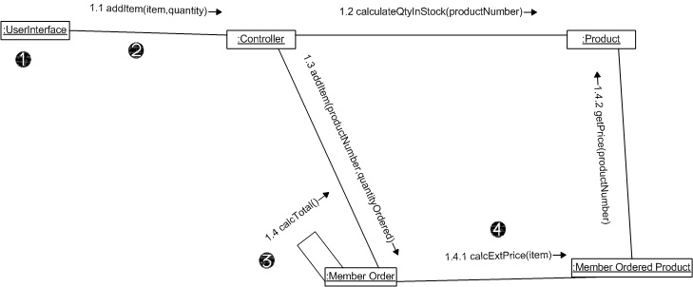
Communication Diagram
Class
Messages
Self-calls
Numbering scheme - messages should be numbered with a nested scheme.

Slide 46
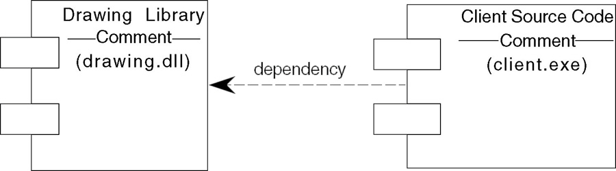
Component Diagram
Notes:
Chapter 18 – Object-Oriented Design and Modeling Using the UML

Slide 47
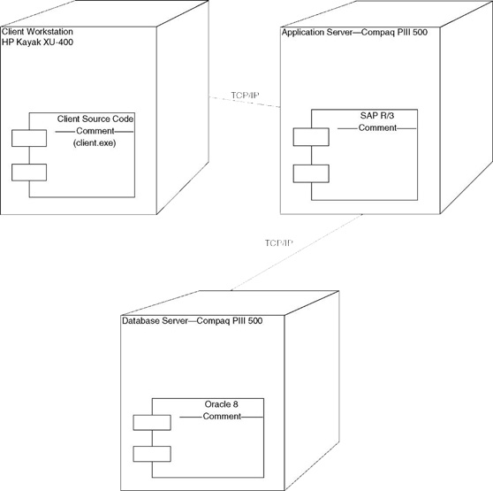
Deployment Diagram
Notes:
Chapter 18 – Object-Oriented Design and Modeling Using the UML

