Slide 1
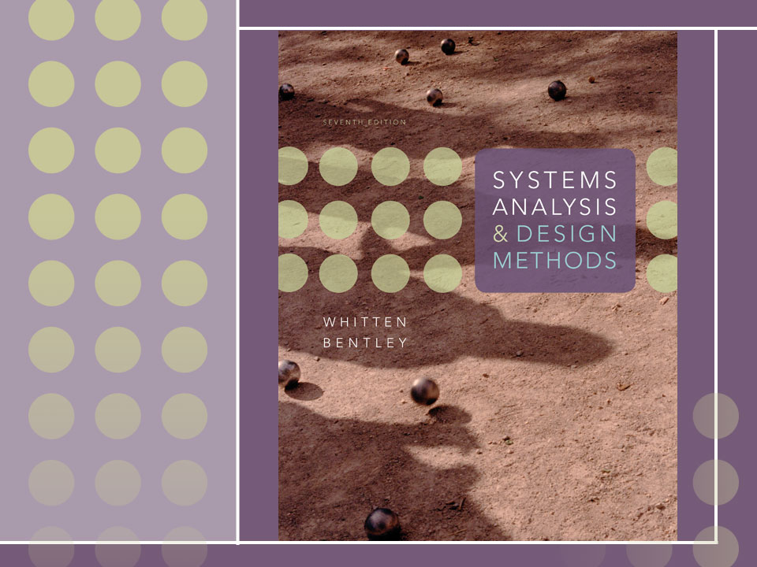
Chapter 20
Systems Operations and Support

Slide 2
Objectives
Define systems operations and support.
Describe relative roles of a repository, program library, and database in systems operations and support.
Differentiate between maintenance, recovery, technical support, and enhancement as system support activities.
Describe tasks required to maintain programs in response to bugs.
Describe role of benchmarking in system maintenance.
Describe the systems analyst’s role in system recovery.
Describe forms of technical support provided by a systems analyst for the user community.
Describe tasks that should/may be performed in system enhancement, and relationship between enhancement and original systems development process.
Describe the role of reengineering in systems enhancement. Describe three types of reengineering.

Slide 3
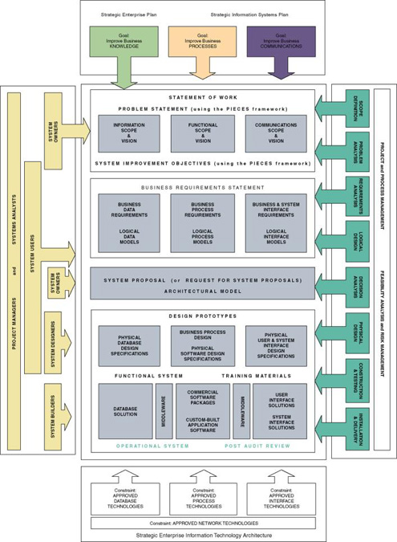

Slide 4
Support versus Operation
Systems support is the on-going technical support for users, as well as the maintenance required to fix any errors, omissions, or new requirements that may arise.
Systems operation is the day-to-day, week-to-week, month-to-month, and year-to-year execution of an information system’s business processes and application programs.
An operational system is a system that has been placed into operation. Frequently called a production system.

Slide 5
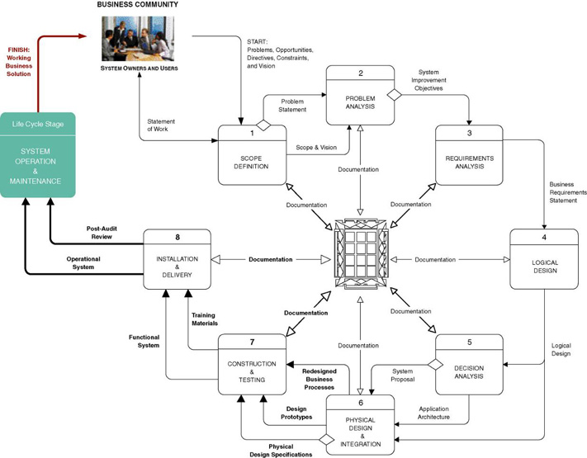
The Context of Systems Operation and Support

Slide 6
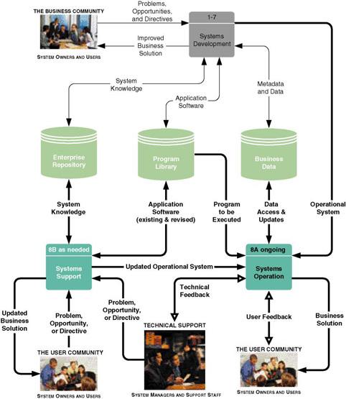
Systems Development, Operation, and Support Functions

Slide 7
Three Important Data Stores
The repository is a data store(s) of accumulated system knowledge—system models, detailed specifications, and any other documentation accumulated during systems development.
The program library is a data store(s) of all application programs.
The business data is all those data stores of the actual business data created and maintained by the production application programs.

Slide 8
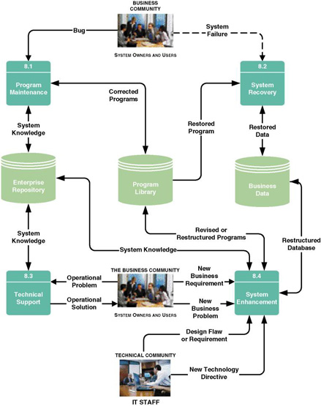
Systems Support Activities

Slide 9
System Support Activities
System maintenance corrects “bugs” or errors that slipped through the system development process.
System recovery is the restoration of the system and data after a system failure.
Technical support is any assistance provided to users in response to inexperience or unanticipated situations.
System enhancement is the improvement of the system to handle new business problems, new technical problems, or new technology requirements.

Slide 10
System Maintenance -
Causes of “Bugs”
Poorly validated requirements.
Poorly communicated requirements.
Misinterpreted requirements.
Incorrectly implemented requirements or designs.
Simple misuse of the programs.

Slide 11
System Maintenance Objectives
To make predictable changes to existing programs to correct errors.
To preserve those aspects of the programs that were correct, and to avoid “ripple effects” of changes that may adversely affect the correctly functioning aspects.
To avoid, as much as possible, the degradation of system performance.
To complete the task as quickly as possible without sacrificing quality and reliability of the system.

Slide 12
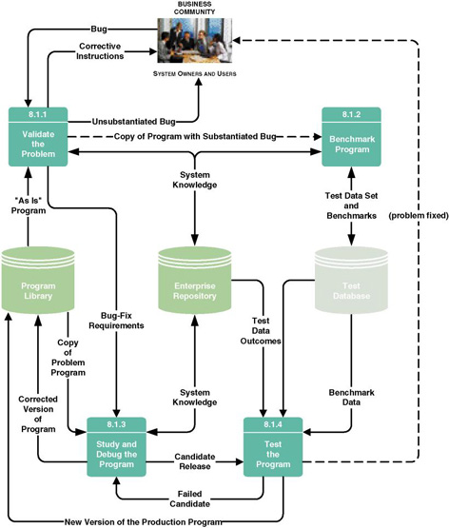
System Maintenance Tasks

Slide 13
System Maintenance Tasks
Validate the problem.
Benchmark the program.
  test script - a repository of test cases to be executed against all program revisions.
Study and debug the program to fix:
  Poor program structure.
  Unstructured (or poorly structured) logic.
  Prior maintenance (so-called “ripple” effects.)
  Dead code.
  Poor or inadequate documentation.
Test the program.

Slide 14
Testing
Unit testing (essential) ensures that the stand-alone program fixes the bug without undesirable side effects to the program.
System testing (essential) ensures that the entire application, of which the modified and unit tested program was a part, still works as a complete system.
Regression testing (recommended) extrapolates the impact of the changes on system performance (throughput and response time) by analyzing before-and-after performance against the test script.
Version control - a process whereby a librarian program keeps track of changes made to programs to facilitate backtracking.

Slide 15
System Recovery Activities
Recover from user’s terminal.
  Menu option
  Reboot
Systems operations personnel correct server problem (network admin, database admin, webmaster).
Data administrator recovers lost data or corrupted files.
  Lost transactions must be reprocessed (roll forward)
  Partially processed transactions must be undone (roll back)
Network administrator fixes LAN or WAN problem.
Technicians or vendor reps fix hardware problem.
Software bug must be trapped and fixed.

Slide 16
Technical Support
Being on call to assist users
Typical tasks:
  Routinely observing use of system
  Conducting user-satisfaction surveys and meetings
  Changing business procedures for clarification
  Providing additional training
  Logging enhancement ideas and requests in repository

Slide 17
System Enhancement Triggers
New business problems
New business requirements
New technology requirements (inclusive of hardware and software upgrades)
New design requirements

Slide 18
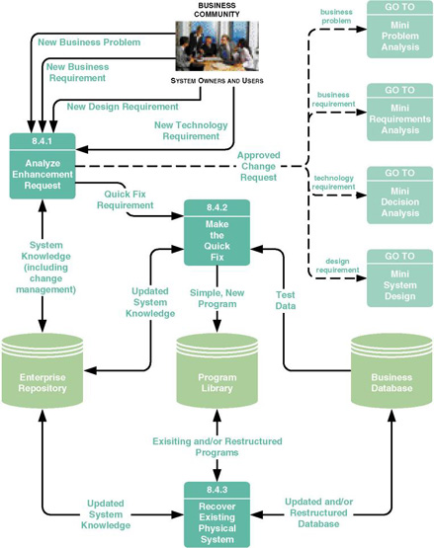
System Enhancement Tasks

Slide 19
System Enhancement Tasks
Analyze enhancement request.
If appropriate, make the quick fix.
  Changes that can be made without
    Restructuring stored data
    Updating stored data
    Inputting new data
  In other words, reports and outputs
  Requirements that exceed this should be subjected to systems analysis and design to consider implications.
  Can be written in 4GLs

Slide 20
System Enhancement Tasks (continued)
Recover the existing physical system:
  Updating repository and documentation for changes
  Database recovery and restructuring
  Program analysis, recovery, and restructuring
    Software metrics - mathematically proven measurements of software quality and developer productivity.
      Measurement of control flow knots (logic complexity)
      Measurement of cycle complexity
    Code reorganization of modularity and/or logic
    Code conversion from one language to another
    Code slicing to create reusable software components or objects out of existing code

Slide 21
System Obsolescence
All systems degrade over time
At some point, not cost-effective to support and maintain
Leads to a new systems development project
Full circle to chapters 3-19

