Slide 1

Kidney Transplant Outcome Prediction
Sherry Fan
Source: https://www.qdaily.com/articles/54115.html

Slide 2
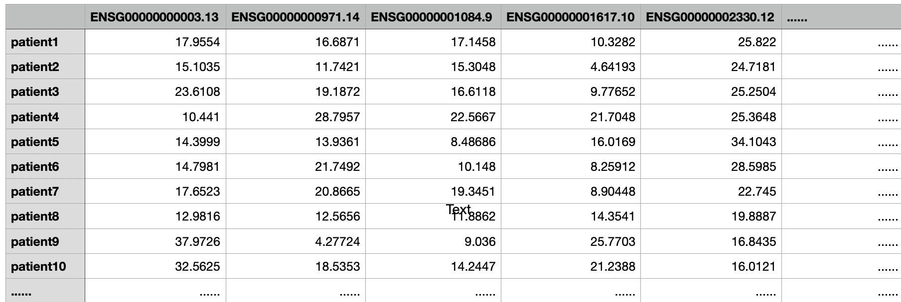
Patient RNA-seq Data: GSE131179
34 Patients
6047 RNA-seqs
Table 1: A preview of training dataset
Outcome: Acute Cellular Rejection or Normal/Non-Specific
Source: https://www.qdaily.com/articles/54115.html

Slide 3
Predictive Model: Random Forest
Ensemble Learning Method
Has multiple runs of decision trees
Take the majority of the results
Reduce the model instability for small dataset
Source: https://www.qdaily.com/articles/54115.html

Slide 4
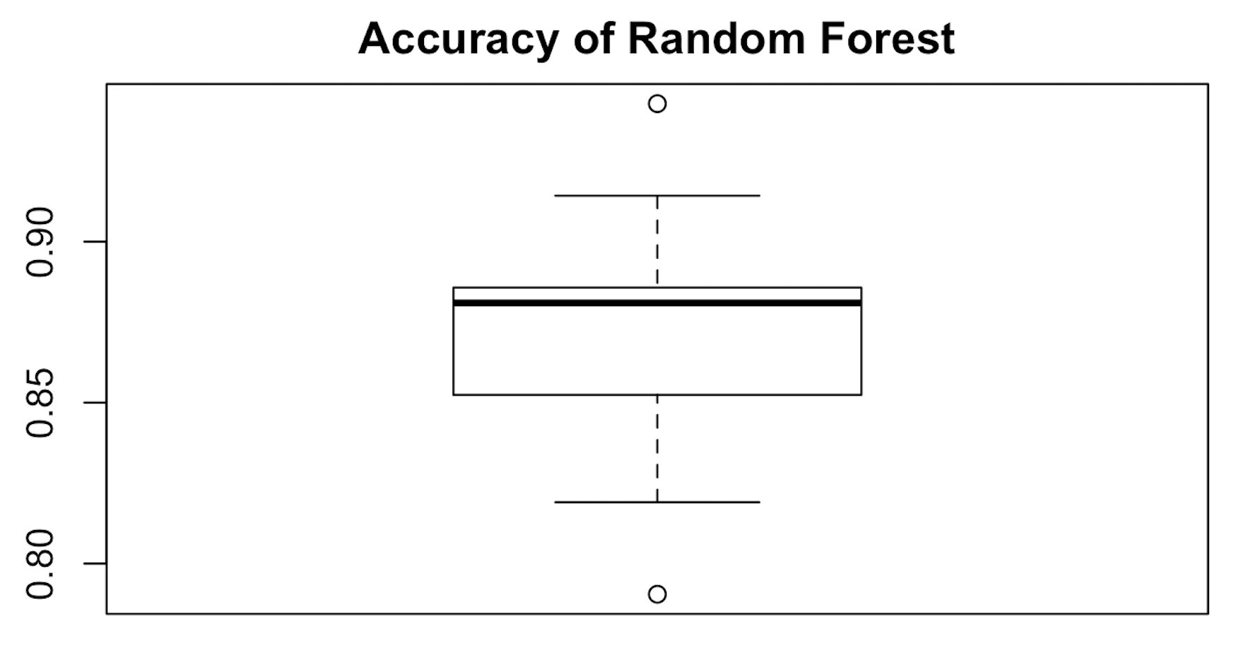
Predictive Model: Random Forest
Average accuracy: ～0.87
Figure 1: Accuracy of random forest
Source: https://www.qdaily.com/articles/54115.html

Slide 5
Shiny App
Objectives:
Produce prediction of kidney transplant outcome to help doctors to make decision whether the patient should have kidney transplant surgery
Input:
Patient’s RNA-seq
Output:
Prediction of kidney transplant outcome: rejection or stable
Source: https://www.qdaily.com/articles/54115.html

Slide 6
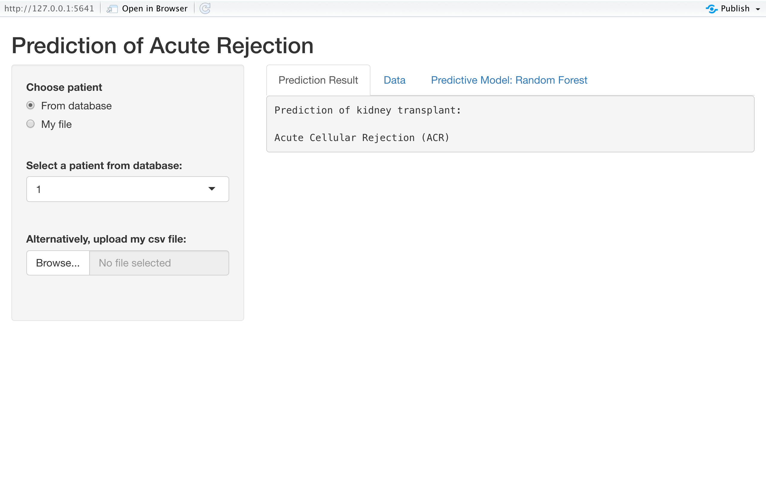
Shiny App Demonstration
Source: https://www.qdaily.com/articles/54115.html

