Slide 1

Welcome to FINLAND Rustlang Meetup 03.02.2017
Hack without fear!

Slide 2
Rust Introduction
Sherry Ummen

Slide 3
Disclaimer
I do not know everything about Rust. I am also learning ☺
And its not about saying that Rust is the best programming language.
I am not a native code programmer.

Slide 4
Agenda
What is Rust?
Tool chain
IDE’s available
Features of Rust
Basic features
Functional programming features
Ownership and Borrowing
Test suite

Slide 5
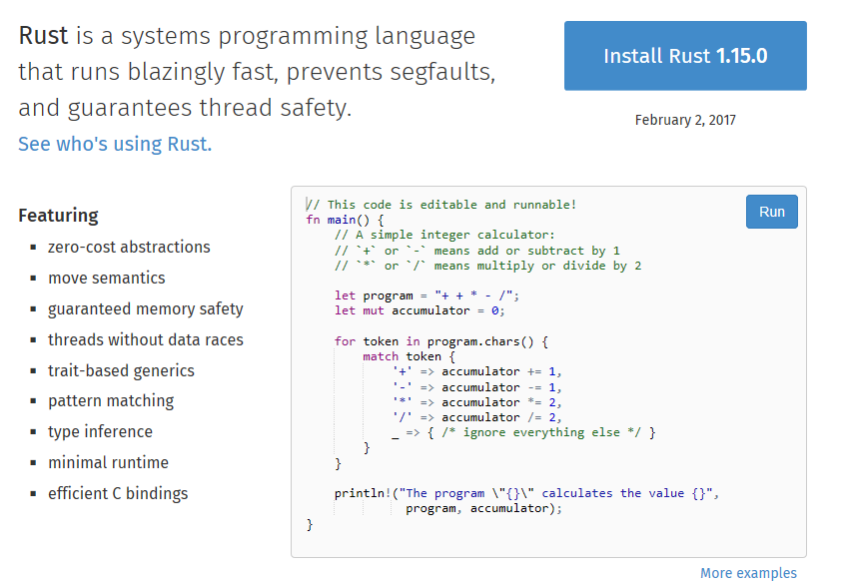
What is Rust?

Slide 6
Tool chain
Rustc
It is the compiler. Written using Rust and uses LLVM as its backend.
Cargo
Cargo is the package manager for Rust. It can build your code and manage dependencies also. Can also run test suite.
Rustup
Installs rustc, cargo, rustup and other standard tools to Cargo bin directory. Allow to switch easily between diff version of rust and makes cross compiling easier.
Crates
It’s the central package repository. Cargo pull its dependencies from here. You can publish your crates as well.

Slide 7
IDE available
Visual Studio Code
Intellij rust
Visual studio
RLS (Rust language Server) – Not an IDE but a service for the IDE’s

Slide 8
Features of Rust - Basic
DEMO

Slide 9
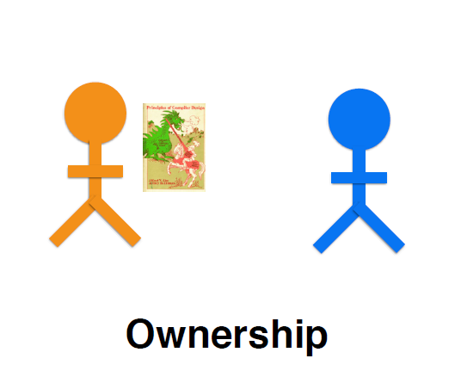
Ownership and Borrowing
Image Borrowed from Nicholas Matsakis

Slide 10
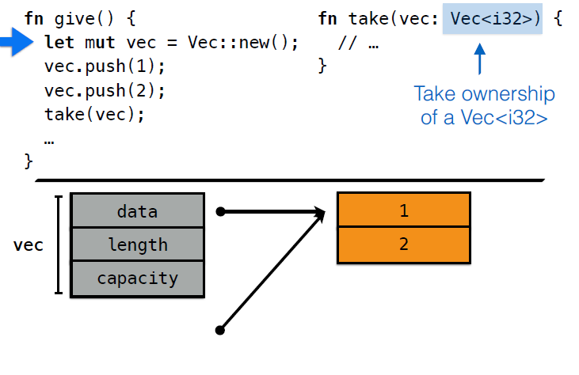
Image Borrowed from Nicholas Matsakis

Slide 11
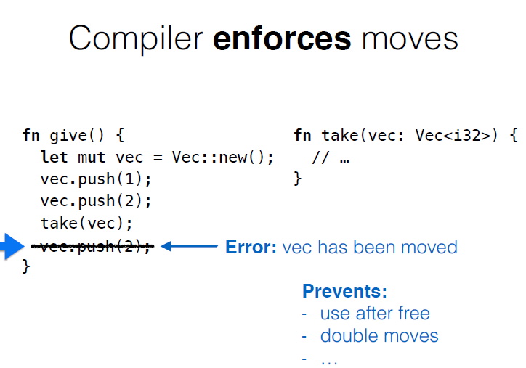
Image Borrowed from Nicholas Matsakis

Slide 12
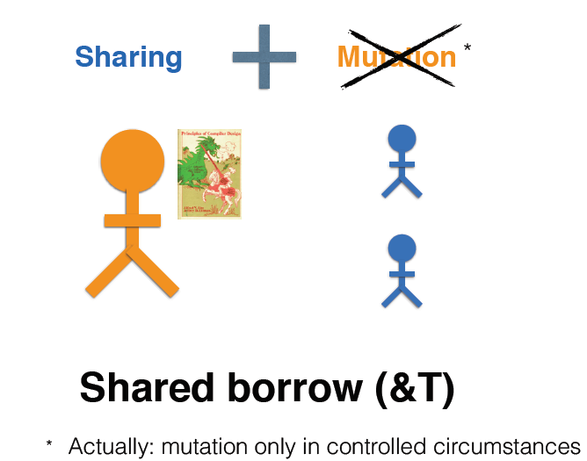
Image Borrowed from Nicholas Matsakis

Slide 13
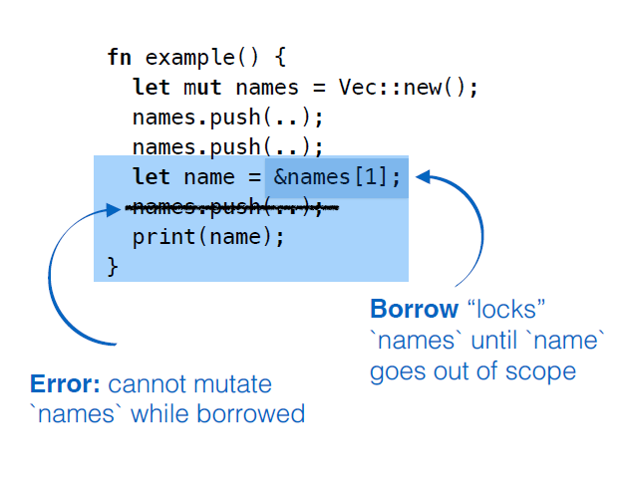
Image Borrowed from Nicholas Matsakis

Slide 14
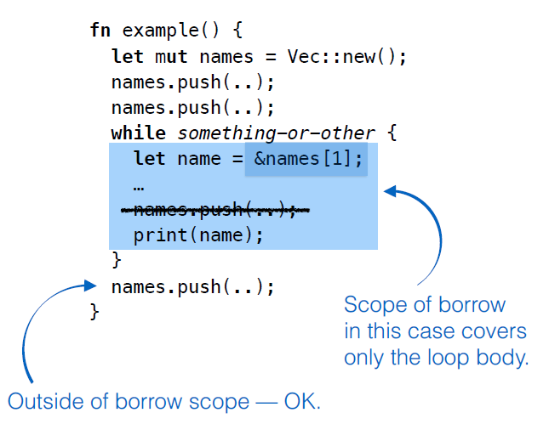
Image Borrowed from Nicholas Matsakis

Slide 15
Test suite
Demo

Slide 16
That’s all folks
Thank you

