Slide 1
Evanston Restaurant Recommender System
STAT 415: Homework 2
Xinhui Qian
Notes:
Hi professor! Today I'll be presenting my analysis of the Evanston Restaurant Recommender System. This project explores different approaches to building recommendation systems using restaurant review data from Evanston.

Slide 2
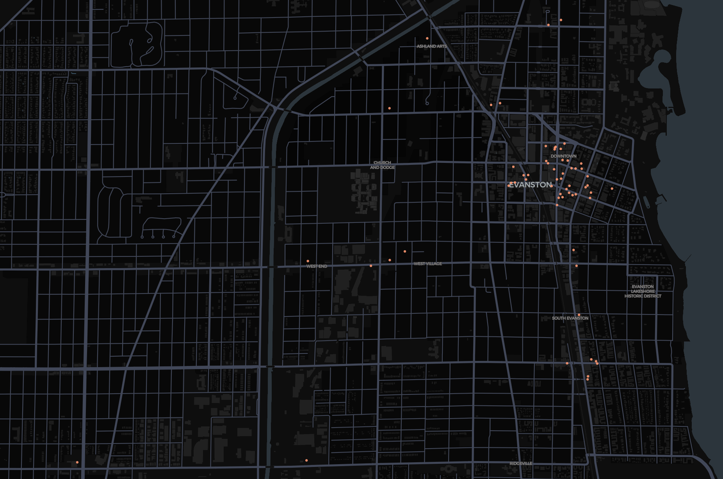
Project Introduction
Analyze restaurant reviews from Evanston, IL.
Dataset: 68 restaurants, 1,500 reviews.
Goals: evaluate recommendation methods: popularity, content‑based, text‑based.
Data includes restaurant attributes & reviewer demographics.
Notes:
The core problem addressed is recommendation—helping users discover relevant options from many choices.
I worked with a dataset containing:
- 68 restaurants with attributes (cuisine, cost, location)
- 1,500 customer reviews with ratings and demographics

Slide 3
Presentation Overview
1. Project Introduction
2. Data Preprocessing
3. Exploratory Data Analysis
4. Content‑Based Filtering
5. Popularity Matching
6. Natural Language Analysis
Notes:
My analysis includes:
1. Data preprocessing and cleaning
2. Exploratory data analysis
3. content-based filtering
4. and i will talk about popularity matching, , and natural language analysis if i have extra time

Slide 4
Data Preprocessing Steps
Dataset Structure
Restaurants (68): cuisine, cost, location, descriptions.
Reviews (1,500): 1‑5 ratings, 14 demographic variables, review text.
Outcome variable: star rating.
Preprocessing Steps
Removed 7 duplicate reviews & fixed category labels Marital Status.
Corrected longitude formatting & name typos.
Standardized date‑time format.
Merged restaurant & review tables on restaurant ID.
Corrected restaurant name variants (e.g., "Claire's Korner" spelling differences)
Normalized categorical & geographic variables.
Notes:
Before analysis, I addressed several data quality issues:
- Removed 7 duplicated reviews
- Standardized inconsistent category labels (e.g., different "single" variations in Marital Status)
- Fixed longitude format errors (missing negative signs, extra commas)
- Corrected restaurant name variants (e.g., "Claire's Korner" spelling differences)
- Standardized date-time formats (imputing missing days using median day by restaurant)

Slide 5
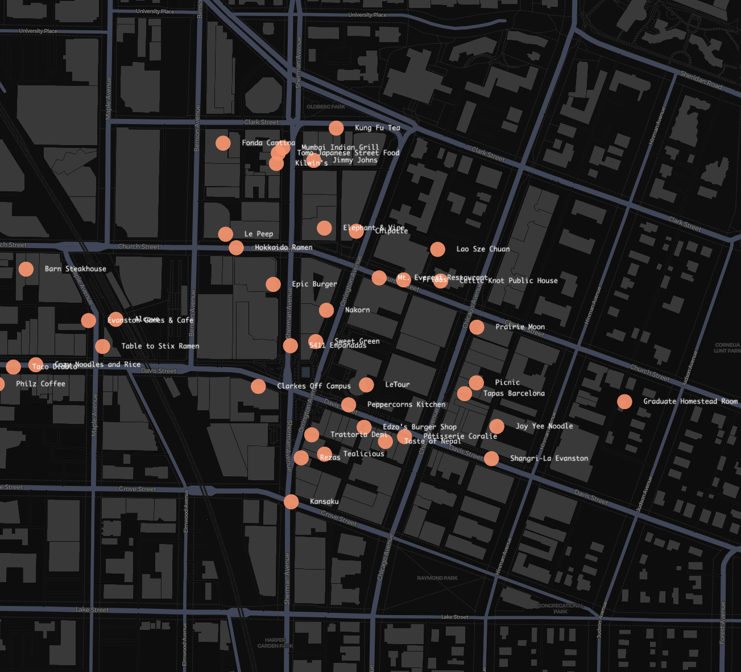
Restaurants Geographical Distribution
Major cluster around downtown & Northwestern campus.
Few outliers north & south of core area.
Notes:
After cleaning, I merged the restaurant and review datasets and visualized restaurant locations, which revealed a concentration in central Evanston, particularly around downtown and Northwestern campus.

Slide 6
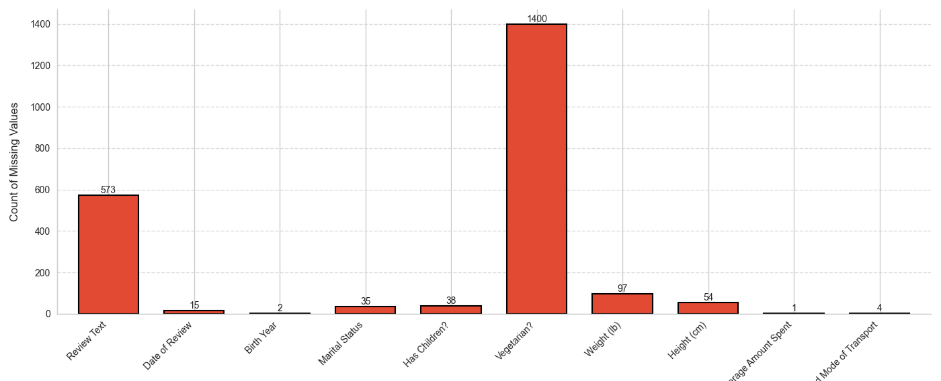
Missing Values Analysis
Review text: 38.4% missing — limits NLP.
Vegetarian?: 93.7% missing — impute.
Weight/Height: 6.5% / 3.6% missing — impute.
Low missingness in birth year, marital status, children.
Patterns reflect collection priorities & behavior.
Notes:
My analysis revealed significant missing data patterns:
- Review text: 38.4% missing — limiting text-based recommendation approaches
- Vegetarian?: 93.7% missing — effectively unusable
- Weight/height: 6.5%/3.6% missing — moderate missingness
- Birth year/marital status/children: Low missingness (0.1-2.5%)

Slide 7
Missing Data (Conditional) Imputation Strategy
Categorical → 'Unknown' to preserve users.
Numerical → median per restaurant.
Dates → median day per restaurant.
Aim: retain data, minimize bias.
Notes:
because not missing at random
I implemented this imputation strategy:
- Categorical variables → 'Unknown' category
- Numerical variables → Median values by restaurant
<!-- This approach preserves the maximum amount of data while minimizing bias introduction. -->

Slide 8
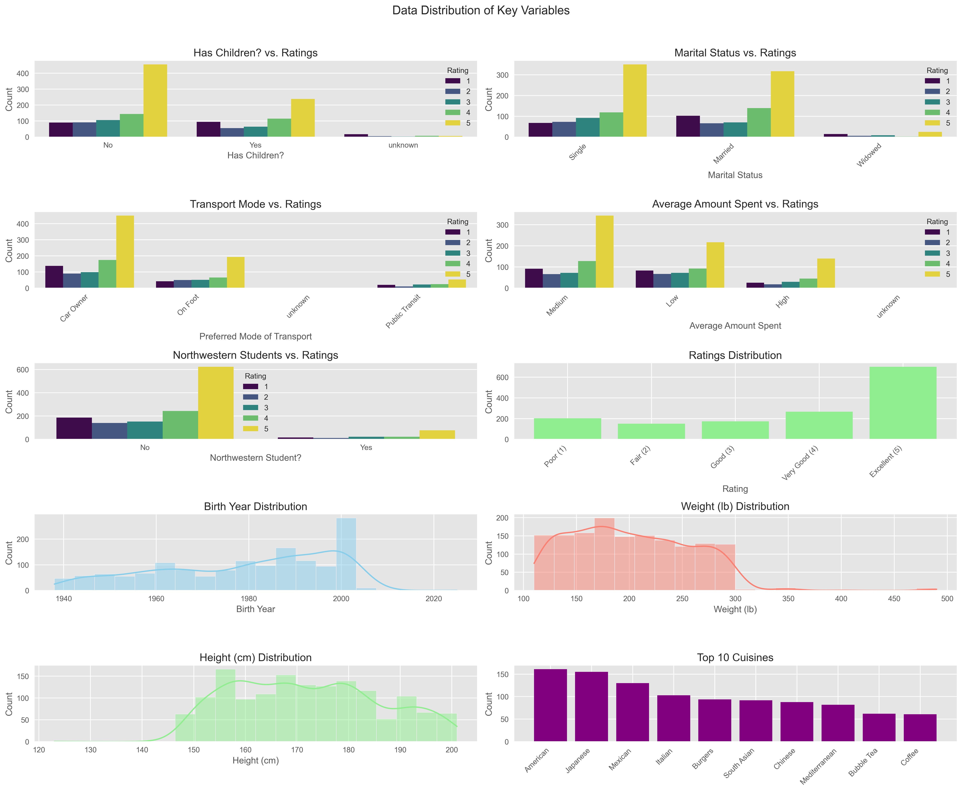
Data Distribution — Demographics
Northwestern students: 9.9% of reviewers.
Has children?: 59% no, 38% yes.
Transport: 63.8% car, 27% foot, 8.9% transit.
Birth years span 1960s‑1990s, peak ~2000.
Notes:
Key demographic patterns:
- Northwestern students: Only 9.9% of reviewers
- Has children?: 59% no, 38% yes
- Transport: Car owners (63.8%), on foot (27%), public transit (8.9%)

Slide 9
Cuisine Distribution
Top cuisines: American 11.8%, Mexican 10.3%, Japanese 8.8%, South Asian 7.2%, Burgers 6.9%.
Uneven representation influences recommendation reliability.
Notes:
Cuisine distribution:
- American (11.8%), Mexican (10.3%), Japanese (8.8%) restaurants are overrepresented
This imbalance presents challenges for recommendation systems, as we'll have more reliable data for popular cuisines but potentially unreliable suggestions for niche categories.

Slide 10
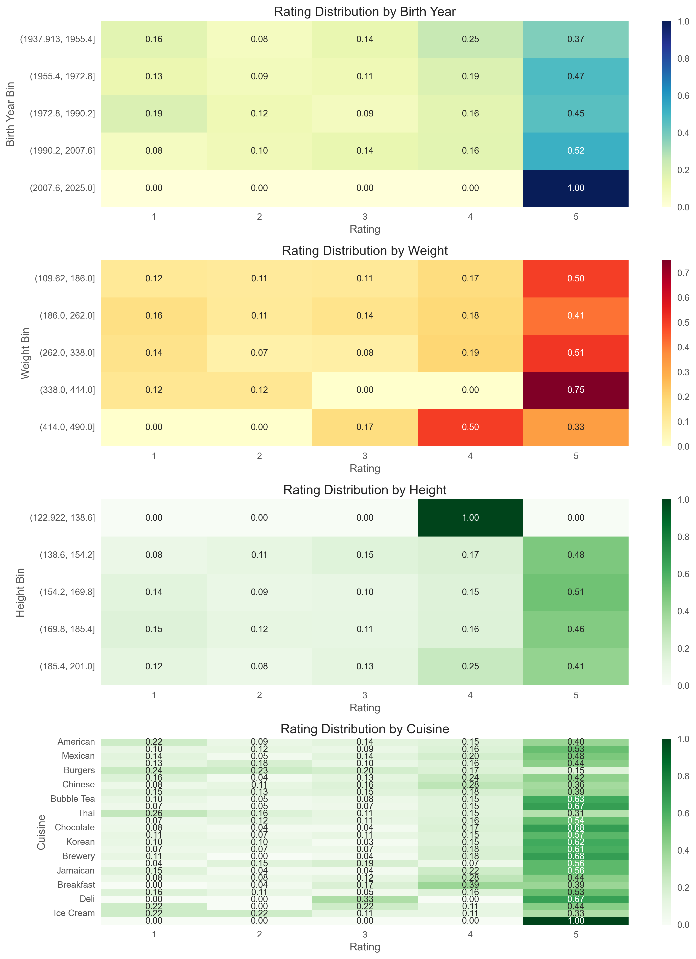
Data Distribution — Ratings
46.9% five‑star ratings ⇒ positivity bias.
Extreme scores (5 & 1) dominate.
Younger reviewers rate higher; widows rate lower.
Notes:
Rating patterns:
- Strong positive skew (46.9% are 5-star ratings)
看ppt

Slide 11
Clustering

Slide 12
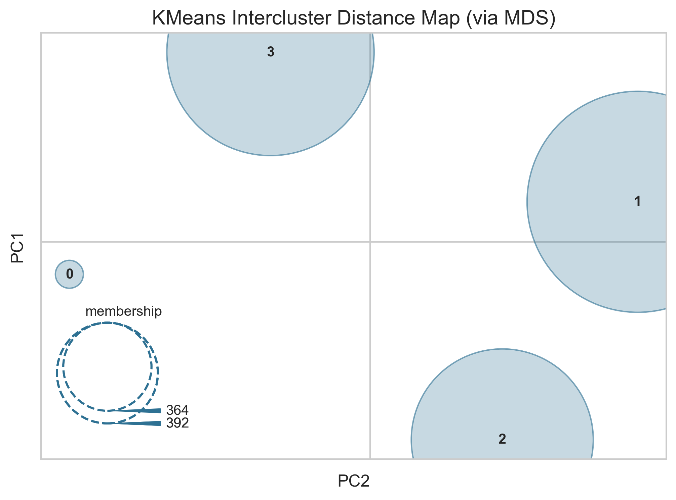
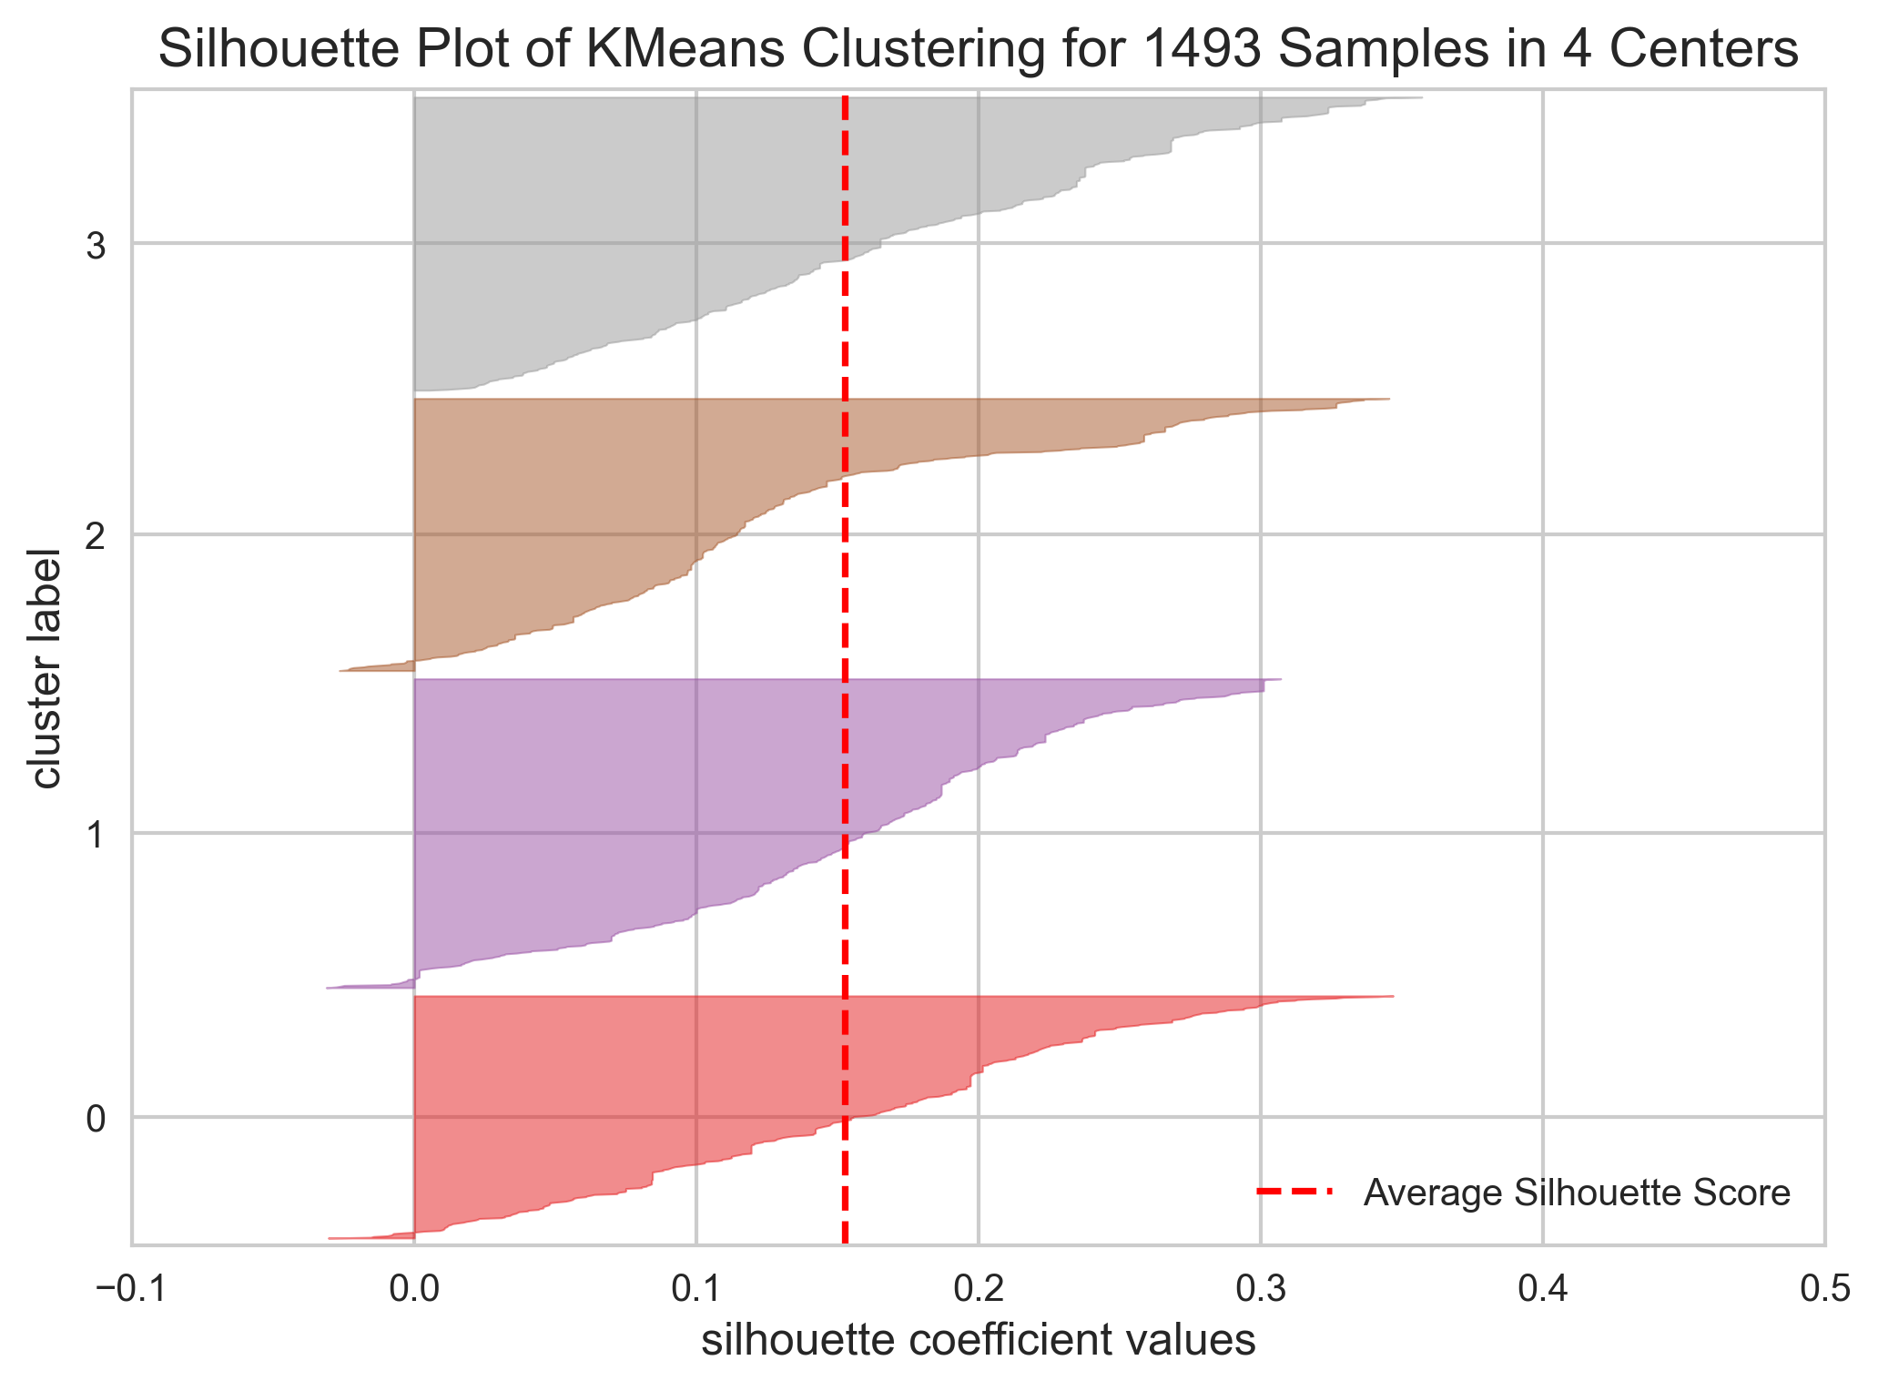
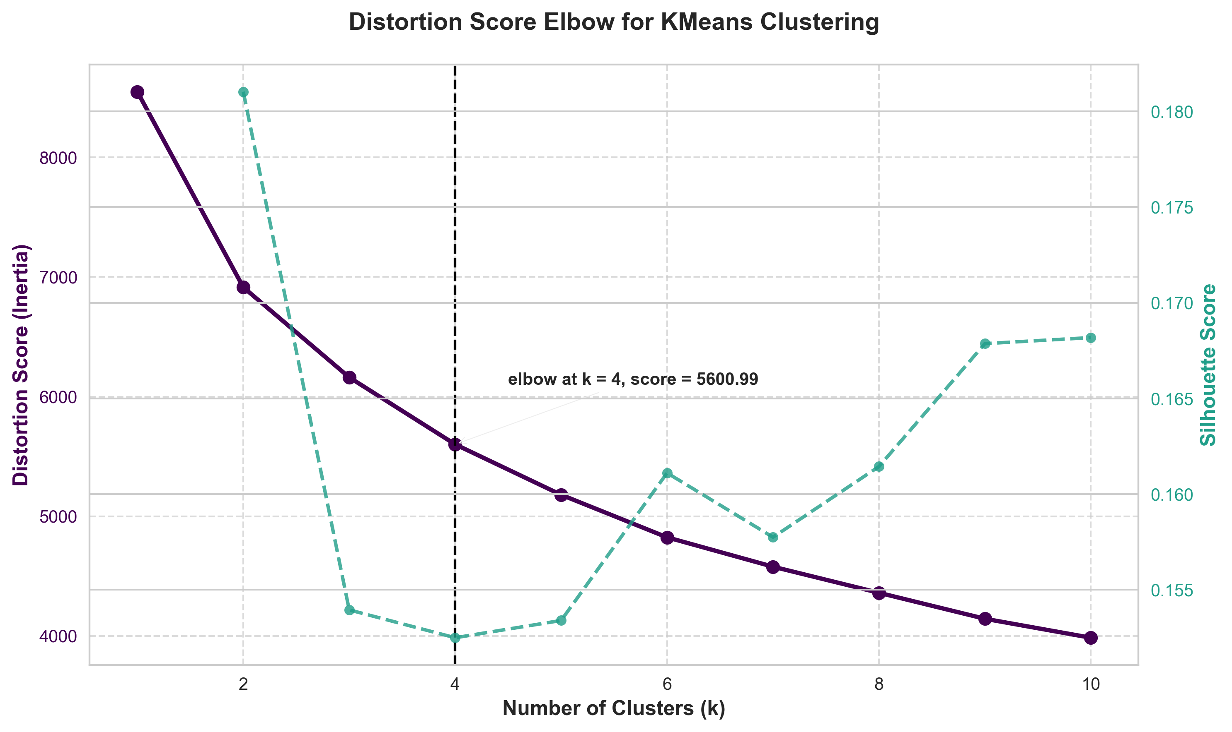
User Segmentation — Clustering Methodology
One‑hot encode categorical variables.
Standardize numeric features.
K‑Means (k=4) selected via elbow method (silhouette 0.15).
Validated with Agglomerative Method.
Notes:
I applied K-Means clustering with k=4 (determined by elbow method)
解释图片

Slide 13
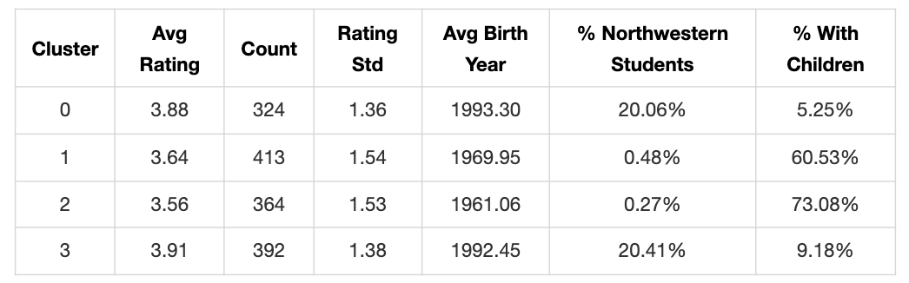
User Clusters & Rating Behavior
Cluster 0: 3.88 avg rating, 20% NU students, young no‑kids.
Cluster 1: 3.64 avg rating, older w/ kids (60%).
Cluster 2: 3.56 avg rating, oldest w/ kids (73%).
Cluster 3: 3.91 avg rating, young NU students, 9% kids.
Notes:
Clusters 0 and 3 represent younger populations born in the early 1990s, with about 20% being Northwestern students. Within this younger demographic, those with children (Cluster 3) give slightly higher ratings (3.91) than those without children (3.88).
Clusters 1 and 2 consist of older individuals born in the 1960s and 1970s, most of whom have children. The oldest group (Cluster 2, average birth year 1961) gave the lowest average ratings at 3.56, suggesting they might be more critical in their evaluations.

Slide 14
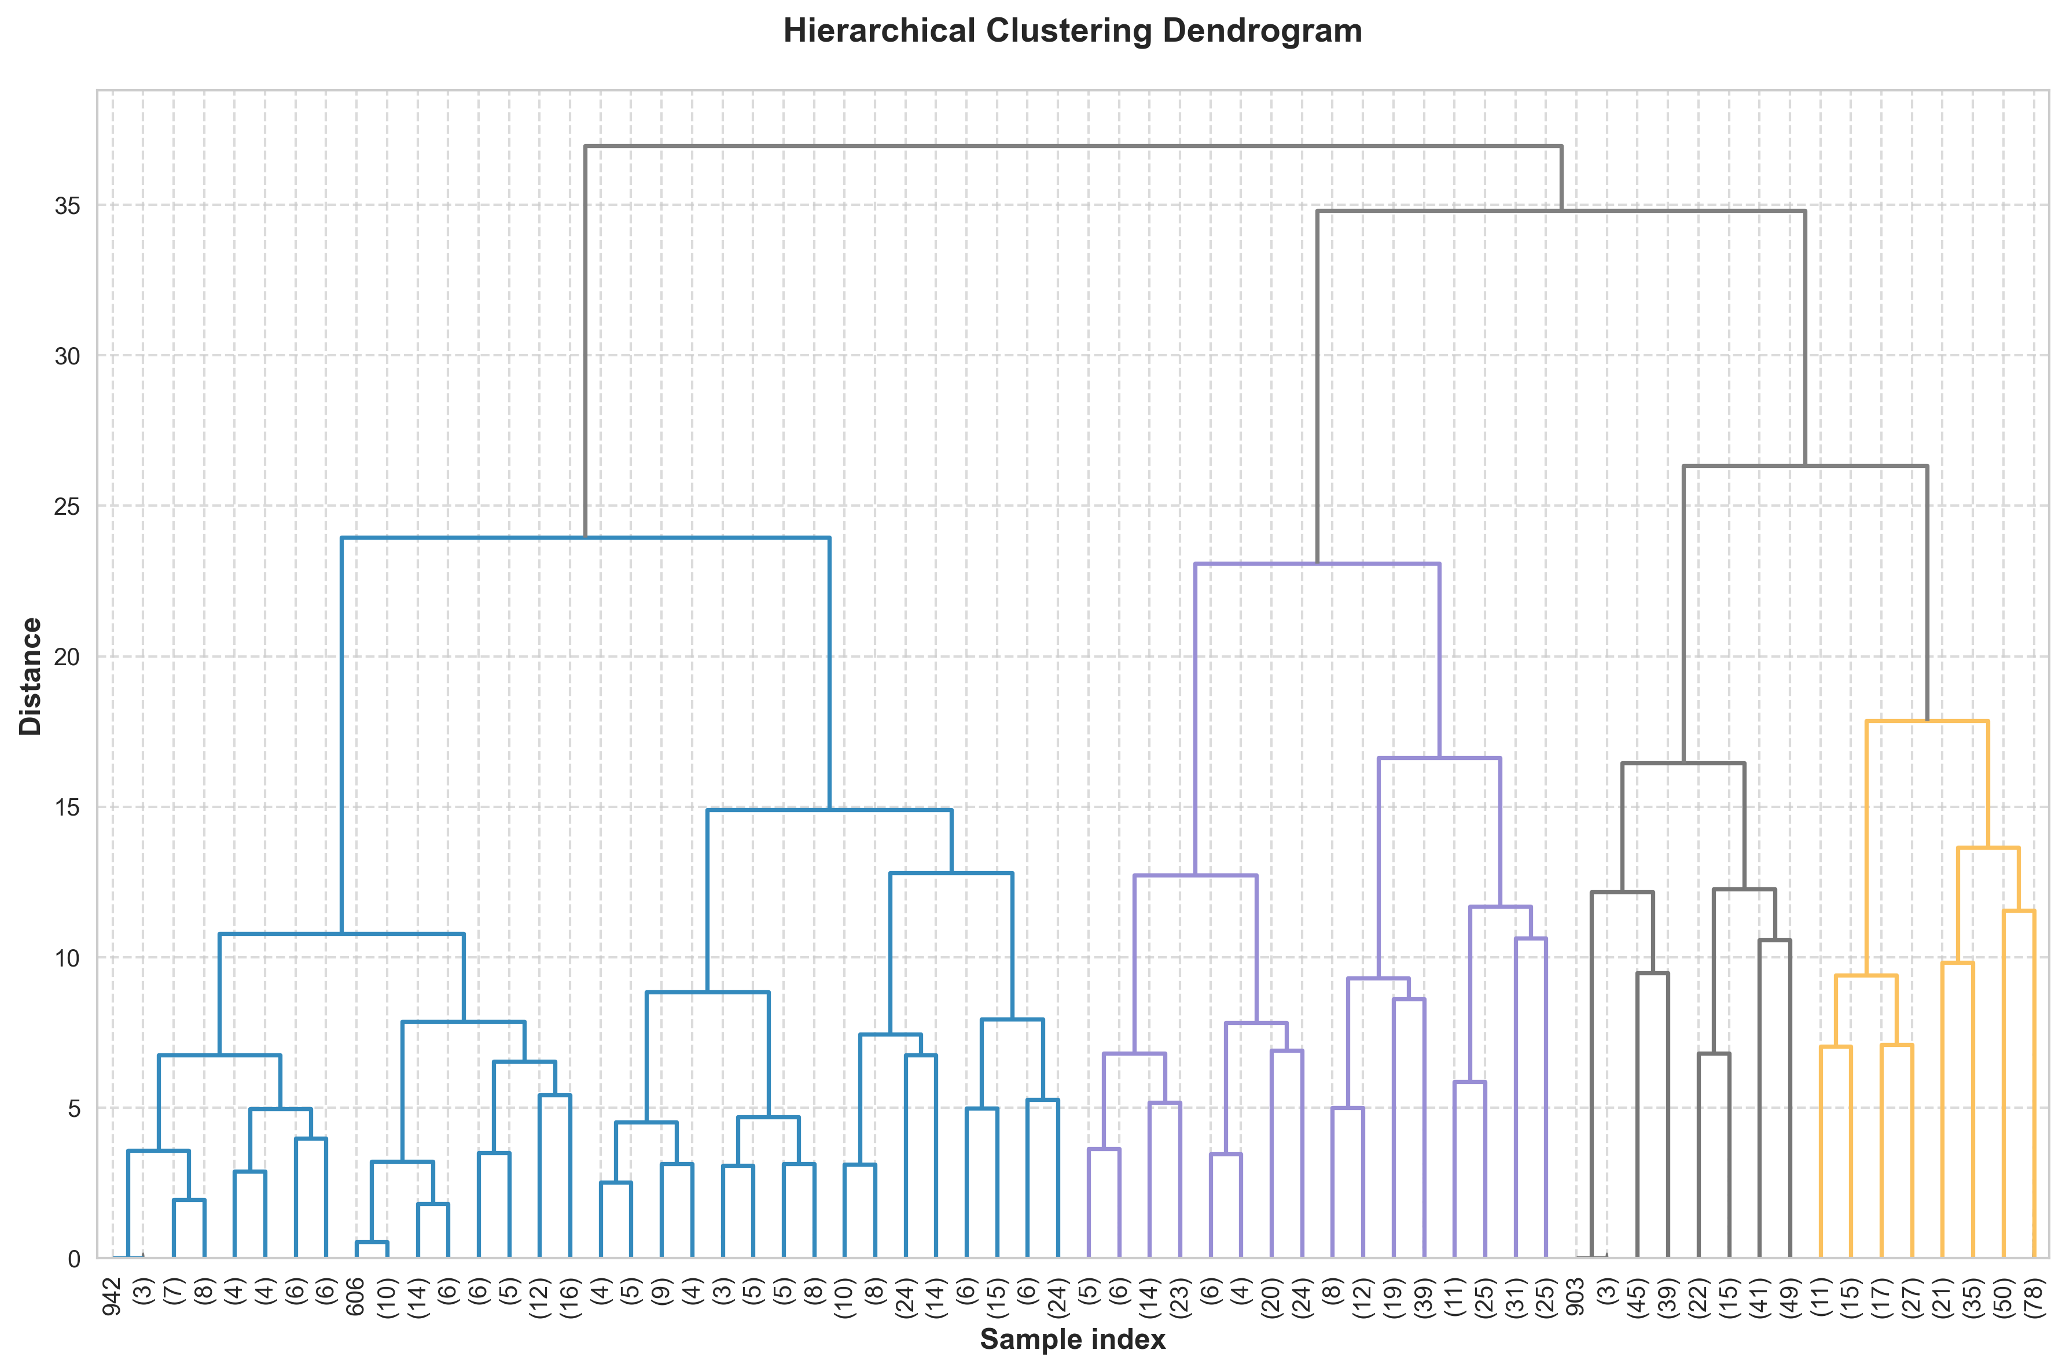
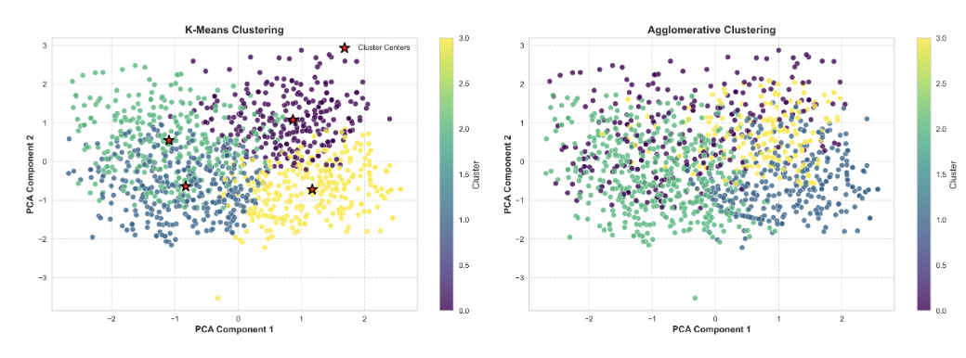
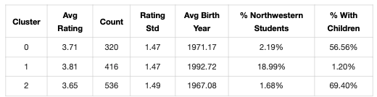
Validating Clusters — Agglomerative
Hierarchical clustering produced similar 4‑segment split.
Confirms young‑student vs older‑family dichotomy.
Notes:
I validated these findings through Agglomerative Hierarchical clustering, which confirmed the four distinct user segments with similar demographic characteristics.
By comparing the method, K-Means is a better approach. showing clearer and more compact clusters. Agglomerative Clustering struggles with this PCA-reduced space, showing overlapping and fuzzier cluster borders.

Slide 15
CONTENT‑BASED FILTERING APPROACH

Slide 16
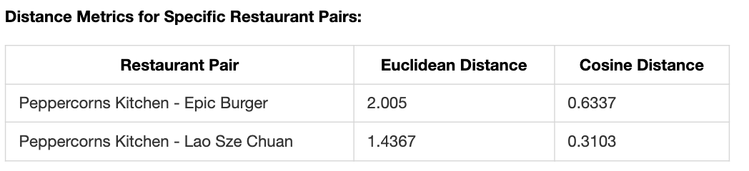
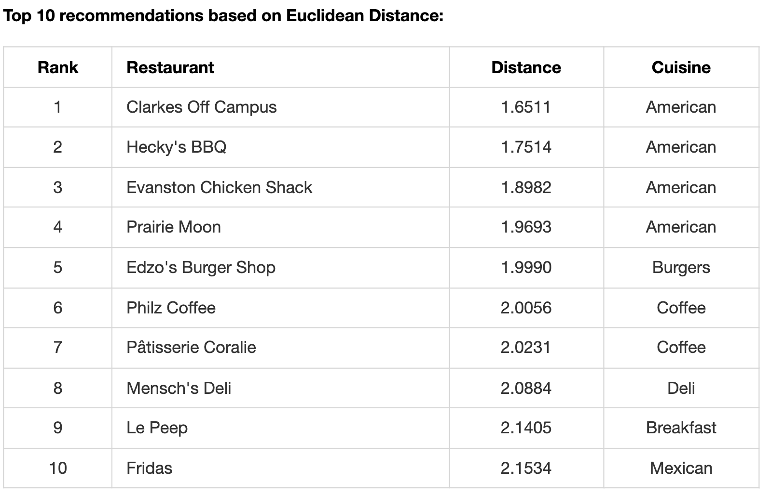
Content‑Based Filtering Methodology
Encode categories, scale numerics, build unified feature space.
Compute pairwise Euclidean & cosine distances.
Recommend closest restaurants to user favorite.
Personalized Recommendations Example
User: Willie Jacobsen — favorite: Jimmy Johns.
Top 5 similar (Euclidean): Clarkes Off Campus, Hecky's BBQ, Evanston Chicken Shack, Prairie Moon, Edzo's.
Notes:
For content-based filtering, I:
1. Encoded categorical variables (one-hot encoding)
2. Normalized numerical features
3. For restaurant descriptions, I
generated TF-IDF embeddings limited to 100 features, capturing key textual information without introducing excessive dimensionality.
4. Created a unified feature space for similarity calculations
Testing confirmed meaningful relationships between restaurants:
- Peppercorns Kitchen vs. Lao Sze Chuan (both Chinese) are more similar than- Peppercorns Kitchen vs. Epic Burger (different cuisines):
For each user, I identified their favorite restaurant and recommended similar ones. For example, Willie Jacobsen's favorite was Jimmy Johns (American), so the system recommended:
1. Clarkes Off Campus (American)
2. Hecky's BBQ (American)
…. American and fast food restaurant

Slide 17
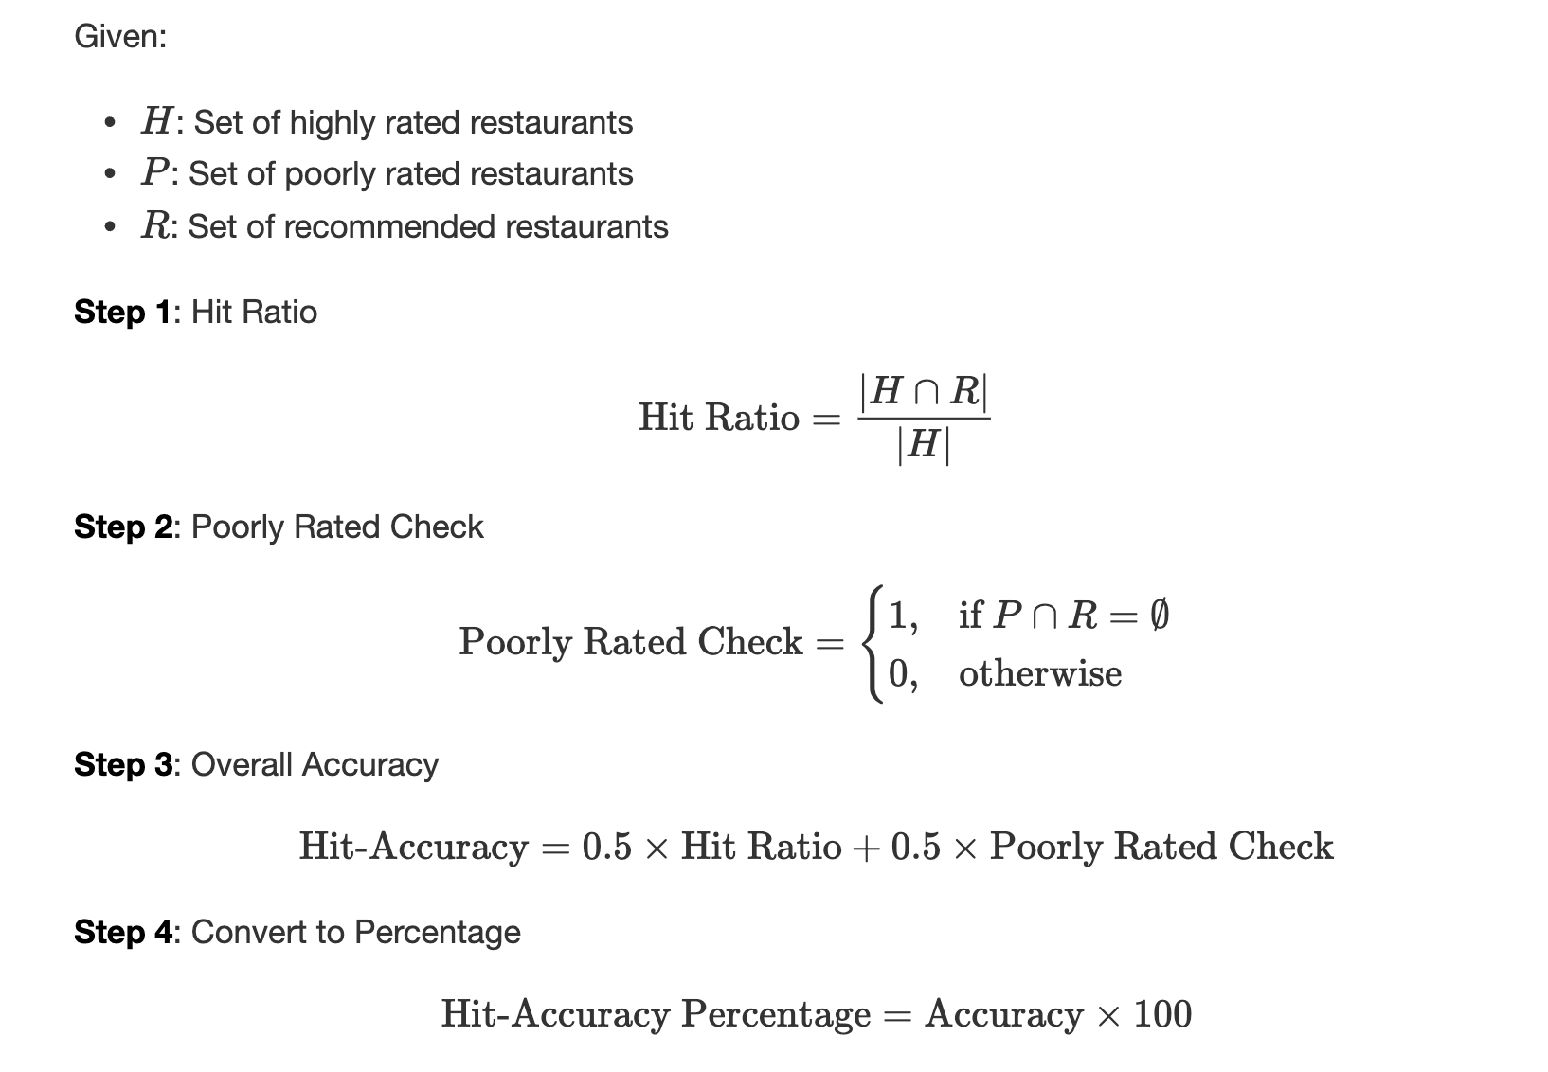
Recommendation Evaluation — `Hit‑Accuracy`
Metric balances inclusion of liked & exclusion of disliked restaurants.
Formula combines hit ratio & poorly‑rated check.
Euclidean accuracy: 97.17%.
Cosine accuracy: 96.95%.
Euclidean edges out cosine similarity.
Notes:
To compare the eﬀectiveness of diﬀerent distance metrics, I evaluated performance based on Hit-
Accuracy—the percentage of highly rated restaurants by the reviewer (rating ≥ 4) that appear in the recommendation
list.
The overall evaluation considers two equally weighted aspects
I evaluated performance euclidean and cosine similarity using a custom hit-accuracy metric considering:
- How well the system recommends highly-rated restaurants
- How well it avoids poorly-rated restaurants
<!-- Applying this metric across all users with sufficient history, the Euclidean distance method achieved 97.17% accuracy, slightly outperforming cosine similarity at 96.95%. While both methods performed well overall, Euclidean distance was generally better at capturing overall similarity. -->
This aligns with our instinct. Since the features have been standardized, there's no big diﬀerences
between these two methods. However, eculidian method is a better one than the cosine similarity
method

Slide 18
Thank You!
Questions?

Slide 19

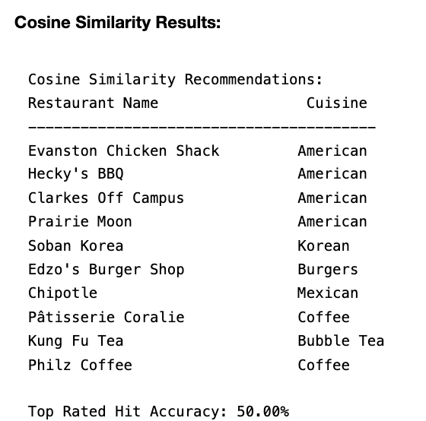
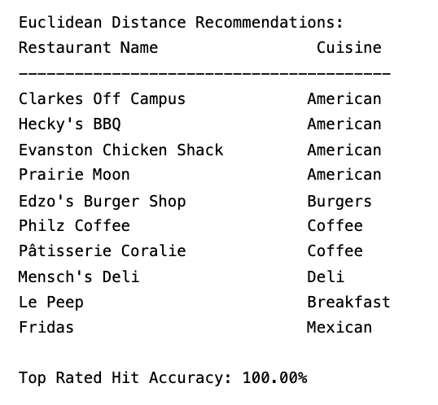
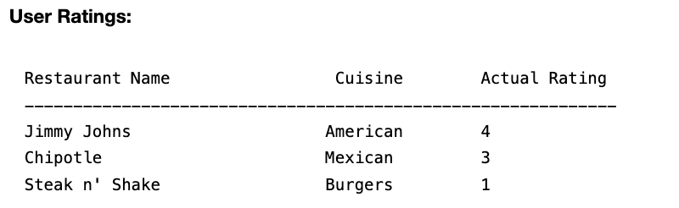
Appendix: Example of calculating Hit-Accuracy

Slide 20
Bonus SLides

Slide 21
POPULARITY MATCHING APPROACH

Slide 22
Popular Restaurants Analysis
Highest average rating: Evanston Games & Cafe (5.0/5, 1 review).
Most reviews: Campagnola (48) vs median 22.5.
Rating reliability improves with review volume.
Notes:
I identified notable restaurants:
- Highest-rated: Evanston Games & Cafe (5.0/5.0 vs. dataset average 3.75)
- But based on single review (reliability issue)
- Most-reviewed: Campagnola (48 reviews vs. dataset median 22.5)
- Strong rating of 4.0/5.0

Slide 23
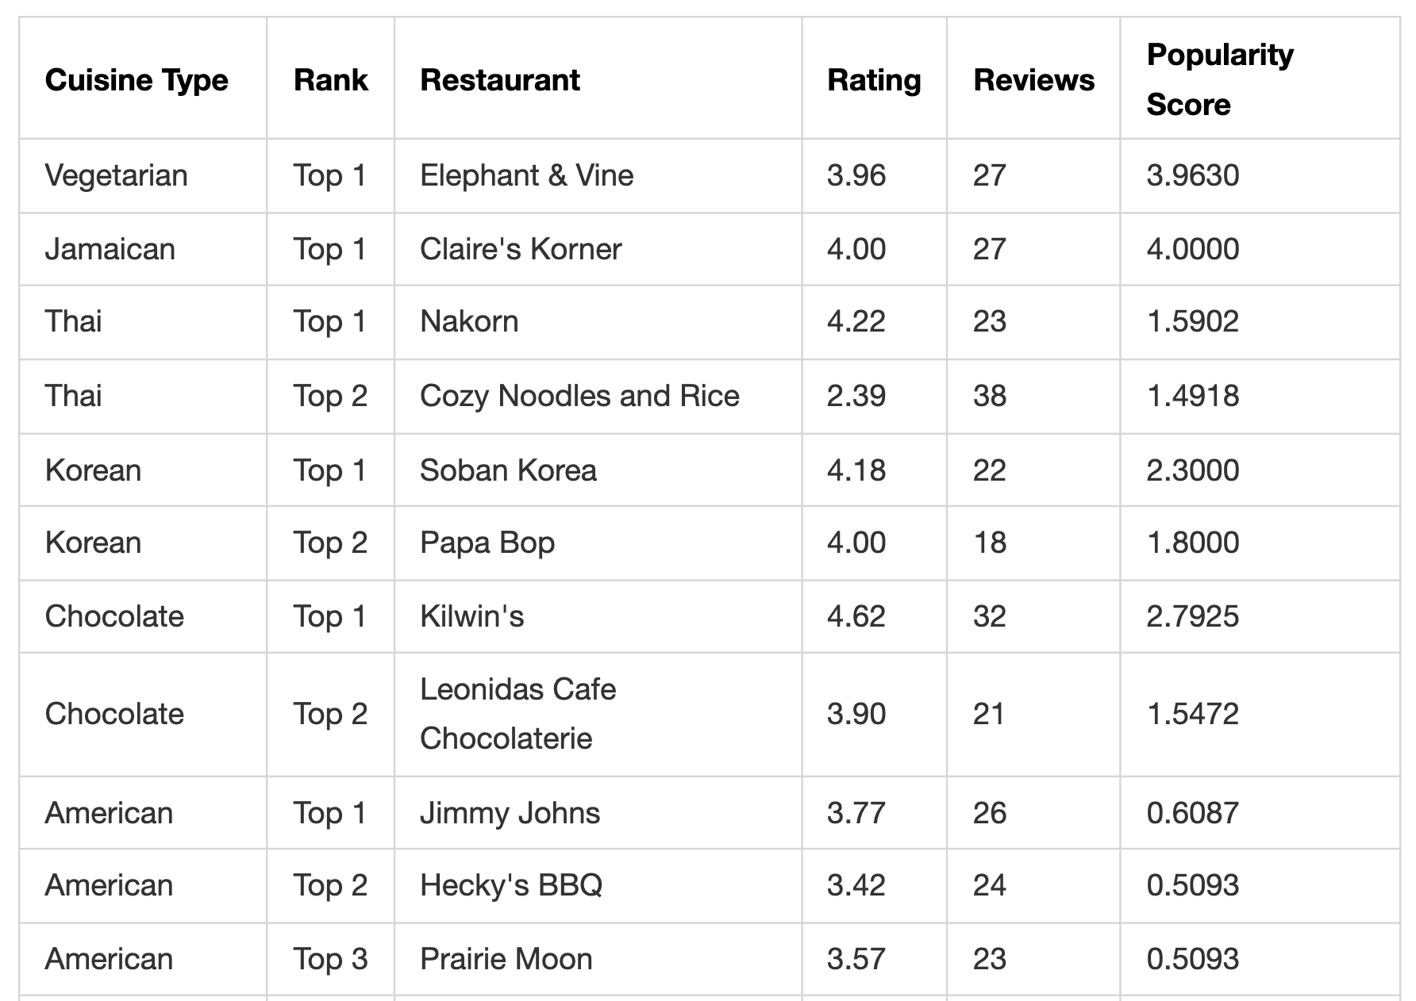
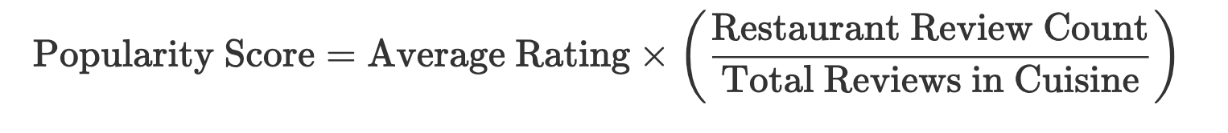
Cuisine‑Based Popularity Scoring
Balances quality & quantity within cuisine context.
Example:
Top Recommendations by Cuisine: Spanish: Tapas Barcelona (4.21, 29 reviews, 2.14 score). Chinese: Joy Yee Noodle (4.29, 31, 1.51). Mexican: Taco Diablo (4.30, 37, 1.22). Coffee: Pâtisserie Coralie (4.03, 30, 1.98).
Notes:
I developed a popularity score formula:
```
Popularity Score = Average Rating × (Restaurant Review Count / Total Reviews in Cuisine)
```
This generated cuisine-specific recommendations:
- Spanish: Tapas Barcelona (4.21 rating, 29 reviews, score 2.14)
- Chinese: Joy Yee Noodle (4.29 rating, 31 reviews, score 1.51)

Slide 24
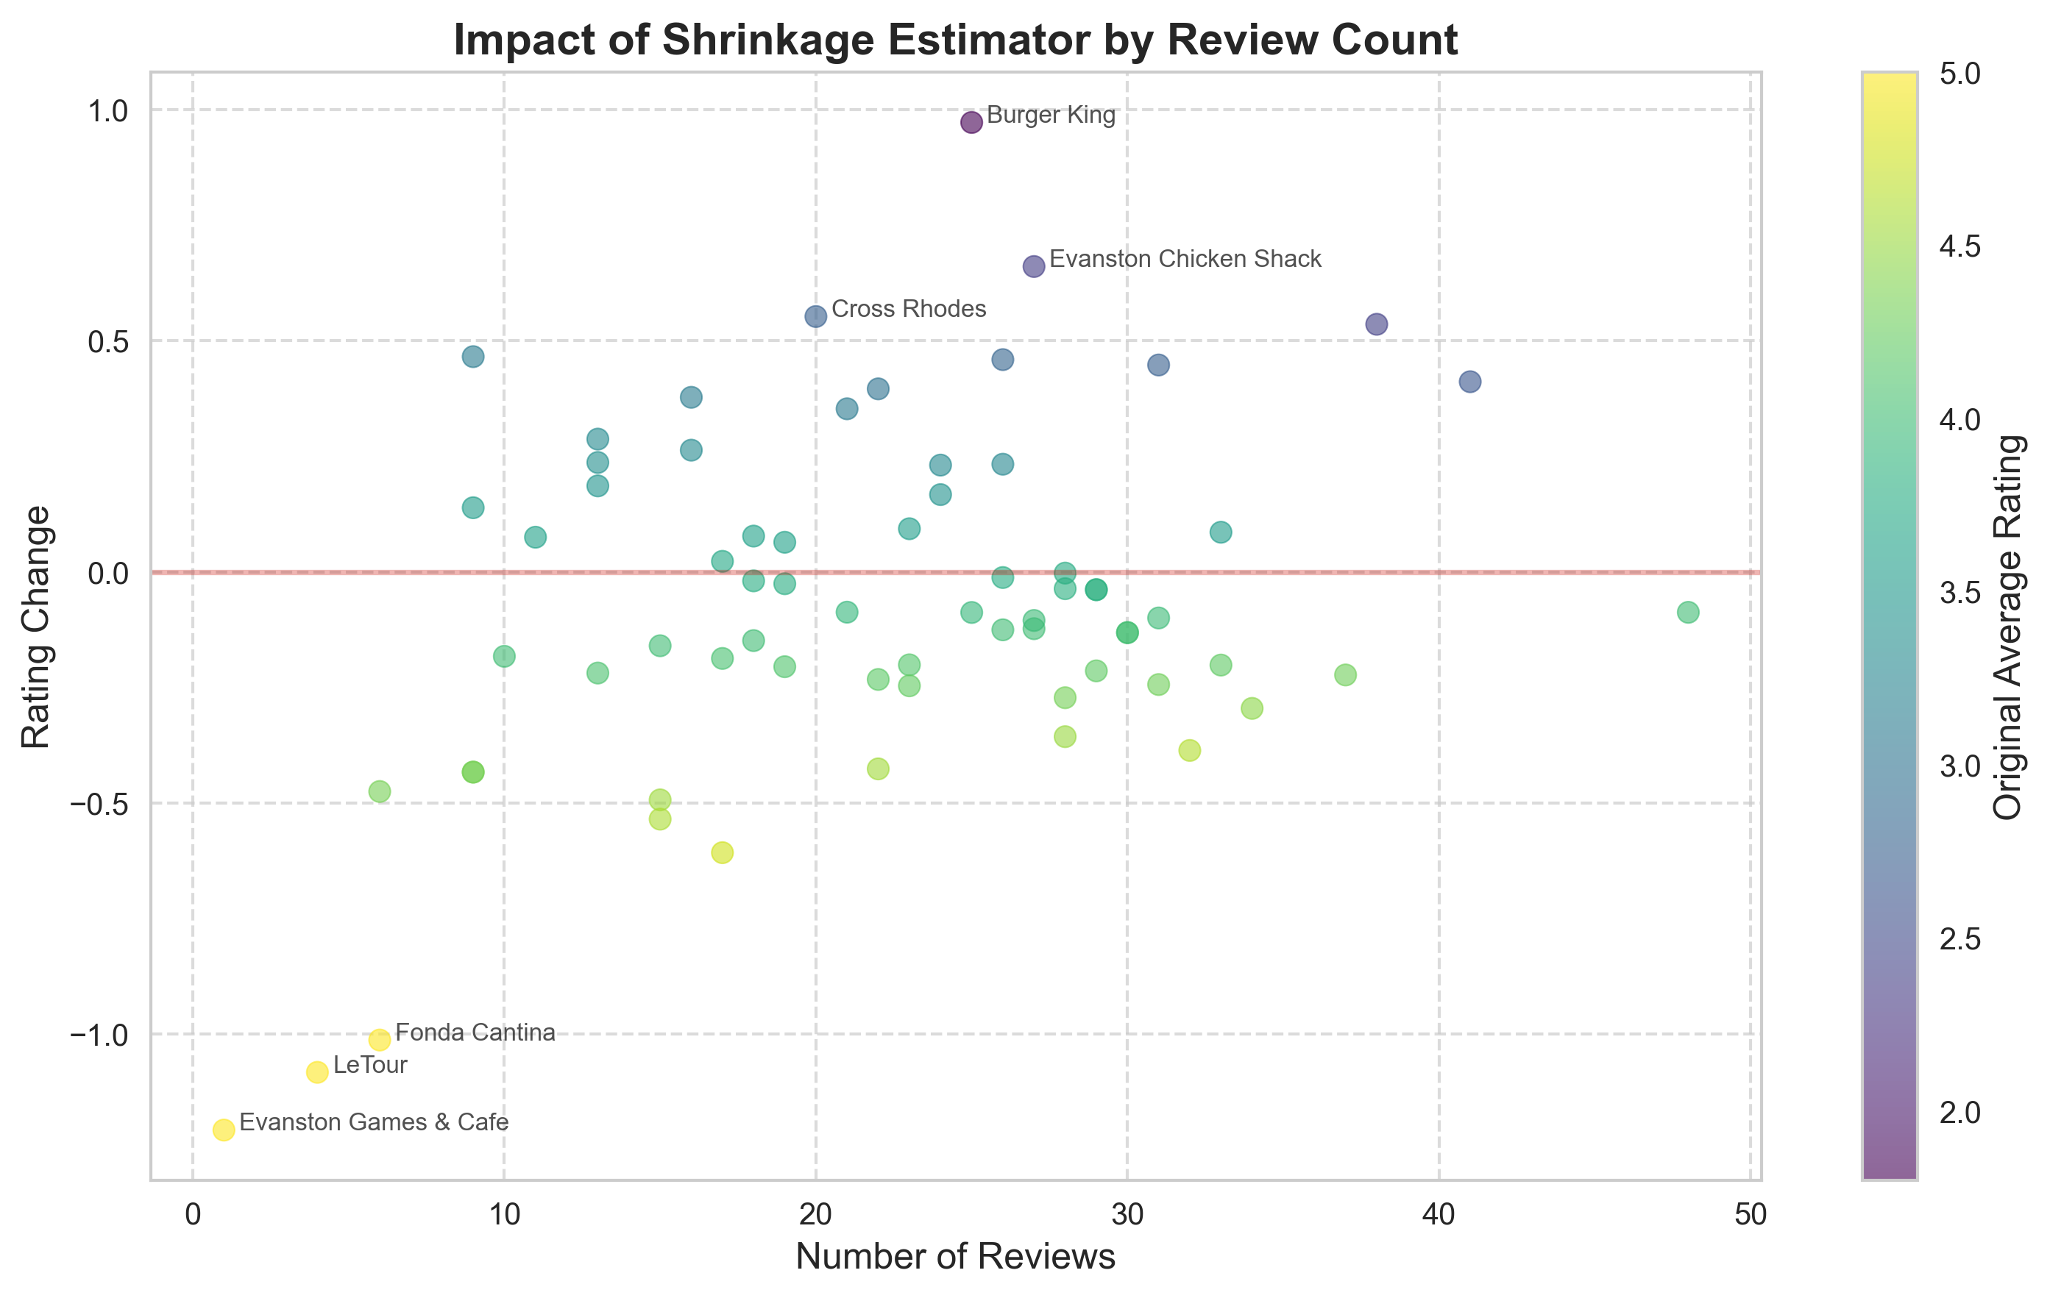
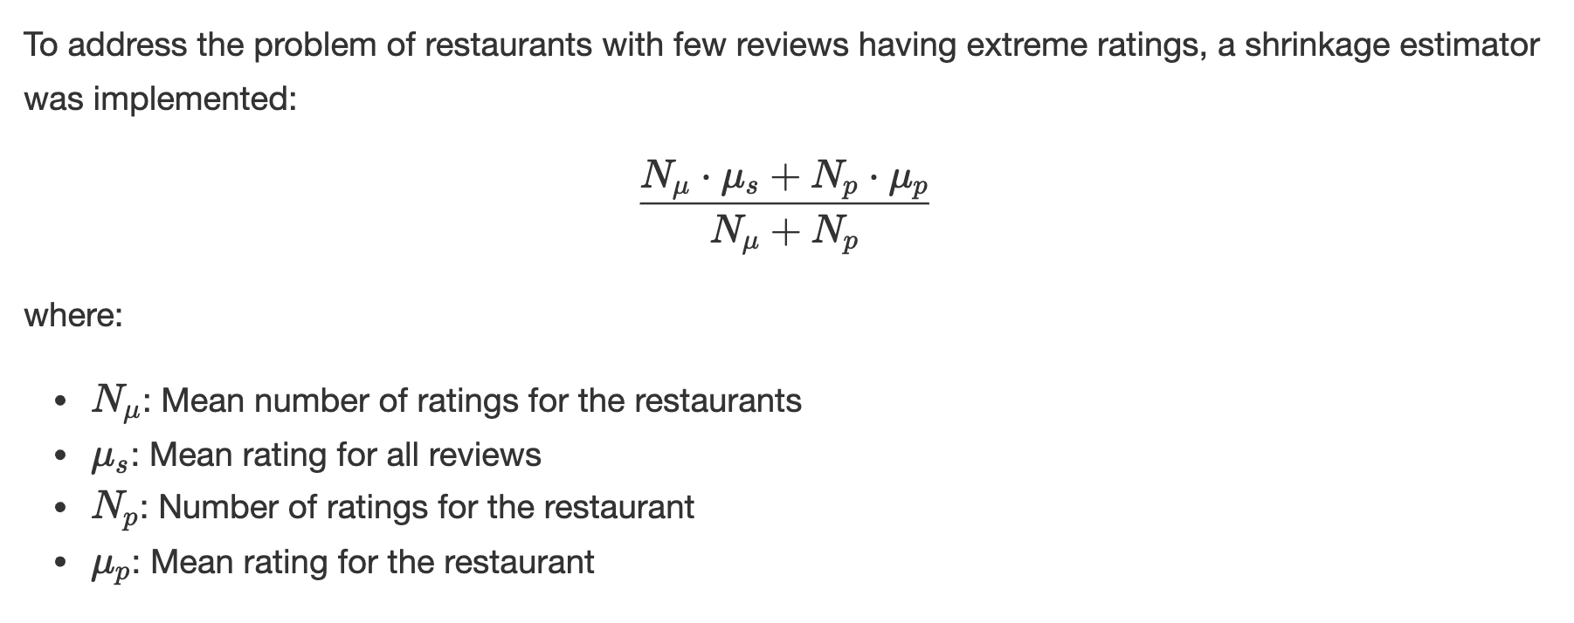
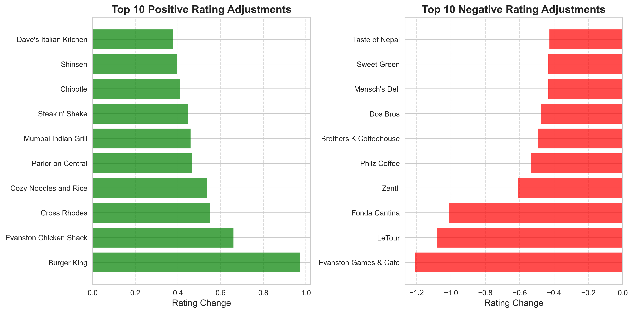
Rating Reliability — Shrinkage Estimator
Largest increases: Burger King (+0.97), Evanston Chicken (+0.90).
Largest decreases: Evanston Games & Cafe (-1.21), LeTour (-1.13).
Notes:
To address rating reliability, I implemented a shrinkage estimator adjusting ratings toward the mean:
- Burger King: +0.97 (1.80 → 2.77)
- Evanston Games & Cafe: -1.21 (5.00 → 3.79)
<!-- This creates a more balanced recommendation system that's less susceptible to outliers and rating inflation. -->

Slide 25
NATURAL LANGUAGE ANALYSIS APPROACH

Slide 26
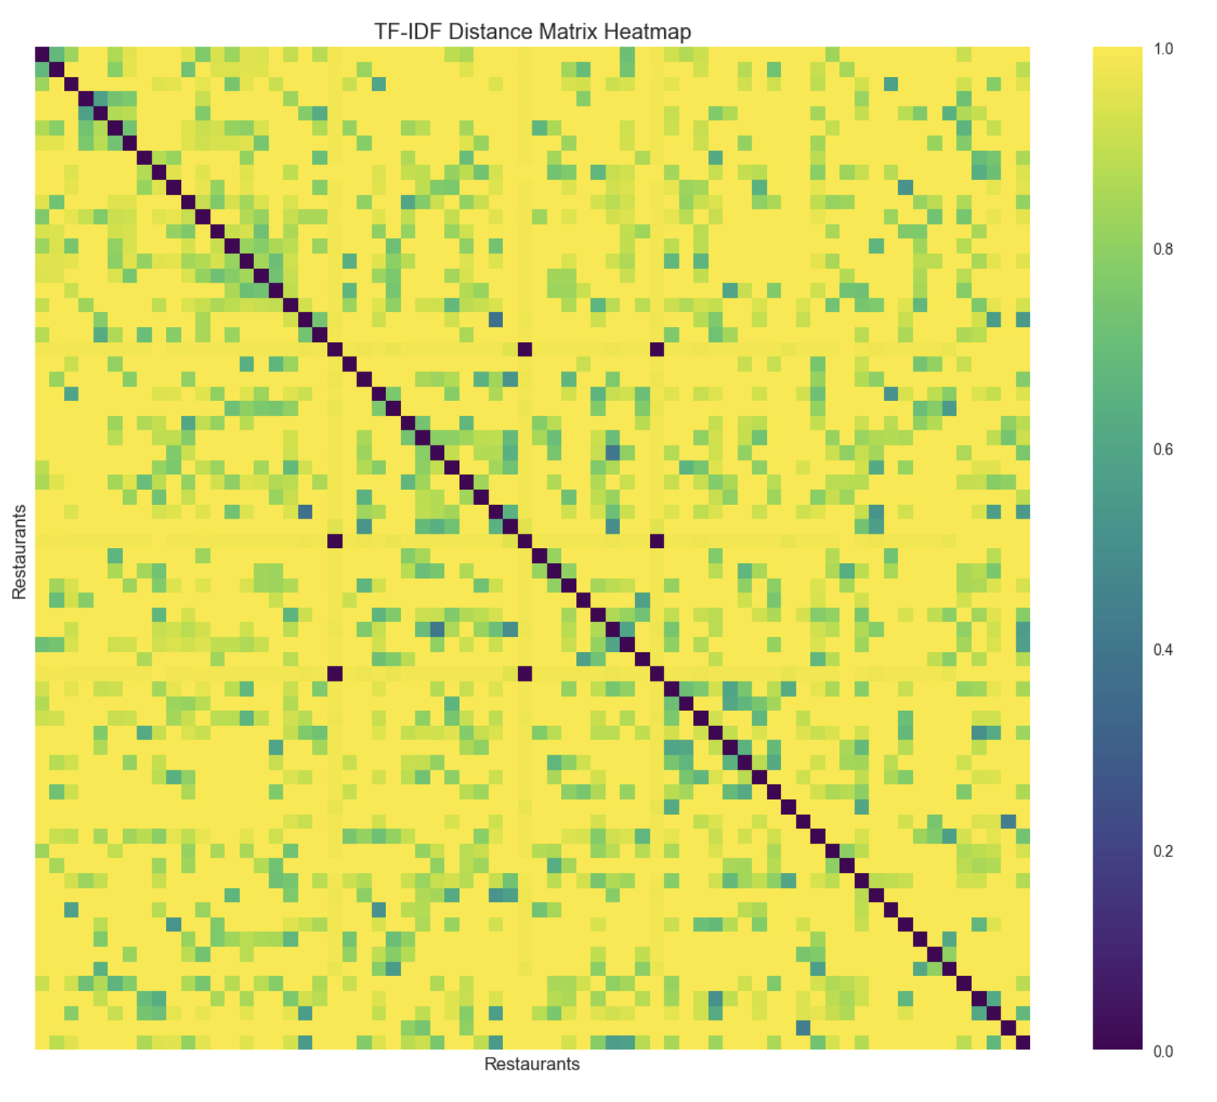
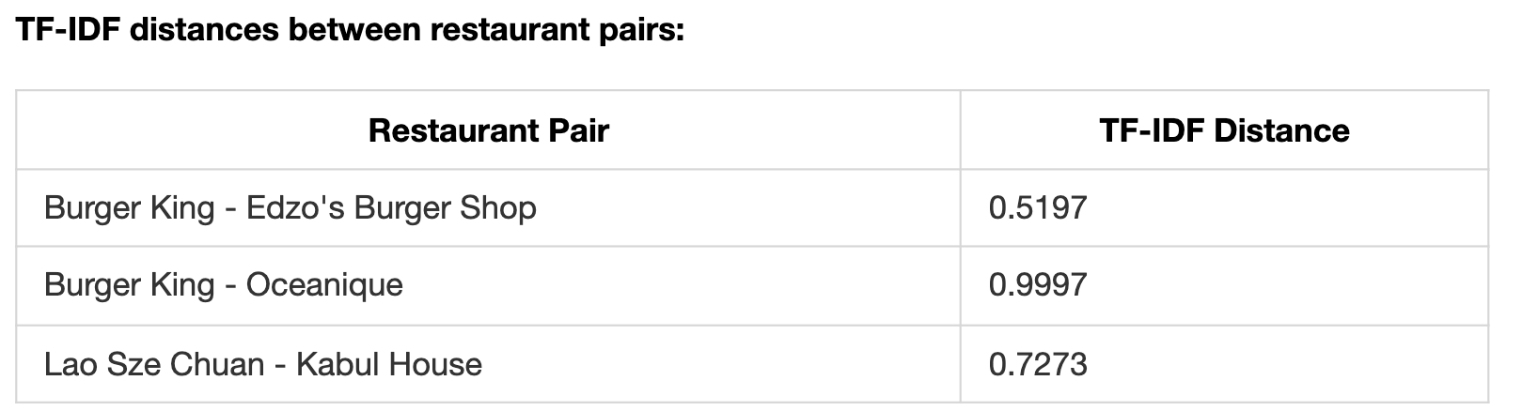
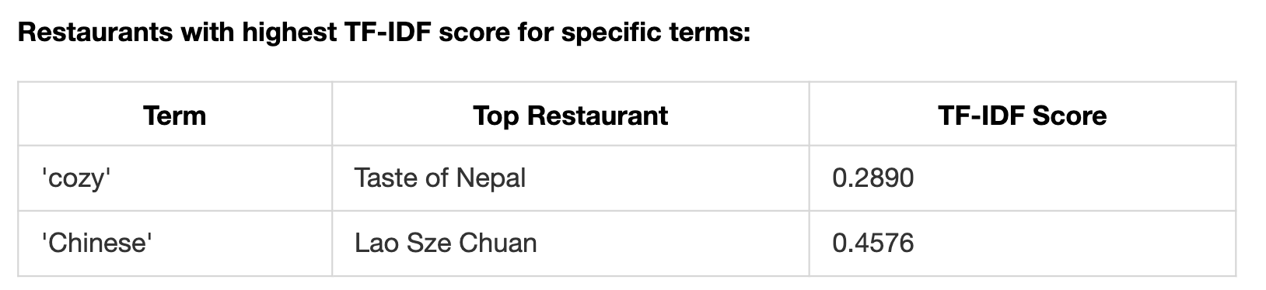
Natural Language Analysis Methodology
Augment descriptions with cuisine type.
Remove stop words; compute TF‑IDF.
Create 100‑word vectors & calculate distances.
Notes:
For text-based recommendations, I:
1. Augmented restaurant descriptions with cuisine type
2. Removed common stop words
3. Computed TF-IDF scores for distinctive terms
Key findings:
- "Cozy" had highest TF-IDF score for Taste of Nepal (0.289)
- "Chinese" had highest score for Lao Sze Chuan (0.458)
TF-IDF vector distances revealed meaningful similarities:
- Burger King vs. Edzo's Burger Shop: 0.520
- Burger King vs. Oceanique (seafood): 0.999
This approach captures nuanced aspects like ambiance and specialties beyond structured data, enhancing recommendations by identifying cross-cuisine similarities based on descriptive elements.

