Slide 1
Road construction
Dongjae Kim

Slide 2
Brief intro
Two conditions: with/without Undo
46 trials for each condition
Same puzzles (=map) with rotation
Optimal scores of puzzles ranged from 7 to 12.
N = 10 subjects (10 from Prolific)
Terminology
“Puzzle-level”: variables related to each puzzle
“Choice-level”: variables related to each move
Used Wilcoxon signed-rank test.
Notes:
Centered on 9 and 10.

Slide 3
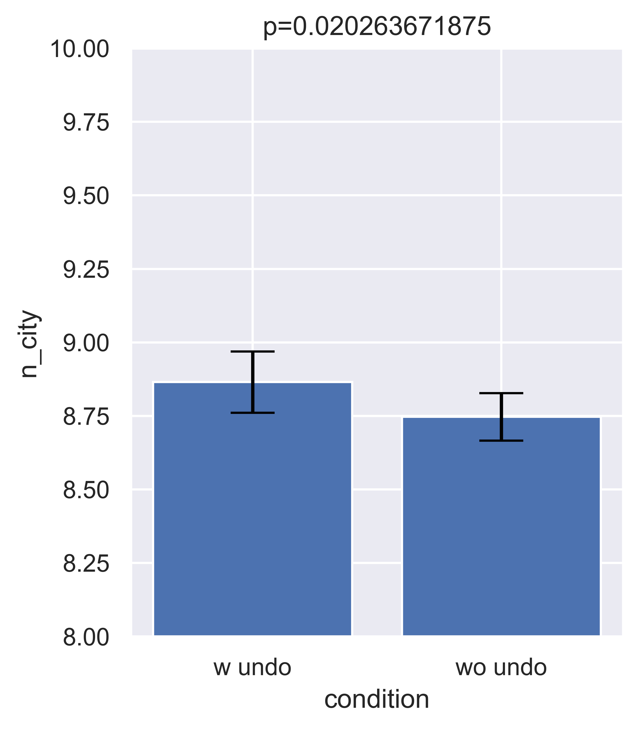
Performed better in “with undo” condition
*Wilcoxon signed-rank test
Number of cities connected
Puzzle-level,
N = 10 and error bars are SEM.

Slide 4
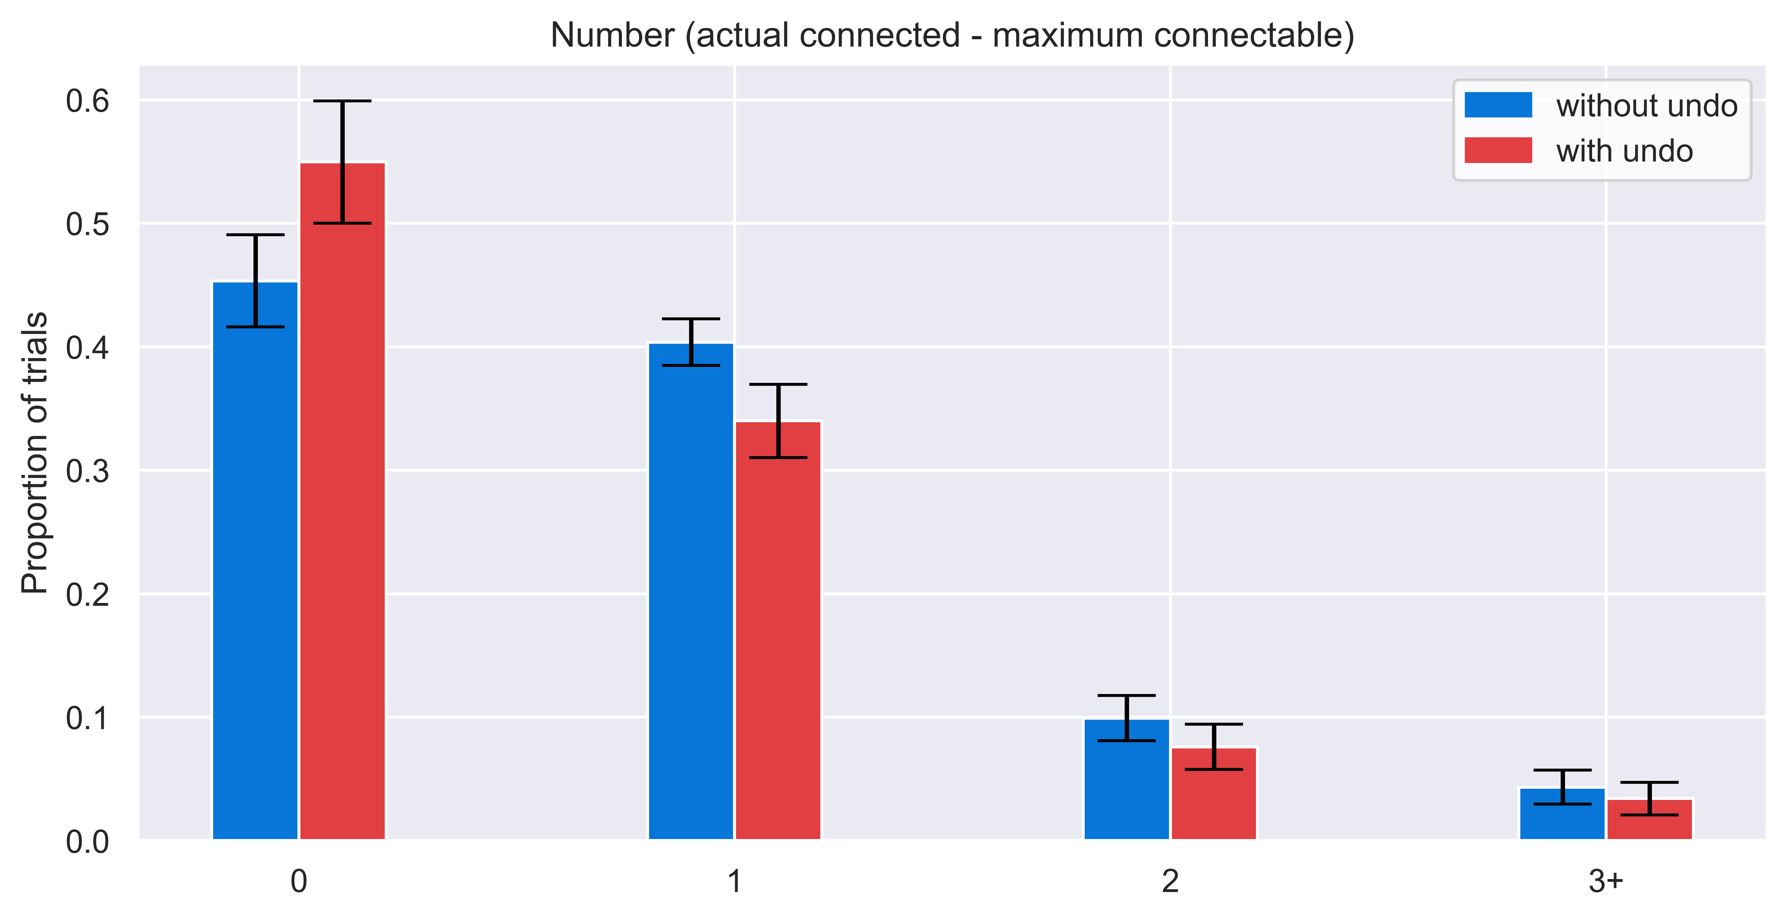
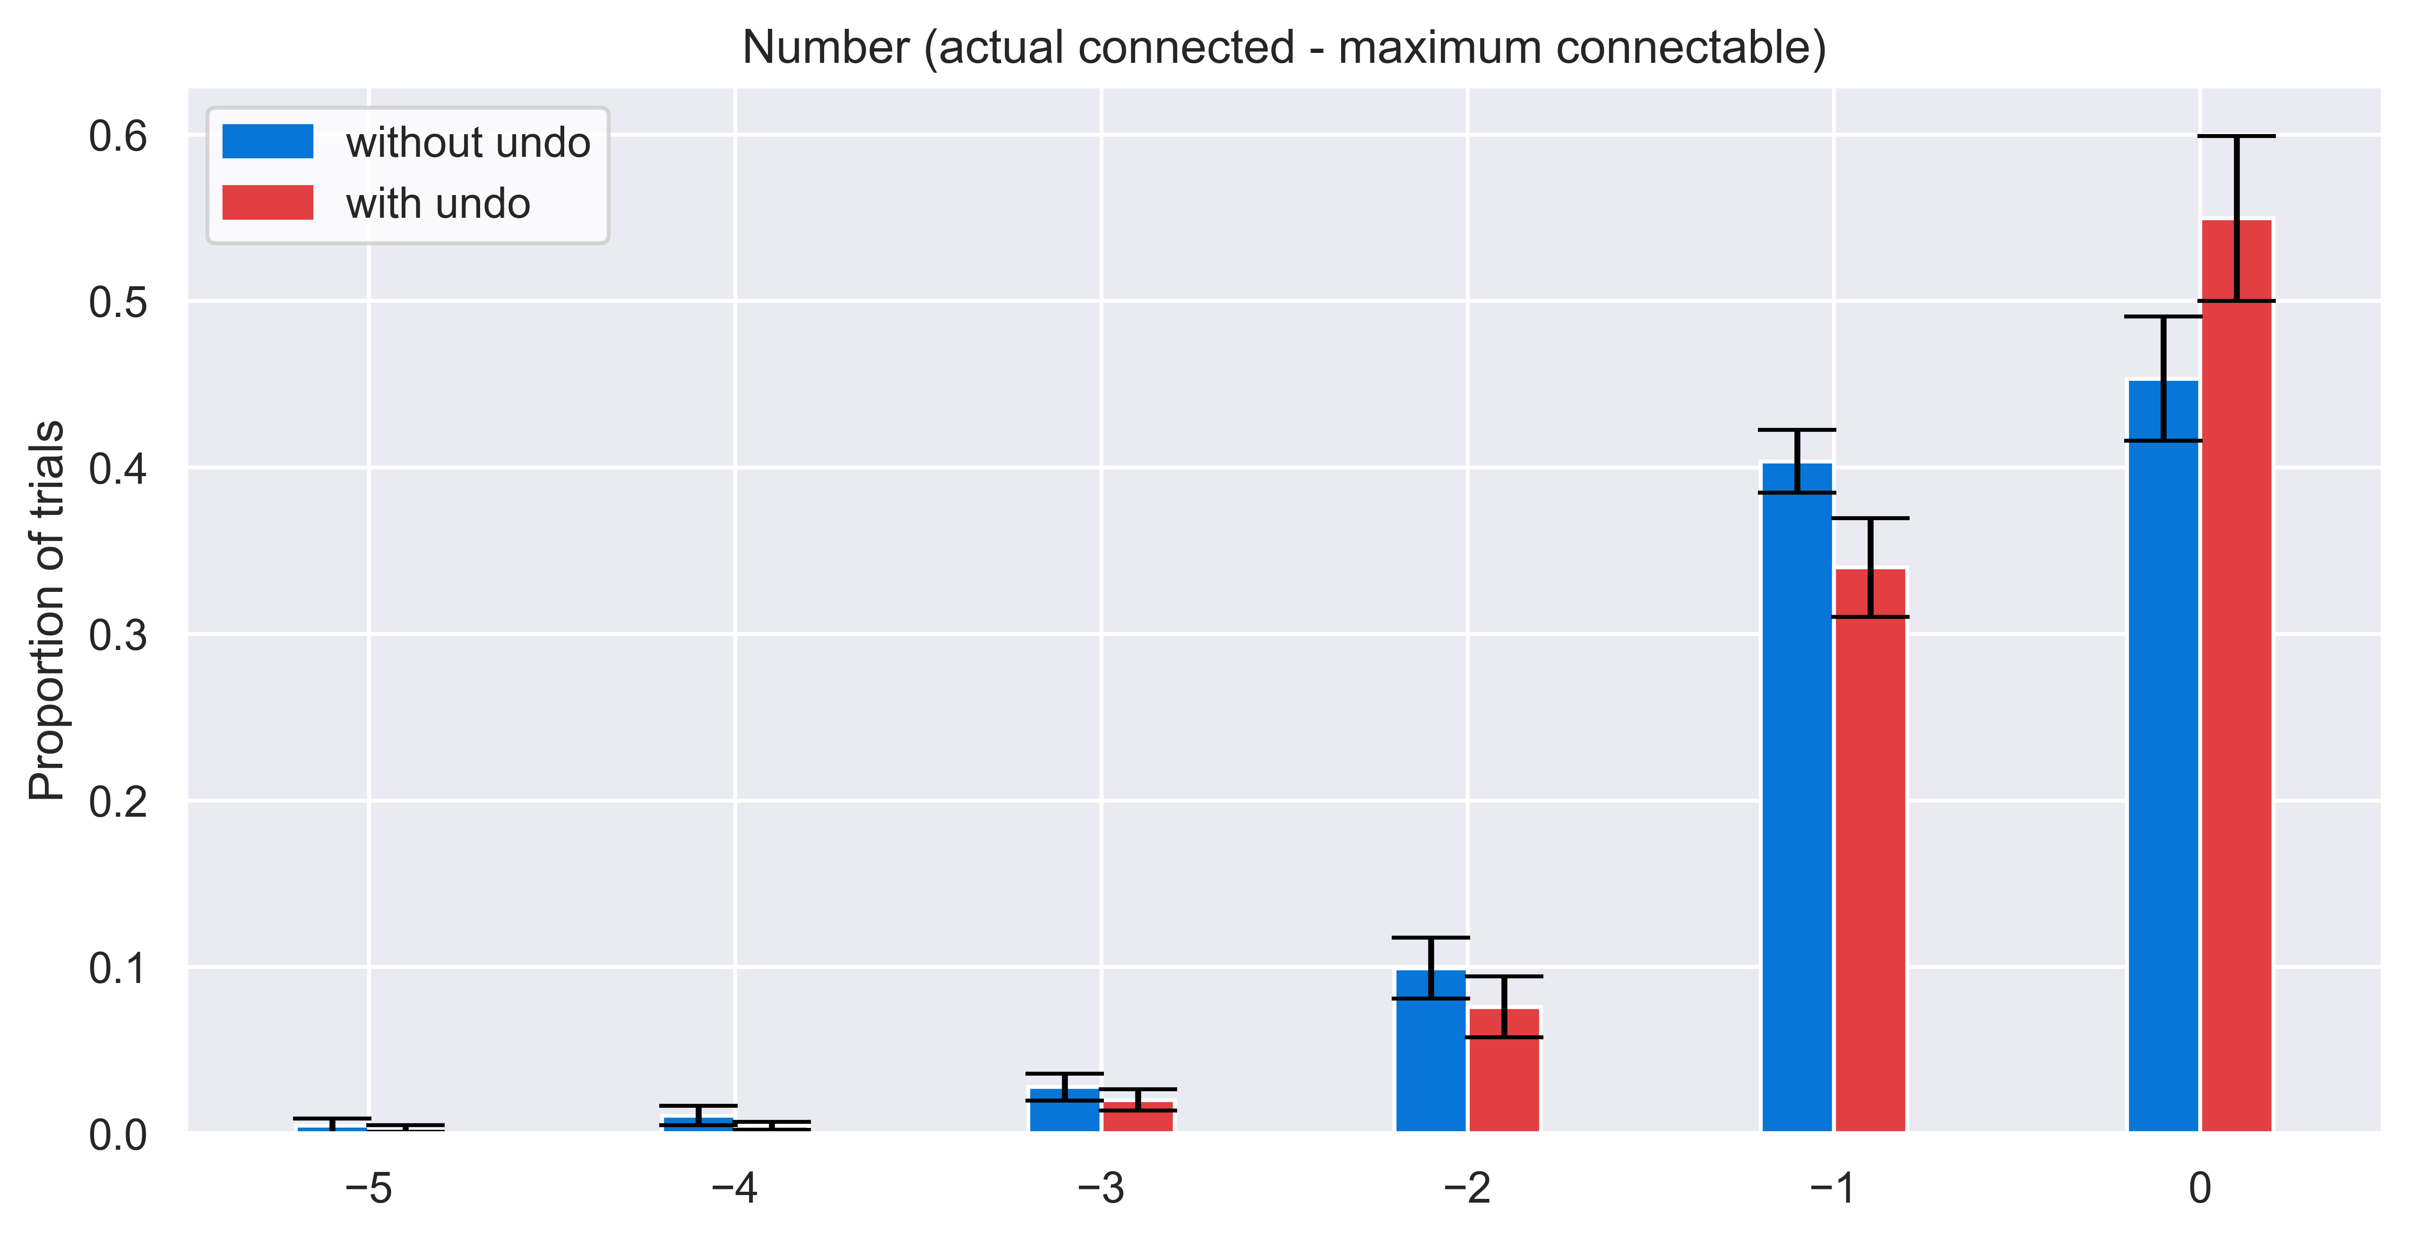
Less errors in “with undo” condition
Puzzle-level,
N = 10 and error bars are SEM.
actually connected - maximum connectable

Slide 5
Why/When do people undo?
Puzzle-level analysis
Choice-level analysis
Number of cities connected.
Undo more when they connected more?
Error:
Already seen that people make less errors in “with undo” condition.
How about within “with undo” condition?
Maximum achievable score (MAS):
Undo more to perform better if you can connect more in the puzzle?
Number of optimal solutions:
Multiple optimal solutions make people confused and undo more?
Choice-level number of cities connected
Choice-level Error
Undo more after experiencing severer errors?
Choice-level MAS
Choice-level number of optimal solutions
Notes:
Undo more when they have better MAS?

Slide 6
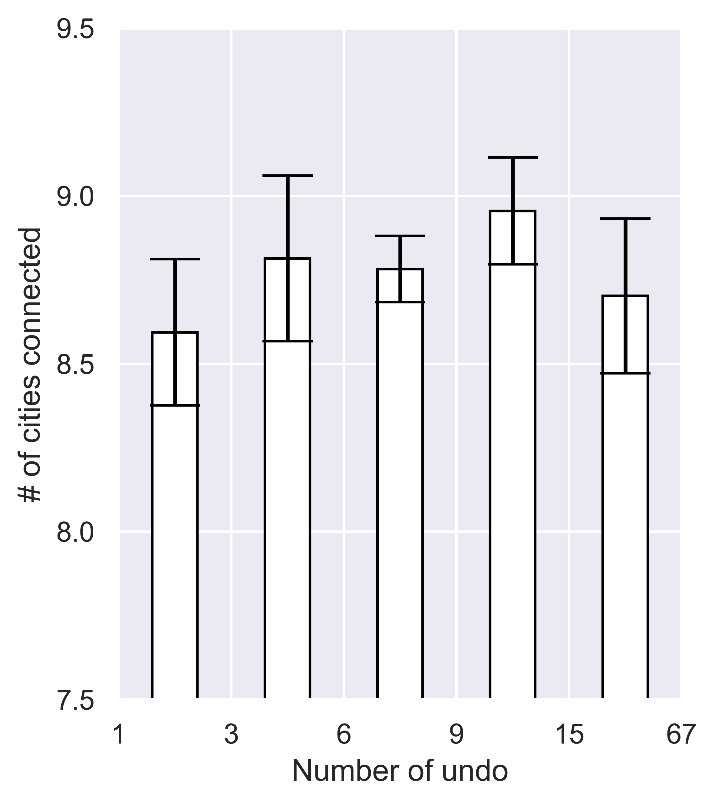
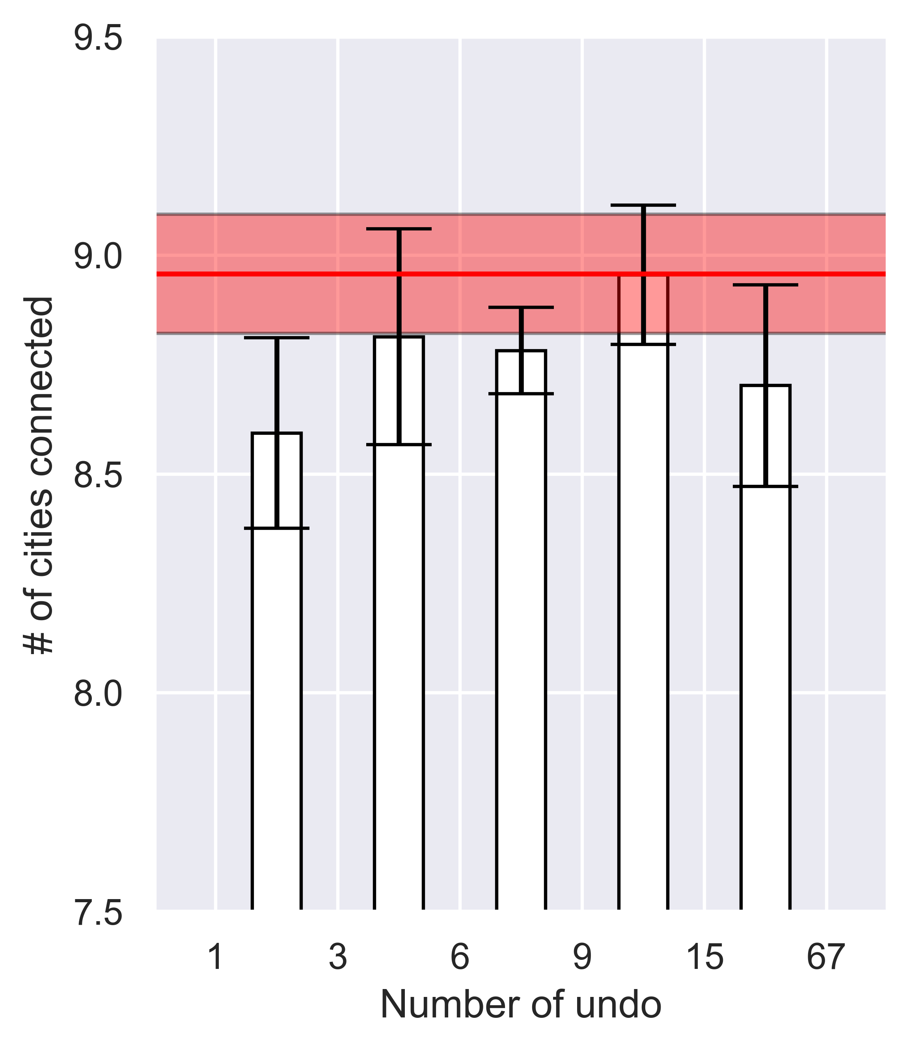
Puzzle-level: number of cities connected
When they didn’t undo
N = 10 and error bars are SEM.
Only “with undo” trials are used.
Notes:
How many times they undid in the map

Slide 7
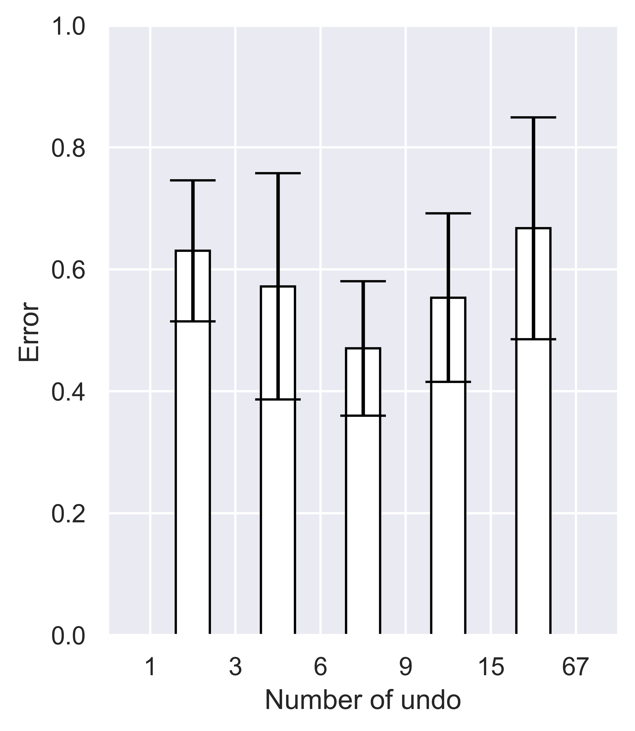
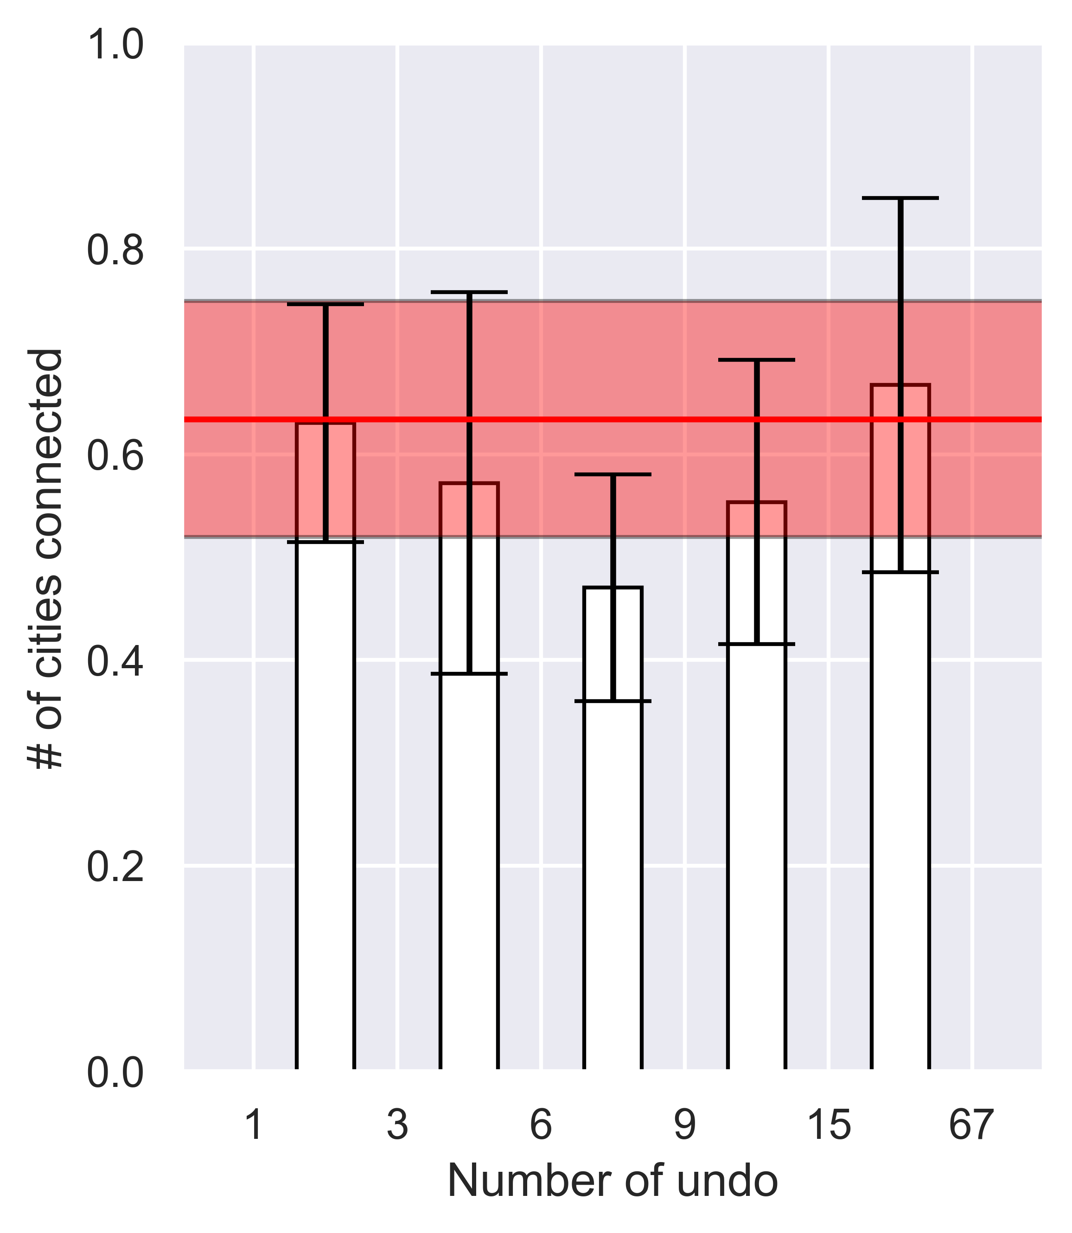
Puzzle-level: Errors (MAS-#citiesConnected)
When they didn’t undo
N = 10 and error bars are SEM.
Only “with undo” trials are used.
Notes:
How many times they undid in the map

Slide 8
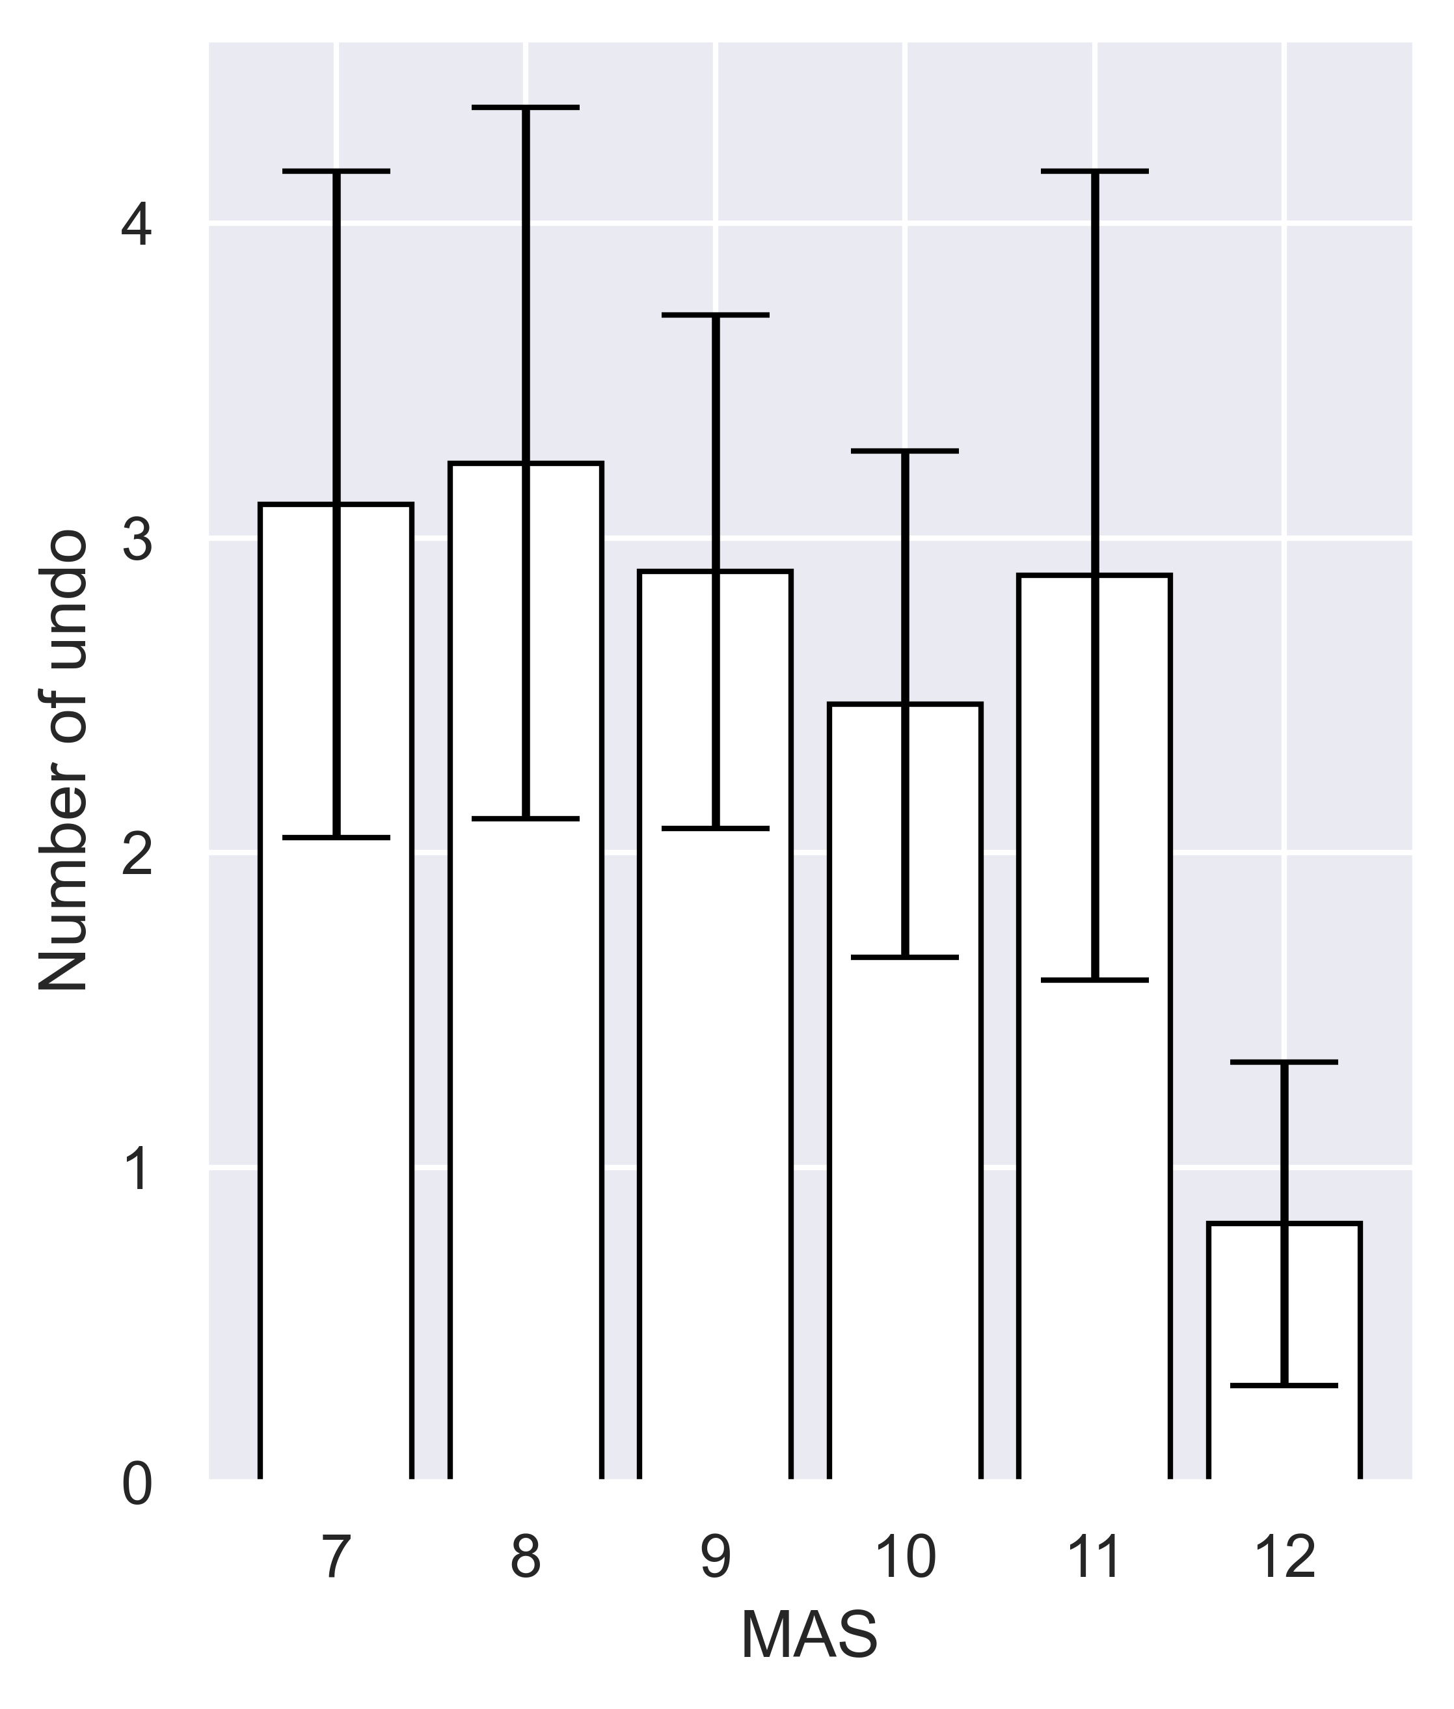
Puzzle-level: MAS
No significant difference (p=0.22 between 11 and 12).
Undoing behavior seems independent of MAS
N = 10 and error bars are SEM.
Only “with undo” trials are used.
Notes:
How many times they undid in the map

Slide 9
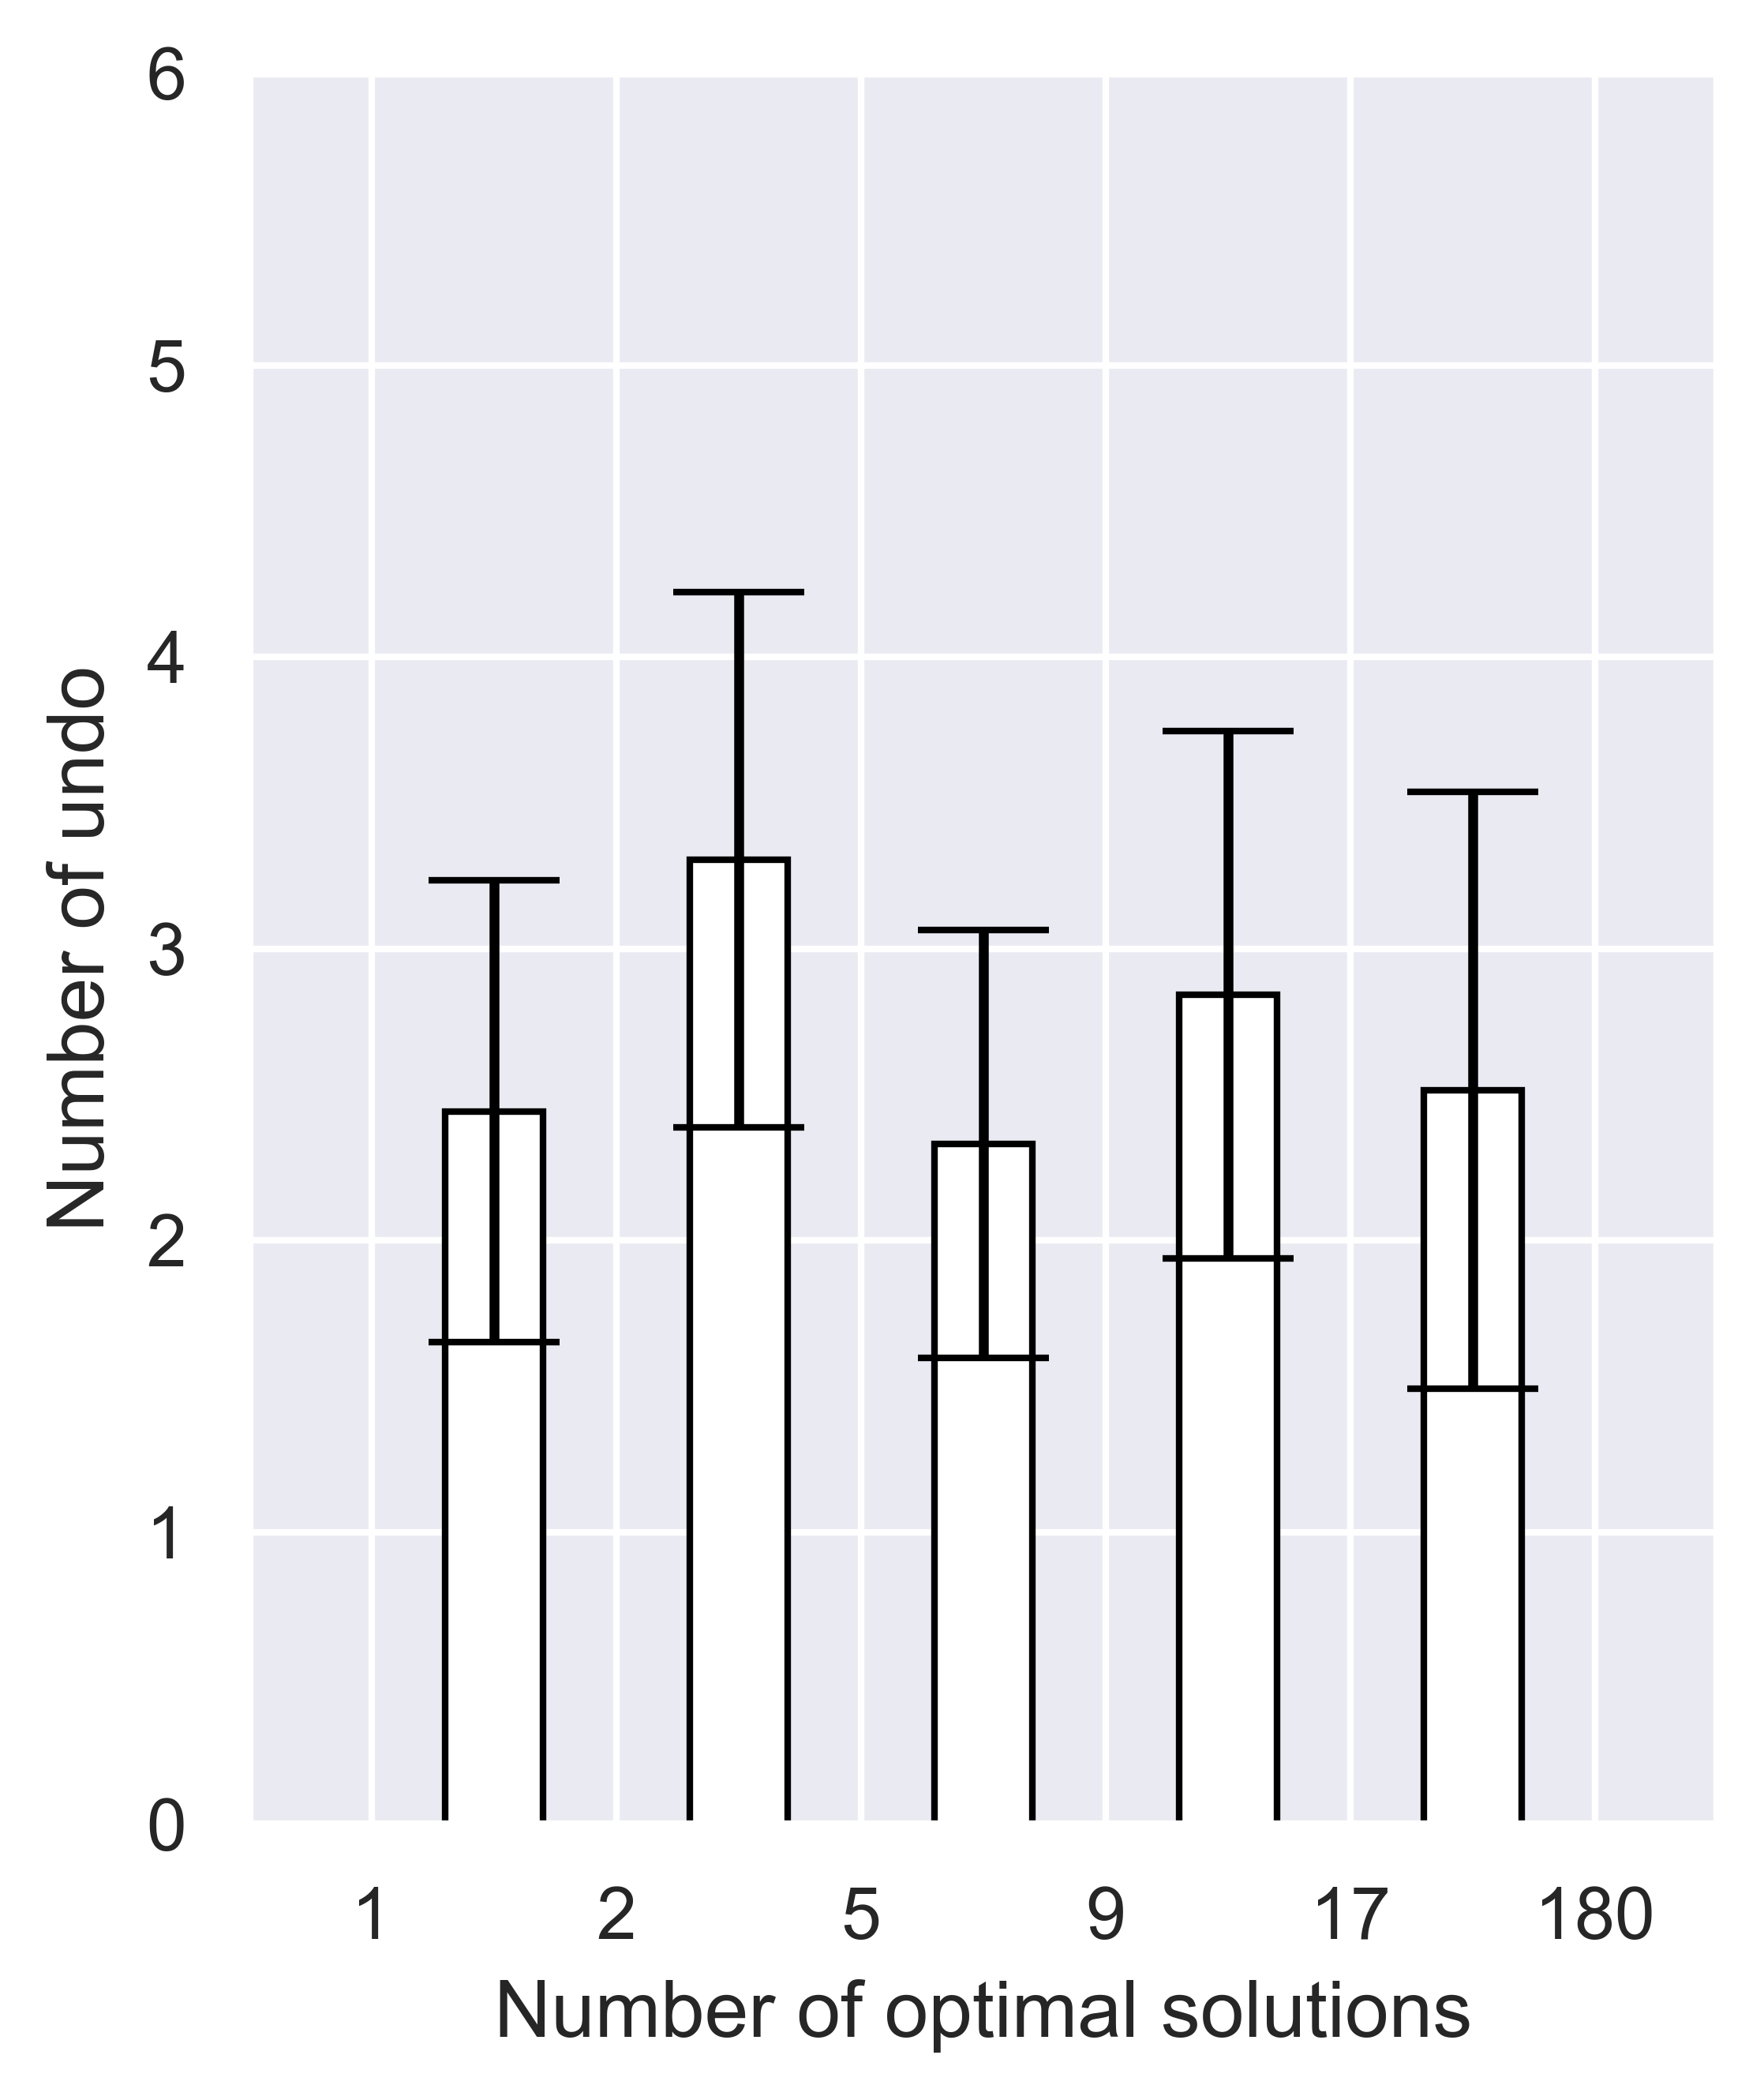
Puzzle-level: number of optimal solutions
Undoing behavior seems independent of number of optimal solutions
N = 10 and error bars are SEM.
Only “with undo” trials are used.
Notes:
How many times they undid in the map

Slide 10
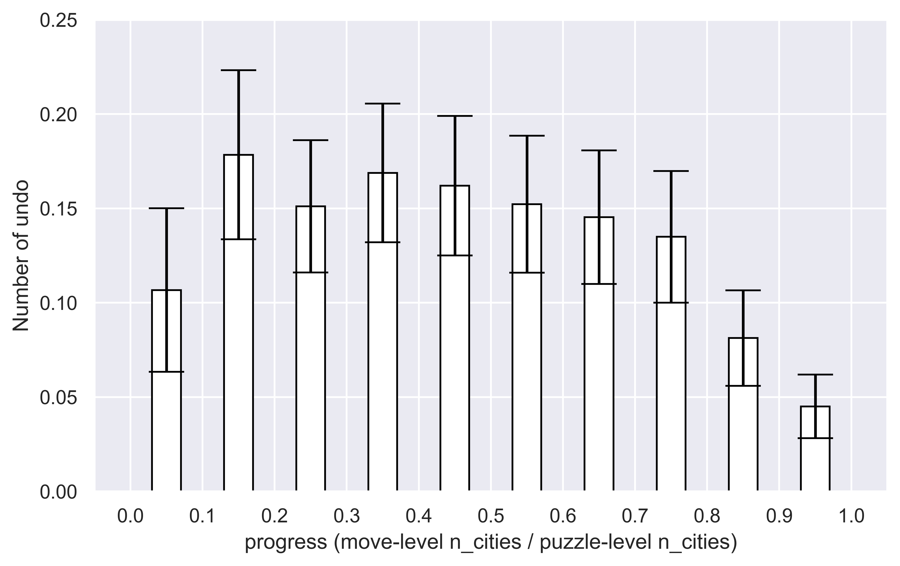
Choice-level: number of cities connected
N = 10 and error bars are SEM.
Only “with undo” trials are used.
Notes:
Numbers on y-axis is small because we calculated from choice-level.

Slide 11
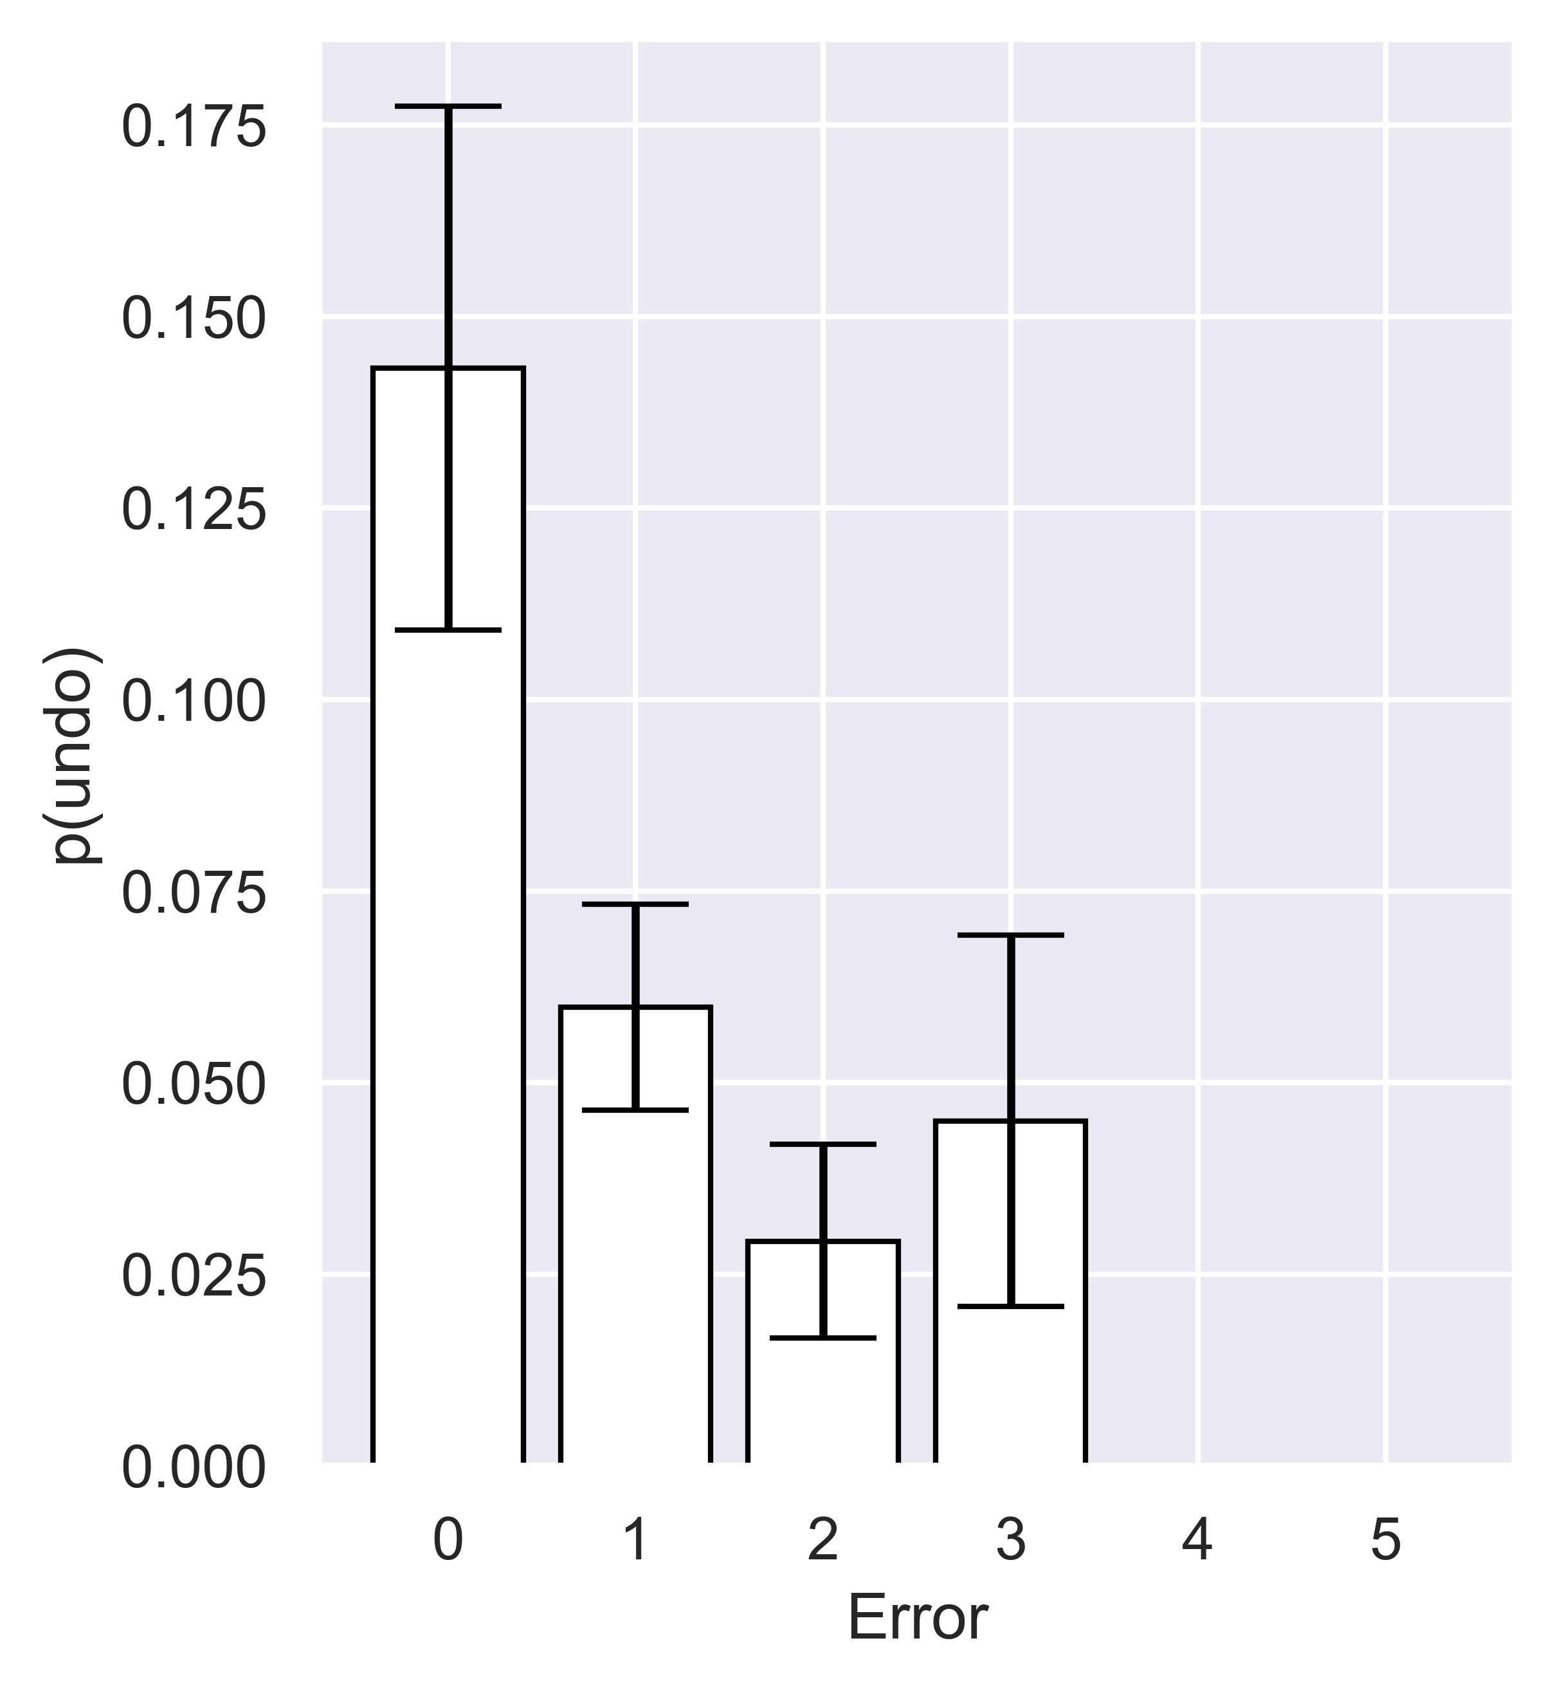
Choice-level: Errors (=|mas(curr)-mas(prev)|)
They undid when there was no error
Because it is not an error compared to the choice-level MAS.
Need to use different error (that using puzzle-level MAS)
N = 10 and error bars are SEM.
Only “with undo” trials are used.

Slide 12
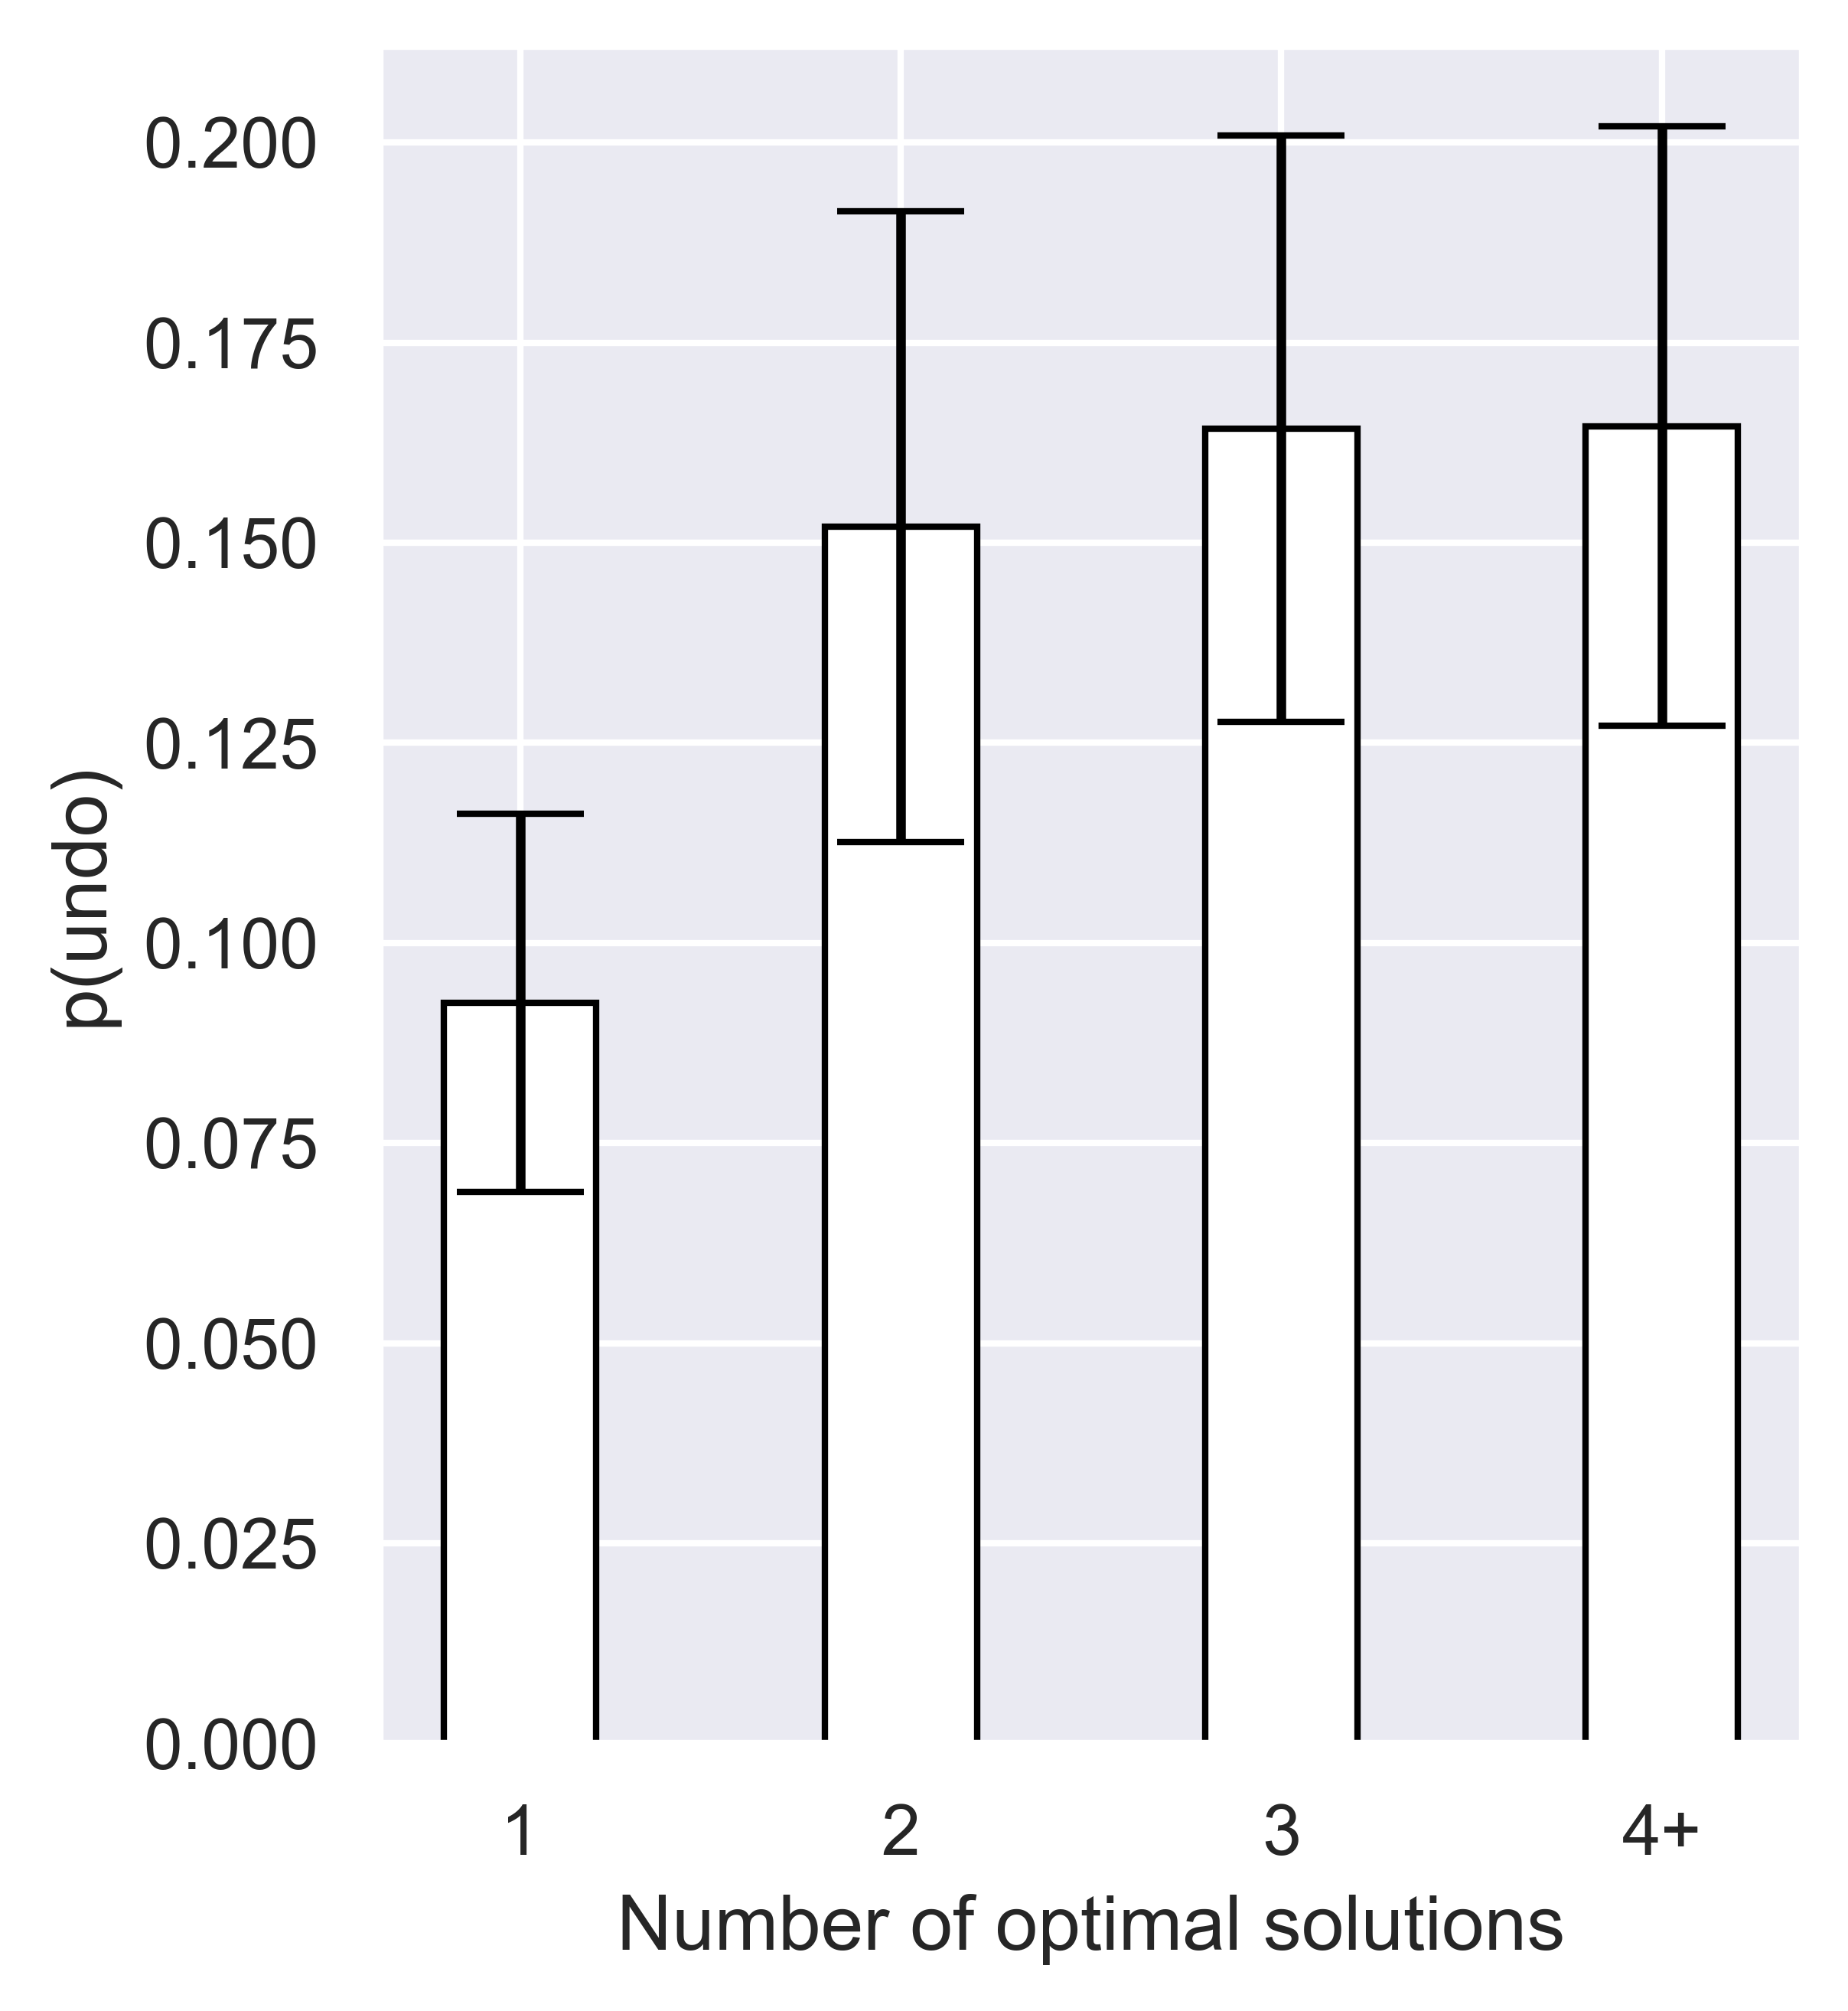
choice-level: number of optimal solutions
Choice-level, N = 10 and error bars are SEM.
Only “with undo” trials are used.
Notes:
How many times they undid in the map

Slide 13
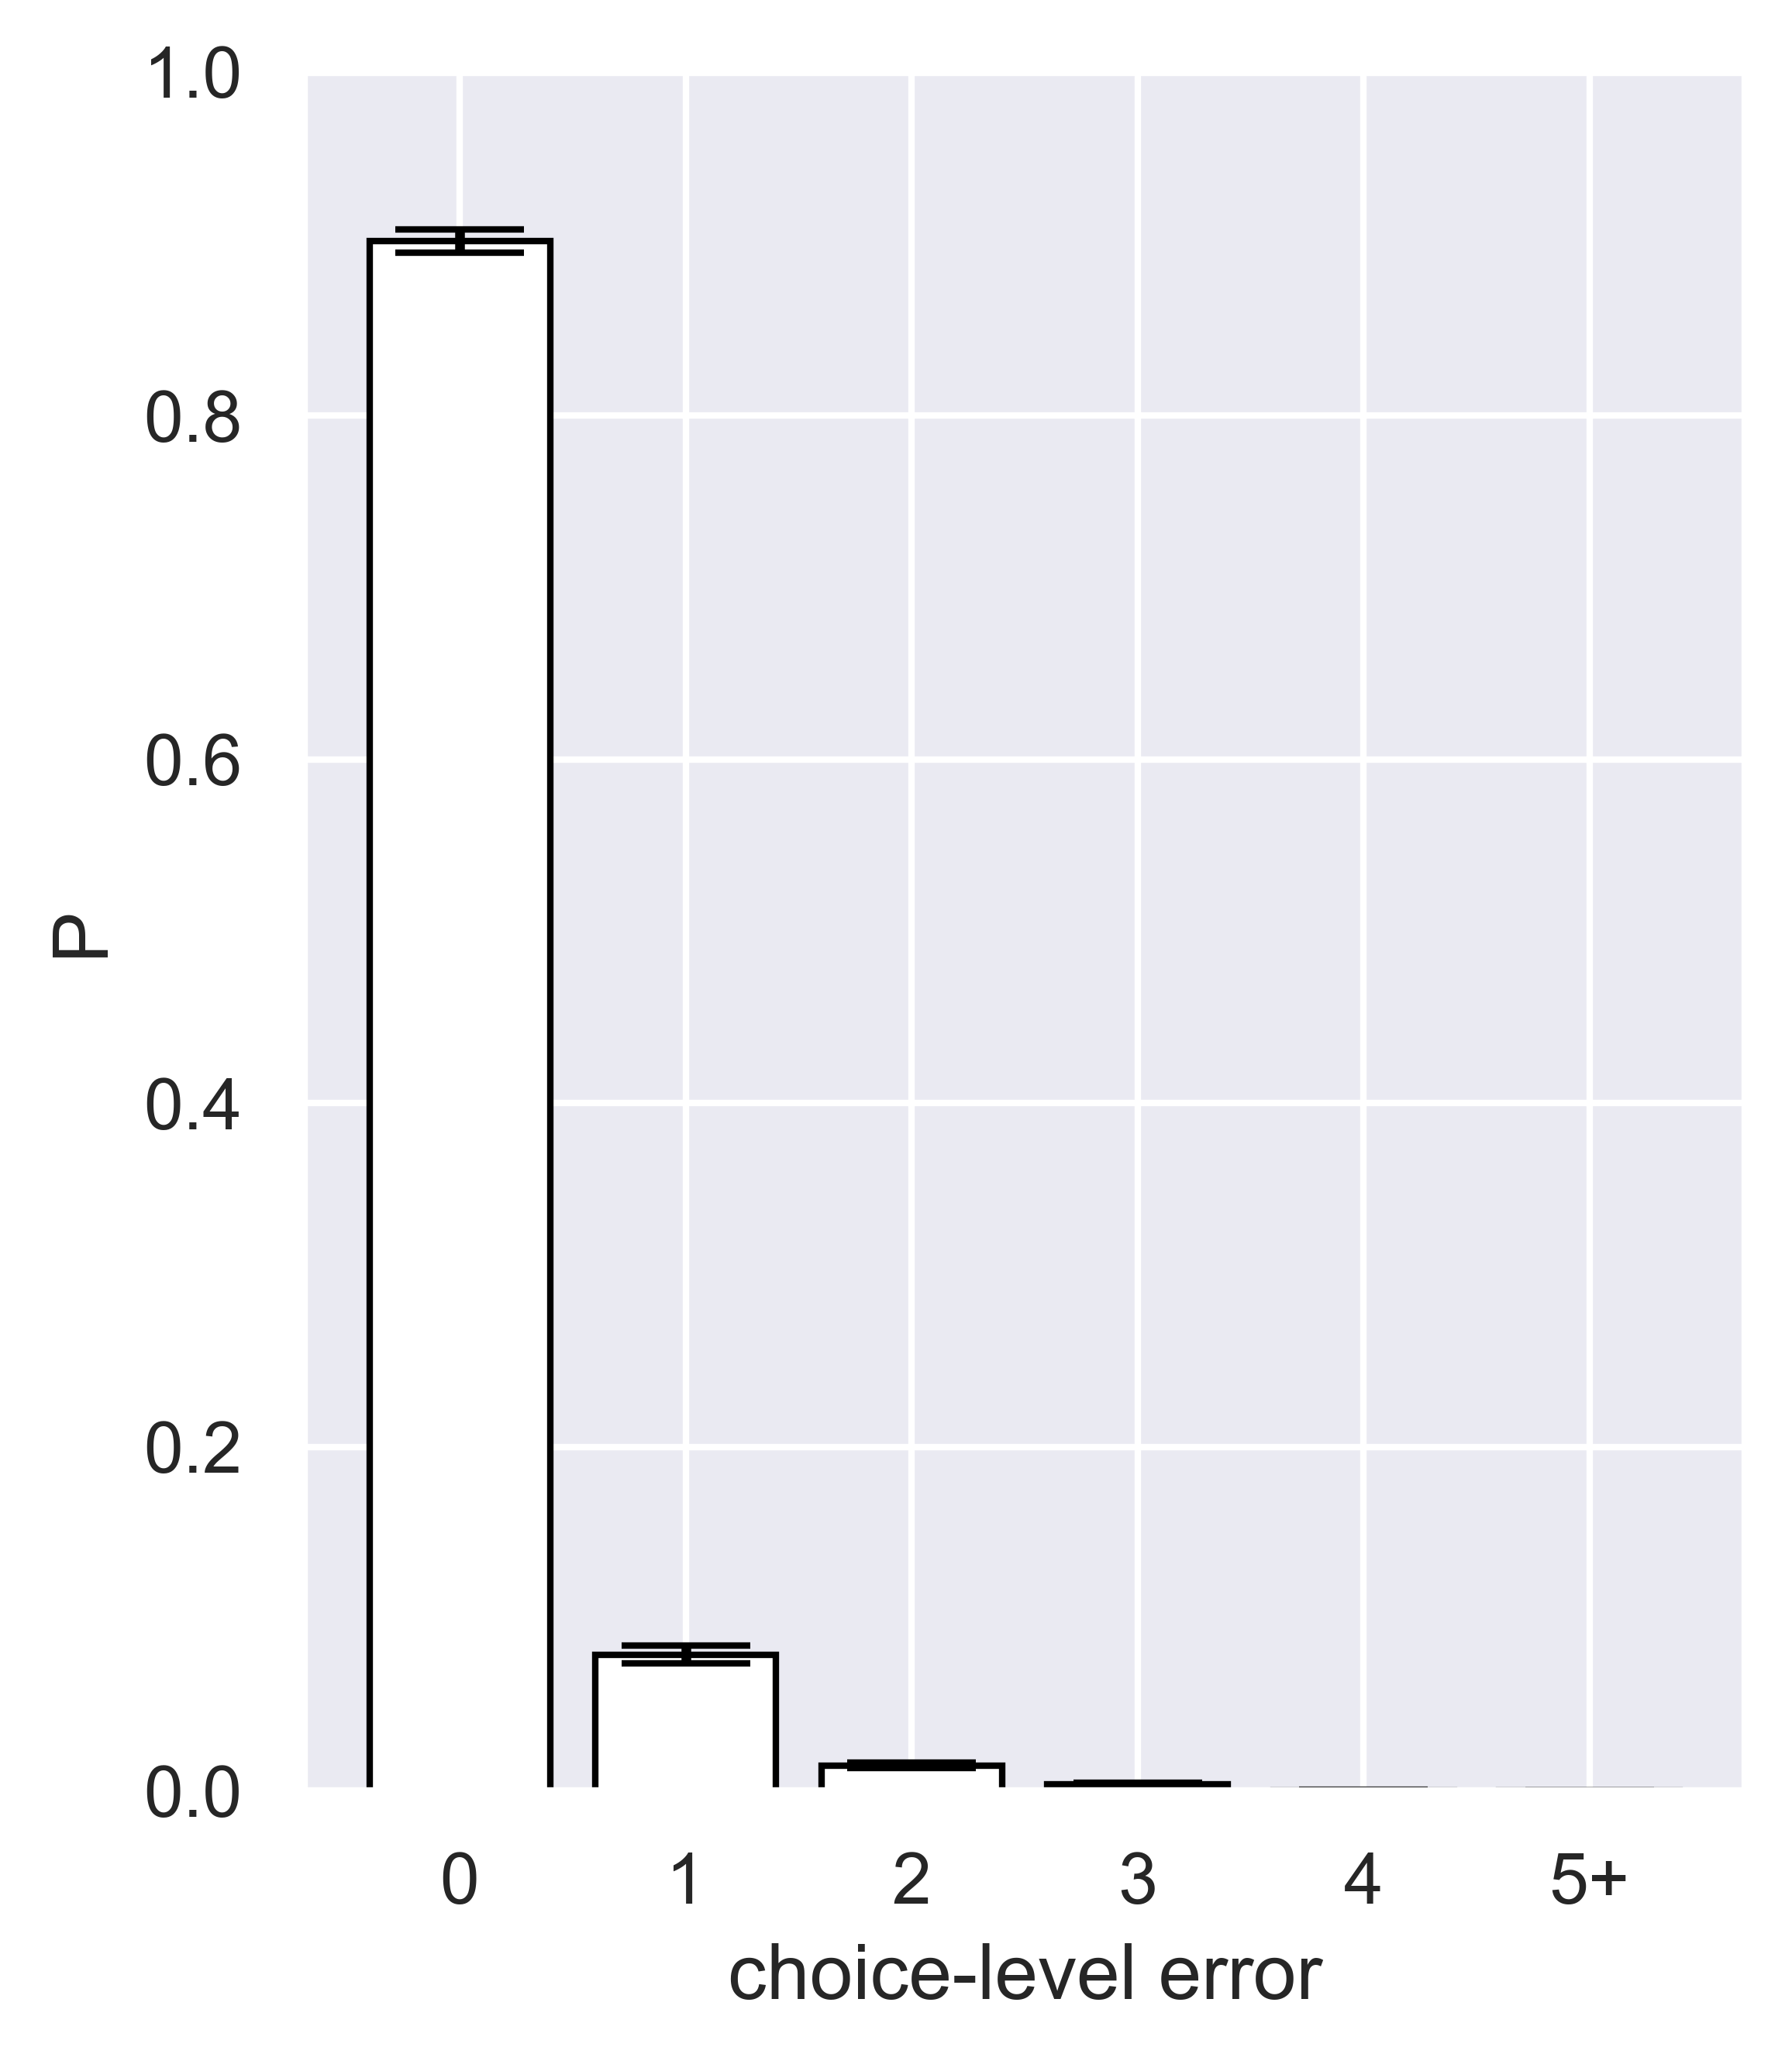
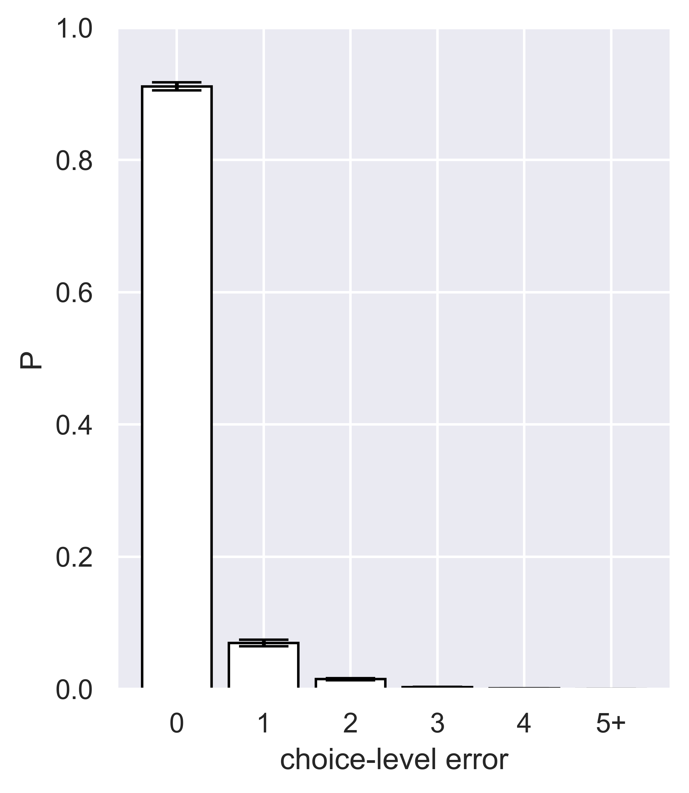
Choice-level: error histogram (including 0)
Without undo
With undo
Will merge into one figure

Slide 14
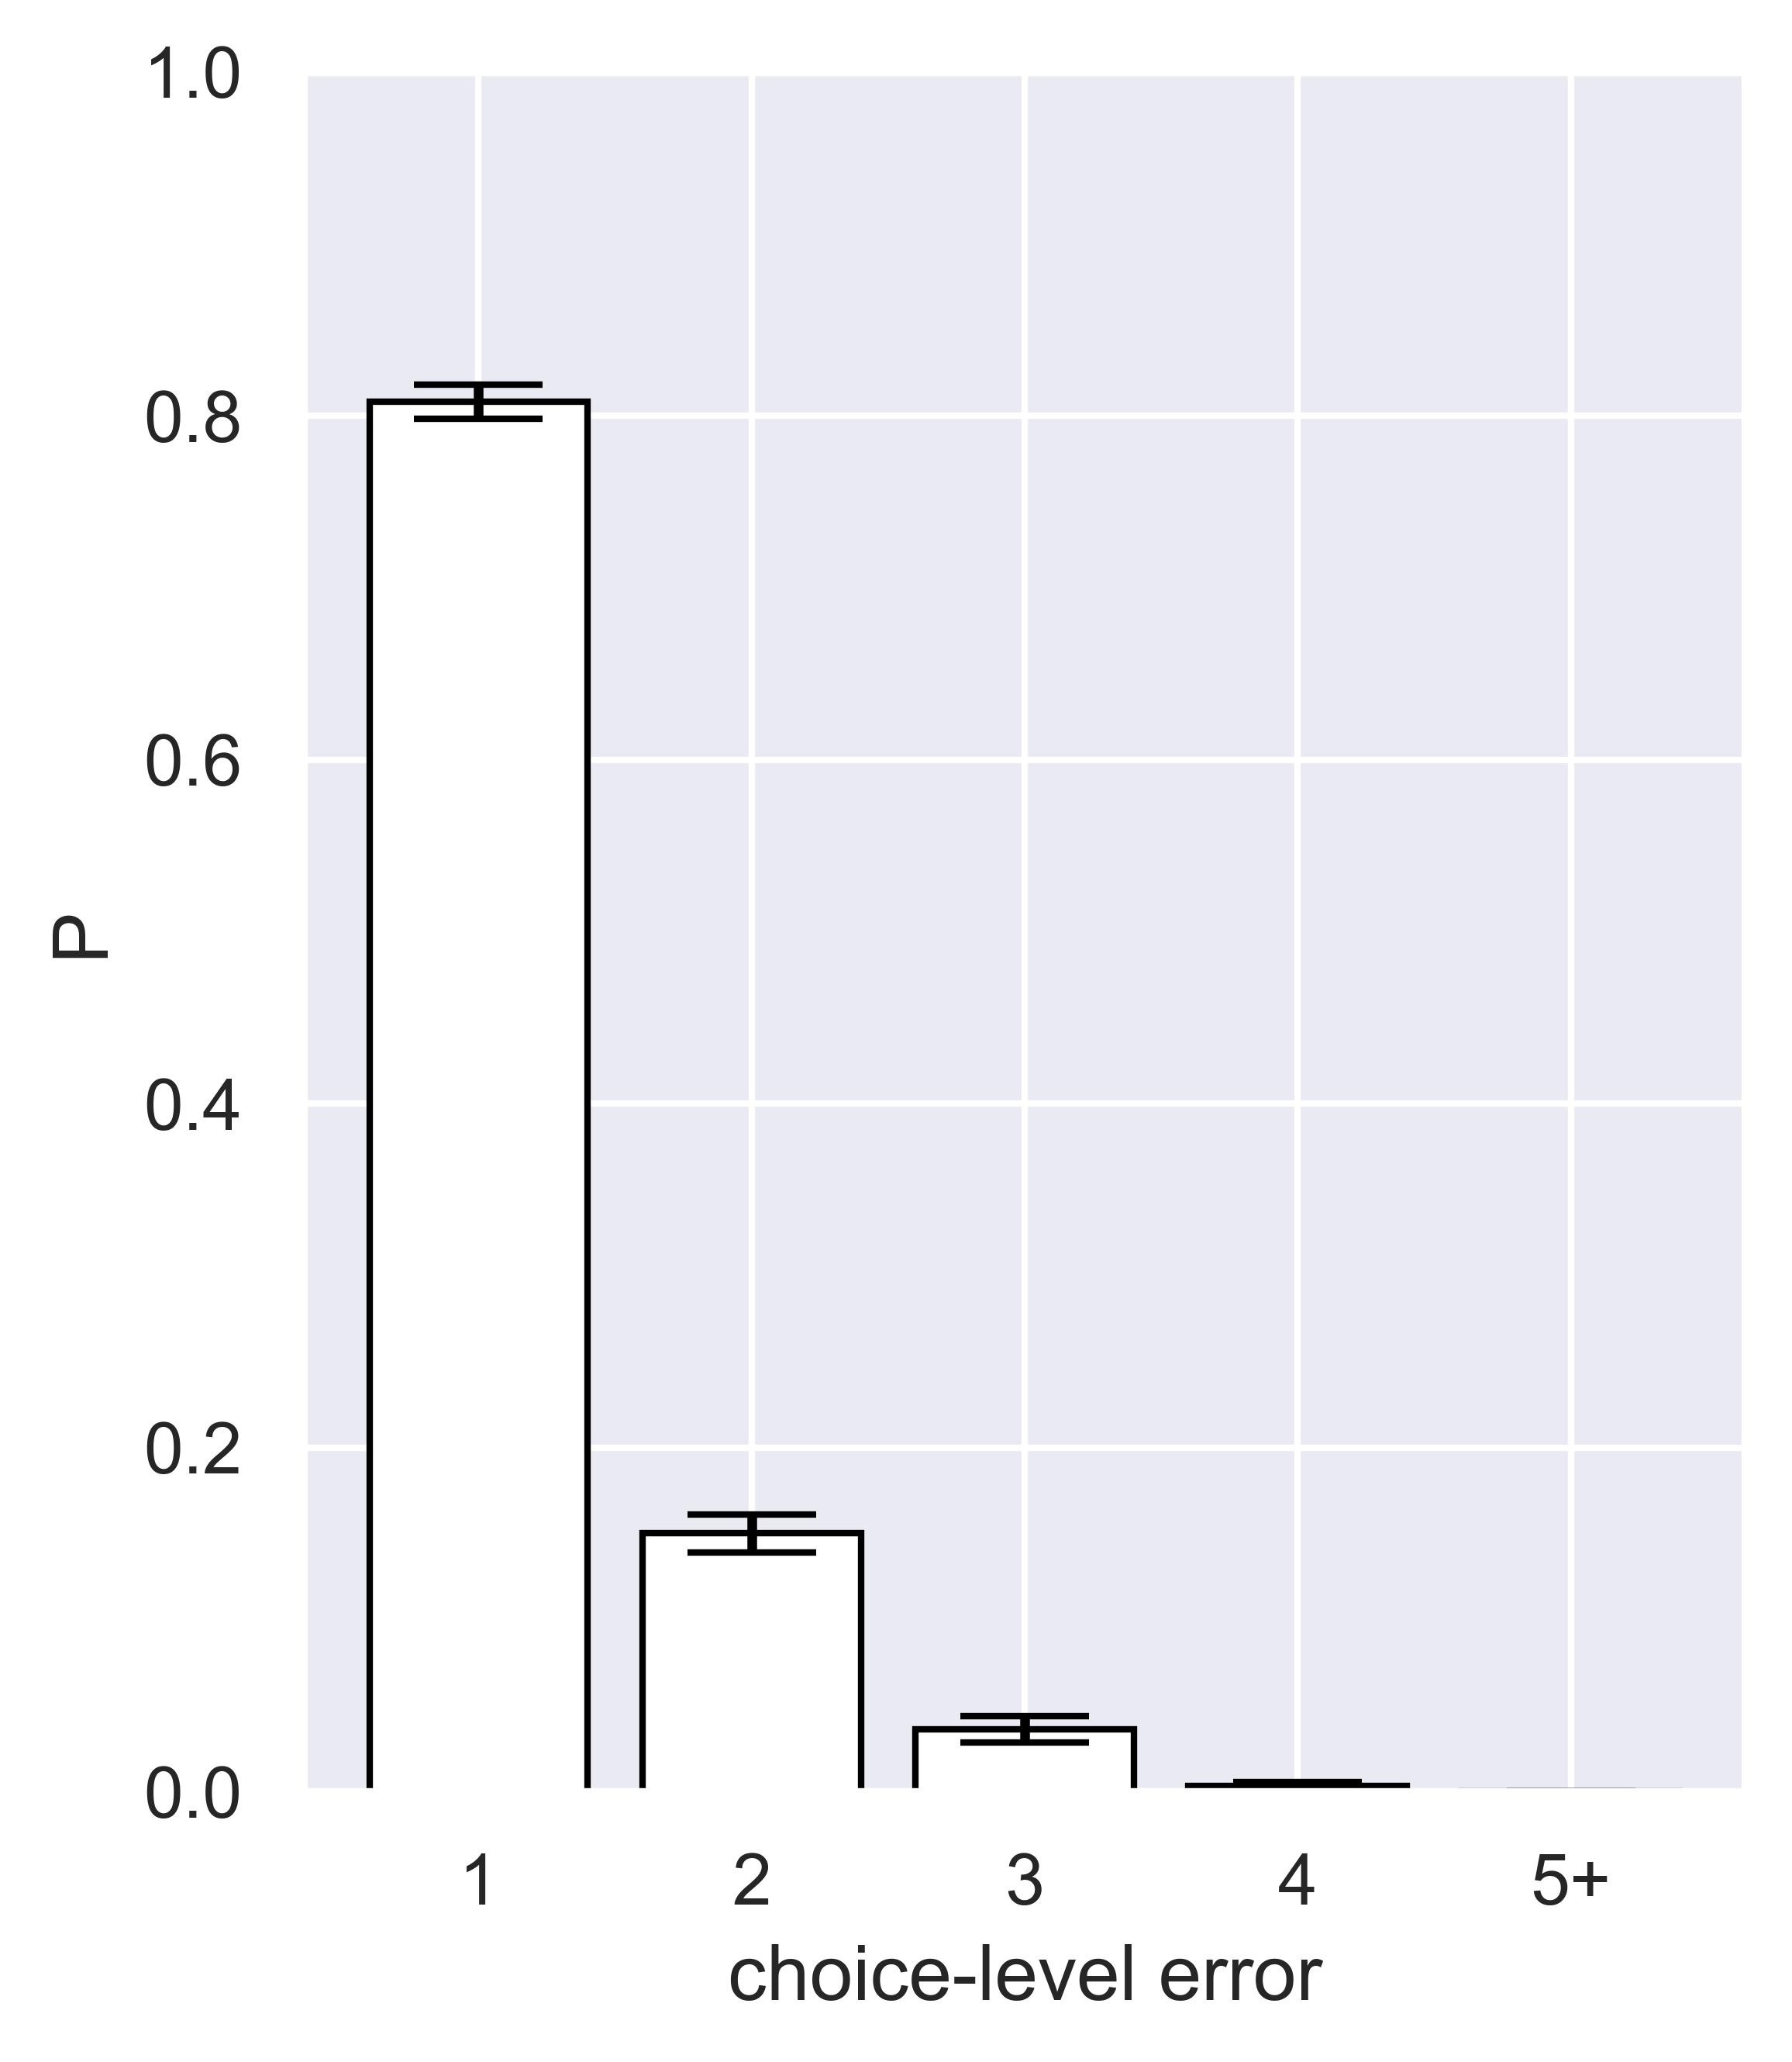
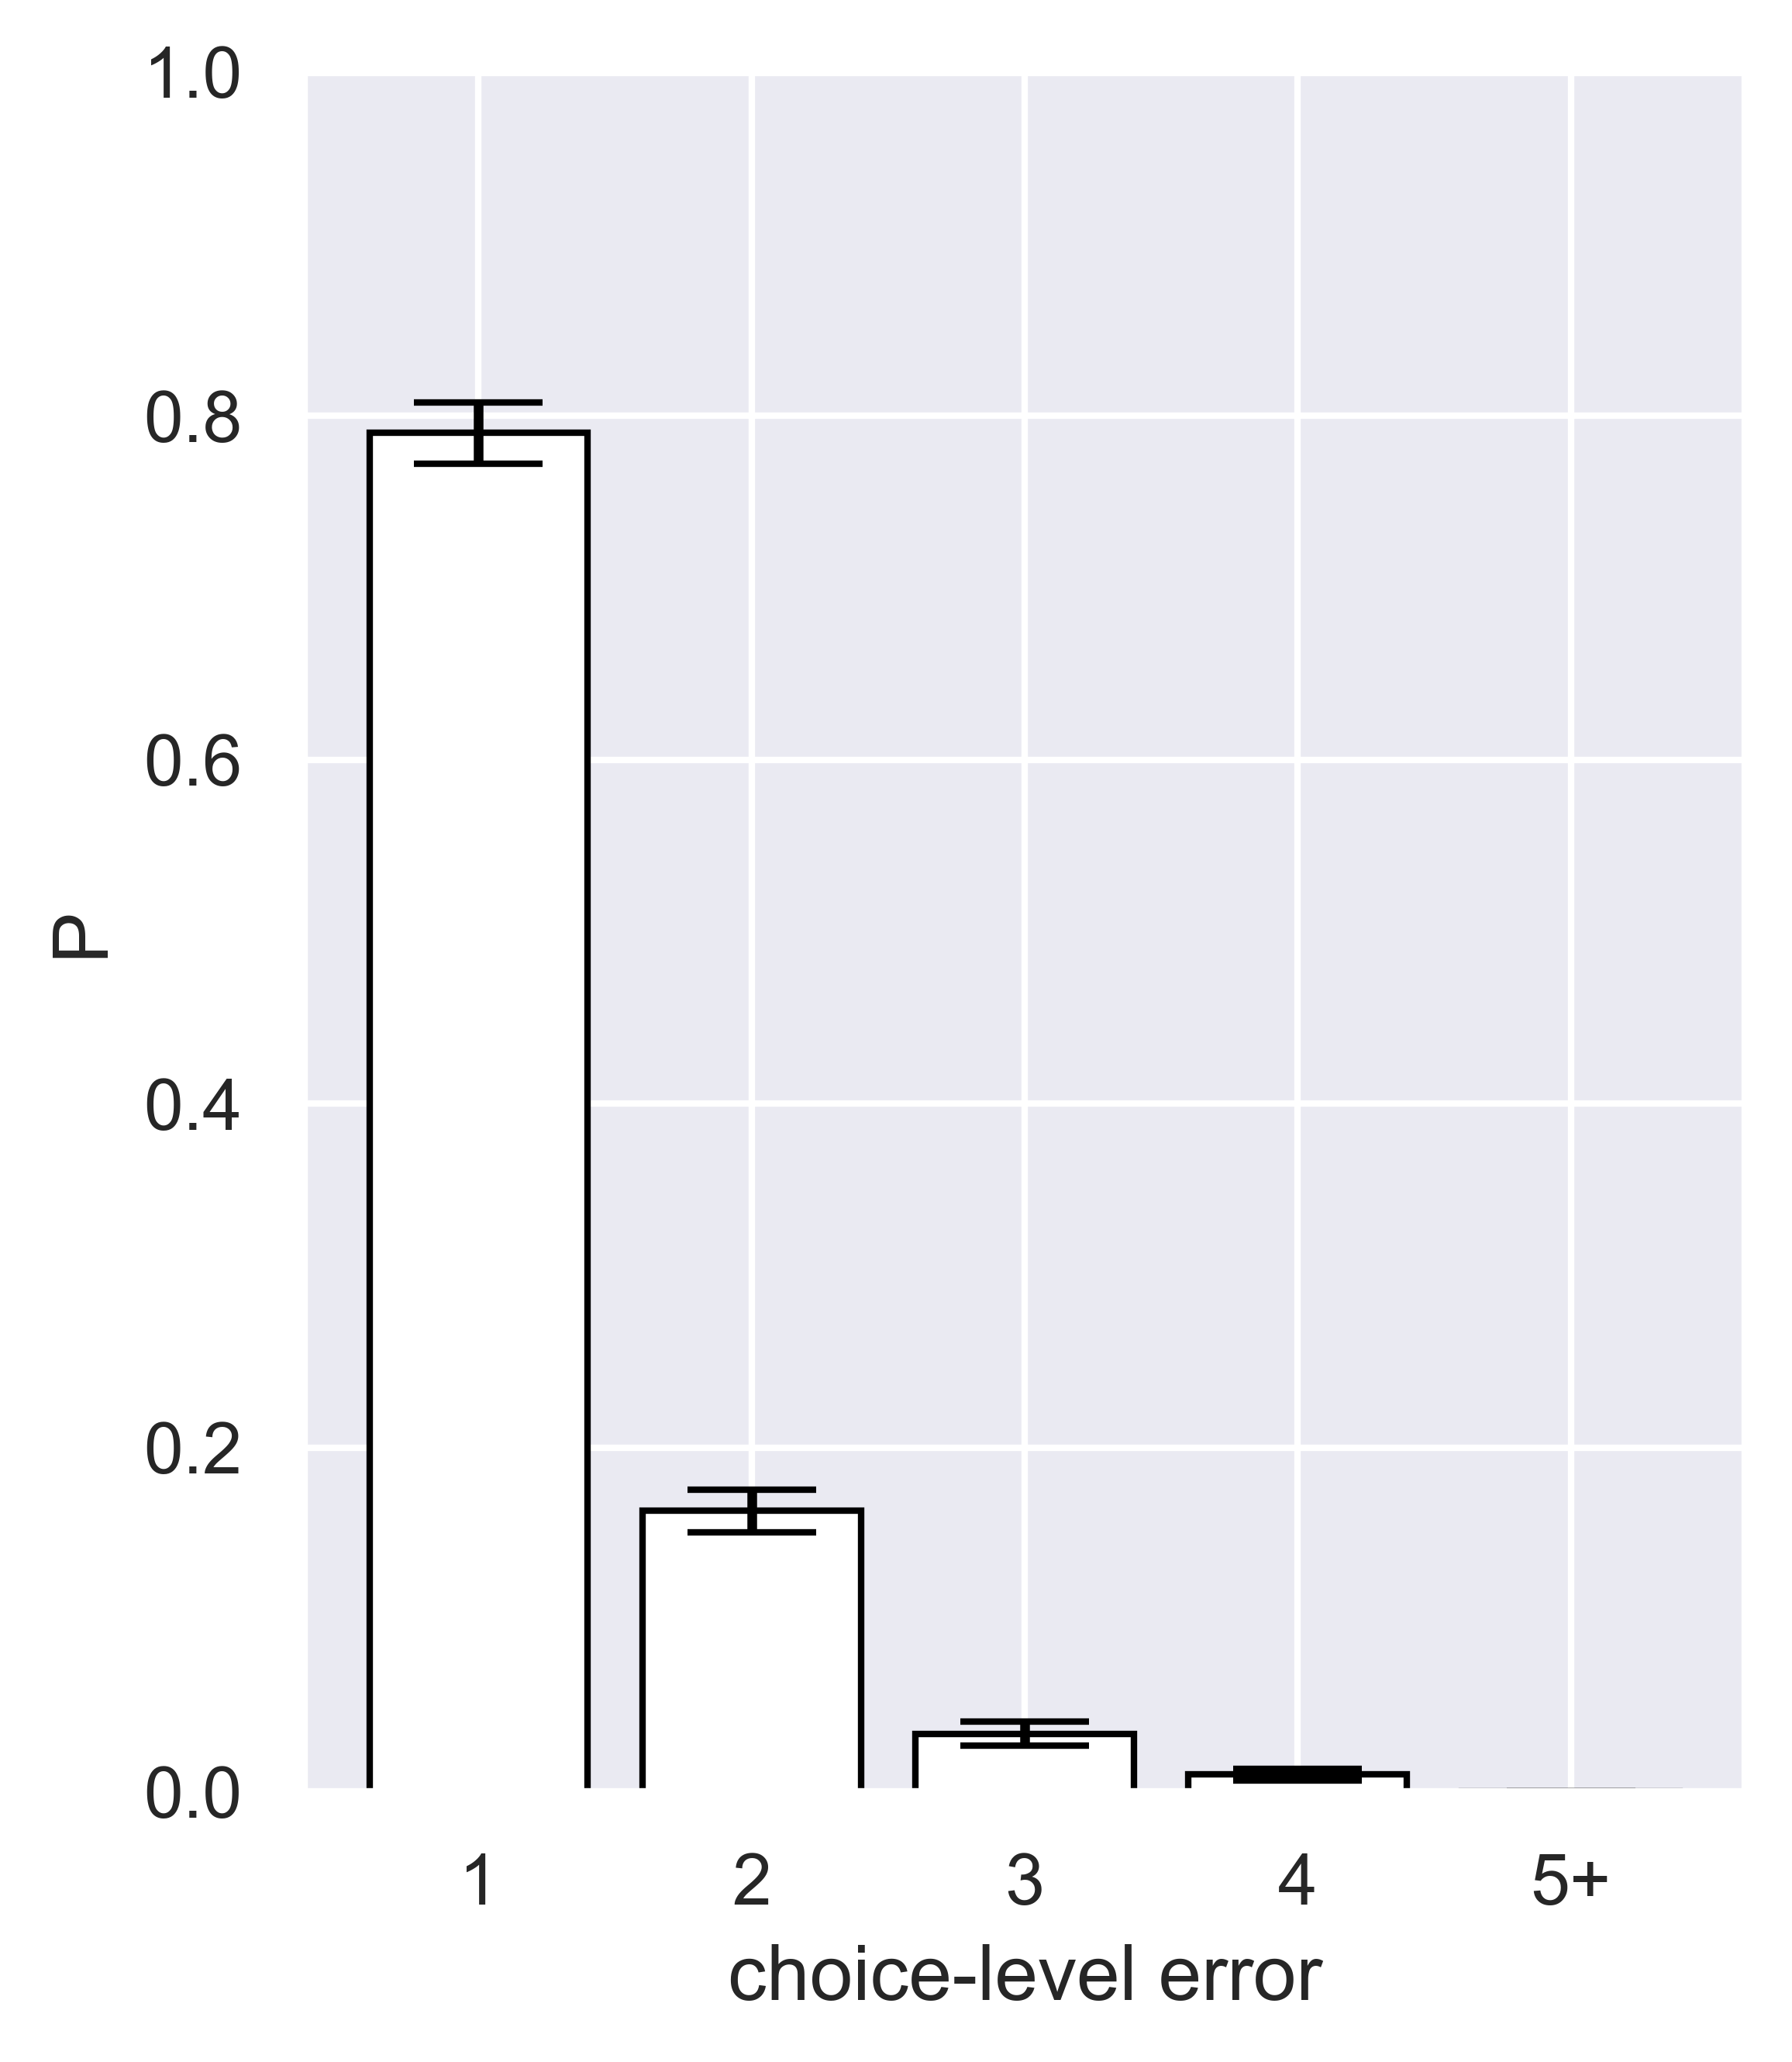
Choice-level: error histogram (excluding 0)
Without undo
With undo
Will merge into one figure

Slide 15
Initial hypothesis of why/when people undo
Error correction – undoing after making/realizing error.
Instant (undid once)
Delayed (undid multiple times in a row to go back to a specific node, “branching node
Prediction:
Undo after your move made an “error”
Longer undo-RTs compared to playout.
Playout – scheduled exploration (undid multiple times in a row): trying path A,B,C and comparing them.
Prediction:
Undo regardless of error
Shorter undo-RTs, because you are undoing as you scheduled.

Slide 16
Initial hypothesis of why/when people undo
 | (Expected-Scheduled; Shorter undo-RT?) | (Unexpected; Longer undo-RT?)
(undid once) |  | Error correction | Instant
(undid multiple times in a row) | Playout – scheduled exploration |  | Delayed

Slide 17
Future works
Collecting more data!
Plotting other variables: RT, and budget left after connecting cities, etc.
Some more plots about the hypothesis
GLMM analysis
And more.
Notes:
Still debugging but it seems the budget left has strong effect on number of undo. People tend to undo more when they have more budget left after connecting cities.

