Slide 1
DATA ANALYTICS CAPSTONE
Vehicle Sales
Data Analytics
From Raw Data to Business Insights
SQL Server
Python
Pandas
Power BI
Excel
WORKFLOW
SQL Server
Python Cleaning
Feature Engineering
Power BI
Business Insights

Slide 2
02 · DATASET & EXECUTIVE KPIs
Dataset Overview & Headline KPIs
558,799
24
Jan 1, 2014 – Jul 20, 2015
97
974
Vehicle sales records
Columns
Date range
Makes
Models
TOTAL VEHICLES SOLD
TOTAL SALES VALUE
AVERAGE SELLING PRICE
558,799
$7,433,616,780
$13,302.85
MEDIAN SELLING PRICE
AVERAGE MMR
AVG PRICE DIFFERENCE
$12,100
$13,457.18
-$158.02
AVG PRICE DIFFERENCE %
AVERAGE VEHICLE AGE
AVERAGE ODOMETER
-0.67%
4.96 years
67,552 miles

Slide 3
03 · MARKET OVERVIEW
Top Makes & Models by Transactions
Top 10 makes · transactions and share
16.74%
Ford is the largest make by transaction volume, representing 16.74% of all sales.
Top 5 models

Slide 4
04 · VEHICLE CHARACTERISTICS
Body Type, Transmission & Age
Body type
Transmission
Vehicle age
4.96
3
years · average age
years · median age
33.76%
31.74%
Automatic 475,904 · 85.17%
Manual 17,544 · 3.14%
Unknown 65,351 · 11.69%
aged 0–2 years
aged 3–5 years
Vehicles aged 0–5 years represent 65.50% of transactions.

Slide 5
05 · PRICING & MMR ANALYSIS
Selling Price vs. MMR
AVG SELLING PRICE
AVG MMR
DIFFERENCE
DIFFERENCE %
$13,302.85
$13,457.18
-$158.02
-0.67%
Price status vs. MMR
SellingPrice vs MMR correlation
Above MMR
+0.982
268,674 · 48.08%
At MMR
10,847 · 1.94%
-1
0
+1
Below MMR
MMR is strongly aligned with final selling price: vehicles with higher MMR values tend to sell at higher prices.
279,278 · 49.98%
The market is almost evenly split around MMR, with 49.98% of transactions below MMR and 48.08% above MMR.

Slide 6
06 · PRICE, MILEAGE & CONDITION
Price Bands, Mileage & Vehicle Condition
Transactions by price band
Mileage (odometer)
67,552
52,254
-0.652
Average miles
Median miles
Corr. with price
Average selling price by condition
$10K–$15K is the largest price band at 25.57% of transactions.
High-condition vehicles average $9,053.85 more than low-condition vehicles. Condition is associated with price; this does not show cause.

Slide 7
07 · GEOGRAPHIC & TIME ANALYSIS
Top States & Sales Timeline
Top 5 states
Transactions by year
State | Transactions | Share | Avg Price
Florida | 82,945 | 14.84% | $13,542.83
California | 73,148 | 13.09% | $13,844.60
Pennsylvania | 53,907 | 9.65% | $15,576.08
Texas | 45,913 | 8.22% | $12,963.55
Georgia | 34,750 | 6.22% | $12,611.64
2014 SALES VALUE
2015 SALES VALUE
163,053
sales in February: the highest monthly transaction volume
$594.34M
$6.839B
53,727 transactions
505,072 transactions
90.39% of transactions occurred in 2015.

Slide 8
08 · SELLERS & CORRELATIONS
Top Sellers & Drivers of Selling Price
Top sellers by transactions
Correlation with SellingPrice
MMR shows the strongest relationship with SellingPrice, while mileage and vehicle age show negative relationships.
Correlation does not prove causation.

Slide 9
09 · KEY BUSINESS INSIGHTS & RECOMMENDATIONS
What the Data Tells Us
Key Insights
Recommendations
1
MMR is strongly aligned with final selling price — correlation +0.982.
Use MMR as a core pricing benchmark.
1
2
49.98% of sales are below MMR, compared with 48.08% above MMR.
3
Ford represents 16.74% of transactions, the largest make share.
Segment pricing by vehicle age and mileage.
2
4
65.50% of vehicles are 0–5 years old.
Mileage is negatively associated with price, correlation -0.652.
Investigate patterns behind below-MMR transactions.
5
3
6
High-condition vehicles average $18,751.09, versus $9,697.24 for low-condition vehicles.
Focus inventory analysis on high-volume makes and body types.
7
Florida leads transaction volume with 14.84%.
4
8
The $10K–$15K band contains 25.57% of transactions.
Use geographic segmentation for market-specific pricing and inventory decisions.
90.39% of transactions occurred in 2015.
5
9

Slide 10
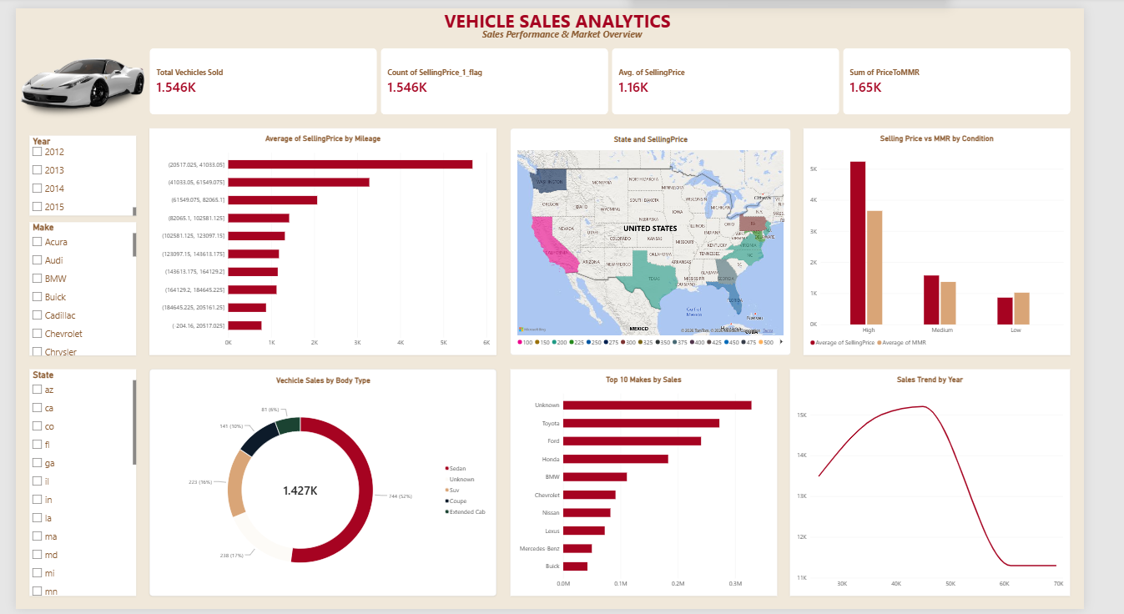
10 · DASHBOARD
Interactive Power BI Dashboard
Executive Overview
Interactive dashboard enabling filtering, cross-filtering, drill-down, and detailed analysis across vehicle, pricing, geographic, time, and seller dimensions.

