Slide 1
Chapter 22: Parallel and Distributed Query Processing

Slide 2
Chapter 22: Parallel And Distributed Query Processing
Overview
Parallel Sort
Parallel Join
Other Operations
Parallel Evaluation of Query Plans
Query Processing on Shared Memory
Query Optimization
Distributed Query Processing

Slide 3
Parallel Query Processing
Different queries/transactions can be run in parallel with each other.
Interquery parallelism
Concurrency control takes care of conflicts in case of updates
More on parallel transaction processing in Chapter 23
Focus in this chapter is on read-only queries
Individual relational operations (e.g., sort, join, aggregation) can be executed in parallel
data can be partitioned and each processor can work independently on its own partition.
Queries are expressed in high level language (SQL, translated to relational algebra)
makes parallelization easier.

Slide 4
Intraquery Parallelism
Intraquery parallelism: execution of a single query in parallel on multiple processors/disks; important for speeding up long-running queries.
Two complementary forms of intraquery parallelism:
Intraoperation Parallelism – parallelize the execution of each individual operation in the query
Supports high degree of parallelism
Interoperation Parallelism – execute the different operations in a query expression in parallel.
Limited degree of parallelism

Slide 5
Parallel Processing of Relational Operations
Our discussion of parallel algorithms assumes:
read-only queries
shared-nothing architecture
n nodes, N₁, ..., N_{n}
Each assumed to have disks and processors.
Initial focus on parallelization to a shared-nothing node
Parallel processing within a shared memory/shared disk node discussed later
Shared-nothing architectures can be efficiently simulated on shared-memory and shared-disk systems.
Algorithms for shared-nothing systems can thus be run on shared-memory and shared-disk systems.
However, some optimizations may be possible.

Slide 6
Intraoperation Parallelism

Slide 7
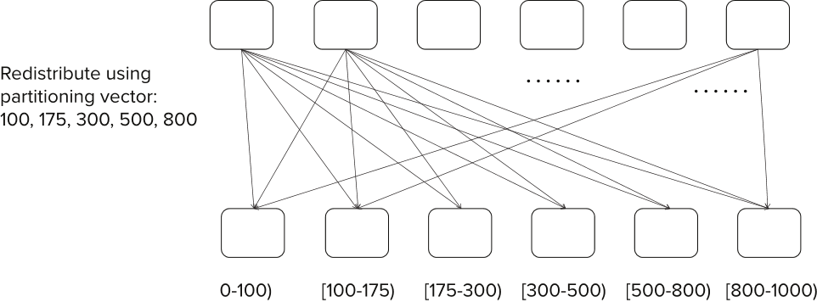
Range Partitioning

Slide 8
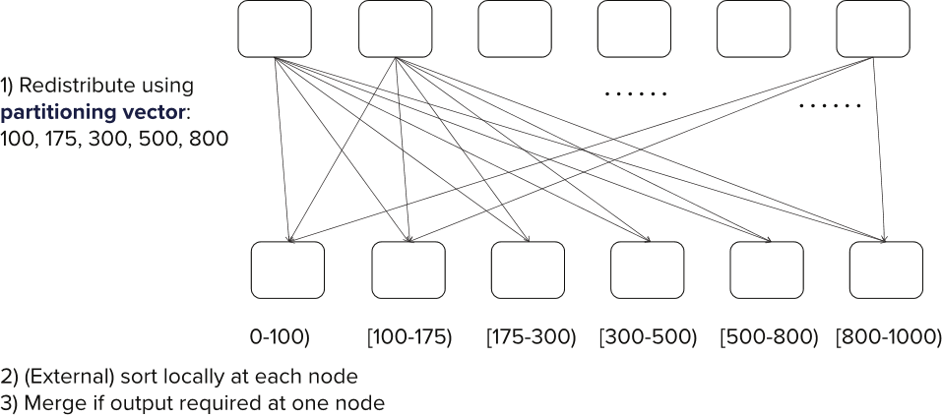
Range-Partitioning Parallel Sort

Slide 9
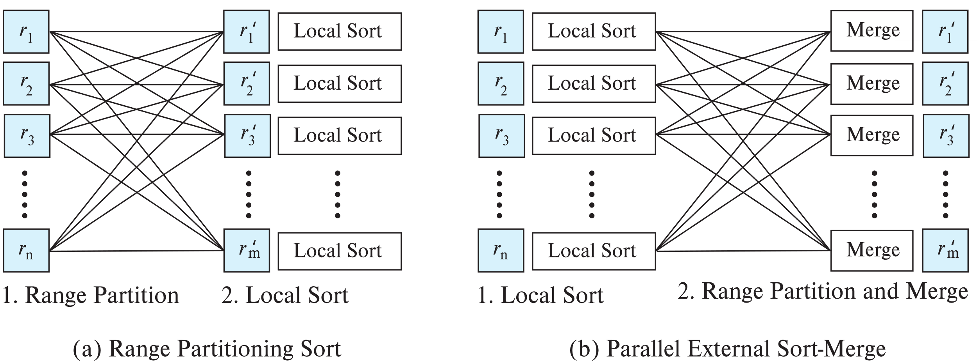
Parallel Sort

Slide 10
Parallel Sort
Range-Partitioning Sort
Choose nodes N₁, ..., N_{m}, where m ≤ n -1 to do sorting.
Create range-partition vector with m-1 entries, on the sorting attributes
Redistribute the relation using range partitioning
Each node N_{i} sorts its partition of the relation locally.
Example of data parallelism: each node executes same operation in parallel with other nodes, without any interaction with the others.
Final merge operation is trivial: range-partitioning ensures that, if i < j, all key values in node N_{i} are all less than all key values in N_{j}.

Slide 11
Parallel Sort (Cont.)
Parallel External Sort-Merge
Assume the relation has already been partitioned among nodes N₁, ..., N_{n} (in whatever manner).
Each node N_{i} locally sorts the data (using local disk as required)
The sorted runs on each node are then merged in parallel:
The sorted partitions at each node Ni are range-partitioned across the processors N₁, ..., N_{n}.
Each node Ni performs a merge on the streams as they are received, to get a single sorted run.
The sorted runs on nodes N₁, ..., N_{n} are concatenated to get the final result.
Algorithm as described vulnerable to execution skew
all nodes send to node 1, then all nodes send data to node 2, …
Can be modified so each node sends data to all other nodes in parallel (block at a time)

Slide 12
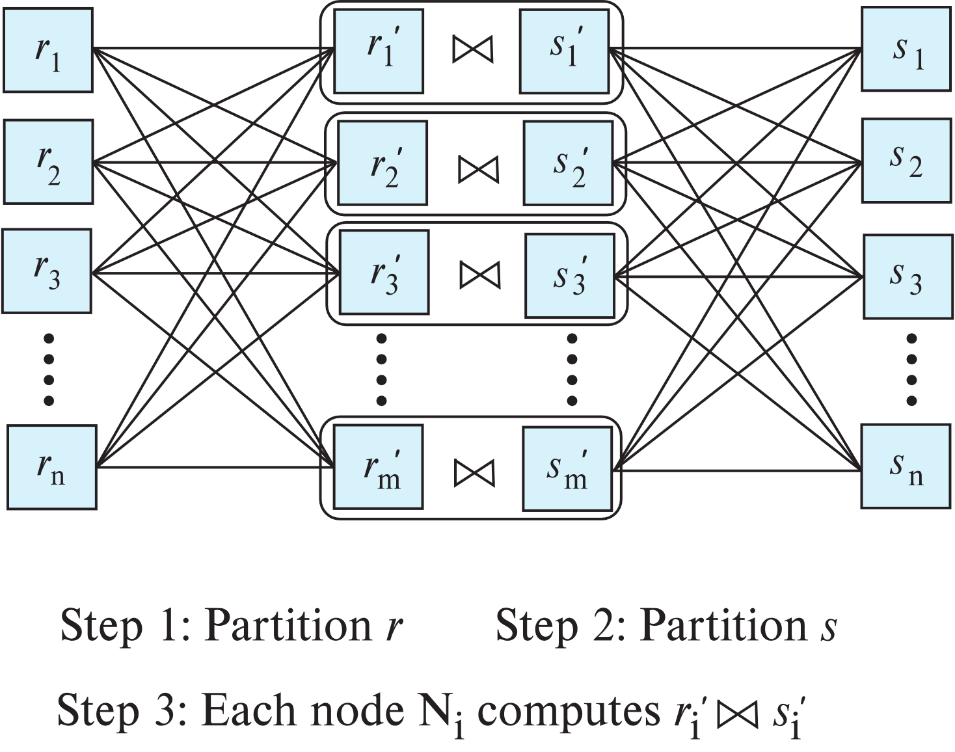
Partitioned Parallel Join
Partition using range or hash partitioning, on join attributes
Notes:
s_k instead of s_n? Move ahead in chapter 23….

Slide 13
Partitioned Parallel Join (Cont.)
For equi-joins and natural joins, it is possible to partition the two input relations across the processors, and compute the join locally at each processor.
Can use either range partitioning or hash partitioning.
r and s must be partitioned on their join attributes r.A and s.B), using the same range-partitioning vector or hash function.
Join can be computed at each site using any of
Hash join, leading to partitioned parallel hash join
Merge join, leading to partitioned parallel merge join
Nested loops join, leading to partitioned parallel nested-loops join or partitioned parallel index nested-loops join

Slide 14
Partitioned Parallel Hash-Join
Parallelizing partitioned hash join:
A hash function h₁ takes the join attribute value of each tuple in s and maps this tuple to one of the n nodes.
As tuples of relation s are received at the destination nodes, they are partitioned further using another hash function, h₂, which is used to compute the hash-join locally.
Repeat above for each tuple in r.
Each node N_{i} executes the build and probe phases of the hash-join algorithm on the local partitions r_{i} and s_{i} of r and s to produce a partition of the final result of the hash-join.
Note: Hash-join optimizations can be applied to the parallel case
e.g., the hybrid hash-join algorithm can be used to cache some of the incoming tuples in memory and avoid the cost of writing them and reading them back in.

Slide 15
Fragment-and-Replicate Joins
Asymmetric and Symmetric Fragment-and-Replicate Joins

Slide 16
Fragment-and-Replicate Join
Partitioning not possible for some join conditions
E.g., non-equijoin conditions, such as r.A > s.B.
For joins were partitioning is not applicable, parallelization can be accomplished by fragment and replicate technique
Special case – asymmetric fragment-and-replicate:
One of the relations, say r, is partitioned; any partitioning technique can be used.
The other relation, s, is replicated across all the processors.
Node Ni then locally computes the join of ri with all of s using any join technique.
Also referred to as broadcast join

Slide 17
Fragment-and-Replicate Join (Cont.)
Both versions of fragment-and-replicate work with any join condition, since every tuple in r can be tested with every tuple in s.
Usually has a higher cost than partitioning, since one of the relations (for asymmetric fragment-and-replicate) or both relations (for general fragment-and-replicate) have to be replicated.
Sometimes asymmetric fragment-and-replicate is preferable even though partitioning could be used.
E.g., if s is small and r is large, and r is already partitioned, it may be cheaper to replicate s across all nodes, rather than repartition r and s on the join attributes.
Question: how do you implement left outer join using above join techniques?

Slide 18
Handling Skew
Skew can significantly slow down parallel join
Join skew avoidance
Balanced partitioning vector
Virtual node partitioning
Dynamic handling of join skew
Detect overloaded physical nodes
If a physical node has no remaining work, take on a waiting task (virtual node) currently assigned to a different physical node that is overloaded
Example of work stealing
Cheaper to implement in shared memory system, but can be used even in shared nothing/shared disk system

Slide 19
Other Relational Operations
Selection σ_{θ}(r)
If θ is of the form a_{i} = v, where a_{i} is an attribute and v a value.
If r is partitioned on a_{i} the selection is performed at a single node.
If θ is of the form l <= a_{i} <= u (i.e., θ is a range selection) and the relation has been range-partitioned on a_{i}
Selection is performed at each node whose partition overlaps with the specified range of values.
In all other cases: the selection is performed in parallel at all the nodes.
Notes:
----- Meeting Notes (10/01/17 12:42) -----
also consider in or OR queries. And global index as an option

Slide 20
Other Relational Operations (Cont.)
Duplicate elimination
Perform by using either of the parallel sort techniques
eliminate duplicates as soon as they are found during sorting.
Can also partition the tuples (using either range- or hash- partitioning) and perform duplicate elimination locally at each node.
Projection
Projection without duplicate elimination can be performed as tuples are read from disk, in parallel.
If duplicate elimination is required, any of the above duplicate elimination techniques can be used.

Slide 21
Grouping/Aggregation
Step 1: Partition the relation on the grouping attributes
Step 2: Compute the aggregate values locally at each node.
Optimization: Can reduce cost of transferring tuples during partitioning by partial aggregation before partitioning
For distributive aggregate
Can be done as part of run generation
Consider the sum aggregation operation:
Perform aggregation operation at each node N_{i} on those tuples stored its local disk
results in tuples with partial sums at each node.
Result of the local aggregation is partitioned on the grouping attributes, and the aggregation performed again at each node N_{i} to get the final result.
Fewer tuples need to be sent to other nodes during partitioning.

Slide 22
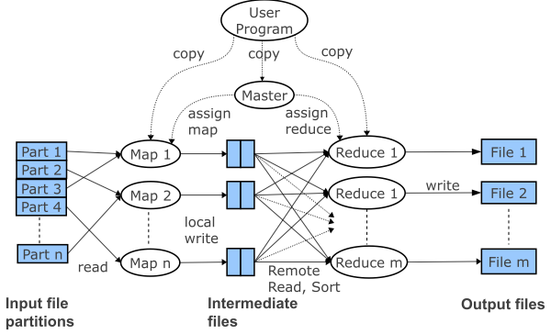
Map and Reduce Operations

Slide 23
Map and Reduce Operations
Map and reduce workers
Threads/processes that execute map and reduce functions
Map and reduce tasks
Units of map and reduce work
Many more tasks than workers
Similar to virtual node partitioning
Skew handling
Straggler tasks
Can be handled by initiating an extra copy of the task at another node
Partial aggregation (combiners) helps reduce skew at reduce nodes

Slide 24
Parallel Evaluation of Query Plans

Slide 25
Interoperator Parallelism
Pipelined parallelism
Consider a join of four relations
r₁ ⨝ r₂ ⨝ r₃ ⨝ r₄
Set up a pipeline that computes the three joins in parallel
Each of these operations can execute in parallel, sending result tuples it computes to the next operation even as it is computing further results
Provided a pipelineable join evaluation algorithm (e.g. indexed nested loops join) is used
r₄
r₃
r₁
r₂

Slide 26
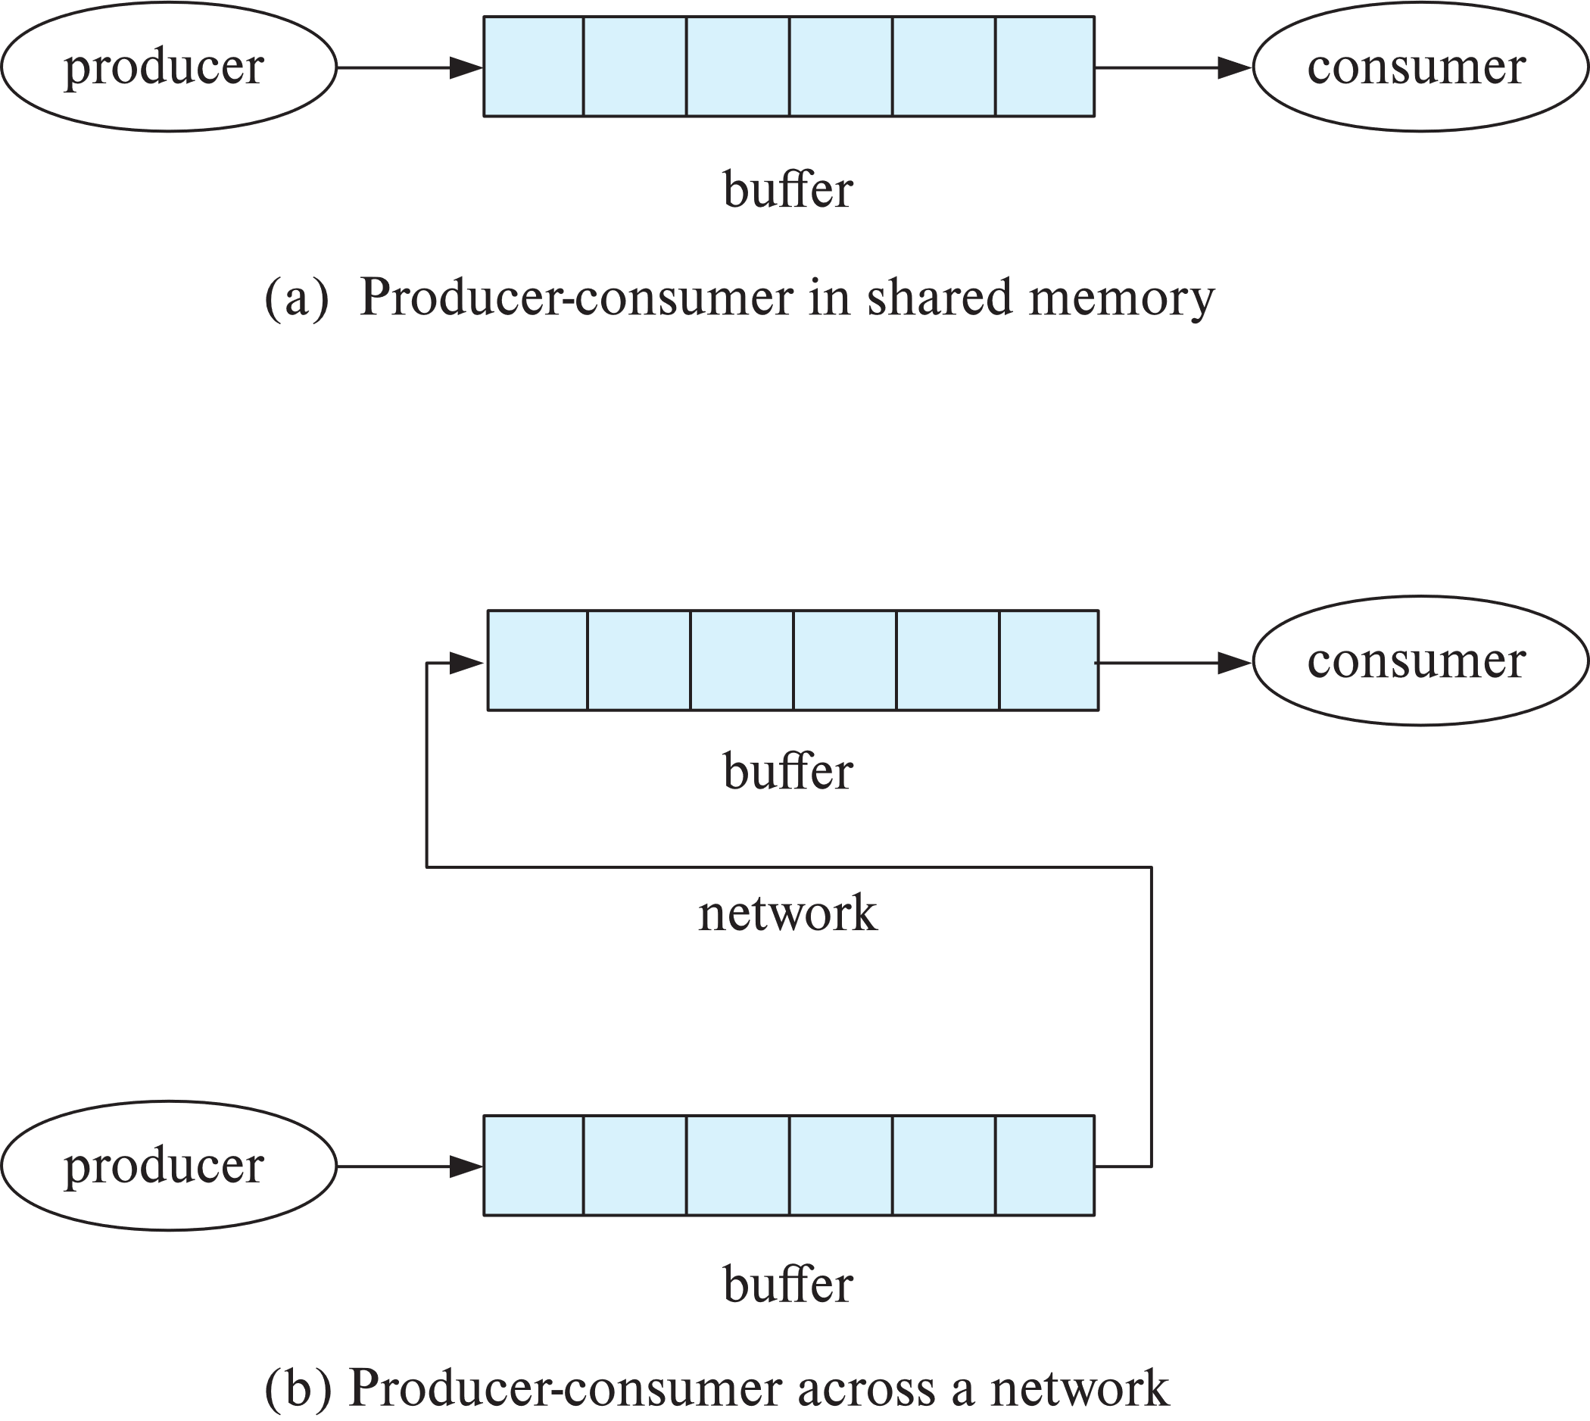
Pipelined Parallelism
Push model of computation appropriate for pipelining in parallel databases
Buffer between consumer and producer
Can batch tuples before sending to next operator
Reduce number of messages,
reduce contention on shared buffers

Slide 27
Utility of Pipeline Parallelism
Limitations
Does not provide a high degree of parallelism since pipeline chains are not very long
Cannot pipeline operators which do not produce output until all inputs have been accessed (e.g. aggregate and sort)
Little speedup is obtained for the frequent cases of skew in which one operator's execution cost is much higher than the others.
But pipeline parallelism is still very useful since it avoids writing intermediate results to disk

Slide 28
Independent Parallelism
Independent parallelism
Consider a join of four relations
r₁ ⨝ r₂ ⨝ r₃ ⨝ r₄
Let N₁ be assigned the computation of temp1 = r₁ ⨝ r₂
And N₂ be assigned the computation of temp2 = r₃ ⨝ r₄
And N₃ be assigned the computation of temp1 ⨝ temp₂
N₁ and N₂ can work independently in parallel
N₃ has to wait for input from N₁ and N₂
Can pipeline output of N₁ and N₂ to N₃, combining independent parallelism and pipelined parallelism
Does not provide a high degree of parallelism
useful with a lower degree of parallelism.
less useful in a highly parallel system,

Slide 29
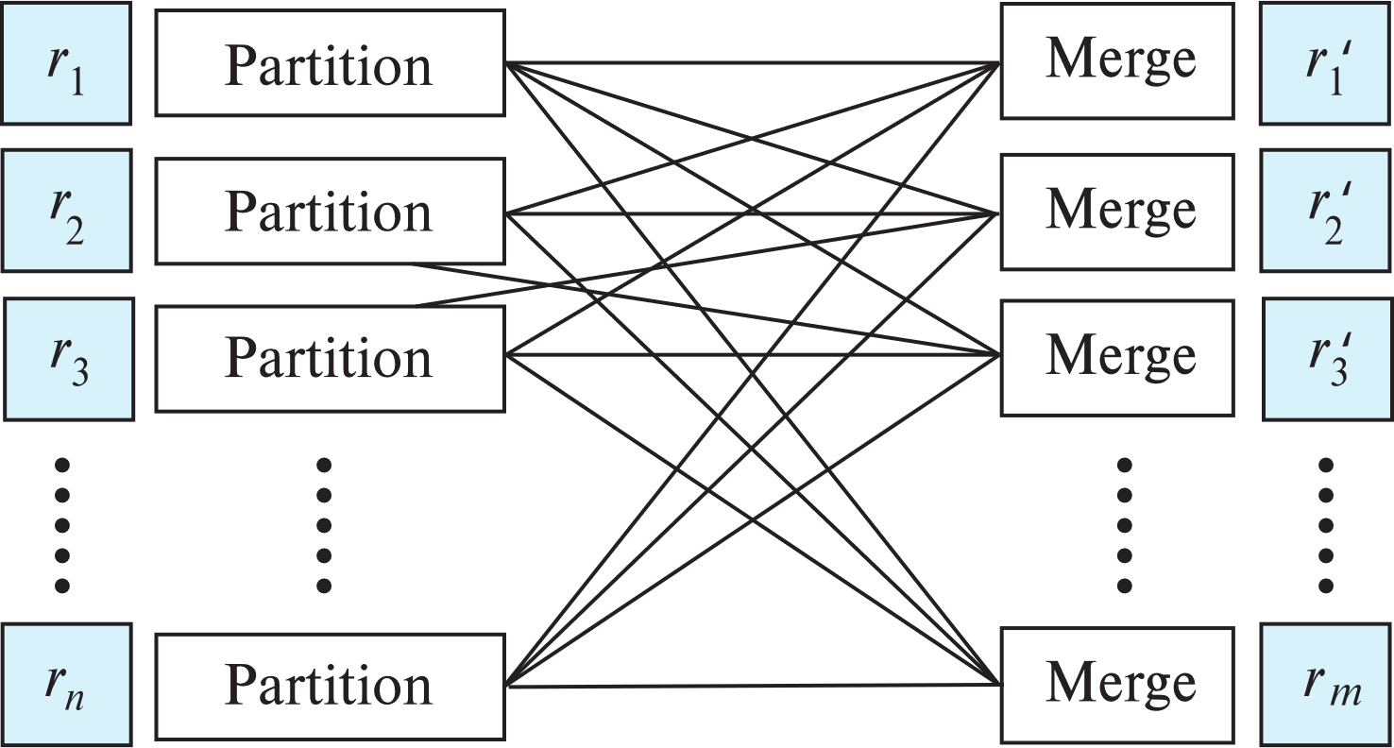
Exchange Operator
Repartitioning implemented using the exchange operator
Partition and merge steps

Slide 30
Exchange Operator Model
Movement of data encapsulated in exchange operator
Partitioning of data can be done by
Hash partitioning
Range partitioning
Replicating data to all nodes (called broadcasting)
Sending all data to a single node
Destination nodes can receive data from multiple source nodes. Incoming data can be merged by:
Random merge
Ordered merge
Other operators in a plan can be unaware of parallelism
Data parallelism: each operator works purely on local data
Not always best way, but works well in most cases

Slide 31
Parallel Plans Using Exchange Operator
Range partitioning sort:
Exchange operator using range partitioning, followed by
Local sort
Parallel external sort merge
Local sort followed by
Exchange operator with ordered merge
Partitioned join
Exchange operator with hash or range partitioning, followed by
Local join
Asymmetric fragment and replicate
Exchange operator using broadcast replication, followed by
Local join
Exchange operator can also implement push model, with batching

Slide 32
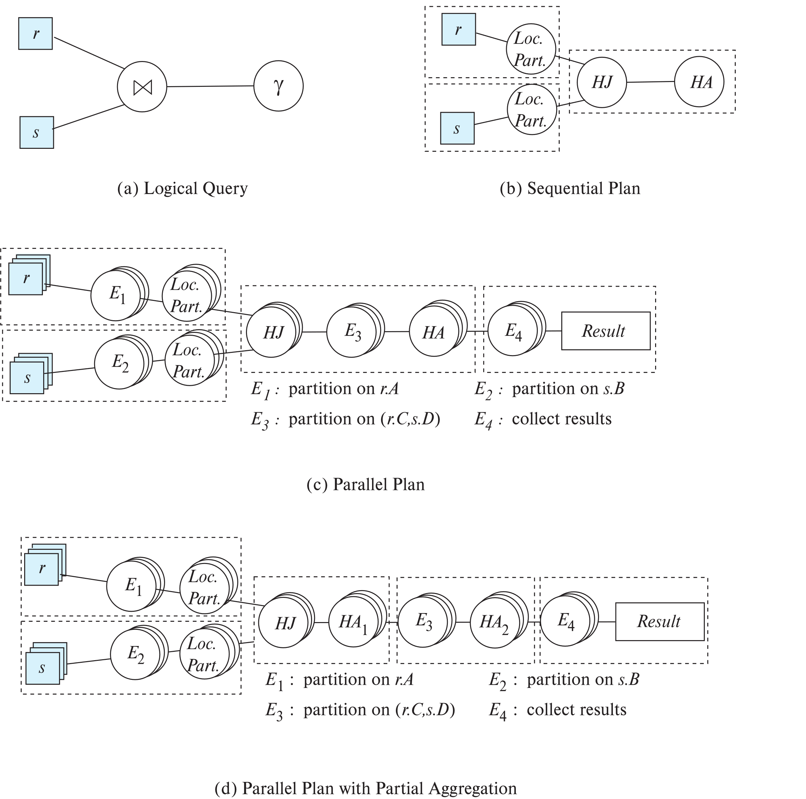
Parallel Plans
Dashed boxes denote pipelined segment

Slide 33
Parallel Plans (Cont.)
(c) Parallel Plan
(c) Parallel Plan with Partial Aggregation

Slide 34
Fault Tolerance in Query Plans
Alternative 1: Re-execute the query on failure
Works well if mean time to failure >> query execution time
Good for medium scale parallelism with 100’s of machines
Works badly on massively parallel execution of long queries
Where probability of some node failing during execution of a single query is high

Slide 35
Fault Tolerance in Query Plans
Alternative 2: Re-execute work of only failed nodes
Works well if consumers process data only after it is completely generated
Just discard partial data
Used in map-reduce implementations
Problems arise if consumers process data as it is generated (pipelined execution)
Only new tuples must be consumed from re-execution
Re-execution must generate tuples in exactly same order to efficiently determine which tuples are new
Straggler nodes (nodes that are running slow) can be treated similar to failed nodes

Slide 36
Fault Tolerance in Map-Reduce

Slide 37
Fault Tolerance in Map Reduce Implementation
Map workers writes data to local disk
Cheaper than writing to distributed file system
When task is complete, data is sent to reducers
Reducers use data only after it is fully received
On map worker failure:
Reexecute map tasks on a new node
Reducers get data from new node, discarding partially received data (if any) from failed node
On reduce worker failure
Reexecute reduce task on new node
Re-fetch data from map nodes
On completion of a map-reduce phase, result is written to distributed file system
Replication ensures result is safe from failures

Slide 38
Fault Tolerant Query Execution
Overheads of fault-tolerant query execution
Materialization cost
Each step has to wait till the previous step finishes
Stragglers can cause significant delays
Pipelined execution can avoid these costs
But harder to make pipelined execution fault-tolerant
E.g. duplication of tuples when failed task is reexecuted
Apache Spark uses concept of Resilient Distributed Datasets (RDDs)
Data can be replicated in memory/on disk
But intermediate results are not materialized
Query nodes can be reexecuted to regenerate results

Slide 39
Query Processing in Shared Memory Systems
Parallel query processing techniques discussed so far can be optimized if data is in shared memory
Shared memory parallel processing usually based on threads, instead of processes
Usually number of threads = number of cores * number off hardware threads per core

Slide 40
Query Processing in Shared Memory Systems
Optimized algorithms for shared memory
With asymmetric fragment-and-replicate join, the smaller relation can be in shared memory, instead of being replicated for each thread
Hash join can be done by
Partitioning build relation to each thread, OR
Shared build relation with singe index, in shared memory
Probe relation can be partitioned into small pieces (a.k.a. morsels)
Each thread processes one piece of the probe at a time, in parallel with other threads
Shared index construction can be parallelized, but carefully
Multiple threads may try to write to same location in shared memory
Atomic instruction (test-and-set/compare-and-swap) can be used to add entries to hash table list

Slide 41
Query Processing in Shared Memory Systems
Skew can be handled by work stealing
Idle processors can take up tasks allocated to other processors
Virtual node partitioning allows tasks to be broken into small pieces
Cost of reallocating a partition is low in shared memory
Even simpler if shared build relation is used
only probe relation partitioned need to be reassigned
Query processing algorithms should be are of NUMA: Non-uniform memory access
Each thread scheduled as far as possible on same core every time it runs
Data structures used by only 1 thread allocated in memory local to the core on which the thread is running

Slide 42
Query Processing in Shared Memory Systems
Cache-conscious algorithms used in main-memory centralized query processing should also be used in shared-memory systems
Single Instruction Multiple Data (SIMD) parallelism is increasingly used
In GPUs as well as Intel Xeon Phi co-processors
Vector processing
Vector processing can be used for relational operations

Slide 43
Query Optimization for Parallel Query Execution

Slide 44
Query Optimization For Parallel Execution
Query optimization in parallel databases is significantly more complex than query optimization in sequential databases.
Different options for partitioning inputs and intermediate results
Cost models are more complicated, since we must take into account partitioning costs and issues such as skew and resource contention.

Slide 45
Parallel Query Plan Space
A parallel query plan must specify
How to parallelize each operation, including which algorithm to use, and how to partition inputs and intermediate results (using exchange operators)
How the plan is to be scheduled
How many nodes to use for each operation
What operations to pipeline within same node or different nodes
What operations to execute independently in parallel, and
What operations to execute sequentially, one after the other.
E.g., In query _{r.A} 𝛾_{sum(s.C)}(r ⋈ _{r.A=s.A r.B=s.B} s)
Partitioning r and s on (A,B) for join will require repartitioning for aggregation
But partitioning r and s on (A) for join will allow aggregation with no further repartitioning
Query optimizer has to choose best plan taking above issues into account

Slide 46
Cost of Parallel Query Execution
Resource consumption cost model
used for centralized databases
Response time cost model
attempts to better estimate the time to completion of a query
E.g., If an operation performs I/O operations in parallel with CPU execution, the response time T = max(CPU cost, I/O cost)
Resource consumption cost model uses (CPU cost + I/O cost).
E.g., if two operations o₁ and o₂ are in a pipeline, with CPU and I/O costs c₁; io₁ and c₂; io₂ respectively, then response time T = max(c₁ + c₂, io₁ + io₂).
Operators in parallel: T = max (T₁, T₁, …, T_{n})
Skew is an issue
Notes:
Add in text: T = max (T₁, T₁, …, T_{n})

Slide 47
Cost of Parallel Query Execution (Cont.)
Response time cost model would have to take into account
Start-up costs for initiating an operation on multiple nodes
Skew in distribution of work
Response time cost model better suited for parallel databases
But not used much since it increases cost of query optimization
Notes:
Add in text: T = max (T₁, T₁, …, T_{n})

Slide 48
Choosing Query Plans
The number of parallel evaluation plans from which to choose from is much larger than the number of sequential evaluation plans
Many alternative partitioning options
Choosing a good physical organization (partitioning technique) is important to speed up queries.
Two alternatives often used for choosing parallel plans:
First choose most efficient sequential plan and then choose how best to parallelize the operations in that plan
Heuristic, since best sequential plan may not lead to best parallel plan
Parallelize every operation across all nodes
Use exchange operator to perform (re)partitioning
Use standard query optimizer with extended cost model
Notes:
Update text to reflect above organization

Slide 49
Physical Schema
Partitioning scheme important for queries
Colocate data that is accessed together
E.g., all records for a particular user
E.g., student record with all takes records of the student
Store multiple copies of a relation, partitioned on different attributes
E.g., extra copy of takes partitioned on (course id, year, semester, sec id) for colocation with section record
Materialized views to avoid joins at query time
Materialized view itself is stored partitioned across nodes
Speeds up queries, but extra cost for updates
Extra copy of materialized view may be stored partitioned on different attributes
See book for details of parallel maintenance of materialized views

Slide 50
Streaming Data

Slide 51
Streaming Data
Real-time analytics is increasingly important
Online processing of incoming data
But data must also be stored for later processing
Architecture alternatives:
Lambda architecture: sends a copy of data to real time stream analytics system, and another copy to data storage system
Increasingly, same system provides storage and real time stream analytics

Slide 52
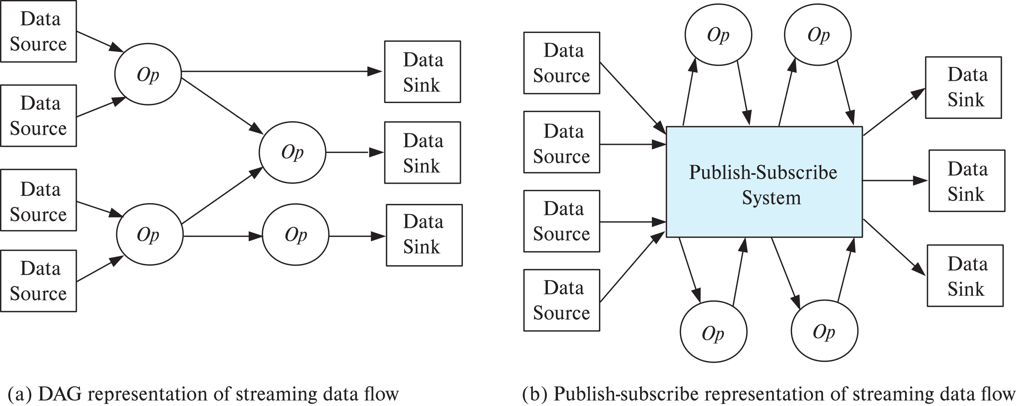
Logical Routing of Streams

Slide 53
Parallel Processing of Streaming Data
Logical routing of tuples is done by creating a Directed Acyclic Graph (DAG)
Can be done by creating a configuration file
Called a topology in the Apache Storm system
OR, can be done dynamically by using publish-subscribe system
E.g., Apache Kafka
Producers publish to topic/stream, consumers subscribe to topic/streams

Slide 54
Parallel Processing of Streaming Data
Physical DAG reflects parallel execution of operator instances
Parallel implementation of publish-subscribe system
Each topic/stream is partitioned (topic-partition)
Multiple instances of each operator, running in parallel
Each subscribes to one or more partitions of a topic
In Kafka, multiple instances of an operator register with an associated consumer group
Each topic-partition sent to a single consumer from the consumer group
Streaming operators often need to store state
Can be stored locally (cheaper) or in a parallel data-store (better for fault tolerance)

Slide 55
Fault Tolerance
Possible semantics when dealing with failures
At-least once
At-most once
Exactly once
Can be implemented in the publish-subscribe/routing system
Need to store tuples, including intermediate results, persistently
Can lower overhead by checkpointing operator state, and replaying operator from checkpoint, instead of persisting operator output
But need to ensure duplicates are removed
Replication of operators: Copy of operator running concurrently with original
Similar to hot-spare
Allows instant recovery from failure

Slide 56
Distributed Query Processing

Slide 57
Data Integration From Multiple Sources
Many database applications require data from multiple databases
A federated database system is a software layer on top of existing database systems, which is designed to manipulate information in heterogeneous databases
Creates an illusion of logical database integration without any physical database integration
Each database has its local schema
Global schema integrates all the local schema
Schema integration
Queries can be issued against global schema, and translated to queries on local schemas
Databases that support common schema and queries, but not updates, are referred to as mediator systems

Slide 58
Data Integration From Multiple Sources
Data virtualization
Allows data access from multiple databases, but without a common schema
External data approach: allows database to treat external data as a database relation (foreign tables)
Many databases today allow a local table to be defined as a view on external data
SQL Management of External Data (SQL MED) standard
Wrapper for a data source is a view that translates data from local to a global schema
Wrappers must also translate updates on global schema to updates on local schema

Slide 59
Data Warehouses and Data Lakes
Data warehouse is an alternative to data integration
Migrates data to a common schema, avoiding run-time overhead
Cost of translating schema/data to a common warehouse schema can be significant
Data lake: architecture where data is stored in multiple data storage systems, in different storage formats, but which can be queried from a single system.

Slide 60
Schema and Data Integration
Schema integration: creating a unified conceptual schema
Requires creation of global schema, integrating a number of local schema
Global-as-view approach
At each site, create a view of local data, mapping it to the global schema
Union of local views is the global view
Good for queries, but not for updates
E.g., which local database should an insert go to?
Local-as-view approach
Create a view defining contents of local data as a view of global data
Site stores local data as before, the view is for update processing
Updates on global schema are mapped to updates to the local views
See book for more details with an example

Slide 61
Unified View of Data
Agreement on a common data model
Typically the relational model
Agreement on a common conceptual schema
Different names for same relation/attribute
Same relation/attribute name means different things
Agreement on a single representation of shared data
E.g., data types, precision,
Character sets
ASCII vs EBCDIC
Sort order variations
Agreement on units of measure

Slide 62
Unified View of Data (Cont.)
Variations in names
E.g., Köln vs Cologne, Mumbai vs Bombay
One approach: globally unique naming system
E.g., GeoNames database (www.geonames.org)
Another approach: specification of name equivalences
E.g., used in the Linked Data project supporting integration of a large number of databases storing data in RDF data

Slide 63
Query Processing Across Data Sources
Several issues in query processing across multiple sources
Limited query capabilities
Some data sources allow only restricted forms of selections
E.g., web forms, flat file data sources
Queries have to be broken up and processed partly at the source and partly at a different site
Removal of duplicate information when sites have overlapping information
Decide which sites to execute query
Global query optimization

Slide 64
Join Locations and Join Ordering
Consider the following relational algebra expression in which the three relations are neither replicated nor fragmented
r1 ⨝ r2 ⨝ r3
r1 is stored at site S₁
r2 at S₂
r3 at S₃
For a query issued at site S_{I}, the system needs to produce the result at site S_{I}

Slide 65
Possible Query Processing Strategies
Ship copies of all three relations to site S_{I} and choose a strategy for processing the entire locally at site S_{I.}
Ship a copy of the r1 relation to site S₂ and compute temp₁ = r1 ⨝ r2 at S₂.
Ship temp₁ from S₂ to S₃, and compute temp₂ = temp₁ ⨝ r3 at S₃
Ship the result temp₂ to S_{I}.
Devise similar strategies, exchanging the roles S₁, S₂, S₃
Must consider following factors:
amount of data being shipped
cost of transmitting a data block between sites
relative processing speed at each site

Slide 66
Semijoin Strategy
Let r₁ be a relation with schema R₁ stores at site S₁
Let r₂ be a relation with schema R₂ stores at site S₂
Evaluate the expression r₁ ⨝ r₂ and obtain the result at S₁.
Compute temp₁ ← ∏_{R1 ∩ R2} (r1) at S1.
Ship temp₁ from S₁ to S₂.
Compute temp₂ ← r₂ ⨝ temp1 at S₂
Ship temp₂ from S₂ to S₁.
Compute r₁ ⨝ temp₂ at S₁. This is the same as r₁ ⨝ r₂.

Slide 67
Semijoin Reduction
The semijoin of r₁ with r₂, is denoted by:
r₁ ⋉ r₂ ∏_{R1} (r₁ ⨝ r₂)
Thus, r₁ ⋉ r₂ selects those tuples of r₁ that contributed to r₁ ⨝ r₂.
In step 3 above, temp₂=r₂ ⋉ r₁.
For joins of several relations, the above strategy can be extended to a series of semijoin steps.
Semijoin can be computed approximately by using a Bloom filter
For each tuple of r₂ compute hash value on join attribute; if hash value is i, and set bit i of the bitmap
Send bitmap to site containing r₁
Fetch only tuples of r₁ whose join attribute value hashes to a bit that is set to 1 in the bitmap
Bloom filter is an optimized bitmap filter structure (Section 24.1)

Slide 68
Distributed Query Optimization
New physical property for each relation: location of data
Operators also need to be annotated with the site where they are executed
Operators typically operate only on local data
Remote data is typically fetched locally before operator is executed
Optimizer needs to find best plan taking data location and operator execution location into account.

Slide 69
Distributed Directory Systems
Distributed directory systems are widely used
Internet Domain Name Service (DNS)
Lightweight Directory Access Protocol (LDAP)
Widely used to store organizational data, especially user profiles
Data in a distributed directory system are stored and controlled in a distributed hierarchical manner
E.g., data about yale.edu is provided by a Yale, and about IIT Bombay by an IIT Bombay server
Data can be queries in a uniform manner regardless of where it is stored
Queries get forwarded to the site where the information is stored

Slide 70
End of Chapter 22

Slide 71
Join Strategies that Exploit Parallelism
Consider r₁ ⨝ r₂ ⨝ r₃ ⨝ r₄ where relation ri is stored at site S_{i}. The result must be presented at site S₁.
r₁ is shipped to S₂ and r₁ ⨝ r₂ is computed at S₂: simultaneously r₃ is shipped to S₄ and r₃ ⨝ r₄ is computed at S₄
S₂ ships tuples of (r₁ ⨝ r₂) to S₁ as they produced; S₄ ships tuples of (r₃ ⨝ r₄) to S₁
Once tuples of (r₁ ⨝ r₂) and (r₃ ⨝ r₄) arrive at S₁ (r₁ ⨝ r₂) ⨝ (r₃ ⨝ r₄) is computed in parallel with the computation of (r₁ ⨝ r₂) at S₂ and the computation of (r₃ ⨝ r₄) at S₄.

Slide 72
Mediator Systems
Mediator systems are systems that integrate multiple heterogeneous data sources by providing an integrated global view, and providing query facilities on global view
Unlike full fledged multidatabase systems, mediators generally do not bother about transaction processing
But the terms mediator and multidatabase are sometimes used interchangeably
The term virtual database is also used to refer to mediator/ multidatabase systems

Slide 74
Distributed Query Processing
For centralized systems, the primary criterion for measuring the cost of a particular strategy is the number of disk accesses.
In a distributed system, other issues must be taken into account:
The cost of a data transmission over the network.
The potential gain in performance from having several sites process parts of the query in parallel.

Slide 75
Query Transformation
Translating algebraic queries on fragments.
It must be possible to construct relation r from its fragments
Replace relation r by the expression to construct relation r from its fragments
Consider the horizontal fragmentation of the account relation into
account₁ = σ _{branch_name = “Hillside”} (account )
account₂ = σ _{branch_name = “Valleyview”} (account )
The query σ _{branch_name = “Hillside”} (account ) becomes
σ _{branch_name = “Hillside”} (account₁ ∪ account₂)
which is optimized into
σ _{branch_name = “Hillside”} (account₁) ∪ σ _{branch_name = “Hillside”} (account₂)

Slide 76
Example Query (Cont.)
Since account₁ has only tuples pertaining to the Hillside branch, we can eliminate the selection operation.
Apply the definition of account₂ to obtain
σ _{branch_name = “Hillside”} (σ _{branch_name = “Valleyview”} (account )
This expression is the empty set regardless of the contents of the account relation.
Final strategy is for the Hillside site to return account₁ as the result of the query.

Slide 77
Advantages
Preservation of investment in existing
hardware
system software
Applications
Local autonomy and administrative control
Allows use of special-purpose DBMSs
Step towards a unified homogeneous DBMS
Full integration into a homogeneous DBMS faces
Technical difficulties and cost of conversion
Organizational/political difficulties
Organizations do not want to give up control on their data
Local databases wish to retain a great deal of autonomy

Slide 78
End of Chapter 22
Notes:
78

Slide 79
Cache Coherency Protocol
Example of a cache coherency protocol for shared disk systems:
Before reading/writing to a page, the page must be locked in shared/exclusive mode.
On locking a page, the page must be read from disk
Before unlocking a page, the page must be written to disk if it was modified.
More complex protocols with fewer disk reads/writes exist.
Cache coherency protocols for shared-nothing systems are similar. Each database page is assigned a home processor. Requests to fetch the page or write it to disk are sent to the home processor.

Slide 80
Cost of Parallel Evaluation of Operations
If there is no skew in the partitioning, and there is no overhead due to the parallel evaluation, expected speed-up will be 1/n
If skew and overheads are also to be taken into account, the time taken by a parallel operation can be estimated as
T_{part} + T_{asm} + max (T₁, T₁, …, T_{n})
T_{part} is the time for partitioning the relations
T_{asm} is the time for assembling the results
T_{i} is the time taken for the operation at node N_{i}
this needs to be estimated taking into account the skew, and the time wasted in contention.

