Slide 1
Chapter 23: Parallel and Distributed Transaction Processing

Slide 2
Distributed Transactions
Local transactions
Access/update data at only one database
Global transactions
Access/update data at more than one database
Key issue: how to ensure ACID properties for transactions in a system with global transactions spanning multiple database

Slide 3
Distributed Transactions
Transaction may access data at several sites.
Each site has a local transaction manager
Each site has a transaction coordinator
Global transactions submitted to any transaction coordinator

Slide 4
Distributed Transactions
Each transaction coordinator is responsible for:
Starting the execution of transactions that originate at the site.
Distributing subtransactions at appropriate sites for execution.
Coordinating the termination of each transaction that originates at the site
transaction must be committed at all sites or aborted at all sites.
Each local transaction manager responsible for:
Maintaining a log for recovery purposes
Coordinating the execution and commit/abort of the transactions executing at that site.

Slide 5
System Failure Modes
Failures unique to distributed systems:
Failure of a site.
Loss of massages
Handled by network transmission control protocols such as TCP-IP
Failure of a communication link
Handled by network protocols, by routing messages via alternative links
Network partition
A network is said to be partitioned when it has been split into two or more subsystems that lack any connection between them
Note: a subsystem may consist of a single node
Network partitioning and site failures are generally indistinguishable.

Slide 6
Commit Protocols
Commit protocols are used to ensure atomicity across sites
a transaction which executes at multiple sites must either be committed at all the sites, or aborted at all the sites.
cannot have transaction committed at one site and aborted at another
The two-phase commit (2PC) protocol is widely used
Three-phase commit (3PC) protocol avoids some drawbacks of 2PC, but is more complex
Consensus protocols solve a more general problem, but can be used for atomic commit
More on these later in the chapter
The protocols we study all assume fail-stop model – failed sites simply stop working, and do not cause any other harm, such as sending incorrect messages to other sites.
Protocols that can tolerate some number of malicious sites discussed in bibliographic notes online

Slide 7
Two Phase Commit Protocol (2PC)
Execution of the protocol is initiated by the coordinator after the last step of the transaction has been reached.
The protocol involves all the local sites at which the transaction executed
Protocol has two phases
Let T be a transaction initiated at site S_{i}, and let the transaction coordinator at S_{i} be C_{i}

Slide 8
Phase 1: Obtaining a Decision
Coordinator asks all participants to prepare to commit transaction T_{i}.
C_{i} adds the records <prepare T> to the log and forces log to stable storage
sends prepare T messages to all sites at which T executed
Upon receiving message, transaction manager at site determines if it can commit the transaction
if not, add a record <no T> to the log and send abort T message to C_{i}
if the transaction can be committed, then:
add the record <ready T> to the log
force all records for T to stable storage
send ready T message to C_{i}
Transaction is now in ready state at the site

Slide 9
Phase 2: Recording the Decision
T can be committed of C_{i} received a ready T message from all the participating sites: otherwise T must be aborted.
Coordinator adds a decision record, <commit T> or <abort T>, to the log and forces record onto stable storage. Once the record stable storage it is irrevocable (even if failures occur)
Coordinator sends a message to each participant informing it of the decision (commit or abort)
Participants take appropriate action locally.

Slide 10
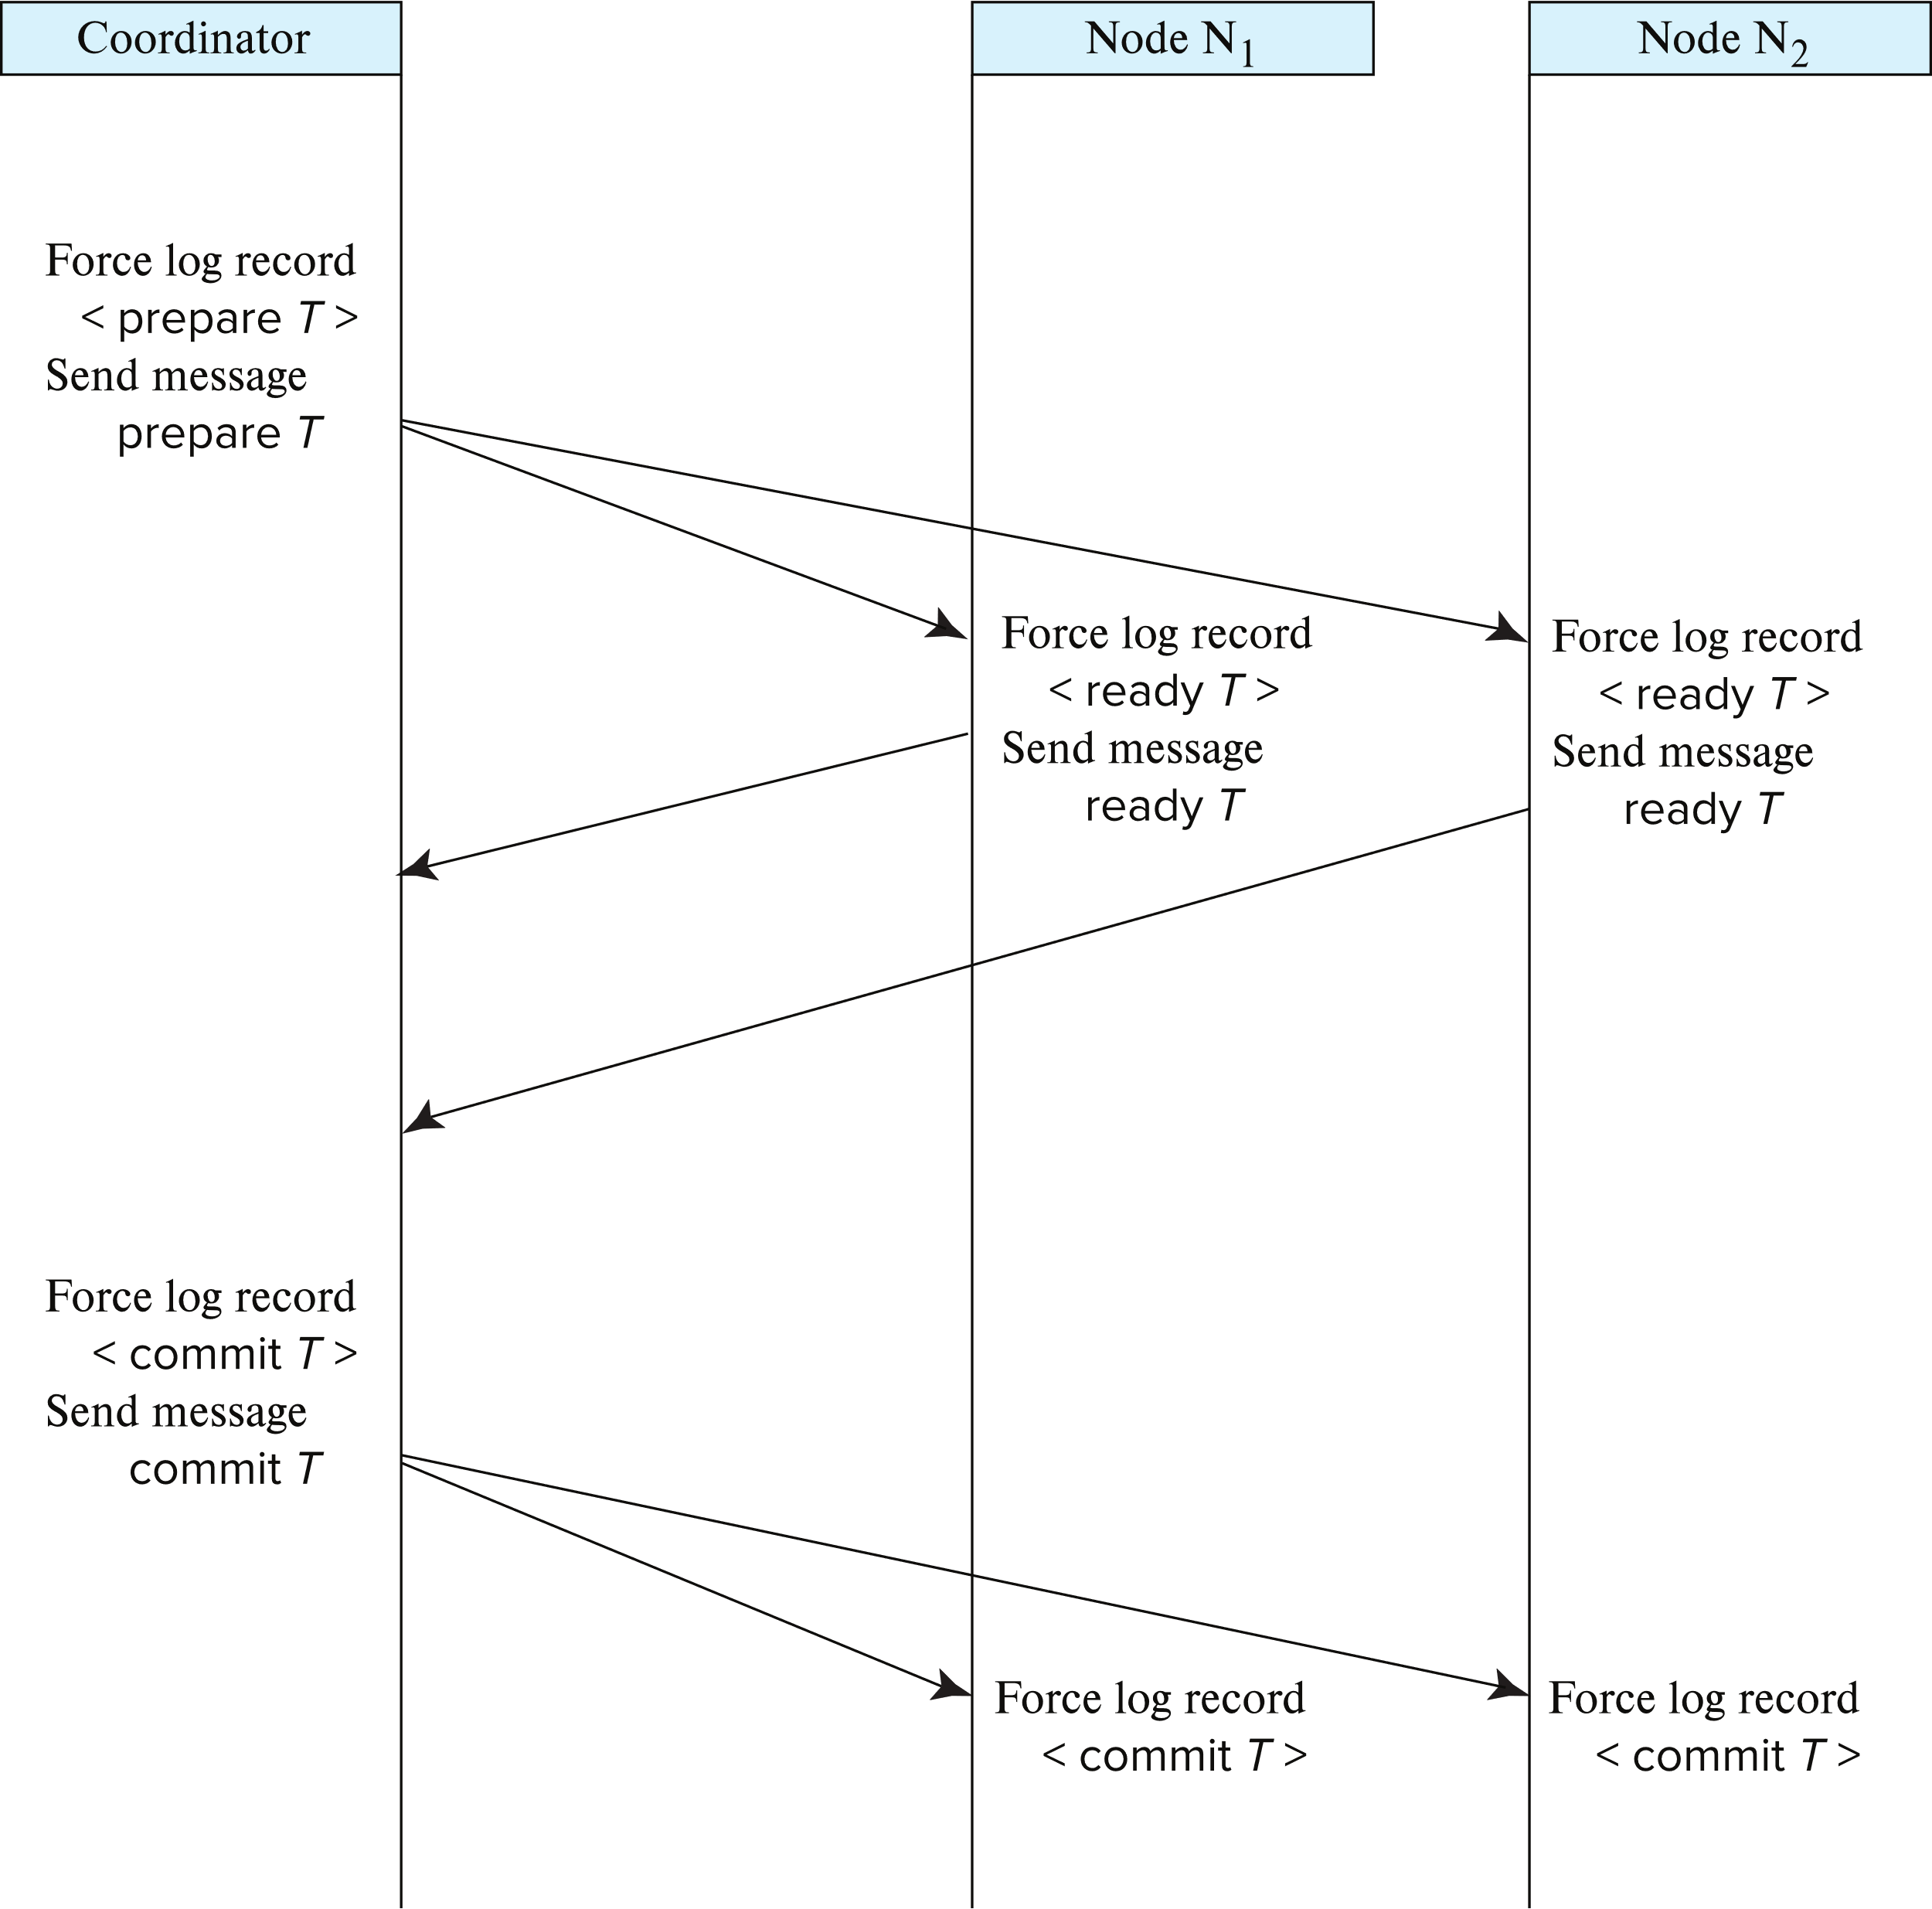
Two-Phase Commit Protocol

Slide 11
Handling of Failures - Site Failure
When site S_{k} recovers, it examines its log to determine the fate of
transactions active at the time of the failure.
Log contain <commit T> record: site executes redo (T)
Log contains <abort T> record: site executes undo (T)
Log contains <ready T> record: site must consult C_{i} to determine the fate of T.
If T committed, redo (T)
If T aborted, undo (T)
The log contains no control records concerning T implies that S_{k} failed before responding to the prepare T message from C_{i}
since the failure of S_{k} precludes the sending of such a response C_{i} must abort T
S_{k} must execute undo (T)

Slide 12
Handling of Failures- Coordinator Failure
If coordinator fails while the commit protocol for T is executing then participating sites must decide on T’s fate:
If an active site contains a <commit T> record in its log, then T must be committed.
If an active site contains an <abort T> record in its log, then T must be aborted.
If some active participating site does not contain a <ready T> record in its log, then the failed coordinator C_{i} cannot have decided to commit T. Can therefore abort T.
If none of the above cases holds, then all active sites must have a <ready T> record in their logs, but no additional control records (such as <abort T> of <commit T>). In this case active sites must wait for C_{i} to recover, to find decision.
Blocking problem: active sites may have to wait for failed coordinator to recover.

Slide 13
Handling of Failures - Network Partition
If the coordinator and all its participants remain in one partition, the failure has no effect on the commit protocol.
If the coordinator and its participants belong to several partitions:
Sites that are not in the partition containing the coordinator think the coordinator has failed, and execute the protocol to deal with failure of the coordinator.
No harm results, but sites may still have to wait for decision from coordinator.
The coordinator and the sites are in the same partition as the coordinator think that the sites in the other partition have failed, and follow the usual commit protocol.
Again, no harm results

Slide 14
Recovery and Concurrency Control
In-doubt transactions have a <ready T>, but neither a <commit T>, nor an <abort T> log record.
The recovering site must determine the commit-abort status of such transactions by contacting other sites; this can slow and potentially block recovery.
Recovery algorithms can note lock information in the log.
Instead of <ready T>, write out <ready T, L> L = list of locks held by T when the log is written (read locks can be omitted).
For every in-doubt transaction T, all the locks noted in the <ready T, L> log record are reacquired.
After lock reacquisition, transaction processing can resume; the commit or rollback of in-doubt transactions is performed concurrently with the execution of new transactions.

Slide 15
Avoiding Blocking During Consensus
Blocking problem of 2PC is a serious concern
Idea: involve multiple nodes in decision process, so failure of a few nodes does not cause blocking as long as majority don’t fail
More general form: distributed consensus problem
A set of n nodes need to agree on a decision
Inputs to make the decision are provided to all the nodes, and then each node votes on the decision
The decision should be made in such a way that all nodes will “learn” the same value for the even if some nodes fail during the execution of the protocol, or there are network partitions.
Further, the distributed consensus protocol should not block, as long as a majority of the nodes participating remain alive and can communicate with each other
Several consensus protocols, Paxos and Raft are popular
More later in this chapter

Slide 16
Using Consensus to Avoid Blocking
After getting response from 2PC participants, coordinator can initiate distributed consensus protocol by sending its decision to a set of participants who then use consensus protocol to commit the decision
If coordinator fails before informing all consensus participants
Choose a new coordinator, which follows 2PC protocol for failed coordinator
If a commit/abort decision was made as long as a majority of consensus participants are accessible, decision can be found without blocking
If consensus process fails (e.g., split vote), restart the consensus
Split vote can happen if a coordinator send decision to some participants and then fails, and new coordinator send a different decision
The three phase commit protocol is an extension of 3PC which avoids blocking under certain assumptions
Ideas are similar to distributed consensus.
Consensus is also used to ensure consistency of replicas of a data item
Details later in the chapter

Slide 17
Distributed Transactions via Persistent Messaging
Notion of a single transaction spanning multiple sites is inappropriate for many applications
E.g., transaction crossing an organizational boundary
Latency of waiting for commit from remote site
Alternative models carry out transactions by sending messages
Code to handle messages must be carefully designed to ensure atomicity and durability properties for updates
Isolation cannot be guaranteed, in that intermediate stages are visible, but code must ensure no inconsistent states result due to concurrency
Persistent messaging systems are systems that provide transactional properties to messages
Persistent messages are guaranteed to be delivered exactly once

Slide 18
Persistent Messaging
Example: funds transfer between two banks
Two phase commit would have the potential to block updates on the accounts involved in funds transfer
Alternative solution:
Debit money from source account and send a message to other site
Site receives message and credits destination account
Messaging has long been used for distributed transactions (even before computers were invented!)
Atomicity issue
once transaction sending a message is committed, message must guaranteed to be delivered
Guarantee as long as destination site is up and reachable, code to handle undeliverable messages must also be available
e.g., credit money back to source account.
If sending transaction aborts, message must not be sent

Slide 19
Error Conditions with Persistent Messaging
Code to handle messages has to take care of variety of failure situations (even assuming guaranteed message delivery)
E.g., if destination account does not exist, failure message must be sent back to source site
When failure message is received from destination site, or destination site itself does not exist, money must be deposited back in source account
Problem if source account has been closed
get humans to take care of problem
User code executing transaction processing using 2PC does not have to deal with such failures
There are many situations where extra effort of error handling is worth the benefit of absence of blocking
E.g., pretty much all transactions across organizations

Slide 20
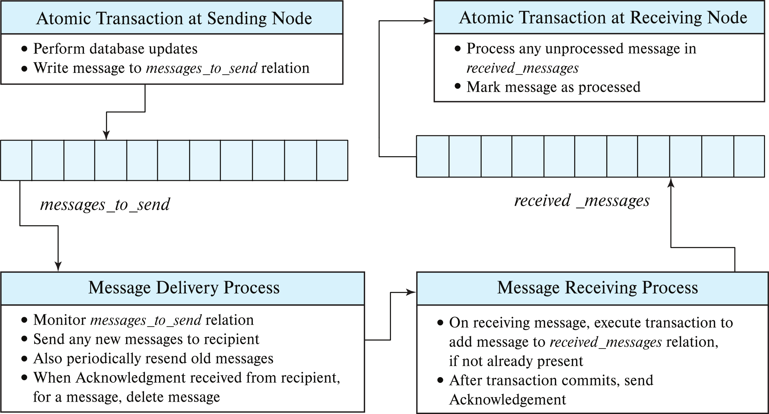
Persistent Messaging Implementation

Slide 21
Persistent Messaging (Cont.)
Receiving site may get duplicate messages after a very long delay
To avoid keeping processed messages indefinitely
Messages are given a timestamp
Received messages older than some cutoff are ignored
Stored messages older than the cutoff can be deleted at receiving site
Workflows provide a general model of transactional processing involving multiple sites and possibly human processing of certain steps
E.g., when a bank receives a loan application, it may need to
Contact external credit-checking agencies
Get approvals of one or more managers
and then respond to the loan application
Persistent messaging forms the underlying infrastructure for workflows in a distributed environment

Slide 22
Concurrency Control in Distributed Databases

Slide 23
Concurrency Control
Modify concurrency control schemes for use in distributed environment.
We assume that each site participates in the execution of a commit protocol to ensure global transaction atomicity.
We assume all replicas of any item are updated
Will see how to relax this in case of site failures later

Slide 24
Single-Lock-Manager Approach
In the single lock-manager approach, lock manager runs on a single chosen site, say S_{i}
All lock requests sent to central lock manager
The transaction can read the data item from any one of the sites at which a replica of the data item resides.
Writes must be performed on all replicas of a data item
Advantages of scheme:
Simple implementation
Simple deadlock handling
Disadvantages of scheme are:
Bottleneck: lock manager site becomes a bottleneck
Vulnerability: system is vulnerable to lock manager site failure.

Slide 25
Distributed Lock Manager
In the distributed lock-manager approach, functionality of locking is implemented by lock managers at each site
Lock managers control access to local data items
Locking is performed separately on each site accessed by transaction
Every replica must be locked and updated
But special protocols may be used for replicas (more on this later)
Advantage: work is distributed and can be made robust to failures
Disadvantage:
Possibility of a global deadlock without local deadlock at any single site
Lock managers must cooperate for deadlock detection

Slide 26
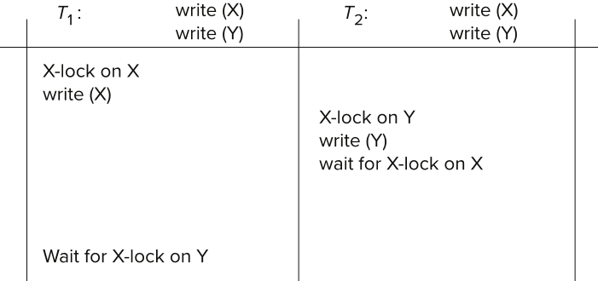
Deadlock Handling
Consider the following two transactions and history, with item X and transaction T₁ at site 1, and item Y and transaction T₂ at site 2:
Result: deadlock which cannot be detected locally at either site

Slide 27
Deadlock Detection
In the centralized deadlock-detection approach, a global wait-for graph is constructed and maintained in a single site; the deadlock-detection coordinator
Real graph: Real, but unknown, state of the system.
Constructed graph: Approximation generated by the controller during the execution of its algorithm .
the global wait-for graph can be constructed when:
a new edge is inserted in or removed from one of the local wait-for graphs.
a number of changes have occurred in a local wait-for graph.
the coordinator needs to invoke cycle-detection.
If the coordinator finds a cycle, it selects a victim and notifies all sites. The sites roll back the victim transaction.

Slide 28
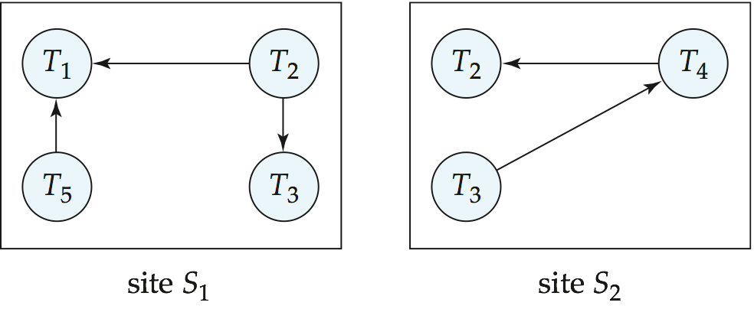
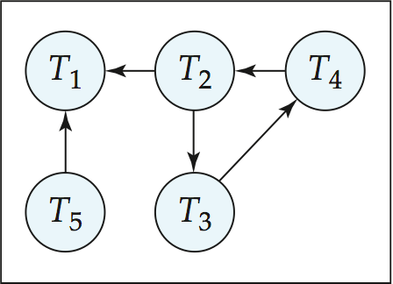
Local and Global Wait-For Graphs
Local
Global

Slide 29
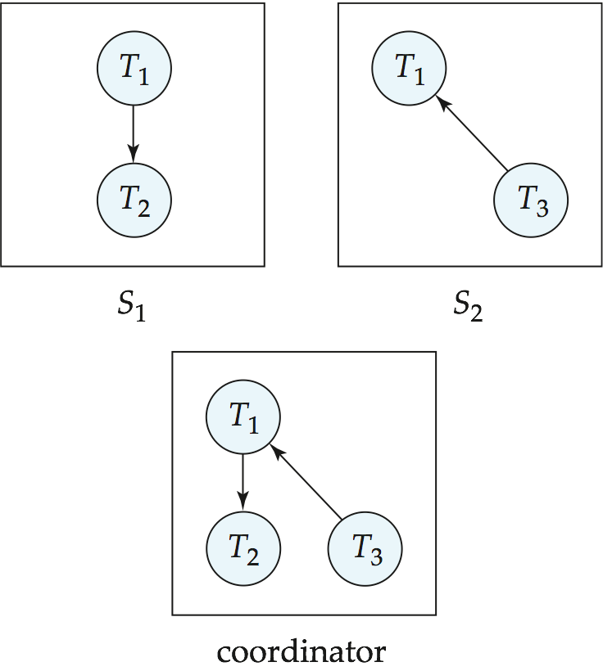
Example Wait-For Graph for False Cycles
Initial state:

Slide 30
False Cycles (Cont.)
Suppose that starting from the state shown in figure,
1. T₂ releases resources at S₁
resulting in a message remove T₁ → T₂ message from the Transaction Manager at site S₁ to the coordinator)
2. And then T₂ requests a resource held by T₃ at site S₂
resulting in a message insert T₂ → T₃ from S₂ to the coordinator
Suppose further that the insert message reaches before the delete message
this can happen due to network delays
The coordinator would then find a false cycle
T₁ → T₂ → T₃ → T₁
The false cycle above never existed in reality.
False cycles cannot occur if two-phase locking is used.

Slide 31
Distributed Deadlocks
Unnecessary rollbacks may result
When deadlock has indeed occurred and a victim has been picked, and meanwhile one of the transactions was aborted for reasons unrelated to the deadlock.
Due to false cycles in the global wait-for graph; however, likelihood of false cycles is low.
In the distributed deadlock-detection approach, sites exchange wait-for information and check for deadlocks
Expensive and not used in practice

Slide 32
Leases
A lease is a lock that is granted for a specific period of time
If a process needs a lock even after expiry of lease, process can renew the lease
But if renewal is not done before end time of lease, the lease expires, and lock is released
Leases can be used to that there is only one coordinator for a protocol at any given time
Coordinator gets a lease and renews it periodically before expire
If coordinator dies, lease will not be renewed and can be acquired by backup coordinator

Slide 33
Leases (Cont.)
Coordinator must check that it still has lease when performing action
Due to delay between check and action, must check that expiry is at least some time t’ into the future
t’ includes delay in processing and maximum network delay
Old messages must be ignored
Leases depend on clock synchronization

Slide 34
Distributed Timestamp-Based Protocols
Timestamp based concurrency-control protocols can be used in distributed systems
Each transaction must be given a unique timestamp
Main problem: how to generate a timestamp in a distributed fashion
Each site generates a unique local timestamp using either a logical counter or the local clock.
Global unique timestamp is obtained by concatenating the unique local timestamp with the unique identifier.

Slide 35
Distributed Timestamps
A node with a slow clock will assign smaller timestamps
Still logically correct: serializability not affected
But: “disadvantages” transactions
To fix this problem
Keep clocks synchronized using network time protocol
Or, define within each node N_{i} a logical clock (LC_{i}), which generates the unique local timestamp
Require that N_{i} advance its logical clock whenever a request is received from a transaction Ti with timestamp < x,y> and x is greater that the current value of LC_{i}.
In this case, site N_{i} advances its logical clock to the value x + 1

Slide 36
Distributed Timestamp Ordering
Centralized TSO and multiversion TSO easily extended to distributed setting
Transactions use a globally unique timestamp
Each site that performs a read or write performs same checks as in centralized case
Clocks at sites should be synchronized
Otherwise a transaction initiated at a site with a slower clock may get restarted repeatedly.

Slide 37
Distributed Validation
The validation protocol used in centralized systems can be extended to distributed systems
Start/validation/finish timestamp for a transaction T_{i} may be issued by any of the participating nodes
Must ensure StartTS(T_{i}) < TS(T_{i}) < FinishTS(T_{i})
Validation for T_{i} is done at each node that performed read/write
Validation checks for transaction T_{i} are same as in centralized case
Ensure that no transaction that committed after T_{i} started has updated any data item read by T_{i}.
A key difference from centralized case is that may T_{i} start validation after a transaction with a higher validation timestamp has already finished validation
In that case T_{i} is rolled back

Slide 38
Distributed Validation (Cont.)
Two-phase commit (2PC) needed to ensure atomic commit across sites
Transaction is validated, then enters prepared state
Writes can be performed (and transaction finishes) only after 2PC makes a commit decision
If transaction T_{i} is in prepared state, and another transaction T_{k} reads old value of data item written by T_{i}, T_{k} will fail if T_{i} commits
Can make the read by T_{k} wait, or create a commit dependency for T_{k} on T_{i}.

Slide 39
Distributed Validation (Cont.)
Distributed validation is not widely used, but optimistic concurrency control without read-validation is widely used in distributed settings
Version numbers are stored with data items
Writes performed at commit time ensure that the version number of a data item is same as when data item was read
Hbase supports atomic checkAndPut() as well as checkAndMutate() operations; see book for details

Slide 40
Replication

Slide 41
Replication
High availability is a key goal in a distributed database
Robustness: the ability to continue function despite failures
Replication is key to robustness
Replication decisions can be made at level of data items, or at the level of partitions

Slide 42
Consistency of Replicas
Consistency of replicas
Ideally: all replicas should have the same value ➔ updates performed at all replicas
But what if a replica is not available (disconnected, or failed)?
Suffices if reads get correct value, even if some replica is out of date
Above idea formalized by linearizability: given a set of read and write operations on a (replicated) data item
There must be a linear ordering of operations such that each read sees the value written by the most recent preceding write
If o₁ finishes before o₂ begins (based on external time), then o₁ must precede o₂ in the linear order
Note that linearizability only addresses a single (replicated) data item; serializability is orthogonal

Slide 43
Consistency of Replicas
Cannot differentiate node failure from network partition in general
Backup coordinator should takeover if primary has failed
Use multiple independent links, so single link failure does not result in partition, but it is possible all links have failed
Protocols that require all copies to be updated are not robust to failure
Will see techniques that can allow continued processing during failures, whether node failure or network partition
Key idea: decisions made based on successfully writing/reading majority
Alternative: asynchronous replication: commit after performing update on a primary copy of the data item, and update replicas asynchronously
Lower overheads, but risk of reading stale data, or lost updates on primary failure

Slide 44
Concurrency Control With Replicas
Focus here on concurrency control with locking
Failures addressed later
Ideas described here can be extended to other protocols
Primary copy
one replica is chosen as primary copy for each data item
Node containing primary replica is called primary node
concurrency control decisions made at the primary copy only
Benefit: Low overhead
Drawback: primary copy failure results in loss of lock information and non-availability of data item, even if other replicas are available
Extensions to allow backup server to take over possible, but vulnerable to problems on network partition

Slide 45
Concurrency Control With Replicas (Cont.)
Majority protocol:
Transaction requests locks at multiple/all replicas
Lock is successfully acquired on the data item only if lock obtained at a majority of replicas
Benefit: resilient to node failures and node failures
Processing can continue as long as at least a majority of replicas are accessible
Overheads
Higher cost due to multiple messages
Possibility of deadlock even when locking single item
How can you avoid such deadlocks?

Slide 46
Concurrency Control With Replicas (Cont.)
Biased protocol
Shared lock can be obtained on any replica
Reduces overhead on reads
Exclusive lock must be obtained on all replicas
Blocking if any replica is unavailable

Slide 47
Quorum Consensus Protocol
Quorum consensus protocol for locking
Each site is assigned a weight; let S be the total of all site weights
Choose two values read quorum Q_{R} and write quorum Q_{W}
Such that Q_{r} + Q_{w} > S and 2 * Q_{w} > S
Each read must lock enough replicas that the sum of the site weights is ≥ Q_{r}
Each write must lock enough replicas that the sum of the site weights is ≥ Q_{w}
Can choose Q_{r} and Q_{w} to tune relative overheads on reads and writes
Suitable choices result in majority and biased protocols.
What are they?

Slide 48
Dealing with Failures
Read one write all copies protocol assumes all copies are available
Will block if any site is not available
Read one write all available (ignoring failed sites) is attractive, but incorrect
Failed link may come back up, without a disconnected site ever being aware that it was disconnected
The site then has old values, and a read from that site would return an incorrect value
With network partitioning, sites in each partition may update same item concurrently
believing sites in other partitions have all failed

Slide 49
Handling Failures with Majority Protocol
The majority protocol with version numbers
Each replica of each item has a version number
Locking is done using majority protocol, as before, and version numbers are returned along with lock allocation
Read operations read the value from the replica with largest version number
Write operations
Find highest version number like reads, and set new version number to old highest version + 1
Writes are then performed on all locked replicas and version number on these replicas is set to new version number
Read operations that find out-of-date replicas may optionally write the latest value and version number to replicas with lower version numbers
no need to obtain locks on all replicas for this task
Notes:
Updated of version by reads needs some local concurrency control. What is required?

Slide 50
Handling Failures with Majority Protocol
Atomic commit of updated replicas must be ensured using either
2 phase commit on all locked replicas, or
distributed consensus protocol such as Paxos (more on this later)
Failure of nodes during 2PC can be ignored as long as majority of sites enter prepared state
Failure of coordinator can cause blocking
Consensus protocols can avoid blocking

Slide 51
Handling Failures with Majority Protocol
Benefits of majority protocol
Failures (network and site) do not affect consistency
Reads are guaranteed to see latest successfully written version of a data item
Protocol can proceed as long as
Sites available at commit time contain a majority of replicas of any updated data items
During reads a majority of replicas are available to find version numbers
No need for any special reintegration protocol: nothing needs to be done if nodes fail and subsequently recover
Drawback of majority protocol
Higher overhead, especially for reads

Slide 52
Reducing Read Cost
Quorum consensus can be used to reduce read cost
But at increased risk of blocking of writes due to failures
Use primary copy scheme:
perform all updates at primary copy
reads only need to be done at primary copy
But what if primary copy fails
Need to ensure new primary copy is chosen
Leases can ensure there is only 1 primary copy at a time
New primary copy needs to have latest committed version of data item
Can use consensus protocol to avoid blocking

Slide 53
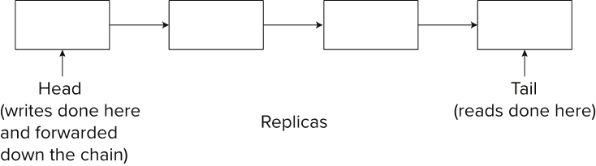
Reducing Read Cost
Chain replication:
Variant of primary copy scheme
Replicas are organized into a chain
Writes are done at head of chain, and passed on to subsequent replicas
Reads performed at tail
Ensures that read will get only fully replicated copy
Any node failure requires reconfiguration of chain
Notes:
Extra figure, not in book

Slide 54
Reconfiguration and Reintegration
To be robust, a distributed system must either
Follow protocols like the majority protocol that work in spite of failures or
Use other protocols like primary copy protocol, but
Detect failures (failed/non-reachable nodes)
Reconfigure the system to remove failed nodes, and assign their tasks to other sites, so computation may continue
Recover/reintegrate nodes a node or link is repaired
Failure detection: distinguishing link failure from site failure is hard
(partial) solution: have multiple links, multiple link failure is likely a site failure

Slide 55
Reconfiguration
Reconfiguration:
Abort all transactions that were active at a failed site
If replicated data items were at failed site, update system catalog to remove them from the list of replicas.
This should be reversed when failed site recovers, but additional care needs to be taken to bring values up to date
If a failed site was a central server for some subsystem, an election must be held to determine the new server
E.g., name server, concurrency coordinator, global deadlock detector

Slide 56
Reconfiguration (Cont.)
Since network partition may not be distinguishable from site failure, the following situations must be avoided
Two or more central servers elected in distinct partitions
More than one partition updates a replicated data item
Updates must be able to continue even if some sites are down
Solution: majority based approach

Slide 57
Site Reintegration
When failed site recovers, it must catch up with all updates that it missed while it was down
Problem: updates may be happening to items whose replica is stored at the site while the site is recovering
Solution 1: halt all updates on system while reintegrating a site
Unacceptable disruption
Solution 2: lock all replicas of all data items at the site, update to latest version, then release locks
Can do this for one partition at a time

Slide 58
Comparison with Remote Backup
Remote backup systems (Section 19.7) are also designed to provide high availability
Remote backup systems are simpler and have lower overhead
All actions performed at a single site, and only log records shipped
No need for distributed concurrency control, or 2 phase commit
Using distributed databases with replicas of data items can provide higher availability by having multiple (> 2) replicas and using the majority protocol
Also avoid failure detection and switchover time associated with remote backup systems

Slide 59
Extended Concurrency Control Protocols

Slide 60
Multiversion 2PL and Globally Consistent Timestamps
Recall multiversion 2PL protocol:
Read only transactions get timestamp at start
T_{i} reads latest committed version of data items with TS < startTS(T_{i})
Update transactions perform 2PL, and also get timestamp at commit
Serialization order defined by timestamp
Question: can we use MV2PL in a distributed system
Answer: yes, but a lot of conditions apply
If commits are serialized at central coordinator, timestamps can be given based on counter
But if commits are distributed, how to give timestamps in a consistent manner?
Clocks may not be in sync, later commit may get lower timestamp
Out of order timestamp issual may result in serialization order not matching timestamp order

Slide 61
Multiversion 2PL and Globally Consistent Timestamps
Centralized coordinator to assign consistent timestamps
Can be done, but becomes bottleneck
Google Spanner ideas:
In an ideal world, clocks are synchronized, and can be used to assign commit timestamps to transactions
In reality, clocks are out of sync
Key ideas
Use atomic clocks, GPS etc to periodically get precise time
Derive bound on how out-of-sync a node’s clock t’ can be w.r.t. to actual time t
t’ – ε ≤ t ≤ t’ + ε
Introduce commit wait: hold locks for some period and assign timestamp ts such that locks were definitely held at actual time ts

Slide 62
Multiversion 2PL and Globally Consistent Timestamps
Google Spanner ideas (cont):
If version of x has timestamp ts, then x definitely had that value at time ts
System can generate transactionally consistent snapshop as of actual time ts (external consistency)
Commit processing can still take time
With 2PC status of transaction may not be known for a while
Reads may have to wait till status of transaction is known
But read-only transactions can use a snapshot timestamp ts such that all transactions before that timestamp have been committed or aborted
Read can proceed without waiting
But perhaps with older versions of data

Slide 63
Other Concurrency Control Techniques
Distributed snapshot isolation
Running Snapshot Isolation separately on each node may result in different serialization orders at different nodes
Extensions to SI to ensure consistent ordering have been proposed
Concurrency control in federated databases
Local transactions
Global transactions
Local serializability may not guarantee global serializability unless all nodes use 2PL
Use idea of tickets to create conflicts that will ensure serializability

Slide 64
Replication With Weak Degrees of Consistency

Slide 65
Consistency
Recall: Consistency in Databases (ACID):
Database has a set of integrity constraints
A consistent database state is one where all integrity constraints are satisfied
Each transaction run individually on a consistent database state must leave the database in a consistent state
Recall: Consistency in distributed systems with replication
Strong consistency: a schedule with read and write operations on an object should give results and final state equivalent to some schedule on a single copy of the object, with order of operations from a single site preserved
Weak consistency (several forms)

Slide 66
Availability
Traditionally, availability of centralized server
For distributed systems, availability of system to process requests
For large system, at almost any point in time there’s a good chance that
a node is down or even
Network partitioning
Availability: ability to continue operations despite node and network failures.

Slide 67
CAP “Theorem”
Three properties of a system
Consistency
an execution of a set of operations (reads and writes) on replicated data is said to be consistent if its result is the same as if the operations were executed on a single node, in a sequential order that is consistent with the ordering of operations issued by each process (transaction)
Availability (system can run even if parts have failed)
Via replication
Partitions (network can break into two or more parts, each with active systems that can’t talk to other parts)
Brewer’s CAP “Theorem”: You can have at most two of these three properties for any system

Slide 68
CAP “Theorem” (Cont.)
Very large systems will partition at some point
Choose one of consistency or availability
Traditional database choose consistency
Many web applications choose availability
Except for specific parts such as order processing
Latency is another factor
Many applications choose to serve potentially stale data to reduce latency

Slide 69
Replication with Weak Consistency
Many systems support replication of data with weak degrees of consistency (I.e., without a guarantee of serializabiliy)
In quorum consistency notation: allow Q_{R} and Q_{W} to be set such that Q_{R} + Q_{W} ≤ S or 2*Q_{W} ≤ S
E.g., can be set in MongoDB and Cassandra
Usually only when not enough sites are available to ensure quorum
But sometimes to allow fast local reads
Tradeoff of consistency versus availability or latency
Key issues:
Reads may get old versions
Some replicas may not get updated
Different updates may be applied to different replicas
Question: how to detect, and how to resolve
Will see in detail later

Slide 70
Eventual Consistency
When no updates occur for a long period of time, eventually all updates will propagate through the system and all the nodes will be consistent
For a given accepted update and a given node, eventually either the update reaches the node or the node is removed from service
Known as BASE (Basically Available, Soft state, Eventual consistency), as opposed to ACID
Soft state: copies of a data item may be inconsistent
Eventually Consistent : Copies may be allowed to become inconsistent, but (once partitioning is resolved) eventually all copies become consistent with each other
at some later time, if there are no more updates to that data item

Slide 71
Asynchronous Replication
With asynchronous replication, updates are done at the primary node (also known as master node), and then propagated to replicas
Transaction can commit once update is done at primary node
Propagation after commit is also referred to as lazy propagation
Allows updates to occur even if some sites are disconnected from the network, but at the cost of consistency
Replicas may not be up-to-date
Transactions that can live with old data can read from replicas
Snapshot reads at a point in time can also be served from replicas that are sufficiently up-to-date
E.g., in Google Spanner
each replica maintains a timestamp t_{safe} such that all updates with timestamp t < t_{safe} have already been received
Reads of a transaction can be satisfied by a replicate if transaction timestamp t < t_{safe}

Slide 72
Asynchronous Replication
Master-slave replication: updates performed only at master, and asynchronously propagated to replicas
replicas can only satisfy reads
Multimaster replication (or update-anywhere replication): updates can be performed at any replica, and propagated synchronously or asynchronously to other replicas
Updates must be propagated to replicas even if there are failures, and processed in the correct order at the replicas
Persistent messaging systems can be used for this, with minor extensions to ensure in-order delivery
Publish-subscribe systems such as Kafka can also be used for this task
More flexible, support parallelism by having multiple topics and partitions of topics
Fault-tolerance is important
Can use log-replication with two-safe protocol (Section 19.7)

Slide 73
Asynchronous View Maintenance
Materialized views can be useful in distributed systems
Secondary indices can be considered as a simple form of materialized view in a parallel database
E.g., given relation r(A,B,C) where A is the primary key on which r is partitioned, a secondary index on B is simply a projection of r on (B,A), partitioned on B.
Materialized aggregate views are also very useful in many contexts
Performing view maintenance as part of the original transaction may not be possible (if the underlying database does not support distributed transactions), or may be expensive
Asynchronous maintenance of materialized views, after the original transaction commits, is a good option in such a case
Applications using the view/index must then be aware that it may be a little out-of-date

Slide 74
Requirements for Asynchronous View Maintenance
Requirements:
1. Updates must be delivered and processed exactly once despite failures
2. Derived data (such as materialized views/indices) must be updated in
such a way that it will be consistent with the underlying data
Formalized as eventual consistency: if there are no updates for a while, eventually the derived data will be consistent with the underlying data
3. Queries should get a transactionally consistent view of derived data
Potentially a problem with long queries that span multiple nodes
E.g., without transactional consistency, a scan of relation may miss some older updates and see some later updates
Not supported by many systems, supported via snapshots in some systems

Slide 75
Detecting Inconsistency
Data items are versioned
Each update creates a new immutable version
In absence of failure, there is a single latest version
But with failures and weak consistency, versions can diverge
Different nodes may perform different updates on same data
Need to detect, and fix such situations
Key idea: vector-vector identifies each data version
Set of (node, counter) pairs
E.g., with two nodes N1 and N2, ([N1,2],[N2,1])
Represented as a vector [2, 1]
An update to a data item at a node increments the counter for that node
Define a partial order across versions

Slide 76
Vector Vectors
Examples of vector vectors
([Sx,1]): data item created by site Sx
([Sx,2]): data item created by site Sx, and later updated
([Sx,2],[Sy,1]): data item updated twice by site Sx and once by Sy
Update by a site Sx increments the counter for Sx, but leaves counters from other sites unchanged
([Sx,4],[Sy,1]) newer than ([Sx,3],[Sy,1])
But ([Sx,2],[Sy,1]) incomparable with ([Sx,1],[Sy,2])
Read operation may find incomparable versions
Such versions indicate inconsistent concurrent updates
All such versions returned by read operation
Up to application to reconcile multiple versions

Slide 77
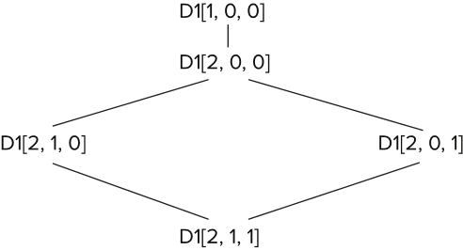
Example of Vector Clock in action
Item D1 created by Node N1
D1 updated by Node N1
D1 concurrently updated by node N2 and N3 (usually due to network partitioning)
Subsequent read from N2 and N3 returns two incomparable versions
Application merges versions and writes new version

Slide 78
Extensions for Detecting Inconsistency
Two replicas may diverge, and divergence is not detected until the replicas is read
To detect divergence early, one approach is to scan all replicas of all items periodically
But requires a lot of network, CPU and I/O load
Alternative approach based on Merkle trees covered shortly

Slide 79
How to Reconcile Inconsistent Versions?
Reconciliation is application specific
E.g., two sites concurrent insert items to cart
Merge adds both items to the final cart state
E.g., S1 adds item A, S2 deletes item B
Merge adds item A, but deleted item B resurfaces
Cannot distinguish S2 deletes B from S1 add B
Problem: operations are inferred from states of divergent versions
Better alternative:
Keep track of history of operations
Merge operation histories

Slide 80
Order Independent Operations
Basic idea: updates are performed as logical operations
Data store is aware of the set of operations that can be carried out
Operation performed at place where data (replica) is stored
If result of a sequence of operations is independent of the operation ordering
Independent update operations can be merged in different orders at different replicas, but will lead to same result
Eventual consistency can be ensured relatively easily

Slide 81
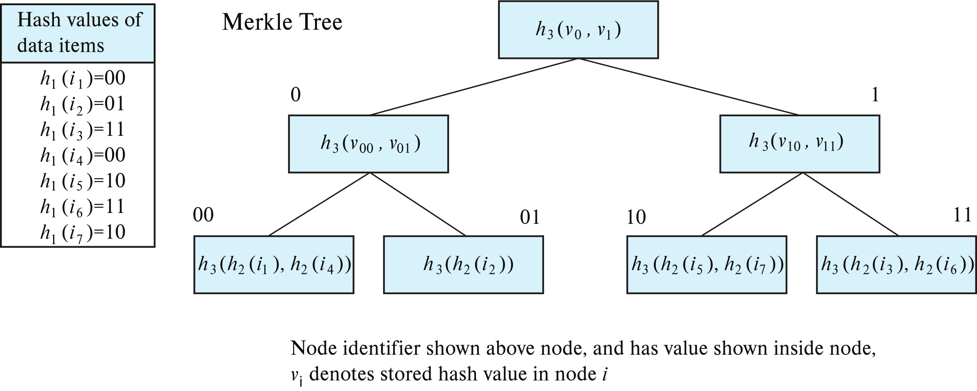
Detecting Differences Using Merkle Trees
Merkle Tree: A data structure that can
Efficiently sign contents of a tree
Efficiently find differences (if any) between two replicas
Example

Slide 82
Detecting Differences Using Merkle Trees (Cont.)
Overall cost of finding differences with Merkle tree
O(m log₂ N) with N data items and m differences using binary tree
Each operation requires communication between the two trees (nodes)
Use wider trees to reduce height/cost
Cost is O(m log_{K} N) if each node has K children instead of 2 children
Particularly important due to high network latency
Merkle trees originally used for verification of contents of a collection
Include digital signature at root in this case.

Slide 83
Weak Consistency Models for Applications
Read-your-writes
if a process has performed a write, a subsequent read will reflect the earlier write operation
Session consistency
Read-your-writes in the context of a session, where application connects to storage system
Monotonic consistency
For reads: later reads never return older version than earlier reads
For writes: serializes writes by a single process
Minimum requirement
Sticky sessions: all operations from a session on a data item go to the same node
Can be implemented by specifying a version vector in get() operations
Result of get guaranteed to be at least as new as specified version vector
Notes:
Extra material, not in book

Slide 84
Coordinator Selection

Slide 85
Coordinator Selection
Backup coordinators
Backup coordinator maintains enough information locally to assume the role of coordinator if the actual coordinator fails
executes the same algorithms and maintains the same internal state information as the actual coordinator
allows fast recovery from coordinator failure but involves overhead during normal processing.
Backup coordinator approach vulnerable to two-site failure
Failure of coordinator and backup leads to non-availability
Key question: how to choose a new coordinator from a set of candidates
Choice done by a master: vulnerable to master failure
Election algorithms are key

Slide 86
Coordinator Selection
Coordinator selection using a fault-tolerant lock manager
Coordinator gets a lease on a coordinator lock, and renews the lease as long as it is alive
If coordinator dies or gets disconnected, lease is losk
Other nodes can detect coordinator failure using heart-beat messages
Nodes request coordinator lock lease from lock manager; only 1 node gets the lease, and becomes new coordinator
Fault-tolerant coordination services such as ZooKeeper, Chubby
Provide fault-tolerant lock management services
And are widely used for coordinator section
Store (small amounts) of data in files
Create and delete files
Which can be used as locks/leases
Coordinator releases lease if it is not renewed in time
Can watch for changes on a file
But these services themselves need a coordinator……..

Slide 87
Election of Coordinator
Election algorithms
Used to elect a new coordinator in case of failures
Heartbeat messages used to detect failure of coordinator
One-time election protocol
Proposers: Nodes that propose themselves as coordinator and send vote requests to other nodes
Acceptors: Nodes that can vote for candidate proposers
Learners: Nodes that ask acceptors who they voted for, to find winner
A node can perform all above roles
Problems with this protocol
What if no one won the election due to split vote?
If election is rerun, need to identify which election a request is for
General approach
Candidates make a proposal with a term number
Term number is 1 more than term number of previous election known to candidate

Slide 88
Election of Coordinator
Election algorithms (Cont.)
Stale messages corresponding to old terms can be ignored
If a candidate wins majority vote it becomes coordinator
Otherwise election is rerun with term number incremented
Minimizing chances of split elections:
Use node IDs to decide who to vote for
e.g., max node ID (Bully algorithm)
Candidates withdraw if they find another candidate with higher ID
Randomized retry: candidates wait for random time intervals before retrying
High probability that only one node is asking to be elected at a time
Special case of distributed consensus

Slide 89
Issues with Multiple Coordinators
Coordinator may get disconnected, and new coordinator elected, without old coordinator ever knowing about the election
Multiple nodes may thus believe they are coordinators
Called a split-brain situation
Solutions:
Term numbers can be used to identify coordinator
Majority of node will know of latest coordinator term since they voted for it
Messages with old term number (stale messages) can be ignored
Leases can be used to ensure only one coordinator at a time
Delayed messages may still be received from old coordinator
Term numbers can be used to ignore such delayed messages

Slide 90
Distributed Consensus

Slide 91
Distributed Consensus
Motivating example: commit decision in two-phase commit (2PC)
Decision made by coordinator alone: vulnerable to blocking problem
If coordinator fails/gets disconnected at certain key points, rest of system does not know if the decision was to commit/abort, and must block till coordinator recovers
Multiple nodes must participate in decision process to ensure fault tolerance
Although initial proposal for decision may be made by a single node
Goal: A decision making protocol that is non-blocking as long as a majority of participating nodes are up and reachable
2PC is a special case of a more general class of decision problems that must be made by a collection of nodes in a fault-tolerant, non-blocking manner

Slide 92
Distributed Consensus
Distributed consensus problem: A set of n nodes (called participants) need to agree on a decision by executing a protocol such that
All participants “learn” the same value for the decision
even if some nodes fail during the execution of the protocol, messages are lost, or there are network partitions
The protocol should not block, and must terminate, as long as some majority of nodes are alive and can communicate with each other

Slide 93
Distributed Consensus: Overview
An real system needs to make a series of decisions: multiple consensus protocol
Problem can be abstracted as adding a record to a log
Each node has a copy of the log, and log records are appended at each node
Potential for conflicts between the nodes on what record is appended at what point in the log
The multiple consensus protocol must ensure that the log is uniquely defined
Copies of the log may temporarily differ, but must be made consistent subsequently
May require deleting parts of the log on a node
Actions can be taken on a log record only after consensus has been reached for that position in the log

Slide 94
Distributed Consensus: Overview (Cont.)
Several protocols proposed
We outline key ideas behind Paxos and Raft
The Zab protocol used in ZooKeeper is another widely used consensus protocol
Key idea: voting to make a decision
A particular decision succeeds only if a majority of the participating nodes have voted for it
Prevents more than one decision being chosen in a round
If majority of nodes are up and agree on a decision voting will not block
But devil in the details!

Slide 95
Paxos Consensus Protocol
Assume a collection of processes that can propose values
Different processes may propose different values
Proposals are sent to acceptors which collectively choose from among the proposals
A single execution of a distributed consensus protocol must ensure that:
At most a single value from amongst those proposed is chosen collectively by the acceptors
If a value has been chosen, then learner processes should be able to learn the chosen value
In case no value is chosen (split-voting), protocol reexecutes
Protocol should not block, and must terminate, as long as some majority of the nodes participating remain alive and can communicate with each other

Slide 96
Consensus Protocols
Paxos family of consensus protocols
Basic Paxos: consensus on one single decision
Multi-Paxos: sequence of consensus decisions
Performance issues
Fully distributed decision making has a much higher cost than centralized decision making
Variants of Paxos optimized for common case where there are no failures
But work correctly even if there are failures
Paxos algorithms are hard to understand
RAFT consensus algorithm
Simpler algorithm, designed to be easy to understand
Optimized for common case where there is no failure

Slide 97
Paxos Consensus Protocol: Overview
Key idea: Consensus is reached when a majority of acceptors have accepted a particular proposal
Learner finds what value (if any) was accepted by a majority of acceptors
If a majority vote for a particular value, all is fine, BUT
Vote may get split, requiring further rounds to reach a majority
Worse, even if a majority accept a value (and even if a learner learns of the majority), some of the acceptors (and the learner) may die or get disconnected
Remaining nodes may not be a majority
If this is treated as failure and another round is run, a different proposal may get accepted, with different learners learning different values!
Once acceptor has voted for a particular proposal in a round, it cannot change its mind for that round
Decision must be logged to ensure no change in decision if acceptor dies and comes back up

Slide 98
Paxos: Overview
To deal with split vote Paxos uses a coordinator
Proposals serialized through coordinator, so only one value is typically proposed in a round
Paxos works correctly (but less efficiently) even if there are multiple coordinators
Coordinator can be elected
Different values getting majorities in different nodes is a more serious problem. To solve it further rounds should give same result.
Key idea:
Each proposal in Paxos has a unique number
Acceptors accept highest numbered proposal received in a round
Proposers will not create new proposals with a different number
Two phase protocol

Slide 99
Paxos Made Simple
Phase 1
Phase 1a: A proposer selects a proposal number n and sends a prepare request with number n to a majority of acceptors
Number has to be chosen in some unique way
Phase 1b: If an acceptor receives a prepare request with number n
If n is less than that of any prepare request to which it has already responded then it ignores the request
Else it remembers n and responds to the request
If it has already accepted a proposal with number m and value v, it sends (m, v) with the response
Otherwise it indicates to the proposer that it has not accepted any value earlier
NOTE: responding is NOT the same as accepting

Slide 100
Paxos Made Simple
Phase 2
Phase 2a: Proposer Algorithm: If the proposer receives a response to its prepare requests (numbered n) from a majority of acceptors
then it sends an accept request to each of those acceptors for a proposal numbered n with a value v, where v is
the value selected by the proposer if none of the acceptors indicated it had already accepted a value.
Otherwise v is the value of the highest-numbered proposal among the responses
i.e., proposer backsoff from its own proposal and votes for highest numbered proposal already accepted by at least one acceptor
If proposer does not hear from a majority it takes no further action in this round

Slide 101
Paxos Made Simple
Phase 2
Phase 2b: Acceptor Algorithm: If an acceptor receives an accept request for a proposal numbered n,
If it has earlier responded to a prepare message with number n1 > n it ignores the message
Otherwise it accepts the proposed value v with number n.
Note: acceptor may accept different values with increasing n

Slide 102
Paxos Details
Key idea: if a majority of acceptors accept a value v (with number n), then even if there are further proposals with number n1 > n, the value proposed will be value v
Why?:
A value can be accepted with number n only if a majority of nodes (say P) respond to a prepare message with number n
Any subsequent majority (say A) will have nodes in common with the first majority P, and at least one of those nodes would have responded with value v and number n
If a higher numbered proposal p was accepted earlier by even one node majority would have responded to p, and will ignore n
Further rounds will use this value v (since highest accepted value is used in Phase 2a)

Slide 103
Paxos Details (Cont.)
At end of phase 2, it is possible that there is no majority have agreed on a value
Learners that believe majority was not reached can initiate a fresh proposal
If majority had actually been reached, same value will be chosen again
Many more details under cover
Above is for a single decision. Multi-Paxos: extension which deals with a series of decisions
Many variants of Paxos optimized for different scenarios

Slide 104
The Raft Consensus Protocol

Slide 105
The Log-Based Consensus Protocols
Fault-tolerant log, to which records are appended
Each participating node maintains a replica of a log
Key goal: keep the log replicas in sync
Logical view of atomically appending records to all copies of the log
Can’t actually be done atomically; logs may diverge
Consensus protocols must ensure
Even if a log replica is temporarily inconsistent with another, it will be brought back to sync
May require log deletion and replacement
A log entry will not be treated as committed until the algorithm guarantees that it will never be deleted

Slide 106
The Raft Consensus Algorithm
Raft is based on having a coordinator, called a leader
Essential in Raft, unlike Paxos, where coordinator is an optimization
Other nodes are called followers
Leaders may die and get replaced
Time divided into terms, each term has a unique leader
Terms have increasing numbers

Slide 107
The Raft Leader Election
Leaders are elected using randomized retry algorithm outlined in Section 23.7.2
Recall that algorithm already uses notion of term
Voting is done for a specific term
Can change in another term
Nodes track currentTerm based on messages received
Leader N1 may get disconnected and get reconnected after new leader N2 is elected
N1 may not even know it was disconnected and may continue leader actions

Slide 108
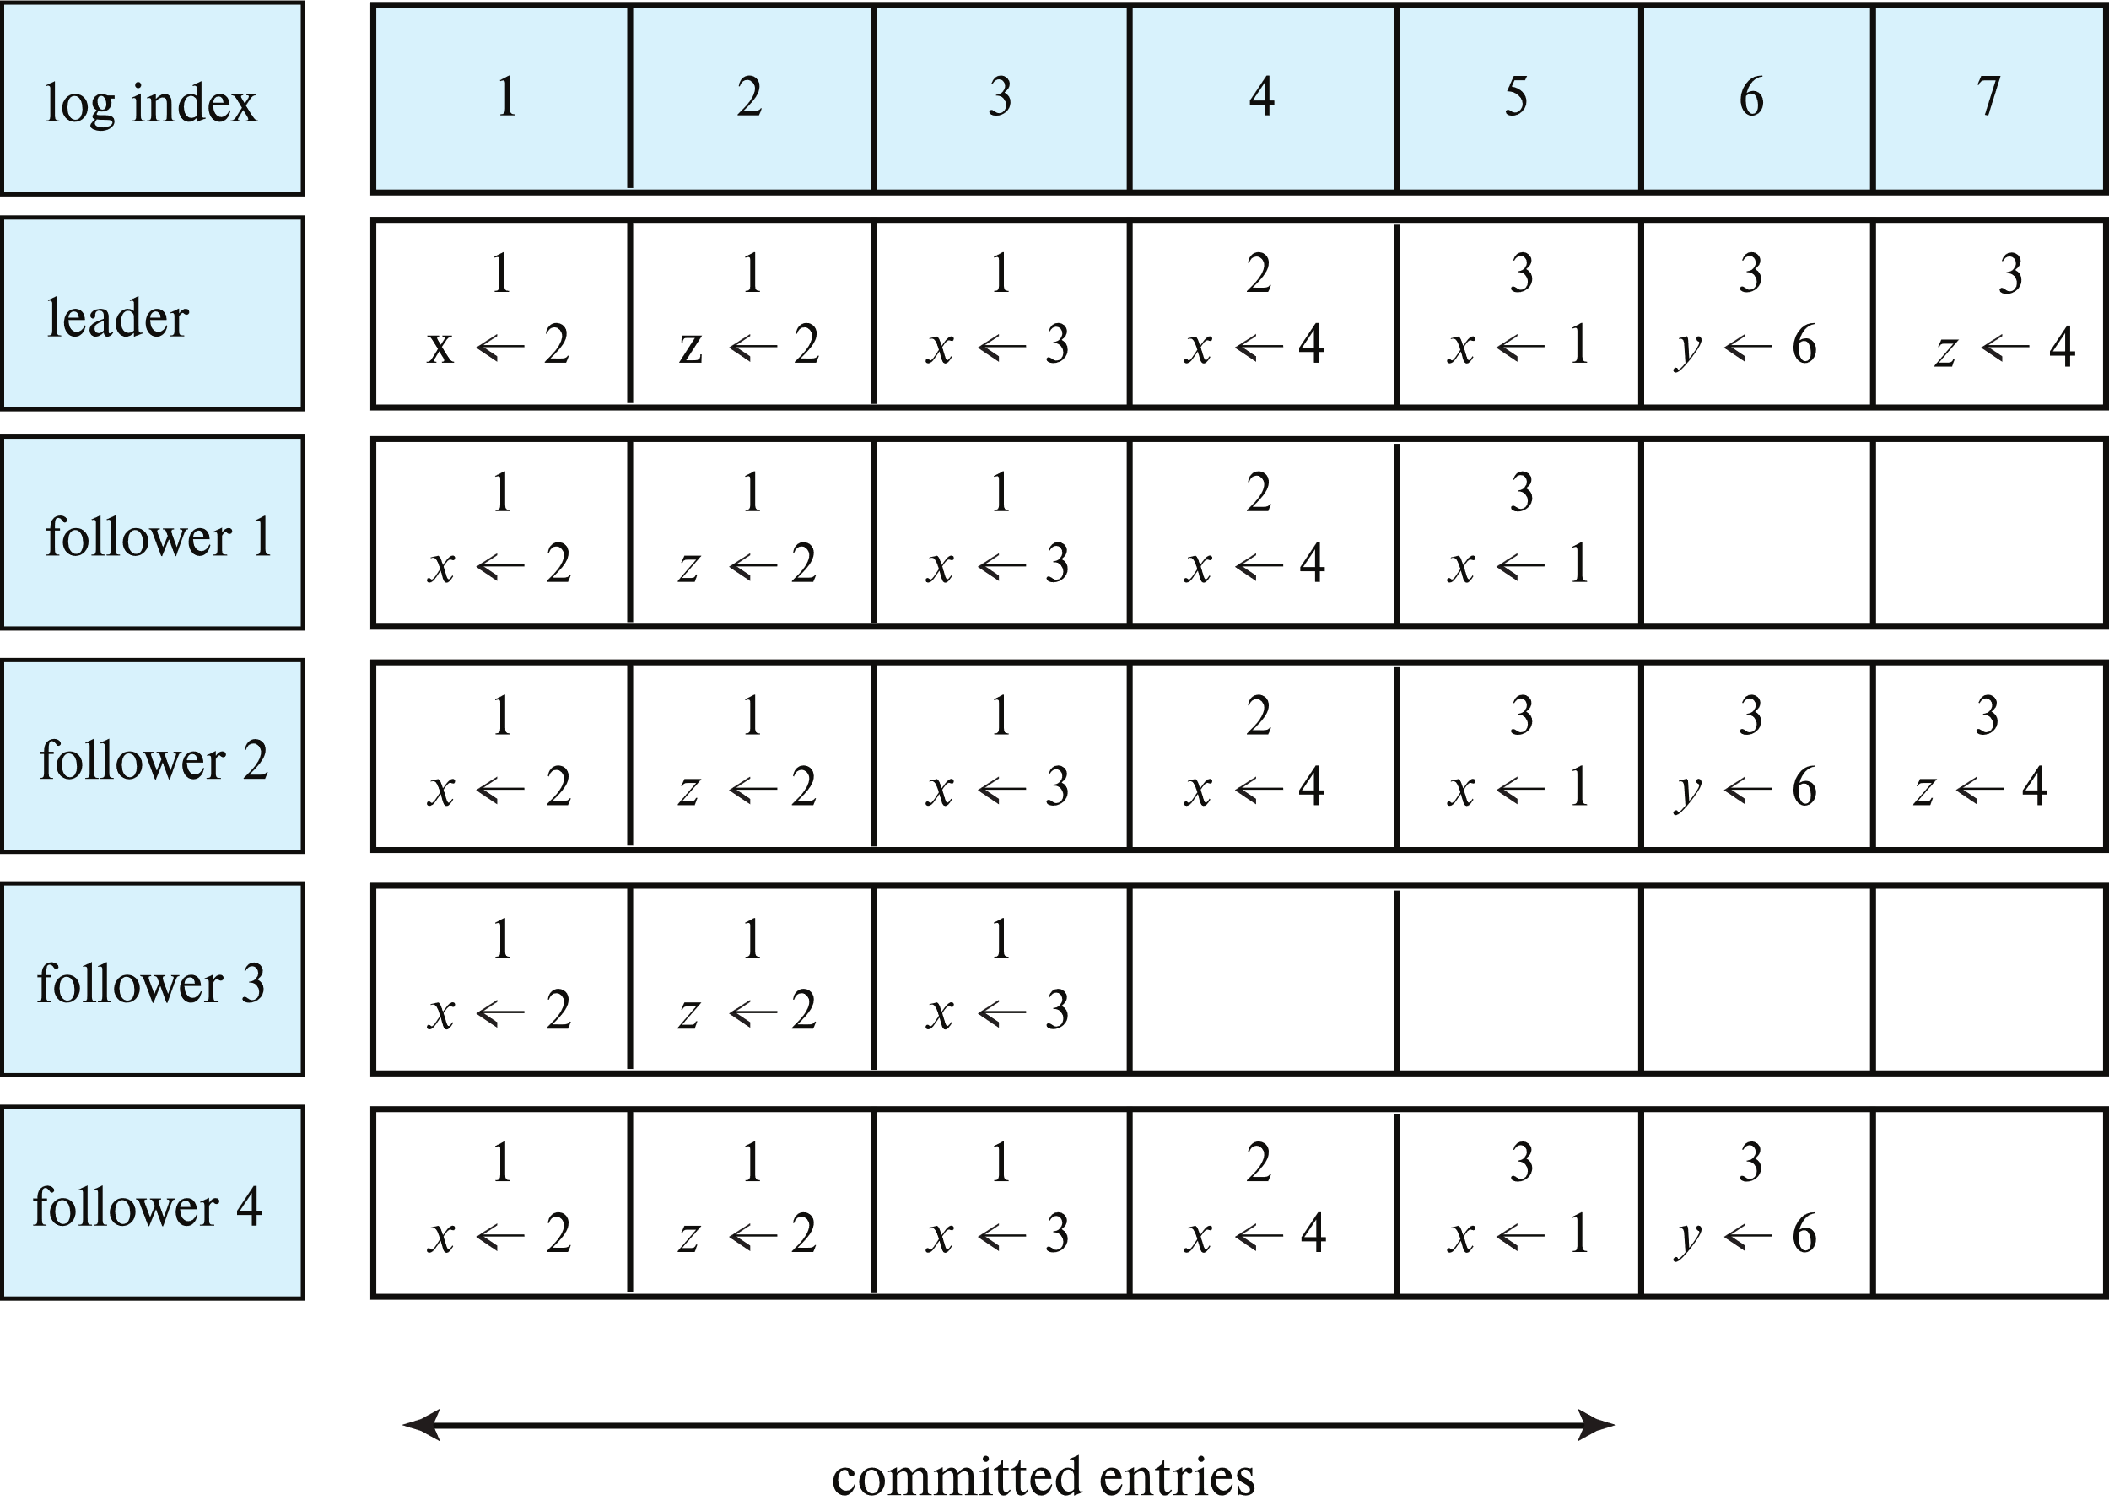
Example of Raft Logs
Number in each entry indicates term
Example log entries are assignments to variables

Slide 109
Raft Log Replication
Appending a log entry done by sending log append request to leader
Leader sends AppendEntries request to all followers, with these parameters
term
previousLogEntryPosition
previousLogEntryTerm
logEntries: array allowing multiple log records to be appended
leaderCommitIndex: an index such that all log records before the index are committed
Followers carry out checks and respond (next slide)
If majority of nodes respond with true, leader can report successful log append to initiating node
Otherwise more work is needed, explained later

Slide 110
Raft AppendEntries Procedure
Follower that receives AppendEntries message does the following
1. If term in message is less than followers currentTerm, Return false
2. If log does not have an entry at previousLogEntryPosition with term
matching previousLogEntryTerm, Return false
3. If entry at previousLogEntryPosition is different from first log record
in AppendEntries message, delete existing entry and all subsequent
entries in log
4. Any log records in logEntries that are not already in log are
appended to log
5. Follower maintains local commitIndex
if leaderCommitIndex > commitIndex, set commitIndex=min(leaderCommitIndex, last log entry index)
6. Return true

Slide 111
Raft AppendEntries Procedure (Cont.)
If leader N1 receives a false message from follower with a higher currentTerm, N1 realizes it is no longer a leader and becomes a follower
Different followers may have different log states
If leader receives false from a node, log in that node is out of date and needs updating
Leader retries AppendEntries for that node, starting from an earlier point in its own log
May get false several times, until it goes far enough back in log to find a matching log entry
Key remaining issue: if a leader dies, and another one takes over, the log must be brought to consistent state
New leader may have an older log

Slide 112
Raft Leader Replacement
Raft protocol ensures any node elected as leader has all committed log entries
Candidate must send information about its own log state when seeking votes
Node votes for candidate only if candidates log state is at least as up-to-date as its own (we omit details)
Since majority have voted for new leader, any committed log entry will be in new leaders log
Raft forces all other nodes to replicate leaders log
Log records at new leader may get committed when log gets replicated
Leader cannot count number of replicas with a record from an earlier term and declare it committed if it is at majority
Details are subtle, and omitted
Instead, leader must replicate a new log record in its current term

Slide 113
Raft Protocol
There are many more subtle details that need to be taken care of
Consistency even in face of multiple failures and restarts
Maintaining cluster membership, cluster membership changes
Raft has been proven formally correct
See bibliographic notes for more details of above

Slide 114
Fault-Tolerant Services using Replicated State Machines
Key requirement: make a service fault tolerant
E.g., lock manager, key-value storage system, ….
State machines are a powerful approach to creating such services
A state machine
Has a stored state, and receives inputs
Makes state transitions on each input, and may output some results
Transitions and output must be deterministic
A replicated state machine is a state machine that is replicated on multiple nodes
All replicas must get exactly the same inputs
Replicated log! State machine processes only committed inputs!
Even if some of the nodes fail, state and output can be obtained from other nodes

Slide 115
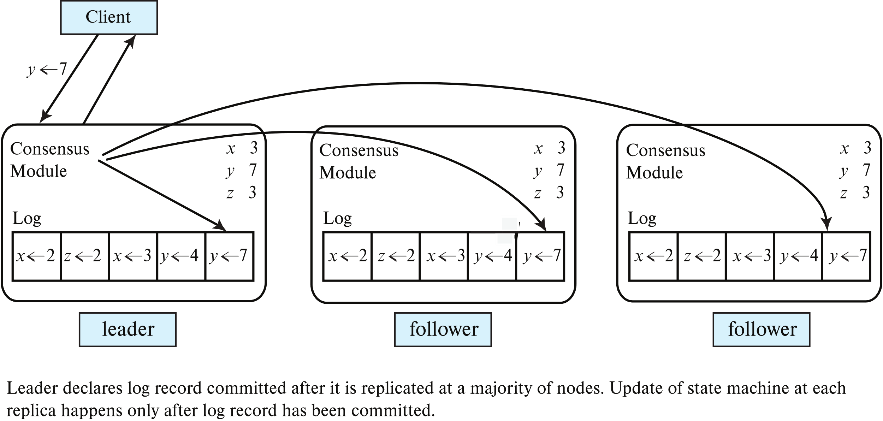
Replicated State Machine
Replicated state machine based on replicated log
Example commands assign values to variables

Slide 116
Uses of Replicated State Machines
Replicated state machines can be used to implement wide variety of services
Inputs can specify operations with parameters
But operations must be deterministic
Result of operation can be sent from any replica
Gets executed only when log record is committed in replicated log
Usually sent from leader, which knows which part of log is committed
Example: Fault-tolerant lock manager
State: lock table
Operations: lock requests and lock releases
Output: grant, or rollback requests on deadlock
Centralized implementation is made fault tolerant by simply running it on a replicated state machine

Slide 117
Uses of Replicated State Machines
Fault tolerant key-value store
State: key-value storage state
Operations: get() and put() are first logged
Operations executed when the log record is in committed state
Note: even get() operations need to be processed via log
Google Spanner uses replicated state machine to implement key-value store
Data is partitioned, and each partition is replicated across multiple nodes
Replicas of a partition form a Paxos group with one node as leader
Operations initiated at leader, and replicated to other nodes

Slide 118
Two-Phase Commit Using Consensus
Basic two-phase commit can result in blocking
Non-blocking two-phase commit can be implemented using consensus
Key idea: Record commit decisions using consensus protocol instead of logging it at coordinator
As long as majority of sites are up and reachable, decision will be known
Blocking is then avoided
Used e.g. in Google spanner, for transactions that span partitions
2PC is coordinated by Paxos group leader at any 1 partition
Lock table is implemented using replicated state machine
Even if leader fails, new leader can see up-to-date lock state

Slide 119
End of Chapter 23

Slide 120
Extra Slides – Material Not in Text
Weak Consistency
Miscellaneous

Slide 121
Dynamo: Basics
Provides a key-value store with basic get/put interface
Data values entirely uninterpreted by system
Unlike Bigtable, PNUTS, Megastore, etc.
Underlying storage based on DHTs using consistent hashing with virtual processors
Replication (N-ary)
Data stored in node to which key is mapped, as well as N-1 consecutive successors in ring
Replication at level of key range (virtual node)
Put call may return before data has been stored on all replicas
Reduces latency, at risk of consistency
Programmer can control degree of consistency (Q_{R}, Q_{W} and S) per instance (relation)

Slide 122
Performing Put/Get Operations
Get/put requests handled by a coordinator (one of the nodes containing a replica of the item)
Upon receiving a put() request for a key
the coordinator generates the vector clock for the new version and writes the new version locally
The coordinator then sends the new version (along with the new vector clock) to the N highest-ranked reachable nodes.
If at least Q_{W}-1 nodes respond then the write is considered successful.
For a get() request
the coordinator requests all existing versions of data for that key from the N highest-ranked reachable nodes in the preference list for that key,
Waits for Q_{R} responses before returning the result to the client.
Returns all causally unrelated (incomparable) versions
Application should reconcile divergent versions and write back a reconciled version superseding the current versions

Slide 123
How to Reconcile Inconsistent Versions?
Reconciliation is application specific
E.g., two sites concurrent insert items to cart
Merge adds both items to the final cart state
E.g., S1 adds item A, S2 deletes item B
Merge adds item A, but deleted item B resurfaces
Cannot distinguish S2 deletes B from S1 add B
Problem: operations are inferred from states of divergent versions
Better solution (not supported in Dynamo) keep track of history of operations

Slide 124
Availability vs Latency
Abadi’s classification system: PACELC
CAP theorem only matters when there is a partition
Even if partitions are rare, applications may trade off consistency for latency
E.g. PNUTS allows inconsistent reads to reduce latency
Critical for many applications
But update protocol (via master) ensures consistency over availability
Thus Abadi asks two questions:
If there is Partitioning, how does system tradeoff Availability for Consistency
Else how does system trade off Latency for Consistency
E.g., Megastore: PC/EC PNUTS: PC/EL Dynamo (by default): PA/EL

Slide 125
Amazon Dynamo
Distributed data storage system supporting very high availability
Even at cost of consistency
E.g., motivation from Amazon: Web users should always be able to add items to their cart
Even if they are connected to an app server which is now in a minority partition
Data should be synchronized with majority partition eventually
Inconsistency may be visible (briefly) to users
preferable to losing a customer!
DynamoDB: part of Amazon Web Service, can subscribe and use over the Web

Slide 126
Bully Algorithm Details
If site S_{i} sends a request that is not answered by the coordinator within a time interval T, assume that the coordinator has failed S_{i} tries to elect itself as the new coordinator.
S_{i} sends an election message to every site with a higher identification number, S_{i} then waits for any of these processes to answer within T.
If no response within T, assume that all sites with number greater than i have failed, S_{i} elects itself the new coordinator.
If answer is received S_{i} begins time interval T’, waiting to receive a message that a site with a higher identification number has been elected.

Slide 127
Bully Algorithm (Cont.)
If no message is sent within T’, assume the site with a higher number has failed; S_{i} restarts the algorithm.
After a failed site recovers, it immediately begins execution of the same algorithm.
If there are no active sites with higher numbers, the recovered site forces all processes with lower numbers to let it become the coordinator site, even if there is a currently active coordinator with a lower number.

