Slide 1

The C++
Programming Language
Lecture 7:
Exception Handling

Slide 2
Basic Concepts and
Syntaxes

Slide 3
Exception handling facility
As we are the designer and provider of our classes, we do know when they would be in invalid status or have problems, and could not be used any more
But we do not know the impact it would bring to user’s program and its harm, only users know the degree
Our duty is to notify the user what happened when there was a problem by using the C++ exception handling facility, and let user decide how to response

Slide 4
Exception handling facility (cont.)
Exception handling facility contains two phases:
    Exception recognizing and throwing
    Exception handling
Exception handling process
    Once an exception appears, the running program is suspended
    On the meanwhile, exception handling facility finds positions that have the ability to handle this type of exception
    After the exception is handled, the execution of program is resumed, and continues from the handling position

Slide 5
Throwing an exception
Imaging our previous Fibonacci_Iterator example
class CFibonacci_Iterator
{
public:
CFibonacci_Iterator(int idx) : m_iIdx(idx - 1) {};
bool operator= =(const CFibonacci_Iterator&) const;
bool operator!=(const CFibonacci_Iterator&) const;
int operator*() const;
CFibonacci_Iterator& operator++();
CFibonacci_Iterator operator++( int );
private:
void check_integrity();
int m_iIdx;
}

Slide 6
Throwing an exception (cont.)
m_iIdx may be set to certain value in constructor
Thus Iterator will have the potential danger that exceeds the allowed maximum size of static vector in Fibonacci
How to notify the user this exception?
inline void Fibonacci_Iterator::check_integrity()
{
if (m_iIdx >= Fibonacci::m_iMaxElems)
throw iterator_overflow(m_iIdx, Fibonacci::m_iMaxElems);
if (m_iIdx >= Fibonacci::s_elems.size())
Fibonacci::gen_elems(m_iIdx + 1);
}

Slide 7
Throwing an exception (cont.)
An exception is an object
    throw 42;
    throw “panic: no buffer!”;
In most cases, exceptions thrown belong to certain exception classes, these classes may form a inheritance hierarchy
We define our iterator_overflow exception class

Slide 8
Throwing an exception (cont.)
class iterator_overflow
{
public:
iterator_overflow(int index, int max)
: m_index(index), m_max(max) {};
int index() { return m_index; }
int max() { return m_max; }
void what_happened(ostream& os = cerr)
{
os << “Internal error: current index” << m_index
<< “exceeds the maximum bound: ” << m_max;
}
private:
int m_index, m_max;
}

Slide 9
Throwing an exception (cont.)
Our previous throw example throws an anonymous object of iterator_overflow class, and constructor is directly called
Also we could clarify the exception object name
inline void Fibonacci_Iterator::check_integrity()
{
if (m_iIdx >= Fibonacci::m_iMaxElems)
{ iterator_overflow ex(m_iIdx, Fibonacci::m_iMaxElems);
throw ex; }
if (m_iIdx >= Fibonacci::s_elems.size())
Fibonacci::gen_elems(m_iIdx + 1);
}

Slide 10
Catching an exception
Use single or multiple catch sentences to catch thrown exception objects
extern void log_message(const char*);
extern string err_message[];
extern ostream log_file;
bool funcA()
{
bool status = true;
//…
catch (int errno)
{ log_message(err_message[errno].c_str());
status = false; }
catch (const char* str)
{ log_message(str);
status = false; }
catch (iterator_overflow& iof)
{ iof.what_happened(log_file);
status = false; }
return status;
}
It could handle our previous 3 exception objects:
    throw 42;
    throw “panic: no buffer!”;
    throw iterator_overflow(m_iIdx, Fibonacci::m_iMaxElems);

Slide 11
Catching an exception (cont.)
The type of exception objects will be compared at each catch sentence
Once met, sentences in corresponding catch block will be executed
Program continues after all catch sentences are passed

Slide 12
Catching an exception (cont.)
In some cases, if we could not finish the complete handling of certain exceptions, we could re-throw them and let other “catch-es” to handle it
{
//…
catch (iterator_overflow& iof)
{
log_message(iof.what_happened());
throw; //re-throw this exception,
//it could appear only in catch sentence
}
}

Slide 13
Catching an exception (cont.)
If we want to catch all types of exceptions, we could use catch-all sentence
{
//…
catch (…)
{
log_message(“Exception of unknown type”);
//…
}
}

Slide 14
Trying for an exception
Catch sentences should be companion with try blocks
If there is something abnormal while the execution of the try block, it should be handled in catch sentence

Slide 15
Trying for an exception (cont.)
bool has_elem(Fibonacci_Iterator first, Fibonacci_Iterator last, int elem)
{
bool status = true;
try
{ while (first != last)
{ if (*first == elem)
return status;
first++; }
}
catch (iterator_overflow& iof) //only catch exceptions of iterator_overflow
{ log_message(iof.what_happened()); }
status = false;
return status;
}

Slide 16
Trying for an exception (cont.)
inline int Fibonacci_Iterator::operator*()
{
check_integrity();
return Fibonacci::s_elems[ m_iIdx ];
}
inline void Fibonacci_Iterator::check_integrity()
{
if (m_iIdx >= 1024)
throw iterator_overflow(m_iIdx, 1024);
//…
}

Slide 17
Trying for an exception (cont.)
Suppose that the m_iIdx exceeds the maximum limit 1024, what will happen?
Exception handling facility will check whether the place where exceptions were thrown out is in a try{} block. If so, it try to find a catch sentence that could handle this type of exceptions and do corresponding operations. Programs continues after that.

Slide 18
Trying for an exception (cont.)
But for our previous example, throw is not in a try{} block, exception handling facility will not handle this exception but terminate the execution of remaining codes, and try to find a corresponding catch in caller
    check_integrity() → operator*() → has_elem()
    Programs will continue from status = false;
If an appropriate catch could not be found even in the end of the function calling chain – main(), the terminate() provided in the standard library will be executed, and the whole program terminated
Rule in C++: every exception should be handled

Slide 19
Trying for an exception (cont.)
Why C++ not supports resuming from where exception was thrown after the exception is handled?
    Exception handling facilty could not know how much clean-ups should be done to return to right state and continue the following lines
    If resuming is required, it is also required that programmer writing throw codes be familiar with catch codes which might be written by another programmer, and vice versa
    That will bring complex depending relationship and maintenance problems, in a close coupling form
If you really want a problem “solving-resuming” mode, write a “check-restore” function before throwing an exception

Slide 20
Trying for an exception (cont.)
But that not means every function should handle every possible exception
    If certain sentence which not in a try block may lead to an exception, this exception surely would not be handled in this function
    Though function will be terminated, it will not always be hazard and cause problems (as the operator*())
    It depends on the programmer that which sentences should be in try block and which ones outside

Slide 21
Trying for an exception (cont.)
Why we put the dereference *first in try{} block in has_elem(), and did not pass the iterator_overflow exception to its caller?
    Its caller only focus on whether there exists elem in the range between iterators first and last, it may not be aware of such a type of exception
    Incrementing the iterator and dereferencing are implementation detail of has_elem(), thus iterator_overflow exception is only related to our implementation detail
    Since has_elem() has best understanding of the importance of iterator_overflow exception, we leave it inside, separate it from the caller of has_elem() and make it transparent

Slide 22
Trying for an exception (cont.)
Design strategy
  Find out every potential hazard exception
  Make it handled somewhere of the function calling chain
  Find most appropriate and related places

Slide 23
Exception Safety and
Smart Pointer

Slide 24
Local resource management
Consider this example:
extern Mutex m;
void funcA()
{
//acquiring resources
int* p = new int;
m.acquire();
process(p);
//releasing resources
m.release();
delete p;
}
//if exception thrown in it, function terminates,
//resources could not be guaranteed to be released

Slide 25
Local resource management (cont.)
A reasonable solution:
extern Mutex m;
void funcA()
{
try
{ int* p = new int;
m.acquire();
process(p);
m.release();
delete p; }
catch(…)
{
m.release();
delete p;
throw; }
}
Though it work, it is not completely satisfying
  Same codes appears twice
  More time needed if exception re-thrown
Is there a more simplified and automatic solution?

Slide 26
Local resource management (cont.)
Resource acquisition is initialization
    Object initialization is in constructor, so should be resource acquisition
    Resource releasing should be finished in destructor
C++ guarantees that destructors of all local objects in the function would be called, before exception handling facility terminates the function
#include <memory>
class MutexLock
{ public:
MutexLock(Mutex m) : m_lock(m)
{ m_lock.acquire(); }
~MutexLock() { m_lock.release(); }
private:
Mutex m_lock; };
extern Mutex m;
void funcA()
{ MutexLock m1(m);
auto_ptr<int> p(new int);
process(p);
//no matter whether exceptions are thrown,
//destructors of p and m1 will be called
//thus guarantees the resource releasing
}

Slide 27
Local resource management (cont.)
auto_ptr is a class template that provided in standard library, defined in memory head file
    #include <memory>
auto_ptr will automatically delete object created from new operator in its destructor, which ensures “exception safety”
auto_ptr encapsulates a pointer and overloads operators * and ->, so it could be used just like a normal pointer
auto_ptr< string > aps(new string(“Hello”));
string* ps = new string(“Hello”);
if ((aps->size() == ps->size()) && (*aps == *ps))
//…

Slide 28
Local resource management (cont.)
auto_ptr is a light-weight class that has not the reference count mechanism
That means if auto_ptr p is assigned to another auto_ptr q, the latter will have the real pointer, and the former will have a zero pointer
struct X
{ int m;
//... };
int main()
{ auto_ptr<X> p(new X);
auto_ptr<X> q(p);
cout << "p " << p.get() << " q " << q.get() << "\n"; //auto_ptr::get() returns the real pointer
}
//Result
p 0x0 q 0x378d0

Slide 29
Local resource management (cont.)
In semantic meaning, it is more a “transfer” than a “copy” in auto_ptr assignment
Never to make the auto_ptr be the argument of containers, for they need a “copy” meaning
    vector< auto_ptr<X> > v; //error
An auto_ptr could only contain pointer that point to a single object, not an array pointer; because it uses delete to release the pointer, not delete []
    auto_ptr<X> p(new X[n]); //error
There’s no “auto_array”, if we want to automatically release an array, use vector instead
    vector<X> v(n);

Slide 30
Standard Exception Hierarchy

Slide 31
The standard exceptions
new operator will allocate enough memory from heap store, then call objects constructor, and then assign the address to pointer
On failure, constructor will not be called and address will not be assigned, it will throw a bad_alloc exception
vector<string>* init_text_vector(ifstream& infile)
{
vector<string>* ptext = 0;
try
{ ptext = new vector<string>;
//… }
catch(bad_alloc)
{ cerr << “Heap memory exhausted!” << endl;
//… }
return ptext;
}

Slide 32
The standard exceptions (cont.)
bad_alloc is a class, but not an object
bad_alloc inherits the exception abstract base class, which is the root of the exception class hierarchy
catch(bad_alloc) means we are only interested in the exception type, not the exception object itself
If we don’t want bad_alloc exception to be thrown, we could write in this way, and zero will be returned on failure
    ptext = new (nothrow) vector<string>;

Slide 33
The standard exceptions (cont.)
The exception abstract base class declares a virtual function to describe the thrown exceptions
    virtual const char* what() const;
We could make our iterator_overflow class inherit exception and be part of the standard exception hierarchy
So that it could be caught by any codes that trying to catch standard exceptions, and we need not use catch-all
    catch (const exception& ex)
    { cerr << ex.what() << endl }

Slide 34
The standard exceptions (cont.)
Re-implement our iterator_overflow class
#include <exception>
class iterator_overflow : public exception
{
public:
iterator_overflow(int index, int max)
: m_index(index), m_max(max) {};
int index() { return m_index; }
int max() { return m_max; }
const char* what() const; //override exception::what()
private:
int m_index, m_max;
}

Slide 35
The standard exceptions (cont.)
#include <sstream> //required by ostringstream
#include <string>
const char* iterator_overflow::what() const
{
ostringstream ex_msg;
//provide output to memory ops, useful in convert from various types to string
string msg;
ex_msg << “Internal error: current index” << m_index
<< “exceeds the maximum bound: ” << m_max;
msg = ex_msg.str(); //str() member function returns converted string
return msg.c_str(); //converts string to const char*
}

Slide 36
Summary
Exception handling facility
Throw, catch, try an exception
Local resource management, auto-ptr
Standard exception hierarchy

Slide 37
Excises
Coding:
  Implement a Stack class that supports following operations: push(), pop(), size(), empty(), full(), peek(), print(). The stack contains 20 elements in maximum. Add two types of exception getting_from_empty – “Trying to get elements from an empty stack”, and filling_to_full – “Trying to fill elements to a full stack”. Implement the handling mechanism in the Stack class.(printing the exception description is enough)

Slide 39
OPM – Object Process Methodology
What is OPM?
  A new system modeling methodology
  At the same level as OO
  Including two complementary parts
    OPD : Object Process Diagram
    OPL : Object Process Language

Slide 40
Building blocks of OPM
Object
  Anything that is visible or tangible and is stable in form – Physical Object
  Anything that may be apprehended intellectually – Informatical Object
  Example:
Person

Slide 41
Building blocks of OPM (cont.)
Process
  Affecting an object
  Generating an object
  Consuming an object
  Example:
Moving

Slide 42

Building blocks of OPM (cont.)
Status
  The attribute of object
  Can not stand alone
  Example:

Slide 43
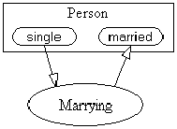
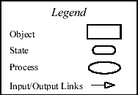
Example of OPD & OPL
The wedding example
Basic building blocks:
  Object: Person
  Process: Marrying
  Status: single / married
OPD
OPL:
  Person can be single or married.
  Marrying changes Person from single to married.

Slide 44
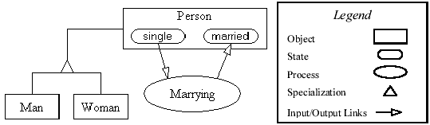
Example of OPD & OPL (cont.)
Specialization and Inheritance
  Specialization is the relationship between a general concept/thing and an entity of that type, “is-a” relation
  OPD
  OPL: Man and Woman are Persons.

Slide 45
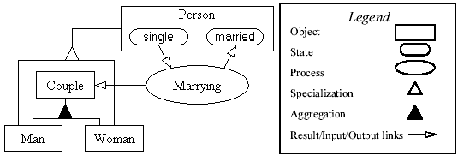
Example of OPD & OPL (cont.)
Aggregation and the Result Link
  Aggregation is the relationship between the whole and a part
  OPD
  OPL:
    Couple consists of Man and Woman.
    Marrying yields Couple.

Slide 46
Example of OPD & OPL (cont.)
The complete OPL
  Person can be single or married.
  Marrying changes Person from single to married.
  Man and Woman are Persons.
  Marrying yields Couple.
  Couple consists of Man and Woman.

Slide 47
Example of OPD & OPL (cont.)
OPM
  Use graphic and textual language to complement each other
  Structure and flow are on the same diagram to make it easy to understand the dynamic of whole system
  The symbols are concise and economical
  Meaning of the symbols are context-sensitive
  Object and Process are at the same important level, process can be stand-alone

Slide 48
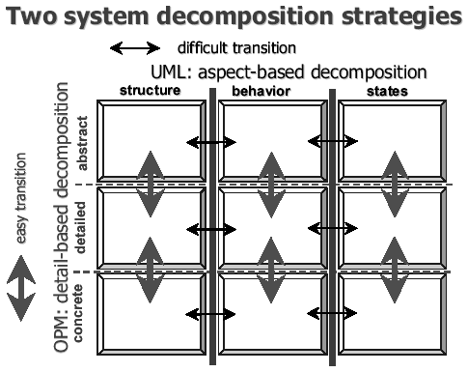
Divide and Conquer:
By Aspects or by Details?

Slide 49
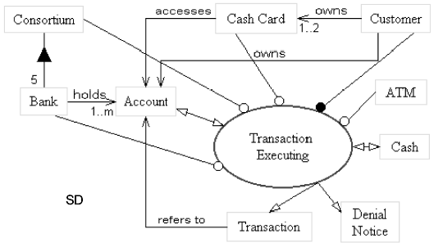
Divide and Conquer:
By Aspects or by Details? (cont.)

Slide 50
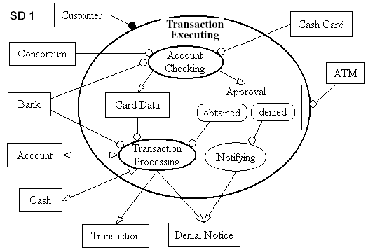
Divide and Conquer:
By Aspects or by Details? (cont.)
Zoom in “Transaction Executing”

Slide 51
Programming Philosophy
– The Tao Of Programming
Part 8 -- Hardware and Software
Thus spake the master programmer:
编程大师如是说：
"Without the wind, the grass does not move. Without software, hardware is useless."
风不动则草不动，没有软件，硬件只是一堆发热的电子器件

Slide 52
Programming Philosophy
– The Tao Of Programming
A novice asked the master: "I perceive that one computer company is much larger than all others. It towers above its competition like a giant among dwarfs. Any one of its divisions could comprise an entire business. Why is this so?"
一个初学者问编程大师：“我知道有一家计算机公司比所有其它的公司都大。在它面前它的竞争对手就象站在巨人面前的侏儒。它的任一部门都有各自的业务，为什么会这样呢？”

Slide 53
Programming Philosophy
– The Tao Of Programming
The master replied, "Why do you ask such foolish questions? That company is large because it is so large. If it only made hardware, nobody would buy it. If it only maintained systems, people would treat it like a servant. But because it combines all of these things, people think it one of the gods! By not seeking to strive, it conquers without effort."
大师说，“为什么你问如此愚蠢的问题呢？那家公司大是因为它就是如此之大，如果它只做硬件，就没有人会买，如果它只维护系统，人们只会把它当作仆人，但是它的业务囊括了所有这些东西，人们就对它顶礼莫拜好象不用努力奋斗就可击败竞争对手。

Slide 54
Programming Philosophy
– The Tao Of Programming
A master programmer passed a novice programmer one day. The master noted the novice's preoccupation with a hand-held computer game. "Excuse me", he said, "may I examine it?"
有一天编程大师碰见了一个正玩掌上游戏机的编程新手，他说：“给我看一下？”

Slide 55
Programming Philosophy
– The Tao Of Programming
The novice bolted to attention and handed the device to the master. "I see that the device claims to have three levels of play: Easy, Medium, and Hard", said the master. "Yet every such device has another level of play, where the device seeks not to conquer the human, nor to be conquered by the human."
新手把游戏机递给大师，“我看到上面说明了三种难度的玩法：容易，中等，高难”，大师说，“但是每个这样的游戏机都有另外一种玩法，此时游戏机即不是想着怎么赢你，也不是怎么被你赢。”

Slide 56
Programming Philosophy
– The Tao Of Programming
"Pray, great master," implored the novice, "how does one find this mysterious setting?"
“那么请问大师”，初学者说，“这种玩法到底是怎样玩的呢？”
The master dropped the device to the ground and crushed it under foot. And suddenly the novice was enlightened.
大师把游戏机摔到地下然后用脚踩碎它，突然初学者明白了。

Slide 57
Programming Philosophy
– The Tao Of Programming
There was once a programmer who worked upon microprocessors. "Look at how well off I am here," he said to a mainframe programmer who came to visit, "I have my own operating system and file storage device. I do not have to share my resources with anyone. The software is self-consistent and easy-to-use. Why do you not quit your present job and join me here?"
有一个工作在微机上的程序员对前来参观的大型机程序员说：“看看我这里吧，我有自己的操作系统和文件存储设备，我不需要与别人共享任何资源，软件条条有理并且易于操作。为什么你不辞去你的工作到这里来呢？”

Slide 58
Programming Philosophy
– The Tao Of Programming
The mainframe programmer then began to describe his system to his friend, saying: "The mainframe sits like an ancient sage meditating in the midst of the data center. Its disk drives lie end-to-end like a great ocean of machinery. The software is a multi-faceted as a diamond and as convoluted as a primeval jungle. The programs, each unique, move through the system like a swift-flowing river. That is why I am happy where I am."
大型机的程序员对他的朋友说：“大型机就象古代圣贤一样深思熟虑，它的磁盘设备从头到尾就象是一个巨大的机械设备的海洋。软件象钻石一样有多个面，象远古的森林一样令人费解。每一个程序都象水经过河流一样穿行于系统中，那就是为什么我乐于为它工作”

Slide 59
Programming Philosophy
– The Tao Of Programming
The microcomputer programmer, upon hearing this, fell silent. But the two programmers remained friends until the end of their days.
微机程序员听了这些话后，默默不语，但这两个程序员至死都是很好的朋友

Slide 60
Programming Philosophy
– The Tao Of Programming
Hardware met Software on the road to Changtse. Software said: "You are the Yin and I am the Yang. If we travel together we will become famous and earn vast sums of money." And so the pair set forth together, thinking to conquer the world.
硬件和软件在路上碰见了，软件说：“你是阴我是阳，如果我们联手就可以赚大钱。”所以它们走到了一起，考虑怎样征服世界。

Slide 61
Programming Philosophy
– The Tao Of Programming
Presently, they met Firmware, who was dressed in tattered rags, and hobbled along propped on a thorny stick. Firmware said to them: "The Tao lies beyond Yin and Yang. It is silent and still as a pool of water. It does not seek fame, therefore nobody knows its presence. It does not seeks fortune, for it is complete within itself. It exists beyond space and time."
不久，它们遇到了固件，固件衣衫褴褛，拄着一根拐棍步履蹒跚。固件对它们说：“道在于阴阳之外。它静如止水，它从不指望能扬名远近，所以没有人知道它的存在。它也不寻求幸福，它只是与它自己的存在在一起，它存在于空间和时间之外。”

Slide 62
Programming Philosophy
– The Tao Of Programming
Software and Hardware, ashamed, returned to their homes.
软件和硬件面有惭色，各自回了家。

Slide 63
Programming Philosophy
– The Tao Of Programming
Part 9 -- Epilogue
Thus spake the master programmer:
编程大师如是说：
"Time for you to leave."
“现在是你出师的时候了。”

