Slide 1
Sudoku
Keni Mou/ Magie Wu
CS 375 – B1 (Spring 2016)
Binghamton University SUNY

Slide 2
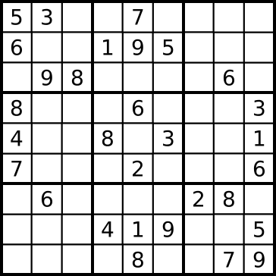
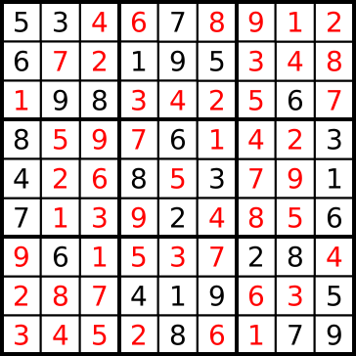
Algorithm Purpose
Sudoku (Number Place) is a number placement puzzle game.
Fill the 9X9 grid with number 1-9
Each row, column and all the 3X3 blocks cannot have repeated numbers
Usually given a partially filled 9X9 grid
Notes:
Keni: So our algorithms are made to solve Sudoku. The player starts with a 9 by 9 grid, with some predetermined numbers in random spots. Then, you have to fill out the rest of the empty spots so that each row, column and sub grid do not contain repeated numbers.

Slide 3
Different algorithms
Brute-Force: check solutions one by one
Stochastic: check solutions randomly
Backtracking: depth-first search with pruning
Notes:
Keni:
We have discovered 3 different algorithms.
The brute-force solution simply checks each possible combination individually
The stochastic solution is a slightly modified version of the brute-force solution, instead of checking them one by one, it generates solutions randomly
And the backtracking method is the most efficient method so far, it performs a depth first search of a tree

Slide 4
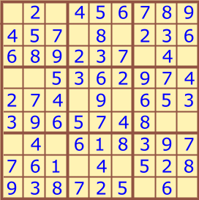
Backtracking – perform depth first search w/ pruning
root
1
3
(Not promising)
2
(Not promising)
…
1
(not promising)
3
4
(Not promising)
…
…
Feasible solution
…
…
Notes:
Magie

Slide 5
Backtracking
Backtracking(string filename) //filename = output file
for i = 0 to 8
for j = 0 to 8
initialize matrix M with input file
if(M[i][j] == 0)
ans[num][0] = i
//ans is the 81*3 matrix that stores answer
ans[num][1] = j
num++
//number of items added to ans.
(also used as index)
num--
Backtracking_part2(1);
output(M,filename)
Notes:
Magie
//Change pseudocode

Slide 6
Backtracking - countinue
Backtracking_part2(int n)
while pos <= num
//pos and num are both global variable initialized to 0
while (!isPromising(M, ans[pos][0], ans[pos][1], n) && n < 9)
n++ // n is the number to fill in
if(isPromising(M, ans[pos][0], ans[pos][1], n))
M[ans[pos][0][ans[pos][1]] = n
ans[pos][2] = n
pos++
Backtracking_part2(1)
else if (pos <= num)
pos--
M[ans[pos][0][ans[pos][1]] = 0
temp = ans[pos][2]
ans[pos][2] = 0
while(temp == 9)
pos--;
temp = ans[pos][2];
M[ans[pos][0][ans[pos][1]] = 0
ans[pos][2] = 0
Backtracking_part2(temp+1);
Notes:
Magie

Slide 7
Supplementary function - pruning
isPromising (M, x, y, num)
SubMatrix = locate(x,y)
For i from 1 to 9 in SubMatrix
If num == sub(i)
return false
For i from 1 to 9 //check row
If num == M[x,i]
return false
For i from 1 to 9 //check column
If num == M[i,y]
return false
return true
Notes:
Magie

Slide 8
Brutal force and stochastic
Empty
Spots
{(0,0),(0,2),(1,3),(1,5),(2,6),(2,8),(3,0),(3,1),(4,3),(4,5),(5,7),(5,8),(6,0),(6,2),(7,3),(7,5),(8,6),(8,8)}
Missing
Numbers
{1, 1, 1, 1, 1, 1, 1, 2, 2, 3, 3, 4, 5, 5, 8, 8, 9, 9}
N = 18
Notes:
Keni:
This is a very simple Sudoku and I just use it for illustration.
So for these 2 methods, we first extract all the coordinates of each empty spot, and also record all the missing numbers in an array
We can do so because in Sudoku, each number will appear exactly 9 times.
Then after we collect all of them, we can enter the numbers in the coordinates.

Slide 9
Brutal force
(0,0) | (0,2) | (1,3) | (1,5) | (2,6) | (2,8) | … | (7,5) | (8,6) | (8,8)
1 | 1 | 1 | 1 | 1 | 1 | … | 8 | 9 | 9
(0,0) | (0,2) | (1,3) | (1,5) | (2,6) | (2,8) | … | (7,5) | (8,6) | (8,8)
9 | 1 | 1 | 1 | 1 | 1 | … | 8 | 8 | 9
(0,0) | (0,2) | (1,3) | (1,5) | (2,6) | (2,8) | … | (7,5) | (8,6) | (8,8)
9 | 9 | 1 | 1 | 1 | 1 | … | 5 | 8 | 8
(0,0) | (0,2) | (1,3) | (1,5) | (2,6) | (2,8) | … | (7,5) | (8,6) | (8,8)
8 | 9 | 8 | 1 | 1 | 1 | … | 5 | 5 | 8
Notes:
Keni:
Then we will have obtained a large number of possible permutations. We will proceed to simply check them one by one until one of them passes the validation test, that’s our solution.
//change to be easier to understand

Slide 10
Stochastic
(0,0) | (0,2) | (1,3) | (1,5) | (2,6) | (2,8) | … | (7,5) | (8,6) | (8,8)
5 | 4 | 1 | 2 | 1 | 1 | … | 8 | 6 | 9
(0,0) | (0,2) | (1,3) | (1,5) | (2,6) | (2,8) | … | (7,5) | (8,6) | (8,8)
9 | 1 | 6 | 5 | 8 | 1 | … | 3 | 8 | 2
(0,0) | (0,2) | (1,3) | (1,5) | (2,6) | (2,8) | … | (7,5) | (8,6) | (8,8)
3 | 9 | 1 | 5 | 1 | 5 | … | 4 | 9 | 8
(0,0) | (0,2) | (1,3) | (1,5) | (2,6) | (2,8) | … | (7,5) | (8,6) | (8,8)
8 | 6 | 4 | 1 | 1 | 6 | … | 5 | 9 | 8
Notes:
Keni:
Then we will have obtained a large number of possible permutations. We will proceed to simply check them one by one until one of them passes the validation test, that’s our solution.
//change to be easier to understand

Slide 11
Brute-Force
Brute_Force(string filename)
Initialize M[9][9]
list = getMissingNumber();
next_permutation(list.begin(), list.end());
//pick a combination out of the list
While(!valid) //valid is initialized to false
Fill out M with one possible combination of list
If(isValid(M))
Valid = true
Else
Make M back to initialization state
next_permutation(list.begin(), list.end())
Print M
Notes:
Keni:
This is the pseudocode of the brute-force solution.

Slide 12
stochastic
Stochastic(string filename)
Initialize M[9][9]
list = getMissingNumbers()
random_shuffle(list.begin(), list.end());
//randomly pick a combination out of the list
While(!valid) //valid is initialized to false
Fill out M with one possible combination of list
If(isValid(M))
Valid = true
Else
Make M back to the initialization state
random_shuffle(list.begin(), list.end())
Print M
Notes:
Keni

Slide 13
Supplementary function
IsValid (M)
for row r in M:
r.sort();
for i in r:
if i == i+1
return false
for column c in M:
c.sort();
for i in c:
if i == i+1
return false
for submatrix s in M
s.sort();
for i in s:
if i == i+1
return false
Notes:
Keni

Slide 14
Implementation
Language used: C++
Key data structure:
Puzzle 9*9 matrix
Storage for backtracking temp values: 81*3 matrix
A list contains all the missing values
Notes:
Magie

Slide 15
Problem Statement
How different are Brute-Force and Stochastic?
How much faster backtracking is compare to the other 2 methods?
Can we apply this algorithm to other practical problems?
Notes:
Magie

Slide 16
Analysis
Brutal Force: O(m^N)
Stochastic: O(m^N)
Backtracking: O(m^N)
m stands for the number of possible values in each spot
N stands for the total number of empty spots
Notes:
Keni

Slide 17

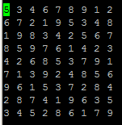
demo
We picked some sudoku puzzles (which have one or more solutions) to test our code
Input file: Output file:
Notes:
Keni in the input file, each line has the x-axis, y-axis and the value of the predetermined numbers.
In the output file, we have a completed matrix of the solution.

Slide 18
Experimental plan
 |  | Brute Force(sec) | Stochastic (sec) | Backtracking
Very Basic | n = 1 | 0.04 | 0/0.04/0.04 | 0
 | n = 3 | 0.1 | 0/0.1/0.1 | 0
 | n = 5 | 0.45 | 0.06/0.32/0.43 | 0
Easy | n = 7 | 4.26 | 4.92/4.92/4.93 | 0
 | n = 8 | 104.64 | 125.67/124.51/124.8 | 0
 | n = 9 | N/A | N/A | 0
Medium | n = 15 | N/A | N/A | 0
 | n = 25 | N/A | N/A | 0
 | n = 35 | N/A | N/A | 0
Hard | n = 81 | N/A | N/A | 0
Notes:
Magie

Slide 19
results
Notes:
Magie

Slide 20
Limitations and future work
Limit problem size
The difficulty of Sudoku does not only depend on the problem size.
We can optimize our program with a priority queue to track said good location.
Notes:
Magie
Sudoku itself is a problem that have a maximum problem size of 9*9, so the maximum problem size is 81​
We can apply the same algorithm to not only the decimal numbers, but also hex numbers (which has problem size 16*16) and even larger matrix.
The difficulty of Sudoku does not only depend on the problems size, but also on the location of each individual empty space. Our algorithm starts by filling out all the number in the first column and row. However, it might be more efficient to start from a spot that would be deemed a good location by human logic. ​
We might need priority queue to track said good location.​

Slide 21
Concluding remarks
We work together
The Sudoku has various solving algorithms, but the backtracking one is way more efficient than others
We can use this algorithm to solve higher complexity problems such as Hex Sudoku
We can apply this algorithm to solve real life problems:
Class scheduling (Room/Time/Teacher)
Notes:
magie

